Slide 1
Supplementary Figure 2:
Subgroup Analyses by Pre-training Competency Levels
The figures show mean skill test scores with median and individual scores across four assessments for each pre-training competency subgroup (beginner, intermediate, and advanced).

Slide 2
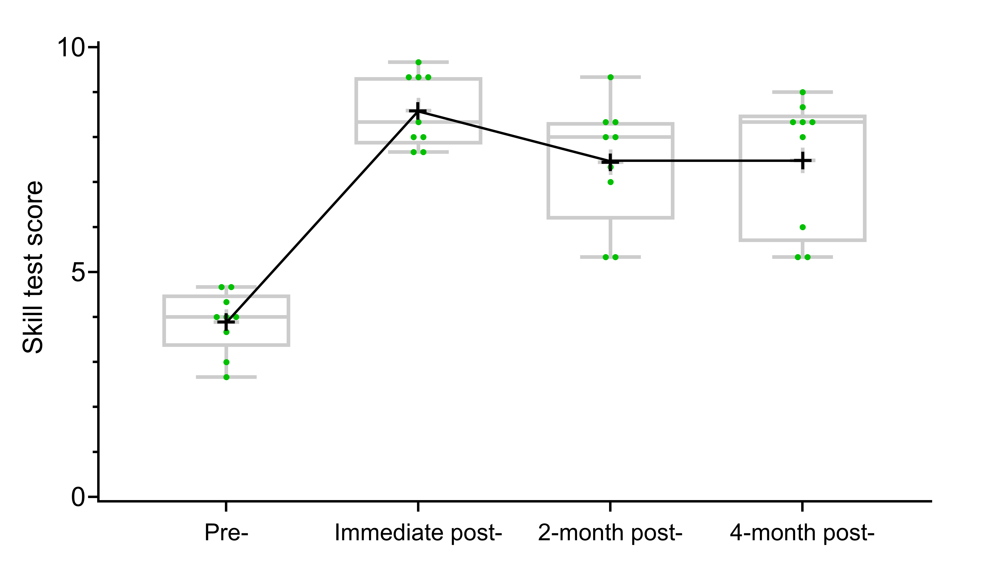
【Subgroup Analysis by Pre-training Competency Level】
Beginner level subgroup (n=9)
Skill test score (mean±SD) | 3.89±0.69 | 8.59±0.81 | 7.44±1.36 | 7.48±1.48
Skill level | Beginner | Advanced | Intermediate | Intermediate

Slide 3
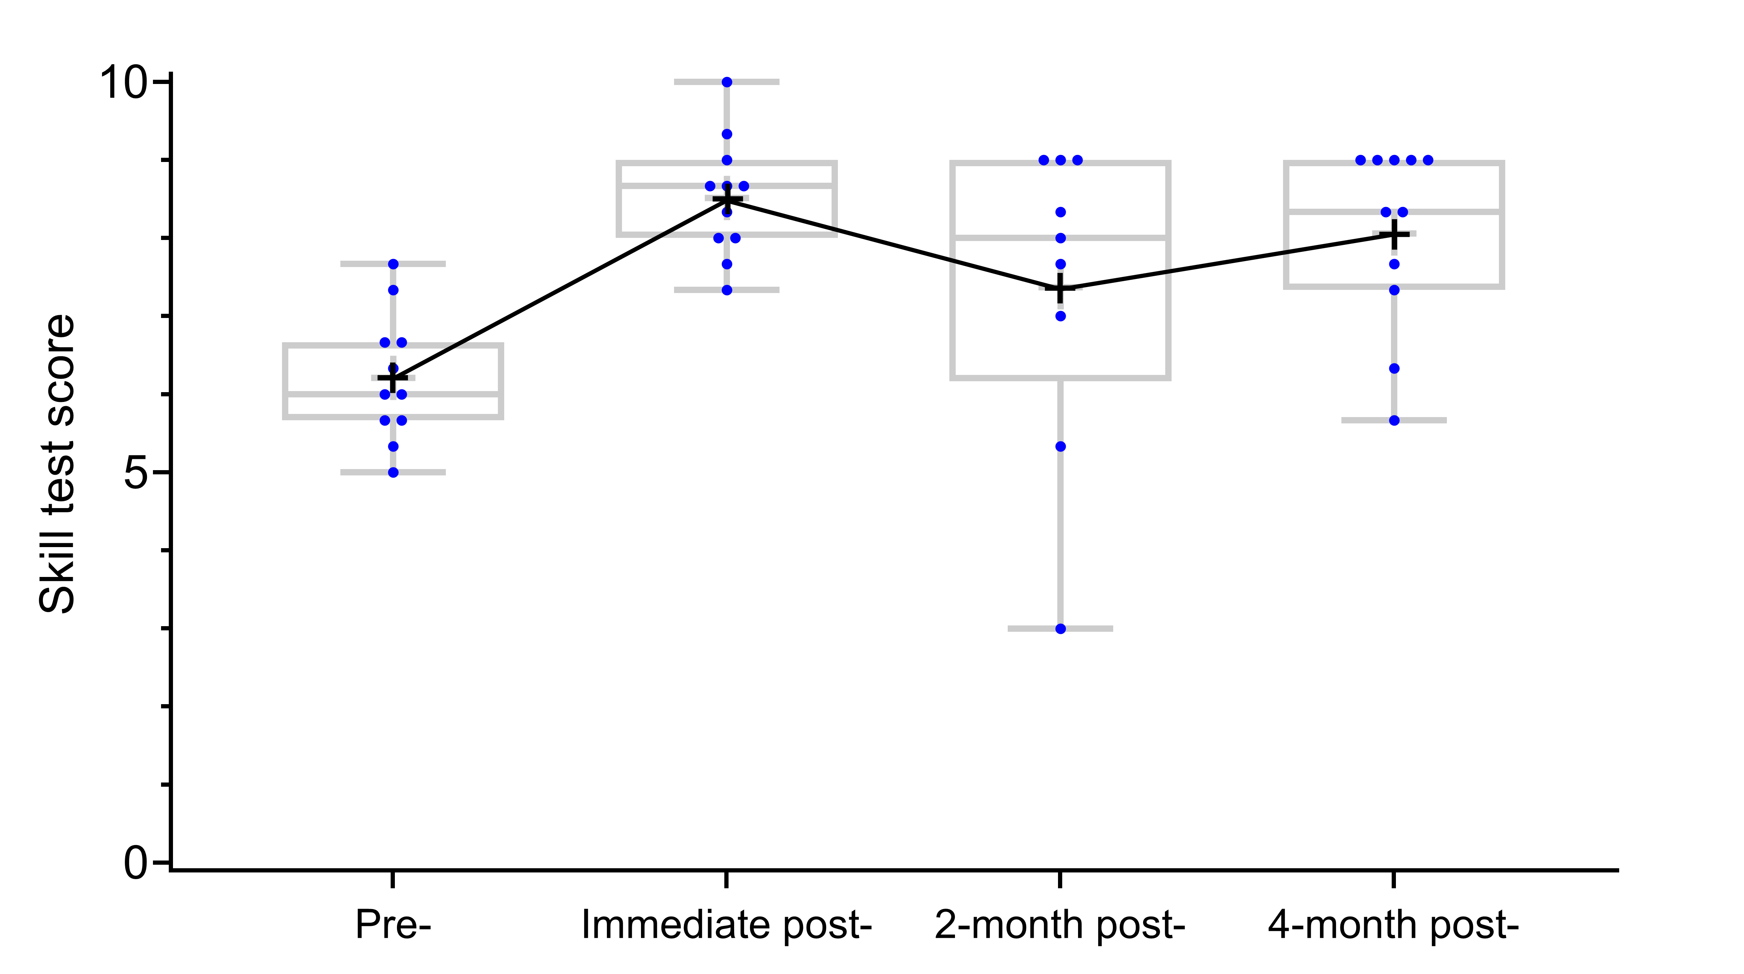
【Subgroup Analysis by Pre-training Competency Level】
Intermediate level subgroup (n=11)
Skill test score (mean±SD) | 6.21±0.82 | 8.52±0.77 | 7.37±2.02 | 8.06±1.18
Skill level | Intermediate | Advanced | Intermediate | Advanced

Slide 4
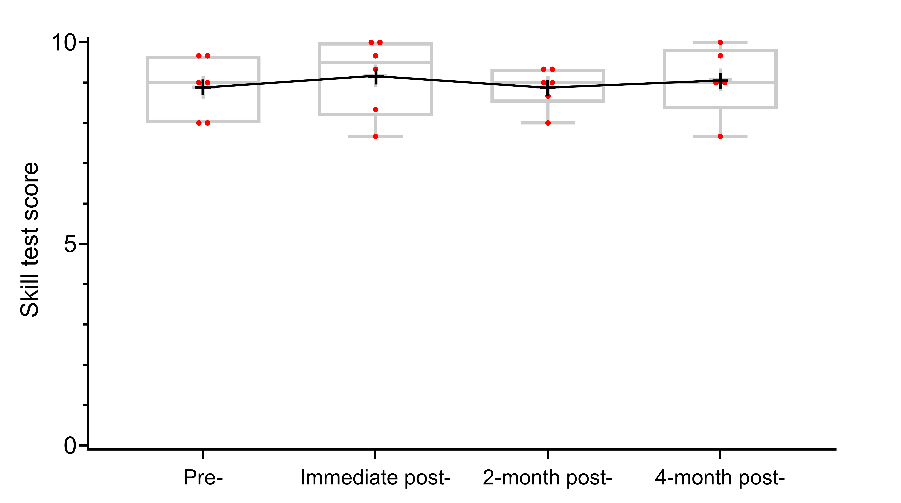
【Subgroup Analysis by Pre-training Competency Level】
Advanced level subgroup (n=6)
Skill test score (mean±SD) | 8.89±0.75 | 9.17±0.96 | 8.89±0.50 | 9.07±0.89
Skill level | Advanced | Advanced | Advanced | Advanced

