Slide 1
Adapted from Jujo et al. The Pilot and Feasibility Studies. 2021;7:175.
Supplementary Appendix 2
5 cardiac POCUS views knowledge test
(40-point maximum)
This knowledge test includes 40 multiple-choice questions;
(Part 1: 9 questions, Part 2: 10 questions, Part 3: 9 questions, Part 4: 7 questions, Part 5: 5 questions).
Please choose correct answer from the answer choices below.
Please complete the test within 30 minutes.
Please do not review any resources such as textbooks or websites prior to or during your knowledge assessment.

Slide 2
Adapted from Jujo et al. The Pilot and Feasibility Studies. 2021;7:175.
Answer choices
Right Atrium
Right Atrial Appendage
Right Ventricle
Left Atrium
Left Atrial Appendage
Left Ventricle
Aortic Valve
Mitral Valve
Tricuspid Valve
Pulmonary Valve
Ascending Aorta
Descending Aorta
Aortic Arch
Pulmonary Artery
Pulmonary Vein
Superior Vena Cava
IVC
Interatrial Septum
Interventricular Septum
Anterior wall of LV
Inferior wall of LV
Lateral wall of LV (Antero-lateral)
Antero-lateral Papillary Muscle
Postero-medial Papillary Muscle
Diaphragm
Pericardium
Liver
Lung
Kidney
Spleen
Parasternal long-axis view
Parasternal short-axis view
Apical 4-chamber view
Apical 2-chamber view
Apical 3-chamber view
Apical 5-chamber view
Suprasternal view
Subcostal 4-chamber view
Subcostal IVC view
I have no idea.
IVC = Inferior Vena Cava, LV = Left Ventricle

Slide 3
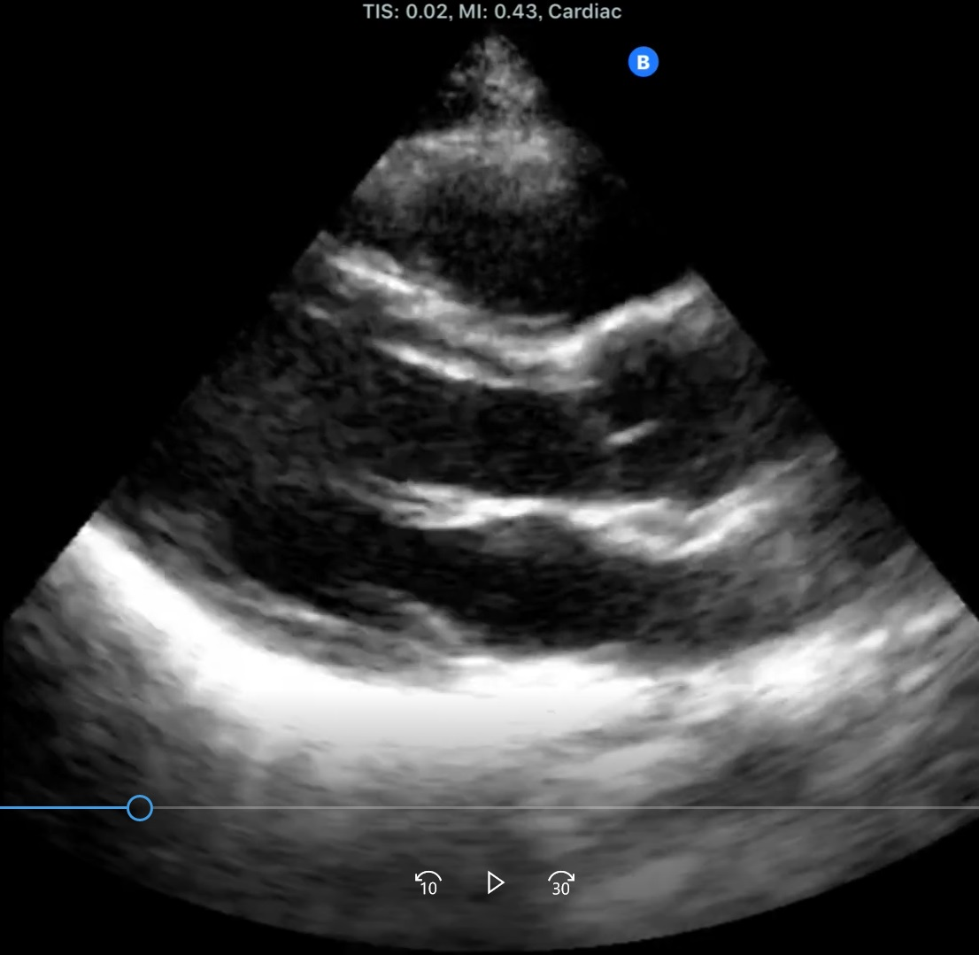
Adapted from Jujo et al. The Pilot and Feasibility Studies. 2021;7:175.
Part 1
1a
Name of this view ?
1e
1b
1C
1f
1d
1g
1i
1h
Question 1-1. What is the name of view 1a ?
Question 1-2. What is 1b ?
Question 1-3. What is 1c ?
Question 1-4. What is 1d ?
Question 1-5. What is 1e ?
Question 1-6. What is 1f ?
Question 1-7. What is 1g ?
Question 1-8. What is 1h ?
Question 1-9. What is the brighter region 1i ?

Slide 4
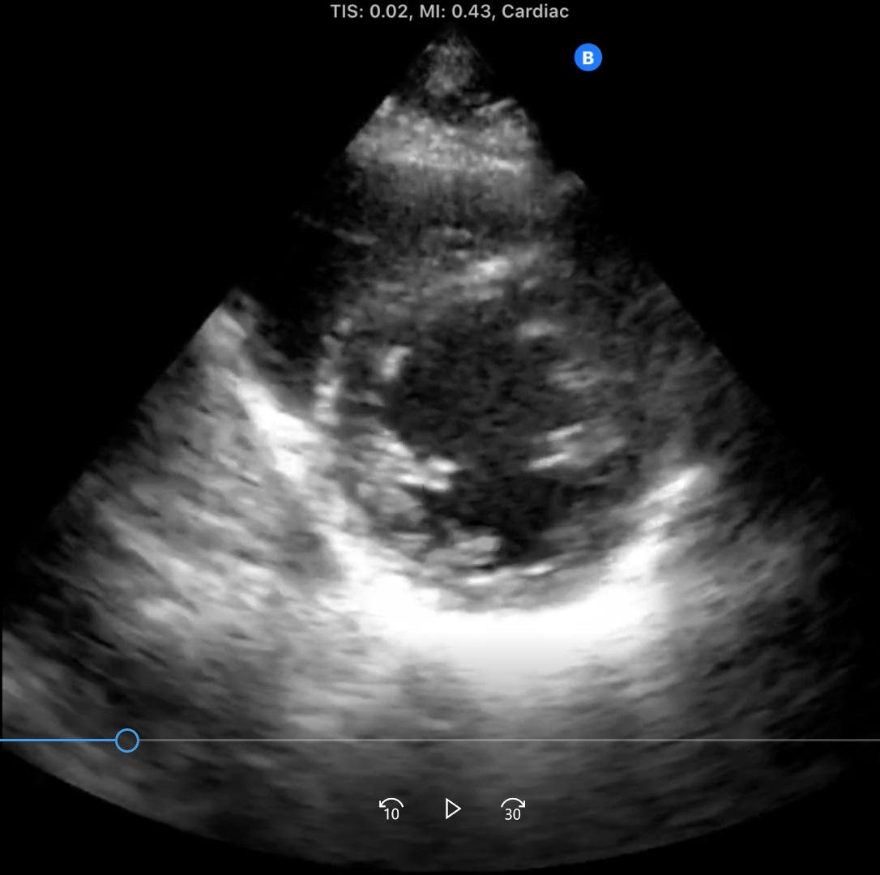
Adapted from Jujo et al. The Pilot and Feasibility Studies. 2021;7:175.
Part 2
2a
Name of this view ?
2b
2f
2C
2e
2d
Question 2-1. What is the name of view 2a ?
Question 2-2. What is 2b ?
Question 2-3. What is 2c ?
Question 2-4. What is 2d ?
Question 2-5. What is 2e ?
Question 2-6. What is 2f ?

Slide 5
Adapted from Jujo et al. The Pilot and Feasibility Studies. 2021;7:175.
Part 2
2g
2h
2i
Question 2-7. What segment of left ventricle wall is 2g ?
Question 2-8. What segment of left ventricle wall is 2h ?
Question 2-9. What segment of left ventricle wall is 2i ?

Slide 6
Adapted from Jujo et al. The Pilot and Feasibility Studies. 2021;7:175.
Part 2
2j
Question 2-10. What is the brighter region 2j ?

Slide 7
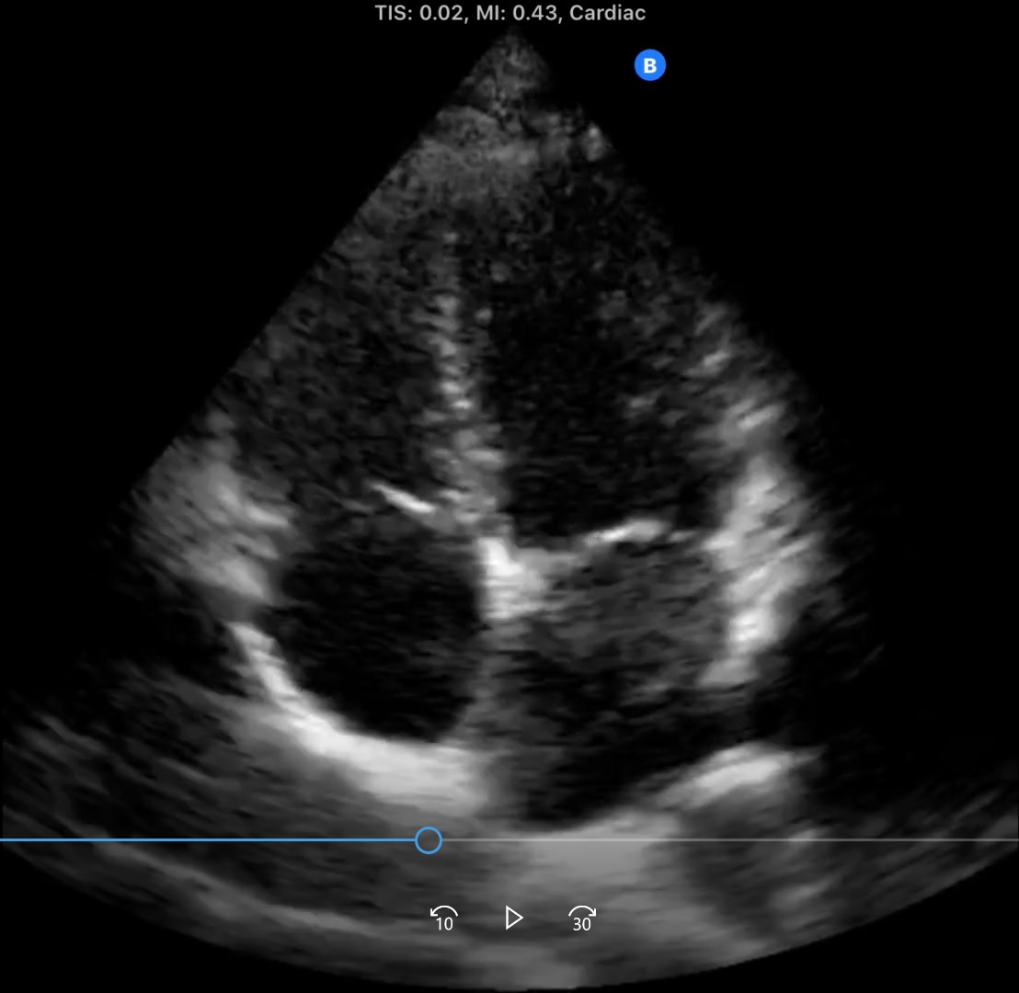
Adapted from Jujo et al. The Pilot and Feasibility Studies. 2021;7:175.
Part 3
3a
Name of this view ?
3e
3g
3b
3f
3c
3d
3i
3h
Question 3-1. What is the name of view 3a ?
Question 3-2. What is 3b ?
Question 3-3. What is 3c ?
Question 3-4. What is 3d ?
Question 3-5. What is 3e ?
Question 3-6. What is 3f ?
Question 3-7. What is 3g ?
Question 3-8. What is 3h ?
Question 3-9. What is 3i ?

Slide 8
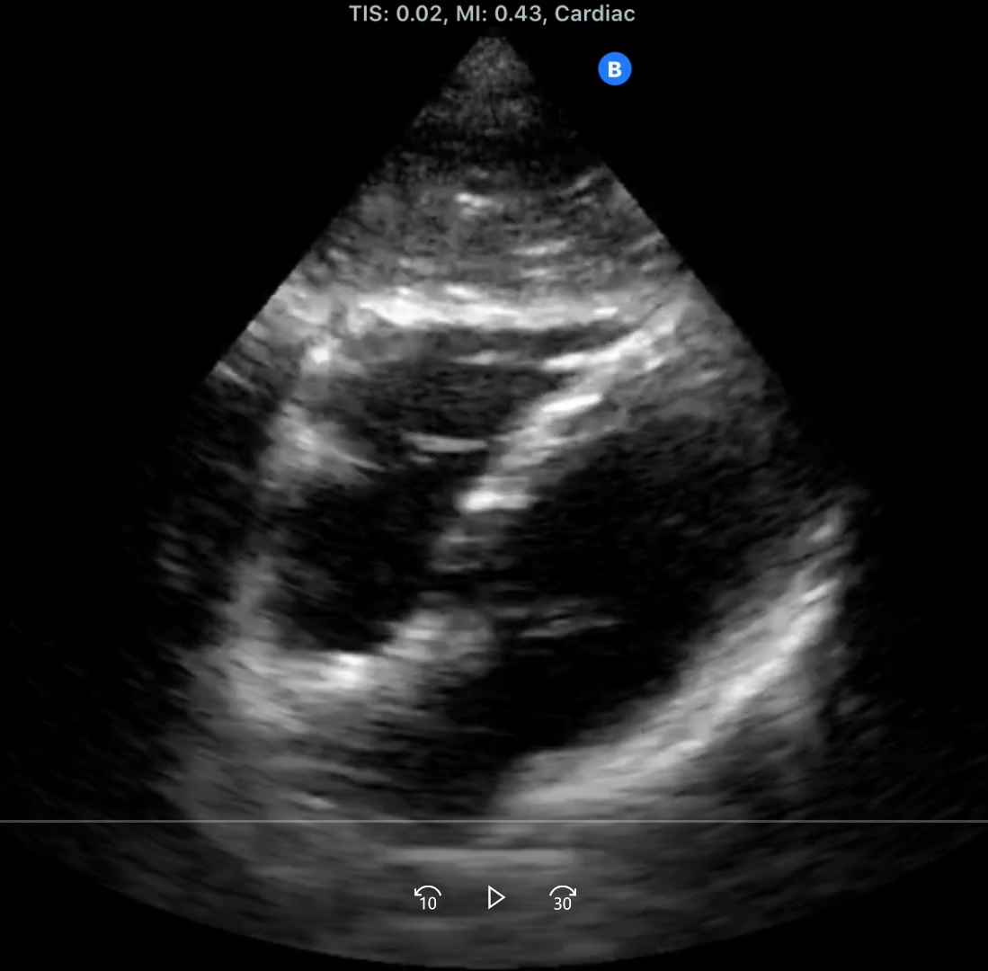
Adapted from Jujo et al. The Pilot and Feasibility Studies. 2021;7:175.
Part 4
4a
Name of this view ?
4b
4g
4d
4c
4f
4e
Question 4-1. What is the name of view 4a ?
Question 4-2. What is 4b ?
Question 4-3. What is 4c ?
Question 4-4. What is 4d ?
Question 4-5. What is 4e ?
Question 4-6. What is 4f ?
Question 4-7. What is 4g ?

Slide 9
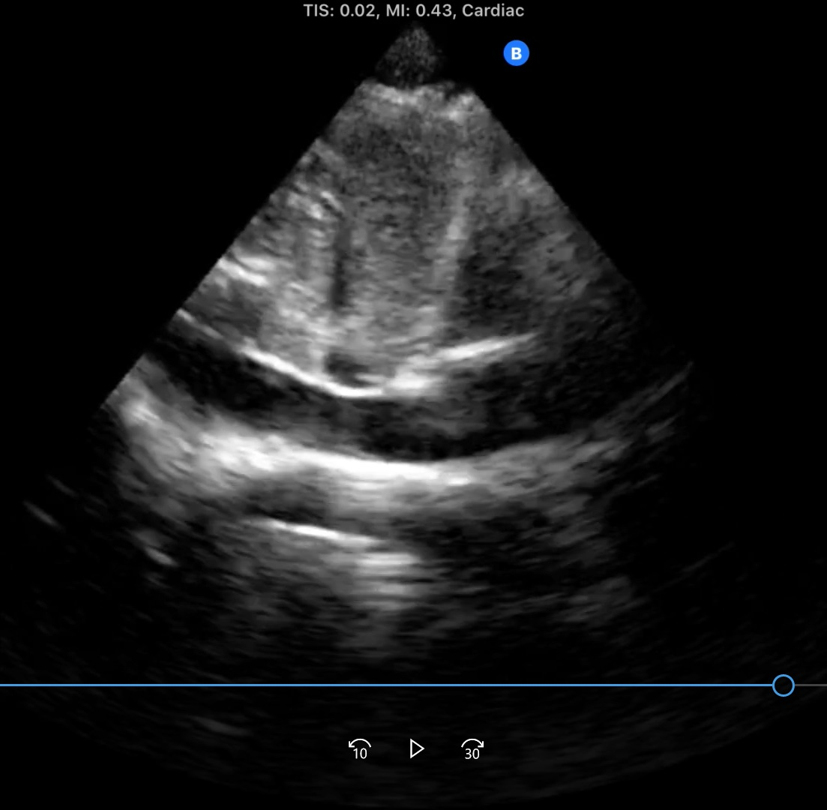
Adapted from Jujo et al. The Pilot and Feasibility Studies. 2021;7:175.
Part 5
5a
Name of this view ?
5b
5c
5e
5d
Question 5-1. What is the name of view 5a ?
Question 5-2. What is 5b ?
Question 5-3. What is 5c ?
Question 5-4. What is 5d ?
Question 5-5. What is 5e ?

Slide 10
Adapted from Jujo et al. The Pilot and Feasibility Studies. 2021;7:175.
Correct Answers: Part 1 and 2.
Question | Answer
Part 1
Question 1-1. 1a | 31 (Parasternal long-axis view)
Question 1-2. 1b | 3 (Right Ventricle)
Question 1-3. 1c | 19 (Interventricular Septum)
Question 1-4. 1d | 6 (Left Ventricle)
Question 1-5. 1e | 7 (Aortic Valve)
Question 1-6. 1f | 11 (Ascending Aorta)
Question 1-7. 1g | 4 (Left Atrium)
Question 1-8. 1h | 8 (Mitral Valve)
Question 1-9. 1i | 26 (Pericardium)
Part 2
Question 2-1. 2a | 32 (Parasternal short-axis view)
Question 2-2. 2b | 3 (Right Ventricle)
Question 2-3. 2c | 6 (Left Ventricle)
Question 2-4. 2d | 24 (Postero-medial Papillary Muscle)
Question 2-5. 2e | 23 (Antero-lateral Papillary Muscle)
Question 2-6. 2f | 19 (Interventricular Septum)
Question 2-7. 2g | 20 (Anterior wall of LV)
Question 2-8. 2h | 22 (Lateral wall of LV (Antero-lateral))
Question 2-9. 2i | 21 (Inferior wall of LV)
Question 2-10. 2j | 26 (Pericardium)
LV = Left Ventricle

Slide 11
Adapted from Jujo et al. The Pilot and Feasibility Studies. 2021;7:175.
Correct Answers: Part 3,4, and 5
Question | Answer
Part 3
Question 3-1. 3a | 33 (Apical 4-chamber view)
Question 3-2. 3b | 3 (Right Ventricle)
Question 3-3. 3c | 9 (Tricuspid Valve)
Question 3-4. 3d | 1 (Right Atrium)
Question 3-5. 3e | 19 (Interventricular Septum)
Question 3-6. 3f | 6 (Left Ventricle)
Question 3-7. 3g | 8 (Mitral Valve)
Question 3-8. 3h | 18 (Interatrial Septum)
Question 3-9. 3i | 4 (Left Atrium)
Part 4
Question 4-1. 4a | 38 (Subcostal 4-chamber view)
Question 4-2. 4b | 27 (Liver)
Question 4-3. 4c | 1 (Right Atrium)
Question 4-4. 4d | 3 (Right Ventricle)
Question 4-5. 4e | 4 (Left Atrium)
Question 4-6. 4f | 6 (Left Ventricle)
Question 4-7. 4g | 19 (Interventricular Septum)
Part 5
Question 5-1. 5a | 39 (Subcostal IVC view)
Question 5-2. 5b | 27 (Liver)
Question 5-3. 5c | 25 (Diaphragm)
Question 5-4. 5d | 17 (IVC)
Question 5-5. 5e | 1 (Right Atrium)
IVC = Inferior Vena Cava.

