Slide 1
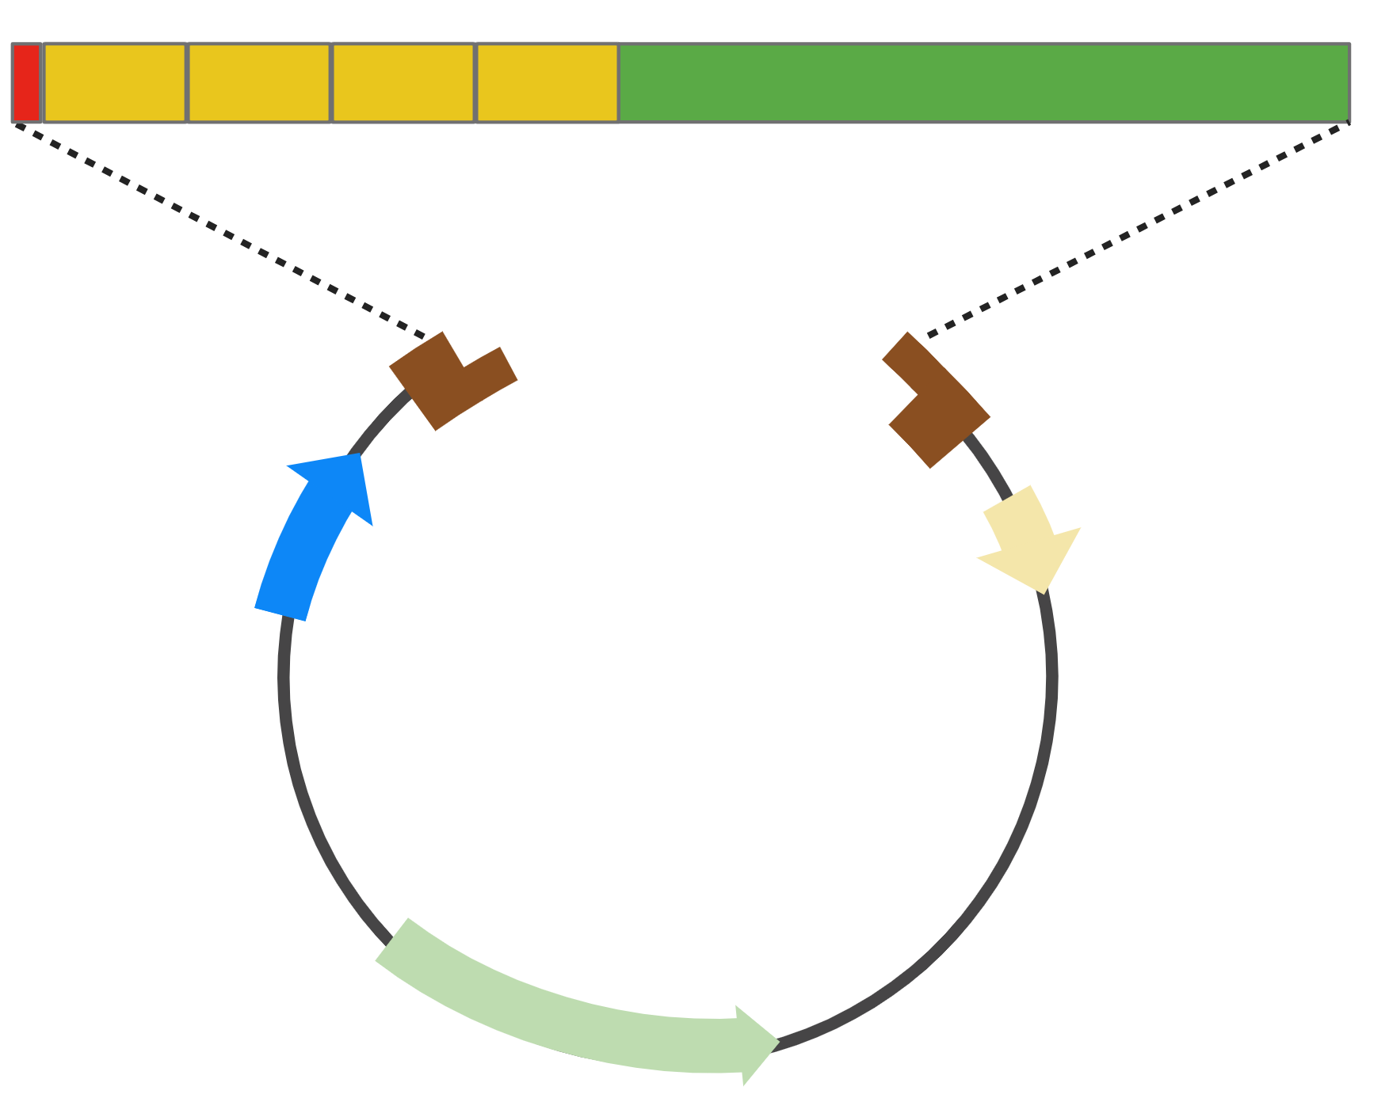
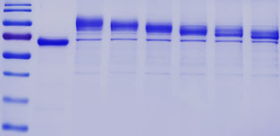
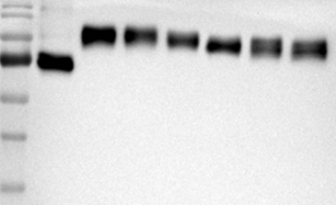
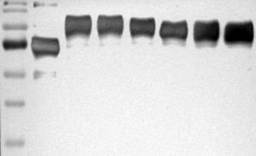


Supplementary Figure 1
D
4xE7$∆$NLS
FlaB variants
eDEF: DCpep6-4xE7ΔNLS-FlaB (wild type FlaB)
eDEF1: DCpep6-4xE7ΔNLS-FlaB^{N83A}
eDEF2: DCpep6-4xE7ΔNLS-FlaB^{N83/101A}
eDEF3: DCpep6-4xE7ΔNLS-FlaB^{N83/101/139A}
eDEF4: DCpep6-4xE7ΔNLS-FlaB^{N83/101/139/273A}
eDEF5: DCpep6-4xE7ΔNLS-FlaB^{N83/101/139/273/330A}
(A)
BamHI
NotI
Ig$κ$ Leader
6x His
pSecTag2B
Amp^{R}
(B)
Marker
eDEF3
eDEF5
pDEF
pDEF
eDEF2
eDEF4
eDEF2
eDEF1
eDEF1
Marker
eDEF
eDEF
eDEF4
eDEF3
eDEF3
eDEF5
pDEF
eDEF4
Marker
eDEF2
eDEF5
eDEF1
eDEF
100
100
100
70
70
70
55
55
55
40
40
40
35
35
35
WB: anti-E7
WB: anti-FlaB
(C)
(D)

Slide 2
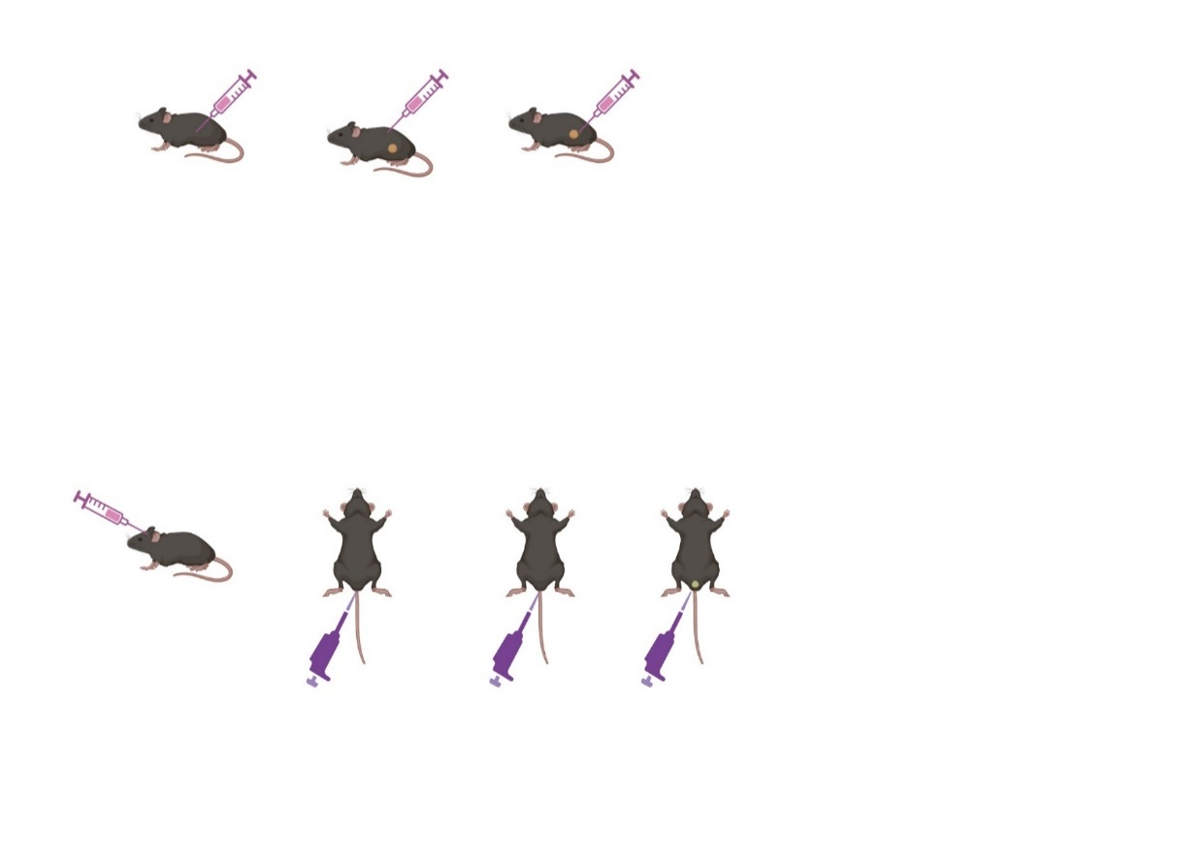
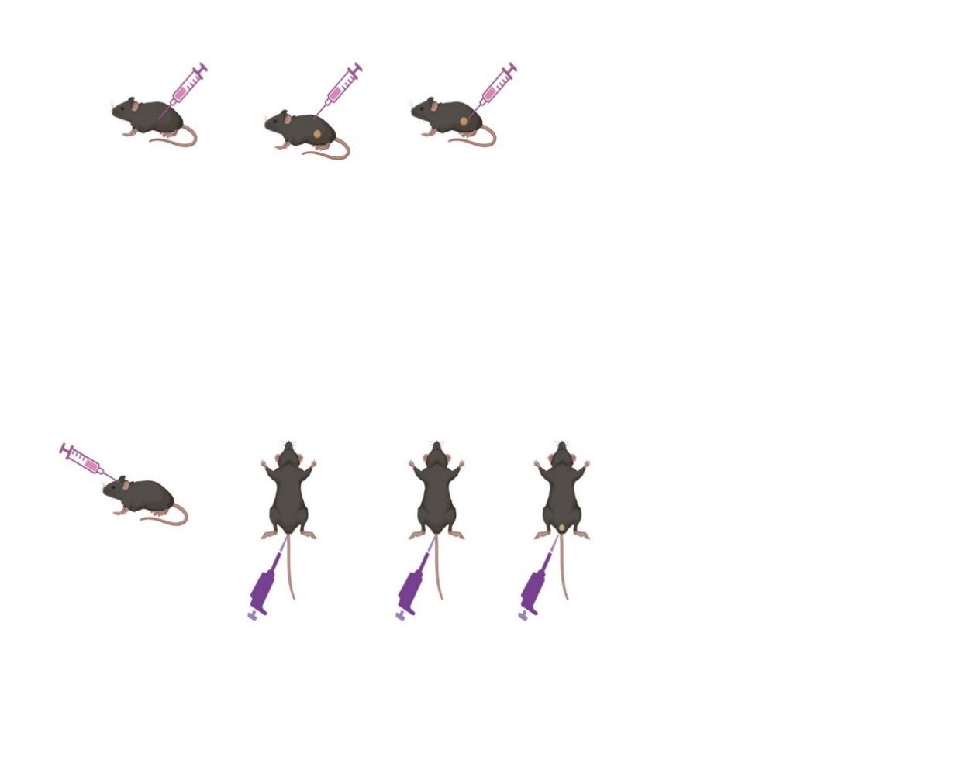
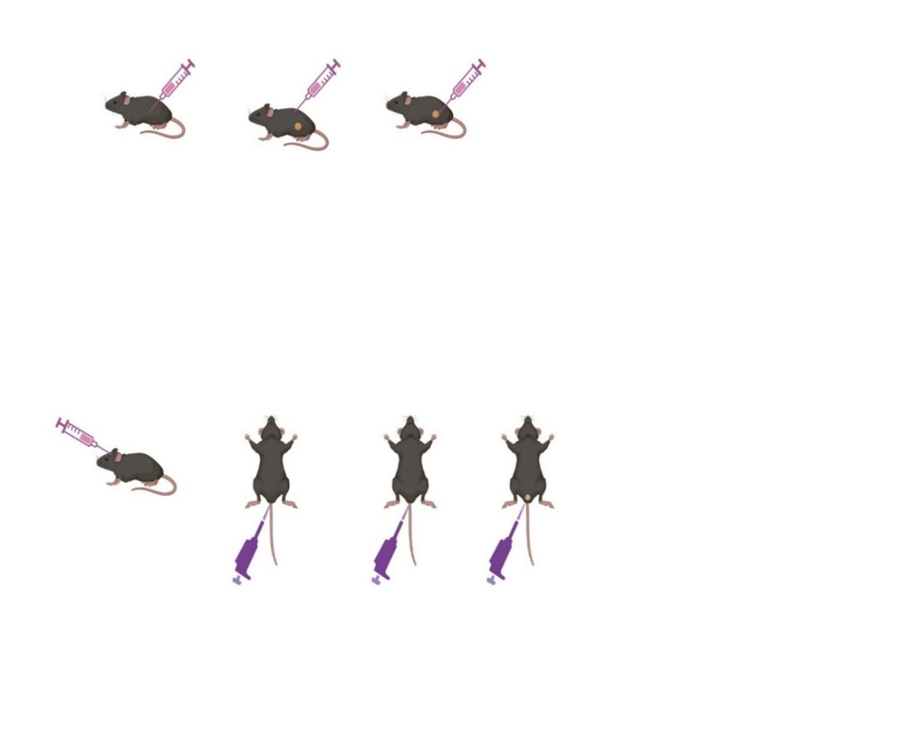
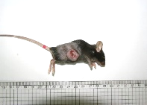
Supplementary Figure 2
(A)
5 x 10⁴/mouse
TC-1 cell injection (S.C.)
Immunization
(peritumoral subcutaneous inj)
PBS
pDEF (20 ug)
eDEF3 (20 ug)
eDEF5 (20 ug)
5days
5days
I I I
Tumor size
(3~5 mm)
(B)
(C)

Slide 3
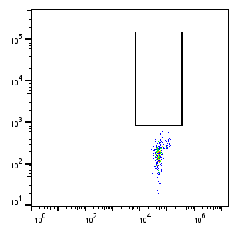
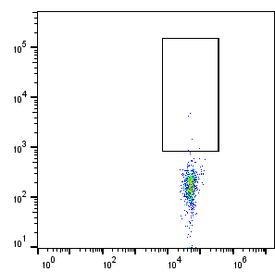
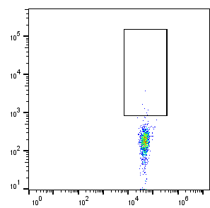
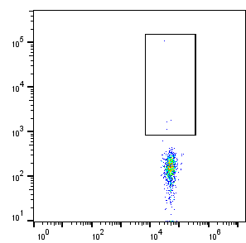

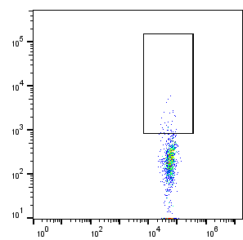
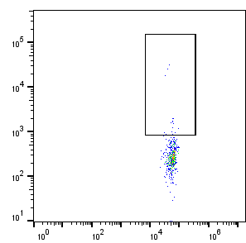
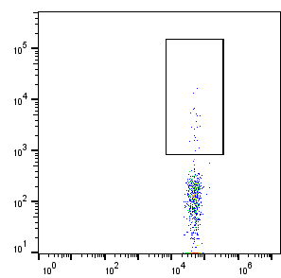
Supplementary Figure 3
(A)
Immunization
(peritumoral subcutaneous inj)
5 x 10⁴/mouse
TC-1 cell injection (S.C.)
Age-matched mice control (n=5)
eDEF3 survived mice (n=3)
5days
5days
I I I
Day 113
Tetramer
staining
Tumor size (3~5 mm)
Day 90
Re-challenge
(1 x 10⁵/mouse)
(B)
Age-matched Control (Con)
0.45
0.6
0.5
0.41
0.41
eDEF3
2.92
3.66
2.74
HPV16 E7(49-57) tetramer + (%)
CD8

Slide 4
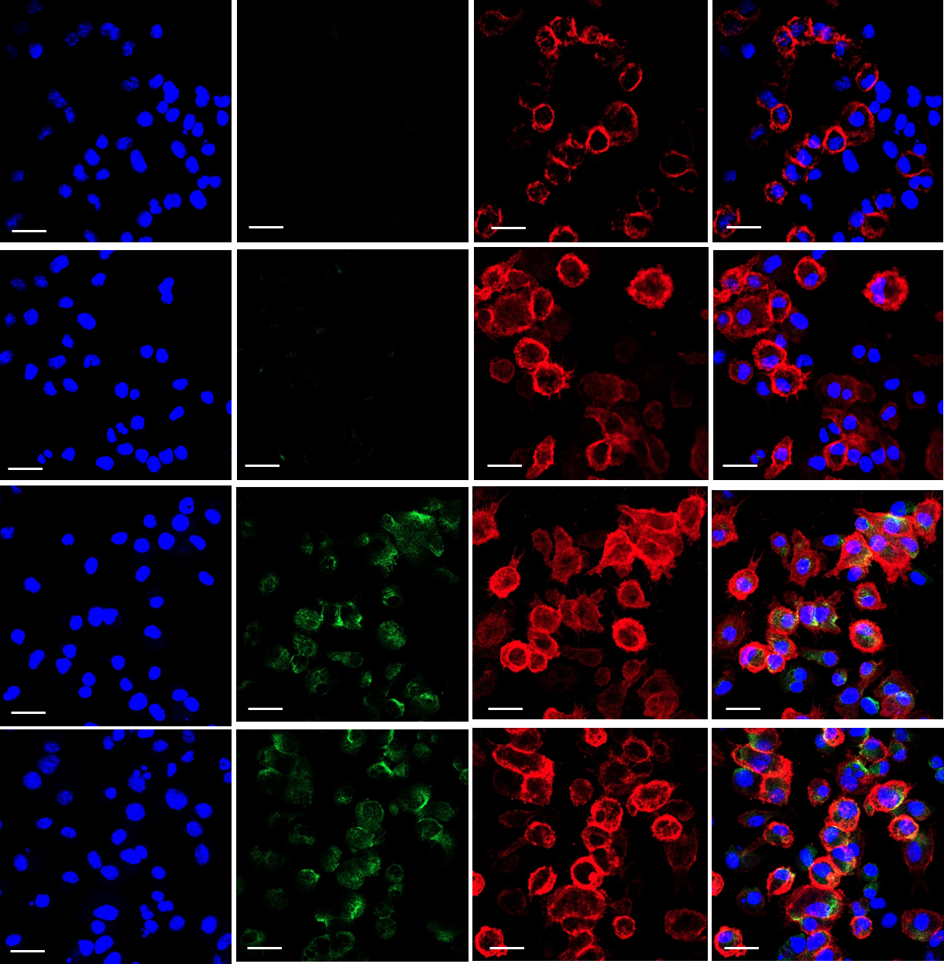
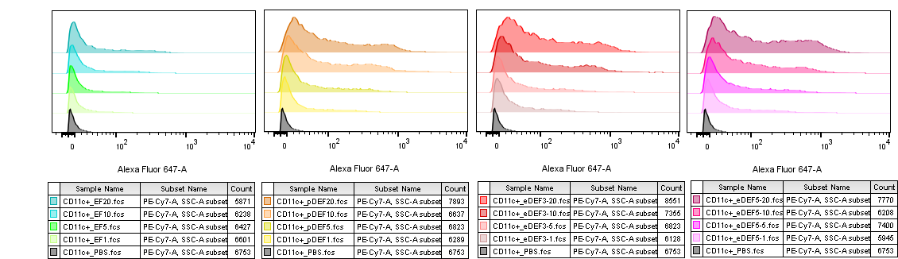
Supplementary Figure 4
(A)
DAPI
FlaB+
CD11c+
Merged
PBS
pEF
pDEF
eDEF3
(B)
pEF
pDEF
eDEF3
20 μg/ml
10 μg/ml
5 μg/ml
1 μg/ml
Control
20 μg/ml
10 μg/ml
5 μg/ml
1 μg/ml
Control
20 μg/ml
10 μg/ml
5 μg/ml
1 μg/ml
Control

Slide 5
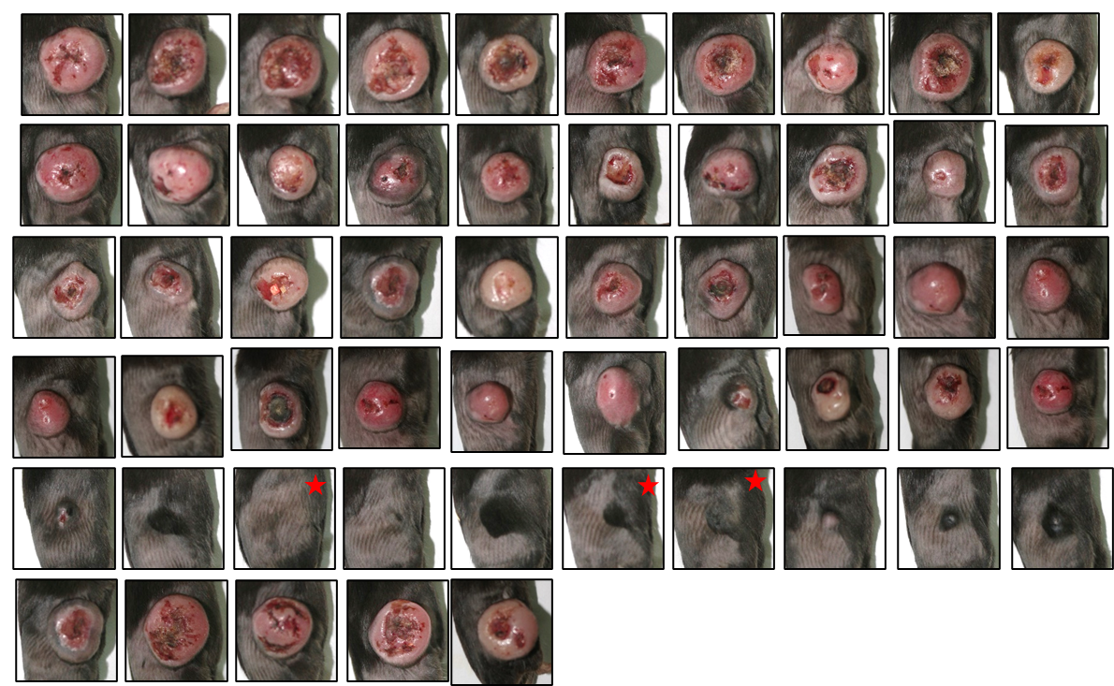
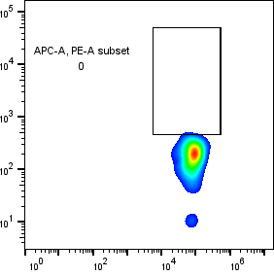
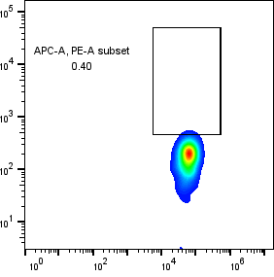
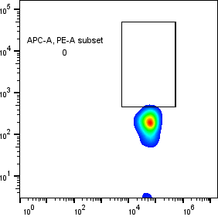
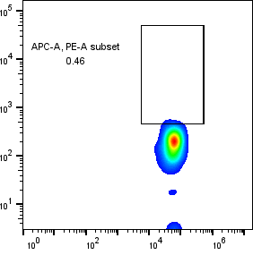

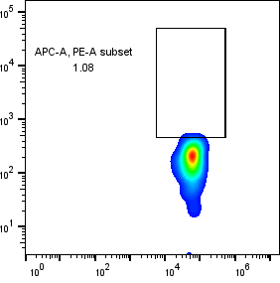
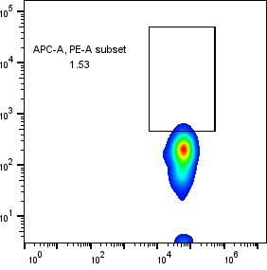
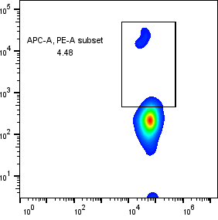

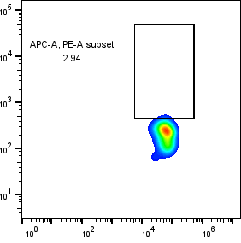
Supplementary Figure 5
38 days after TC-1 cell injection
(A)
PBS
E
DE
EF
DEF
R/L
= tumor free
(B)
PBS
HPV16 E7(49-57) tetramer + (%)
0
0.40
0
0.46
0.46
DEF
CD8
1.08
1.53
4.48
0.81
2.94
HPV16 E7(49-57) tetramer + (%)
CD8

Slide 6
Supplementary Figure 6
(A)
Lymphocyte
Singlet
Live CD45⁺
CD8⁺
Live-dead IR885
FSC-A
SSC-A
FSC-H
FSC-A
FSC-A
CD45 PE-Cy7
CD8 FITC
PBS
mR-E
mR-DEF3
GzmB
HPV16 E7(49-57) tetramer

Slide 7
Supplementary Figure 6
(B)
Lymphocyte
Singlet
Live CD45⁺
CD8⁺
Live-dead IR885
FSC-A
SSC-A
FSC-H
FSC-A
FSC-A
CD45 PE-Cy7
CD8 FITC
Tetramer⁺ SLEC
SLEC
Tem
Tcm
CD8 FITC
KLRG1 BV785
CD44 BV605
MPEC
HPV16 E7(49-57) tetramer PE
CD127 APC
CD62L BUV395
Tetramer⁺ MPEC
Tetramer⁺ Tcm
CD8 FITC
CD8 FITC
HPV16 E7(49-57) tetramer PE
HPV16 E7(49-57) tetramer PE

Slide 8
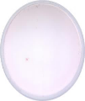
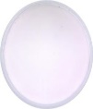
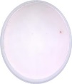

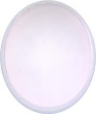
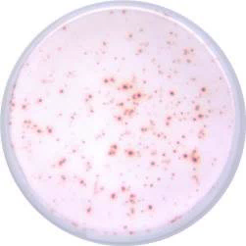
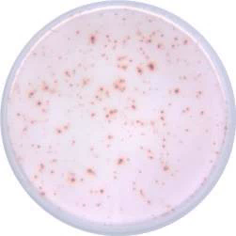
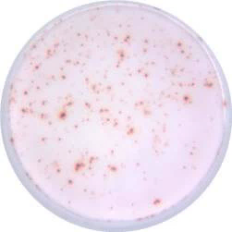
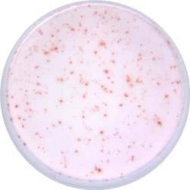
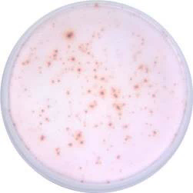
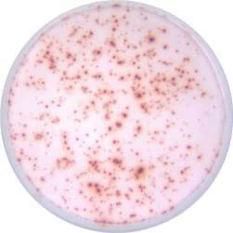
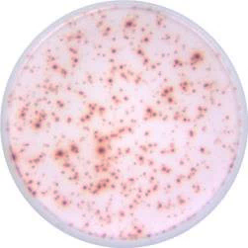
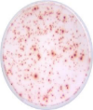
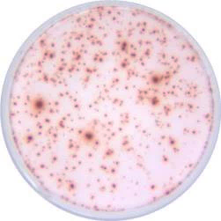

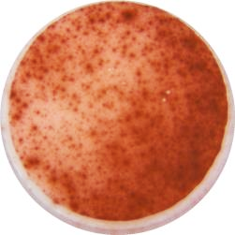

Supplementary Figure 6
(C)
tdLN
Spleen
PBS
mR-E
mR-DEF3
PBS
mR-E
mR-DEF3
(-)
(-)
(+)
(+)
Notes:
5x104 spleen / tdLN / 1ug/ml peptide / 24 hours restimulation
TNF-α+IL-2+ IFN-γ+ CD8+ cell (%) in spleen cells

Slide 9
Supplementary Figure 6
(D)
Lymphocyte
Singlet
Live cells
SSC-A
FSC-H
FSC-A
FSC-A
FSC-A
Live-dead IR885
CD8⁺
TNF-α PE
IL2⁻
IL2⁺
CD8 FITC
FSC-A
IFN-γ BUV737
IL2 APC
CD8 FITC
IL-2⁺
IFN-γ⁺
TNF-α⁺
IFN-γ⁺ TNF-α⁺
TNF-α PE
IL-2⁺ IFN-γ⁺
IL-2⁺ TNF-α⁺
IL-2⁺ IFN-γ⁺ TNF-α⁺
IFN-γ BUV737

Slide 10
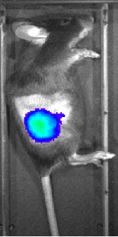
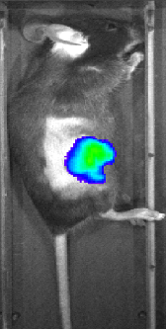
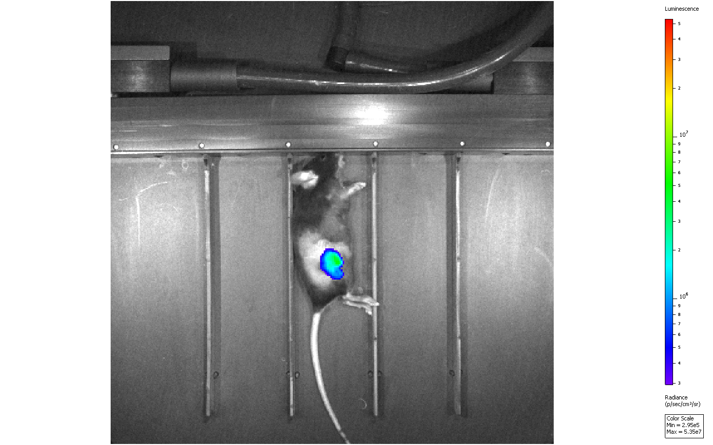
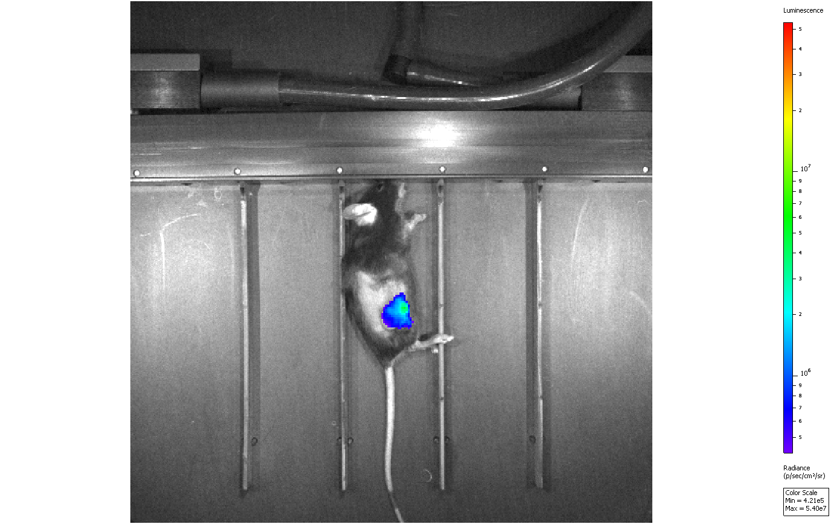
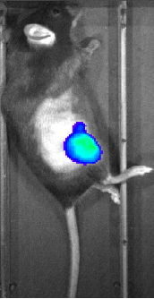

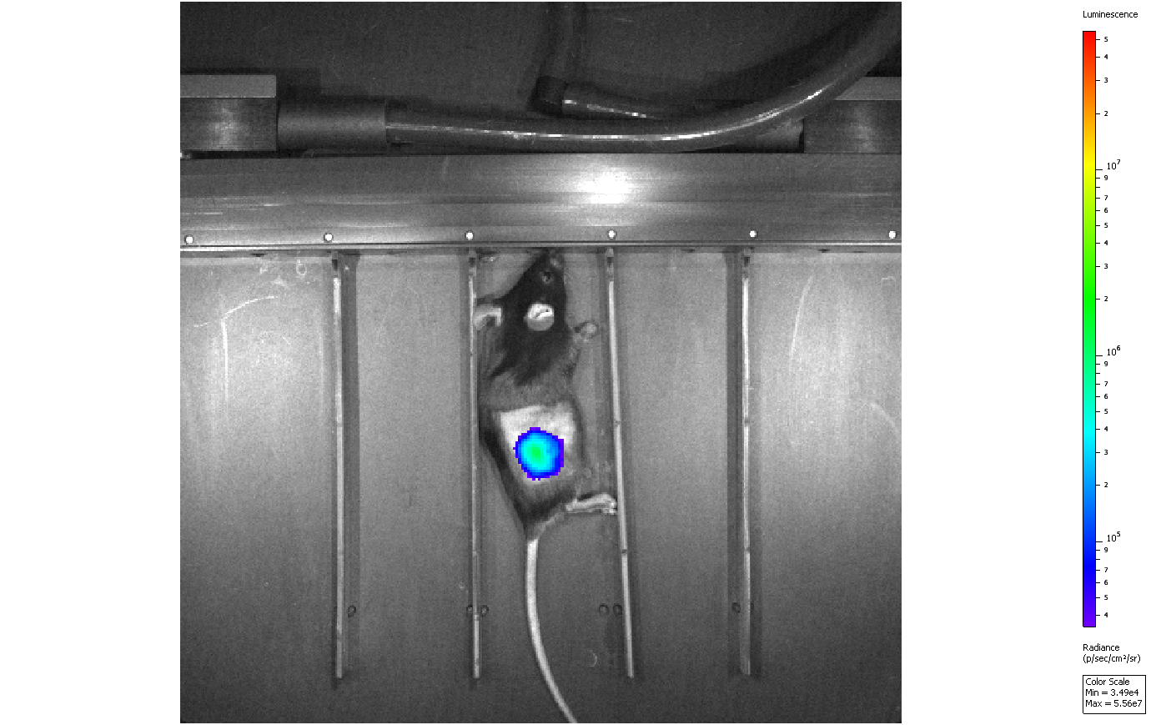
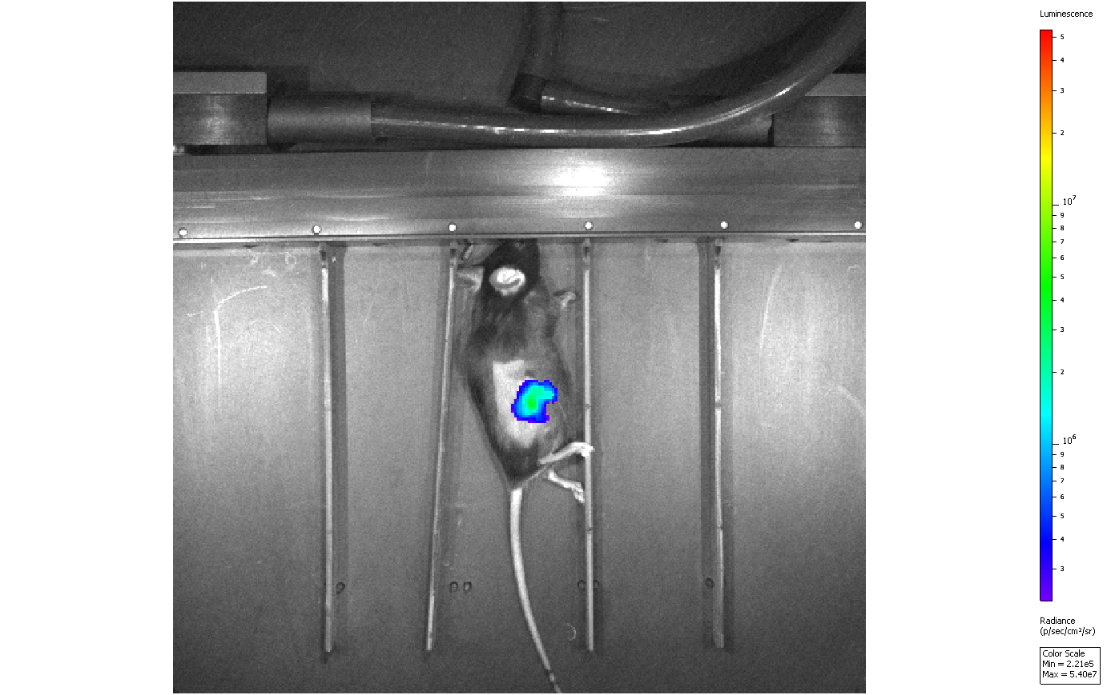
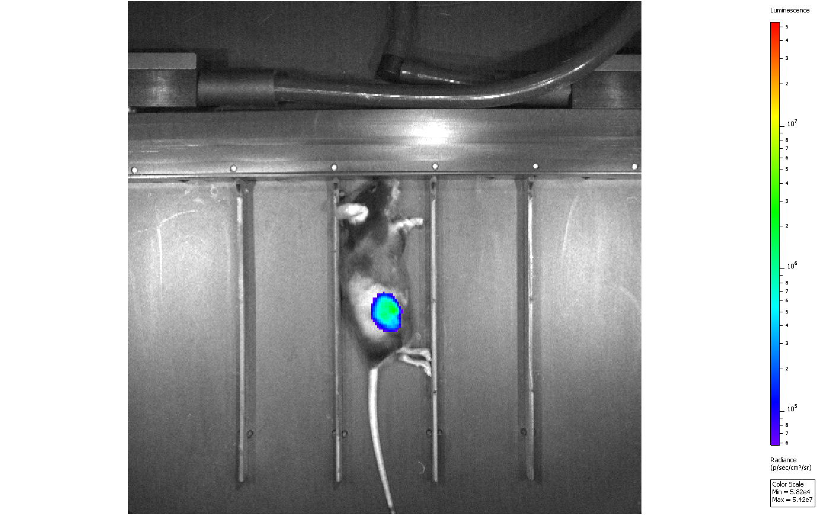
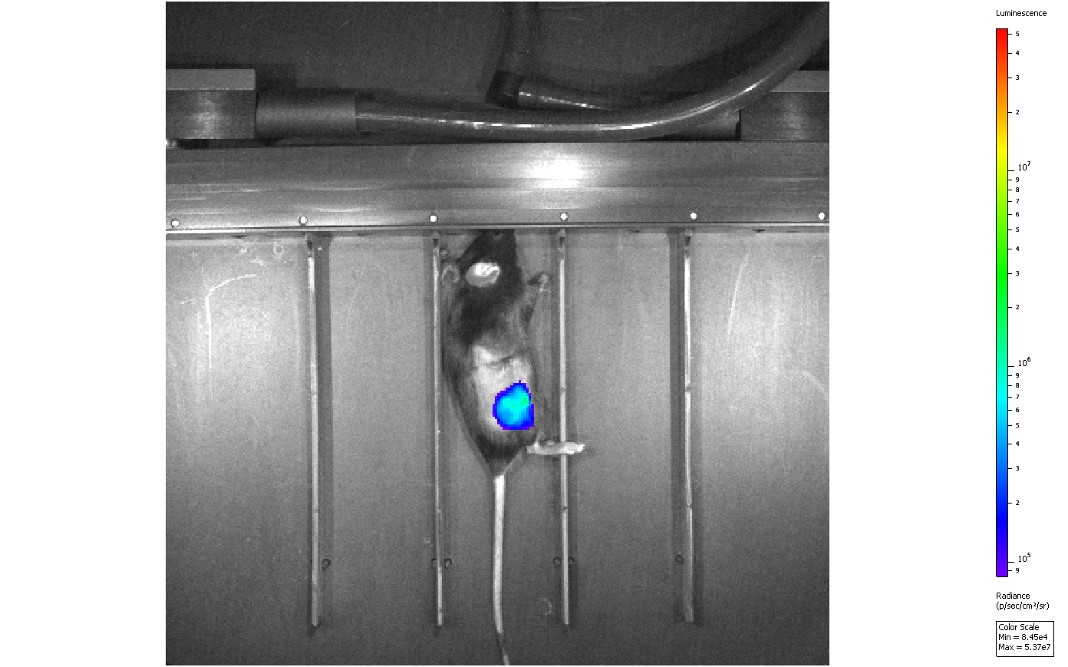
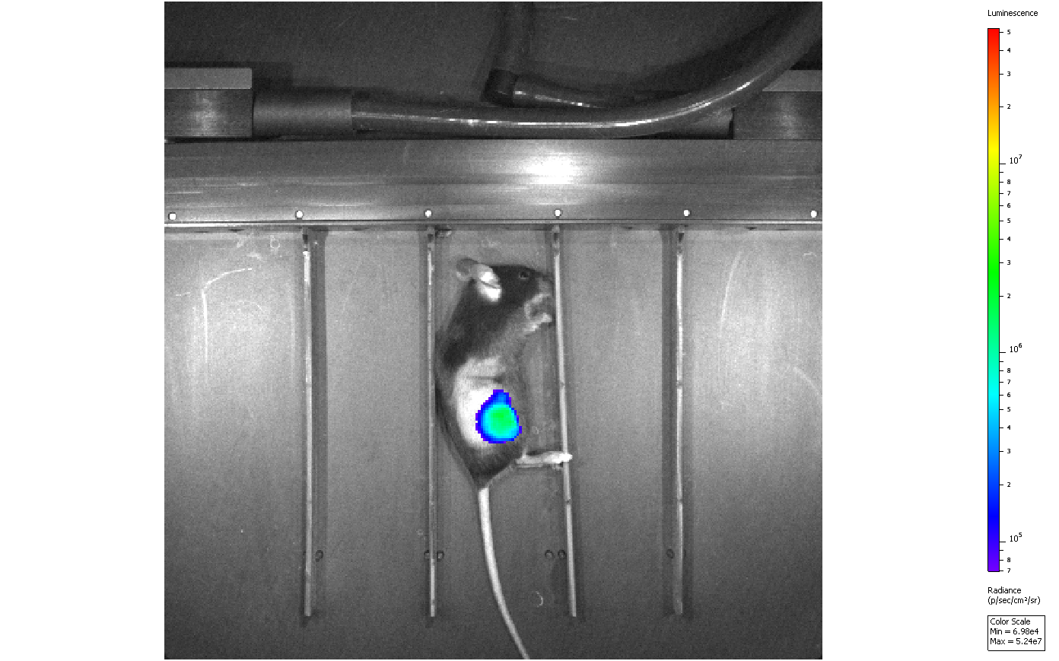










Supplementary Figure 7
(A)
5’cap
5’UTR ORF 3’UTR
Poly(A)
D-Fluc-F
D
Fluc
F3
D: DCpep6
Fluc
F3: FlaB^{N83/101/139A}
(B)
D-Fluc-F-mRNA-LNP
(10μg peritumoral subcutaneous inj)
5 x 10⁴/mouse
TC-1 cell injection (S.C.)
IVIS imaging
I I
2
2
3
6 h 12h 24 h 48h
(C)
1
Tumor size (3~5 mm)
6h
12h
24h
48h
4
3
4
1

Slide 11









































































































Supplementary Figure 8
Tumor diameter at 1st vaccination: 3-5 mm
Day
PBS
DEF
10
16
23
30
37
Tumor diameter at 1st vaccination: 8-10 mm
Day
PBS
DEF
17
23
30
37
44
Tumor diameter at 1st vaccination: 10-15 mm
Day
PBS
DEF
24
30
37
44
51
= tumor free
= expired
Notes:
For Fig 4

Slide 12
Supplementary Figure 9
Lymphocyte
Lymphocyte
Live CD45⁺ cell
Neutrophil
Ly6G-
Live-dead IR885
CD11b BUV395
SSC-A
FSC-H
FSC-A
FSC-A
CD45 PE-Cy7
Ly6G APC
CD11c⁺ monocyte
moDC/InfDC
cDC2
Ly6C APC-Cy7
CD11c PE
Ly6C APC-Cy7
CD11b BUV395
cDC1
CD11b BUV395
MHCII FITC
CD11b BUV395
XCR1 PacificBlue
Monocyte
Ly6C APC-Cy7
CD11b BUV395

Slide 13
Supplementary Figure 10
(A)
MM
MP
(B)
Notes:
Prime boost re-challenge -> 50 ug/ml protein re-stimulation

