Slide 1
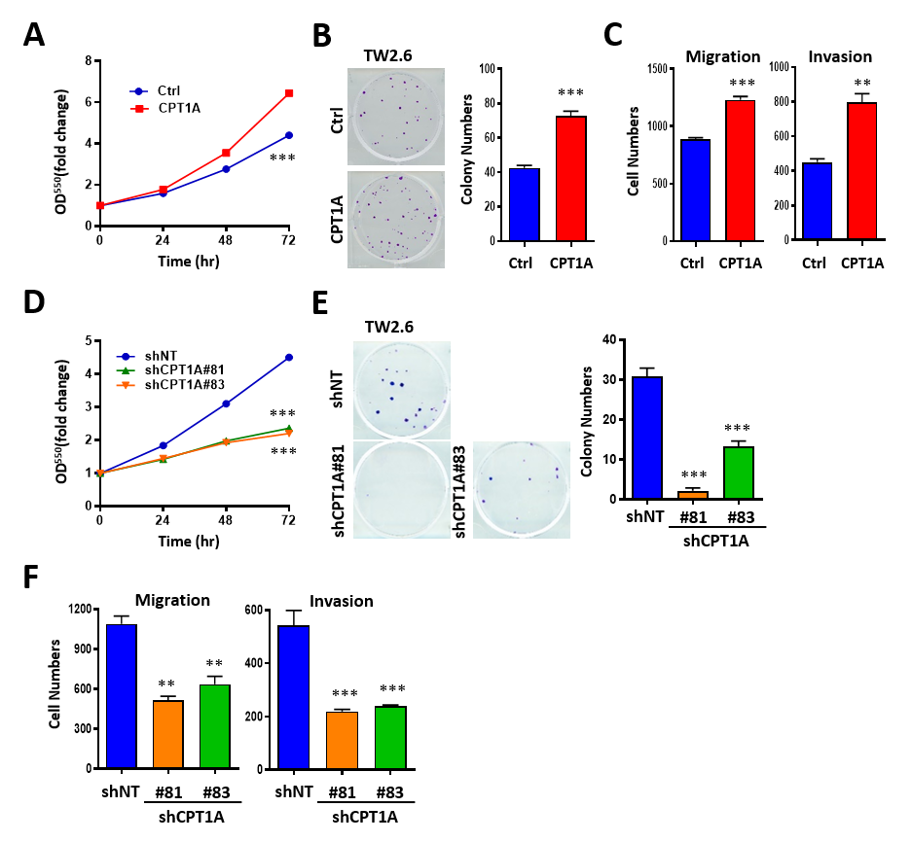
Supplementary Figure-1
Supplementary Figure S1. CPT1A regulates proliferation, motility, and tumor growth of TW2.6 cells. A: MTT assays of TW2.6 cells with CPT1A overexpression. B: Colony formation assay after CPT1A overexpression in TW2.6 cells for 12 days (left). The mean number of colonies for each bar was determined from three independent assays (right). C: Transwell migration (8 h) and invasion (24 h) assay of CPT1A overexpression in TW2.6 cells. D: MTT assays of TW2.6 cells after CPT1A knockdown (shCPT1A#81, #83) vs. empty vector (shNT) for 48 h. E: Colony formation assay after CPT1A knockdown in TW2.6 cells for 12 days (left). The mean number of colonies for each bar was determined from three independent assays (right). F: Transwell migration (8 h) and invasion (24 h) assay of CPT1A knockdown in TW2.6 cells.

Slide 2
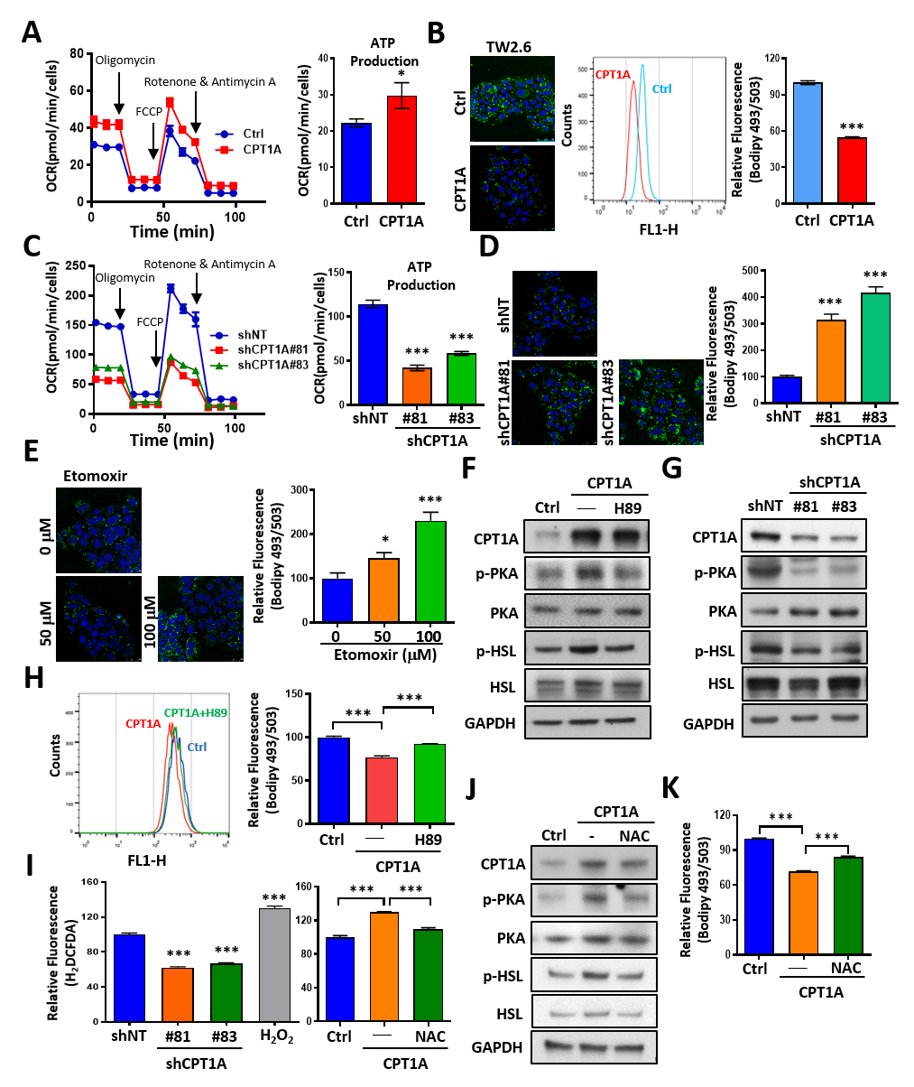
Supplementary Figure-2

Slide 3
Supplementary Figure S2. CPT1A enhances FAO-driven energy metabolism and lipid droplet (LD) breakdown via PKA-mediated lipolysis. A: OCR measured in control (Ctrl) and CPT1A overexpression TW2.6 cells using the Seahorse XF Extracellular Flux analyzer. Oligomycine, FCCP, rotenone and antimycin A were added at the indicated points (left). ATP production ability was calculated by subtracting the oligomycin rate from baseline cellular OCR (right). B: Confocal microscopy (left) and flow cytometry (middle) analysis of lipid droplet stained with BODIPY™ 493/503 (green fluorescence) and the nuclei were labeled with DAPI (blue) in control (Ctrl) or CPT1A transfected TW2.6 cells. The average lipid droplet intensity was measured by BODIPY fluorescence from flow cytometer (right). C: OCR measured in control (shNT) or CPT1A knockdown (shCPT1A#81, #83) TW2.6 cells using the Seahorse XF Extracellular Flux analyzer (left). ATP production ability was calculated by subtracting the oligomycin rate from baseline cellular OCR (right). D: Confocal microscopy (left) analysis of lipid droplet stained with BODIPY™ 493/503 (green fluorescence) and the nuclei were labeled with DAPI (blue) in control (shNT) or CPT1A knockdown (shCPT1A#81, #83) TW2.6 cells. The average lipid droplet intensity was measured by BODIPY fluorescence from flow cytometer (right). E: Confocal microscopy (left) analysis of lipid droplet stained with BODIPY™ 493/503 (green fluorescence) after etomoxir (0, 50, or 100 μM) treatment in TW2.6 for 24 h. The mean intensity of BODIPY fluorescence for each bar was determined from three independent of flow cytometer assays (right). F: Western blot analysis of total and phosphorylated forms of PKA and HSL in control (Ctrl) or CPT1A overexpression TW2.6 cells treated with or without 20 µM of H89. GAPDH was used as an internal control. G: Western blot analysis of total and phosphorylated forms of PKA and HSL in control (shNT) or CPT1A knockdown (shCPT1A#81, #83) TW2.6 cells. H: Flow cytometry (left) analysis of lipid droplet stained with BODIPY™ 493/503 in control (Ctrl) or CPT1A overexpression TW2.6 cells treated with or without 20 µM of H89. The average lipid droplet intensity was measured by BODIPY fluorescence (right). I: Flow cytometry analysis of H2DCFDA (20 μM, 3 h) fluorescence in CPT1A knockdown (left) or CPT1A overexpression (right) TW2.6 cells. H₂O₂ was used as positive control. Cells were treated with 10 mM NAC for 18 h before the end of the experiment. J: Western blot analysis of total and phosphorylated forms of PKA and HSL in control (Ctrl) or CPT1A overexpression TW2.6 cells treated with or without 10 mM NAC for 18 h. K: Flow cytometry analysis of lipid droplet stained with BODIPY™ 493/503 in control (Ctrl) or CPT1A overexpression TW2.6 cells treated with or without 10 mM NAC for 18 h. All data are presented as mean ± SD from three independent experiments. *p < 0.05; **p < 0.01; ***p < 0.001.

Slide 4
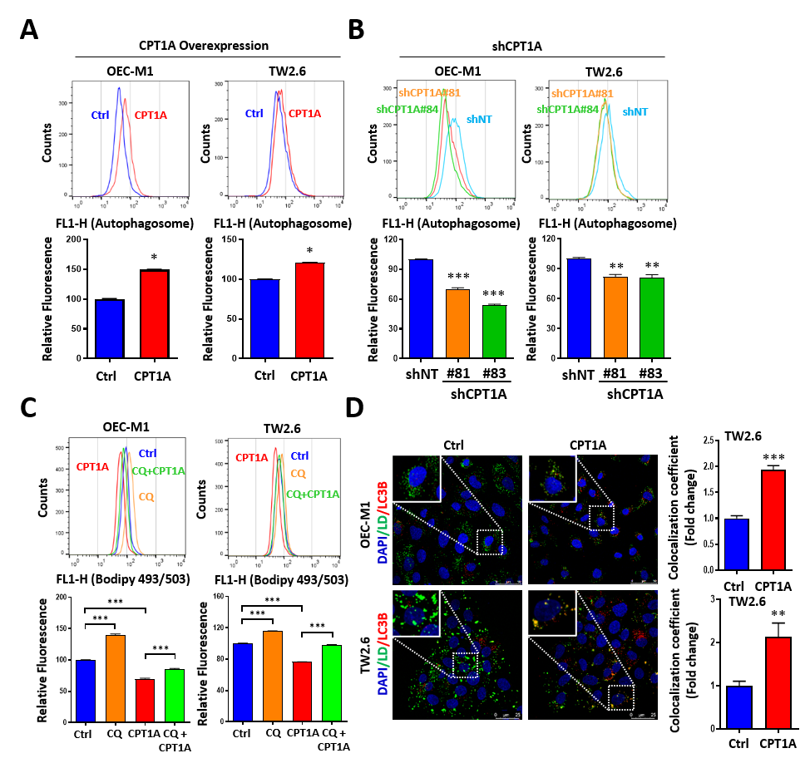
Supplementary Figure-3
Supplementary Figure S3. CPT1A enhances lipophagy in OEC-M1 and TW2.6 cells.
(A, B) Autophagy Detection Kit was used to analyze autophagosome levels in CPT1A overexpression (A) or knockdown (B) OSCC cells by flow cytometry. The bar graph shows the average fluorescence intensity measured by flow cytometry (lower). (C) BODIPY™ 493/503 staining of LDs in OSCC cells with or without CPT1A overexpression and chloroquine (CQ, 50 µM, 16 h) treatment. (D) Confocal microscopy of LDs (BODIPY™ 493/503, green) and LC3B (red) with DAPI-stained nuclei (blue). Co-localization was analyzed using the JaCoP plug-in ImageJ and quantified as Manders and Pearson’s correlation coefficients from 20–30 cells per group. Scale bars = 25 µm. All data are presented as mean ± SD from three independent experiments. *p < 0.05; **p < 0.01; ***p < 0.001.

Slide 5
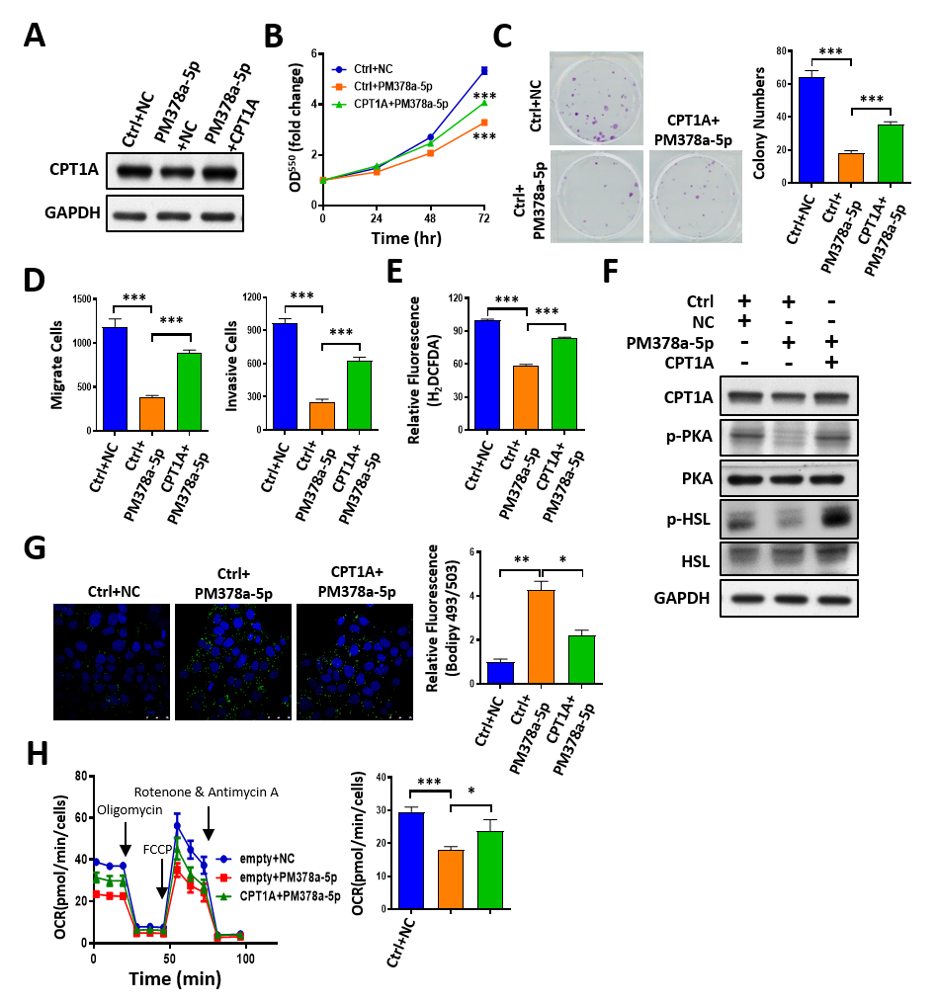
Supplementary Figure-4
Supplementary Figure S4. CPT1A rescues the functional effects of miR-378a-5p on OSCC. A-H: TW2.6 cells were transfected with miR-378a-5p mimics (PM) or scramble control (NC) for 24 h and then transfected with 3’-UTR truncated CPT1A expression vector (CPT1A) expression vector (Ctrl) for another 24 h. Under this condition, the level of CPT1A protein (A), proliferation rate (B), colony formation (C), migration and invasion ability (D), intracellular free radicals (E), total and phosphorylated forms of PKA and HSL (F), lipid droplets levels (G), OCR and ATP production (H) were measures. GAPDH was used as an internal control. I-J: Xenograft tumors were generated from TW2.6 cells transfected with either empty vector (Ctrl+NC), miR-378a-5p mimics (PM378a-5p), or PM378a-5p plus CPT1A expression vector (CPT1A+PM378a-5p). All data are presented as mean ± SD from three independent experiments. *p < 0.05; **p < 0.01; ***p < 0.001.

