Slide 1
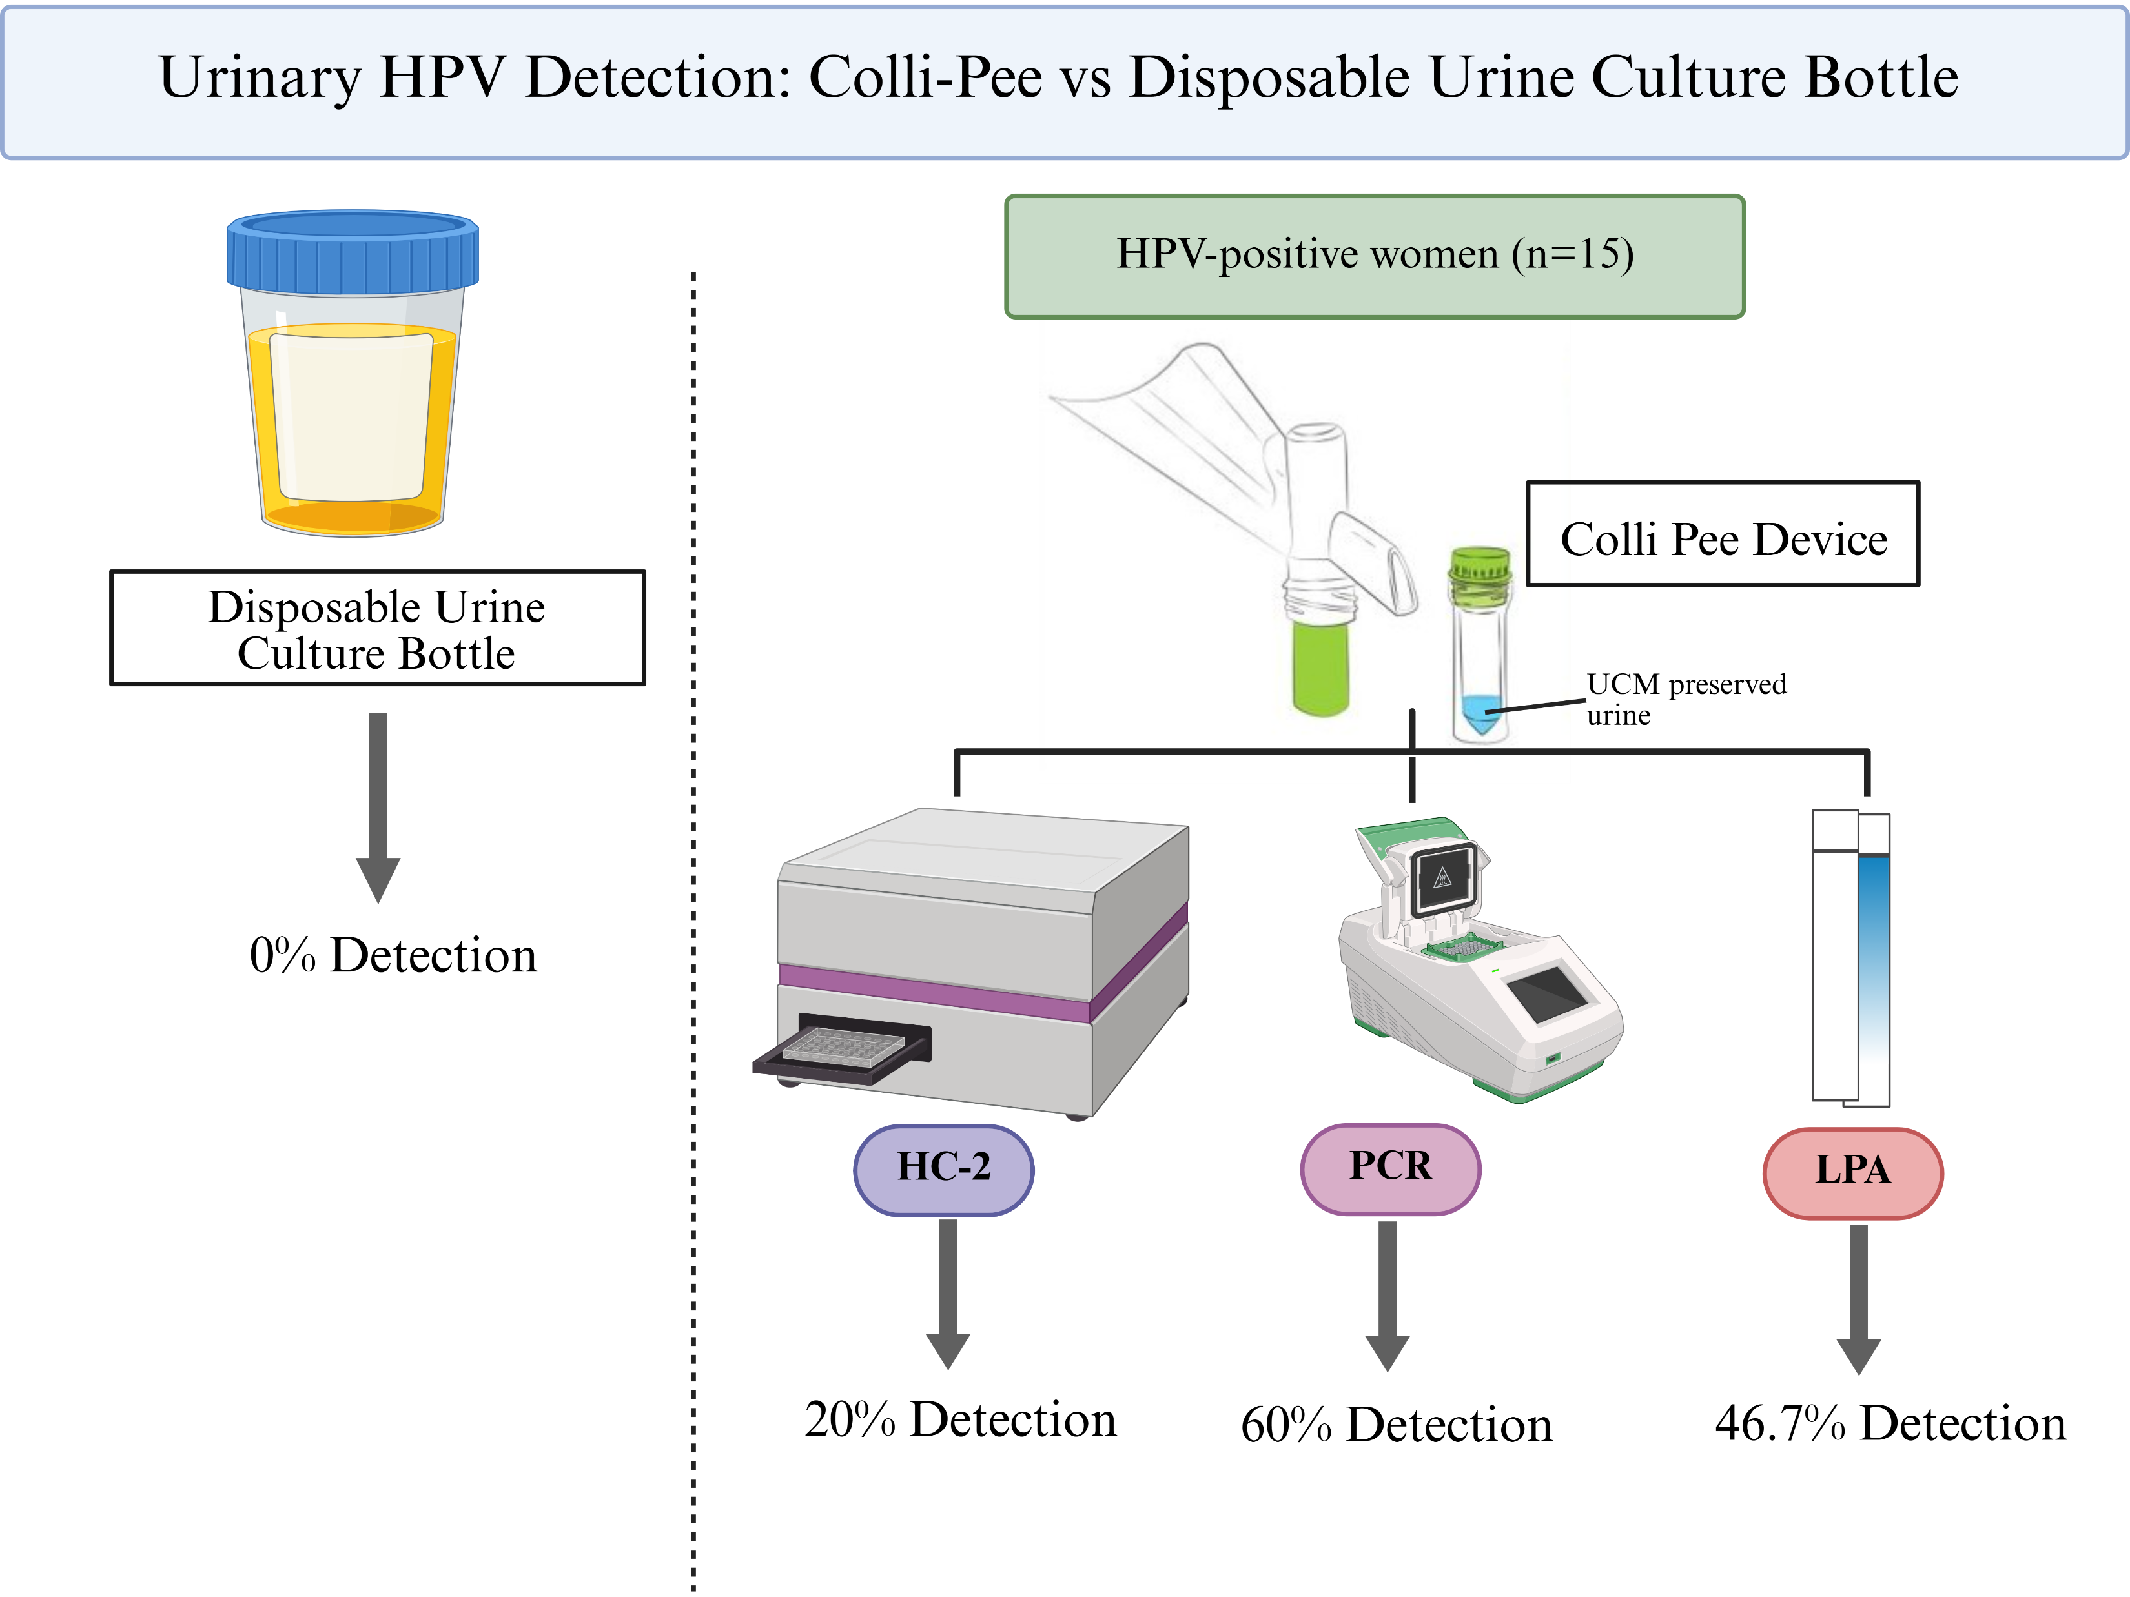
Supplementary Material
Graphical Abstract
Figure S1 – Graphical abstract summarising key findings of urinary HPV DNA detection using the Colli-Pee device in HPV-positive women.

