Slide 1
Supplemental Figure 1
Flow diagram of patients included in the study
45 UTUC patients treated with RNU
Oncogene mutation analysis
Excluded
9 patients with insufficient analysis specimens
4 patients with no histological findings of malignancy
32 eligible UTUC patients
Comparison of two groups according to NAC status
NAC group
n = 7
non-NAC group
n = 25

Slide 2
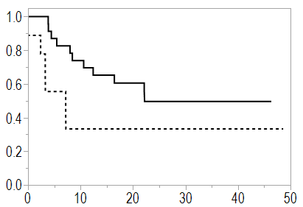
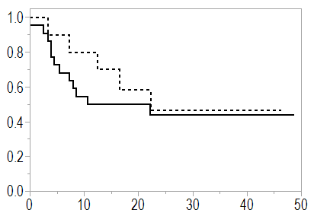
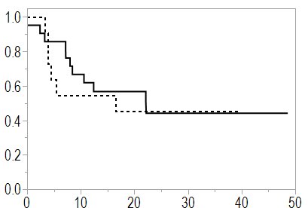
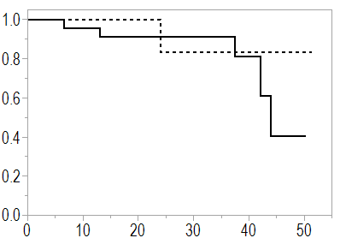
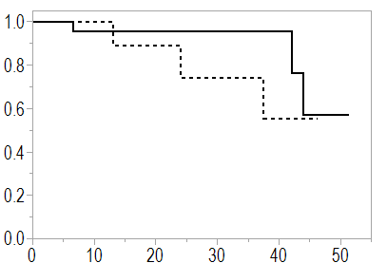
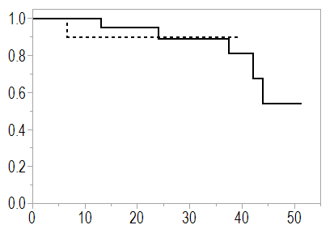
Supplemental Figure 2
(a) PFS
TP53-
FGFR3-
RAS-
p = 0.0184
TP53+
p = 0.3523
p = 0.6199
FGFR3+
RAS+
months
months
months
(b) OS
TP53-
FGFR3-
RAS-
TP53+
FGFR3+
RAS+
p = 0.7831
p = 0.1459
p = 0.8225
months
months
months
Notes:
Supple 1フローチャート作成

Slide 3
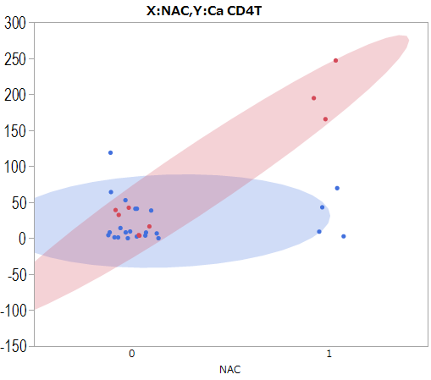
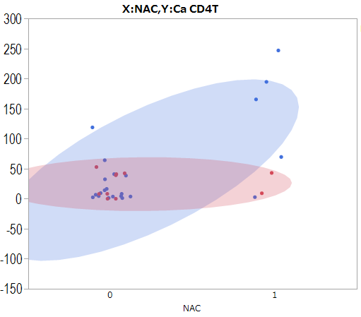
Supplemental Figure 3
TP53 mutation group
FGFR3 mutation group
Intra-tumoral CD4+ T cell densities
TP53-
Intra-tumoral CD4+ T cell densities
FGFR3-
TP53+
FGFR3+

Slide 4
Supplemental Figure 4
HMGB1
(b) Non-NAC
(a) NAC

