Slide 1
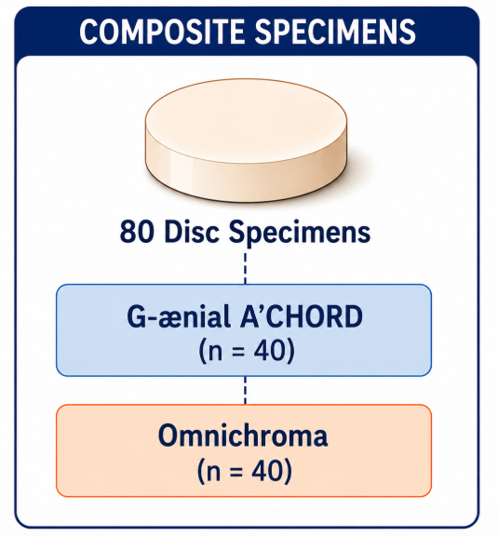
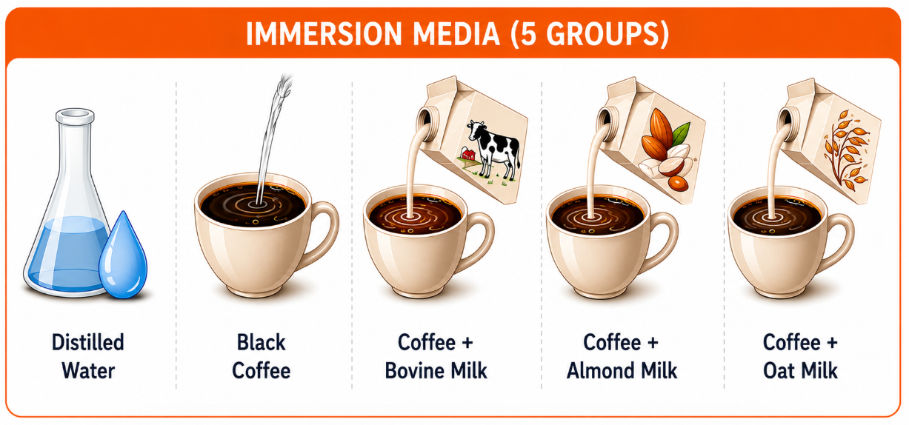


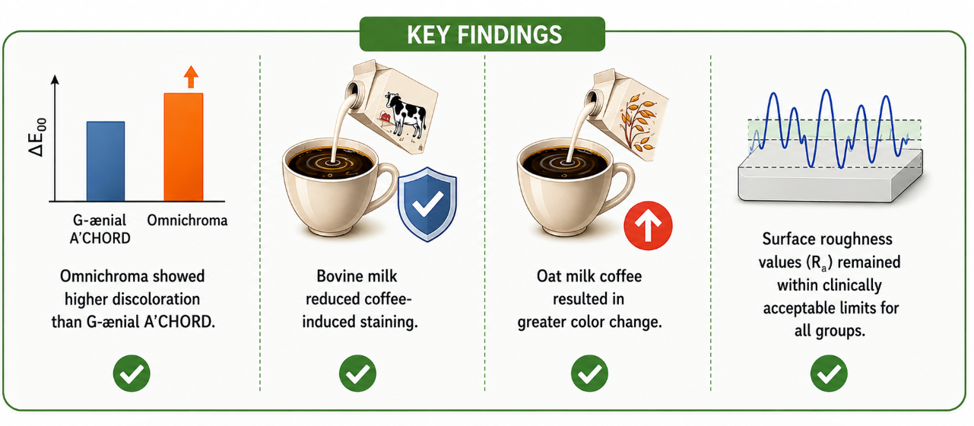
Effects of Coffee Prepared with Different Milk Types on the Color Stability and Surface Roughness of Resin Based Composites

