Slide 1
Supplemental Figures

Slide 2
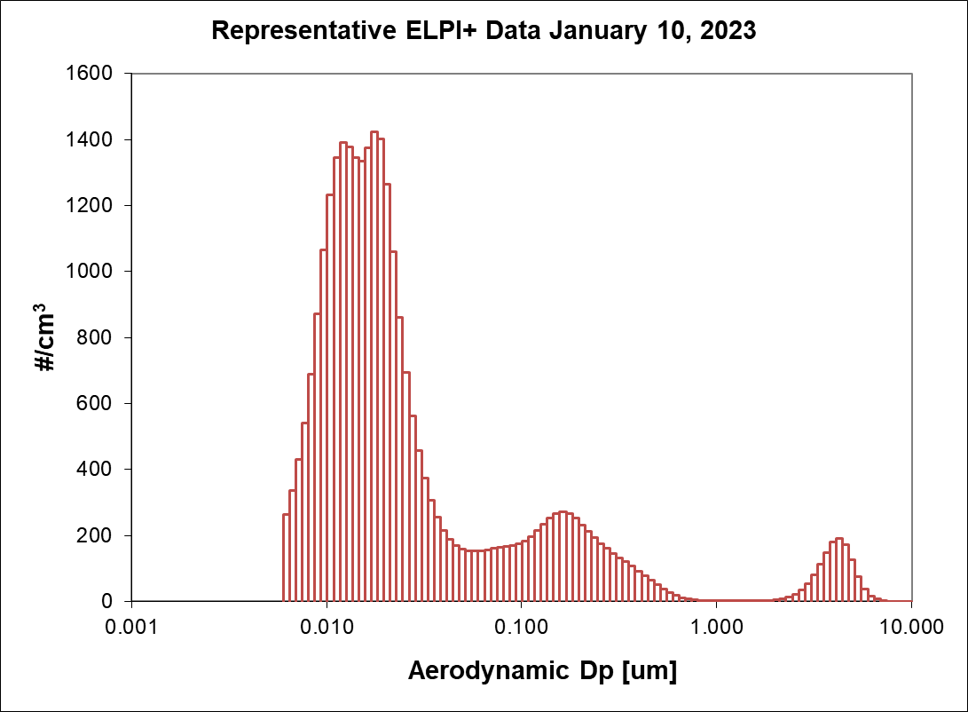
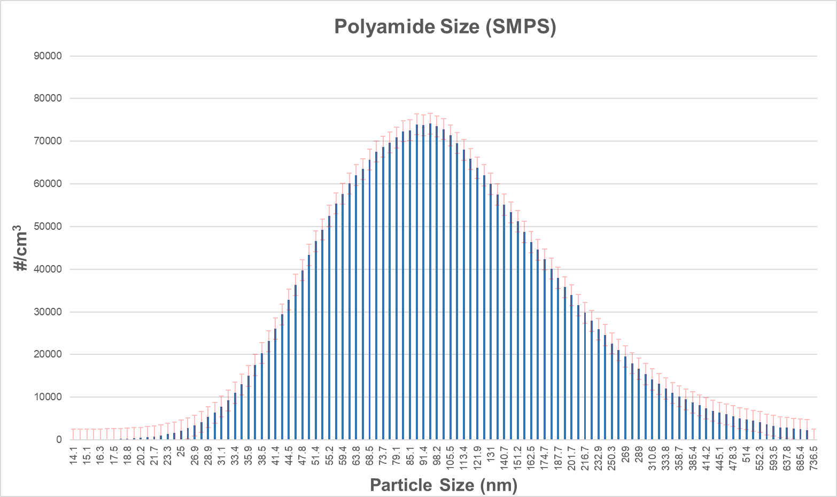
Supplemental Figure 1
A
B
Notes:
Supplemental Figure 1: Real-time size characterization of aerosolized polyamide powder identifies micro- and nano-sized particles as characterized by electrical mobility (A; SMPS) and aerodynamic diameter (B; ELPI). SMPS data (A) are presented as geometric mean ± SEM. HR-ELPI data (B) is presented as representative data acquired on January 10, 2023.

Slide 3
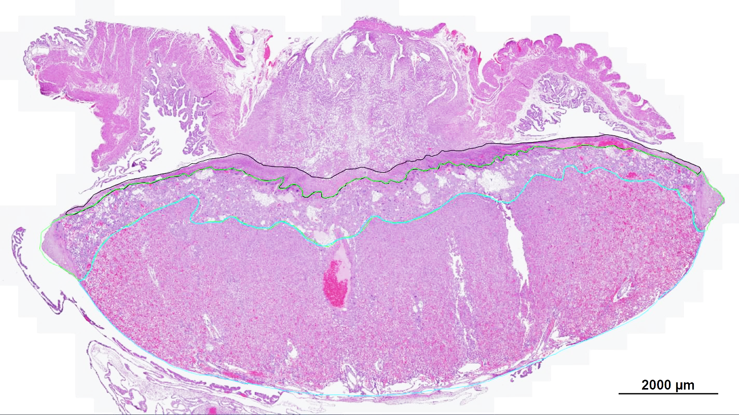
Supplemental Figure 2
Metrial Gland
Decidua
Junctional Zone
Labyrinth
Notes:
Supplemental Figure 2. A representative image of an H&E-stained GD20 rat placental section is labeled to demonstrate the lines of demarcation between the different placental zones

Slide 4
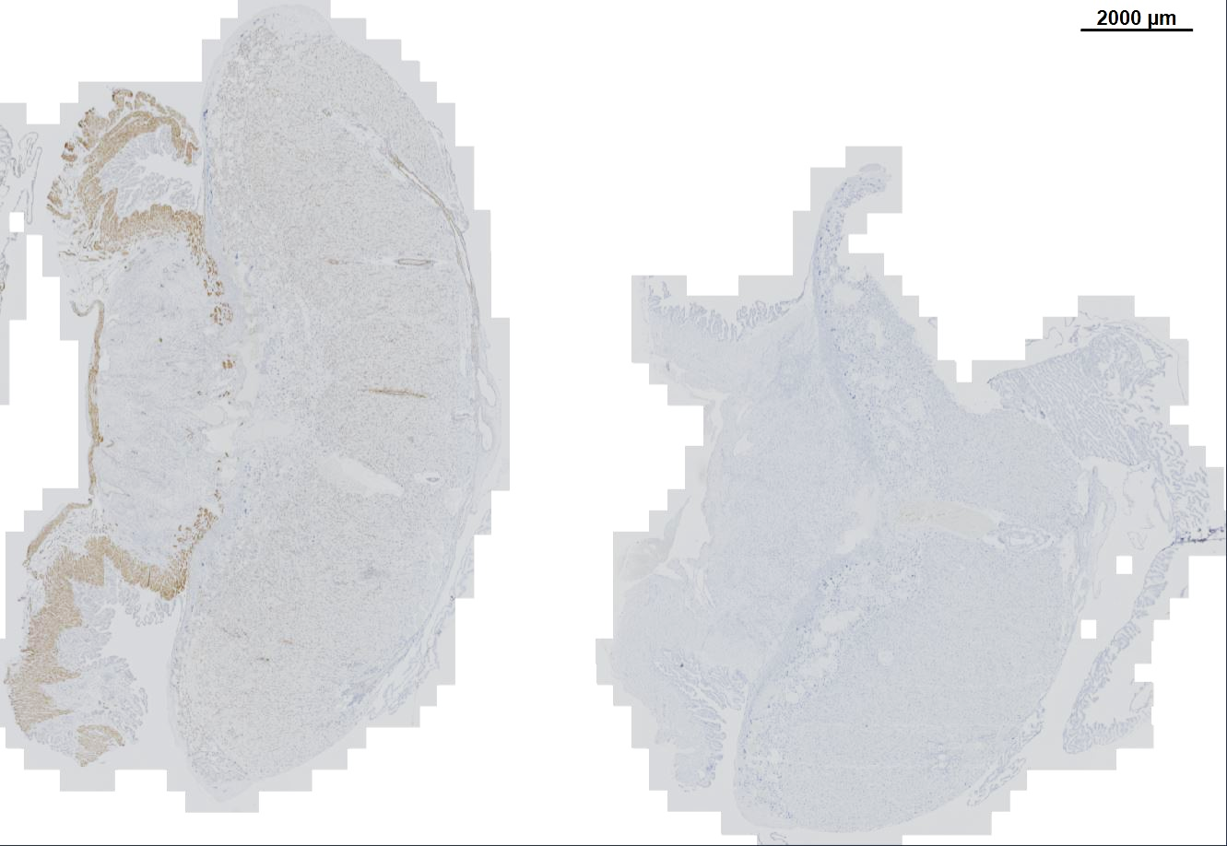
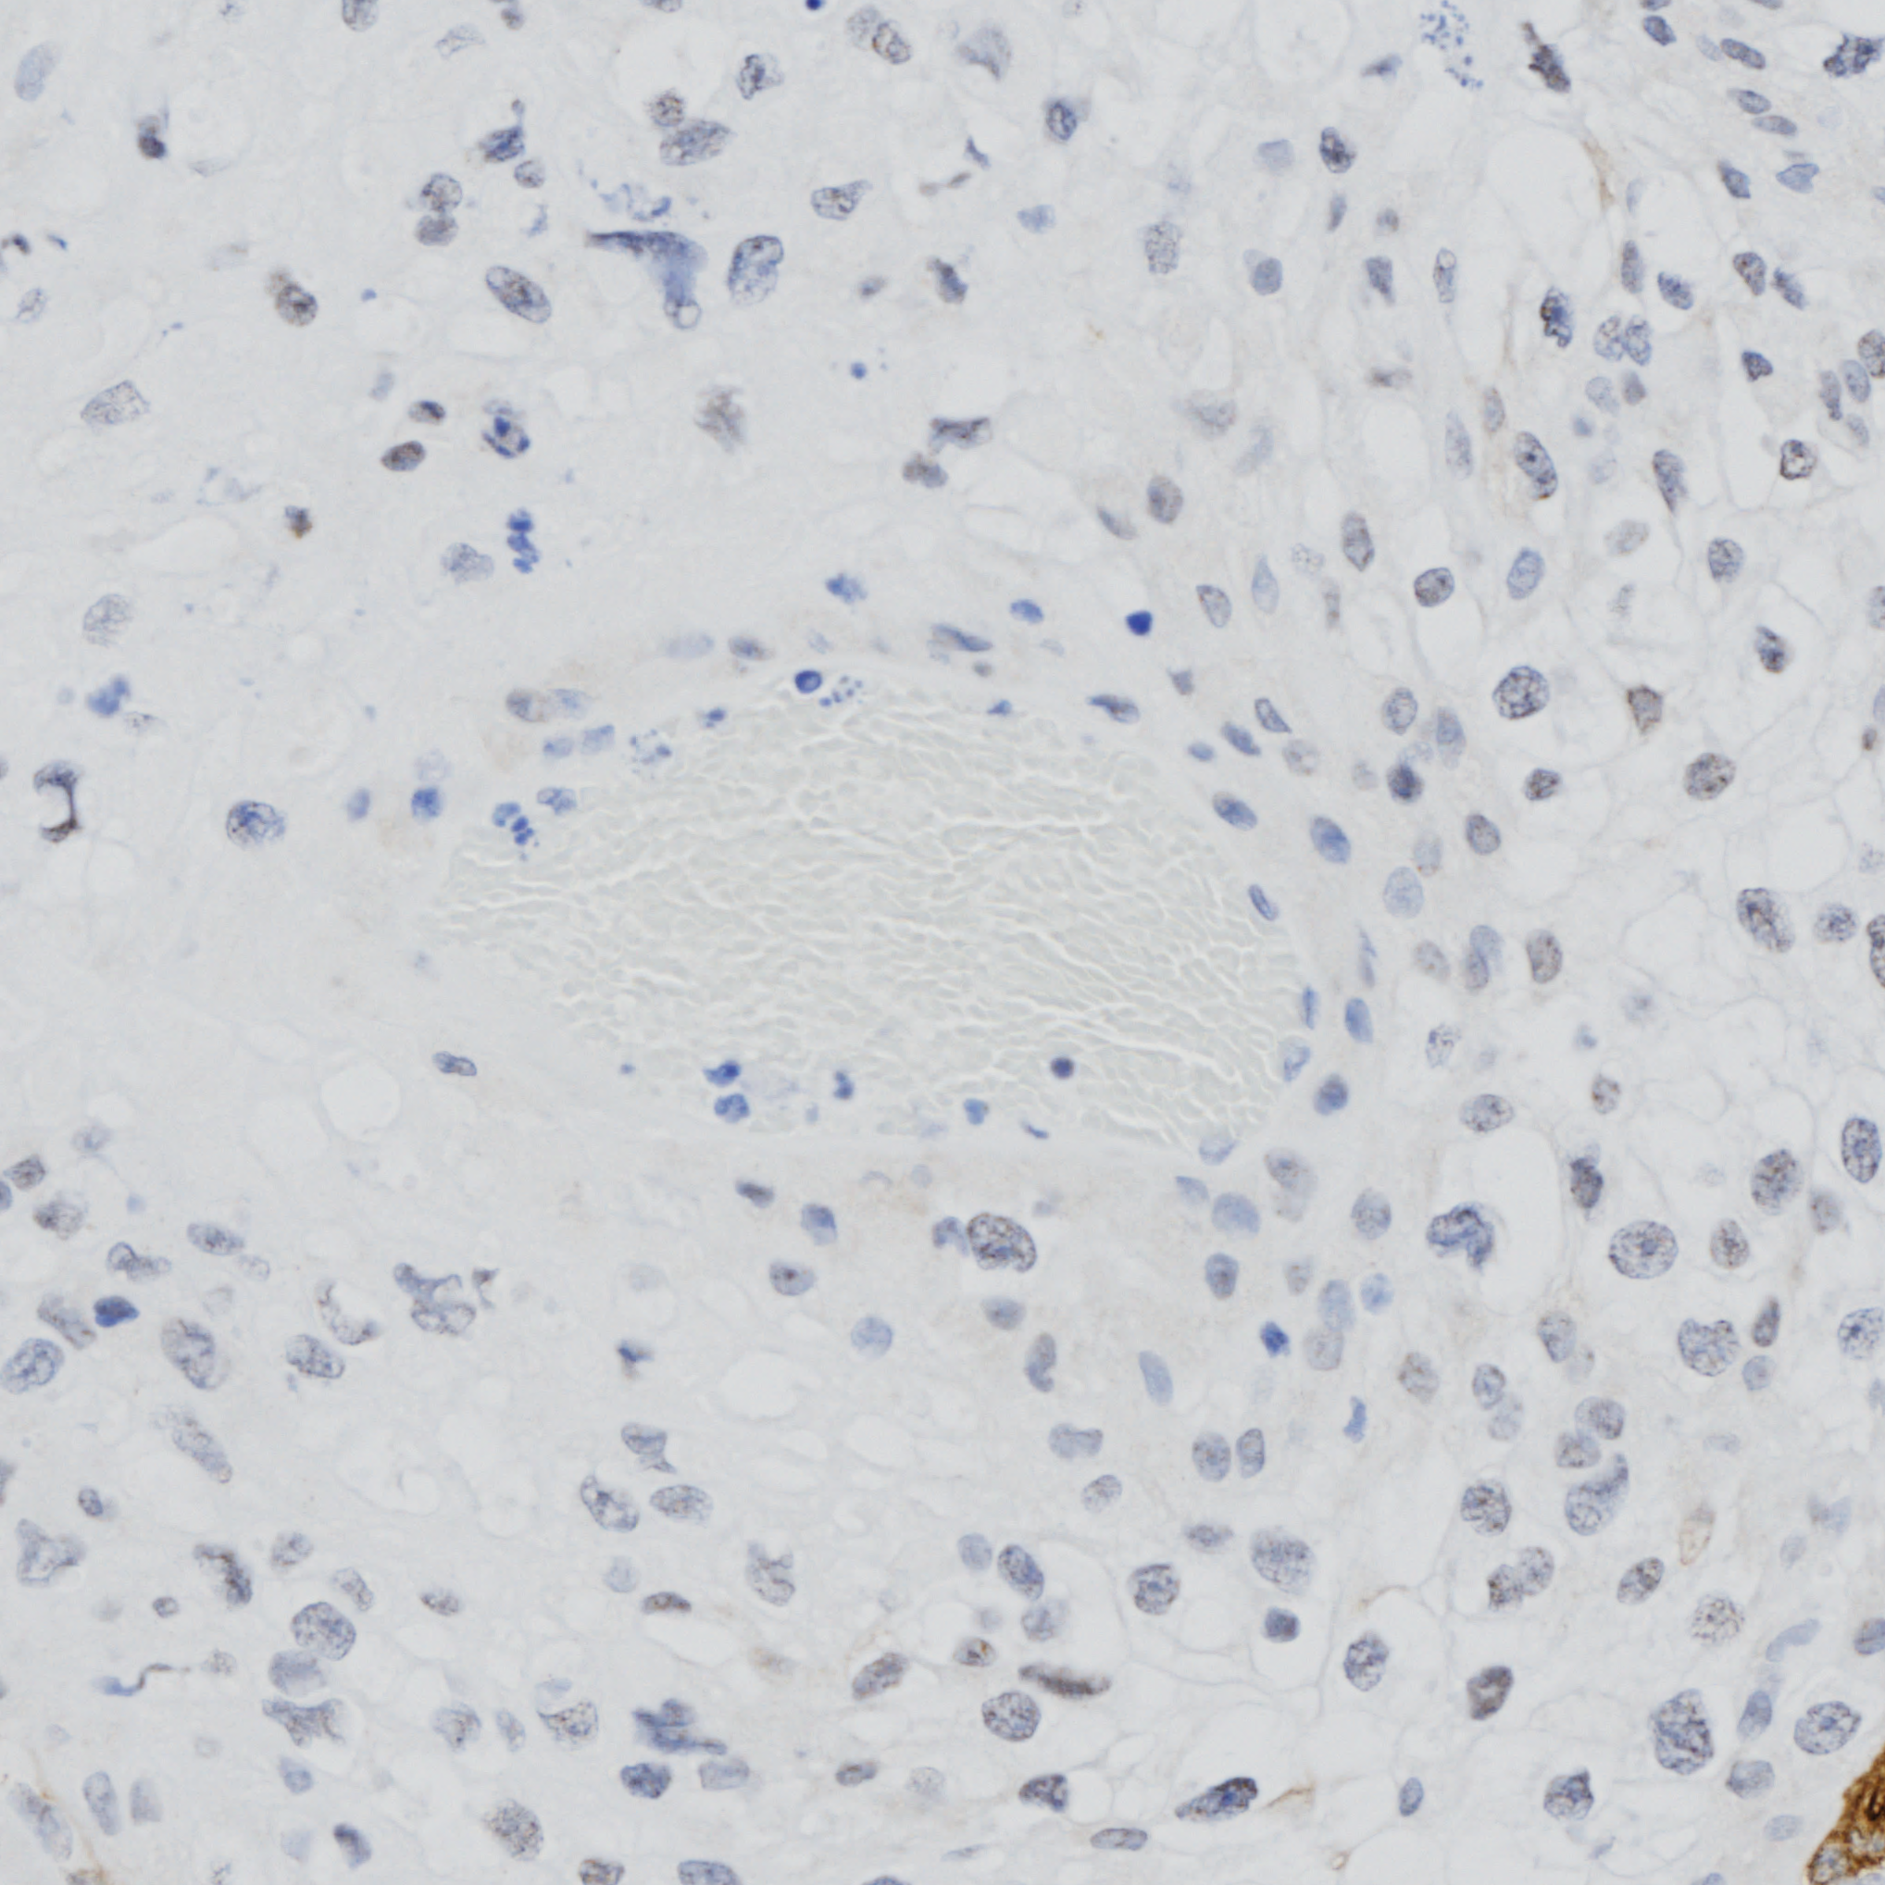
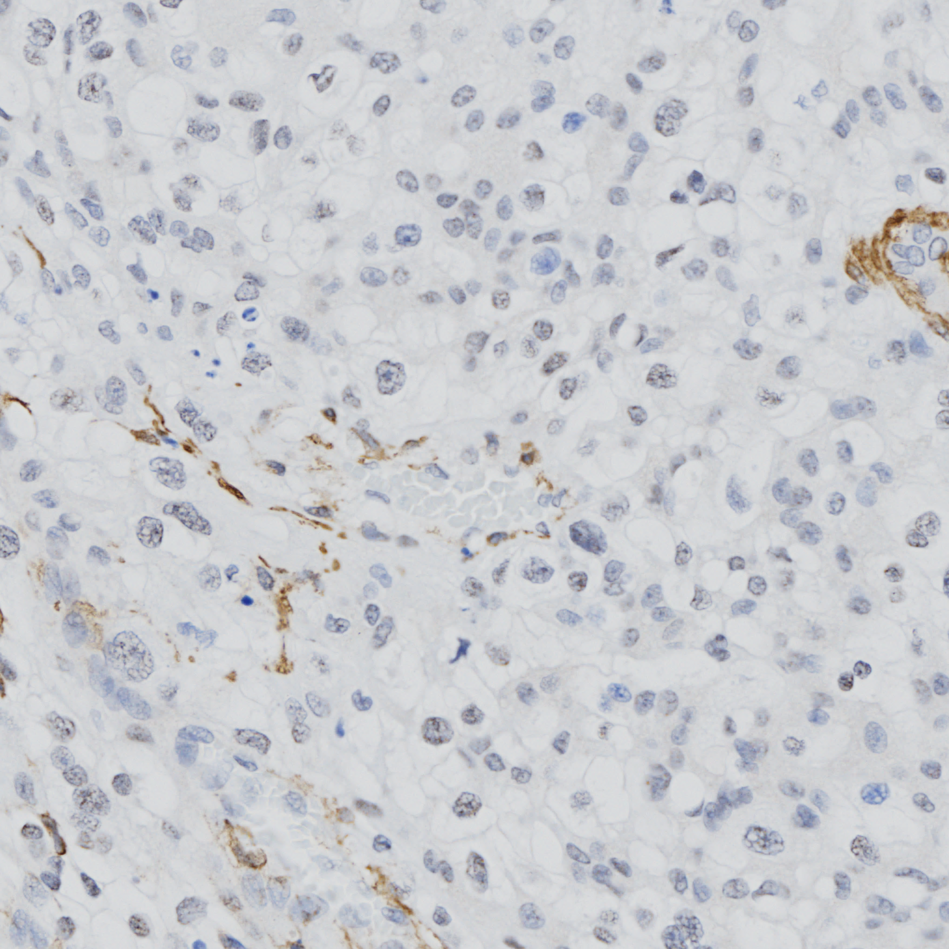
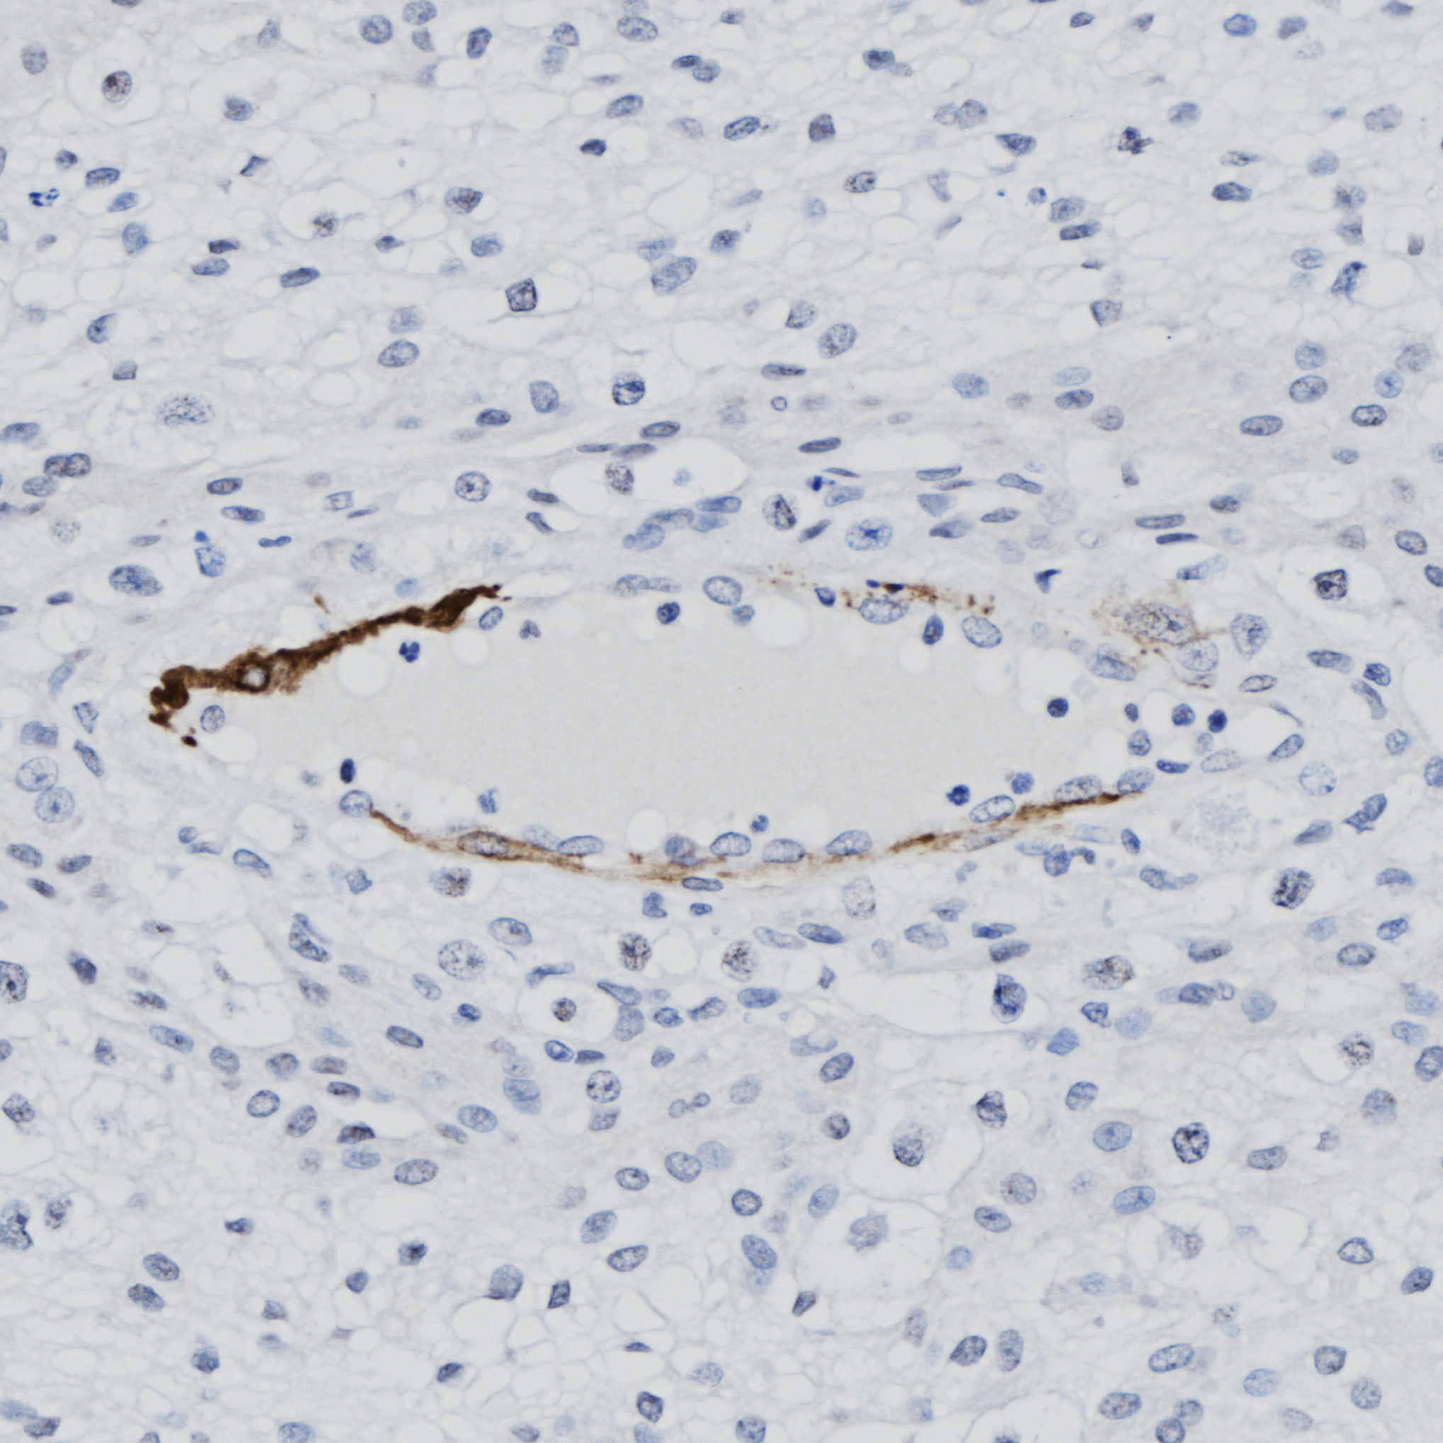
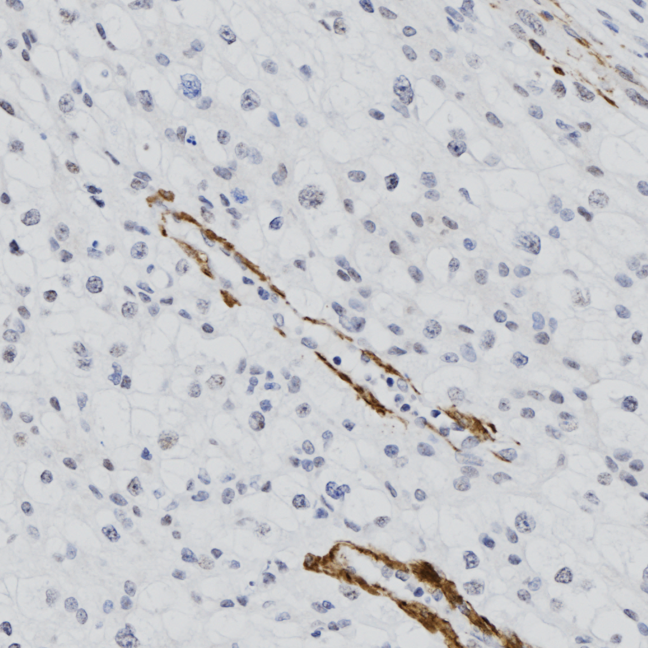
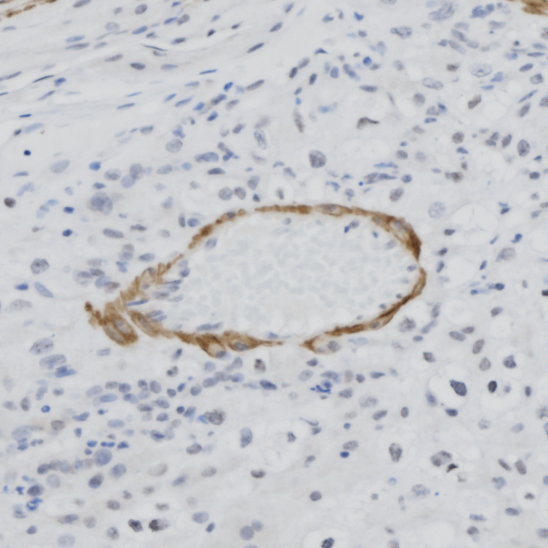
A
α-SMA
IgG Control
MG
L
2000 µm
B
Score:
% Circumscription:
1
0-20%
2
20-40%
3
40-60%
4
60-80%
5
80-100%
2000 µm
100 µm
Notes:
Supplemental Figure 3. Representative images from slides scanned at 20x show α-SMA-positive 3,3′-Diaminobenzidine staining placental sections. Representative images of whole placental sections show prominent staining in the metrial gland (MG) and labyrinth zone (L) while the uterine myometrium (black arrow) has the most prominent staining sections as compared to a negative rabbit IgG control (A). Representative images of scored vessels in the metrial gland are shown (B). Arrows depict α-SMA-positive 3,3′-Diaminobenzidine staining in the vessel wall while arrowheads denote the lumen of the vessel.

Slide 5
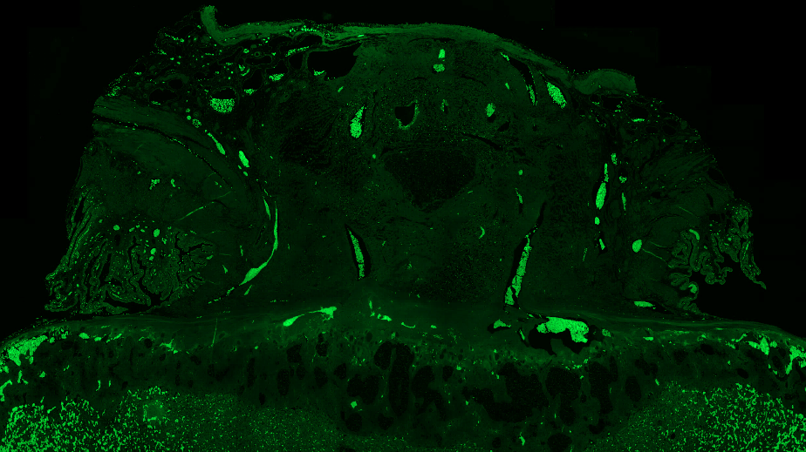
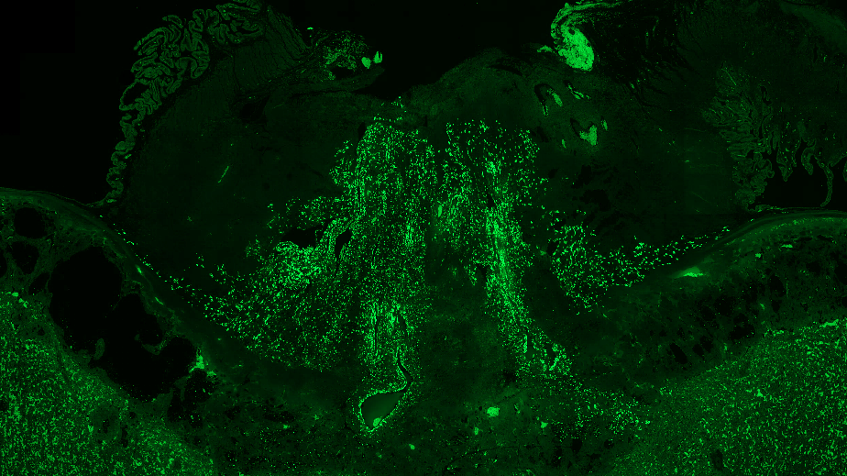
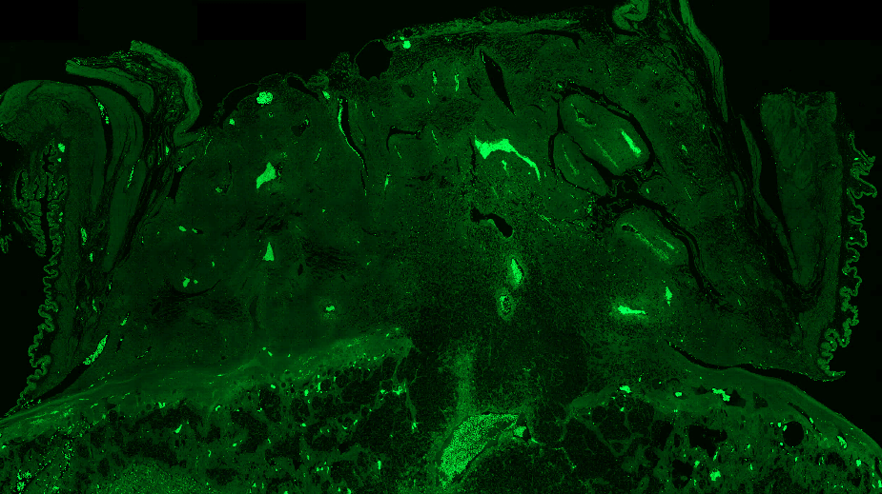
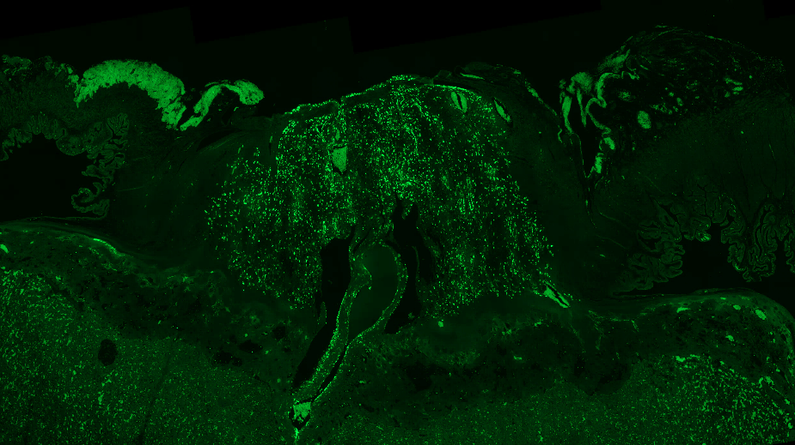
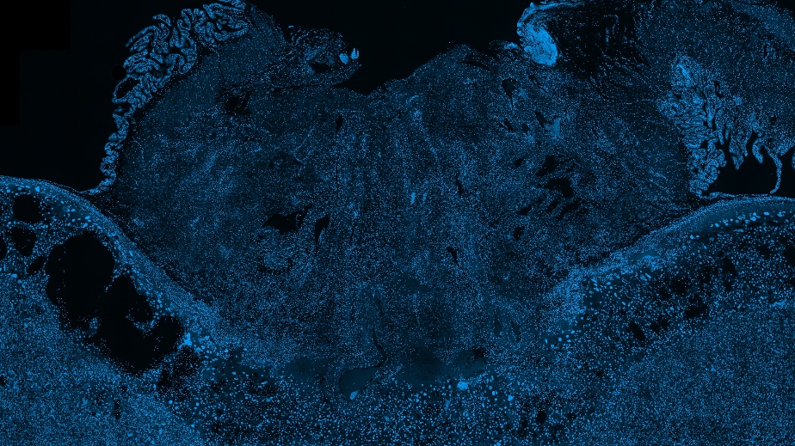
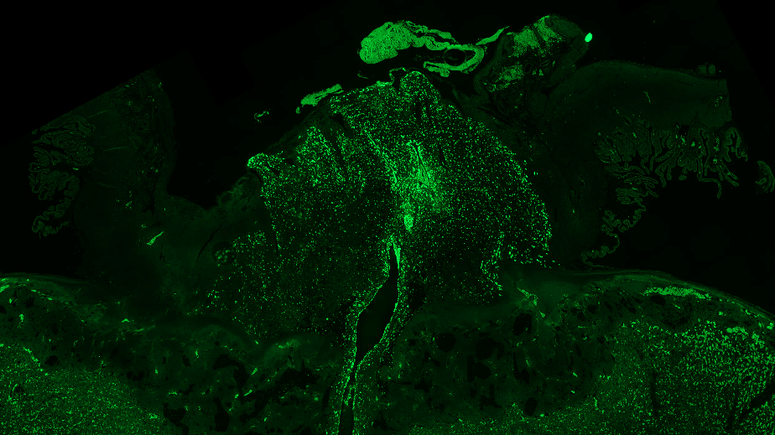
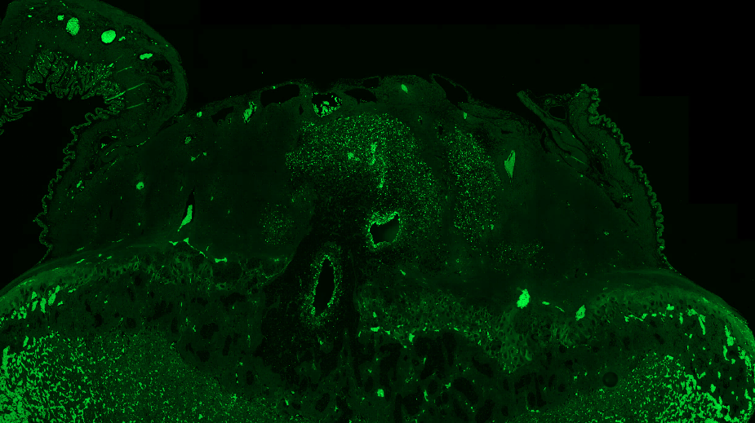
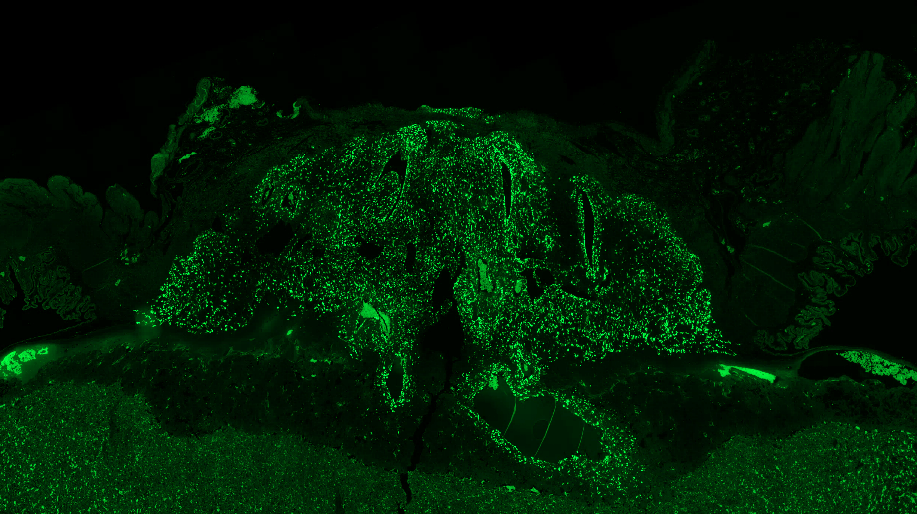
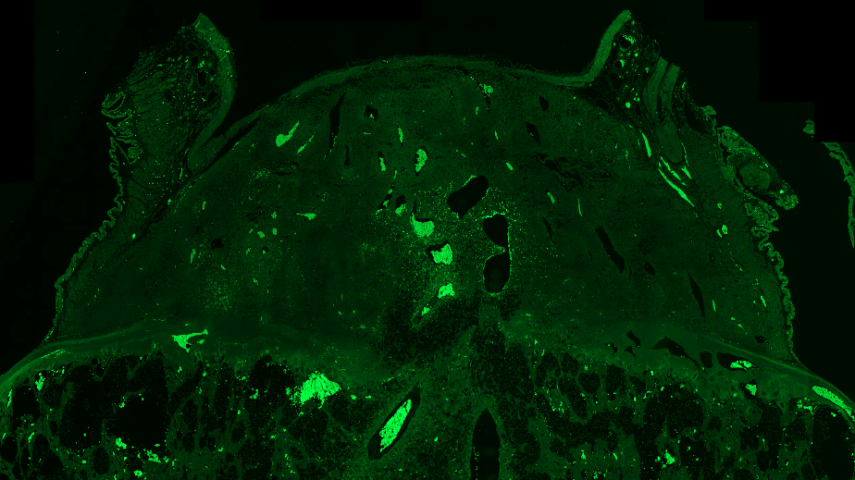
GD16
GD20
Male
Female
Male
Female
MG
MG
MG
MG
Control
JZ
2000 µm
JZ
JZ
JZ
JZ
MG
MG
MG
MG
Polyamide
JZ
JZ
JZ
JZ
Notes:
Supplemental Figure 4. Representative images from slides scanned at 20x show Prl7b1 staining in the metrial gland of the rat placenta at GD16 and GD20. Arrows denote a positive signal indicative of a Prl7b1 mRNA transcript while arrowheads denote signal from erythrocyte autofluorescence.

Slide 6
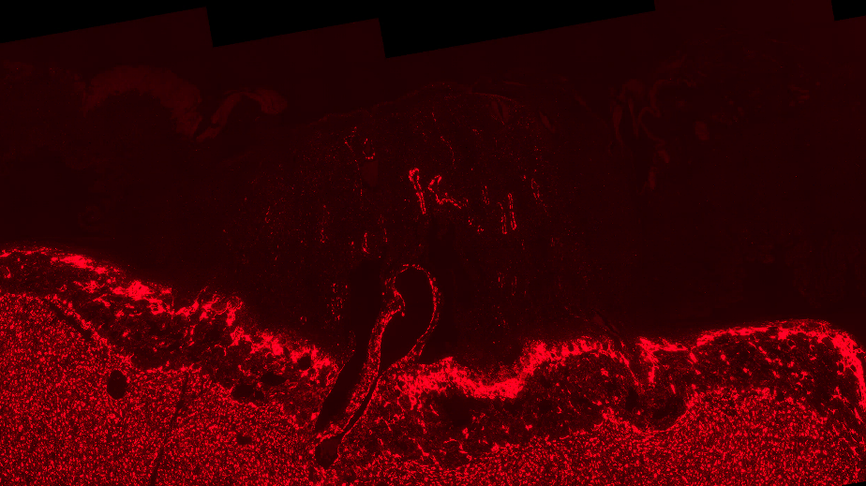
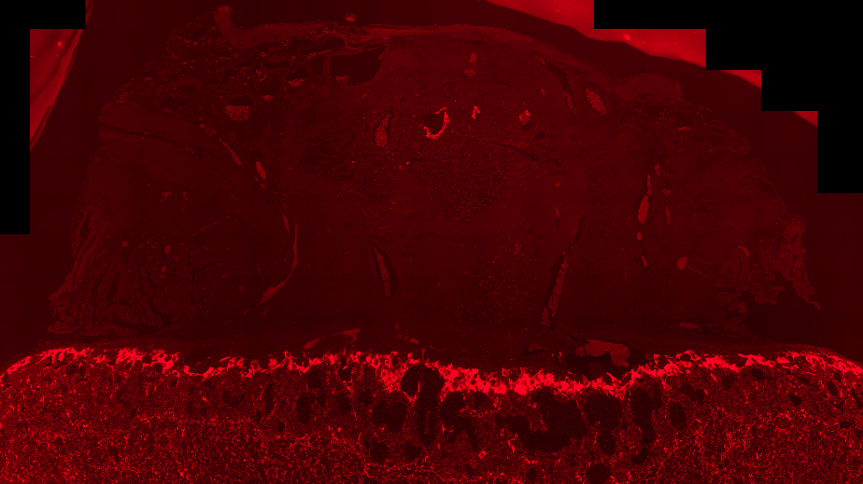
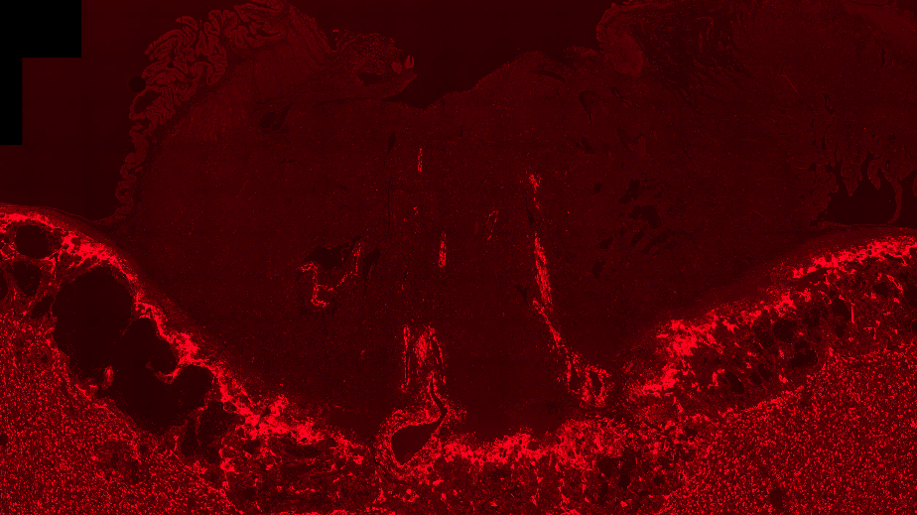
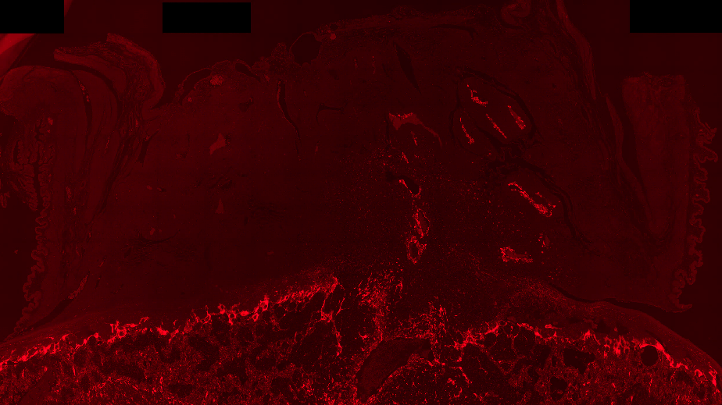
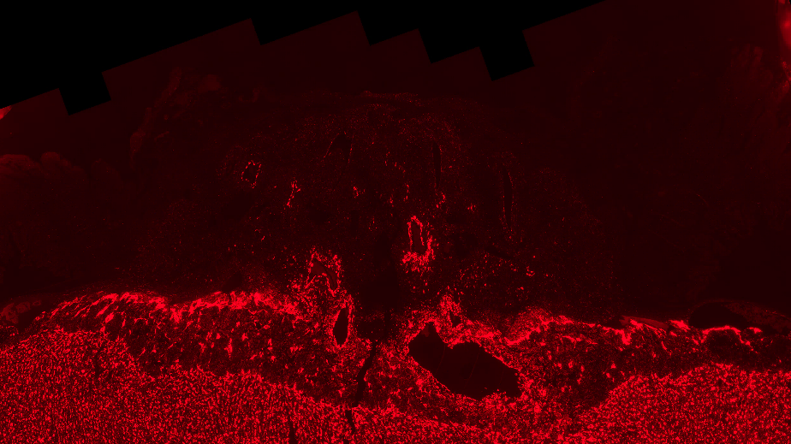

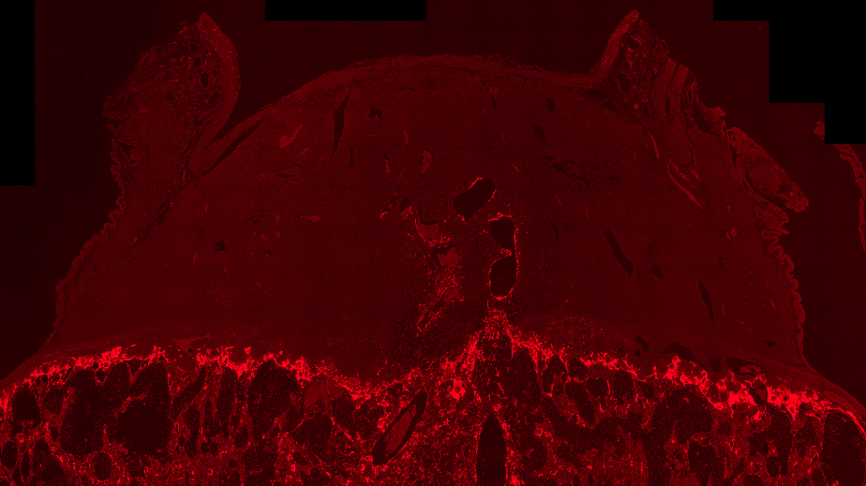
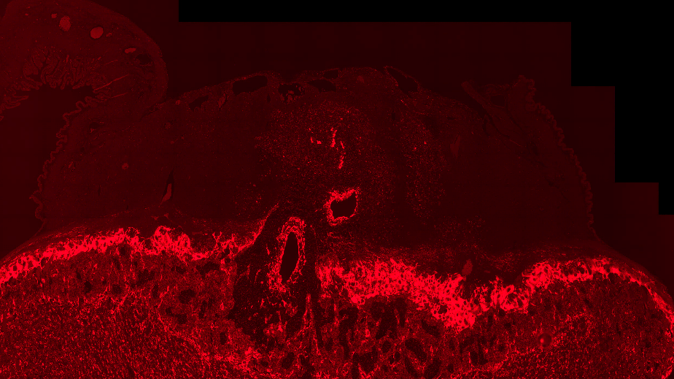
GD16
GD20
Male
Female
Male
Female
MG
MG
MG
MG
Control
JZ
2000 µm
JZ
JZ
JZ
MG
MG
MG
MG
Polyamide
JZ
JZ
JZ
JZ
Notes:
Supplemental Figure 5. Representative images from slides scanned at 20x show Tfpi staining in the metrial gland of the rat placenta at GD16 and GD20. Arrows denote a positive signal indicative of a Tfpi mRNA transcript while arrowheads denote signal from erythrocyte autofluorescence.

Slide 7
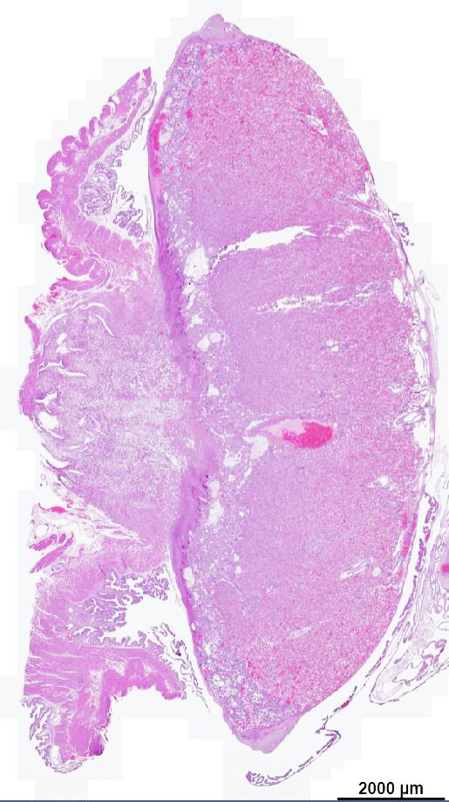
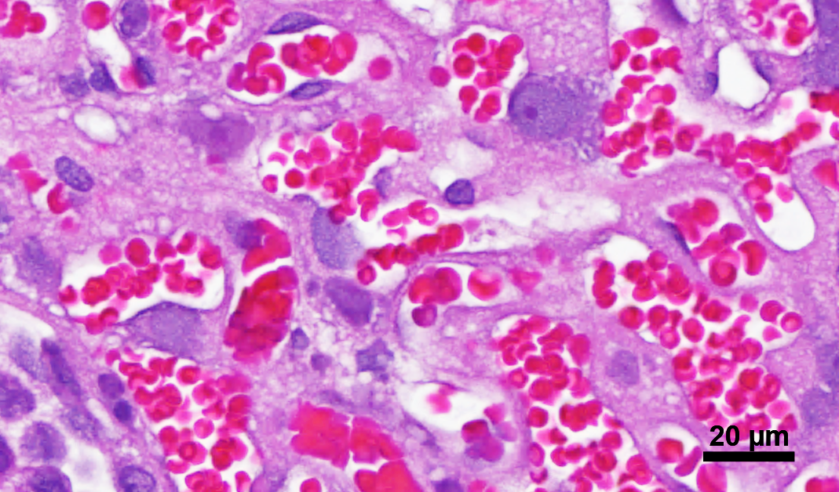
MG
D
JZ
M
F
L
2000 µm
Notes:
Supplemental Figure 6

Slide 8
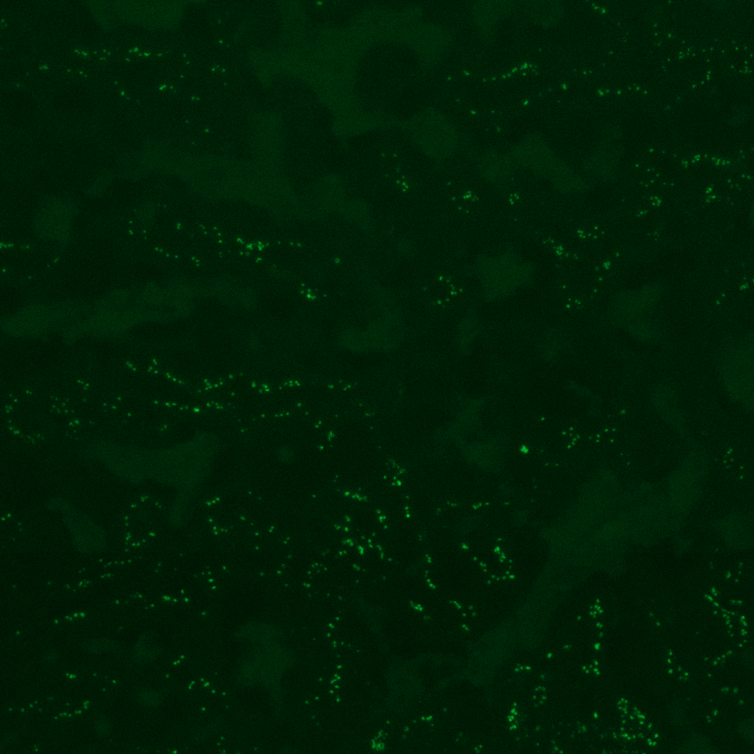
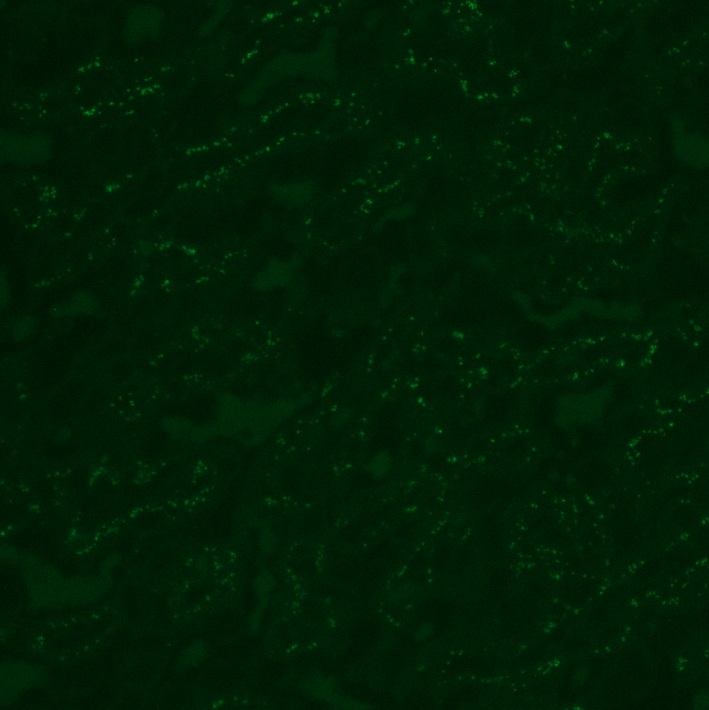
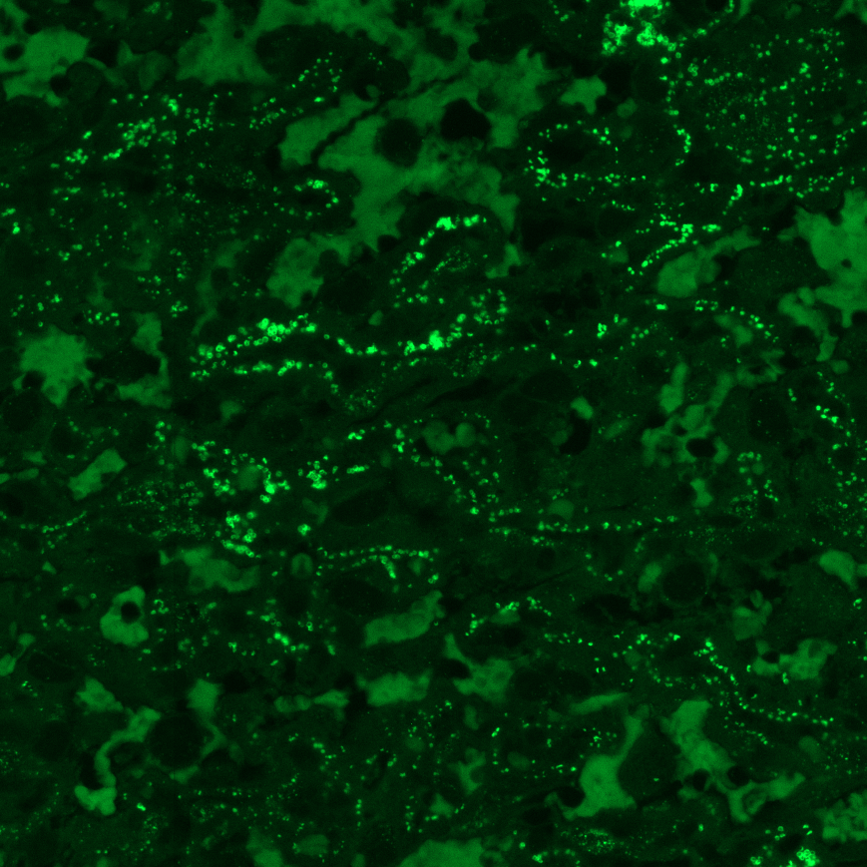
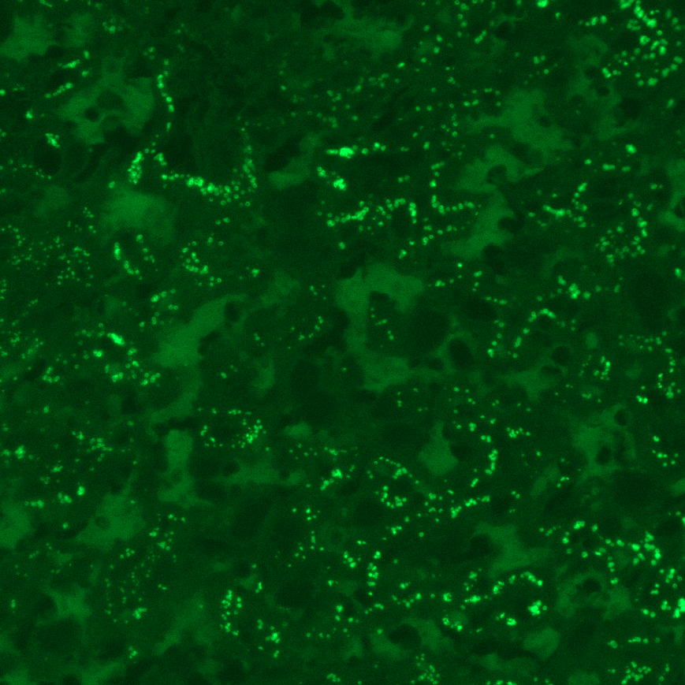
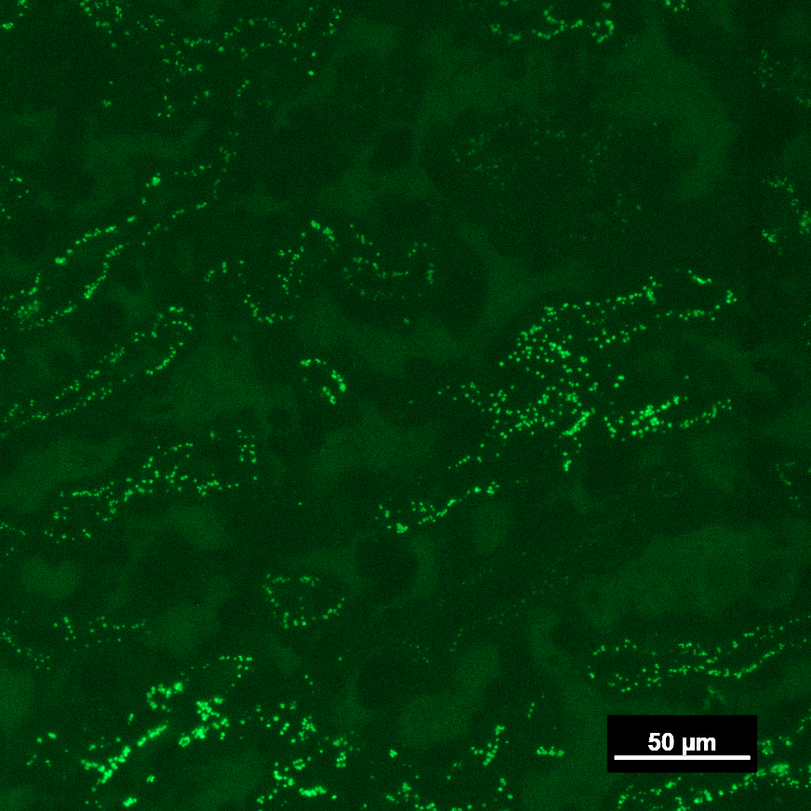
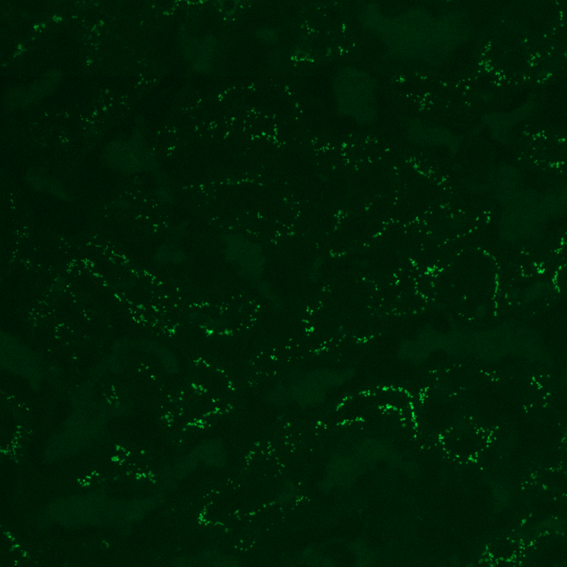

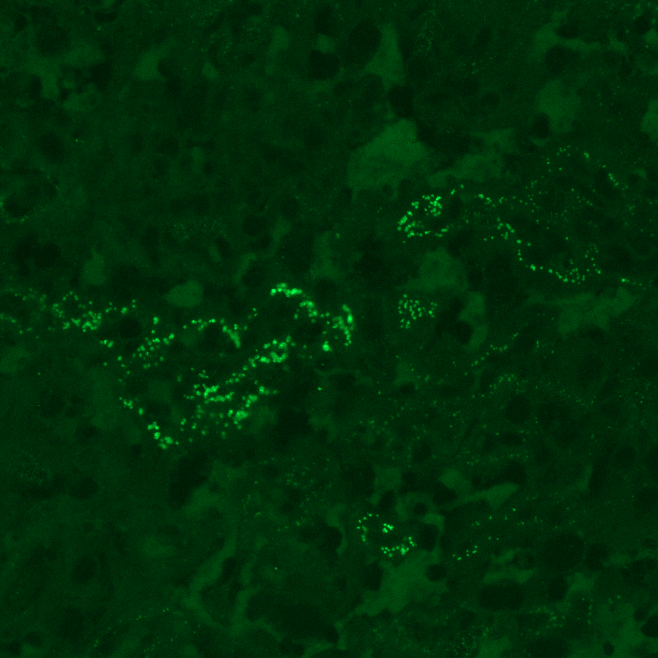
GD16
GD20
Male
Female
Male
Female
Control
50 µm
Polyamide
Notes:
Supplemental Figure 7 Representative images (300 µm x 300 µm) from slides scanned at 20x show Vegfa staining in the labyrinth zone of the rat placenta at GD16 and GD20. Arrows denote a positive signal indicative of a Vegfa mRNA transcript while arrowheads denote signal from erythrocyte autofluorescence.

Slide 9
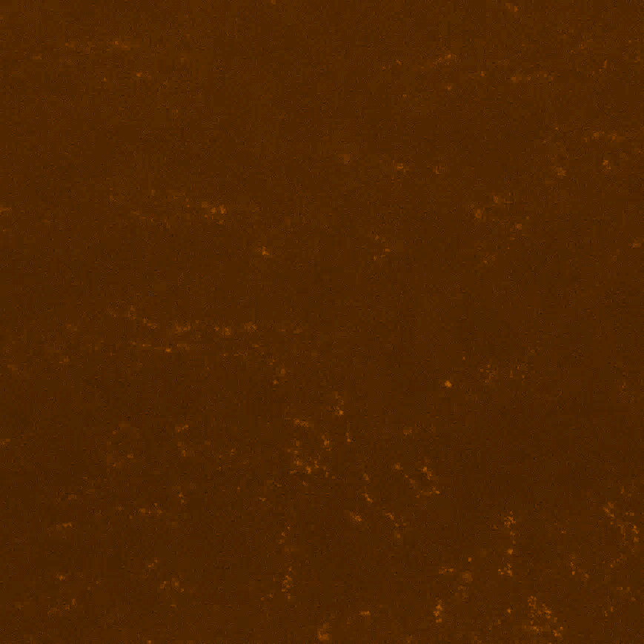
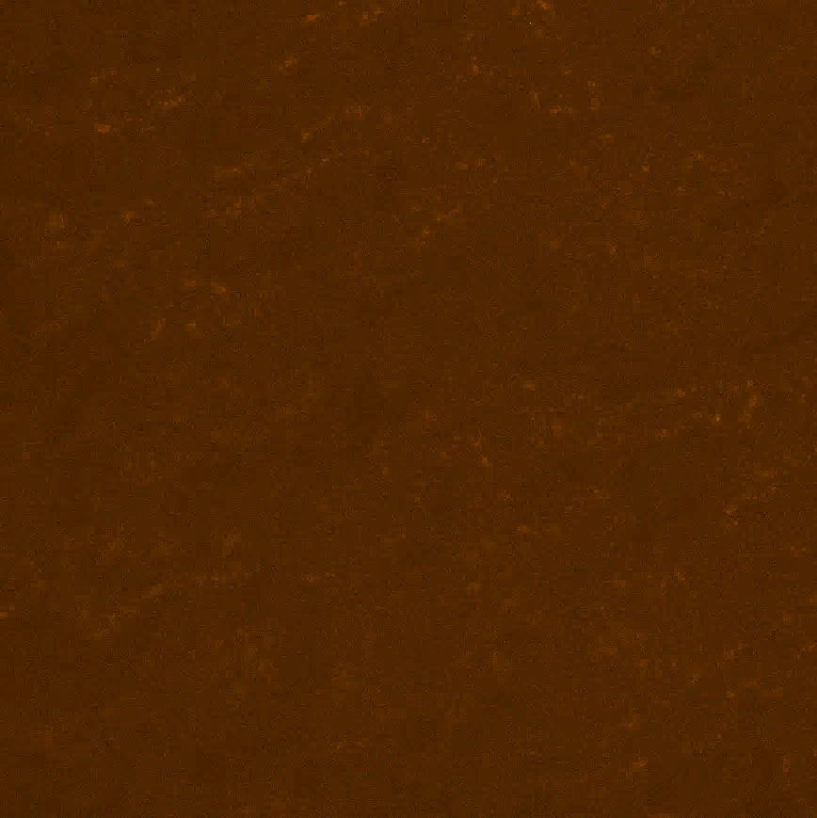
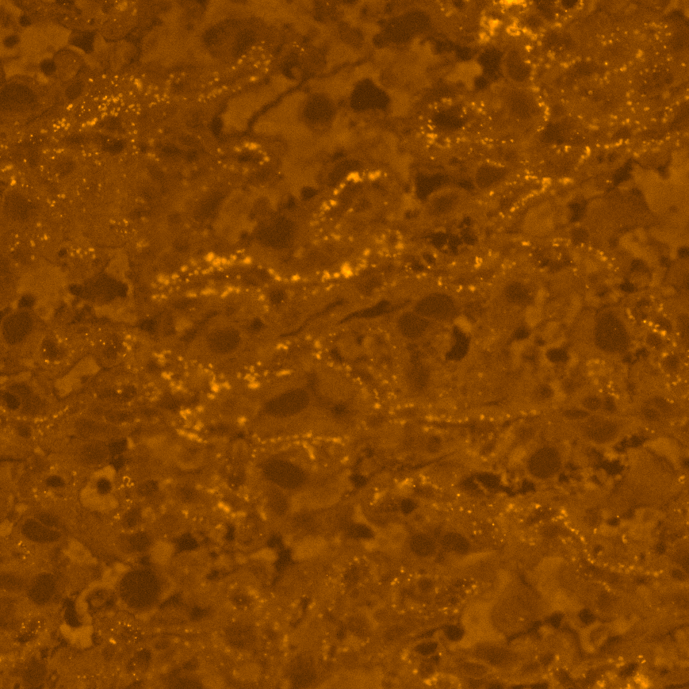
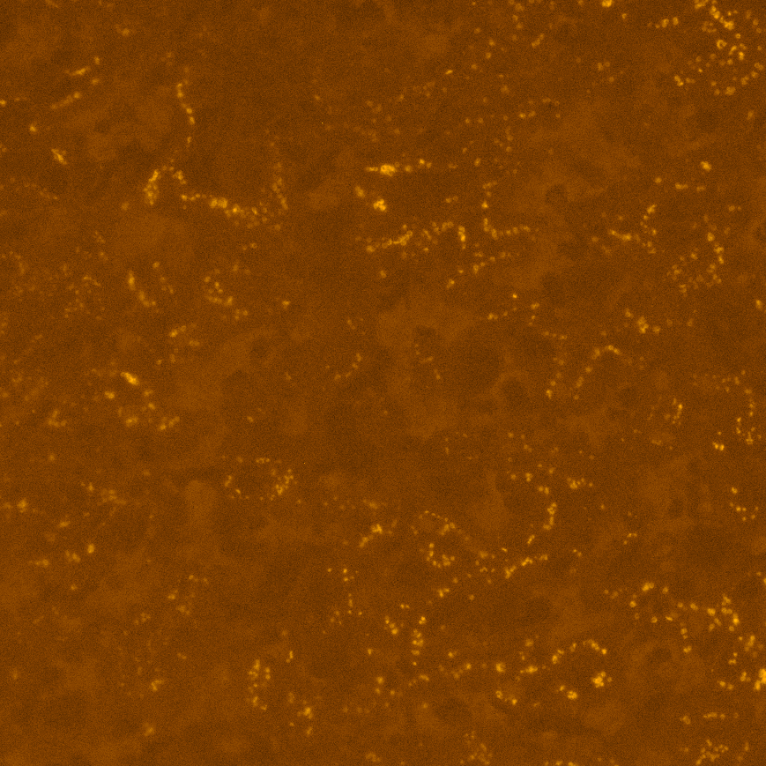


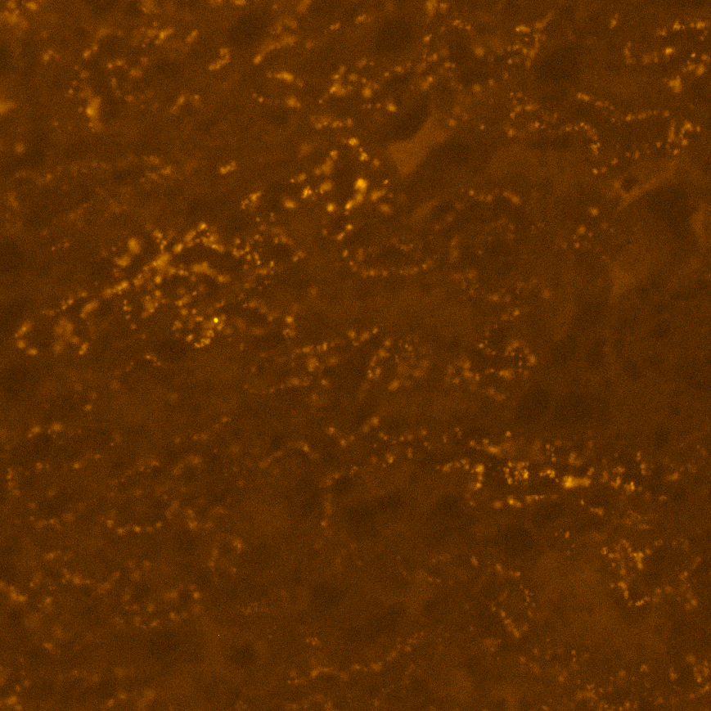
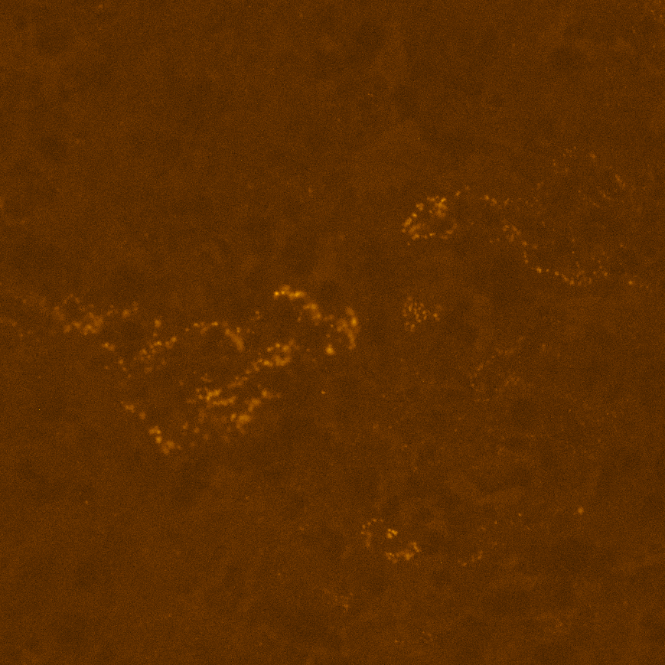
A
GD16
GD20
Male
Female
Male
Female
Control
50 µm
Polyamide
Notes:
Supplemental Figure 8. Representative images (300 µm x 300 µm) from slides scanned at 20x show Kdr staining in the labyrinth zone of the rat placenta at GD16 and GD20. Arrows denote a positive signal indicative of a Kdr mRNA transcript while arrowheads denote signal from erythrocyte autofluorescence.

Slide 10








GD16
GD20
Male
Female
Male
Female
Control
50 µm
Polyamide
Notes:
Supplemental Figure 9. Representative images (300 µm x 300 µm) from slides scanned at 20x show Flt staining in the labyrinth zone of the rat placenta at GD16 and GD20. Arrows denote a positive signal indicative of a Flt mRNA transcript while arrowheads denote signal from erythrocyte autofluorescence.

Slide 11
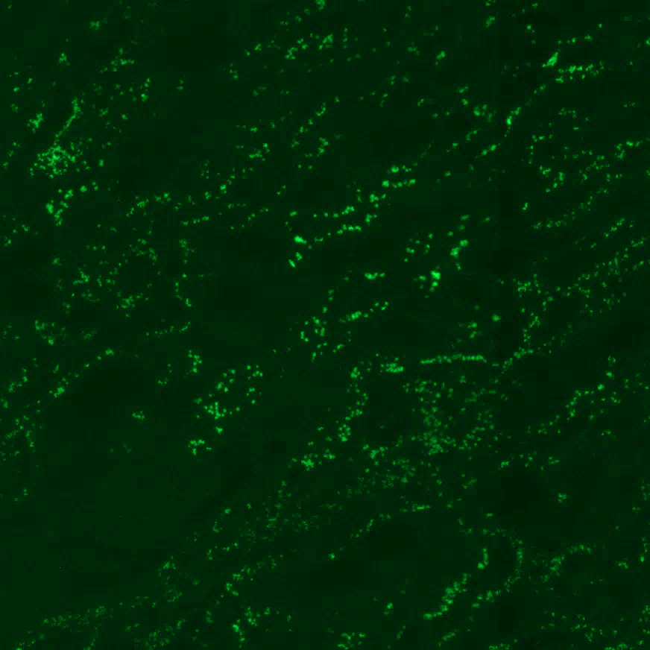
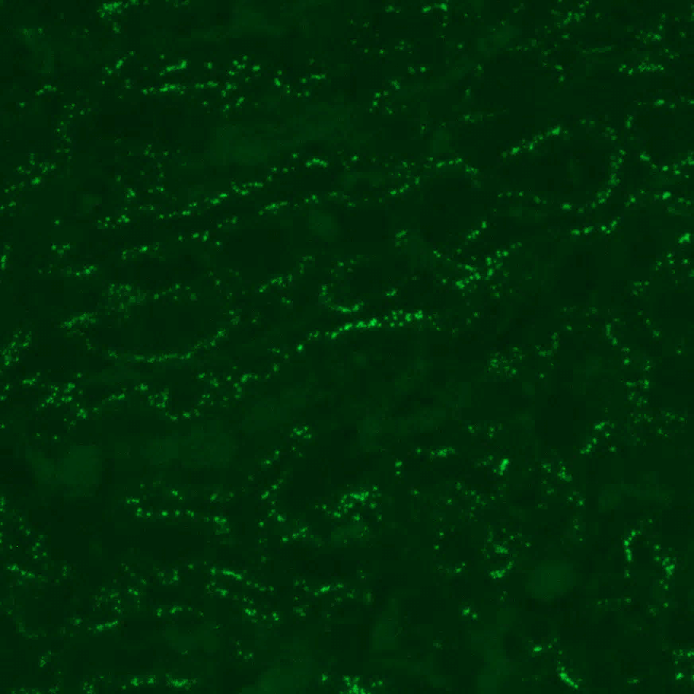
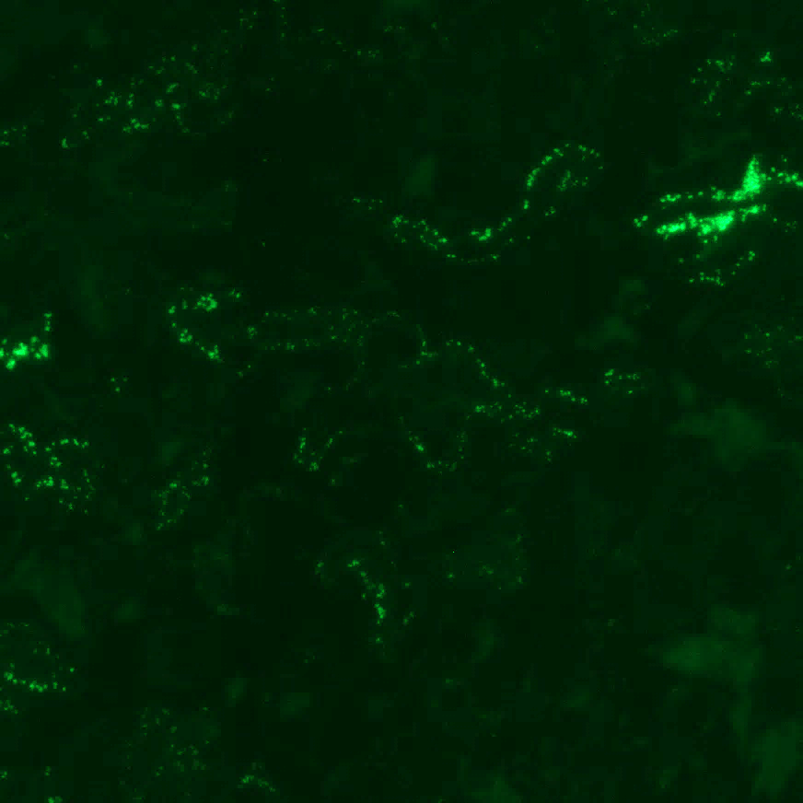
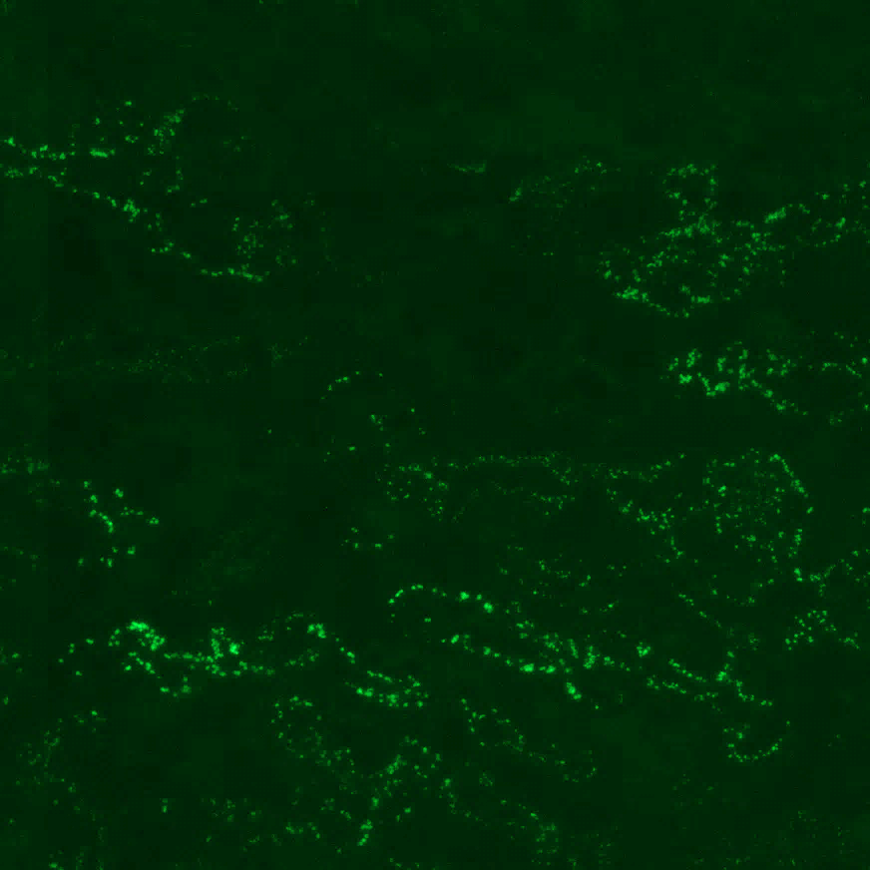
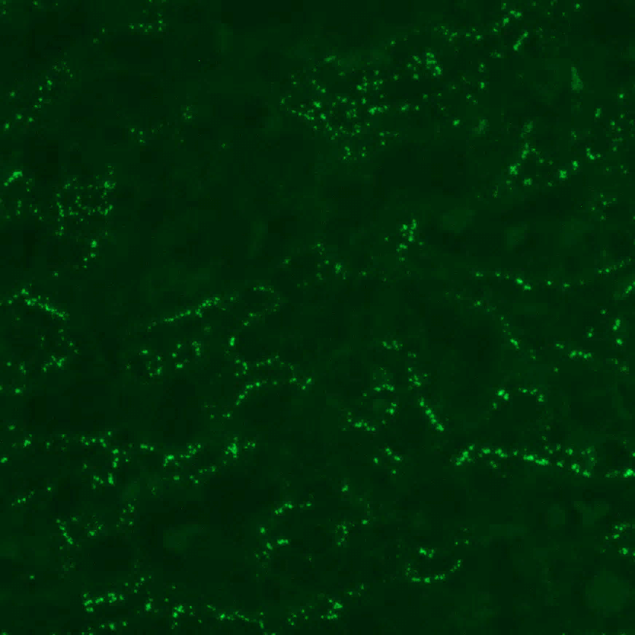
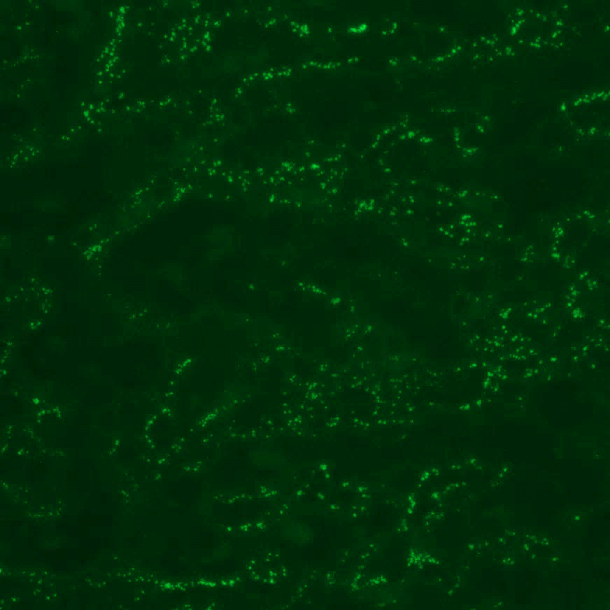
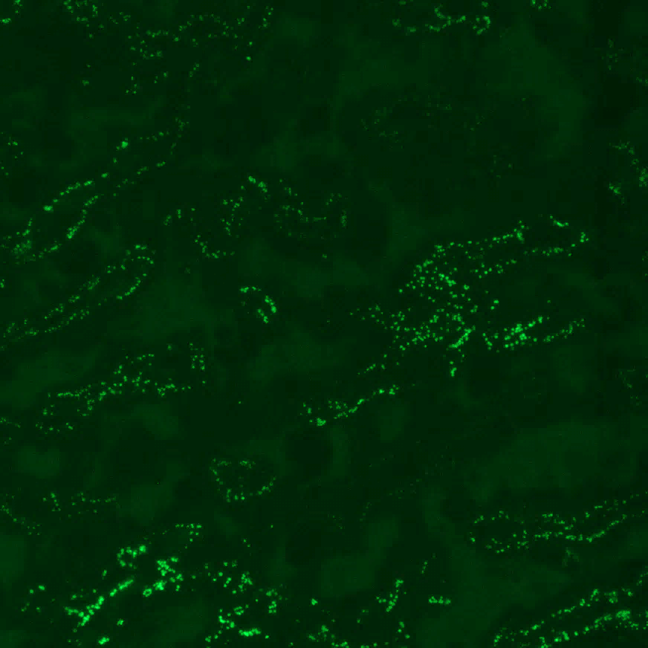
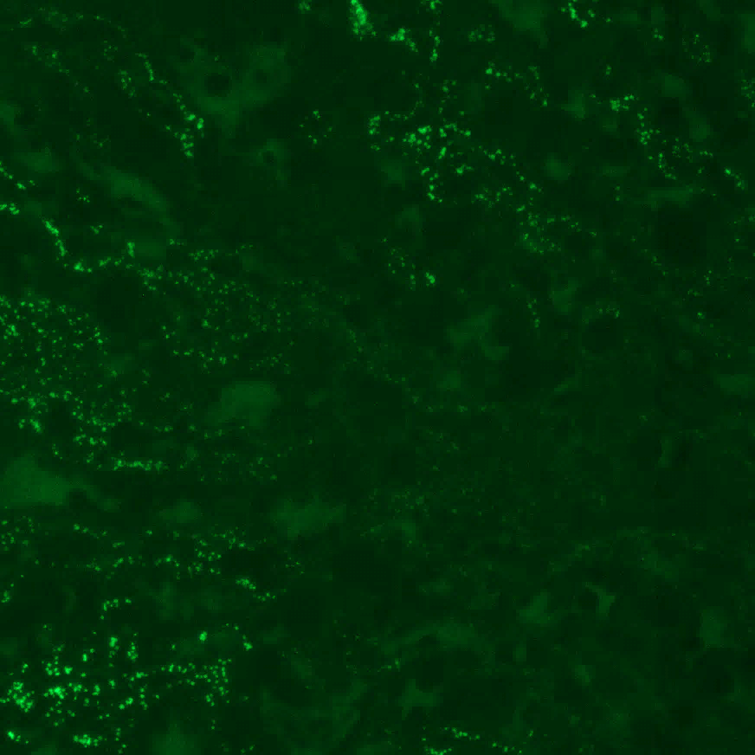
GD16
GD20
Male
Female
Male
Female
Control
50 µm
Polyamide
Notes:
Supplemental Figure 10. Representative images (300 µm x 300 µm) from slides scanned at 20x show Angpt1 staining in the labyrinth zone of the rat placenta at GD16 and GD20. Arrows denote a positive signal indicative of a Angpt1 mRNA transcript while arrowheads denote signal from erythrocyte autofluorescence.
Angpt1 GD16: 660m, PPA 710m, 662/657F (blurry) and 621 f 711f (blurry), 300x300um images
GD20: 573m, 578m 579f 581f
Black 0, white 6442, gamma 1.0
GD16 40% brightness

Slide 12


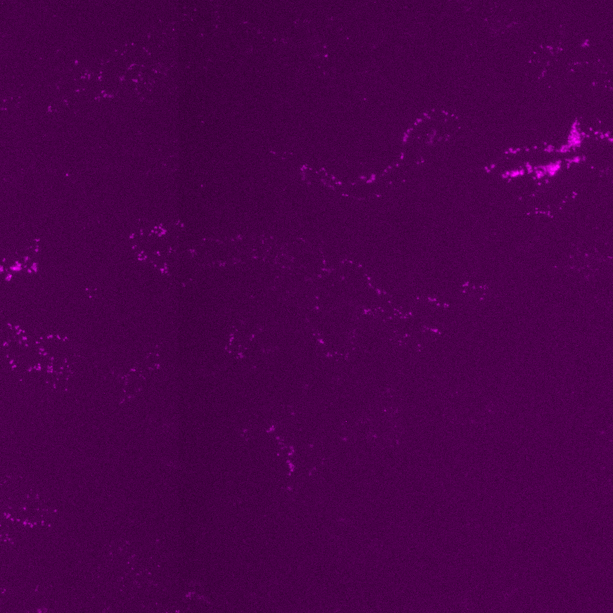





GD16
GD20
Male
Female
Male
Female
Control
50 µm
Polyamide
Notes:
Supplemental Figure 11. Representative images (300 µm x 300 µm) from slides scanned at 20x show Angpt2 staining in the labyrinth zone of the rat placenta at GD16 and GD20. Arrows denote a positive signal indicative of a Angpt2 mRNA transcript.
Angpt2 GD16: 658/657m, PPA 632 , 661F and 710 f
GD20: 573m, 582/578m 573f 577f
Black 0, white 6255, gamma 1.0

Slide 13
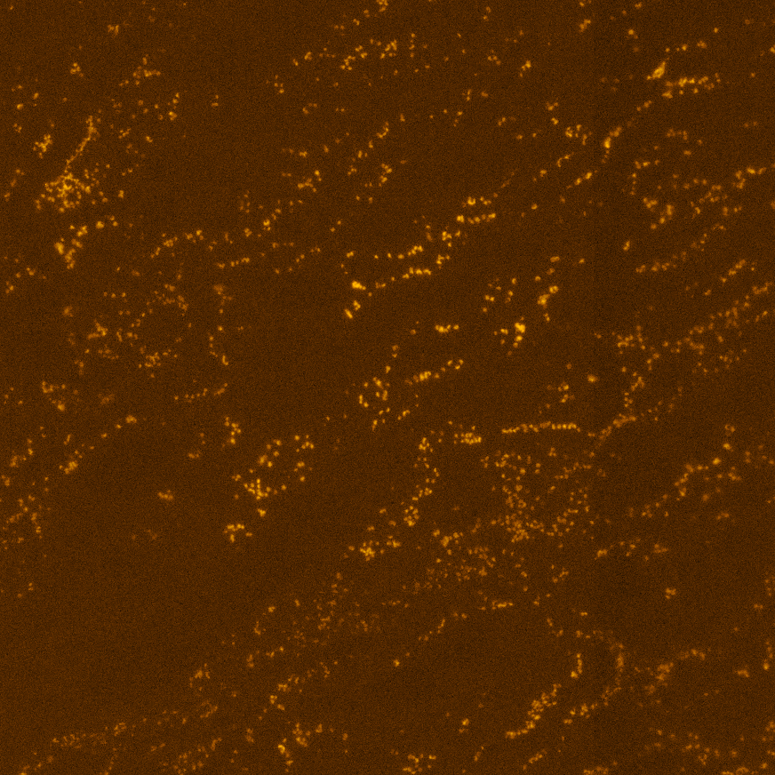







GD16
GD20
Male
Female
Male
Female
Control
50 µm
Polyamide
Notes:
Supplemental Figure 12. Representative images (300 µm x 300 µm) from slides scanned at 20x show Tek staining in the labyrinth zone of the rat placenta at GD16 and GD20. Arrows denote a positive signal indicative of a Tek mRNA transcript.
Tek GD16: 660/661m, PPA 630/710m, 661/660F and 621/630 f
GD20: 573m, 578m 579f 581f
black 0, white 5809, gamma 0.65

Slide 14











A
α-SMA
IgG Control
MG
L
2000 µm
200 µm
B
GD16
GD20
Male
Female
Male
Female
Control
200 µm
Polyamide
Notes:
Supplemental Figure 13. Representative images from slides scanned at 20x show α-SMA-positive 3,3′-Diaminobenzidine staining in the labyrinth zone placental sections. Representative images (750 µm x 750 µm) of the labyrinth zone (L) show prominent staining as compared to a negative rabbit IgG control (A). Representative images of α-SMA-positive 3,3′-Diaminobenzidine staining in the labyrinth zone of GD16 and GD20 placental sections are shown (B).

