Slide 1
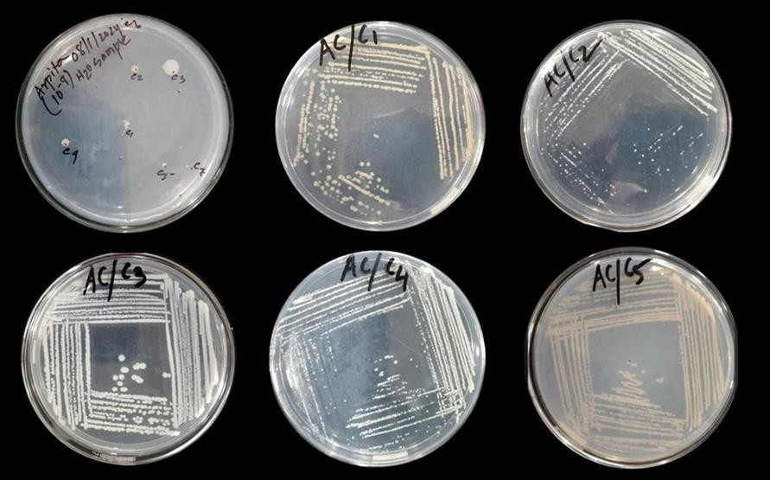
Isolation of Strain Pure Culture

Slide 2
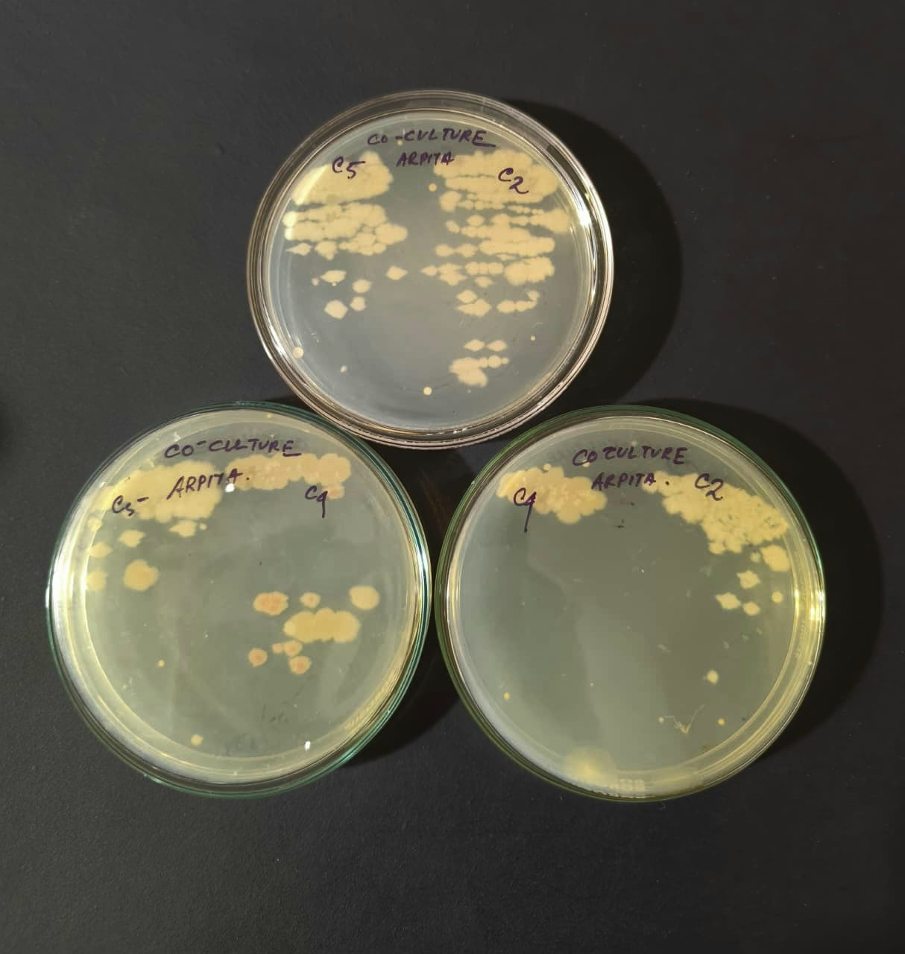
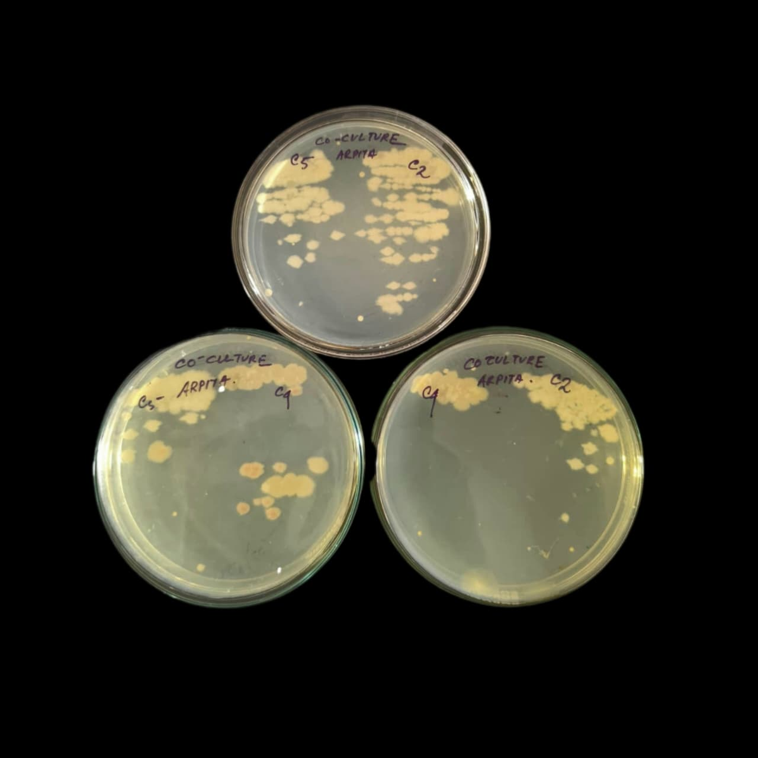
Culture of Consortium

Slide 3
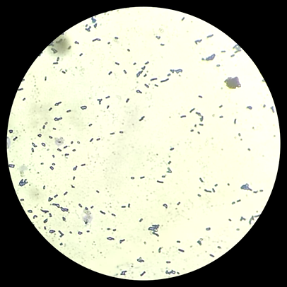
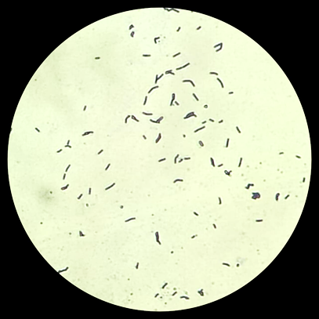
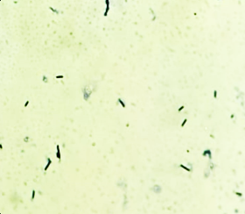
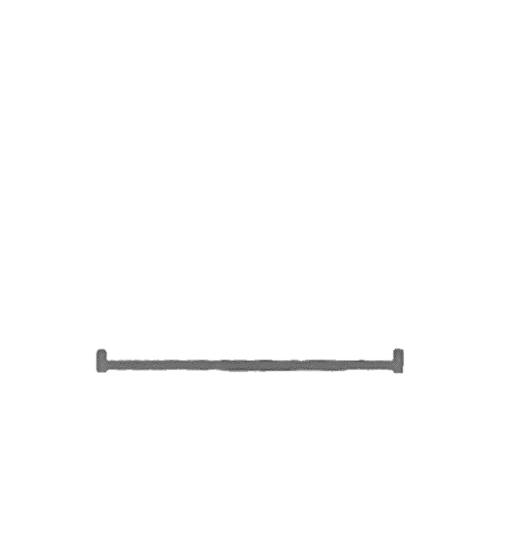
Gram Staining
C2
C5
C4
50 μm
50 μm
50 μm

Slide 4
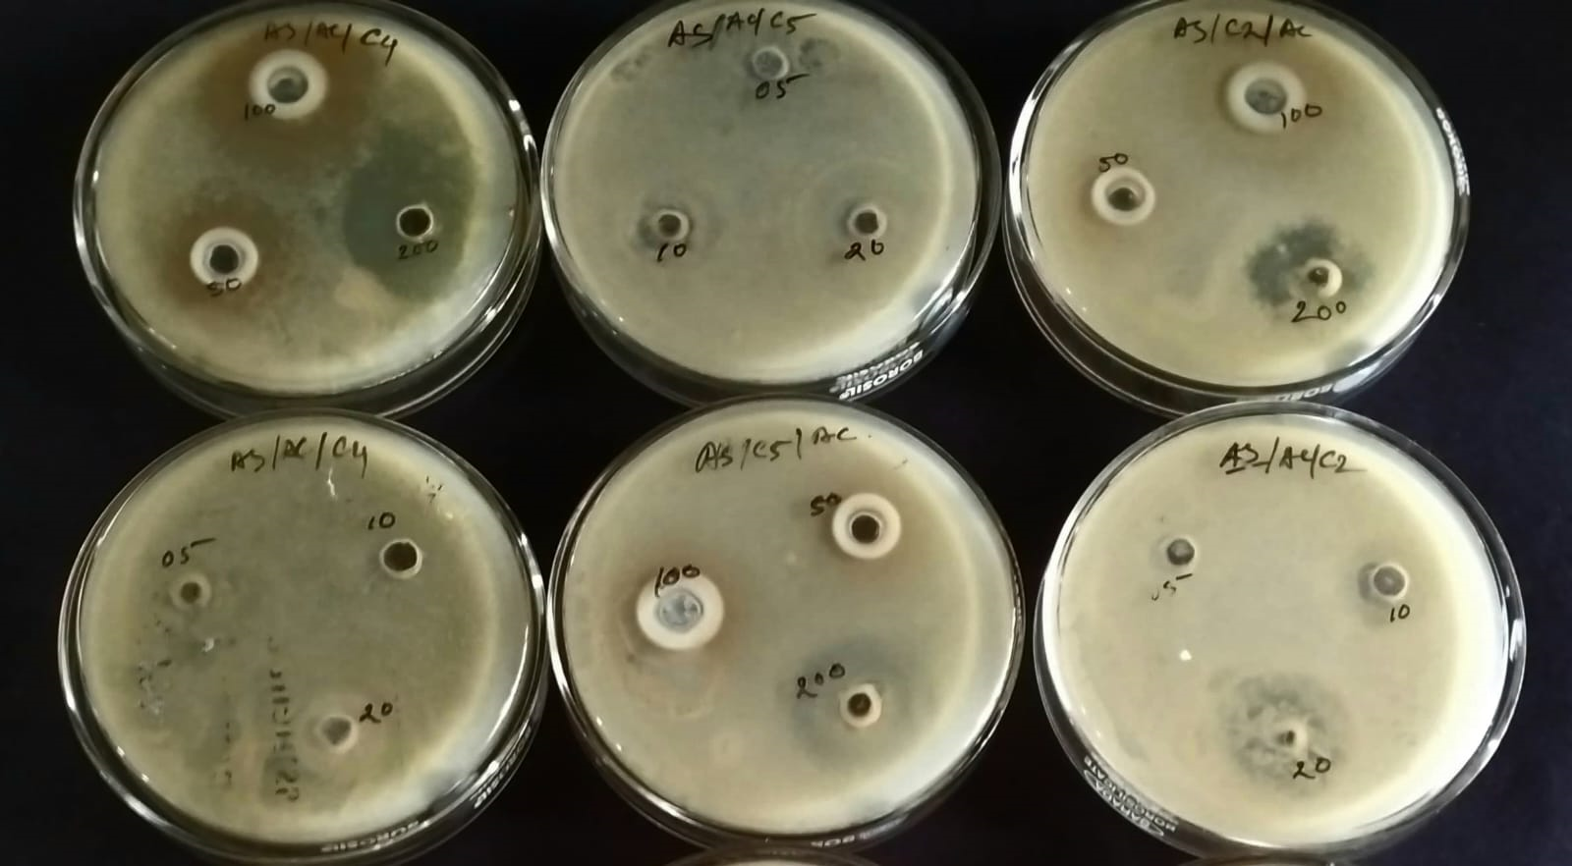
Zone of Inhibition Study- Individual Strain
AS(v) C4
AS (III) C5
AS (v) C2
AS(III) C4
AS(V) C5
AS (III) C2

Slide 5
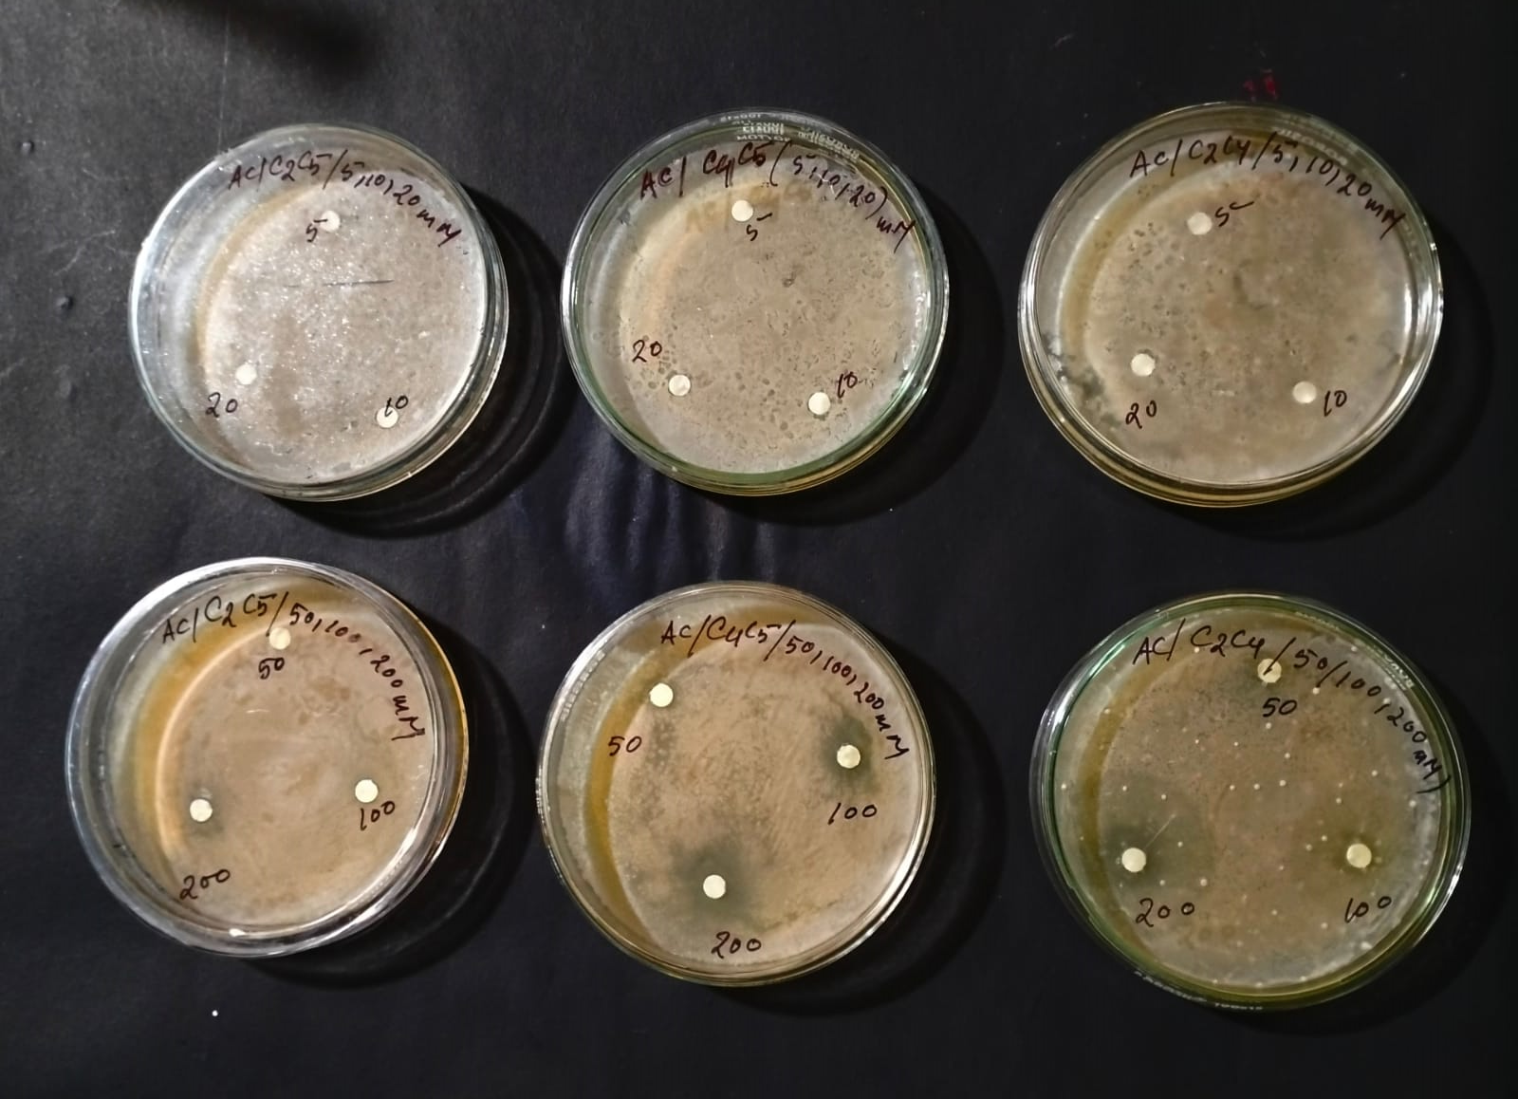
Zone of Inhibition Study- Consortium
AS (III) C2C5
AS(III) C4C5
AS (III) C2C4
AS(V) C2C5
AS (V) C4C5
AS (V) C2C4

Slide 6
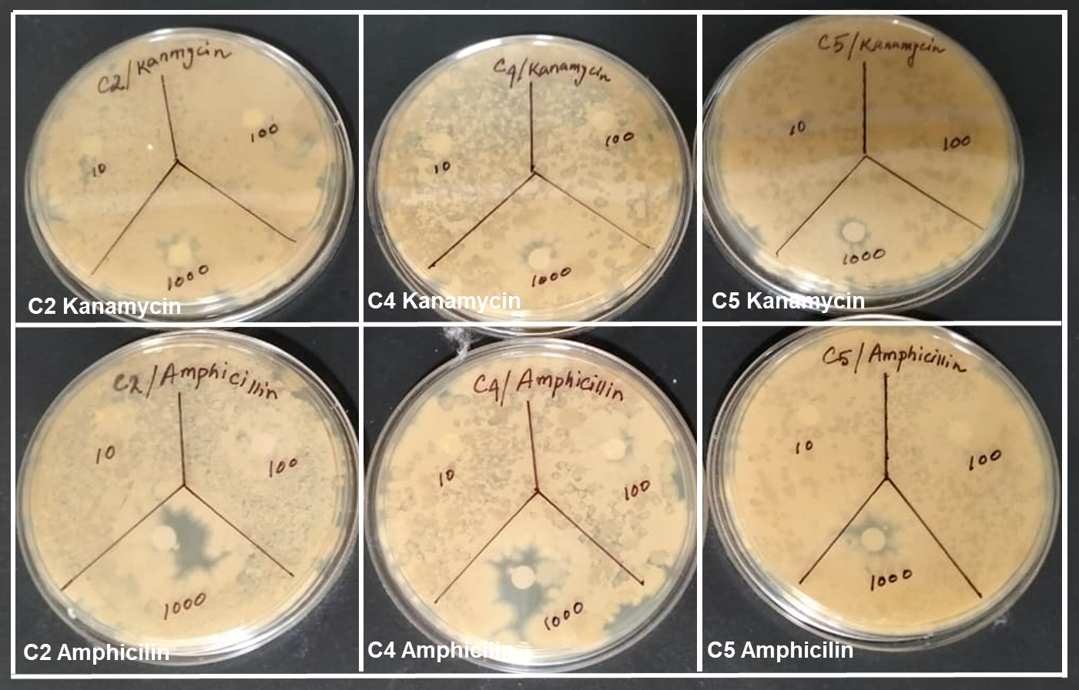
Antibiotics Test (Kanamycin and Amphicilin)

Slide 7
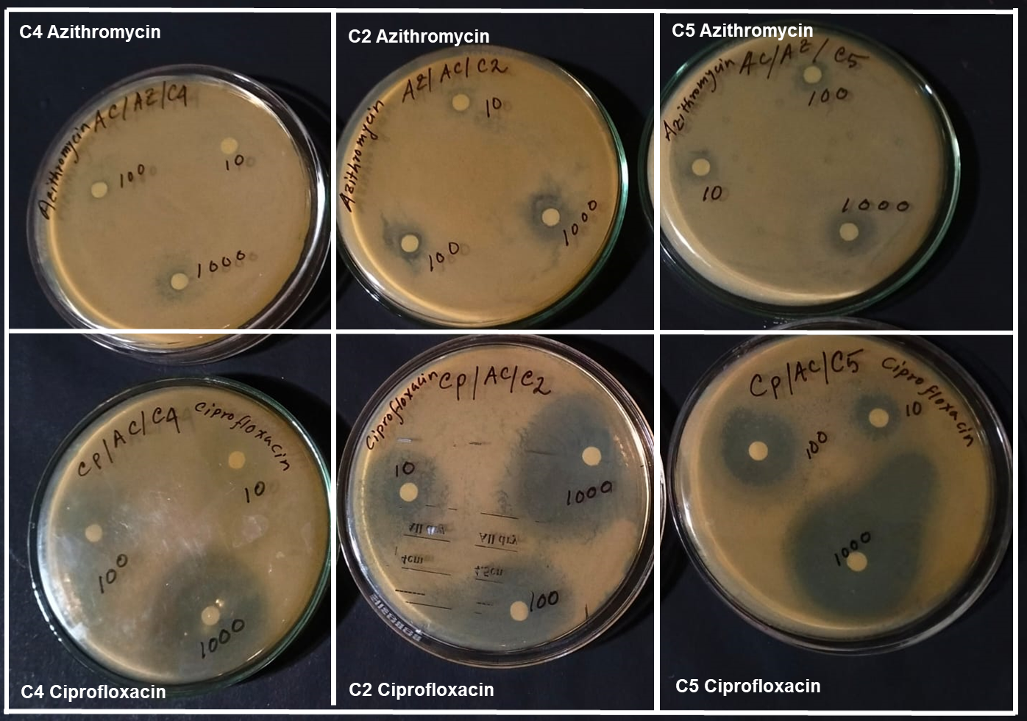
Antibiotics Test (Azithromycin and Ciprofloxacin)

