Slide 1
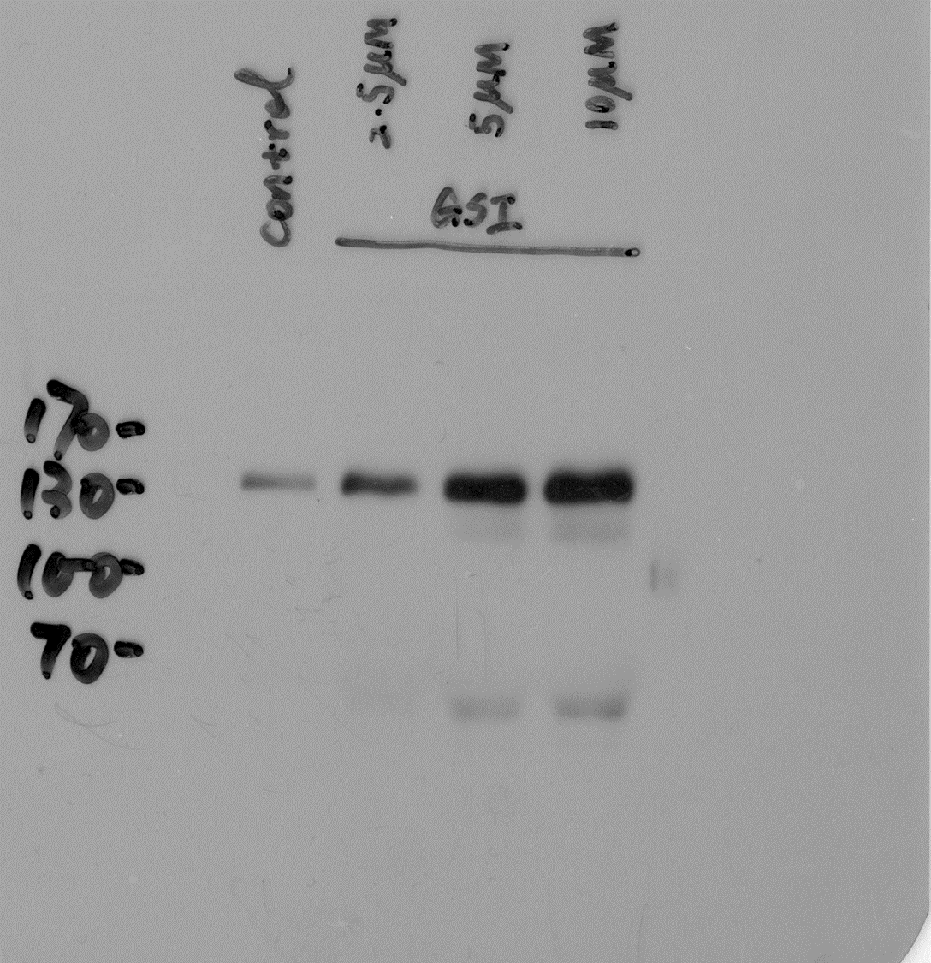
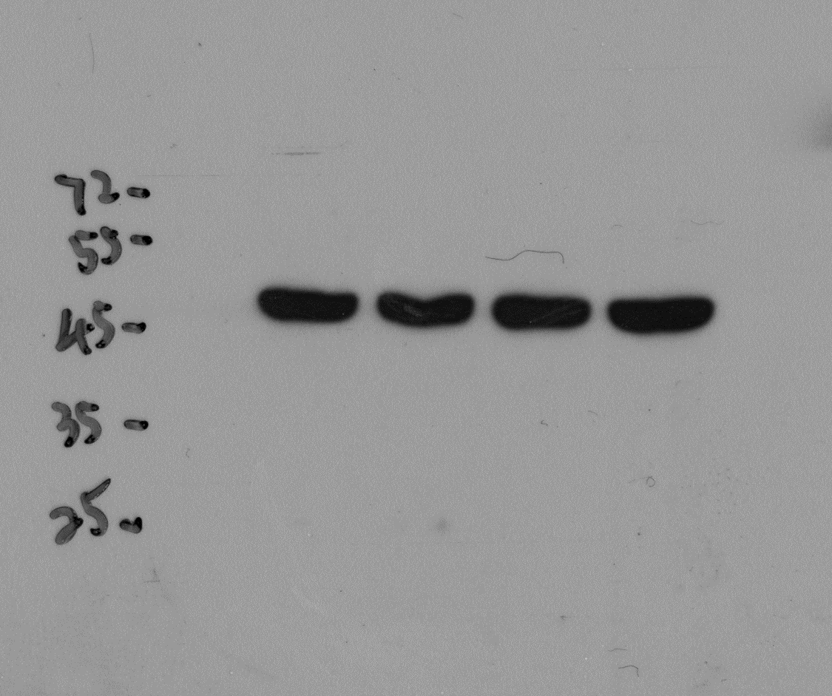
Figure 1. A: DLC-1
Figure 1. A: β-actin
1
2
3
4
1
2
3
4
1: GSI 0 μM
2: GSI 2.5 μM
3: GSI 5.0 μM
4: GSI 10.0 μM
1: GSI 0 μM
2: GSI 2.5 μM
3: GSI 5.0 μM
4: GSI 10.0 μM

Slide 2
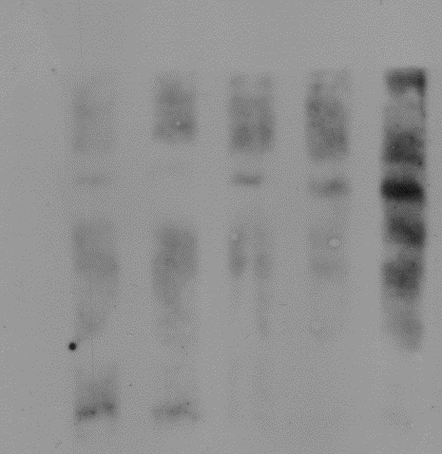
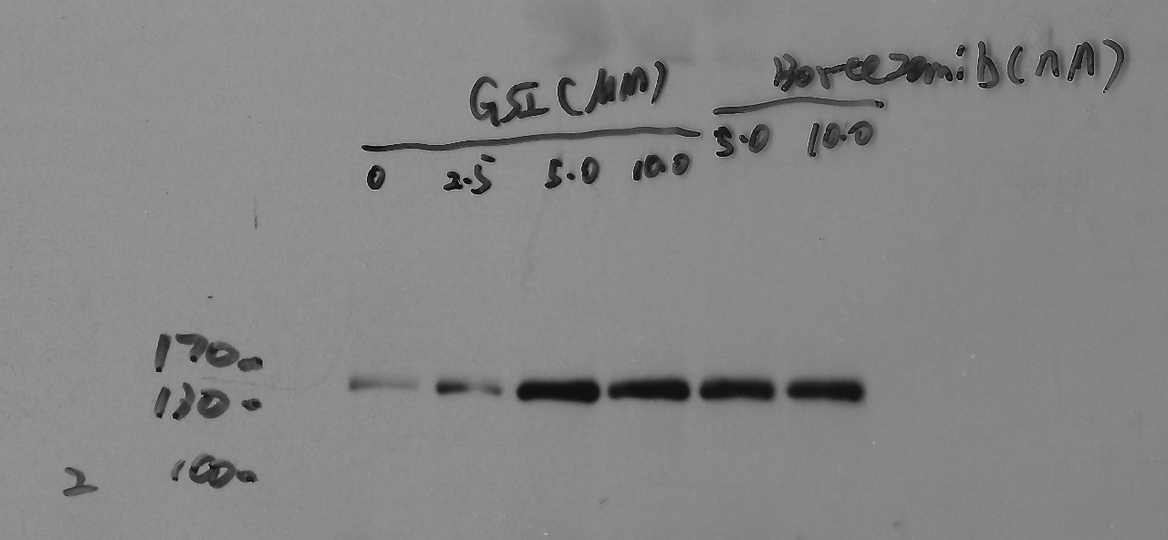
Figure 1. B: Poly-ubiquitinated DLC-1
Figure 1. B: DLC-1
1
2
3
4
5
6
170
1
2
3
4
5
6
130
100
1: GSI 0 μM
2. GSI 2.5 μM
3: GSI 5.0 μM
4: GSI 10.0 μM
5: Bortezomib 5.0 nM
6: Bortezomib 10.0 nM
1: GSI 0 μM
2. GSI 2.5 μM
3: GSI 5.0 μM
4: GSI 10.0 μM
5: Bortezomib 5.0 nM
6: Bortezomib 10.0 nM

Slide 3
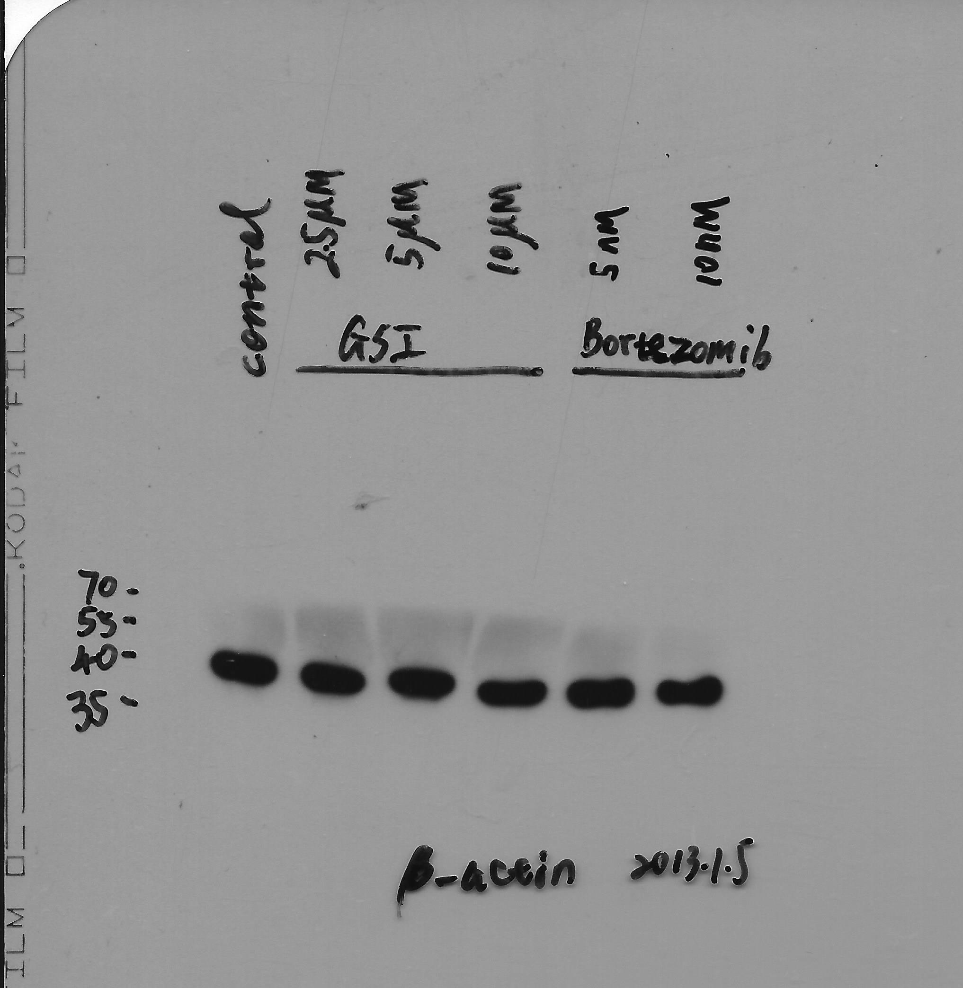
Figure 1. B: β-actin (The orinal image was missing. Replaced by new one.)
1: GSI 0 μM
2: GSI 2.5 μM
3: GSI 5.0 μM
4: GSI 10.0 μM
5: Bortezomib 5.0 nM
6: Bortezomib 10.0 nM
1
2
3
4
5
6

Slide 4
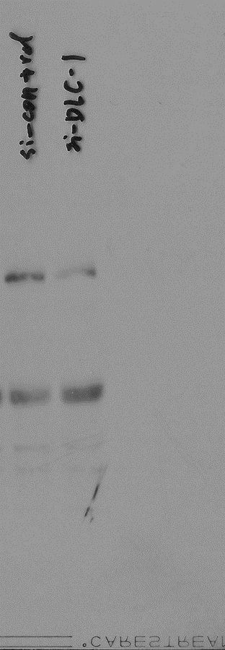
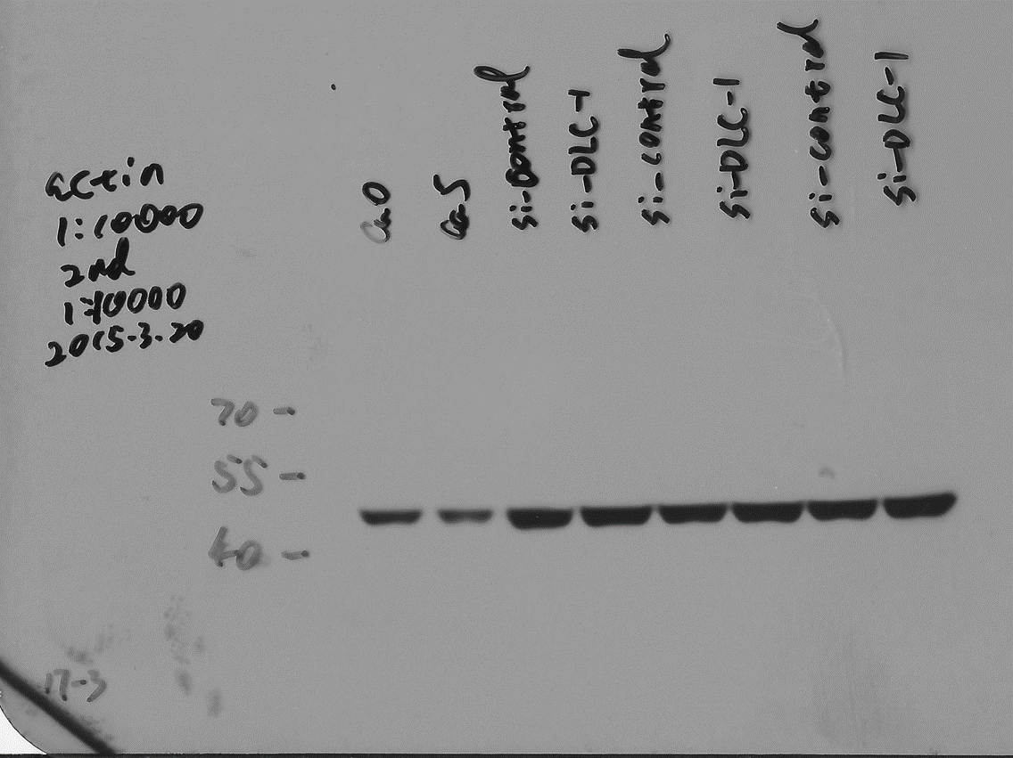
Figure 2. A: DLC-1
Figure 2. A: β-actin
Not relevant
Not relevant
1
2
170
130
1
2
100
1: si-Control
2: si-DLC-1
1: si-Control
2: si-DLC-1

Slide 5
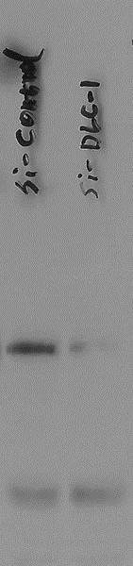
Figure 3. A-1: DLC-1
Figure 3. A-1: β-actin
Not relevant
Not relevant
1
2
1
2
170
130
100
1: si-Control
2: si-DLC-1
1: si-Control
2: si-DLC-1

Slide 6
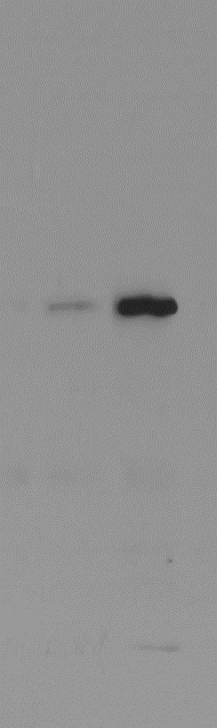
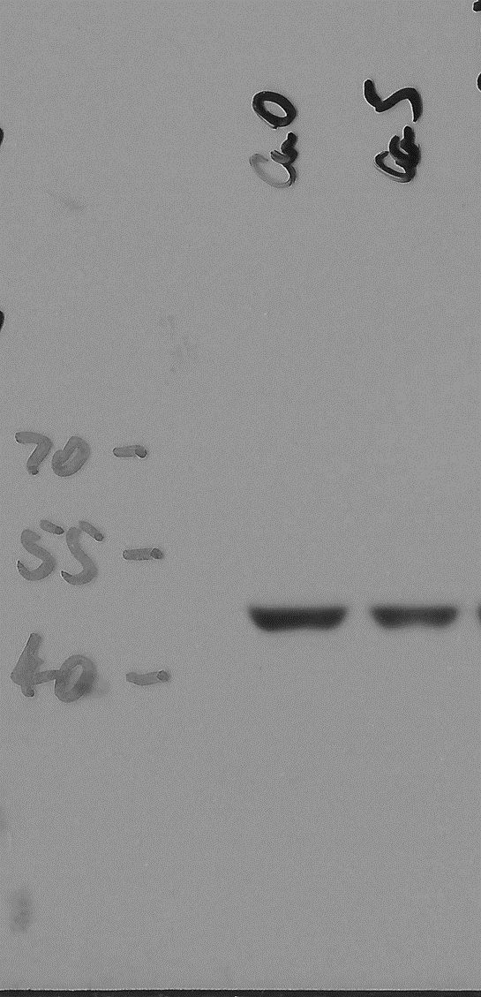
Figure 3. B-1: DLC-1
Figure 3. B-1: β-actin
1
2
170
130
100
1
2
1: pcDNA3.1
2: pc-DNA3.1-DLC-1
1: pcDNA3.1 (Ca0)
2: pc-DNA3.1-DLC-1 (Ca5)

Slide 7
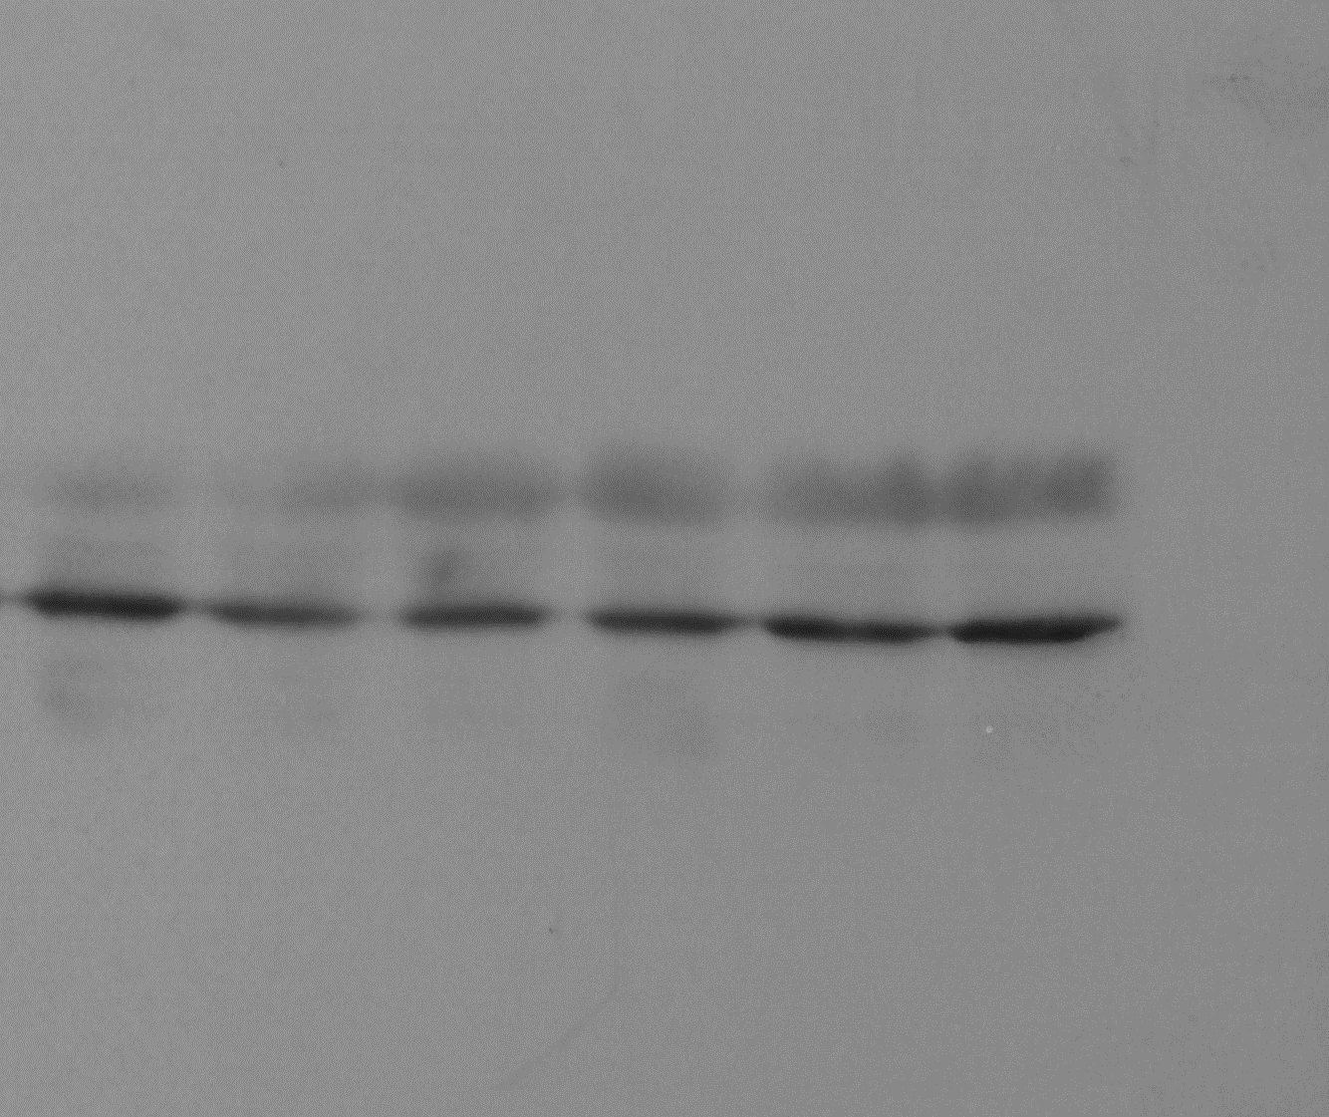
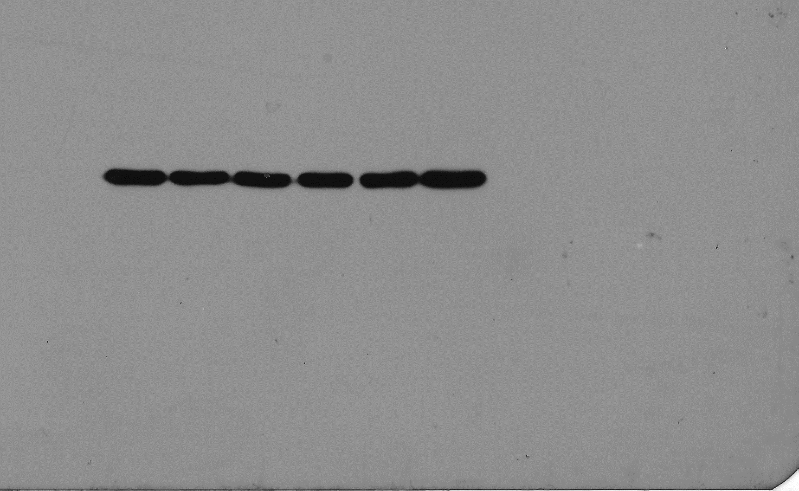
Figure 4. C: IDO1
Figure 4. C: β-actin
55
1
2
3
4
5
6
1
2
3
4
5
6
40
55
35
40
35
1: pcDNA3.1
2: pcDNA3.1-DLC-1
3: pcDNA3.1--DLC-1-1-662
4: pcDNA3.1--DLC-1-Δ622
5: pcDNA3.1--DLC-1-RhoGAP
6: pcDNA3.1--DLC-1-R718E
1: pcDNA3.1
2: pcDNA3.1-DLC-1
3: pcDNA3.1--DLC-1-1-662
4: pcDNA3.1--DLC-1-Δ622
5: pcDNA3.1--DLC-1-RhoGAP
6: pcDNA3.1--DLC-1-R718E

Slide 8
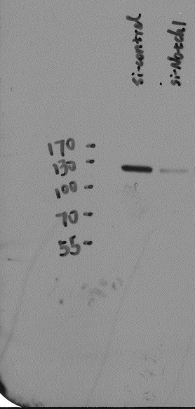
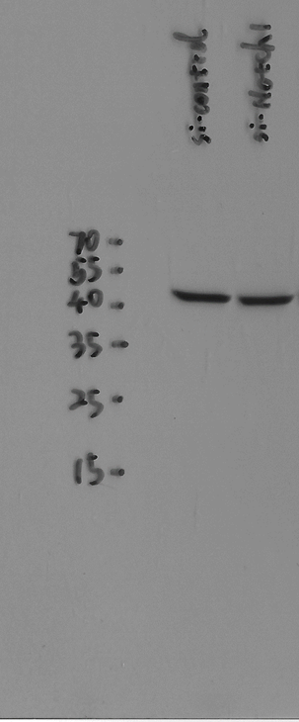
Figure 5A-1. NICD1
Figure 5A-1. β-actin
1
2
1
2
1: si-control
2: si-Notch1
1: si-control
2: si-Notch1

Slide 9
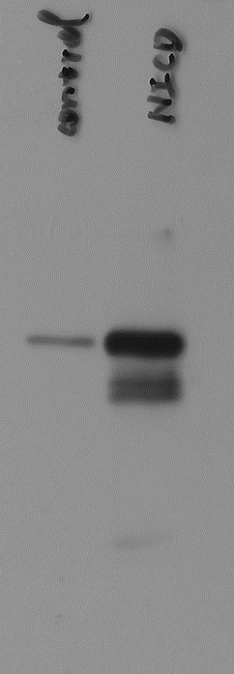
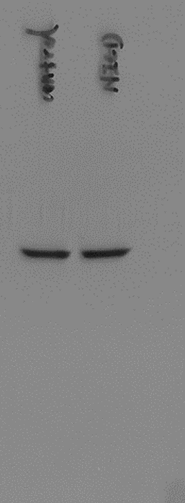
Figure 5B-1. NICD1
Figure 5B-1. β-actin
170
1
2
1
2
55
130
40
100
35
1: pcDNA3.1 (control)
2: pcDNA3.1-Notch1 (NICD)
1: pcDNA3.1 (control)
2: pcDNA3.1-Notch1 (NICD)

Slide 10
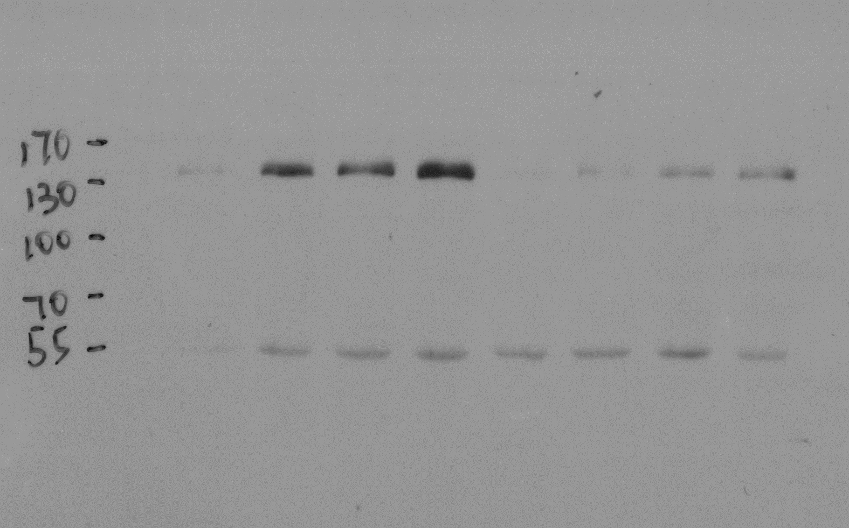
Figure 6A. DLC-1
1
2
3
4
5
6
7
8
1: si-control + 0 μM GSI
2. si-control + 2.5 μM GSI
3: si-control + 5.0 μM GSI
4. si-control + 10.0 μM GSI
5: si-DLC-1 + 0 μM GSI
6. si-DLC-1 + 2.5 μM GSI
7: si-DLC-1 + 5.0 μM GSI
8. si-DLC-1 + 10.0 μM GSI

Slide 11
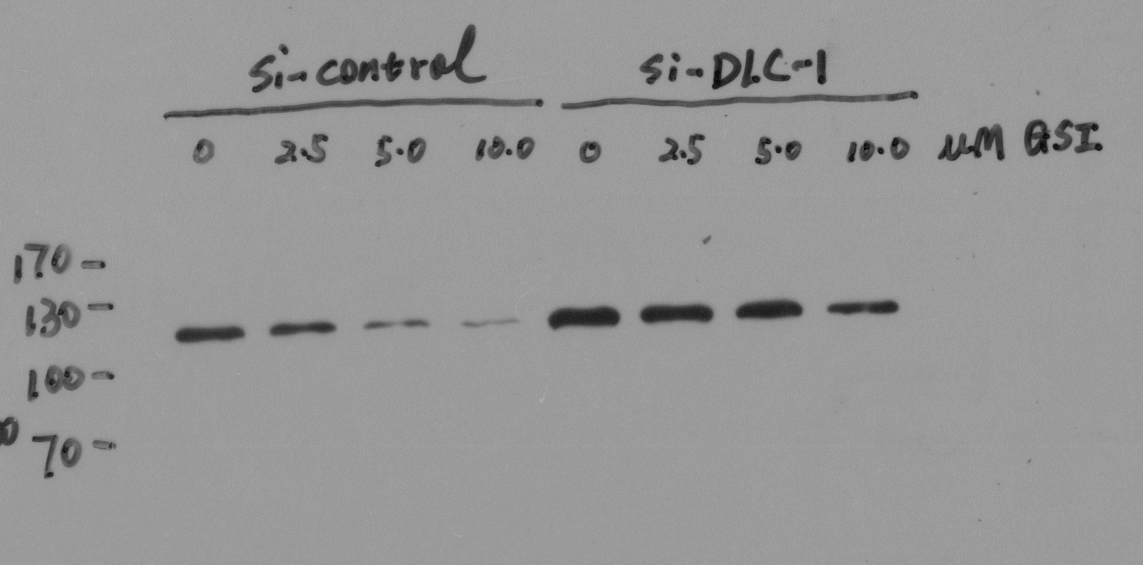
Figure 6A. NICD1
1: si-control + 0 μM GSI
2. si-control + 2.5 μM GSI
3: si-control + 5.0 μM GSI
4. si-control + 10.0 μM GSI
5: si-DLC-1 + 0 μM GSI
6. si-DLC-1 + 2.5 μM GSI
7: si-DLC-1 + 5.0 μM GSI
8. si-DLC-1 + 10.0 μM GSI
1
2
3
4
5
6
7
8

Slide 12
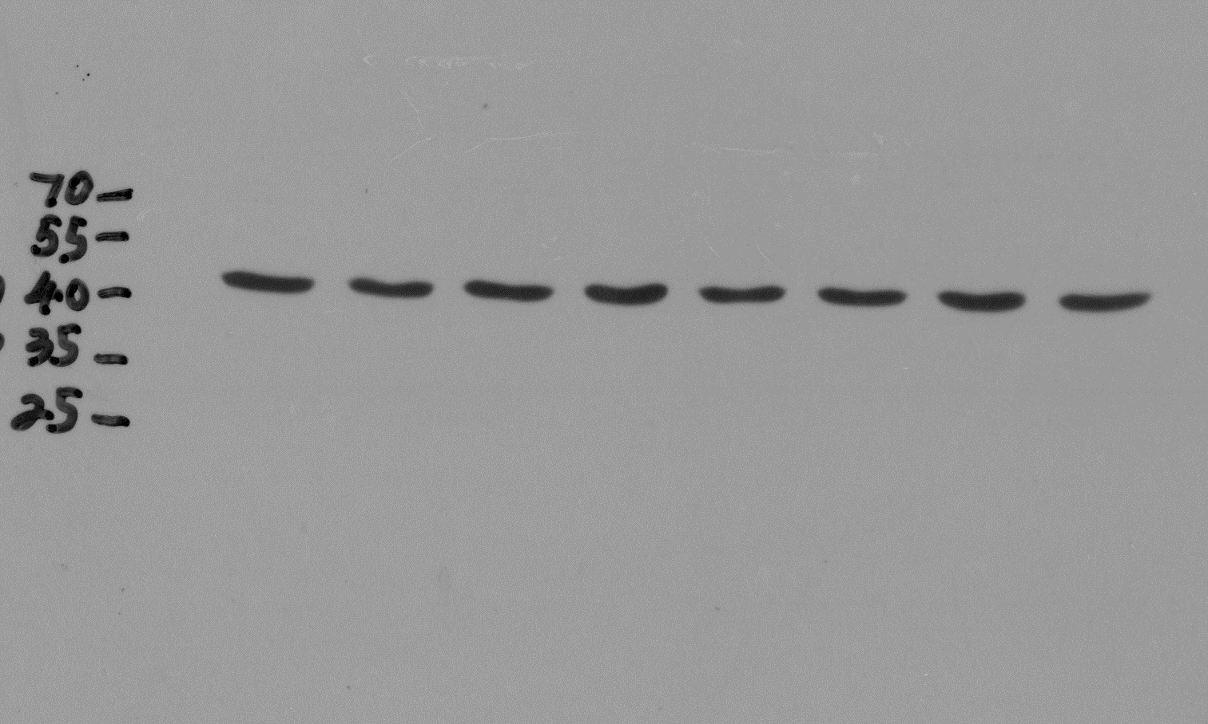
Figure 6A. β-actin
1: si-control + 0 μM GSI
2. si-control + 2.5 μM GSI
3: si-control + 5.0 μM GSI
4. si-control + 10.0 μM GSI
5: si-DLC-1 + 0 μM GSI
6. si-DLC-1 + 2.5 μM GSI
7: si-DLC-1 + 5.0 μM GSI
8. si-DLC-1 + 10.0 μM GSI
1
2
3
4
5
6
7
8

Slide 13
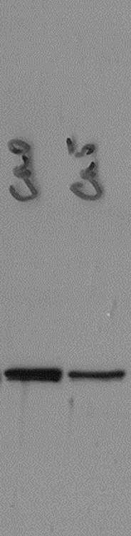
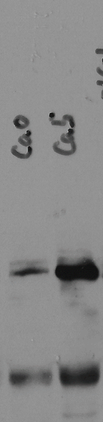
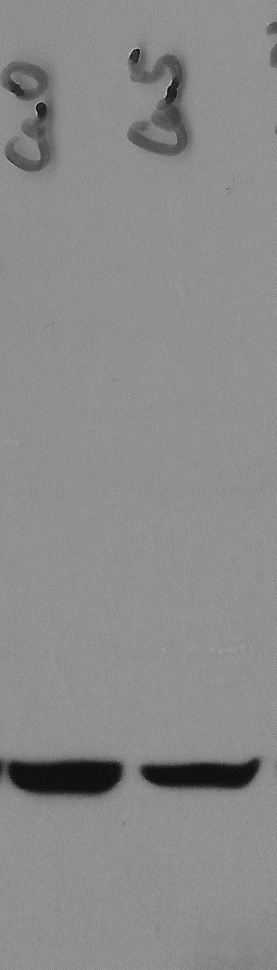
Figure 6B. NICD1
Figure 6B. DLC-1
Figure 6B. β-actin
1
2
170
170
1
2
130
130
1
2
55
100
100
40
35
1: pcDNA3.1 (Ca0)
2. pcDNA3.1-DLC-1 (Ca5)
1: pcDNA3.1 (Ca0)
2. pcDNA3.1-DLC-1 (Ca5)
1: pcDNA3.1 (Ca0)
2. pcDNA3.1-DLC-1 (Ca5)

Slide 14
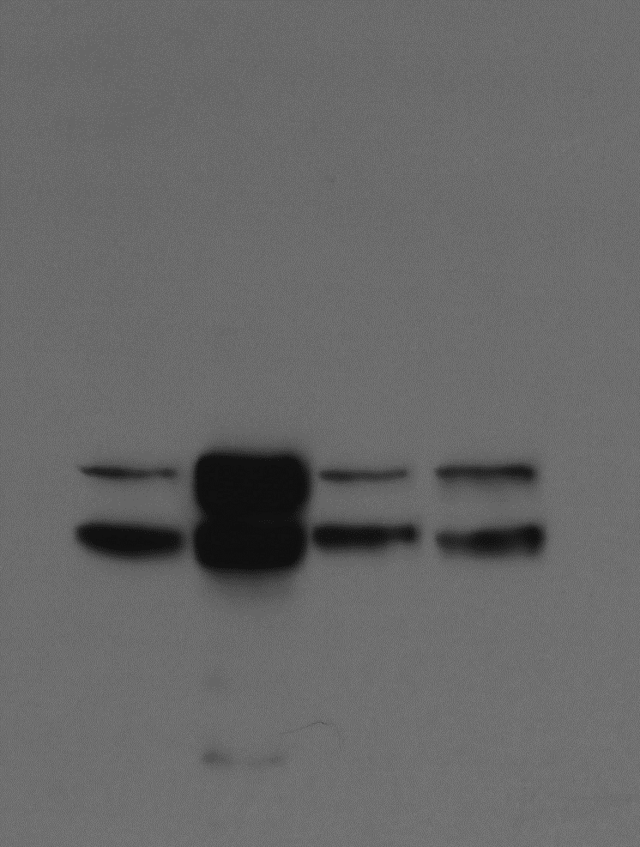
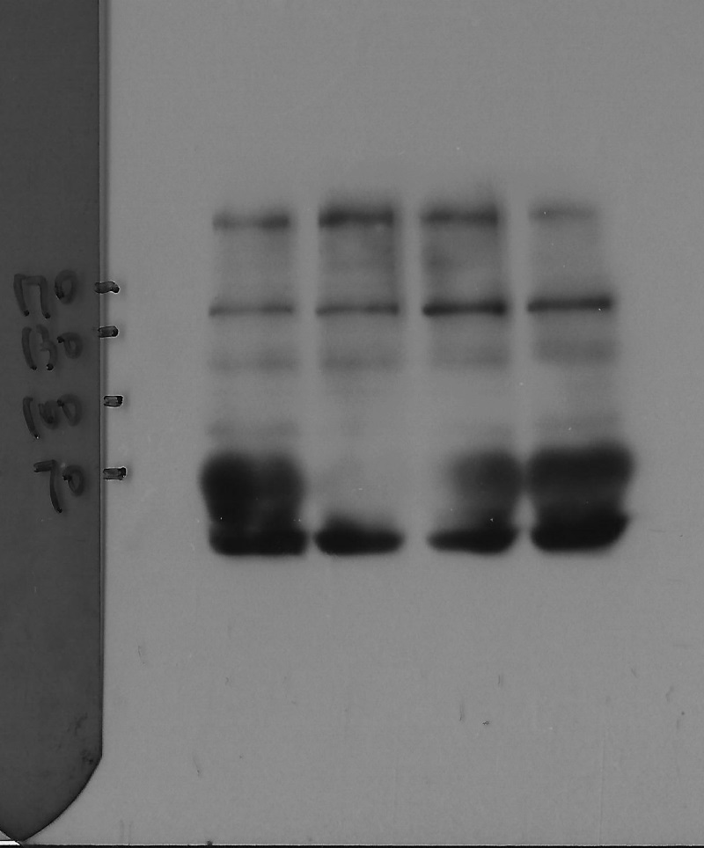
Figure 6C. NICD1
Figure 6C. DLC-1
1
2
3
4
DLC-1
170
1
2
3
4
130
100
1: pcDNA3.1 (IFN-γ 10 ng/ml)
2: pcDNA3.1+pcDNA3.1-Notch1 (IFN-γ 10 ng/ml)
3: pcDNA3.1-DLC-1 (IFN-γ 10 ng/ml)
4: pcDNA3.1-DLC-1+pcDNA3.1-Notch1 (IFN-γ 10 ng/ml)
1: pcDNA3.1 (IFN-γ 10 ng/ml)
2: pcDNA3.1+pcDNA3.1-Notch1 (IFN-γ 10 ng/ml)
3: pcDNA3.1-DLC-1 (IFN-γ 10 ng/ml)
4: pcDNA3.1-DLC-1+pcDNA3.1-Notch1 (IFN-γ 10 ng/ml)

Slide 15
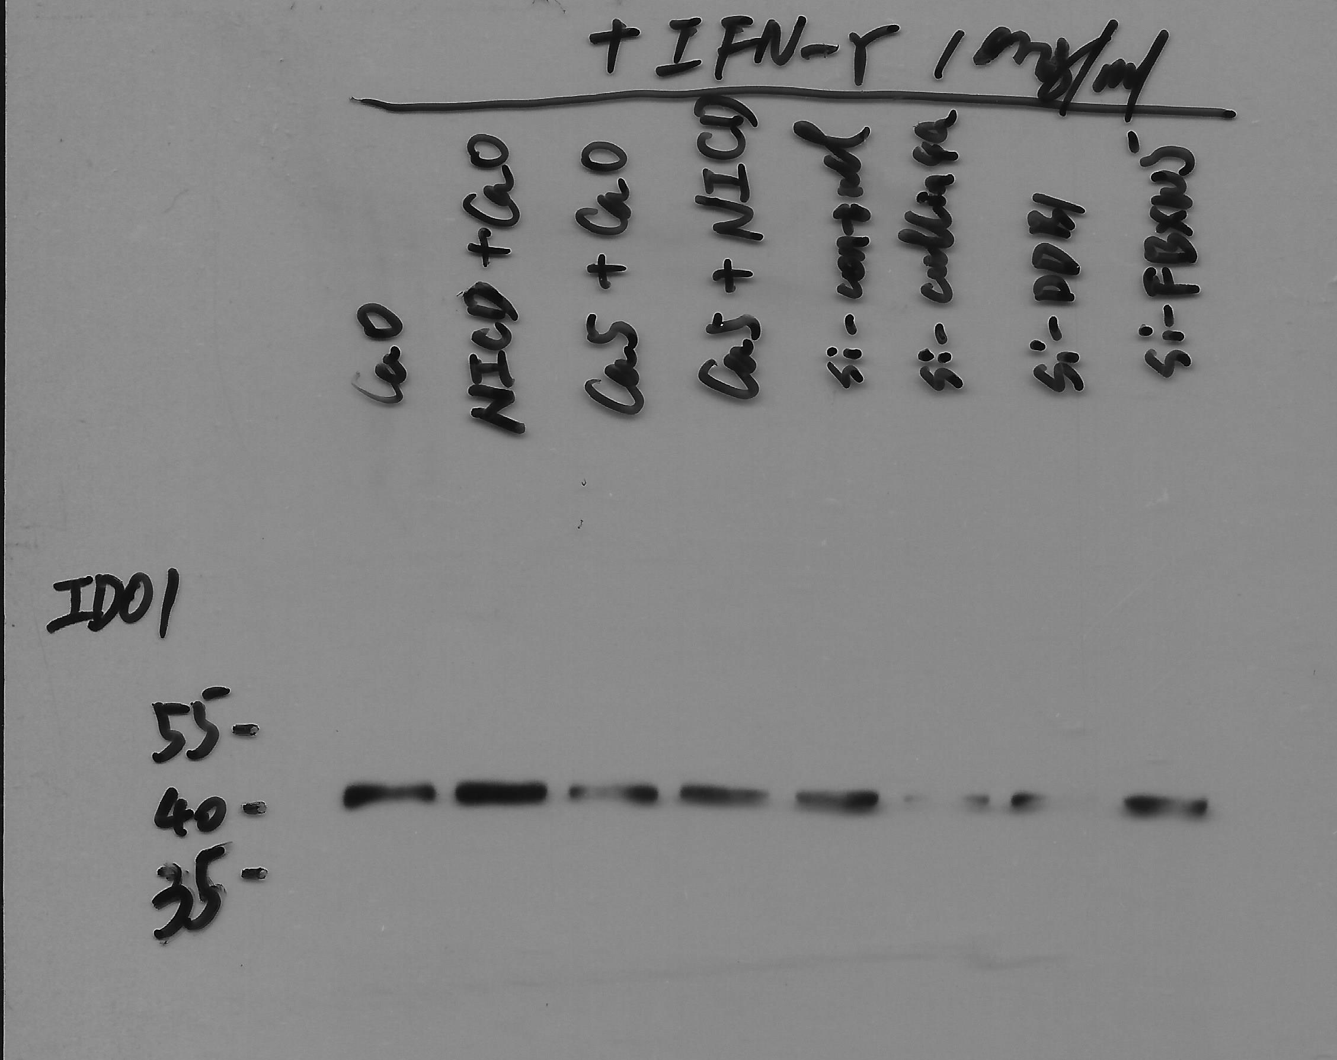
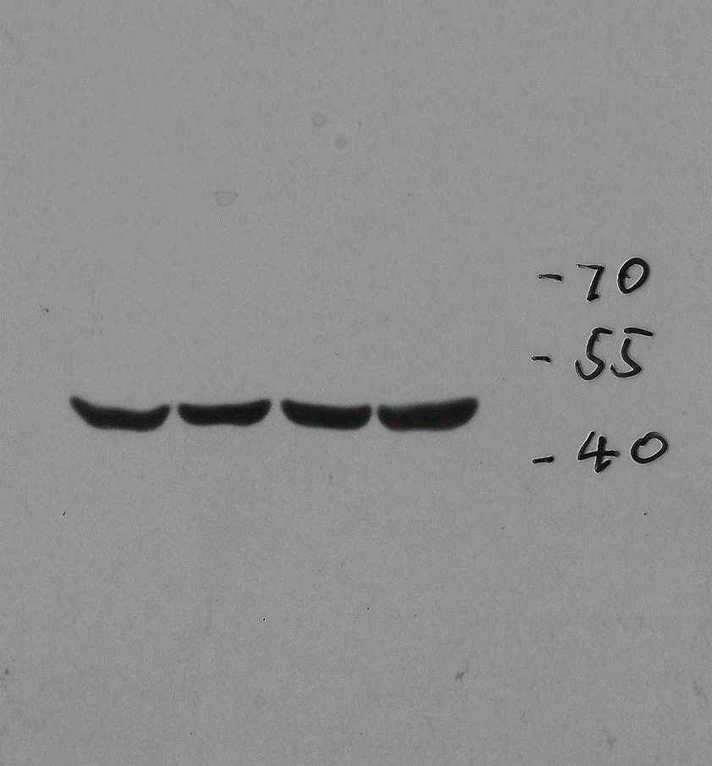
Figure 6C. IDO1
Figure 6C. β-actin
Not relevant
1
2
3
4
1
2
3
4
1: pcDNA3.1 (IFN-γ 10 ng/ml)
2: pcDNA3.1+pcDNA3.1-Notch1 (IFN-γ 10 ng/ml)
3: pcDNA3.1-DLC-1 (IFN-γ 10 ng/ml)
4: pcDNA3.1-DLC-1+pcDNA3.1-Notch1 (IFN-γ 10 ng/ml)
1: pcDNA3.1 (IFN-γ 10 ng/ml)
2: pcDNA3.1+pcDNA3.1-Notch1 (IFN-γ 10 ng/ml)
3: pcDNA3.1-DLC-1 (IFN-γ 10 ng/ml)
4: pcDNA3.1-DLC-1+pcDNA3.1-Notch1 (IFN-γ 10 ng/ml)

Slide 16
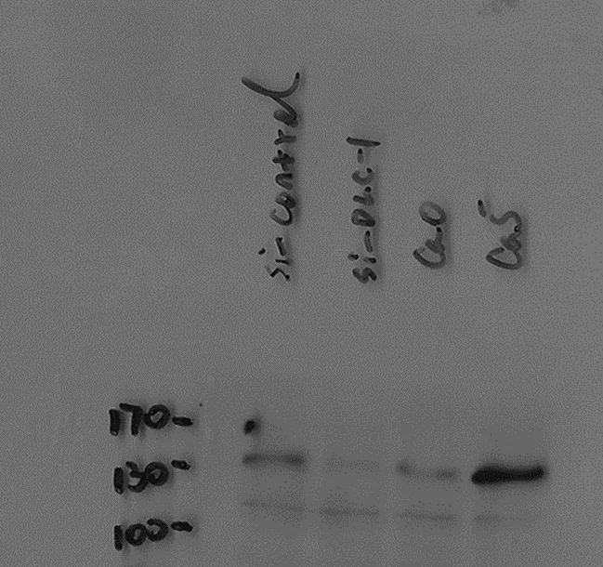
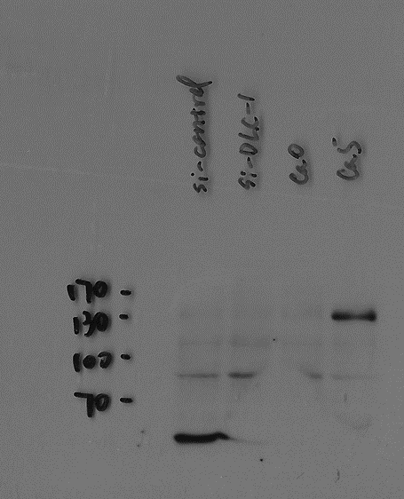
Figure 6D. DLC-1 (Cytoplasm)
Figure 6D. DLC-1 (Nucleus)
1
2
3
4
1
2
3
4
1: si-control
2: si-DLC-1
3: pcDNA3.1 (Ca0)
4: pcDNA3.1-DLC-1 (Ca5)
1: si-control
2: si-DLC-1
3: pcDNA3.1 (Ca0)
4: pcDNA3.1-DLC-1 (Ca5)

Slide 17
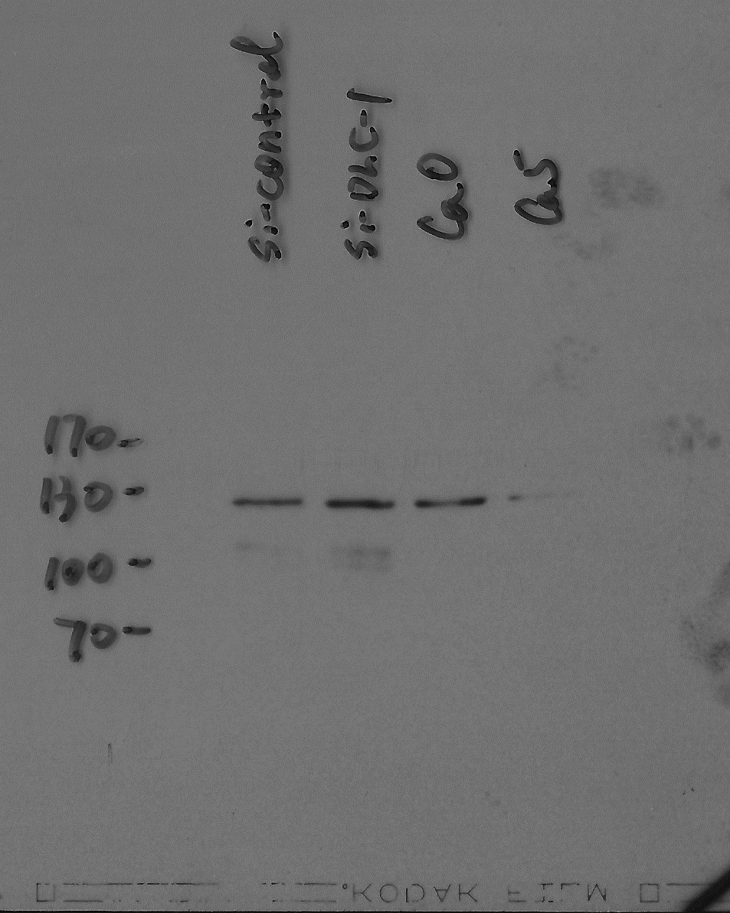
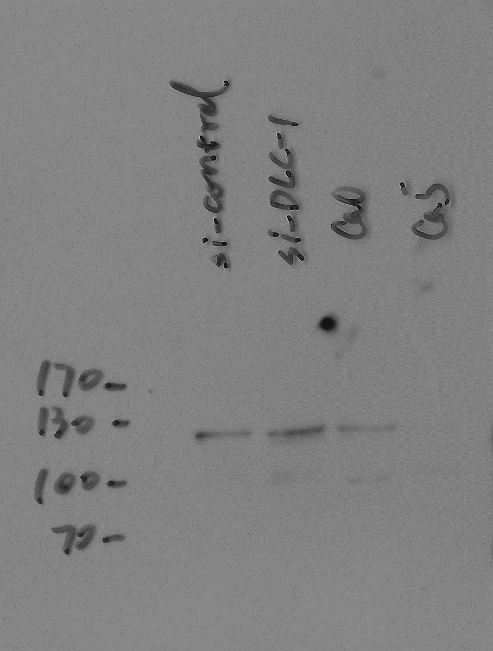
Figure 6D. NICD1 (Cytoplasm)
Figure 6D. NICD1 (Nucleus)
1
2
3
4
1
2
3
4
1: si-control
2: si-DLC-1
3: pcDNA3.1 (Ca0)
4: pcDNA3.1-DLC-1 (Ca5)
1: si-control
2: si-DLC-1
3: pcDNA3.1 (Ca0)
4: pcDNA3.1-DLC-1 (Ca5)

Slide 18
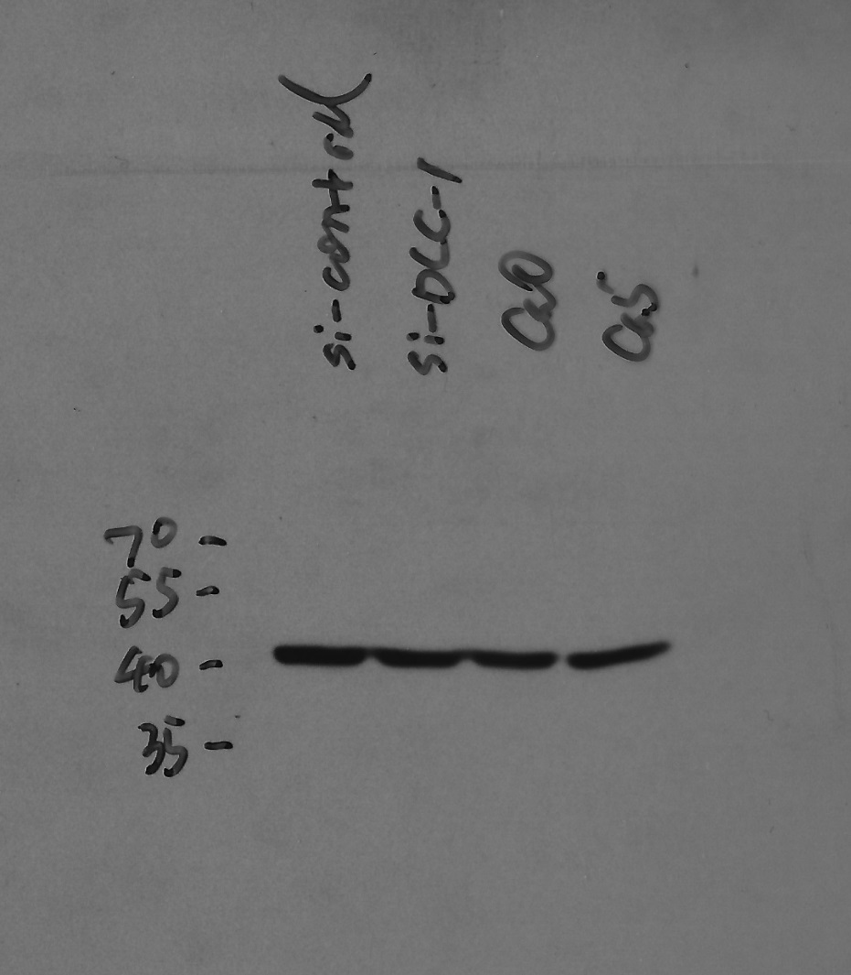
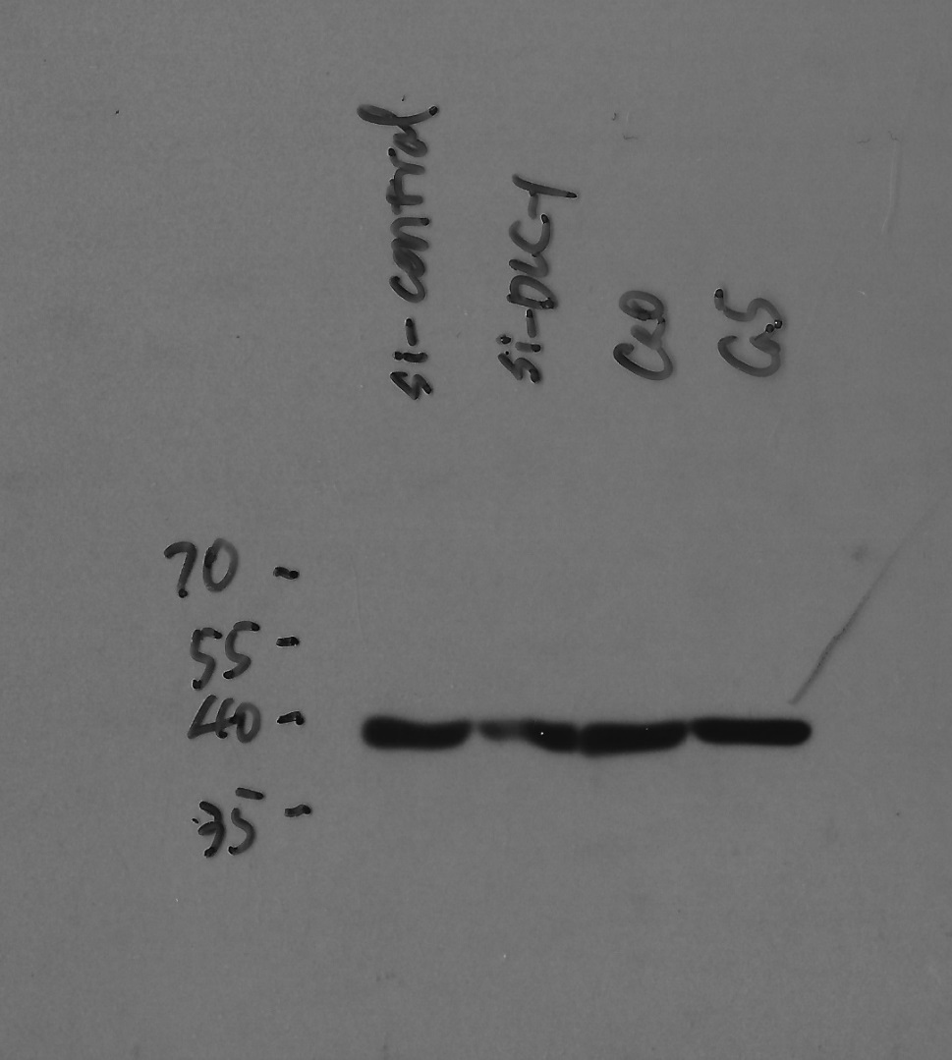
Figure 6D. β-actin (Cytoplasm)
Figure 6D. β-actin (Nucleus)
1
2
3
4
1
2
3
4
1: si-control
2: si-DLC-1
3: pcDNA3.1 (Ca0)
4: pcDNA3.1-DLC-1 (Ca5)
1: si-control
2: si-DLC-1
3: pcDNA3.1 (Ca0)
4: pcDNA3.1-DLC-1 (Ca5)

Slide 19
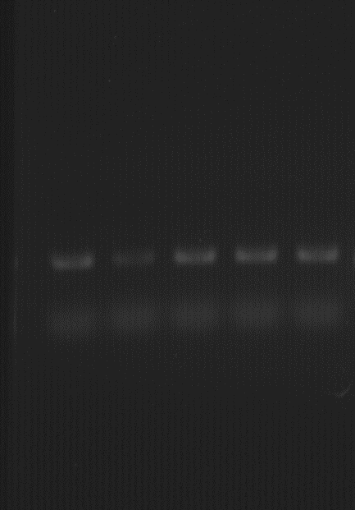
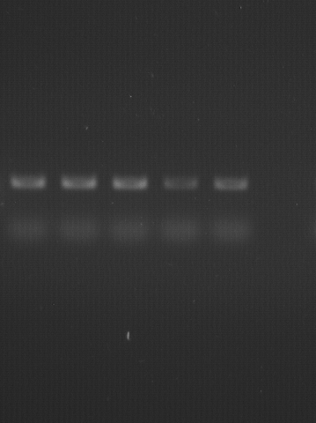
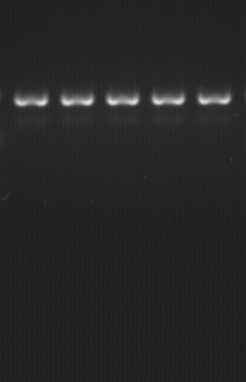
Figure 7A. Hes1
Figure 7A. Hey1
Figure 7A. GAPDH
1
2
3
4
5
1
2
3
4
5
1
2
3
4
5
1: si-control
2: si-Hes1 1#
3: si-Hes1 2#
4: si-Hey1 1#
5: si-Hes1 2#
1: si-control
2: si-Hes1 1#
3: si-Hes1 2#
4: si-Hey1 1#
5: si-Hes1 2#
1: si-control
2: si-Hes1 1#
3: si-Hes1 2#
4: si-Hey1 1#
5: si-Hes1 2#

Slide 20
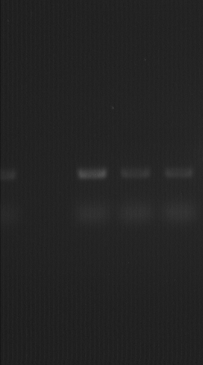
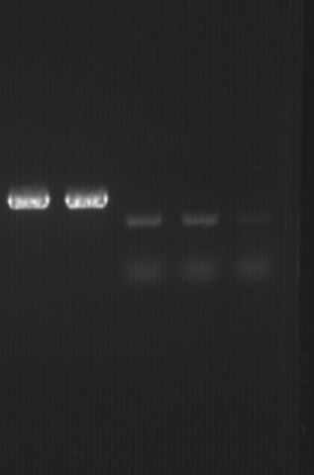
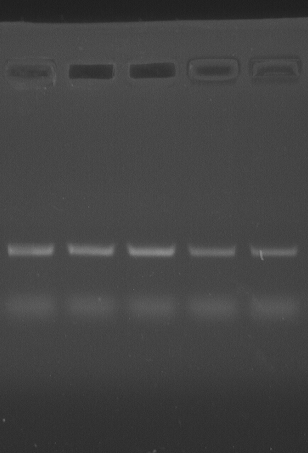
Figure 7D. Hes1
Figure 7D. Hey1
Figure 7D. GAPDH
1
2
3
1
2
3
1
2
3
1: control
2: DAPT (10 μM)
3: GSI (10 μM)
1: control
2: DAPT (10 μM)
3: GSI (10 μM)
1: control
2: DAPT (10 μM)
3: GSI (10 μM)

Slide 21
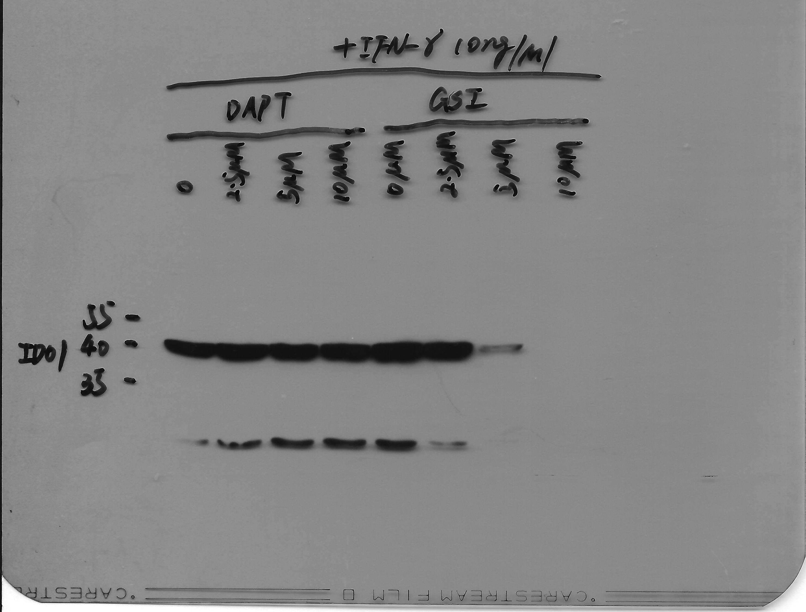
Figure 7E. IDO1 (DAPT)
Figure 7E. IDO1 (GSI)
Not relevant
1
2
3
4
1
2
3
4
1: GSI 0 μM (IFN-γ 10 ng/ml)
2: GSI 2.5 μM (IFN-γ 10 ng/ml)
3: GSI 5.0 μM (IFN-γ 10 ng/ml)
4: GSI 10.0 μM (IFN-γ 10 ng/ml)
1: DAPT 0 μM (IFN-γ 10 ng/ml)
2: DAPT 2.5 μM (IFN-γ 10 ng/ml)
3: DAPT 5.0 μM (IFN-γ 10 ng/ml)
4: DAPT 10.0 μM (IFN-γ 10 ng/ml)

Slide 22
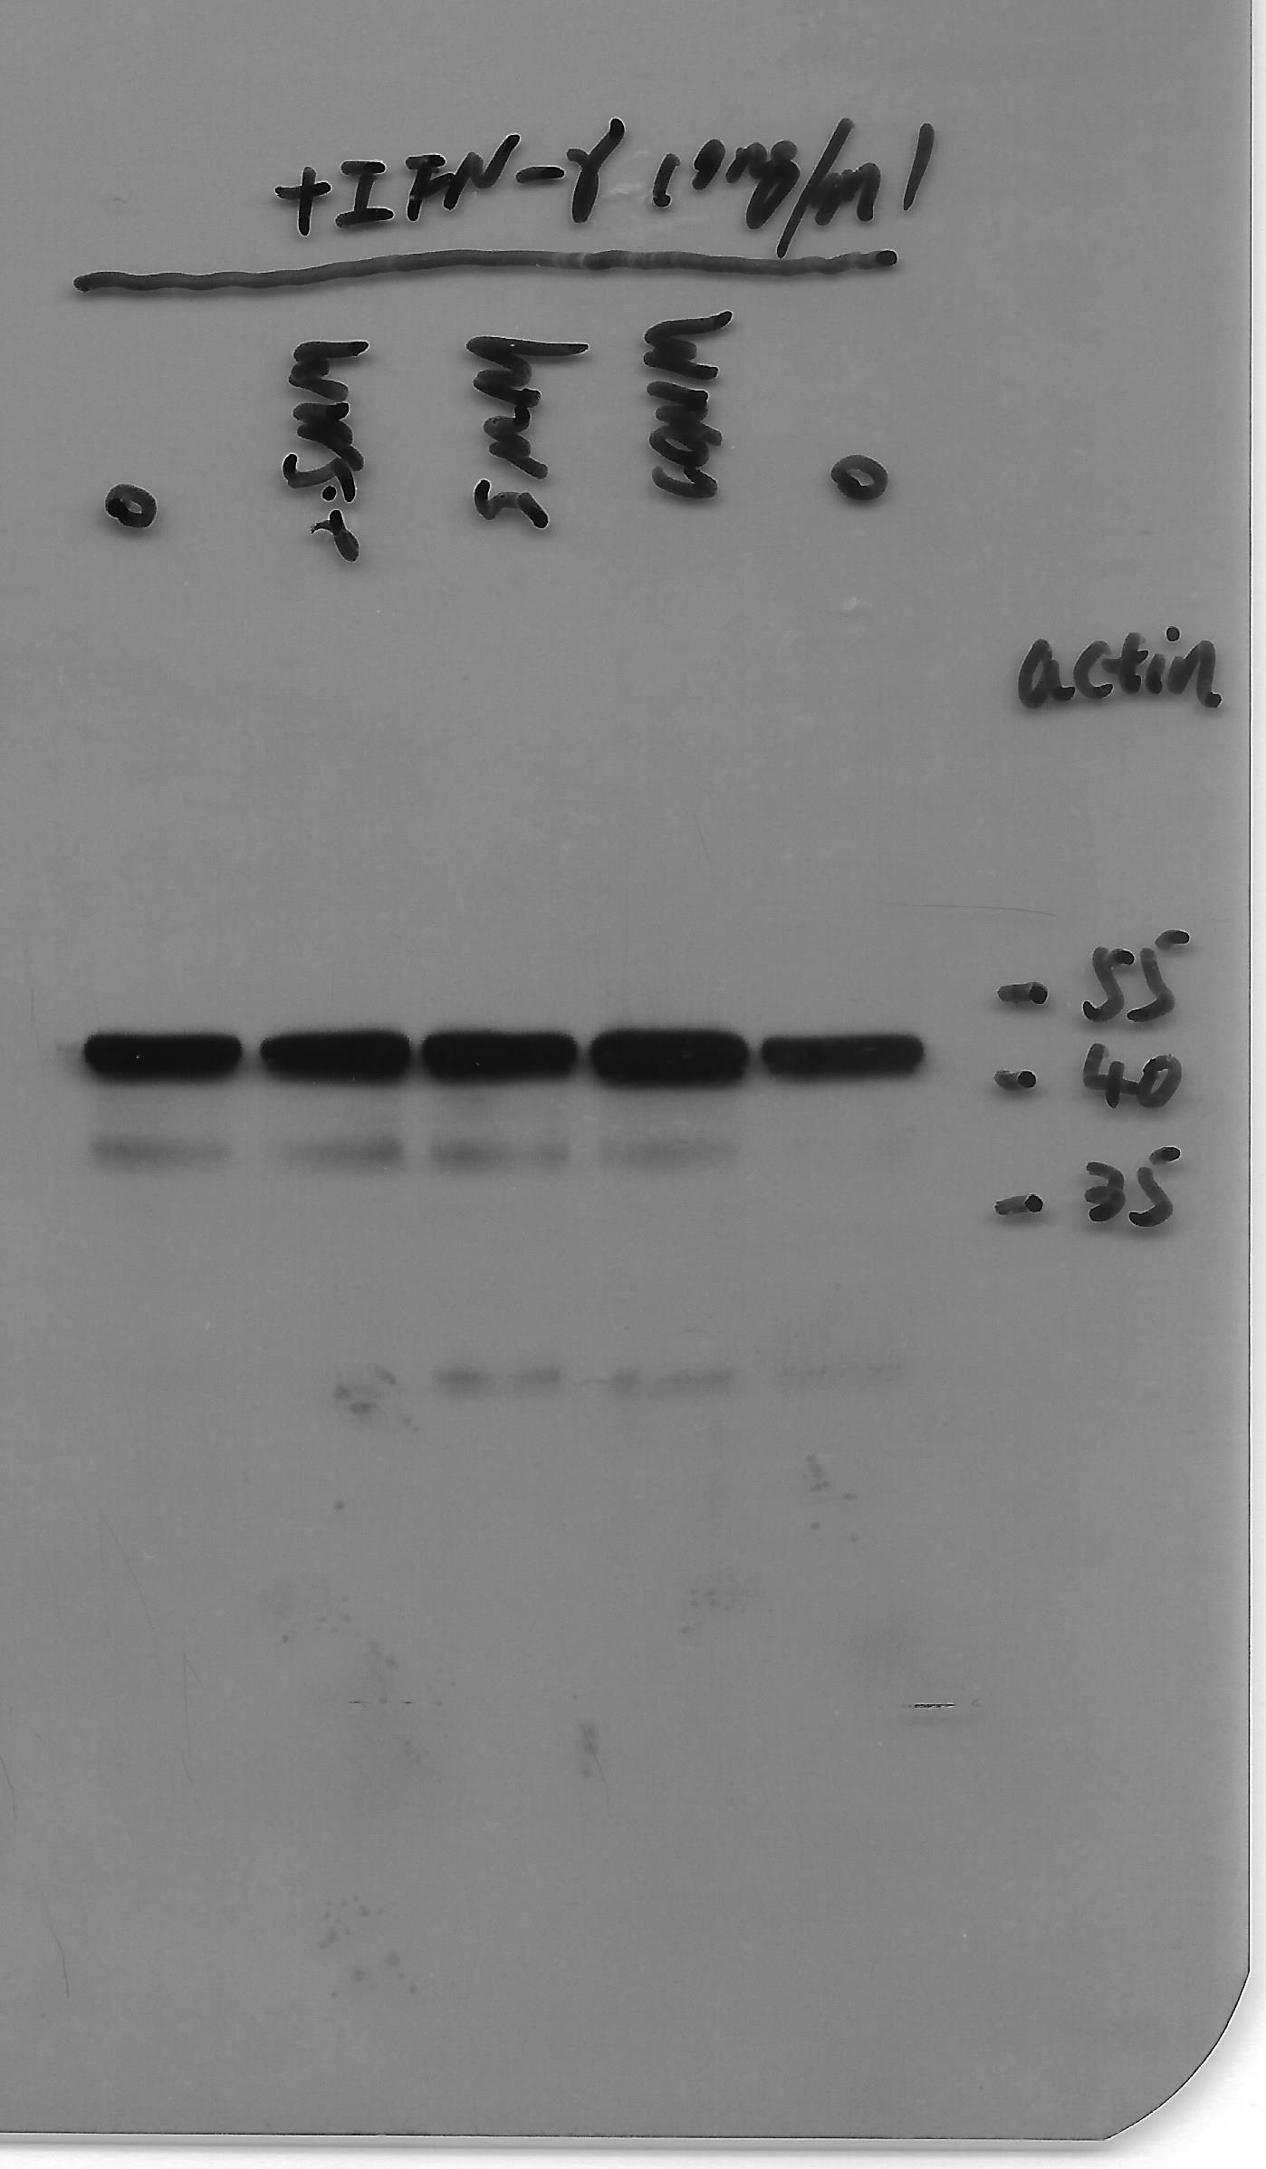
Figure 7E. β-actin (DAPT)
Figure 7E. β-actin (GSI)
Not relevant
1
2
3
4
1
2
3
4
1: GSI 0 μM (IFN-γ 10 ng/ml)
2: GSI 2.5 μM (IFN-γ 10 ng/ml)
3: GSI 5.0 μM (IFN-γ 10 ng/ml)
4: GSI 10.0 μM (IFN-γ 10 ng/ml)
1: DAPT 0 μM (IFN-γ 10 ng/ml)
2: DAPT 2.5 μM (IFN-γ 10 ng/ml)
3: DAPT 5.0 μM (IFN-γ 10 ng/ml)
4: DAPT 10.0 μM (IFN-γ 10 ng/ml)

Slide 23
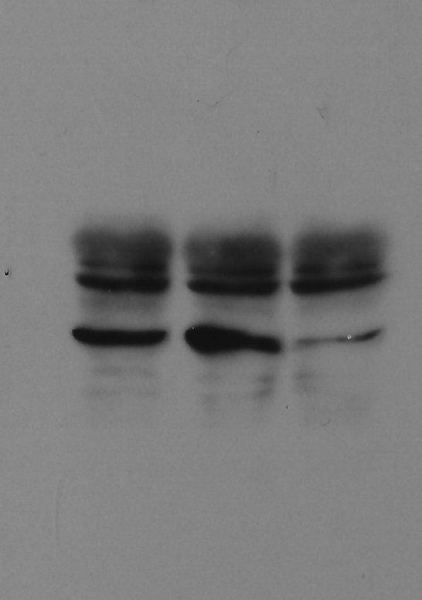
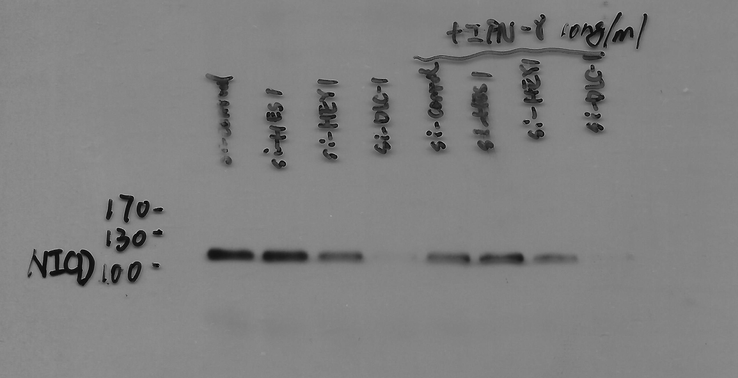
Figure S1.D IDO1
Figure S1.D NICD1
(The orinal image was missing. Replaced by new one.)
Not relevant
Not relevant
1
2
3
55
40
1
2
3
35
1: si-control (IFN-γ 10 ng/ml)
2: si-Hes1 (IFN-γ 10 ng/ml)
3: si-Hey1 (IFN-γ 10 ng/ml)
1: si-control (IFN-γ 10 ng/ml)
2: si-Hes1 (IFN-γ 10 ng/ml)
3: si-Hey1 (IFN-γ 10 ng/ml)

Slide 24
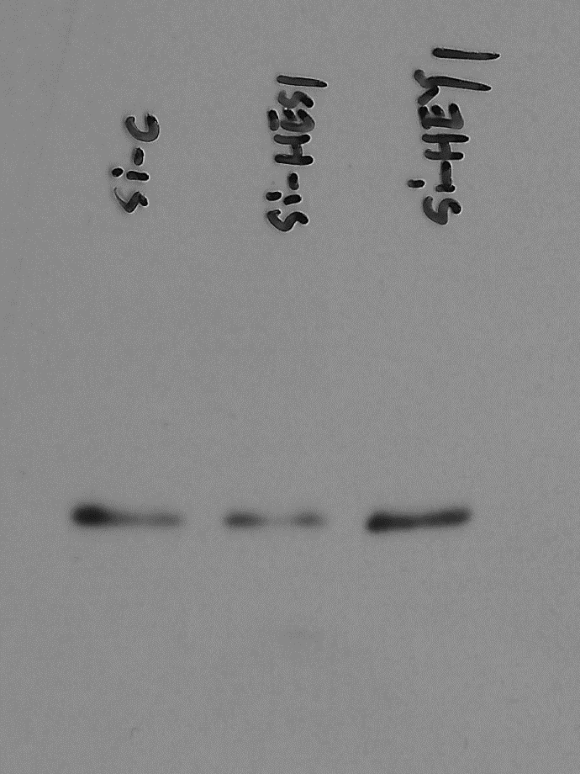
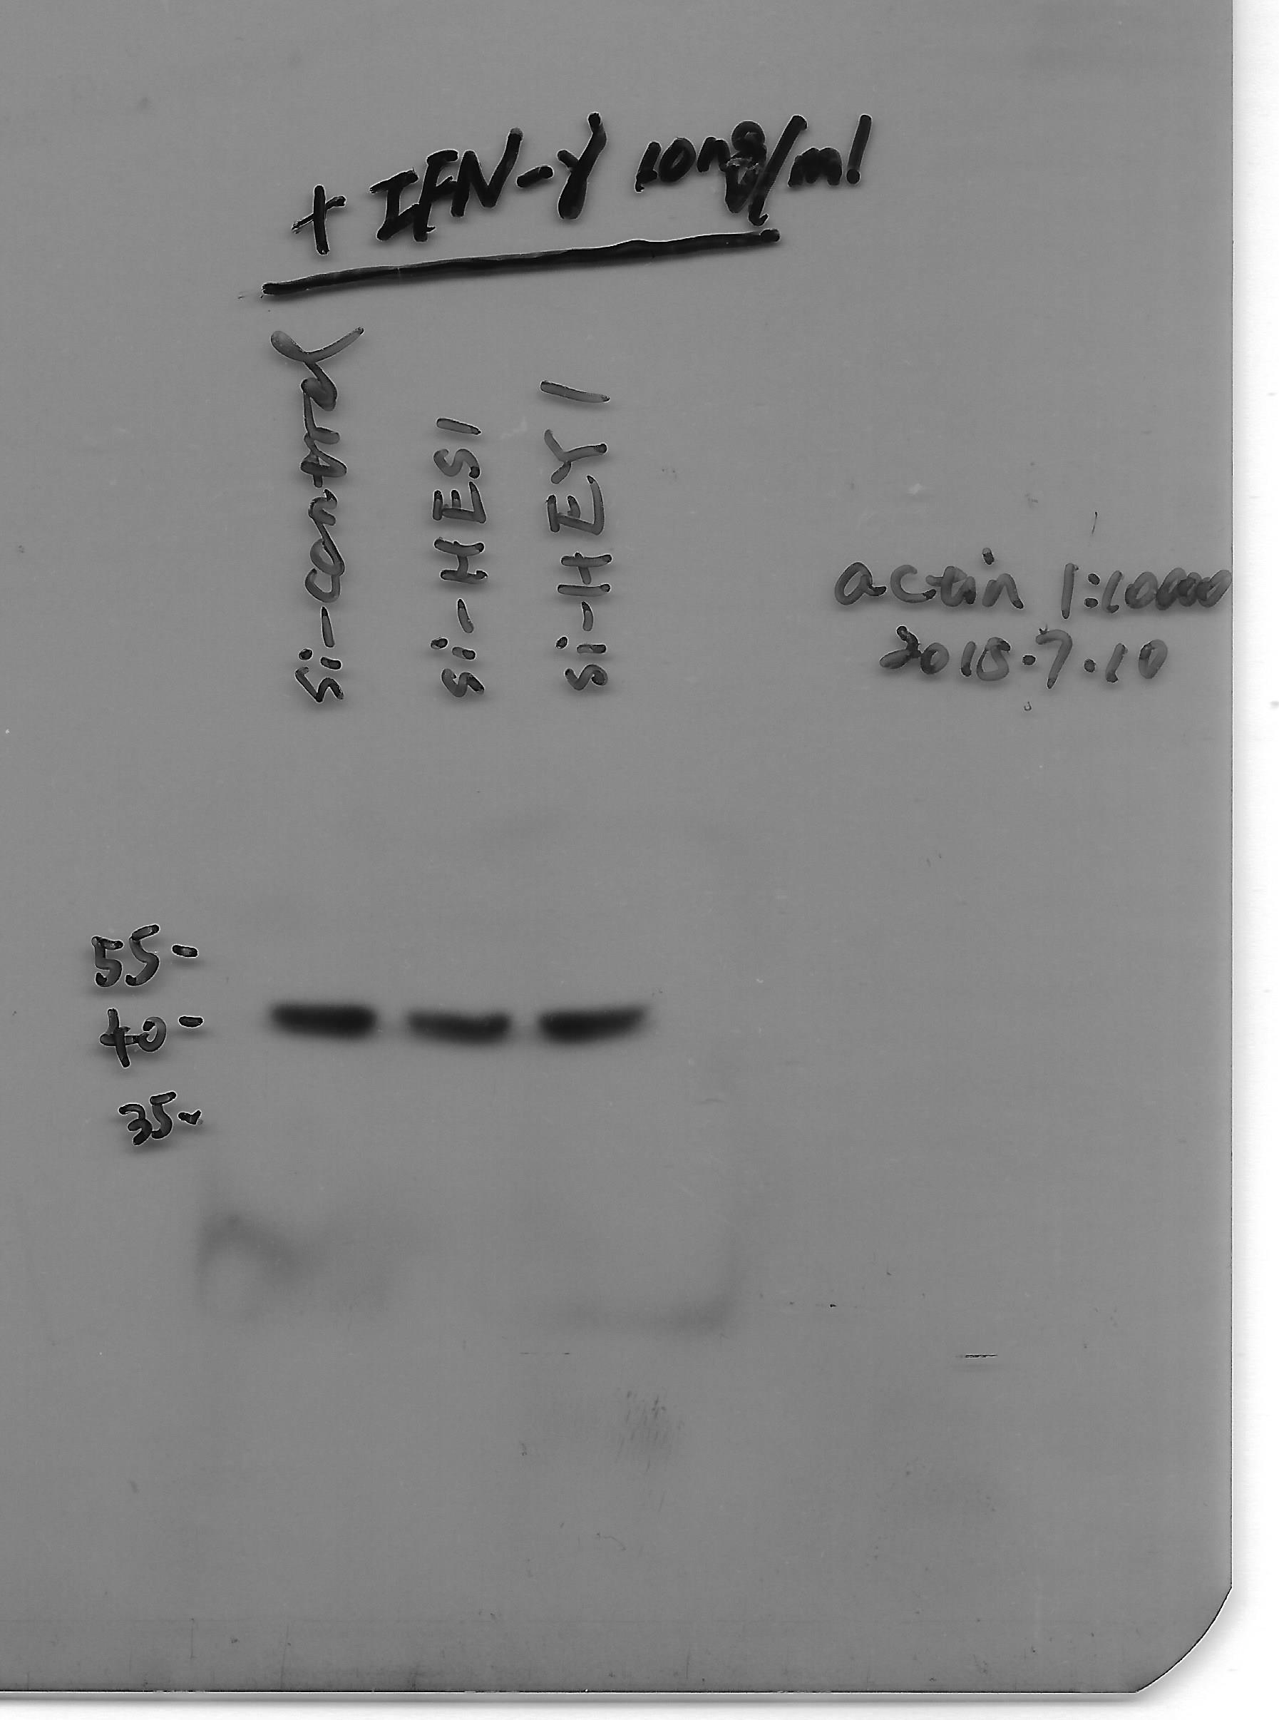
Figure S1.D β-actin
(The orinal image was missing. Replaced by new one.)
Figure S1.D DLC-1
1
2
3
170
1
2
3
130
100
1: si-control (IFN-γ 10 ng/ml)
2: si-Hes1 (IFN-γ 10 ng/ml)
3: si-Hey1 (IFN-γ 10 ng/ml)
1: si-control (IFN-γ 10 ng/ml)
2: si-Hes1 (IFN-γ 10 ng/ml)
3: si-Hey1 (IFN-γ 10 ng/ml)

Slide 25
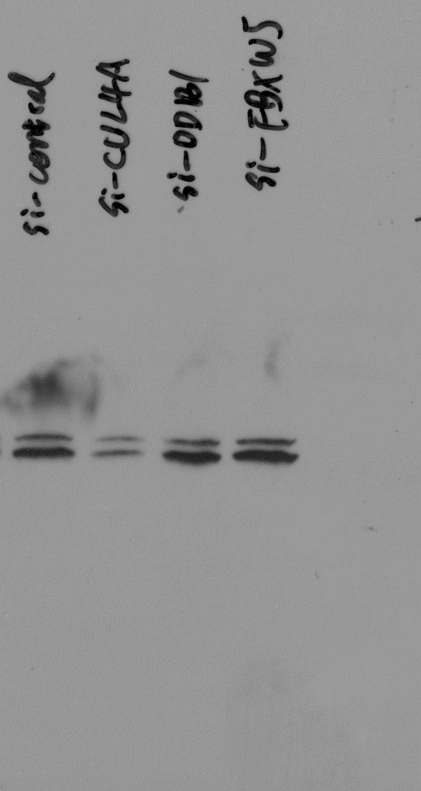
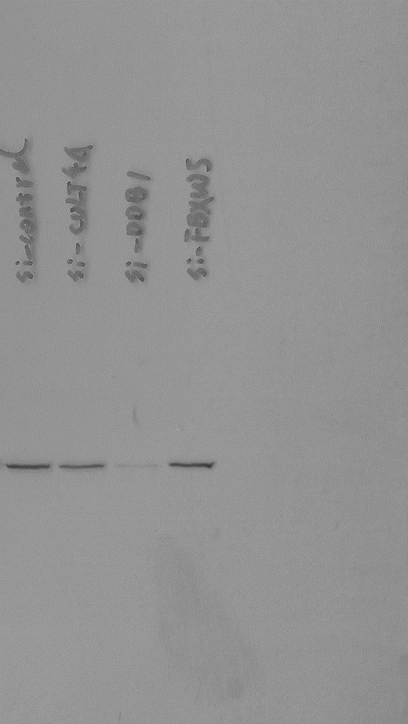
Figure S2. A: Cullin4a
Figure S2. A: DDB1
130
1
2
3
4
100
1
2
3
4
70
170
130
100
1: si-Control (IFN-γ 10 ng/ml)
2. si-Cullin4A (IFN-γ 10 ng/ml)
3: si-DDB1 (IFN-γ 10 ng/ml)
4. si-FBXW5 (IFN-γ 10 ng/ml)
1: si-Control (IFN-γ 10 ng/ml)
2. si-Cullin4A (IFN-γ 10 ng/ml)
3: si-DDB1 (IFN-γ 10 ng/ml)
4. si-FBXW5 (IFN-γ 10 ng/ml)

Slide 26
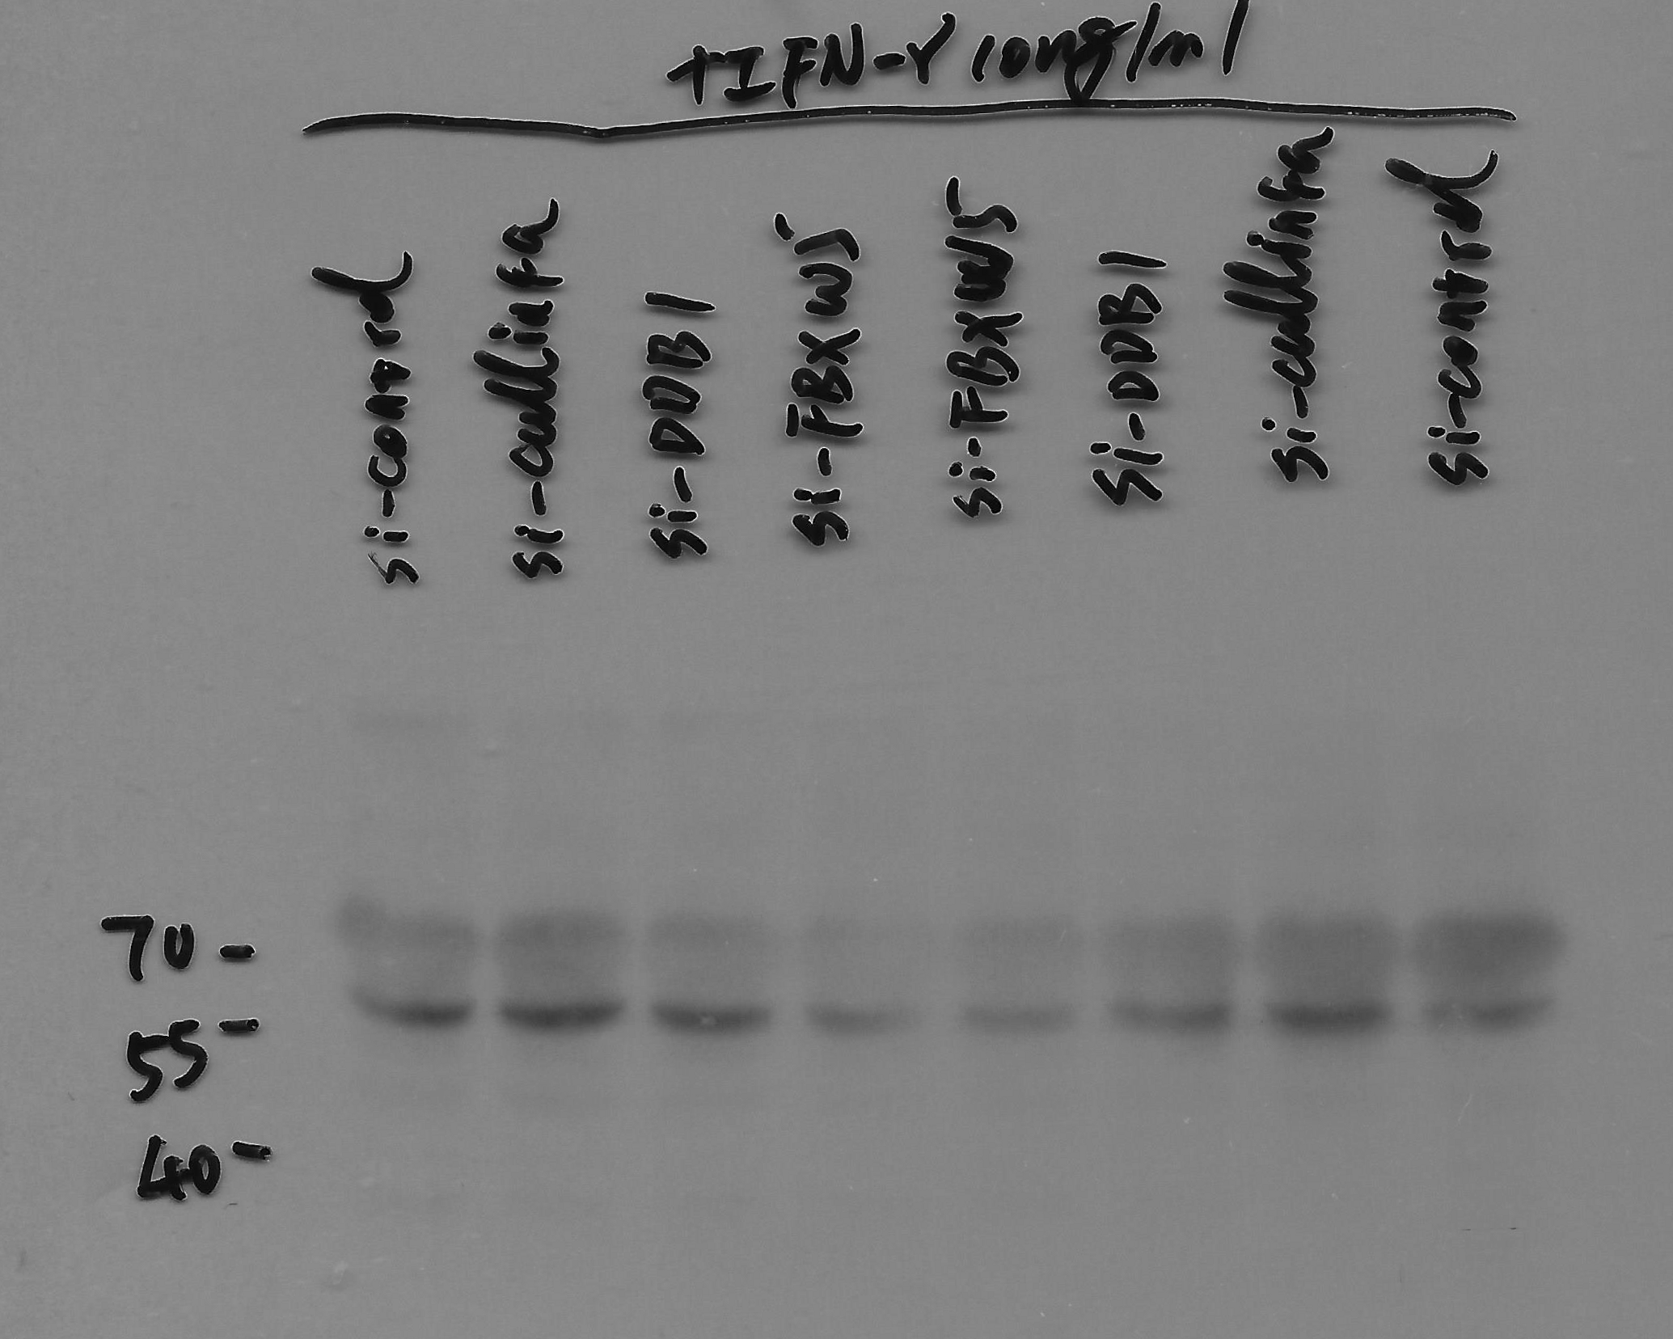
Figure S2. A: FBXW5
Not relevant
1
2
3
4
1: si-Control (IFN-γ 10 ng/ml)
2: si-Cullin4A (IFN-γ 10 ng/ml)
3: si-DDB1 (IFN-γ 10 ng/ml)
4: si-FBXW5 (IFN-γ 10 ng/ml)

Slide 27
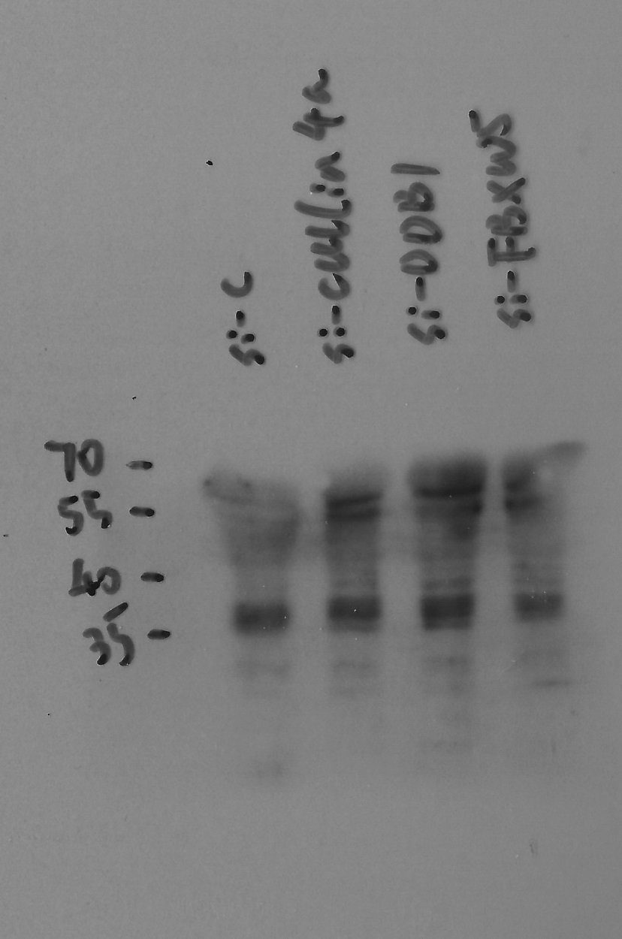
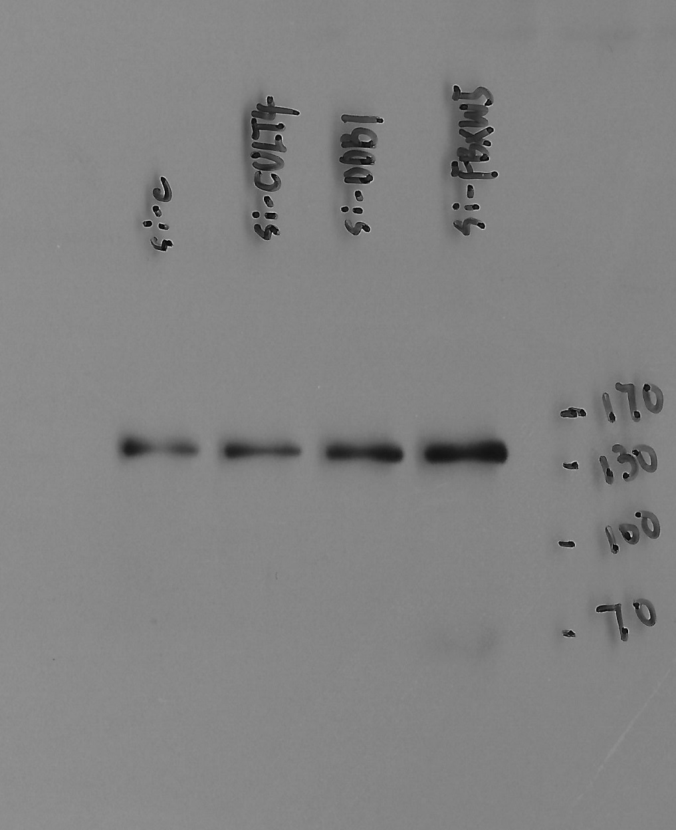
Figure S2. A: Hey1
Figure S2. A: DLC-1
1
2
3
4
1: si-Control (IFN-γ 10 ng/ml)
2: si-Cullin4A (IFN-γ 10 ng/ml)
3: si-DDB1 (IFN-γ 10 ng/ml)
4: si-FBXW5 (IFN-γ 10 ng/ml)
1: si-Control (IFN-γ 10 ng/ml)
2: si-Cullin4A (IFN-γ 10 ng/ml)
3: si-DDB1 (IFN-γ 10 ng/ml)
4: si-FBXW5 (IFN-γ 10 ng/ml)

Slide 28
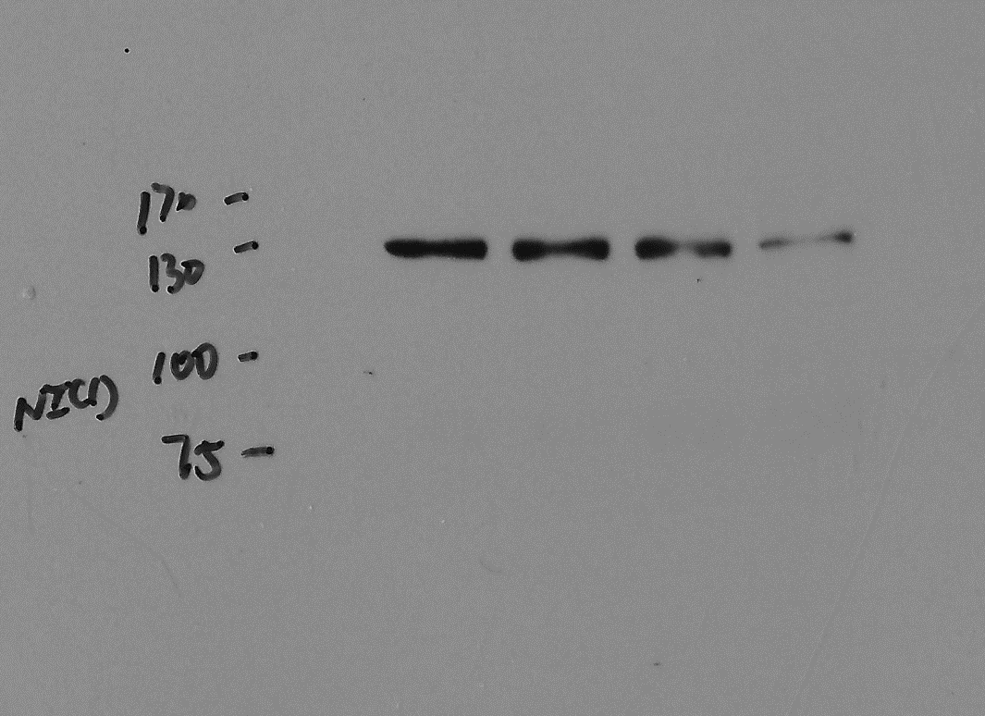

Figure S2. A: NICD1
Figure S2. A: IDO1
1
2
3
4
1
2
3
4
1: si-Control (IFN-γ 10 ng/ml)
2: si-Cullin4A (IFN-γ 10 ng/ml)
3: si-DDB1 (IFN-γ 10 ng/ml)
4: si-FBXW5 (IFN-γ 10 ng/ml)
1: si-Control (IFN-γ 10 ng/ml)
2: si-Cullin4A (IFN-γ 10 ng/ml)
3: si-DDB1 (IFN-γ 10 ng/ml)
4: si-FBXW5 (IFN-γ 10 ng/ml)

Slide 29


Figure S2. A: p-STAT1 (Y701)
Figure S2. A: β-actin
1
2
3
4
1
2
3
4
1: si-Control (IFN-γ 10 ng/ml)
2: si-Cullin4A (IFN-γ 10 ng/ml)
3: si-DDB1 (IFN-γ 10 ng/ml)
4: si-FBXW5 (IFN-γ 10 ng/ml)
1: si-Control (IFN-γ 10 ng/ml)
2: si-Cullin4A (IFN-γ 10 ng/ml)
3: si-DDB1 (IFN-γ 10 ng/ml)
4: si-FBXW5 (IFN-γ 10 ng/ml)

Slide 30


Figure S2. C: Cullin 4A
Figure S2. C: DDB1
1
2
3
170
130
100
70
1
2
3
1: si-control (IFN-γ 10 ng/ml)
2: si-Hes1 (IFN-γ 10 ng/ml)
3: si-Hey1 (IFN-γ 10 ng/ml)
1: si-control (IFN-γ 10 ng/ml)
2: si-Hes1 (IFN-γ 10 ng/ml)
3: si-Hey1 (IFN-γ 10 ng/ml)

Slide 31


Figure S2. C: FBXW5
Figure S2. C: p-STAT1 (Y701)
Not relevant
1
2
3
1
2
3
1: si-control (IFN-γ 10 ng/ml)
2: si-Hes1 (IFN-γ 10 ng/ml)
3: si-Hey1 (IFN-γ 10 ng/ml)
1: si-control (IFN-γ 10 ng/ml)
2: si-Hes1 (IFN-γ 10 ng/ml)
3: si-Hey1 (IFN-γ 10 ng/ml)

Slide 32


Figure S2. C: IDO1
Figure S2. C: β-actin
Not relevant
Not relevant
1
2
3
1
2
3
1: si-control (IFN-γ 10 ng/ml)
2: si-Hes1 (IFN-γ 10 ng/ml)
3: si-Hey1 (IFN-γ 10 ng/ml)
1: si-control (IFN-γ 10 ng/ml)
2: si-Hes1 (IFN-γ 10 ng/ml)
3: si-Hey1 (IFN-γ 10 ng/ml)

Slide 33

Figure S3. A: IDO1
Figure S3. A: DLC-1
1
2
3
4
1
2
3
4
1: Y27632 0 μM (IFN-γ 10 ng/ml)
2: Y27632 2.5 μM(IFN-γ 10 ng/ml)
3: Y27632 5.0 μM ( IFN-γ 10 ng/ml)
4: Y27632 10.0 μM (IFN-γ 10 ng/ml)
1: Y27632 0 μM (IFN-γ 10 ng/ml)
2: Y27632 2.5 μM(IFN-γ 10 ng/ml)
3: Y27632 5.0 μM ( IFN-γ 10 ng/ml)
4: Y27632 10.0 μM (IFN-γ 10 ng/ml)

Slide 34


Figure S3. A: NICD1
Figure S3. A: Rock1
1
2
3
4
170
1
2
3
4
130
100
1: Y27632 0 μM (IFN-γ 10 ng/ml)
2: Y27632 2.5 μM(IFN-γ 10 ng/ml)
3: Y27632 5.0 μM ( IFN-γ 10 ng/ml)
4: Y27632 10.0 μM (IFN-γ 10 ng/ml)
1: Y27632 0 μM (IFN-γ 10 ng/ml)
2: Y27632 2.5 μM(IFN-γ 10 ng/ml)
3: Y27632 5.0 μM ( IFN-γ 10 ng/ml)
4: Y27632 10.0 μM (IFN-γ 10 ng/ml)

Slide 35


Figure S3. A: Rock2
Figure S3. A: Hes1
Not relevant
1
2
3
4
1
2
3
4
1: Y27632 0 μM (IFN-γ 10 ng/ml)
2. Y27632 2.5 μM(IFN-γ 10 ng/ml)
3: Y27632 5.0 μM ( IFN-γ 10 ng/ml)
4. Y27632 10.0 μM (IFN-γ 10 ng/ml)
1: Y27632 0 μM (IFN-γ 10 ng/ml)
2. Y27632 2.5 μM(IFN-γ 10 ng/ml)
3: Y27632 5.0 μM ( IFN-γ 10 ng/ml)
4. Y27632 10.0 μM (IFN-γ 10 ng/ml)

Slide 36


Figure S3. A: Hey1
Figure S3. A: β-actin
1
2
3
4
50
1
2
3
4
40
35
25
1: Y27632 0 μM (IFN-γ 10 ng/ml)
2: Y27632 2.5 μM(IFN-γ 10 ng/ml)
3: Y27632 5.0 μM ( IFN-γ 10 ng/ml)
4: Y27632 10.0 μM (IFN-γ 10 ng/ml)
1: Y27632 0 μM (IFN-γ 10 ng/ml)
2: Y27632 2.5 μM(IFN-γ 10 ng/ml)
3: Y27632 5.0 μM ( IFN-γ 10 ng/ml)
4: Y27632 10.0 μM (IFN-γ 10 ng/ml)

Slide 37


Figure S3. D: Rock1
Figure S3. D: Rock2
1
2
3
1
2
3
1: si-Control (IFN-γ 10 ng/ml)
2: si-Rock1 (IFN-γ 10 ng/ml)
3: si-Rock2 (IFN-γ 10 ng/ml)
1: si-Control (IFN-γ 10 ng/ml)
2: si-Rock1 (IFN-γ 10 ng/ml)
3: si-Rock2 (IFN-γ 10 ng/ml)

Slide 38


Figure S3. D: IDO1
Figure S3. D: DLC-1
Not relevant
1
2
3
1
2
3
1: si-Control (IFN-γ 10 ng/ml)
2: si-Rock1 (IFN-γ 10 ng/ml)
3: si-Rock2 (IFN-γ 10 ng/ml)
1: si-Control (IFN-γ 10 ng/ml)
2: si-Rock1 (IFN-γ 10 ng/ml)
3: si-Rock2 (IFN-γ 10 ng/ml)

Slide 39


Figure S3. D: NICD1
Figure S3. D: p-STAT1 (Y701)
1
2
3
1: si-Control (IFN-γ 10 ng/ml)
2: si-Rock1 (IFN-γ 10 ng/ml)
3: si-Rock2 (IFN-γ 10 ng/ml)
1
2
3
1: si-Control (IFN-γ 10 ng/ml)
2: si-Rock1 (IFN-γ 10 ng/ml)
3: si-Rock2 (IFN-γ 10 ng/ml)

Slide 40

Figure S3. D: β-actin
1
2
3
1: si-Control (IFN-γ 10 ng/ml)
2: si-Rock1 (IFN-γ 10 ng/ml)
3: si-Rock2 (IFN-γ 10 ng/ml)

