Slide 1


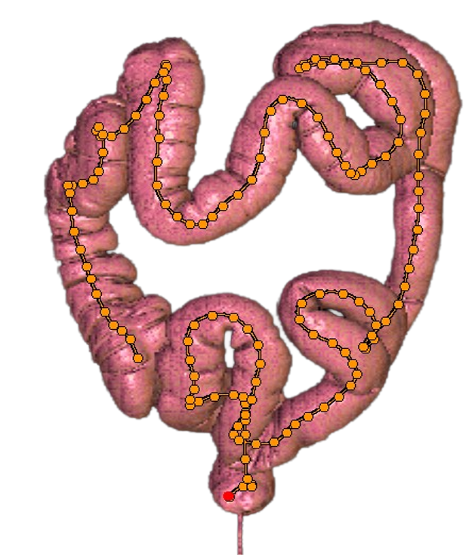
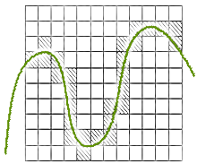
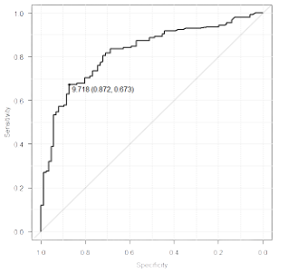
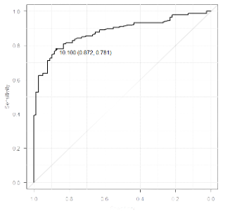
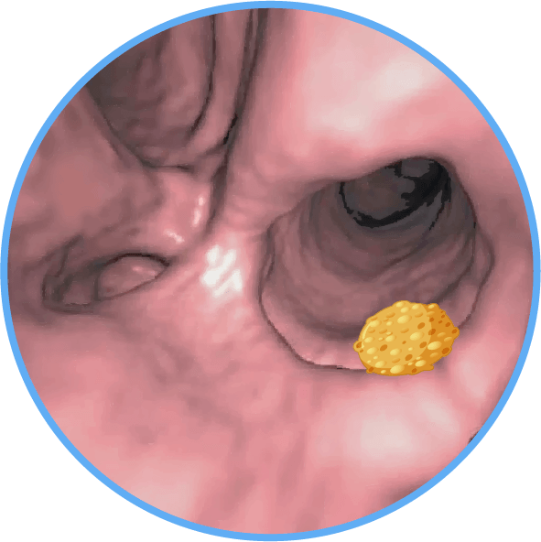
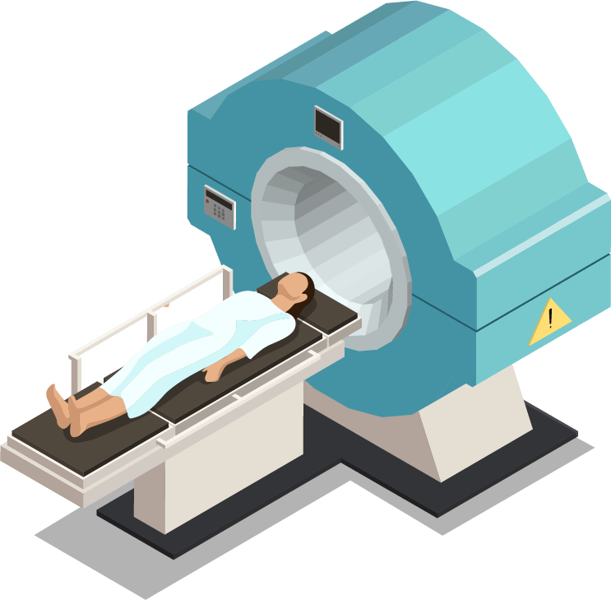

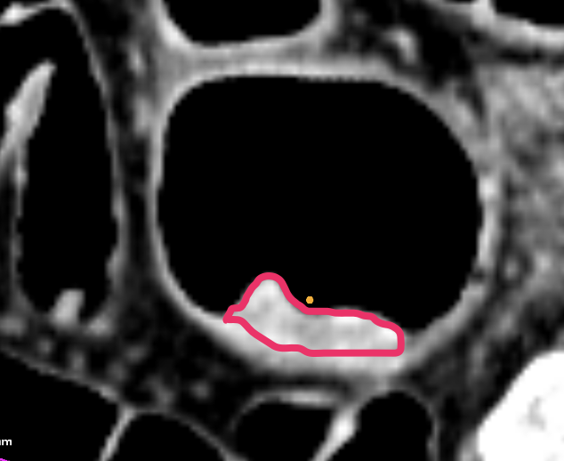

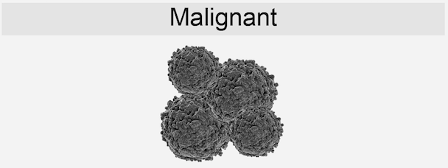
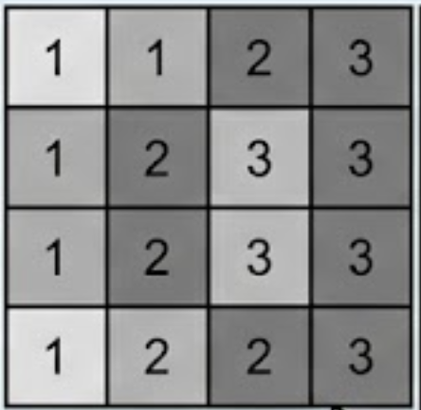
Texture Analysis of 2D MPR Images on CT Colonography for Colorectal Lesion Characterization.
Image acquisition and segmentation
Lesion identification
Texture analysis
Results
Plain CT colonography (PCTC)
and
Contrast-enhanced
CT colonography (CECTC)
Texture features
PCTC
CECTC
Fractal dimension
(FD)
Fractal
analysis
Best-performing feature
Kurtosis
Skewness
Entropy
GLCM entropy
(AUC 0.832)
GLCM entropy
(AUC 0.897)
Histogram
analysis
Adenoma vs Adenocarcinoma
152 patients
April 2021–September 2024
242 colorectal lesions
Manual ROI analysis
GLCM correlation
GLCM autocorrelation
GLCM entropy
GLCM homogeneity
Lower entropy Lower kurtosis Higher FD
Higher entropy Higher kurtosis Lower FD
Manual ROI on largest 2D MPR slice
GLCM
analysis

