Slide 1
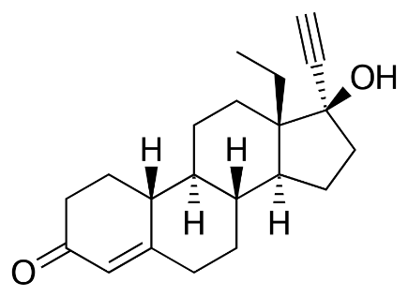
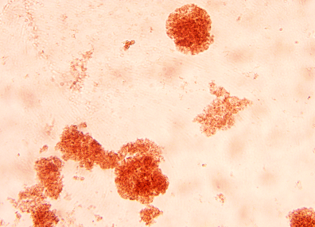
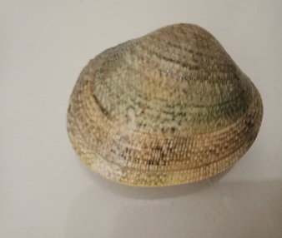
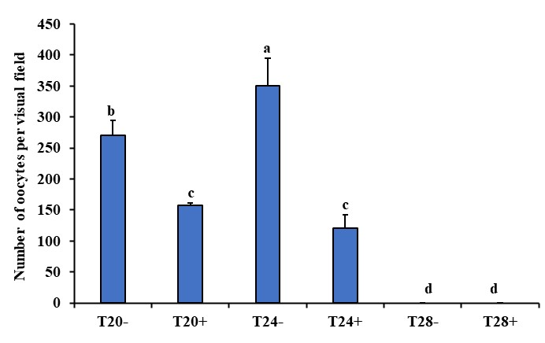

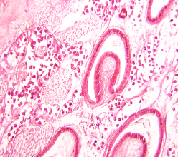
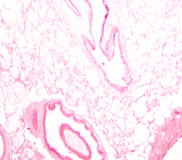

28
24
20
Biochemical and subcellular responses
$$+$$
SOD (+) ,CAT (+) , GST (+) , PSH (+) , MDA, CoD (+), ALP (+) and ICDH (-)
Exposure (28 days)
Lysosomal membrane stabilité
(-)
Physiological responses
Histological analysis
Vitellogenin like proteins (-)
Oestradiol (-)
Testosterone
Gonads oocytes number (-)

