Slide 1
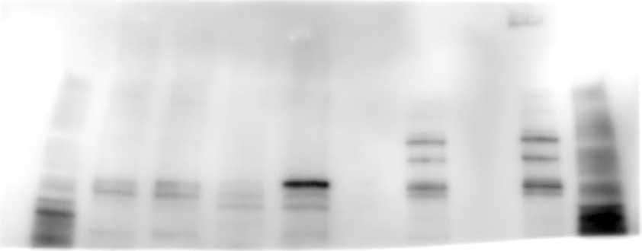
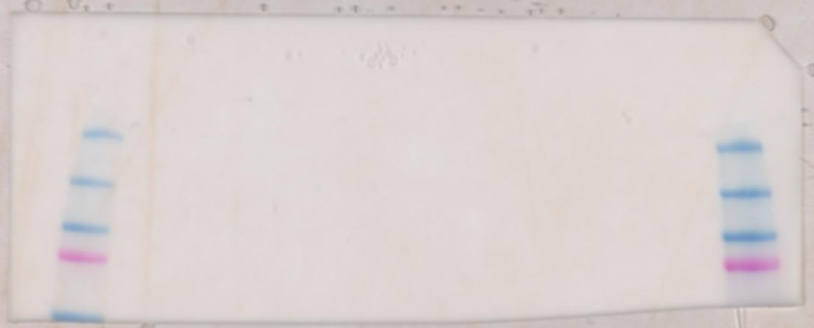
CUL1
Lung
Joint
HEK293
HEK293
marker
naive
arthritis
naive
arthritis
marker
250
150
100
75
50

Slide 2
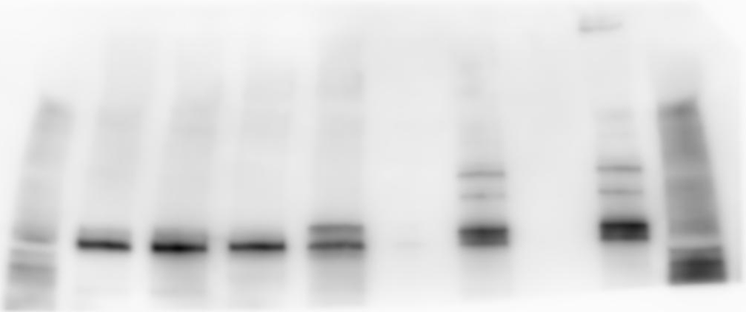
CUL5
Lung
Joint
HEK293
HEK293
marker
naive
arthritis
naive
arthritis
marker

Slide 3
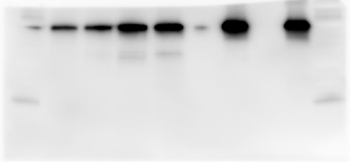
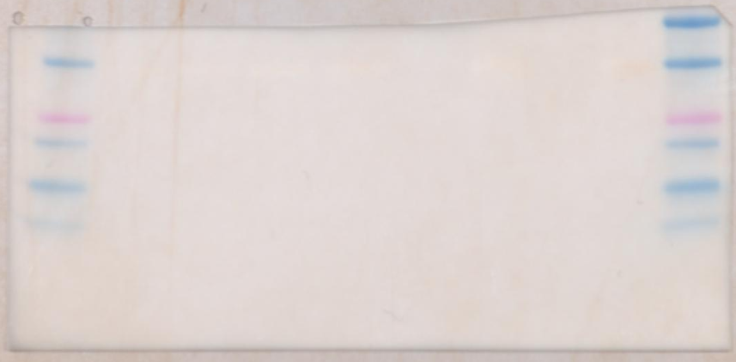
GAPDH
Lung
Joint
HEK293
HEK293
marker
naive
arthritis
naive
arthritis
marker
37
25
20
15
10

Slide 4

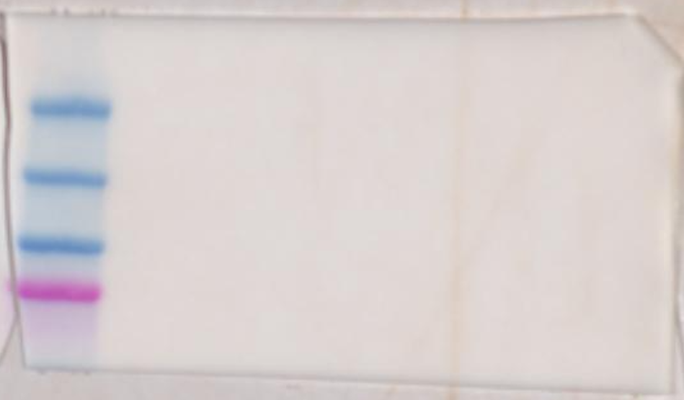
CSN1
Joint
Lung
marker
naive
arthritis
naive
arthritis
75
75

Slide 5
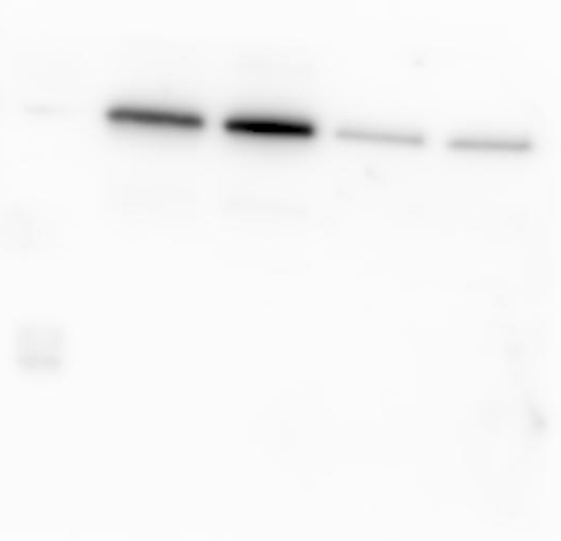
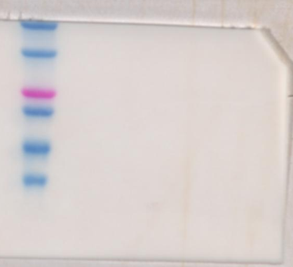
GAPDH
Joint
Lung
marker
naive
arthritis
naive
arthritis
37
37
25

