Slide 1
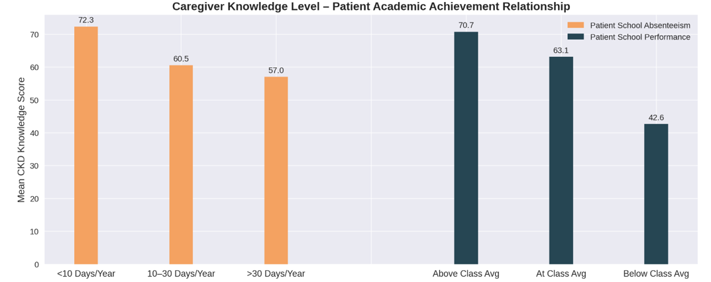

Assessment of Disease Knowledge Level of the Caregivers of Pediatric Patients with Chronic Kidney Disease
Graphical
Abstract
HYPOTHESIS: Better knowledge level is associated with slow progression of disease and improved quality of life
Design and Outcomes:
Caregivers of patients with early-stage CKD (stages 2–3) had higher educational levels (p=0.048)
Mean Knowledge Score: 64.9/100
Higher caregiver knowledge scores associated with:
Prospective, single-center survey
47 pediatric CKD patients
(Stages 2–5, not on kidney replacement therapy) & their primary caregivers
46-item questionnaire
(Max score: 100)
Average follow-up duration: 6.5 years
Mean eGFR at CKD diagnosis: 58.3 mL/min/1.73 m² (Stage 3a)
Mean eGFR during study: 39.5 mL/min/1.73 m² (Stage 3b)
Higher level of knowledge contributes to:
Reduced school absenteeism (p=0.020)
Better academic performance (p=0.008)
Advanced CKD stage at diagnosis (p=0.026)
Having a healthcare professional in their family (p=0.020)
CONCLUSION: We believe that targeted educational interventions to improve caregivers’ knowledge may contribute to better quality of life in pediatric CKD patients
Özden Yıldız et al. 2026
Pediatric Nephrology
Journal of the
International Pediatric Nephrology Association

