Slide 1

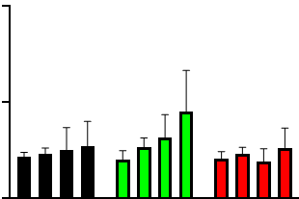
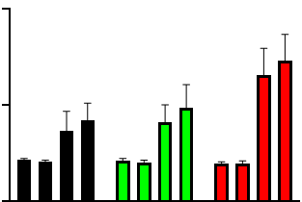
Supplementary Figure 1
A
WT
B
WT
L370F
L370F
Sens
Emax
150
Y537S
150
Y537S
Sens
Emax
Sens
Emax
Sens
Emax
Sens
Emax
Sens
Emax
ERE Activity
ERα Levels
75
75
0
+
0
-
+
-
+
-
+
-
+
-
+
-
MCF-7
+
-
+
-
+
-
+
-
+
-
+
-
-
MCF-7
+
-
+
-
+
-
+
-
+
-
+
HEK293
-
+
-
+
-
+
-
+
-
+
-
+
HEK293

Slide 2
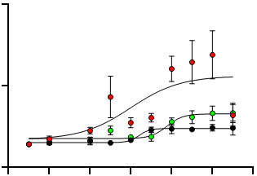
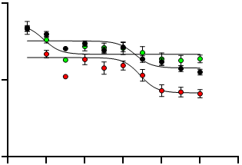
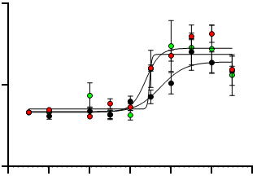


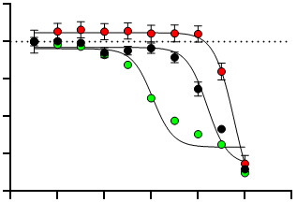
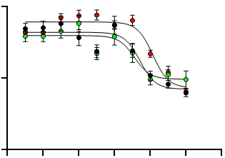
Supplementary Figure 2
A
Log[Tam]
A’
HEK293-WT
-
-14
-12
-11
-10
-9
-8
-7
-6
-5
HEK293-L370F
ERα
700
HEK293-Y537S
WT
Vinculin
ERα Levels
(% on CTR)
ERα
350
L370F
Vinculin
Y537S
ERα
0
-14
-12
-10
-8
-6
-4
Vinculin
Log [Tam]
B
HEK293-WT
HEK293-L370F
120
HEK293-Y537S
ERE-NLuc
(RLU - % on 0)
60
0
-14
-12
-10
-8
-6
-4
Log [Tam]
C
Log[Tam]
C’
MCF-7
-
-14
-12
-11
-10
-9
-8
-7
-6
-5
L370F
ERα
300
Y537S
MCF-7
Vinculin
ERα
ERα Levels
(% on CTR)
L370F
150
Vinculin
Y537S
ERα
0
-14
-12
-10
-8
-6
-4
Vinculin
Log [Tam]
D
E
MCF-7
MCF-7
L370F
L370F
1.0
Y537S
120.0
Y537S
0.0
-1.0
Normalized CI
(Tam Effect CTR MAX)
ERE-Nluc
(RLU - % on 0)
-2.0
60.0
-3.0
-4.0
-12
-10
-8
-6
-4
-2
0.0
-14
-12
-10
-8
-6
-4
Log [Tam]
Log [Tam]

Slide 3
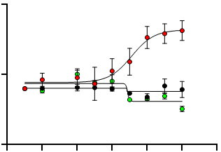
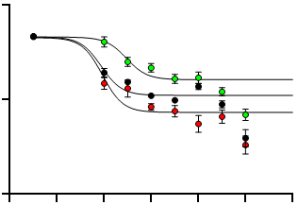
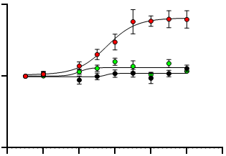
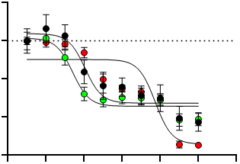
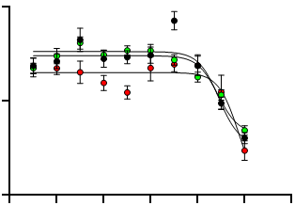
Supplementary Figure 3
A
Log[Laso]
A’
HEK293-WT
-
-14
-12
-11
-10
-9
-8
-7
-6
HEK293-L370F
ERα
250
HEK293-Y537S
WT
Vinculin
ERα Levels
(% on CTR)
ERα
125
L370F
Vinculin
Y537S
ERα
0
-14
-12
-10
-8
-6
-4
Vinculin
Log [Laso]
B
HEK293-WT
HEK293-L370F
120
HEK293-Y537S
ERE-NLuc
(RLU - % on 0)
60
0
-14
-12
-10
-8
-6
-4
Log [Laso]
C
Log[Laso]
C’
MCF-7
-
-14
-12
-11
-10
-9
-8
-7
-6
L370F
ERα
200
Y537S
MCF-7
Vinculin
ERα Levels
(% on CTR)
L370F
ERα
100
Vinculin
Y537S
ERα
0
-14
-12
-10
-8
-6
-4
Vinculin
Log [Laso]
D
E
MCF-7
MCF-7
L370F
L370F
1.0
Y537S
150.0
Y537S
0.0
Normalized CI
(Laso Effect CTR MAX)
ERE-Nluc
(RLU - % on 0)
-1.0
75.0
-2.0
-3.0
-12
-10
-8
-6
-4
-2
0.0
-14
-12
-10
-8
-6
-4
Log [Laso]
Log [Laso]

Slide 4
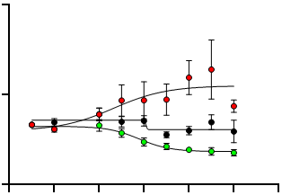
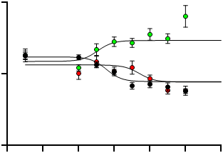
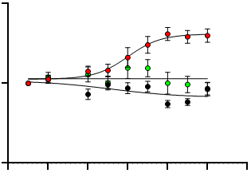
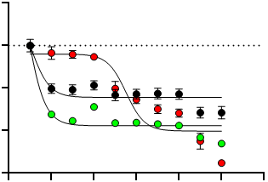
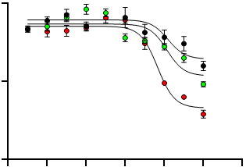
Supplementary Figure 4
A
Log[Ralo]
A’
HEK293-WT
-
-14
-12
-11
-10
-9
-8
-7
-6
HEK293-L370F
ERα
300
HEK293-Y537S
WT
Vinculin
ERα Levels
(% on CTR)
ERα
150
L370F
Vinculin
ERα
0
-14
-12
-10
-8
-6
-4
Y537S
Vinculin
Log [Ralo]
B
HEK293-WT
HEK293-L370F
120
HEK293-Y537S
ERE-NLuc
(RLU - % on 0)
60
0
-14
-12
-10
-8
-6
-4
Log [Raloo]
C
Log[Ralo]
C’
MCF-7
-
-14
-12
-11
-10
-9
-8
-7
-6
L370F
ERα
200
Y537S
MCF-7
Vinculin
ERα Levels
(% on CTR)
L370F
ERα
100
Vinculin
Y537S
ERα
0
-14
-12
-10
-8
-6
-4
Vinculin
Log [Ralo]
D
E
MCF-7
MCF-7
L370F
L370F
1.0
Y537S
150.0
Y537S
0.0
Normalized CI
(Ralo Effect CTR MAX)
ERE-Nluc
(RLU - % on 0)
-1.0
75.0
-2.0
-3.0
-12
-10
-8
-6
-4
-2
0.0
-14
-12
-10
-8
-6
-4
Log [Ralo]
Log [Ralo]

Slide 5
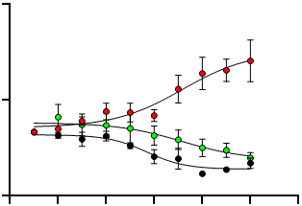
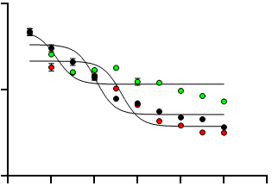
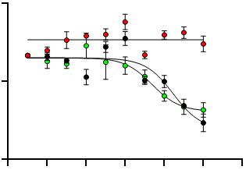
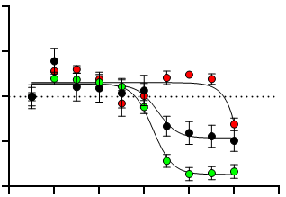
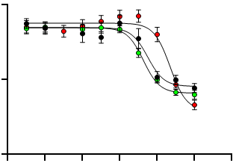
Log[Ela]
Supplementary Figure 5
A
-
-14
-13
-12
-11
-10
-9
-8
-7
-6
A’
HEK293-WT
ERα
HEK293-L370F
WT
300
HEK293-Y537S
Vinculin
ERα
ERα Levels
(% on CTR)
L370F
Vinculin
150
Y537S
ERα
0
Vinculin
-14
-12
-10
-8
-6
-4
Log [Ela]
B
HEK293-WT
HEK293-L370F
120
HEK293-Y537S
ERE-NLuc
(RLU - % on 0)
60
0
-14
-12
-10
-8
-6
-4
Log [Ela]
C
Log[Ela]
C’
MCF-7
-
-14
-12
-11
-10
-9
-8
-7
-6
L370F
ERα
200
Y537S
MCF-7
Vinculin
ERα Levels
(% on CTR)
ERα
100
L370F
Vinculin
ERα
0
-14
-12
-10
-8
-6
-4
Y537S
Vinculin
Log [Ela]
D
E
MCF-7
MCF-7
L370F
L370F
10.0
Y537S
Y537S
5.0
120.0
Normalized CI
(Ela Effect CTR MAX)
0.0
ERE-Nluc
(RLU - % on 0)
-5.0
60.0
-10.0
-14
-12
-10
-8
-6
-4
0.0
Log [Ela]
-14
-12
-10
-8
-6
-4
Log [Ela]

Slide 6
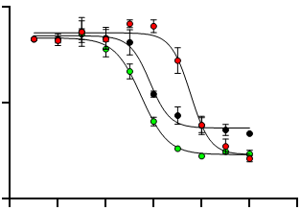
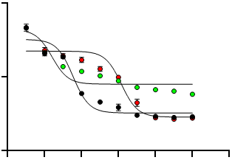
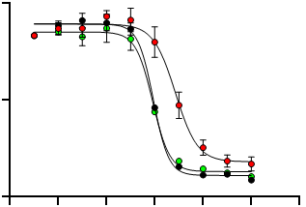
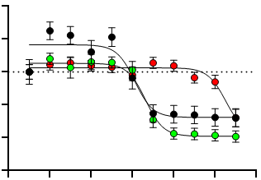
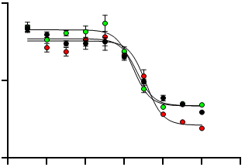
Log[Cami]
Supplementary Figure 6
HEK293-WT
A
-
-14
-13
-12
-11
-10
-9
-8
-7
-6
A’
HEK293-L370F
ERα
120
HEK293-Y537S
WT
Vinculin
ERα
ERα Levels
(% on CTR)
L370F
Vinculin
60
Y537S
ERα
0
Vinculin
-14
-12
-10
-8
-6
-4
Log [Cami]
B
HEK293-WT
HEK293-L370F
120
HEK293-Y537S
ERE-NLuc
(RLU - % on 0)
60
0
-14
-12
-10
-8
-6
-4
C
C’
Log [Cami]
Log[Cami]
MCF-7
-
-14
-13
-12
-11
-10
-9
-8
-7
-6
L370F
ERα
120
Y537S
MCF-7
Vinculin
ERα Levels
(% on CTR)
L370F
ERα
60
Vinculin
Y537S
ERα
0
-14
-12
-10
-8
-6
-4
Vinculin
Log [Cami]
D
MCF-7
E
MCF-7
L370F
L370F
10.0
Y537S
120.0
Y537S
5.0
0.0
Normalized CI
(Cami Effect CTR MAX)
ERE-Nluc
(RLU - % on 0)
-5.0
60.0
-10.0
-15.0
-14
-12
-10
-8
-6
-4
0.0
-14
-12
-10
-8
-6
-4
Log [Cami]
Log [Cami]

Slide 7
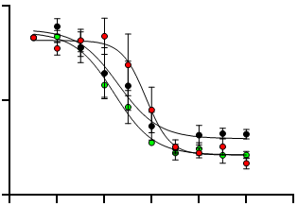
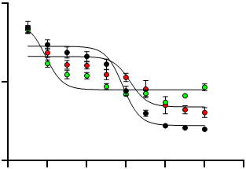
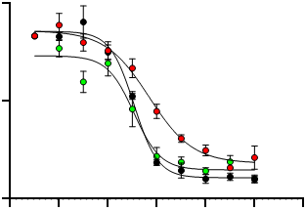
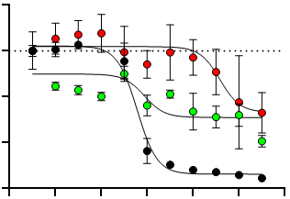
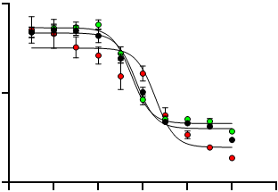
Log[Gire]
Supplementary Figure 7
A
-
-14
-13
-12
-11
-10
-9
-8
-7
-6
A’
ERα
HEK293-WT
WT
HEK293-L370F
Vinculin
120
HEK293-Y537S
L370F
ERα
ERα Levels
(% on CTR)
Vinculin
60
Y537S
ERα
0
Vinculin
-14
-12
-10
-8
-6
-4
B
Log [Gire]
HEK293-WT
HEK293-L370F
120
HEK293-Y537S
ERE-NLuc
(RLU - % on 0)
60
0
-14
-12
-10
-8
-6
-4
Log [Gire]
C
C’
MCF-7
Log[Gire]
L370F
-
-14
-13
-12
-11
-10
-9
-8
-7
-6
120
Y537S
MCF-7
ERα
Vinculin
ERα Levels
(% on CTR)
L370F
ERα
60
Vinculin
Y537S
ERα
0
-14
-12
-10
-8
-6
-4
Vinculin
Log [Gire]
D
MCF-7
E
MCF-7
L370F
L370F
5.0
Y537S
120.0
Y537S
0.0
Normalized CI
(Gire Effect CTR MAX)
ERE-Nluc
(RLU - % on 0)
-5.0
60.0
-10.0
-15.0
-14
-12
-10
-8
-6
-4
0.0
-14
-12
-10
-8
-6
-4
Log [Gire]
Log [Gire]

Slide 8
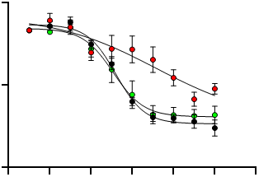
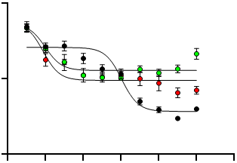
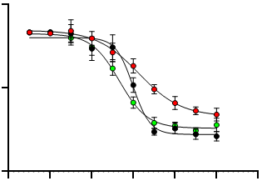
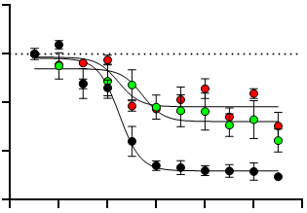
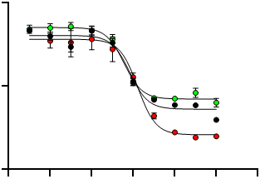
Log[GDC]
Supplementary Figure 8
HEK293-WT
A
-
-14
-13
-12
-11
-10
-9
-8
-7
-6
A’
HEK293-L370F
ERα
120
HEK293-Y537S
WT
Vinculin
ERα Levels
(% on CTR)
ERα
60
L370F
Vinculin
Y537S
ERα
0
-14
-12
-10
-8
-6
-4
Vinculin
Log [GDC]
B
HEK293-WT
HEK293-L370F
120
HEK293-Y537S
ERE-NLuc
(RLU - % on 0)
60
0
-14
-12
-10
-8
-6
-4
Log [GDC]
C
Log[GDC]
C’
MCF-7
-
-14
-13
-12
-11
-10
-9
-8
-7
-6
L370F
ERα
120
Y537S
MCF-7
Vinculin
ERα Levels
(% on CTR)
ERα
60
L370F
Vinculin
ERα
0
-14
-12
-10
-8
-6
-4
Y537S
Vinculin
Log [GDC]
D
MCF-7
E
MCF-7
L370F
L370F
5.0
Y537S
120.0
Y537S
0.0
ERE-Nluc
(RLU - % on 0)
Normalized CI
(GDC Effect CTR MAX)
60.0
-5.0
-10.0
-15.0
-14
-12
-10
-8
-6
-4
0.0
-14
-12
-10
-8
-6
-4
Log [GDC]
Log [GDC]

Slide 9
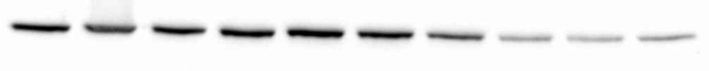
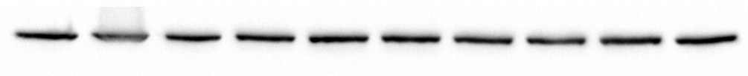
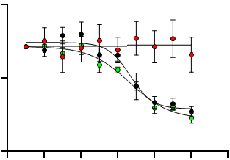
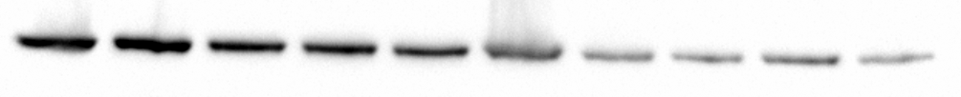
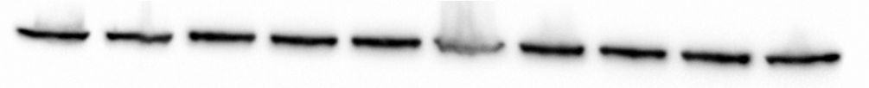
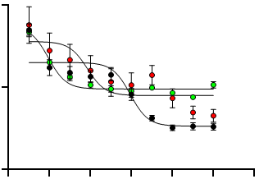
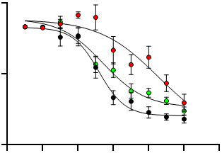
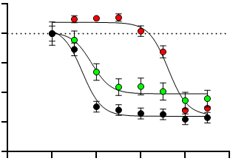
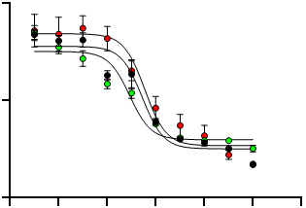
Log[Imlu]
Supplementary Figure 9
A
-
-14
-13
-12
-11
-10
-9
-8
-7
-6
A’
HEK293-WT
HEK293-L370F
ERα
120
HEK293-Y537S
WT
Vinculin
ERα Levels
(% on CTR)
ERα
60
L370F
Vinculin
ERα
0
-14
-12
-10
-8
-6
-4
Y537S
Vinculin
Log [Imlu]
B
HEK293-WT
HEK293-L370F
120
HEK293-Y537S
ERE-NLuc
(RLU - % on 0)
60
0
-14
-12
-10
-8
-6
-4
Log [Imlu]
C
Log[Imlu]
C’
MCF-7
-
-14
-13
-12
-11
-10
-9
-8
-7
-6
L370F
ERα
120
Y537S
MCF-7
Vinculin
ERα Levels
(% on CTR)
ERα
60
L370F
Vinculin
Y537S
ERα
0
-14
-12
-10
-8
-6
-4
Vinculin
Log [Imlu]
D
MCF-7
E
MCF-7
L370F
L370F
5.0
Y537S
120.0
Y537S
0.0
-5.0
Normalized CI
(Imlu Effect CTR MAX)
ERE-Nluc
(RLU - % on 0)
-10.0
60.0
-15.0
-20.0
-12
-10
-8
-6
-4
0.0
Log [Imlu]
-14
-12
-10
-8
-6
-4
Log [Imlu]

Slide 10
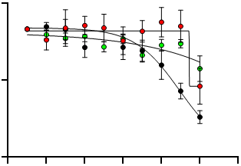
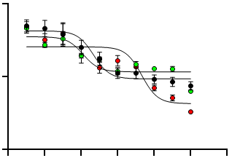
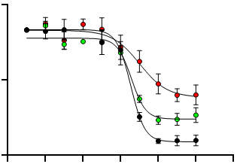
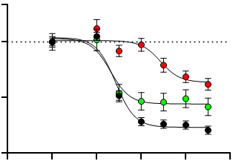

Log[AZD9496]
Supplementary Figure 10
A
-
-14
-13
-12
-11
-10
-9
-8
-7
-6
A’
HEK293-WT
ERα
HEK293-L370F
WT
120
HEK293-Y537S
Vinculin
ERα
ERα Levels
(% on CTR)
L370F
Vinculin
60
Y537S
ERα
0
Vinculin
-14
-12
-10
-8
-6
-4
Log [AZD9496]
B
HEK293-WT
HEK293-L370F
120
HEK293-Y537S
ERE-NLuc
(RLU % on 0)
60
0
-14
-12
-10
-8
-6
-4
Log [AZD9496]
C
Log[AZD9496]
C’
MCF-7
-
-14
-13
-12
-11
-10
-9
-8
-7
-6
L370F
ERα
120
Y537S
MCF-7
Vinculin
ERα Levels
(% on CTR)
L370F
ERα
60
Vinculin
ERα
0
-14
-12
-10
-8
-6
-4
Y537S
Vinculin
Log [AZD9496]
D
MCF-7
E
MCF-7
L370F
L370F
5.0
Y537S
120.0
Y537S
0.0
Normalized CI
(AZD9496 Effect CTR MAX)
ERE-Nluc
(RLU - % on 0)
-7.5
60.0
-15.0
-12
-10
-8
-6
-4
0.0
-14
-12
-10
-8
-6
-4
Log [AZD9496]
Log [AZD946]

Slide 11











Log[H3B]
Supplementary Figure 11
A
-
-13
-11
-10
-9
-8
-7
-6
A’
HEK293-WT
ERα
HEK293-L370F
WT
240
HEK293-Y537S
Vinculin
ERα Levels
(% on CTR)
ERα
120
L370F
Vinculin
0
-14
-12
-10
-8
-6
-4
ERα
Log [H3B]
Y537S
Vinculin
B
HEK293-WT
HEK293-L370F
130
HEK293-Y537S
ERE-NLuc
(RLU - % on 0)
65
0
-14
-12
-10
-8
-6
-4
Log [H3B]
C
Log[H3B]
C’
MCF-7
-
-14
-12
-11
-10
-9
-8
-7
-6
L370F
ERα
300
Y537S
MCF-7
Vinculin
ERα Levels
(% on CTR)
L370F
ERα
150
Vinculin
Y537S
ERα
0
-14
-12
-10
-8
-6
-4
Vinculin
Log [H3B]
D
MCF-7
E
MCF-7
L370F
L370F
5.0
Y537S
Y537S
0.0
300.0
-5.0
Normalized CI
(H3B Effect CTR MAX)
ERE-Nluc
(RLU - % on 0)
-10.0
150.0
-15.0
-20.0
-12
-10
-8
-6
-4
0.0
Log [H3B]
-14
-12
-10
-8
-6
-4
Log [H3B]

Slide 12





Log[BZD]
Supplementary Figure 12
A
-
-14
-13
-12
-11
-10
-9
-8
-7
-6
A’
HEK293-WT
ERα
HEK293-L370F
WT
200
HEK293-Y537S
Vinculin
ERα
ERα Levels
(% on CTR)
L370F
Vinculin
100
Y537S
ERα
0
Vinculin
-14
-12
-10
-8
-6
-4
Log [BZD]
B
HEK293-WT
HEK293-L370F
120
HEK293-Y537S
ERE-NLuc
(RLU - % on 0)
60
0
-14
-12
-10
-8
-6
-4
Log [BZD]
C
Log[BZD]
C’
MCF-7
-
-14
-13
-12
-11
-10
-9
-8
-7
-6
L370F
ERα
200
Y537S
MCF-7
Vinculin
ERα Levels
(% on CTR)
L370F
ERα
100
Vinculin
Y537S
ERα
0
-14
-12
-10
-8
-6
-4
Vinculin
Log [BZD]
D
MCF-7
E
MCF-7
L370F
L370F
6.0
Y537S
120.0
Y537S
3.0
Normalized CI
(BZD Effect CTR MAX)
ERE-Nluc
(RLU - % on 0)
0.0
60.0
-3.0
-6.0
-14
-12
-10
-8
-6
-4
0.0
-14
-12
-10
-8
-6
-4
Log [BZD]
Log [BZD]

Slide 13





Log[Pala]
Supplementary Figure 13
A
-
-12
-11
-10
-9
-8
-7
-6
A’
HEK293-WT
ERα
HEK293-L370F
WT
100
HEK293-Y537S
Vinculin
ERα
ERα Levels
(% on CTR)
L370F
60
Vinculin
ERα
0
-12
-10
-8
-6
-4
Y537S
Vinculin
Log [Pala]
B
HEK293-WT
HEK293-L370F
120
HEK293-Y537S
ERE-NLuc
(RLU - % on 0)
60
0
-14
-12
-10
-8
-6
-4
Log [Pala]
C
Log[Pala]
C’
MCF-7
-
-14
-13
-12
-11
-10
-9
-8
-7
-6
L370F
ERα
120
Y537S
MCF-7
Vinculin
ERα Levels
(% on CTR)
L370F
ERα
60
Vinculin
ERα
0
-14
-12
-10
-8
-6
-4
Y537S
Vinculin
Log [Pala]
D
MCF-7
E
MCF-7
L370F
L370F
5.0
Y537S
Y537S
0.0
120.0
-5.0
Normalized CI
(Pala Effect CTR MAX)
ERE-Nluc
(RLU - % on 0)
-10.0
60.0
-15.0
-20.0
-12
-10
-8
-6
-4
0.0
Log [Pala]
-14
-12
-10
-8
-6
-4
Log [Pala]

Slide 14










Supplementary Figure 14
A
CTR
B
CTR
C
CTR
0.1
0.1
0.1
1
Palbo (µM)
1
Palbo (µM)
1
Palbo (µM)
120
10
120
10
120
10
100
100
100
Normalized CI
(% on CTR MAX)
Normalized CI
(% on CTR MAX)
Normalized CI
(% on CTR MAX)
60
60
60
MCF-7
L370F
Y537S
0
0
0
-20
-20
-20
0
2
4
6
8
10
0
2
4
6
8
10
0
2
4
6
8
10
Time (Days)
Time (Days)
Time (Days)
A’
CTR
B’
CTR
C’
CTR
0.1
0.1
0.1
1
Abe (µM)
1
Abe (µM)
1
Abe (µM)
120
10
120
10
120
10
33
33
33
Normalized CI
(% on CTR MAX)
Normalized CI
(% on CTR MAX)
Normalized CI
(% on CTR MAX)
60
60
60
MCF-7
L370F
Y537S
0
0
0
-20
-20
-20
0
2
4
6
8
10
0
2
4
6
8
10
0
2
4
6
8
10
Time (Days)
Time (Days)
Time (Days)
A’’
CTR
B’’
CTR
C’’
CTR
0.1
0.1
0.1
1
Ribo (µM)
1
Ribo (µM)
1
Ribo (µM)
120
10
120
10
120
10
33
33
33
Normalized CI
(% on CTR MAX)
Normalized CI
(% on CTR MAX)
Normalized CI
(% on CTR MAX)
60
60
60
MCF-7
L370F
Y537S
0
0
0
-20
-20
-20
0
2
4
6
8
10
0
2
4
6
8
10
0
2
4
6
8
10
Time (Days)
Time (Days)
Time (Days)
D
MCF-7
L370F
100nM
120.0
Y537S
°
°
°°°
°°°°
°°
Number of Cells
(% on -)
60.0
0.0
-
+
-
-
-
+
-
-
-
+
-
-
Palbo
-
-
+
-
-
-
+
-
-
-
+
-
Abe
-
-
-
+
-
-
-
+
-
-
-
+
Ribo

Slide 15










Supplementary Figure 15
A
Log[Palbo]
A’
MCF-7
-
-11
-10
-9
-8
-7
-6
-5
L370F
150
Y537S
MCF-7
ERα
Vinculin
ERα Levels
(% on CTR)
ERα
75
L370F
Vinculin
Y537S
ERα
0
-12
-10
-8
-6
-4
Vinculin
Log [Palbo]
B
B’
Log[Abe]
MCF-7
-
-11
-10
-9
-8
-7
-6
L370F
150
Y537S
MCF-7
ERα
Vinculin
ERα Levels
(% on CTR)
ERα
75
L370F
Vinculin
Y537S
ERα
0
-12
-10
-8
-6
-4
Vinculin
Log [Abe]
C
Log[Ribo]
C’
-
-11
-10
-9
-8
-7
-6
MCF-7
ERα
L370F
MCF-7
200
Y537S
Vinculin
ERα
ERα Levels
(% on CTR)
L370F
100
Vinculin
ERα
0
-12
-10
-8
-6
-4
Y537S
Vinculin
Log [Ribo]

Slide 16



Supplementary Figure 16
A
MCF-7
L370F
250
Y537S
ERENLuc-Promoter Activity
(% on -)
125
0
-
-10
-8
-6
-4
B
Log [Palbo]
MCF-7
L370F
250
Y537S
ERENLuc-Promoter Activity
(% on -)
125
0
-
-10
-8
-6
-4
C
Log [Abe]
MCF-7
L370F
250
Y537S
ERENLuc-Promoter Activity
(% on -)
125
0
-
-10
-8
-6
-4
Log [Ribo]

Slide 17






























Supplementary Figure 17

Slide 18






























Supplementary Figure 18

Slide 19












Supplementary Figure 19

