Slide 1
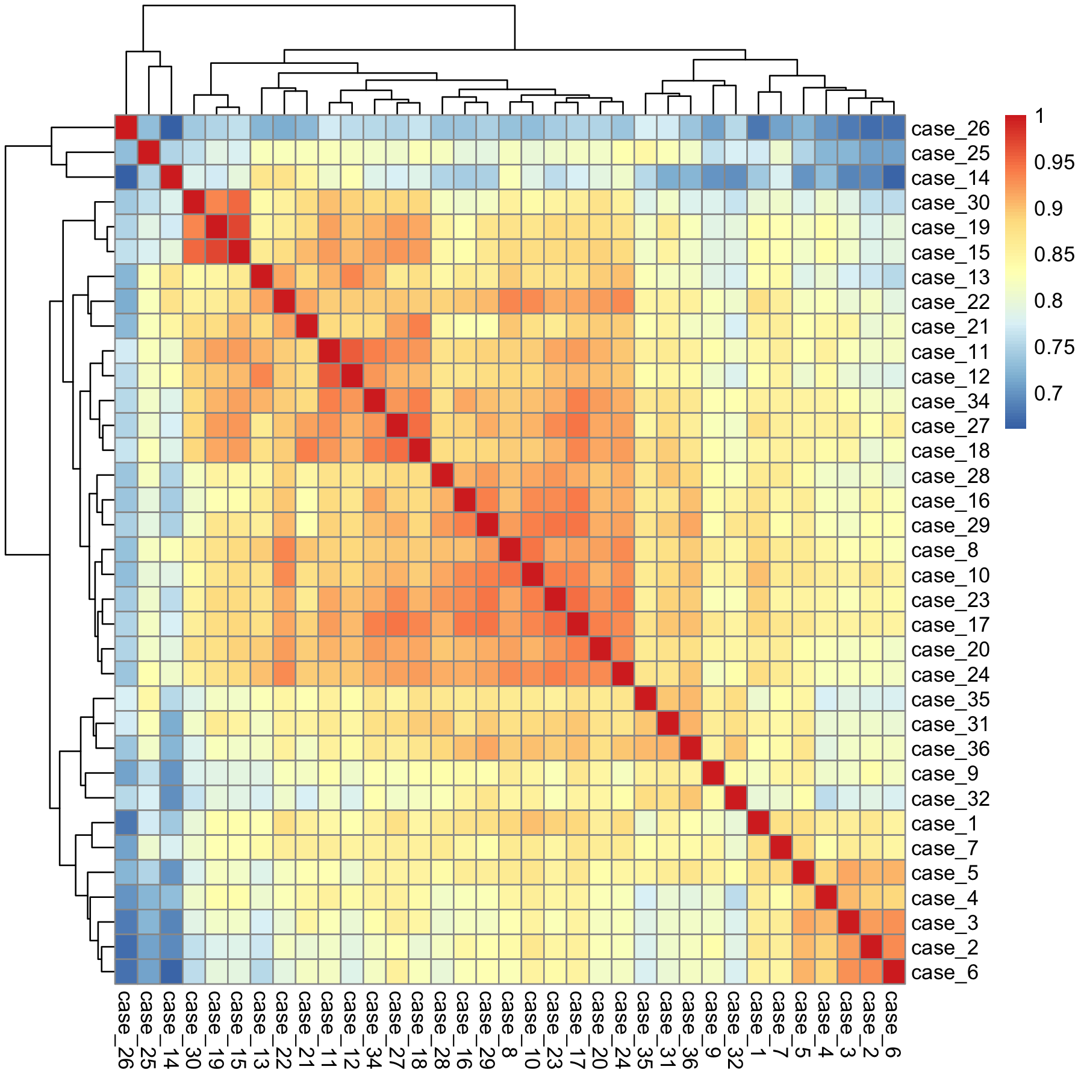
Supplementary Fig S1
Unsupervised clustering of the 35 meningiomas based on the mRNA expression of 770 genes in the nCounter PanCancer Pathways Panel. Note that the oldest seven cases were segregated into a single cluster (cases 1-7).
Case 33 was recurrent tumor of case 30, and was removed from the analysis.

Slide 2
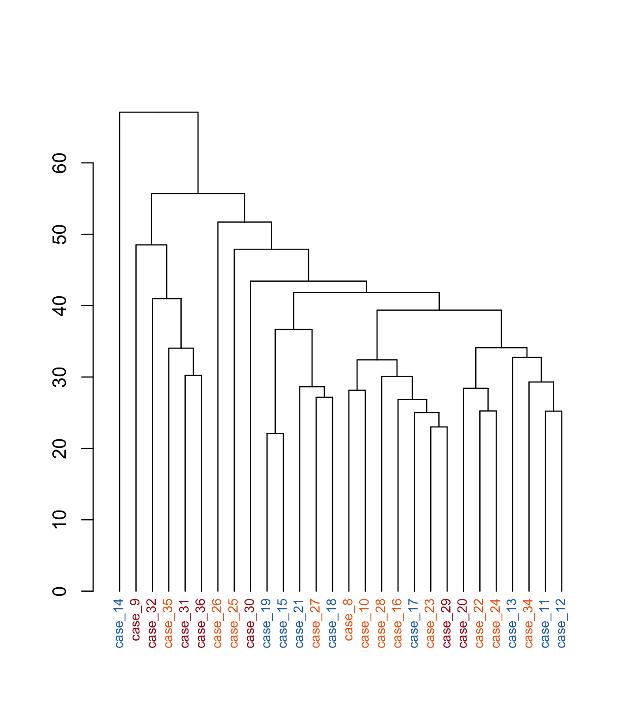
Supplementary Fig S2
Unsupervised clustering of the 28 meningiomas based on the mRNA expression profiling of 770 genes in the nCounter PanCancer Pathways Panel.
Note that the grade 1 tumors were dispersed.

Slide 3
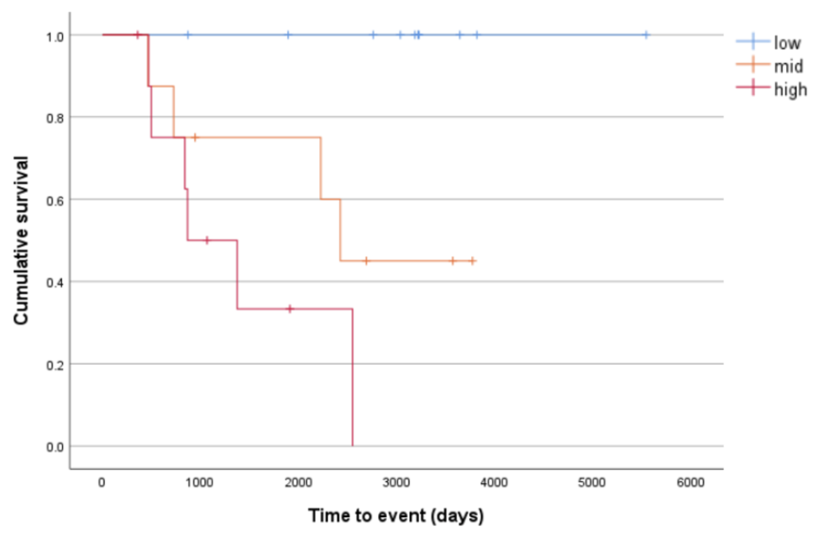
Supplementary Fig S3
Overall survival of the meningioma patients for the Low, Mid, and High group of Cluster M.
The grouping correlated with OS. p=0.0035(log-rank).

Slide 4
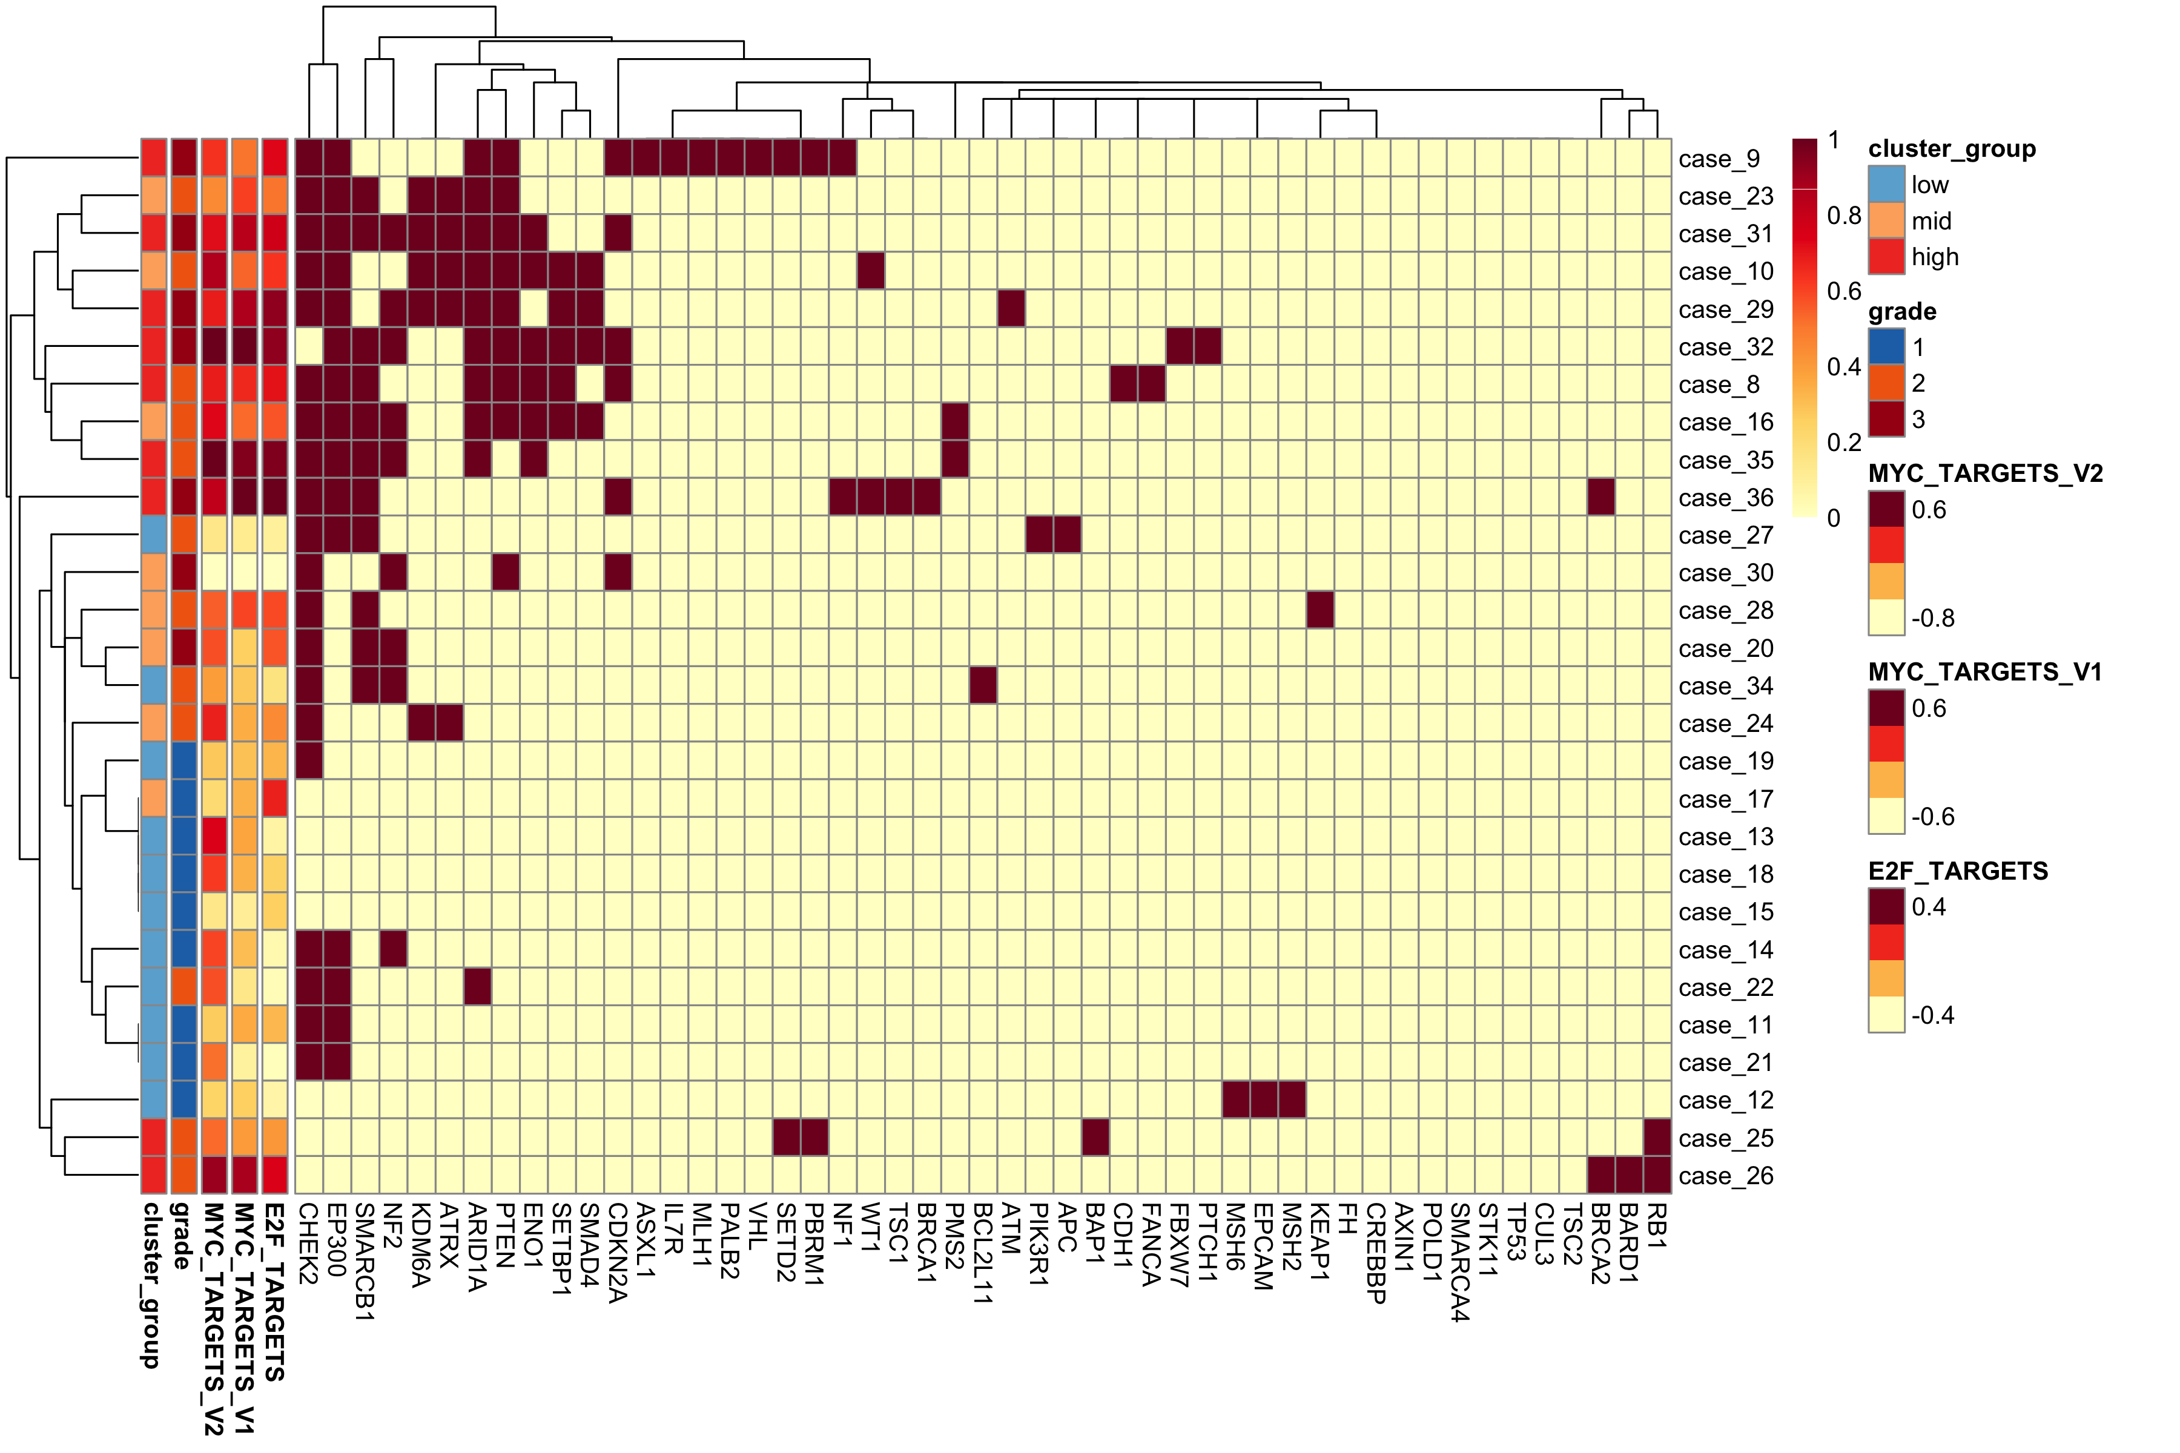
Supplementary Fig S4
Hierarchical clustering based on copy number loss. The cases were divided into two clusters; one was composed of six High and three Mid tumors (red dotted square), and the other was further separated into three, with the largest group composed of ten Low and five Mid tumors (blue dotted square). Note that this clustering was correlated with Cluster M, tumor histological grade, and the enrichment score of MIC targets and E2F targets.

Slide 5
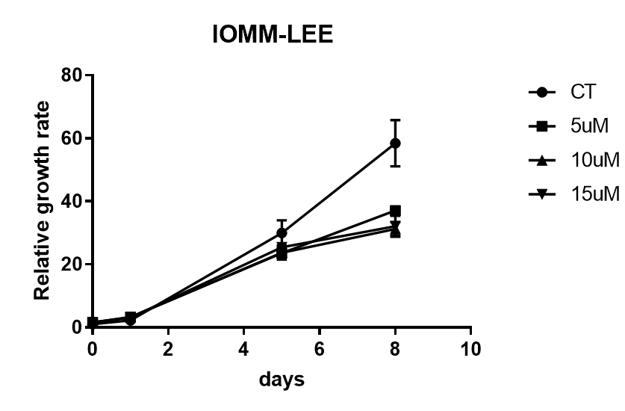
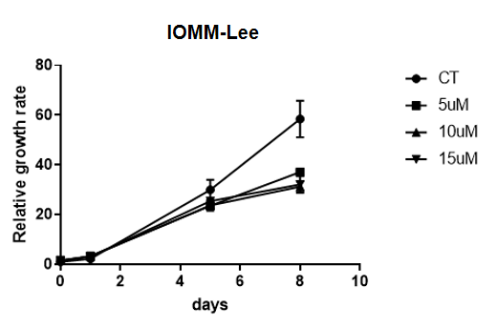
Supplementary Fig S5
WST-8 assay with tazemetostat on meningioma cell lines.
Growth inhibition was stronger in IOMM-Lee than MZ857MM.
IOMM-Lee
**
**
*
* p=0.0002
** p<0.0001
Tazemetostat
Day8
MZ857MM
***
**
*
* p=0.0034
** p=0.0065
*** p=0.0004
Day12
Tazemetostat

Slide 6









Supplementary Fig S6
Cell cycle assay showing that sub-G1 population increased by tazemetostat in all meningioma cell lines.
MZ857MM
50
control
50
tazemetostat
38
1
38
1
HKB-MM
150
control
150
tazemetostat
C ount
25
C ount
25
3
3
113
1
113
1
13
13
2
2
C ount
C ount
75
75
0
0
0
1024 2048
3071
4095
3
3
0
1024 2048
3071
4095
DNA Content (PM2)
100
DNA Content (PM2)
100
38
38
IOMM-Lee
control
tazemetostat
2
2
75
1
75
1
0
0
0
1024 2048
3071
4095
0
1024 2048
3071
4095
DNA Content (PM2)
DNA Content (PM2)
Count
50
Count
50
3
3
25
25
2
2
0
0
0 1024
2048 3071
4095
0 1024
2048 3071
4095
DNA Content (PM2)
DNA Content (PM2)
Notes:
Tazemetostat 添加10日後の cell cycle assay

Slide 7
Supplementary Fig S7
Annexin V assay showing that apoptosis was increased by tazemetostat in meningioma cell lines, especially in IOMM-Lee and HKB-MM.
IOMM-Lee
MZ857MM
control
10e4
15.4% 17.7%
P.I. (RED - HL o g )
10e3
10e2
10e1
60.5% 6.5%
10e0
10e0
10e1 10e2 10e3 10e4
Annexin V (GRN-HLog)
Tazemetostat
10e4
10e3
10e2
10e1
10e0
10e0
10e1 10e2 10e3 10e4

Slide 8
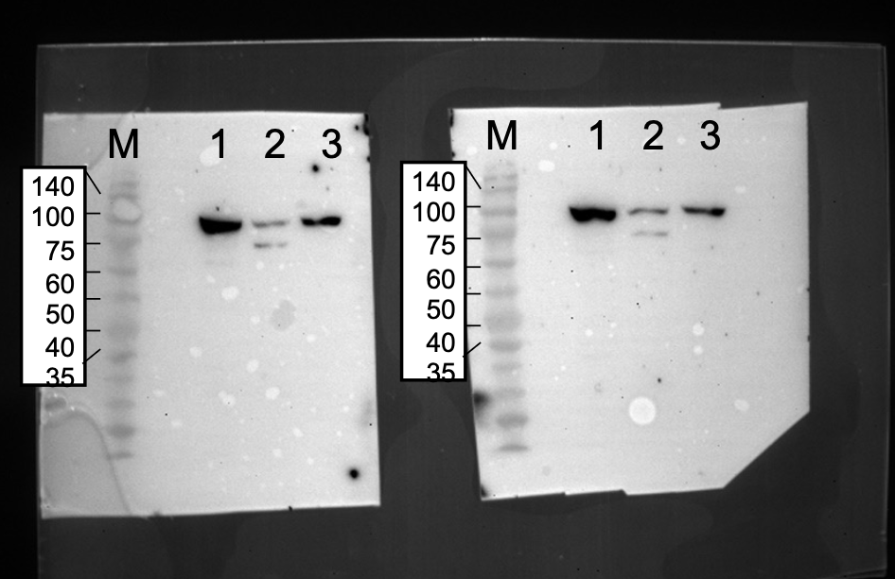
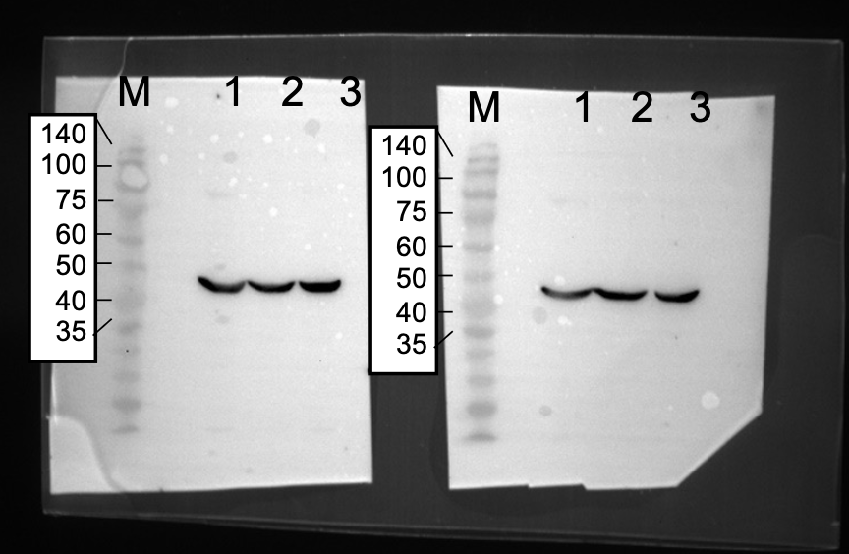
Supplementary Fig S8
Western blot analyses with anti-EZH2 antibody in meningioma cell lines.
Full-length blots/gels (left) and cropped figures (right). Reproducibility was confirmed by making duplicate filters.
M:marker (kDa)
1: IOMM-Lee
2: MZ857MM
3: HKB-MM
1 2 3
anti-EZH2
anti-beta actin
1: IOMM-Lee
2: MZ857MM
3: HKB-MM
1 2 3
anti-EZH2
anti-beta actin
1: IOMM-Lee
2: MZ857MM
3: HKB-MM

Slide 9
Supplementary Fig S9
Fluorescent immunocytochemistry with anti-H3K27me3 and anti-EZH2.
IOMM-Lee after 5 days of treatment with 10uM of tazemetostat.
H3K27me3/VIM/DAPI IOMM-Lee control
H3K27me3/VIM/DAPI IOMM-Lee Taz
EZH2/VIM/DAPI IOMM-Lee Taz

Slide 10
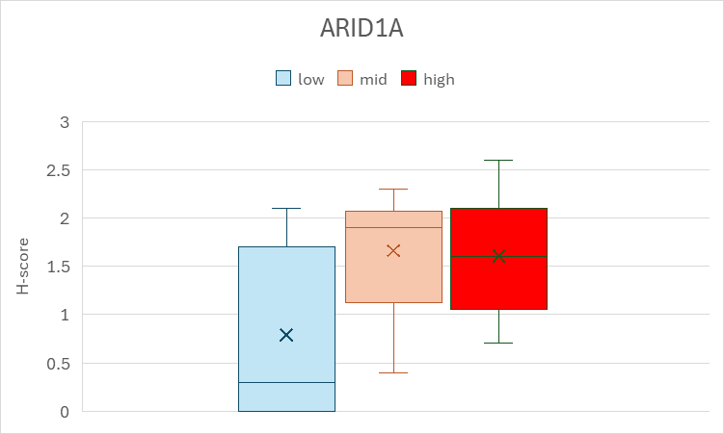
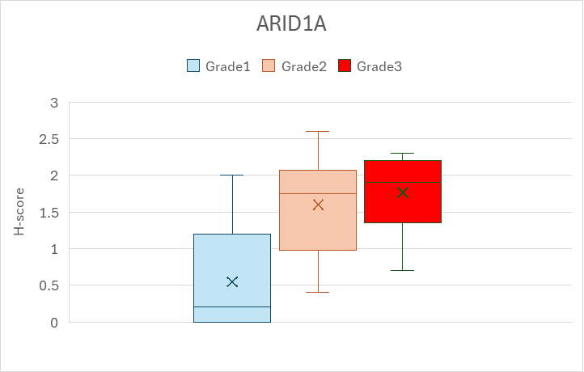
Supplementary Fig S10
Results of immunohistochemistry for ARID1A by Cluster M (left) and histological grade (right)
p=0.05
low-mid 0.08
low-high 0.12
mid-high 0.95
p=0.006
low-mid 0.016
low-high 0.021
mid-high 0.75

Slide 11
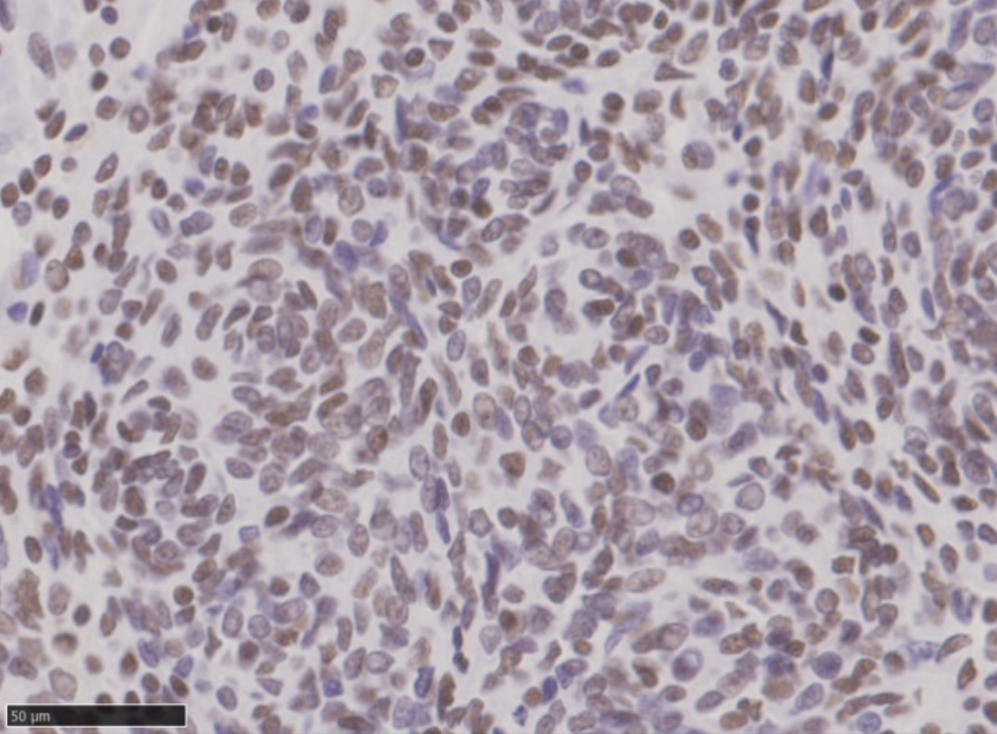
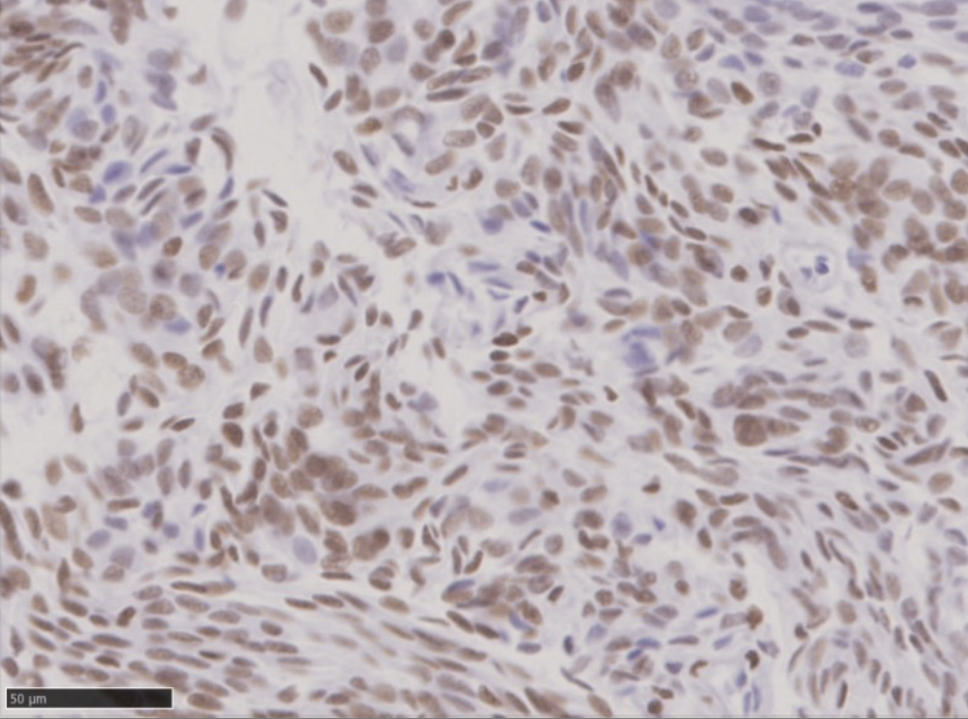
Supplementary Fig S11
Representative microphotographs of immunohistochemistry for ARID1A. Left, case 19(grade 1). Right, case16(grade 2). Bar=50 um.

