Slide 1
Supplemental Figures
Supplemental Figure S1.Identification of metabolism-related genes in HCC. (a, d) Heat map and volcano plot of differently expressed genes (DEGs) in TCGA cohort. (b, e) Heat map and volcano plot of DEGs in ICGC cohort. (c, f) Heat map and volcano plot of DEGs in GSE112790 cohort. (g) Venn diagram of the differential genes from three cohorts identified 457 overlapping DEGs. (h) identification of 100 metabolism-related genes .
Supplemental Figure S2. Construction of a metabolism-related prognostic model in HCC cohort. (a) The univariable cox regression analysis of the metabolism-related genes. Among the 37 metabolism-related genes that are significant to the clinical prognosis of HCC patients, 9 genes predict the poor prognosis and act as risk genes with HR (hazard ratio)＞1, while 28 of them play a positive role in the prognosis of HCC patients with HR＜1.(b-c) LASSO coefficient profiles of 37 genes were related with prognostics. The optimal values of the penalty parameter λ were determined by ten-fold cross-validation.
Supplemental Figure S3. The correlation analysis of the metabolism-related genes with immunity. (a) Correlation between metabolism-related genes and immune genes, (b) Heatmap shows the identification of the immune score in HCC cohort through ssGSEA analysis and the clustering subtypes based on immune scores. (c,d) Acquisition of Metabolism-related genes in the high- and low-immune score groups. (e-h) RiskScore and several risk genes correlate with the immunity groups.
Supplemental Figure S4. The top3 metabolism-related genes correlated with immune infiltrating cells in high(a-c) and low(d-f) immune groups. The immune infiltrating cells include B cell, CD8⁺T cell, CD4⁺T cell, Macrophage, Neutrophil and Dendritic cell.

Slide 2
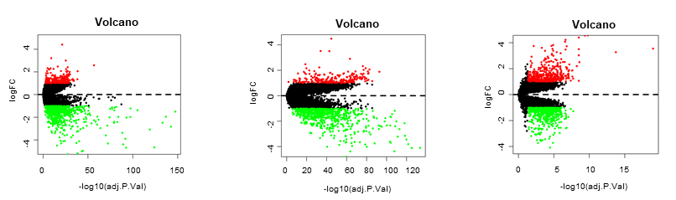
a
b
c
d
e
f
g
h
Supplemental Figure S1

Slide 3
a
b
c
Supplemental Figure S2

Slide 4
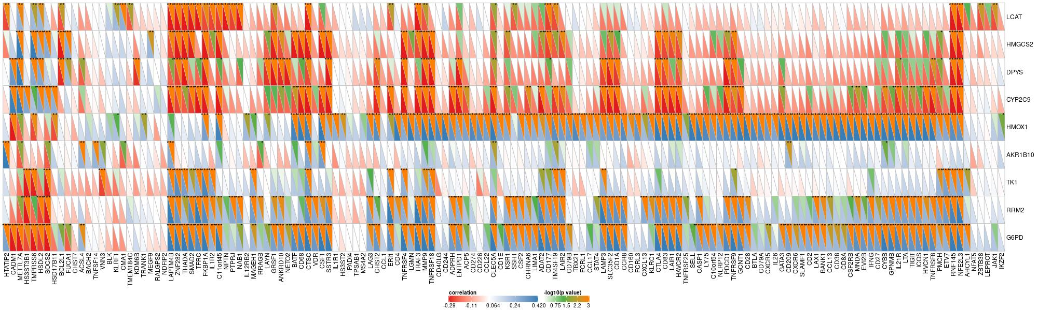
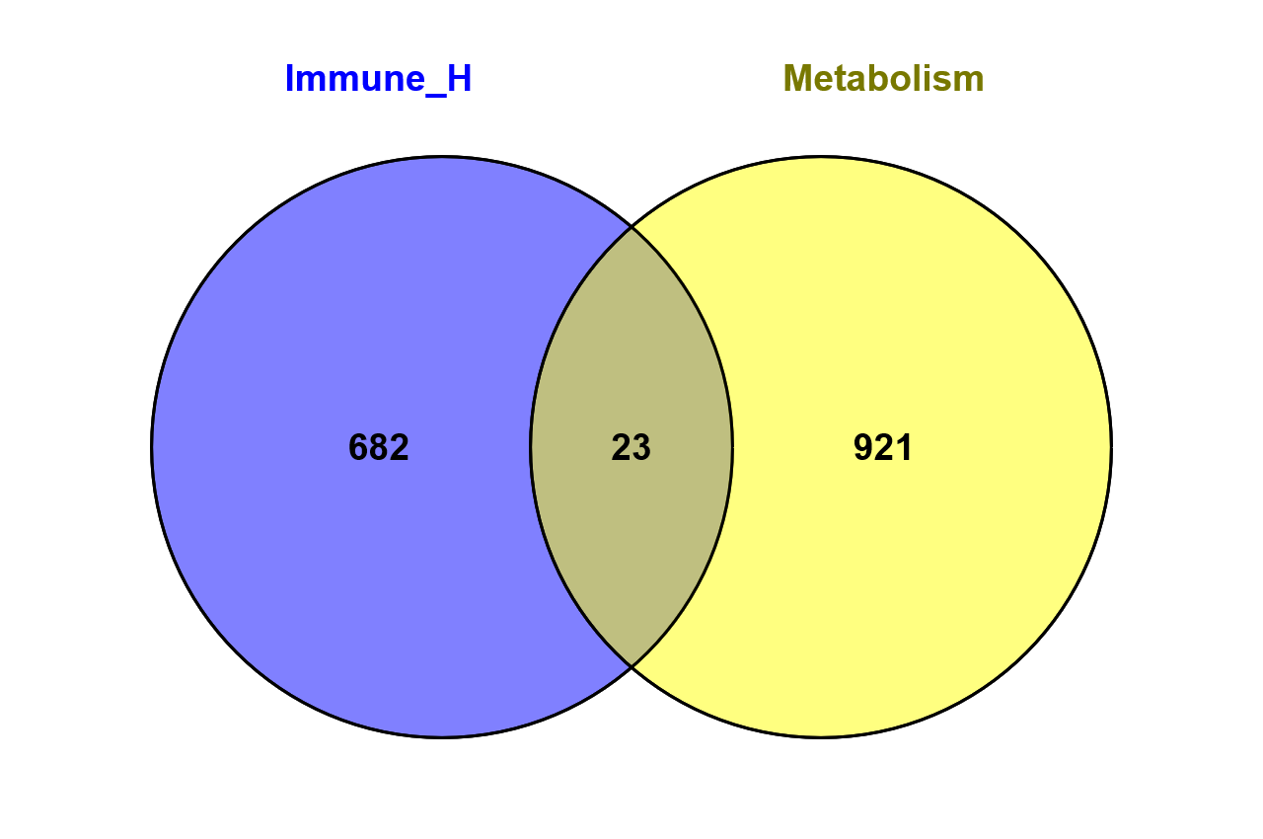

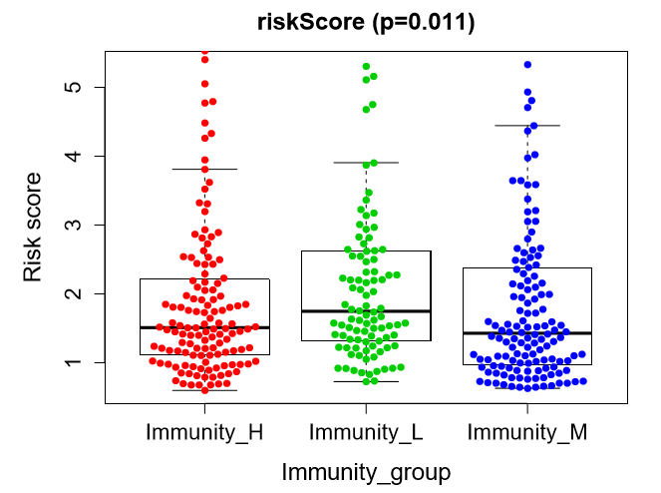
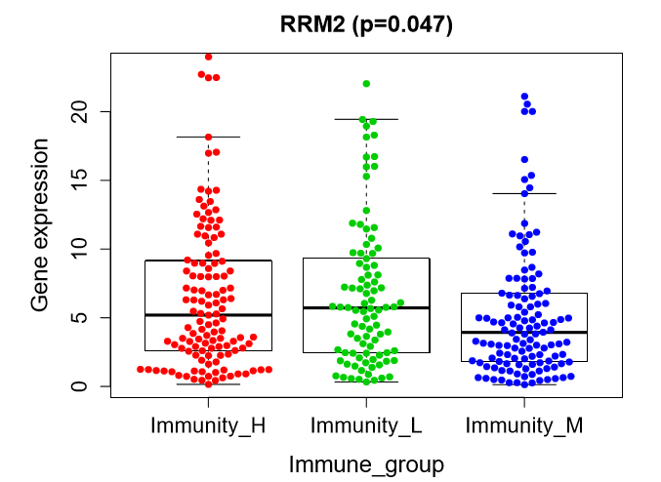
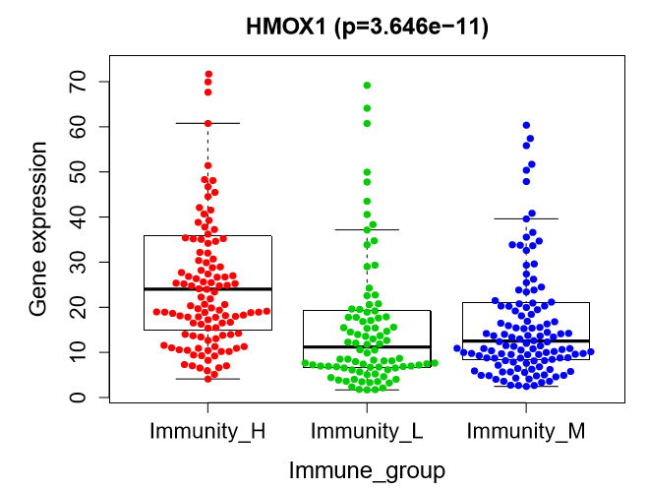
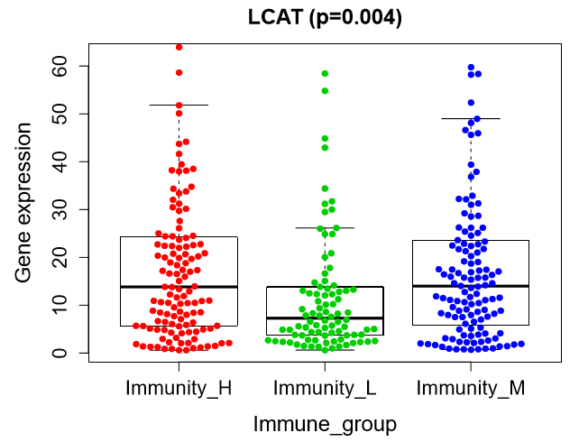
a
b
c
d
e
f
g
h
Supplemental Figure S3

Slide 5
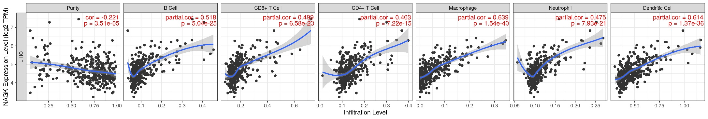
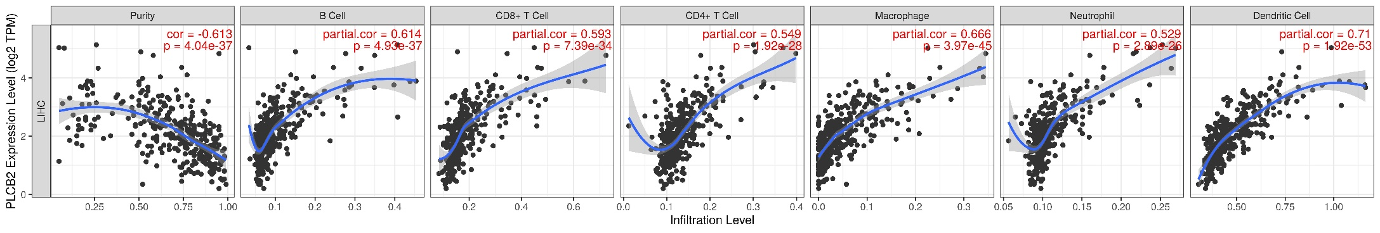
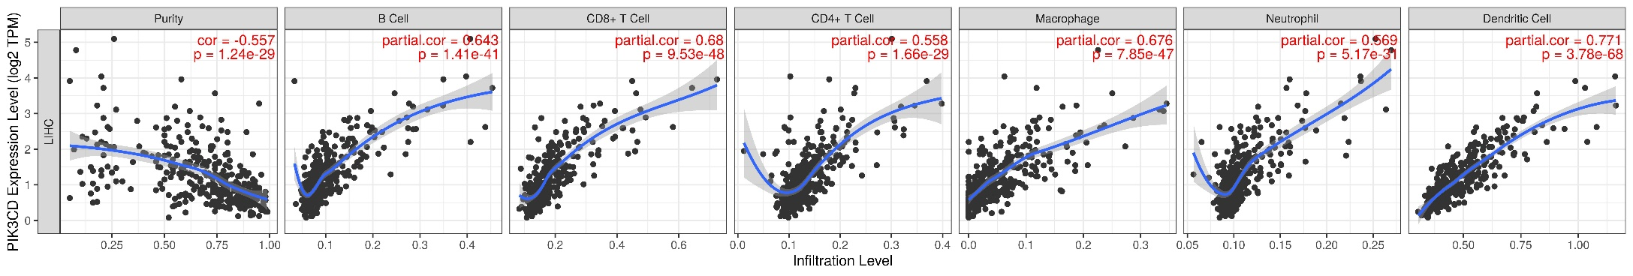
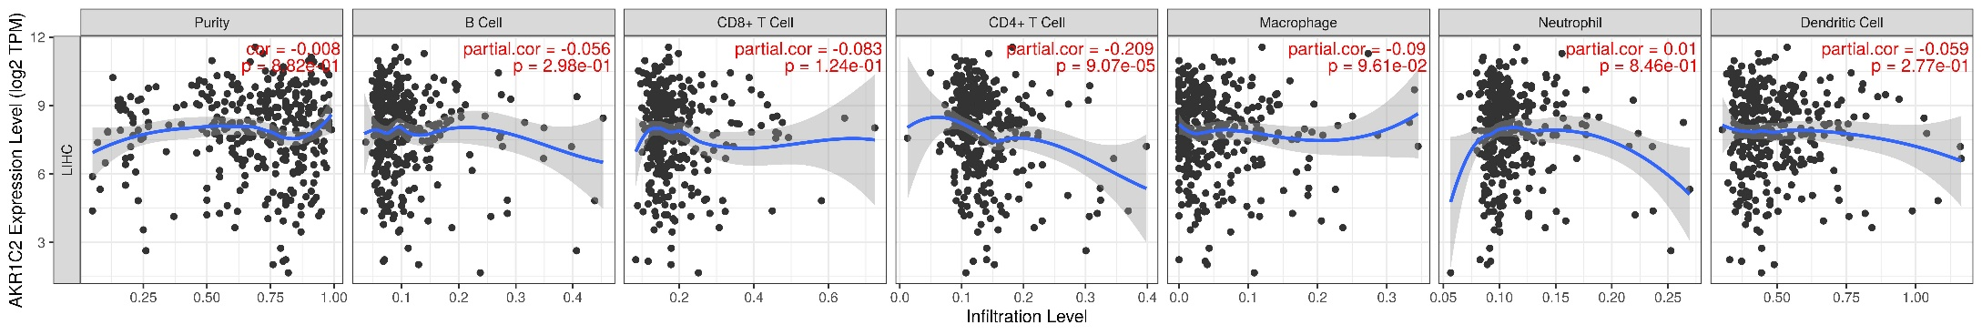
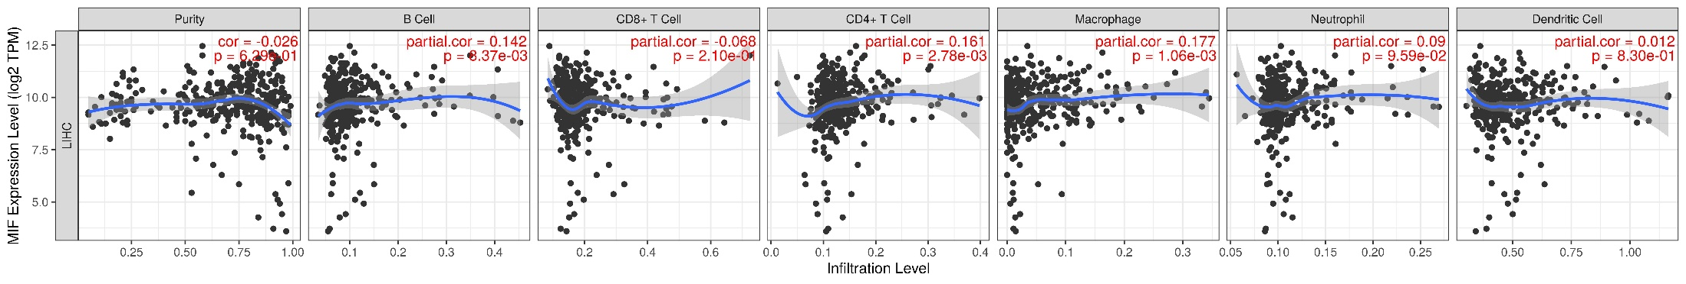
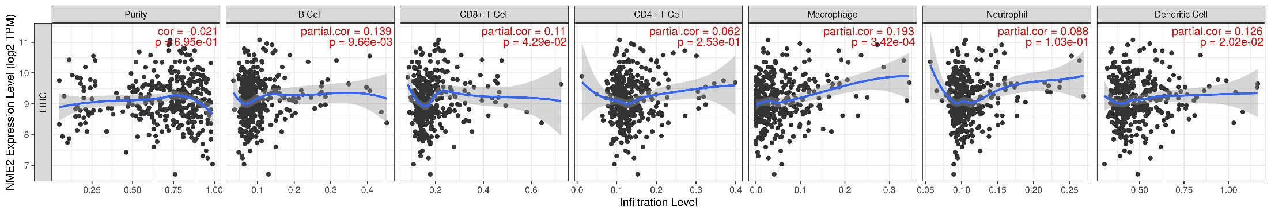
a
b
c
d
e
f
Supplemental Figure S4

