Slide 1
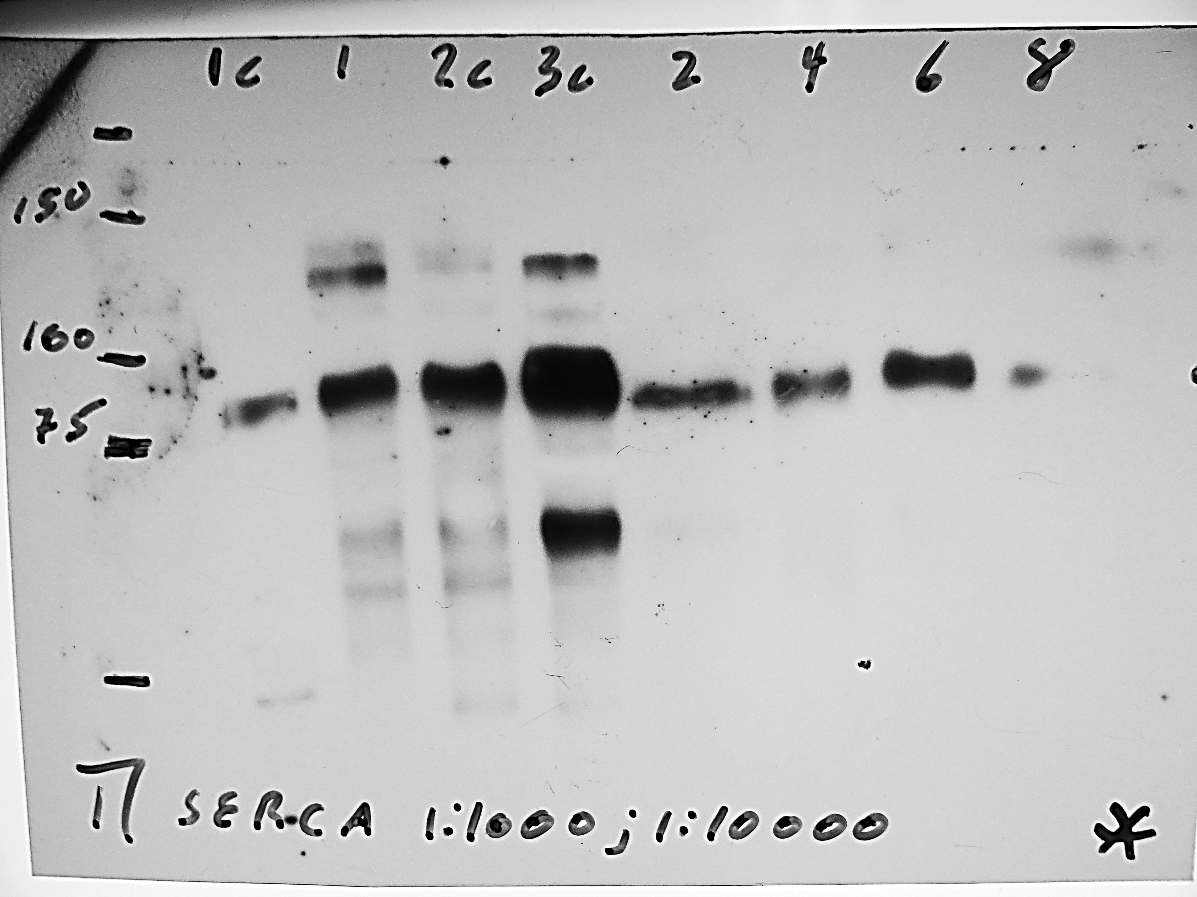
Anti-SERCA2 ATPase (sc-376235)

Slide 2
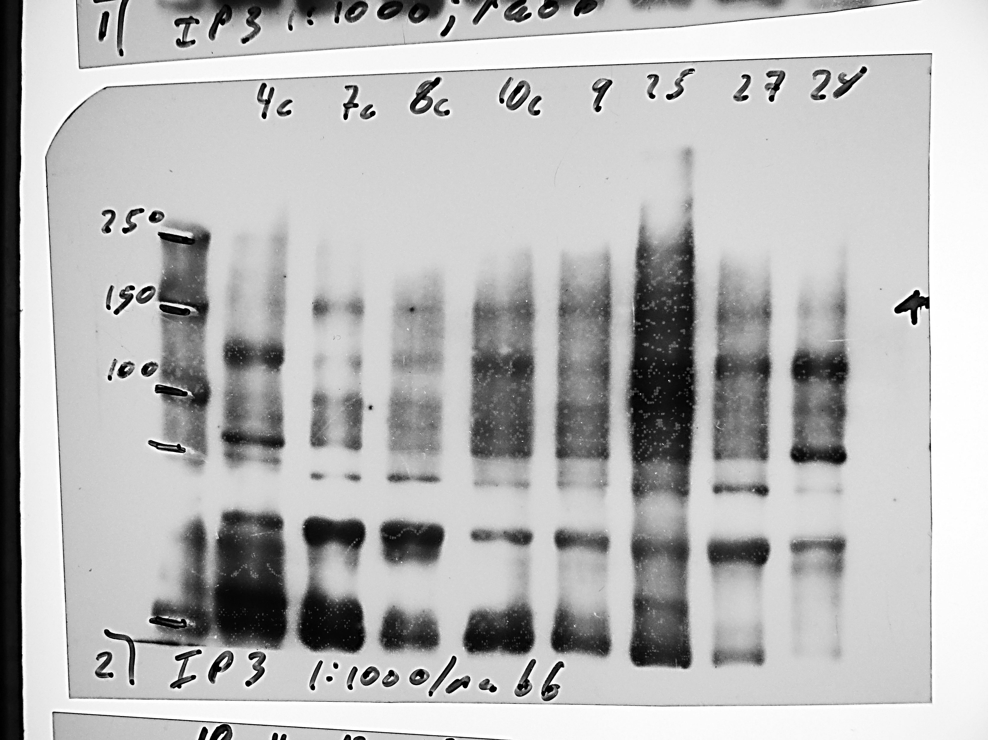
IP3R: (Cat # 8568)

Slide 3
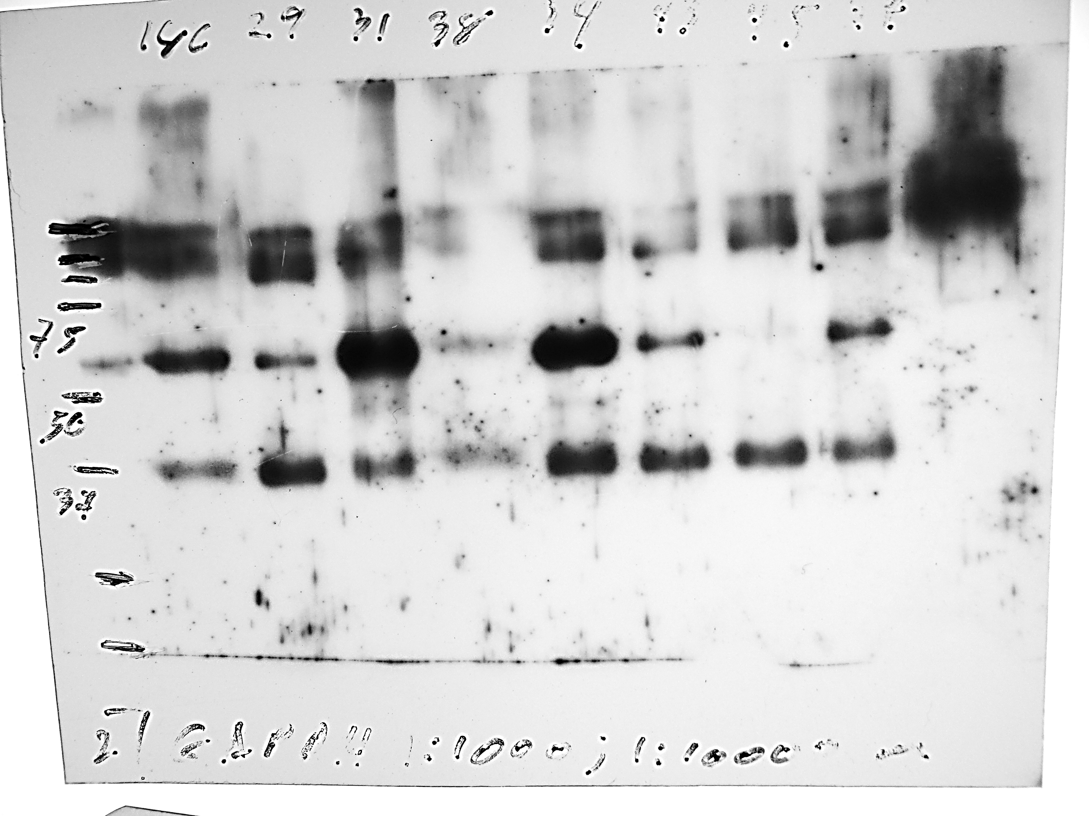
(GAPDH: sc-365062)

Slide 4
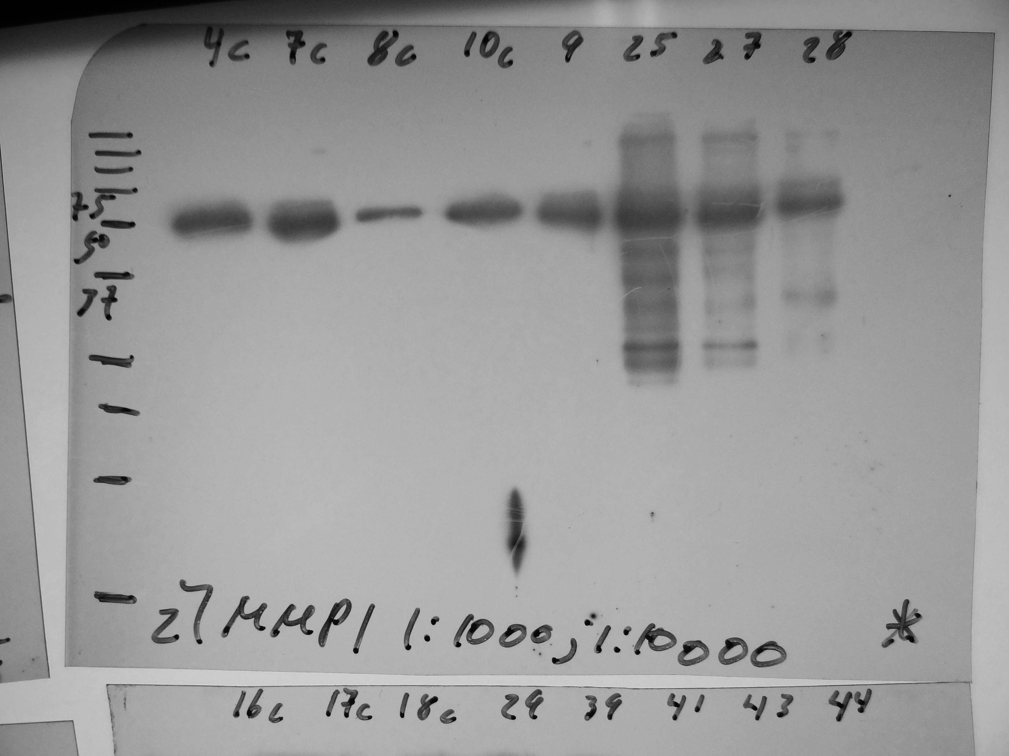
MMP1 (sc-58377)

Slide 5
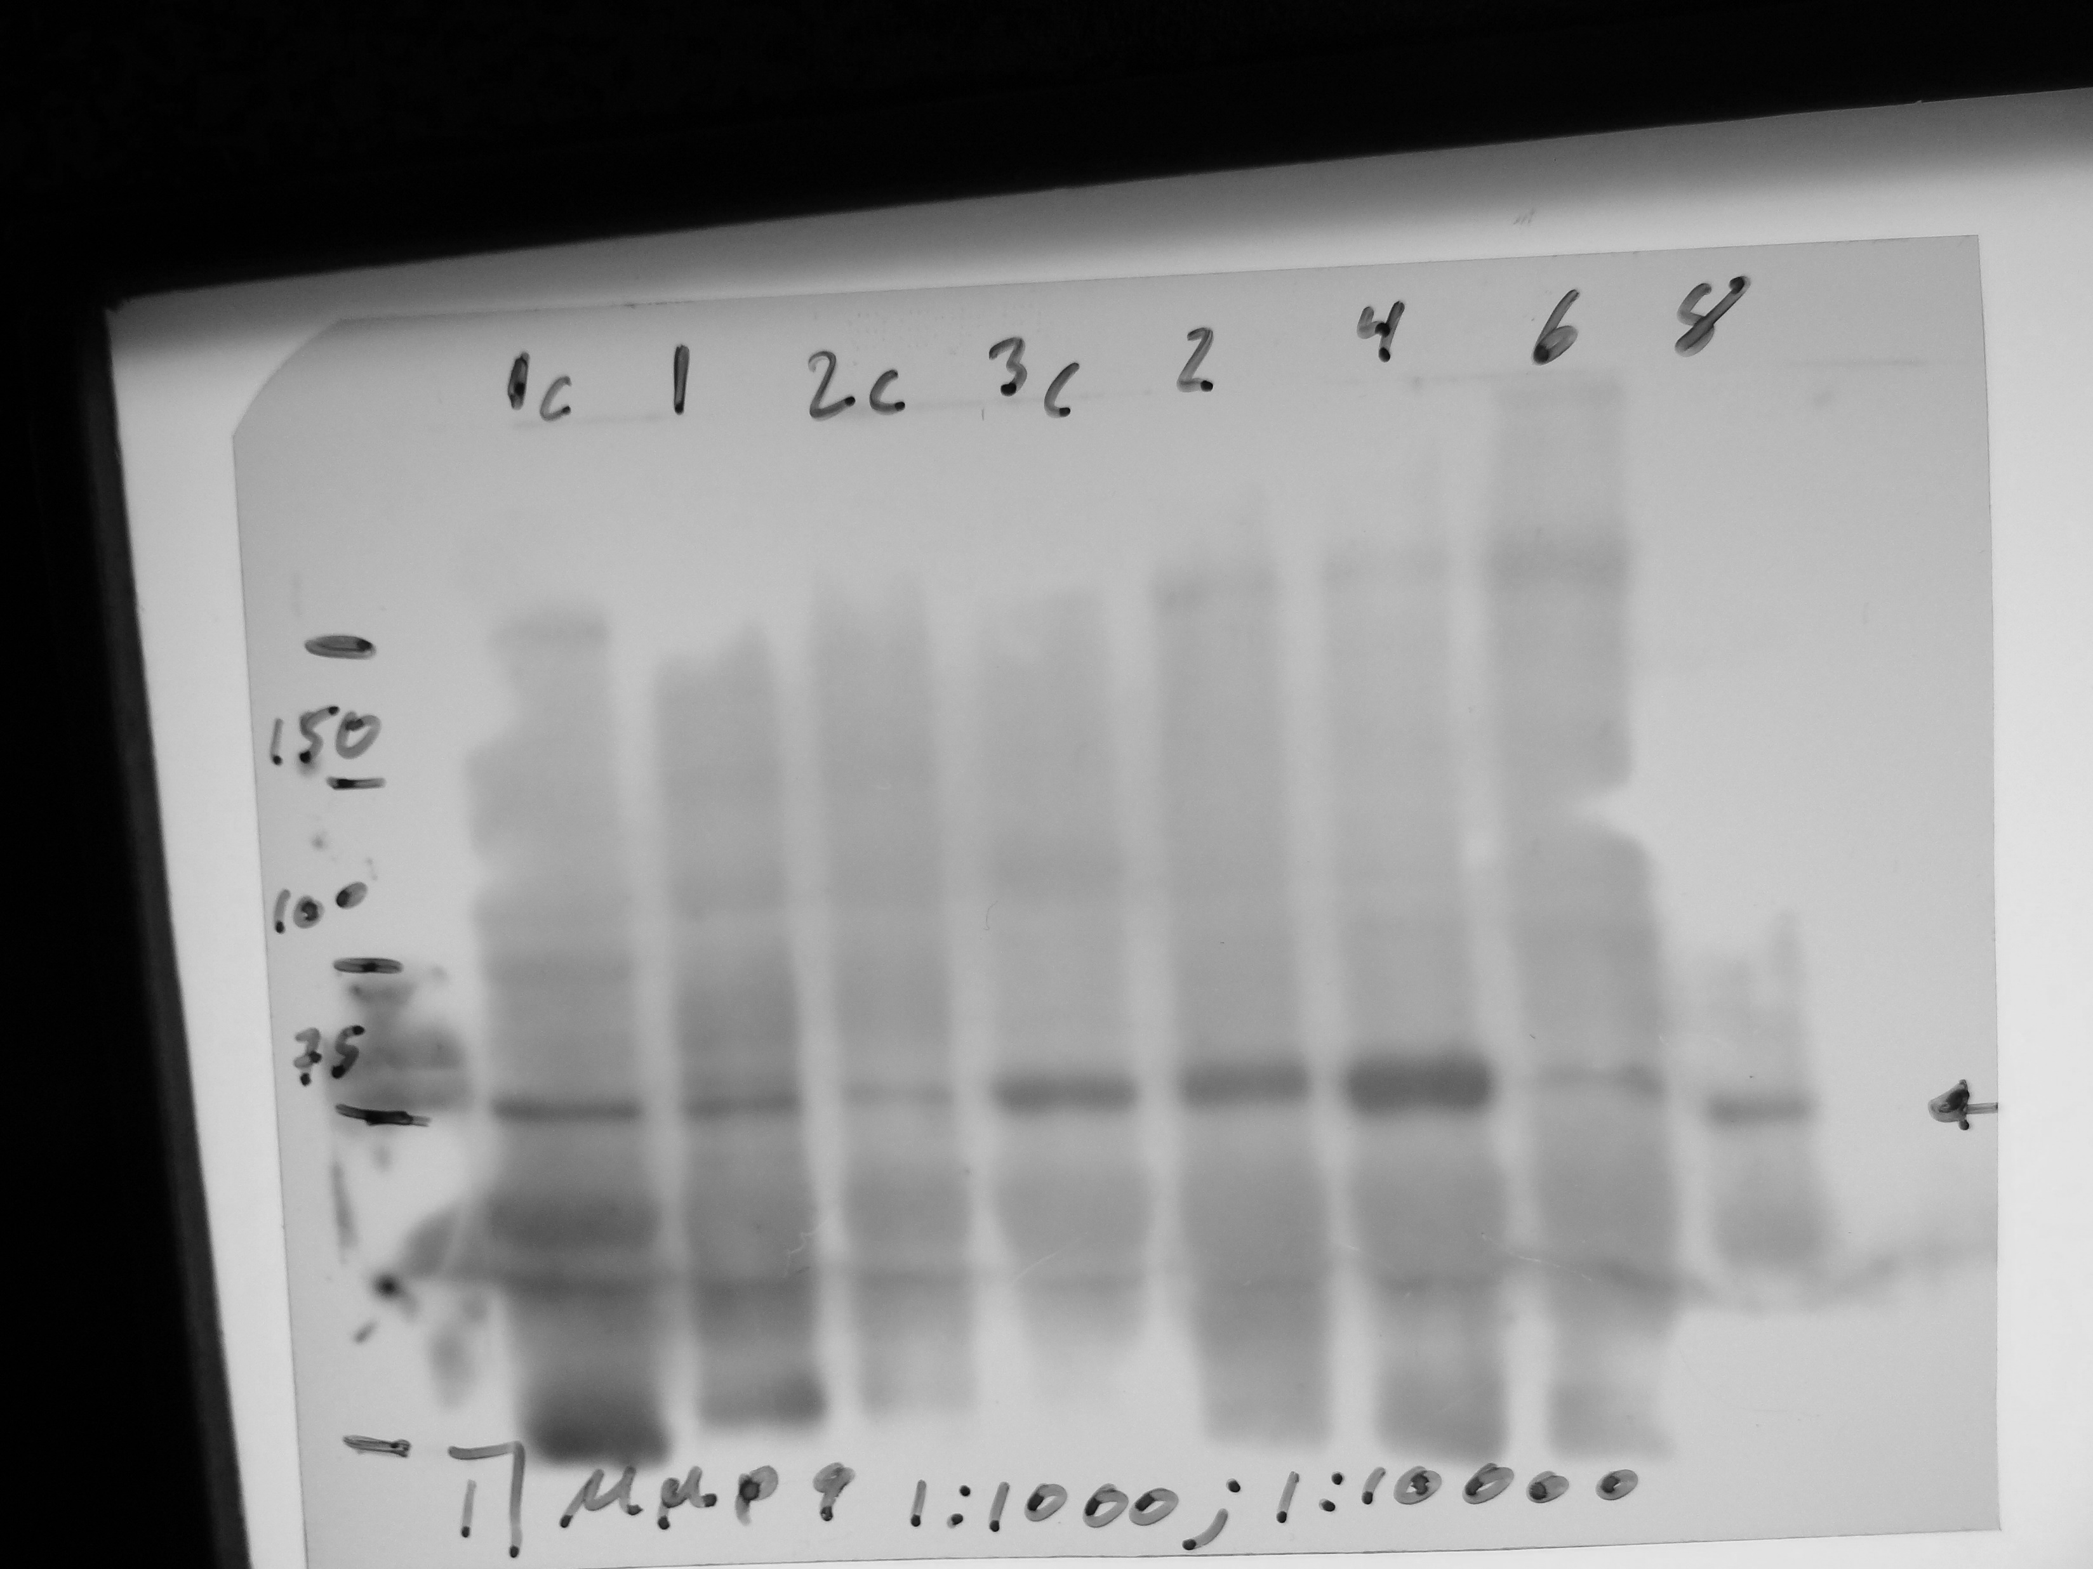
MMP-9 (EP1254 abcam)

Slide 6
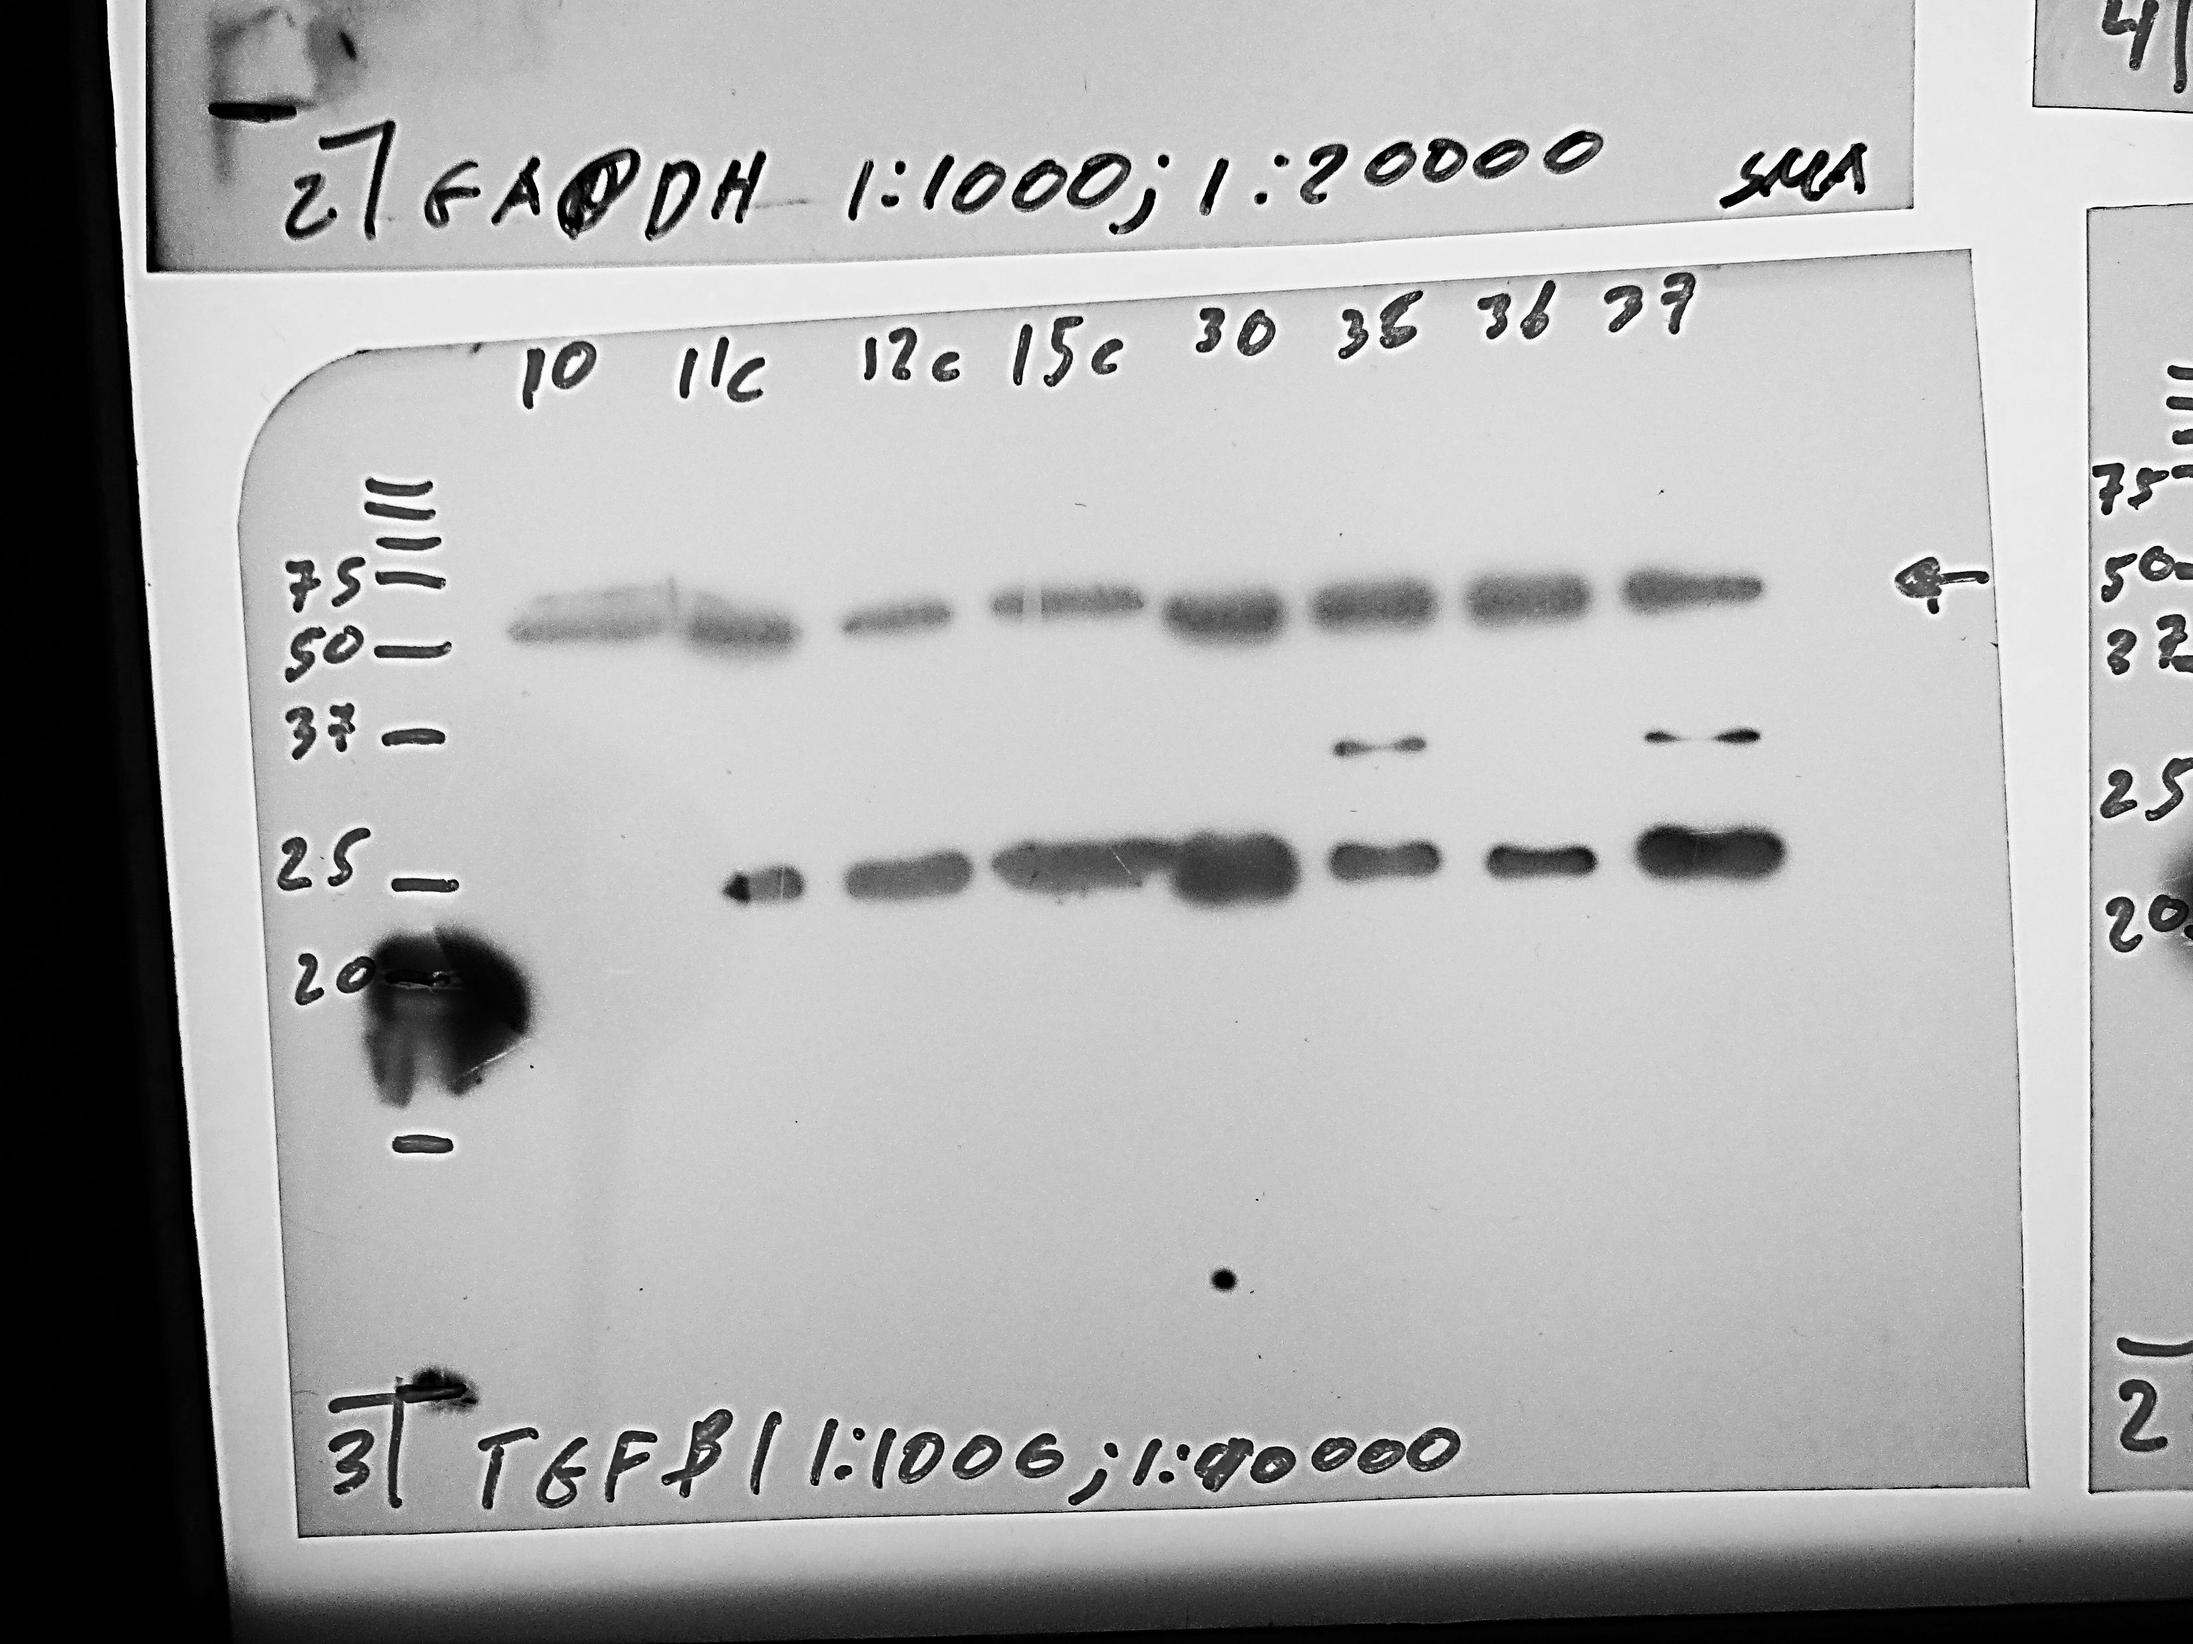
TGF-β1 (sc-52893),

Slide 7
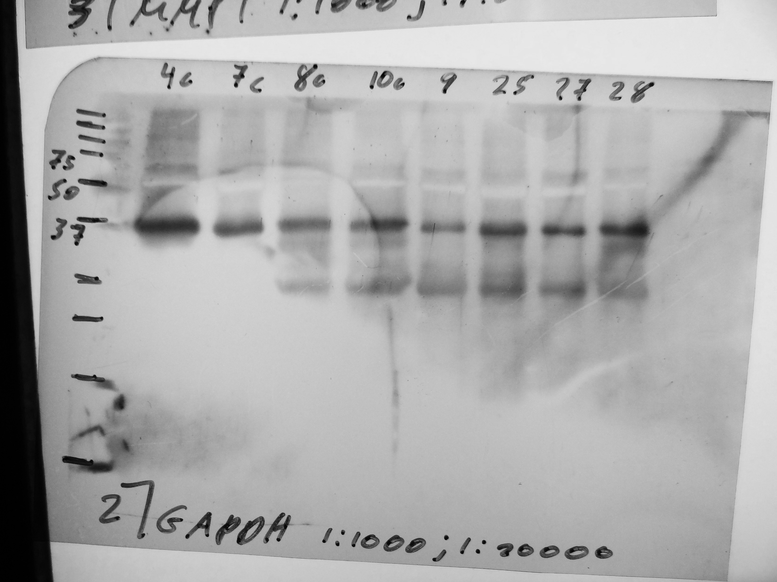
(GAPDH: sc-365062)

Slide 8
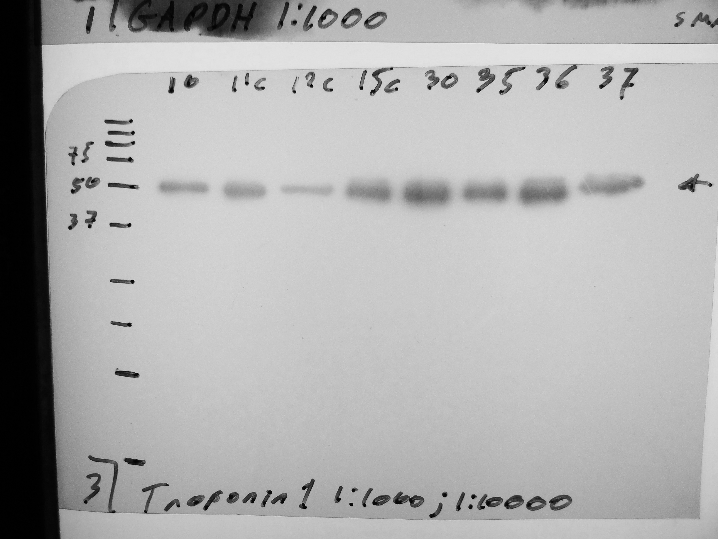
phospho-Troponin I (Cat # 4004)

Slide 9
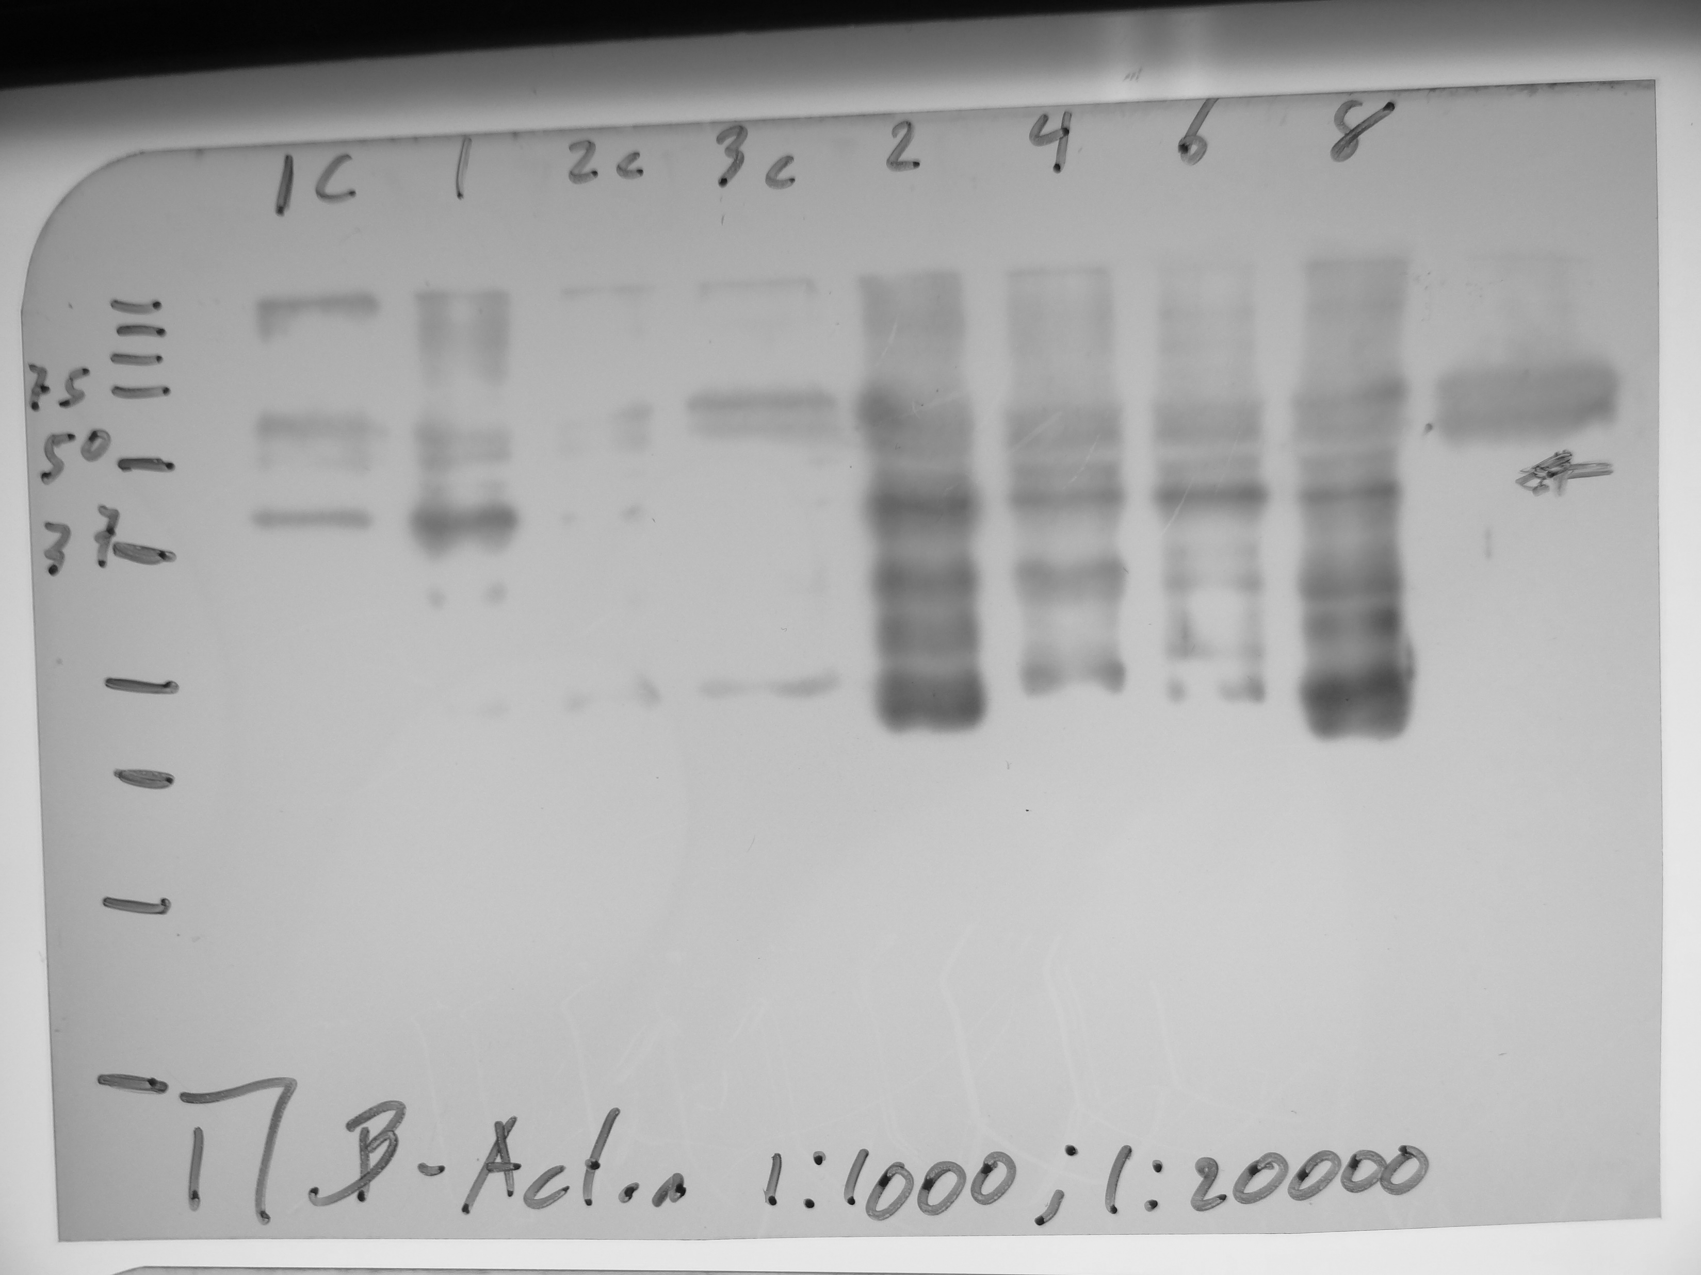
β-Actin (sc-517582)

Slide 10
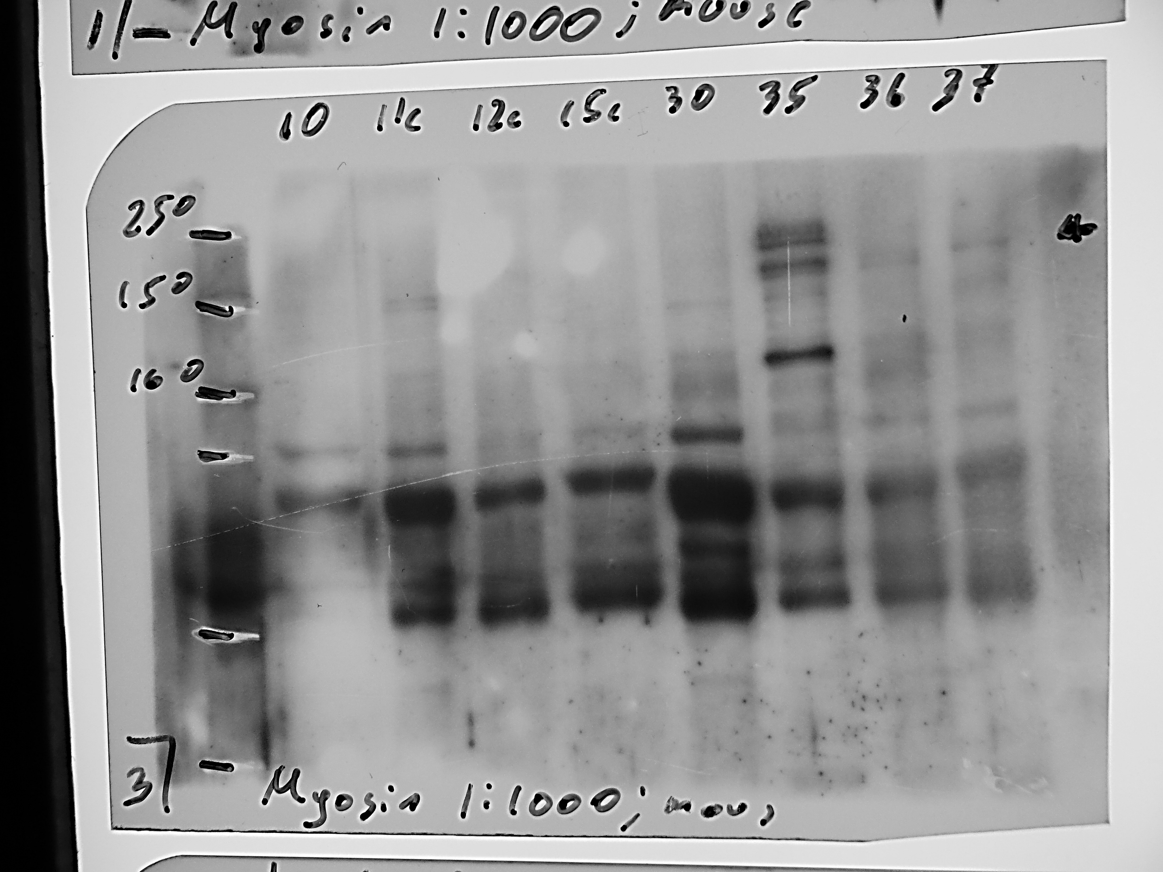
Myosin Heavy Chain 11 antibody [SMMS-1] Cat. No. GTX01765 provide by Gene Tex

Slide 11
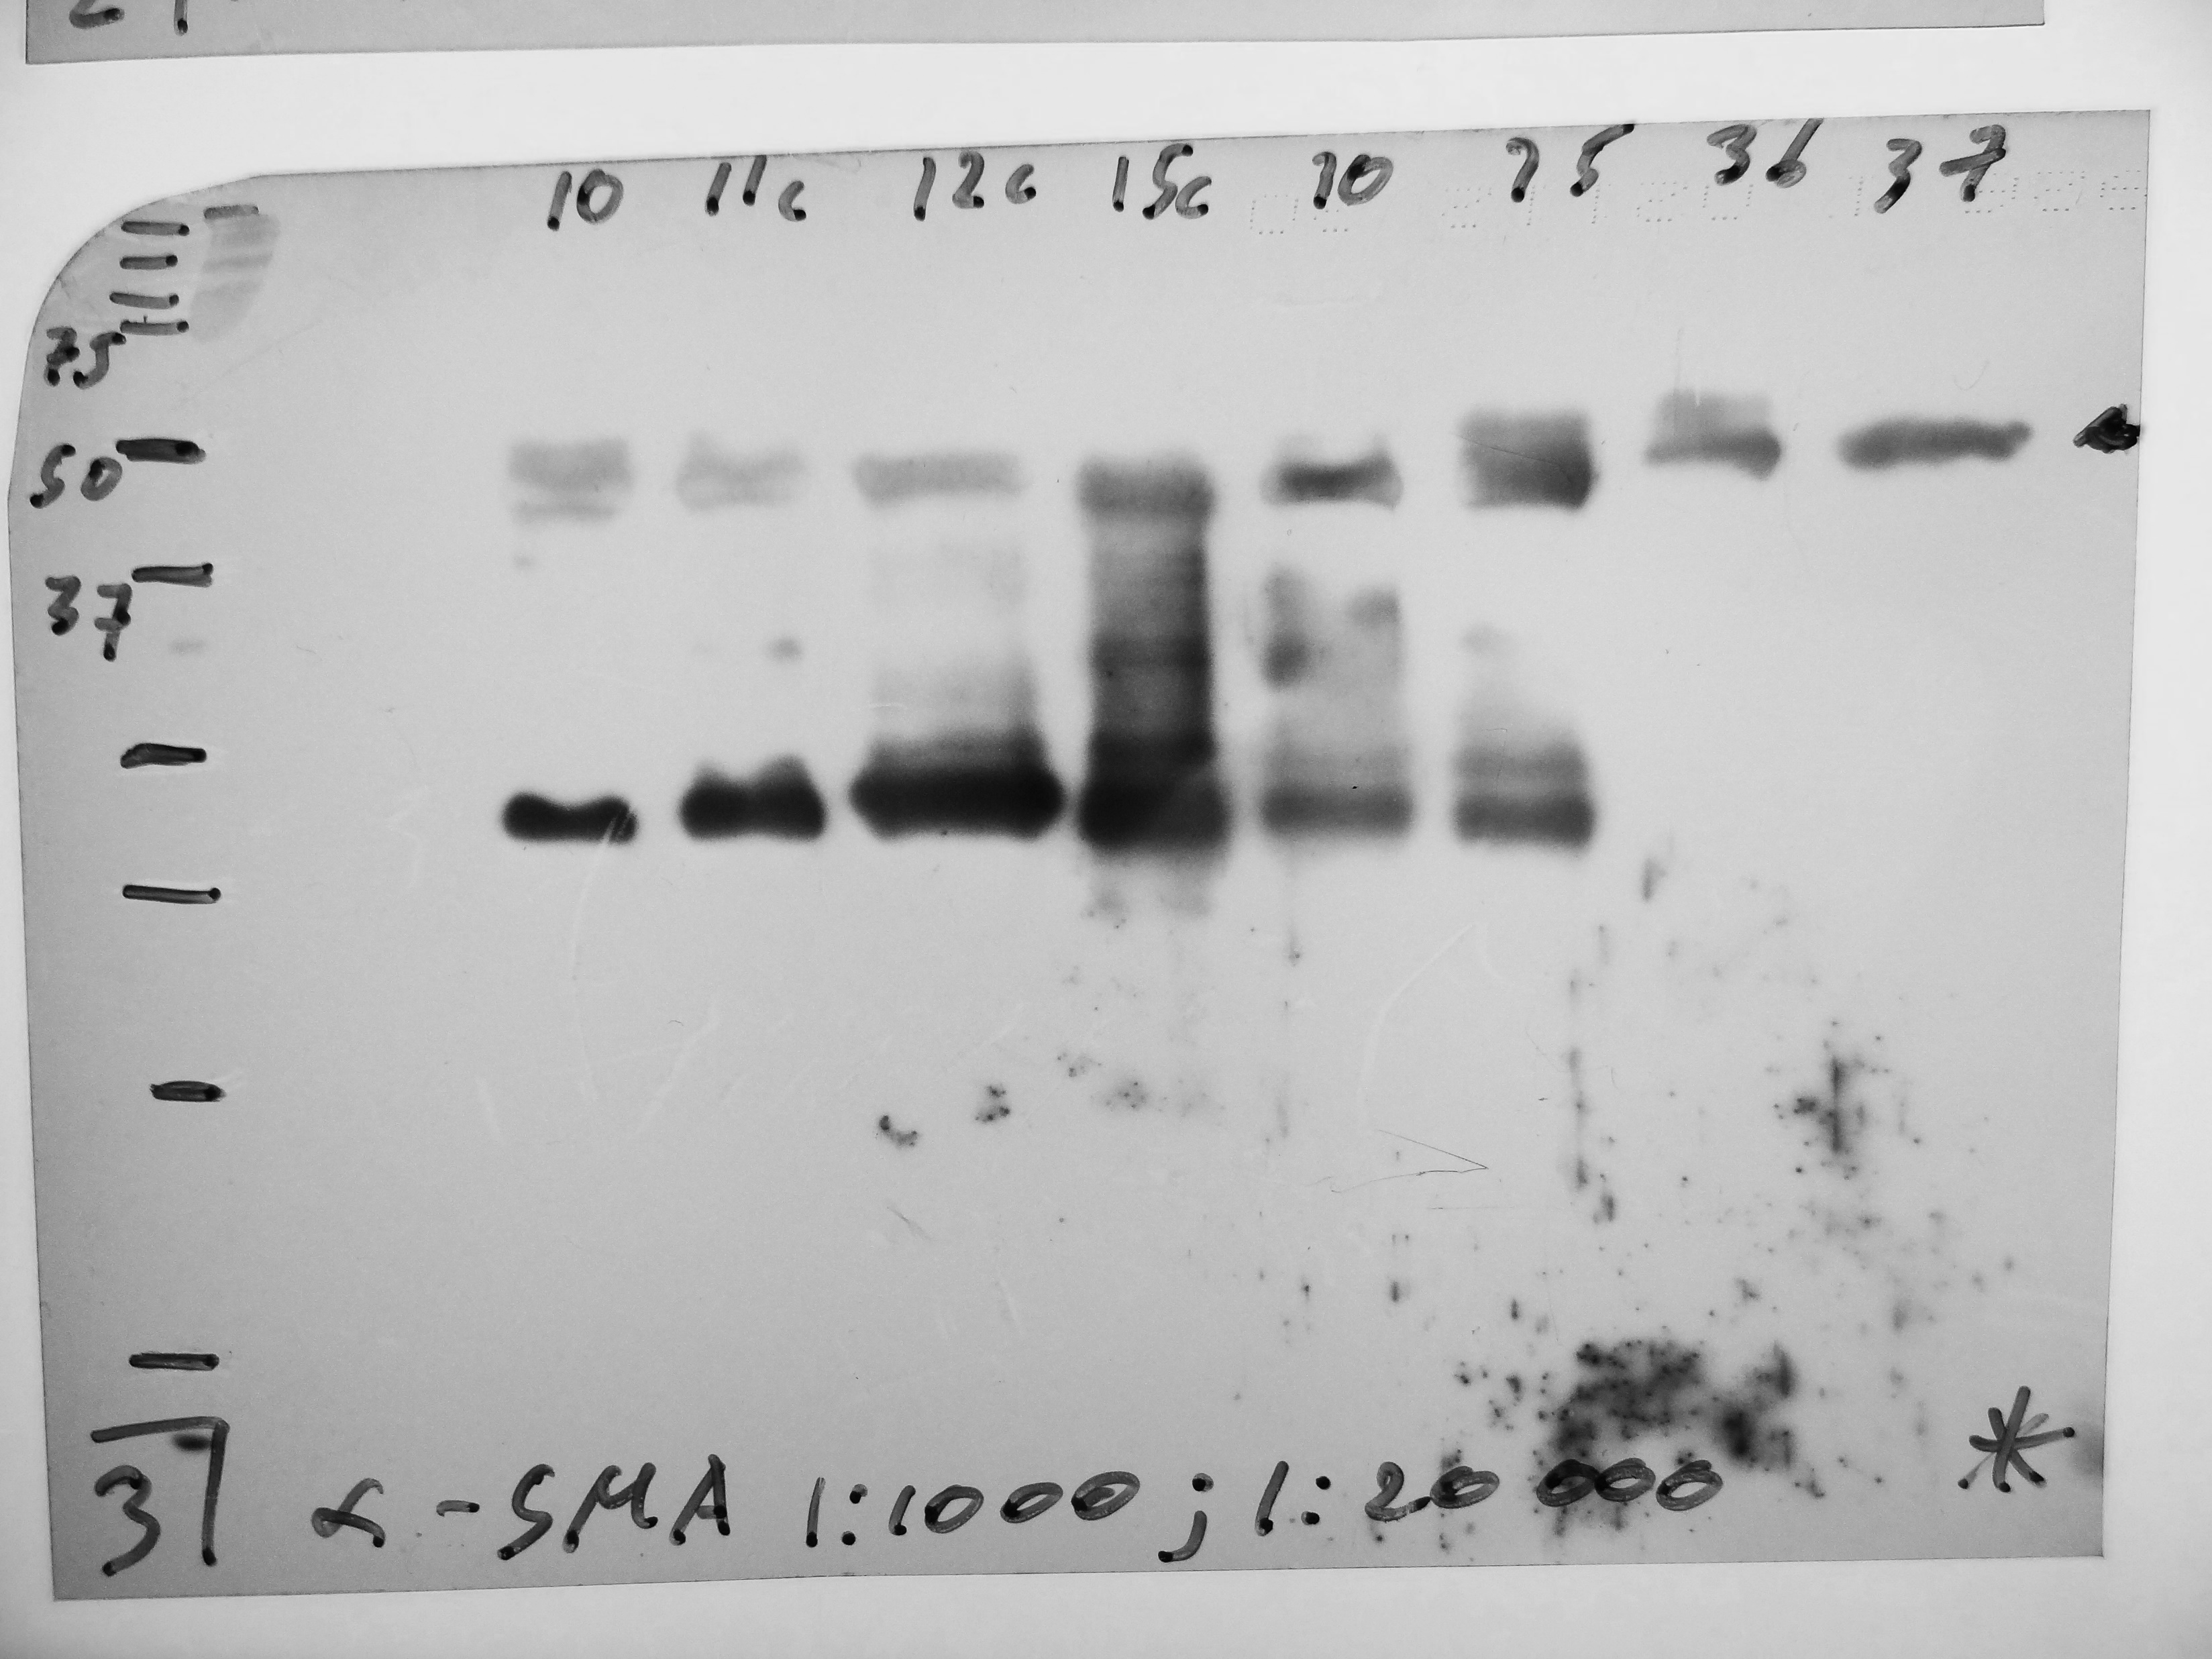
α-Smooth Muscle Actin (alpha-SMA: GTX100034)

Slide 12
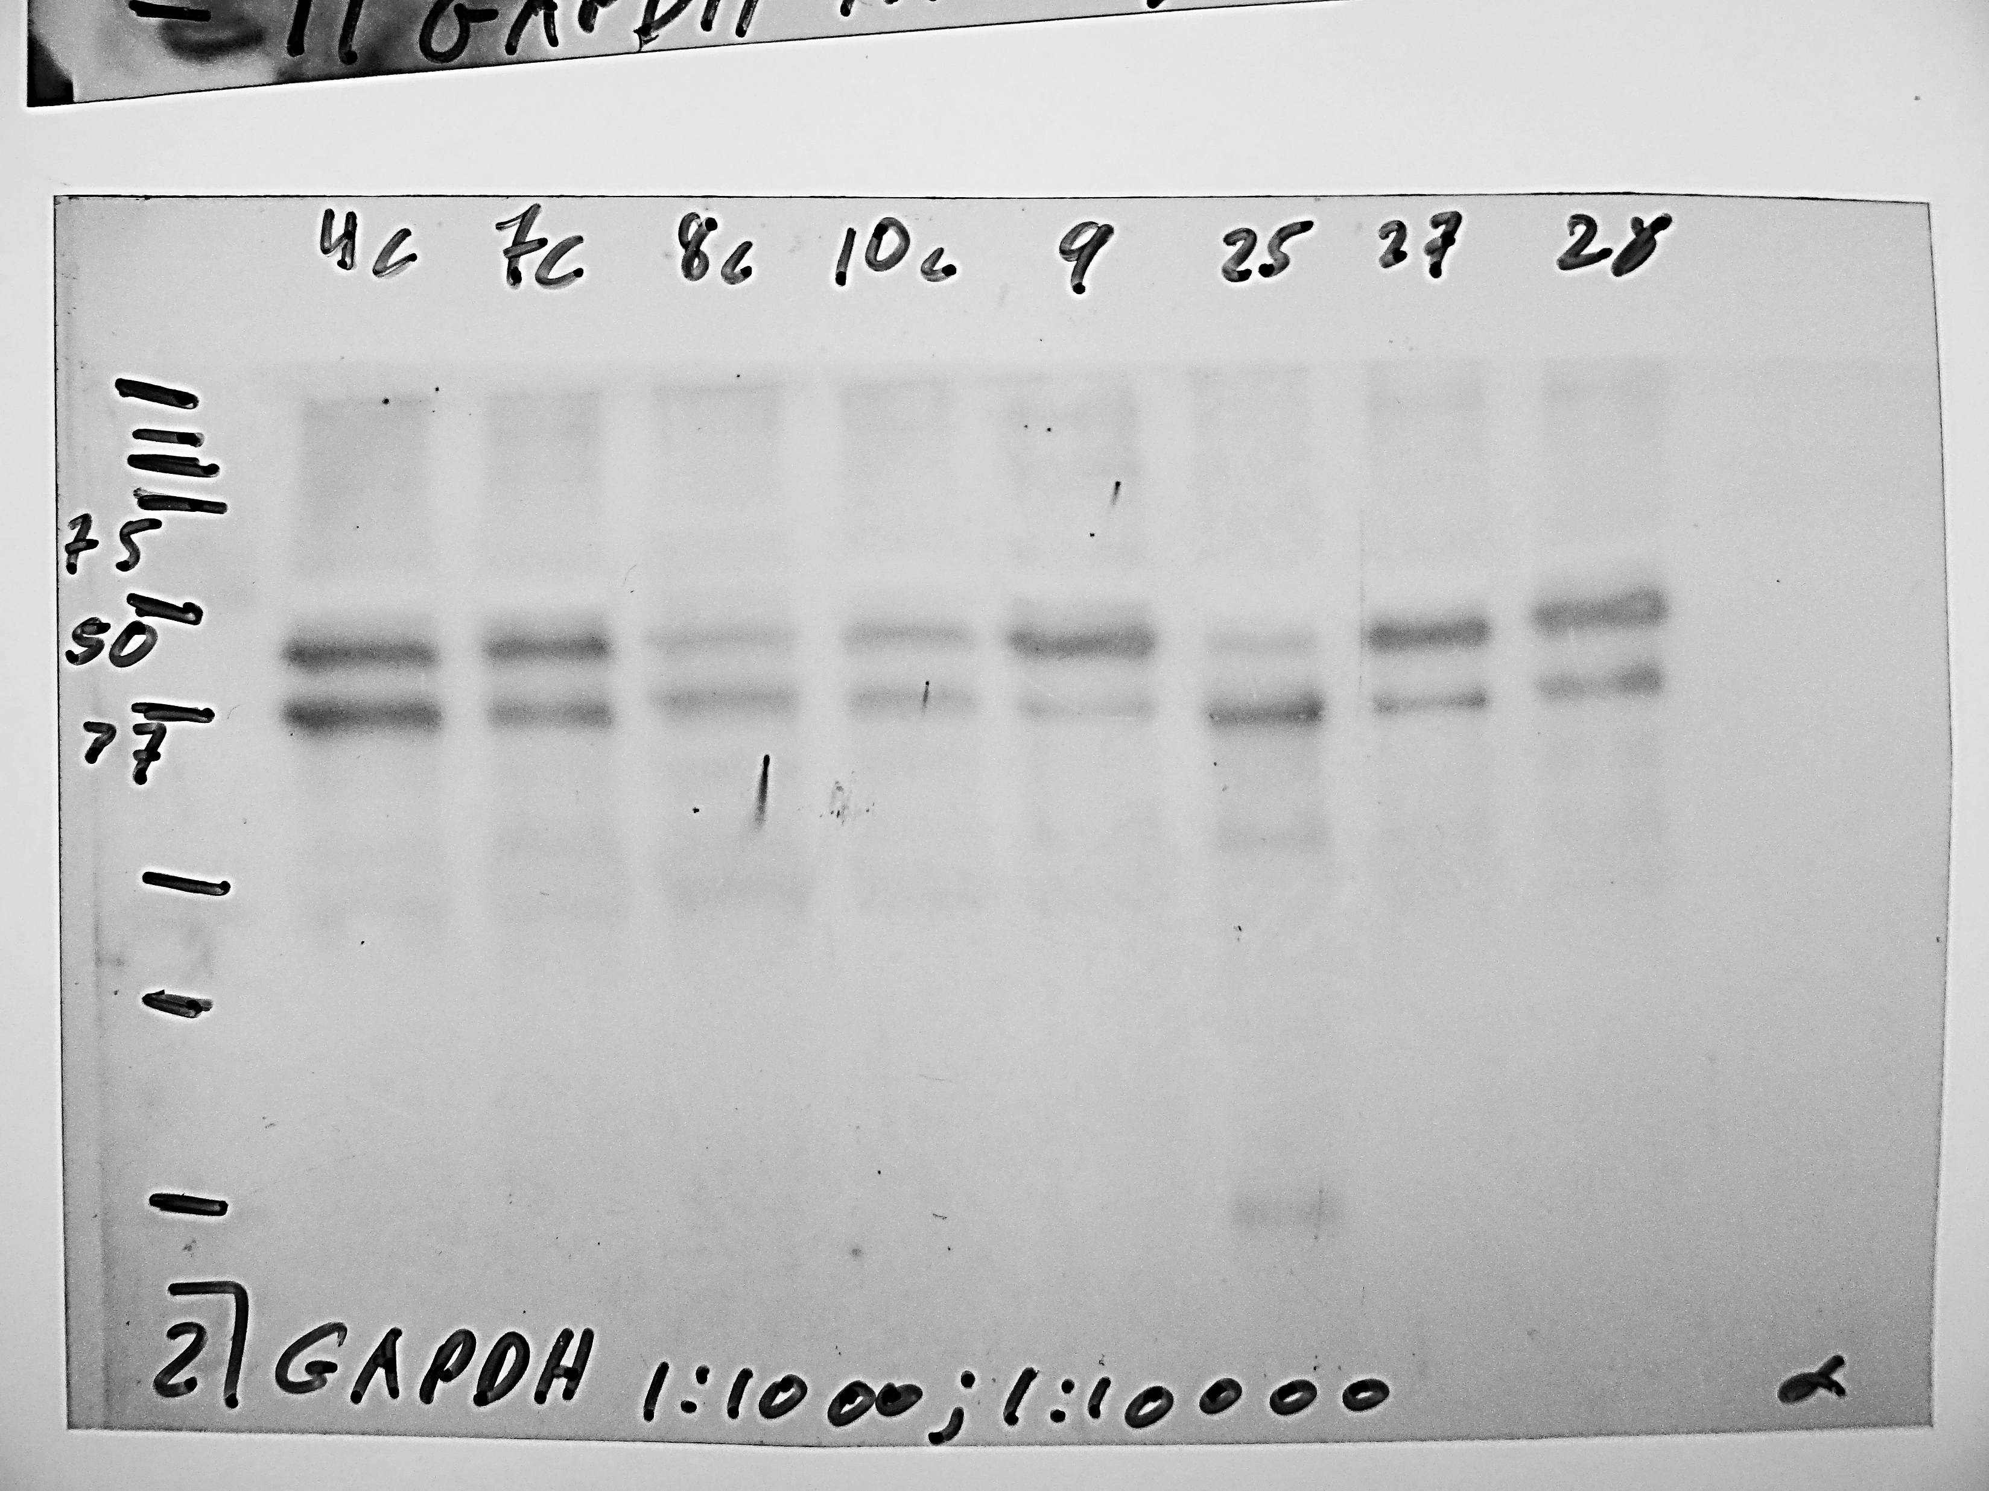
(GAPDH: sc-365062)

Slide 13
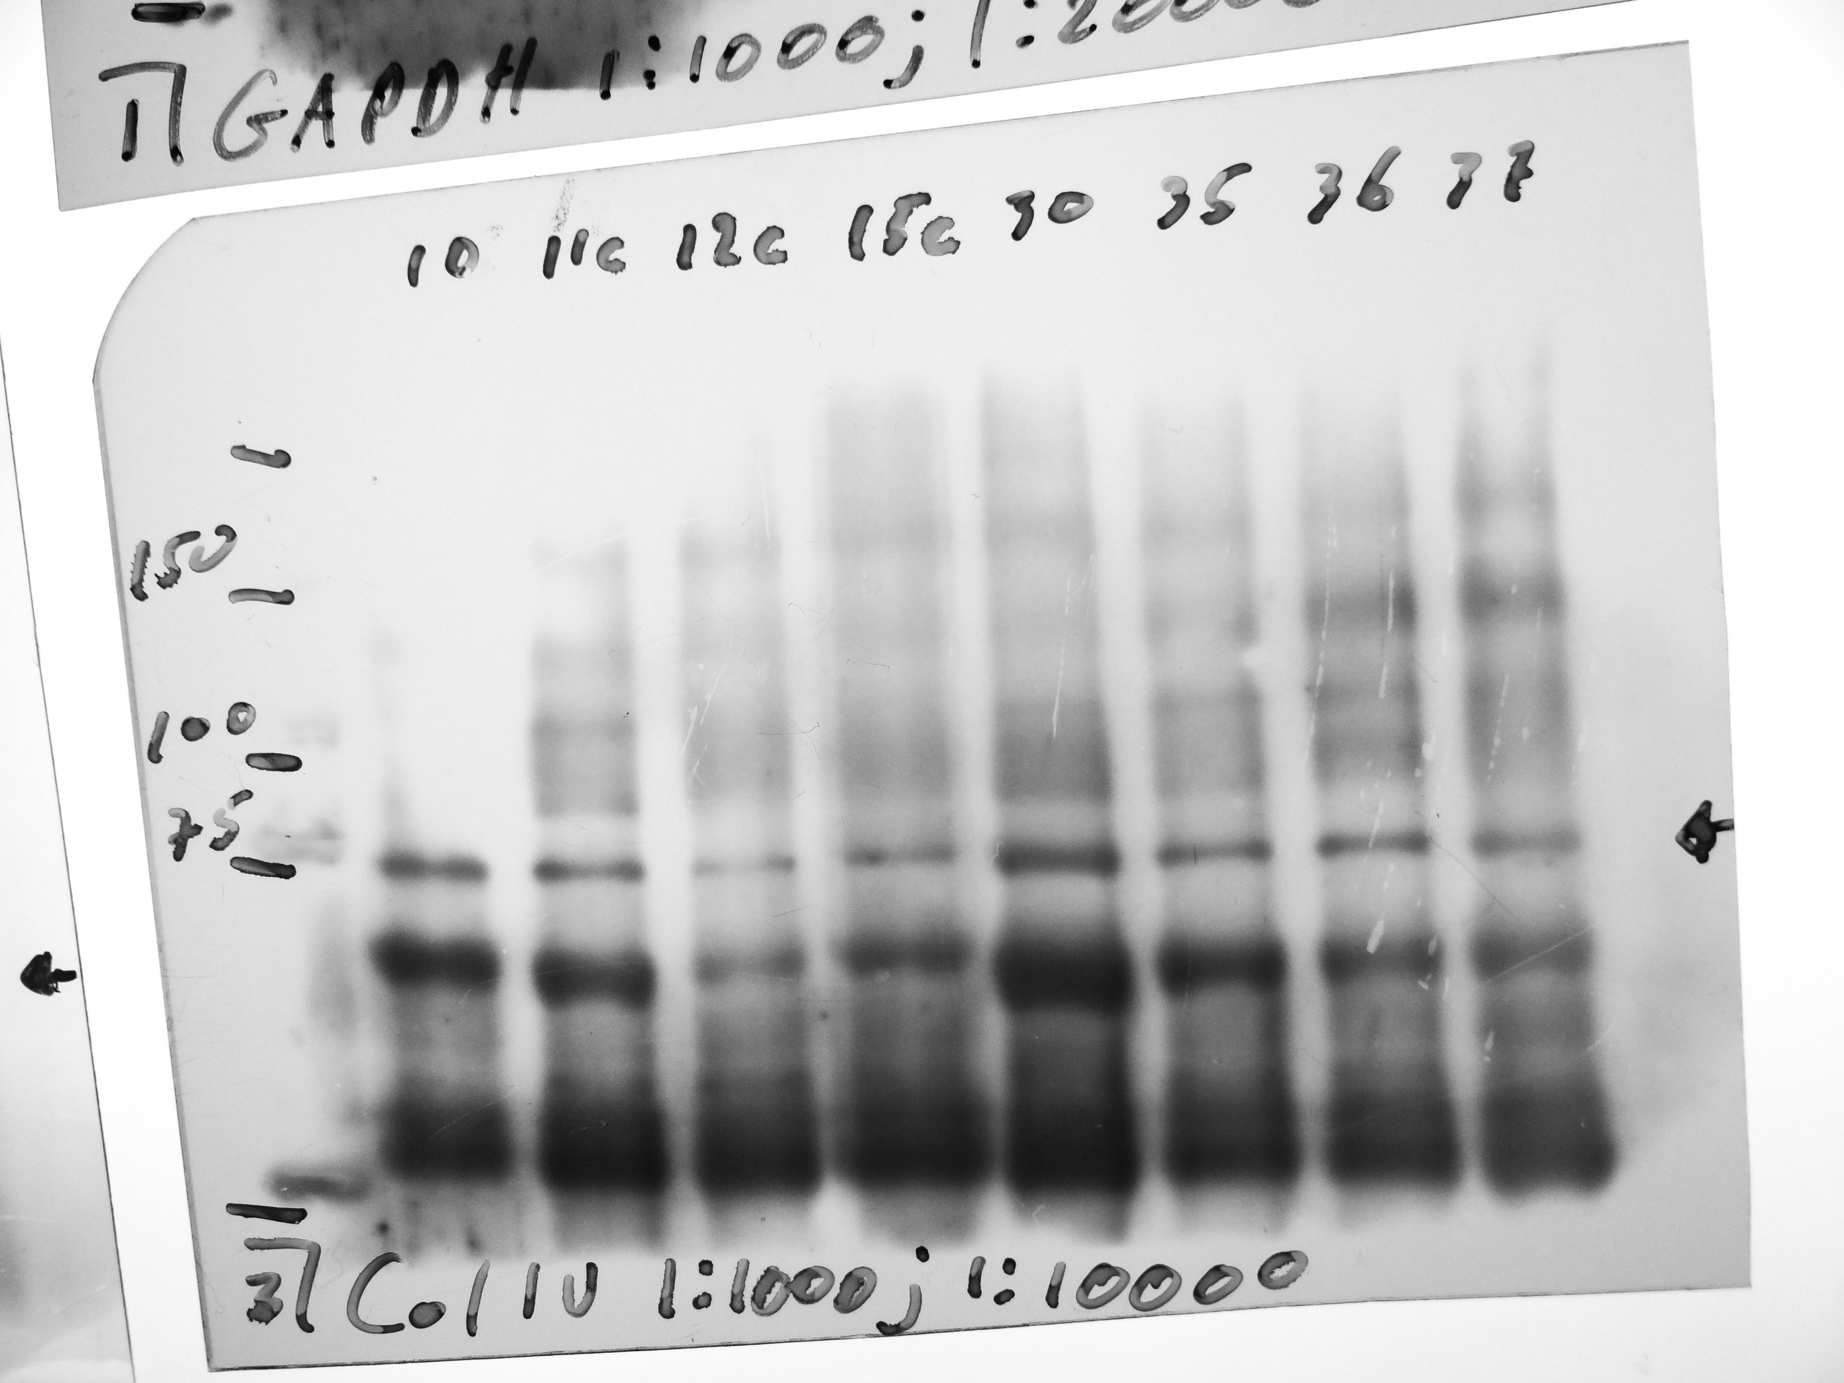
COL4A2 (sc-70244)

Slide 14
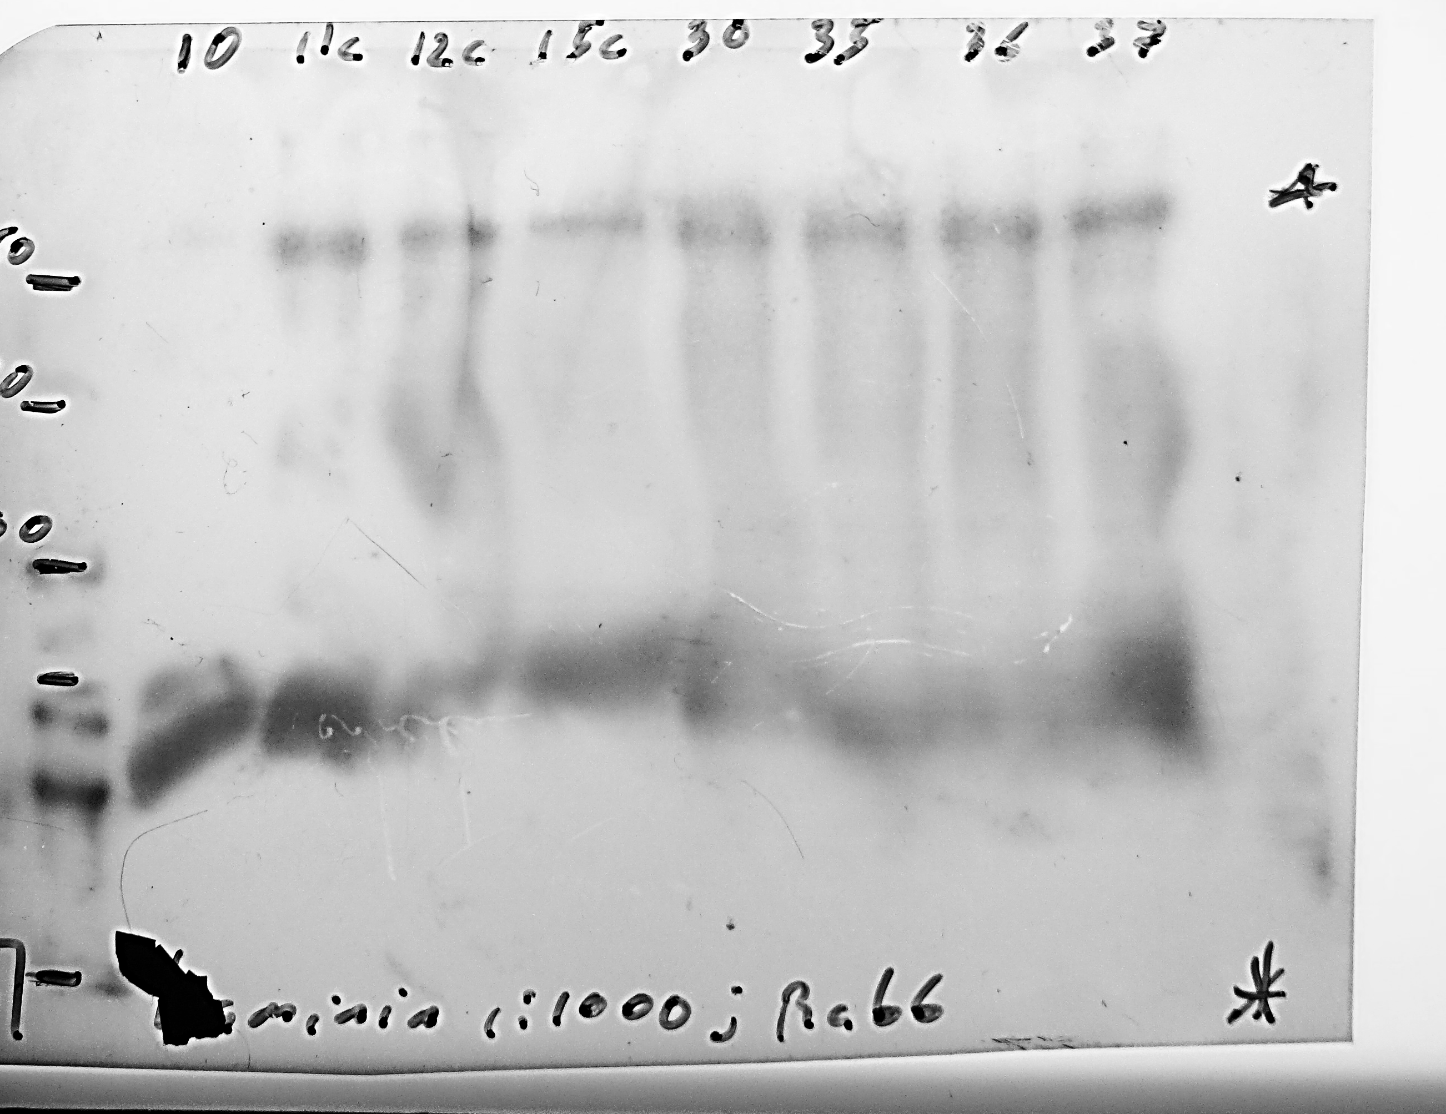
Laminin-𝛾-1 (sc-5584)

Slide 15
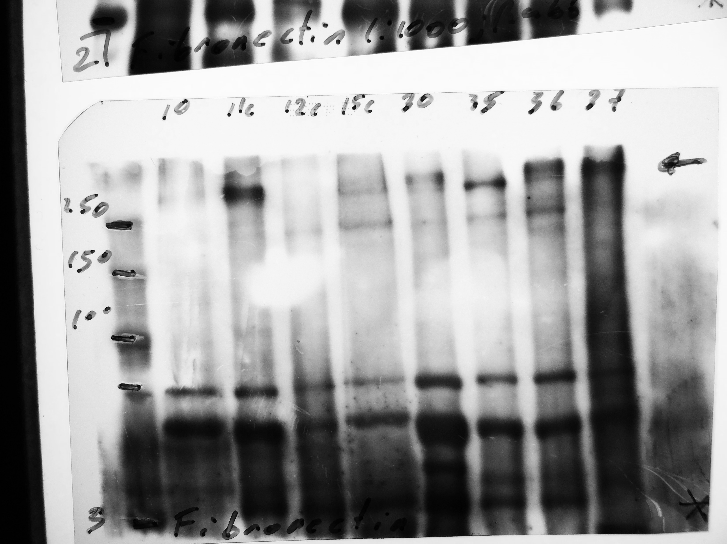
Fibronectin (sc-81769)

Slide 16
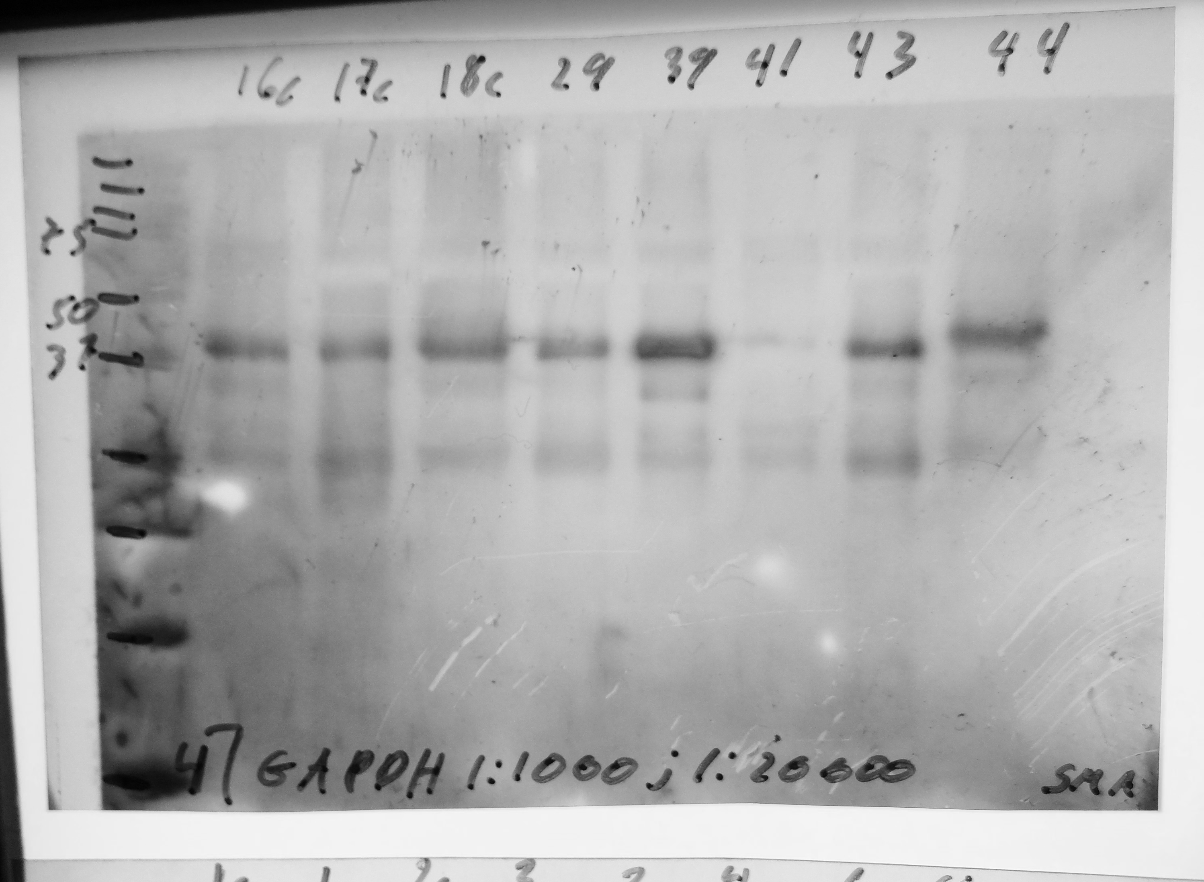
(GAPDH: sc-365062)

Slide 17
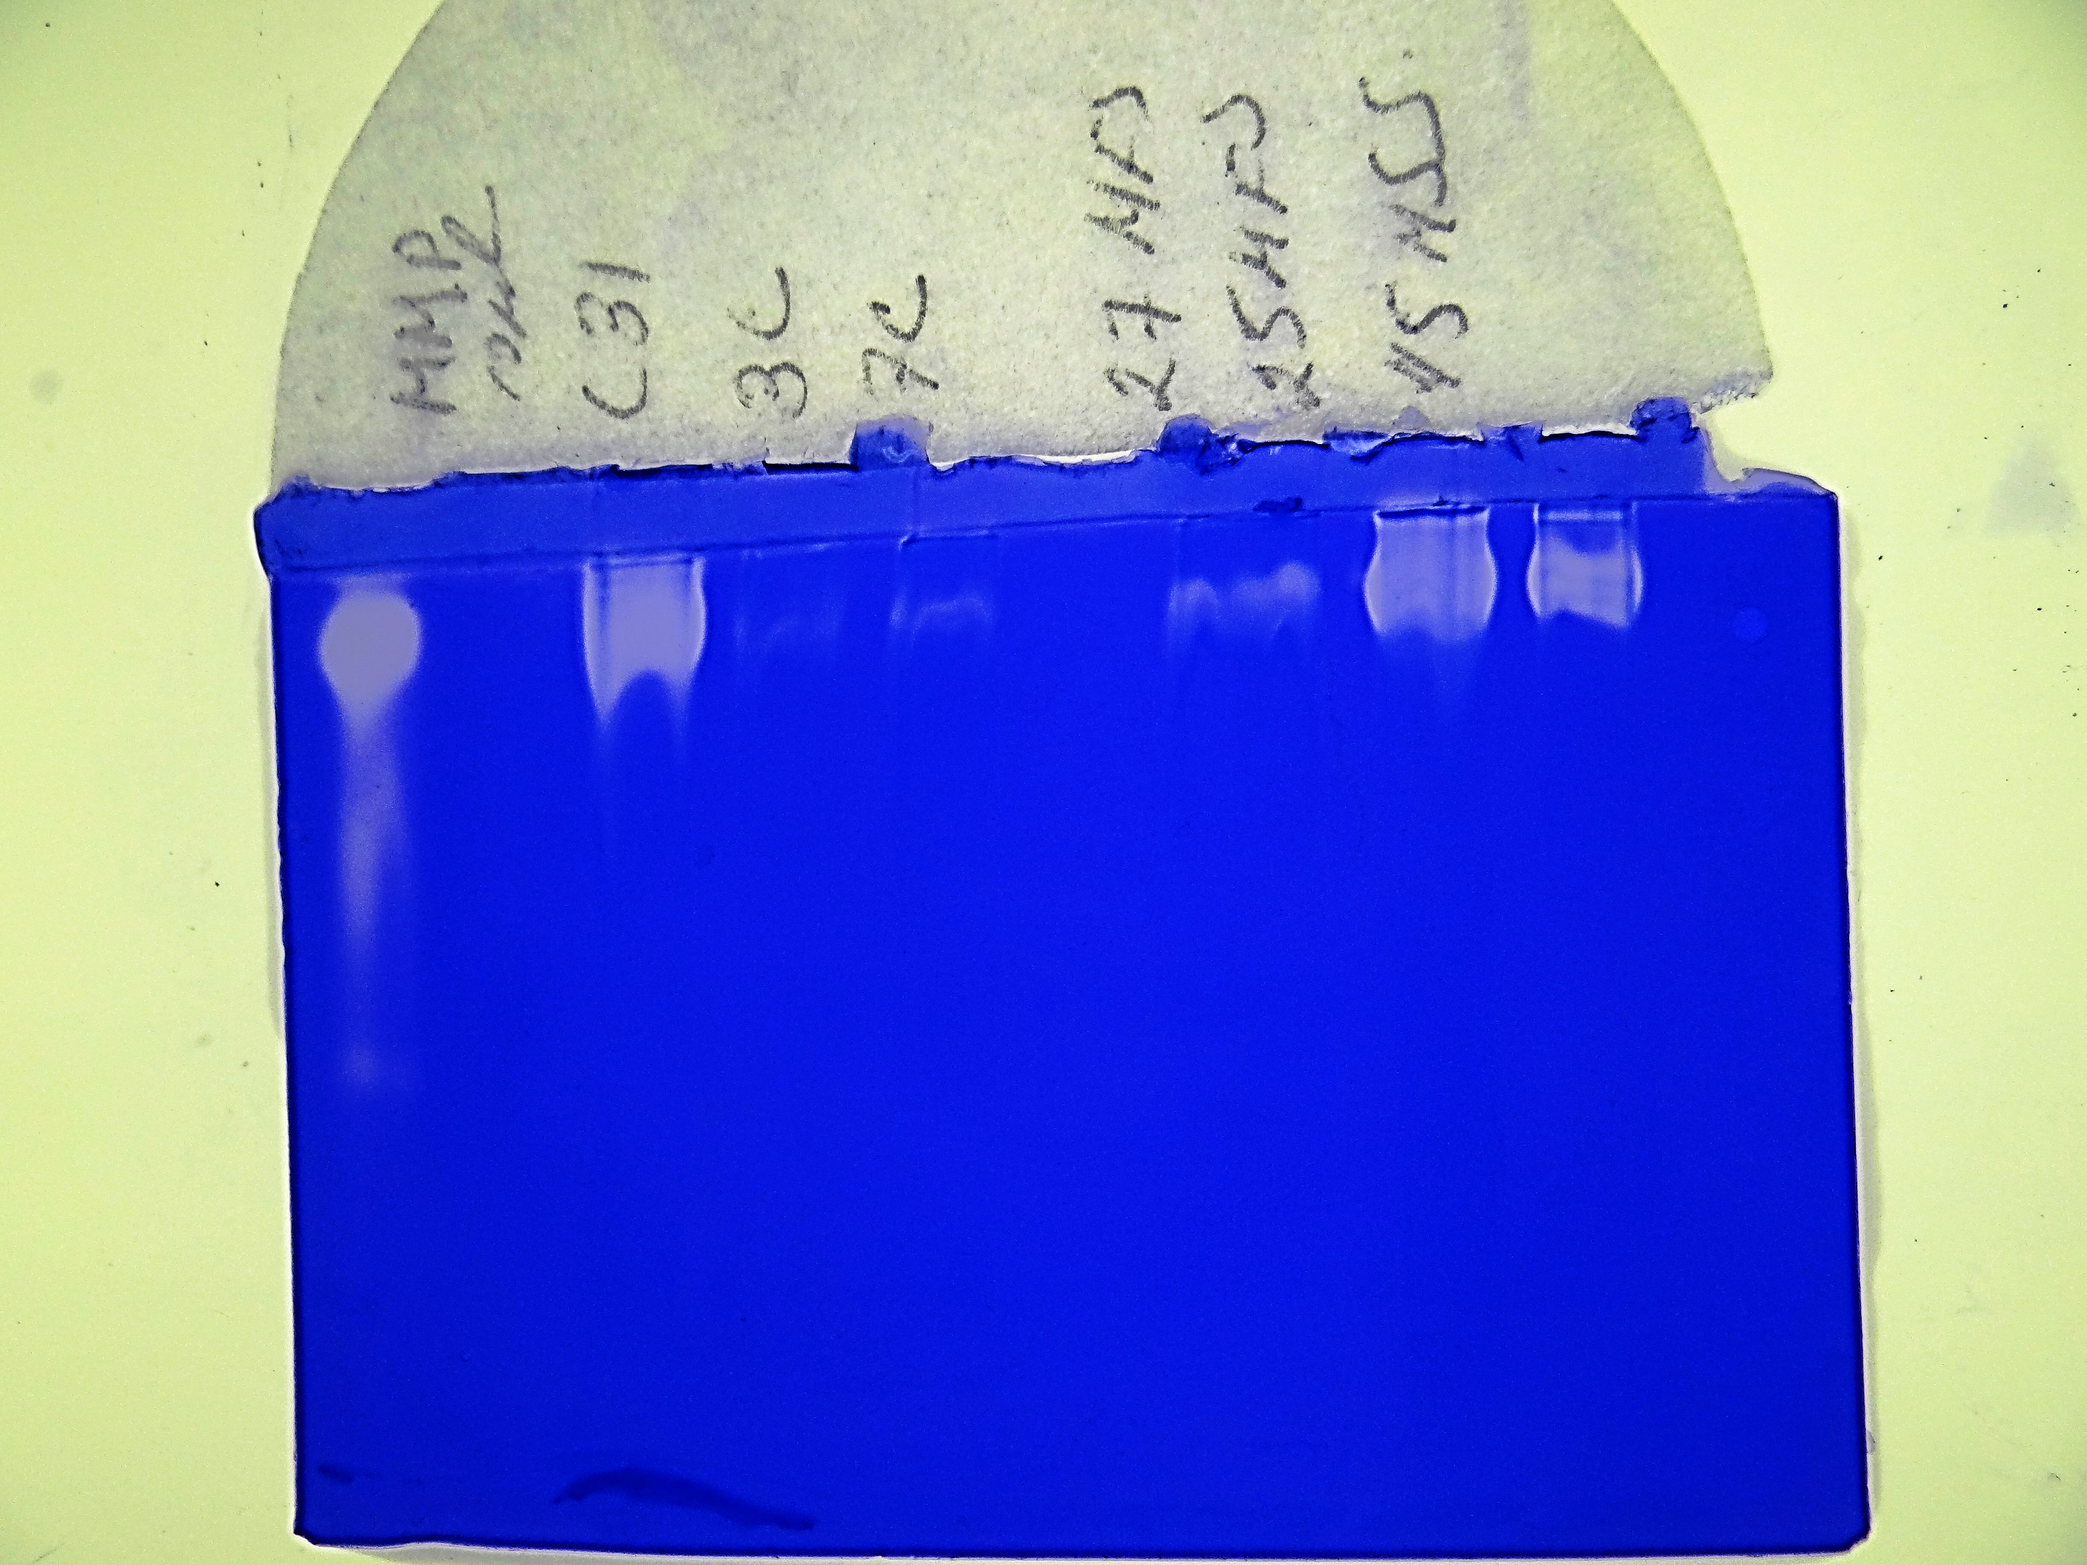
Load control Purified MMPs from human with a specific activity of 10 UG (Cat # M8945-10UG)

Slide 18
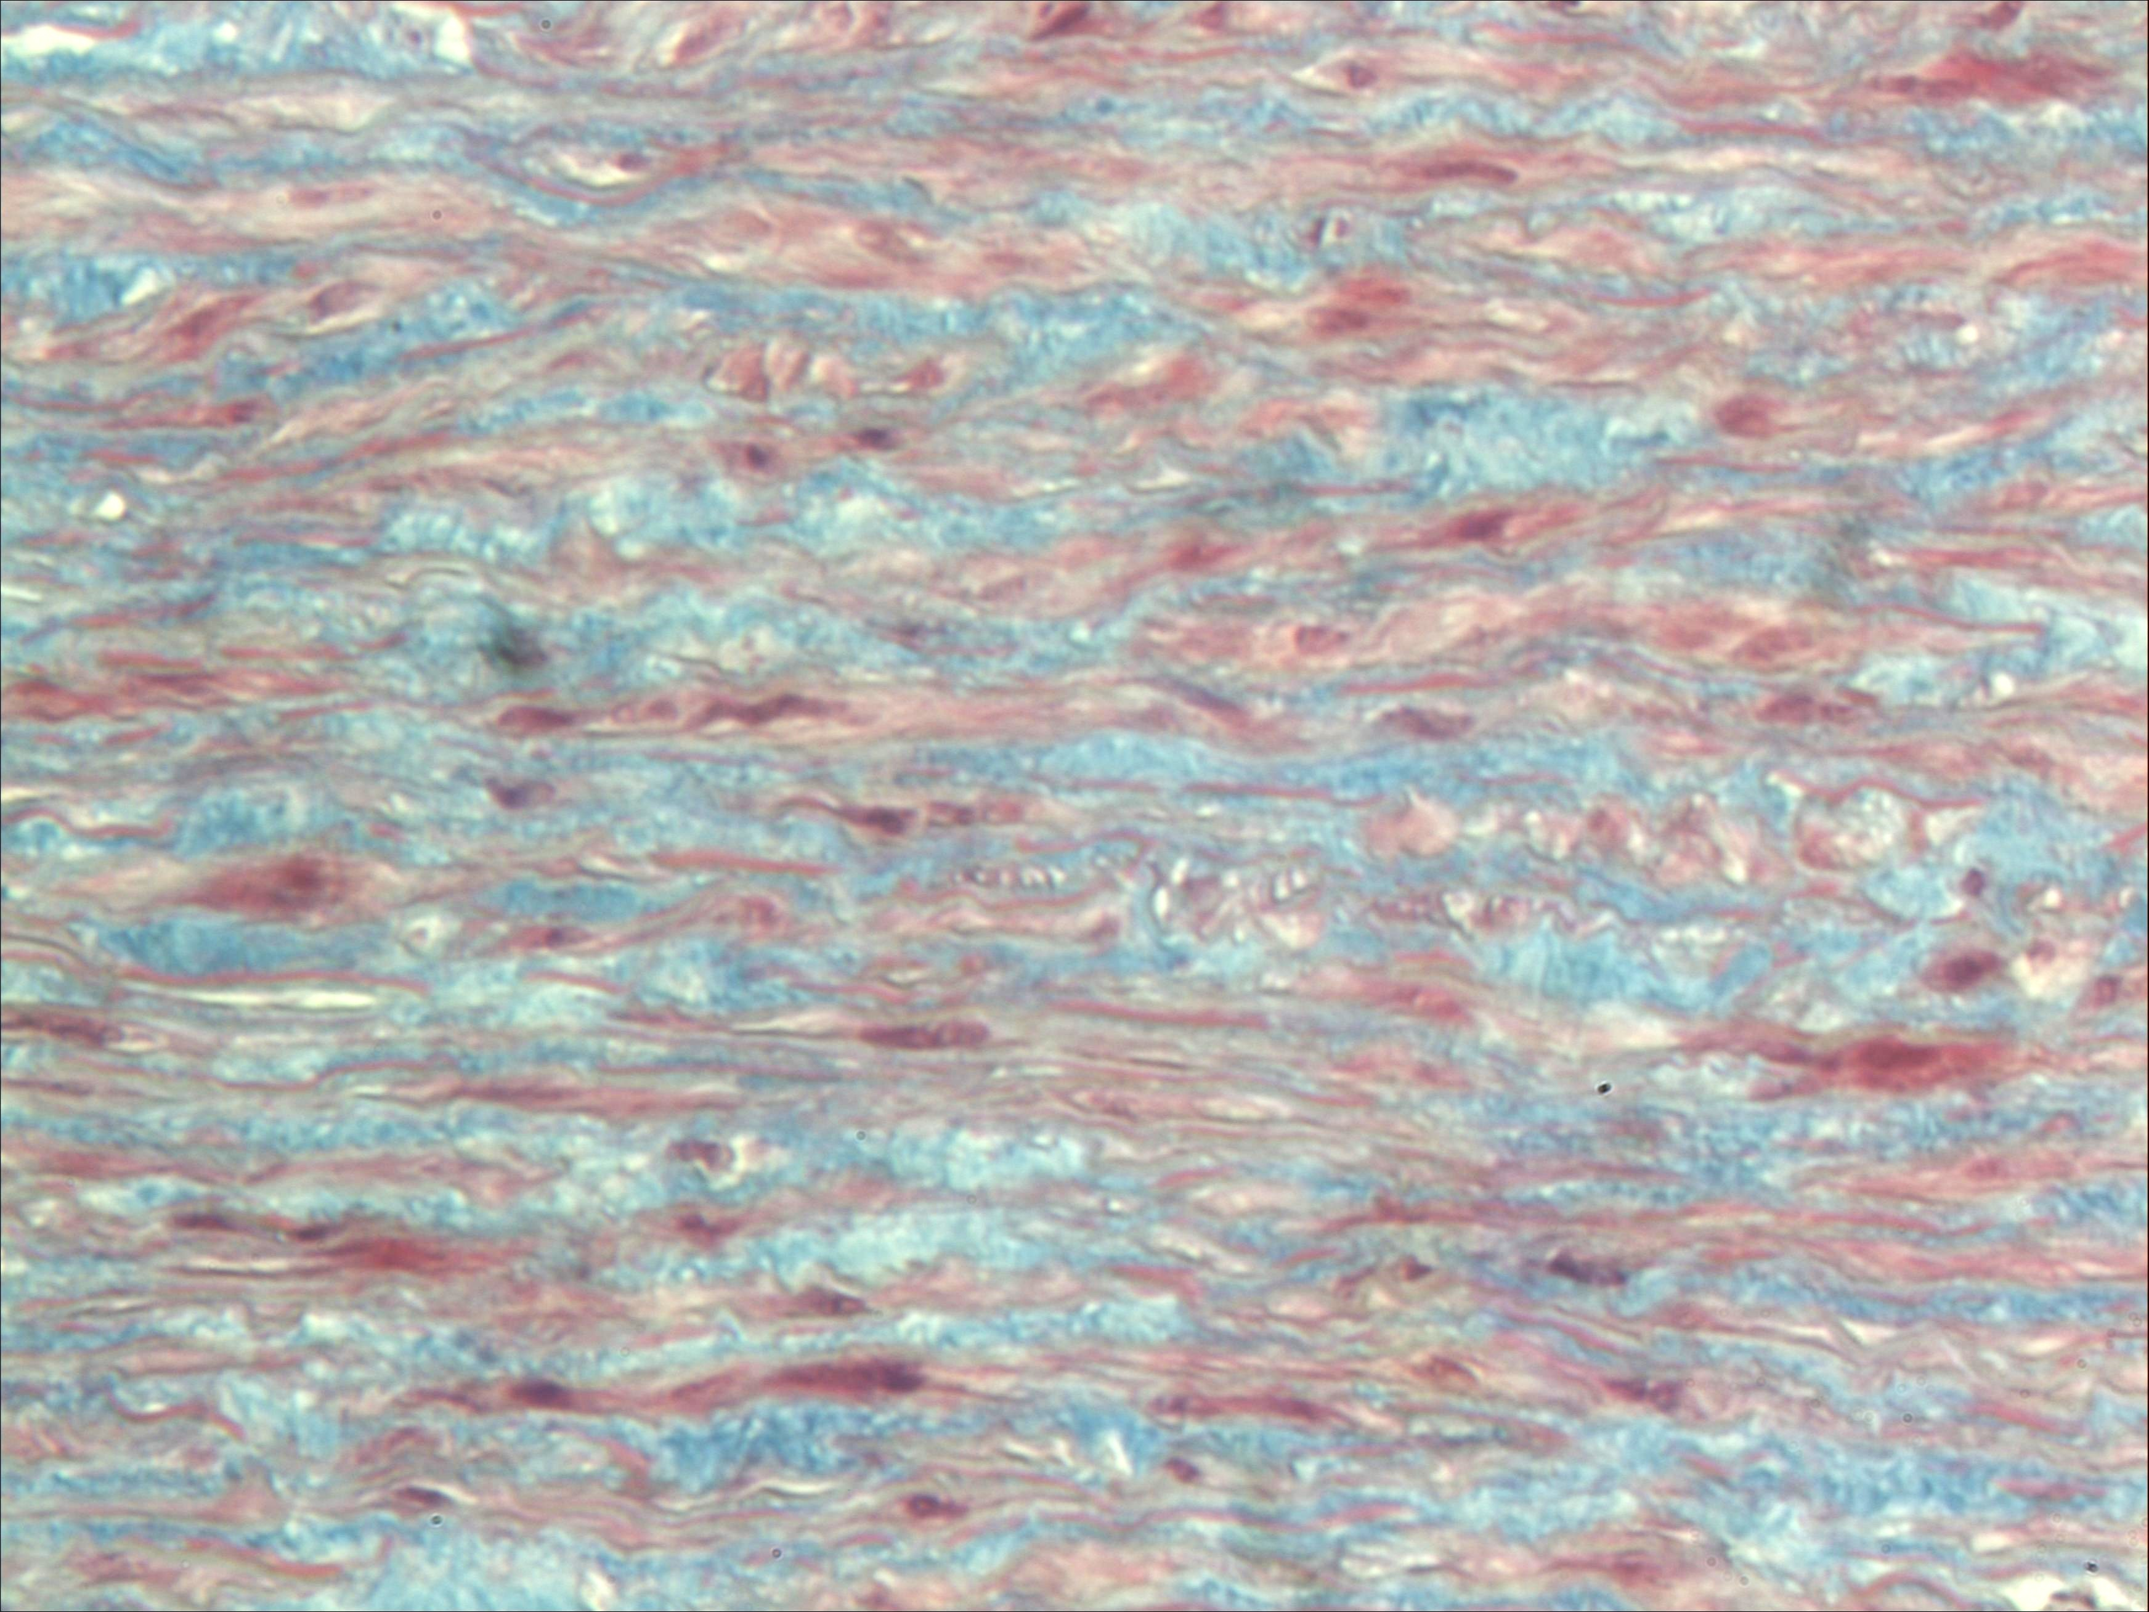
Aortic medial layer stained with Masson techniques in control subjects (CS)

Slide 19
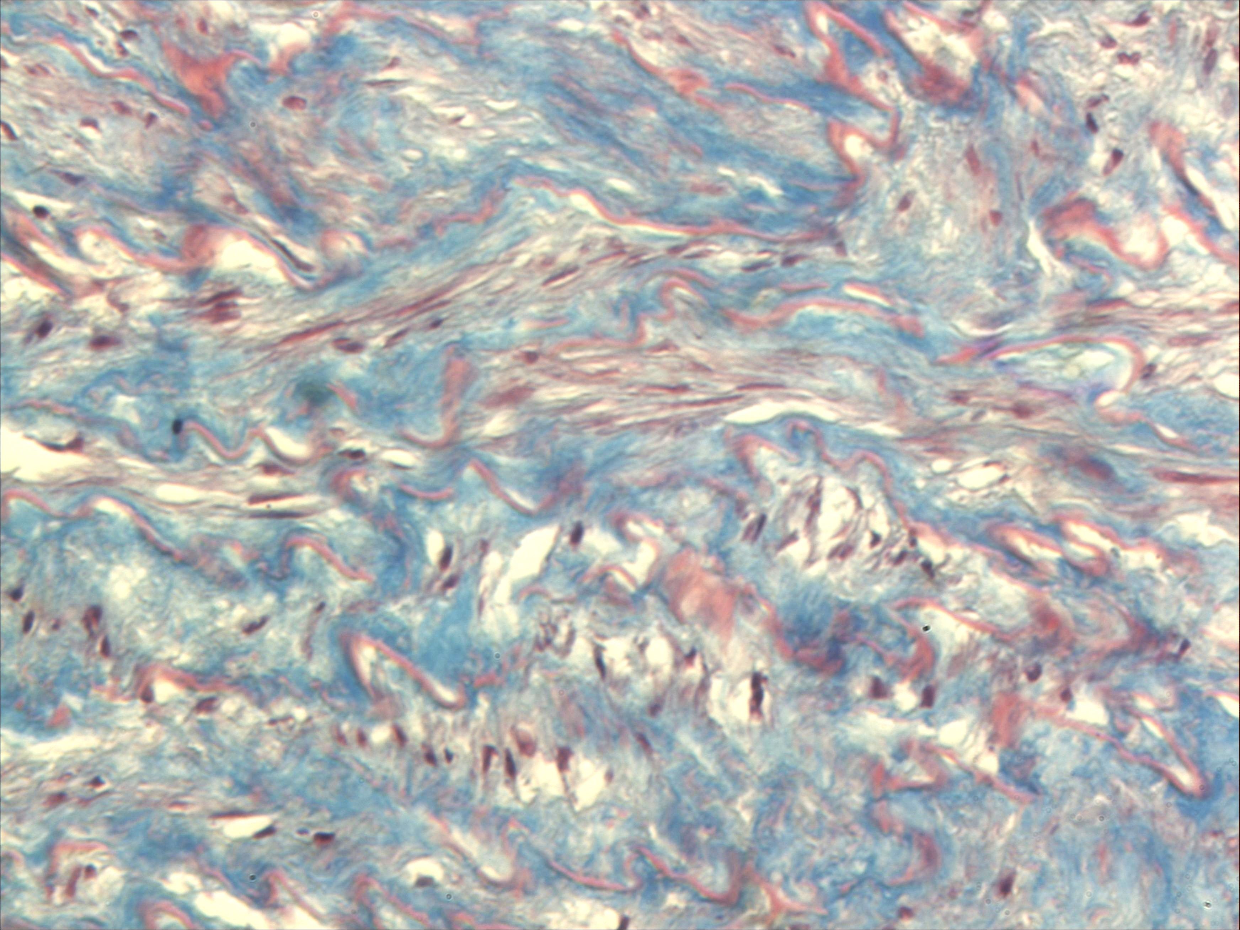
Aortic medial layer stained with Masson techniques in control subjects (CS)

Slide 20
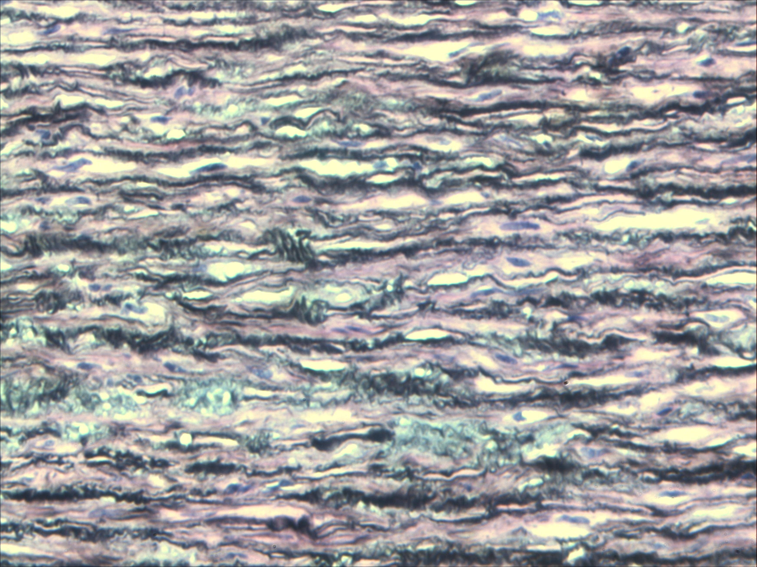
Aortic medial layer stained with Jones methenamine in patients with Marfan syndrome

Slide 21
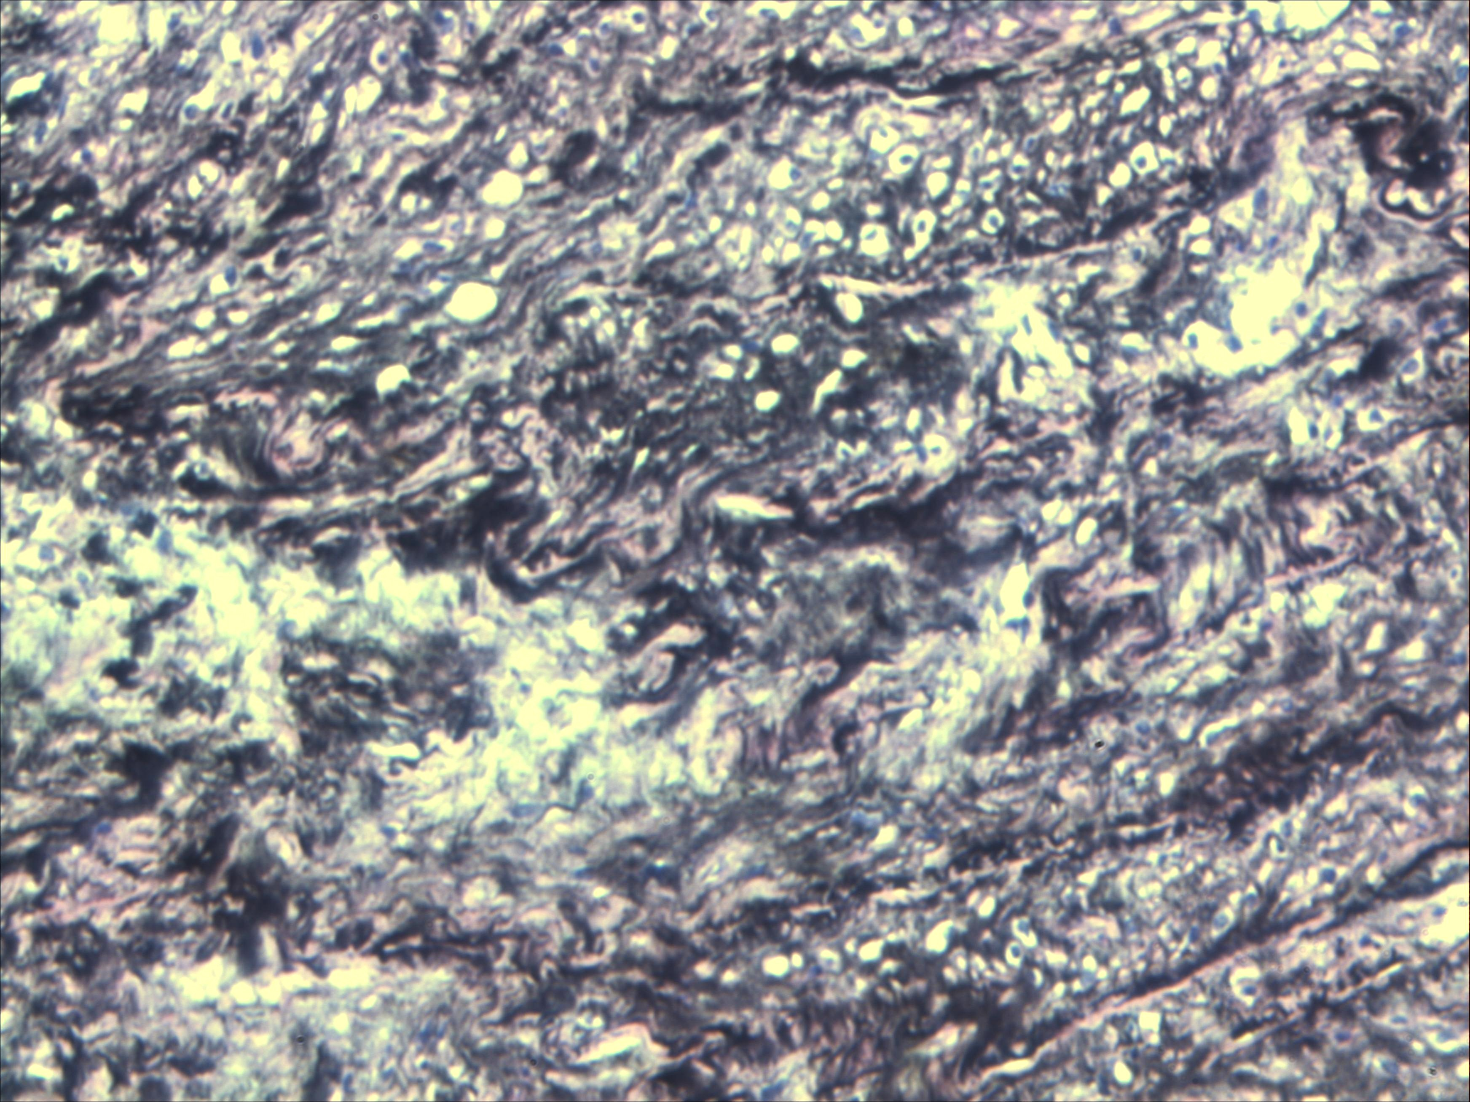
Aortic medial layer stained with Jones methenamine techniques patients with Marfan syndrome

