Slide 1
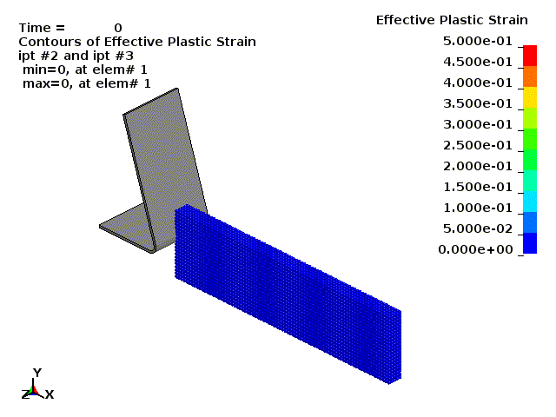
EFG for Manufacturing

Slide 2
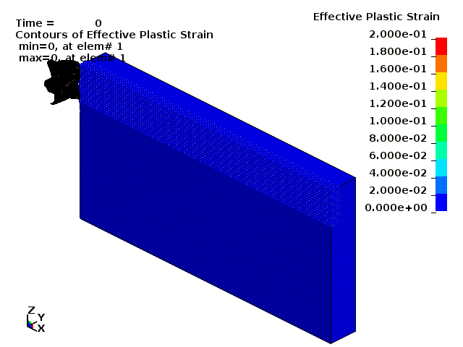
SPG for Manufacturing

