Slide 1



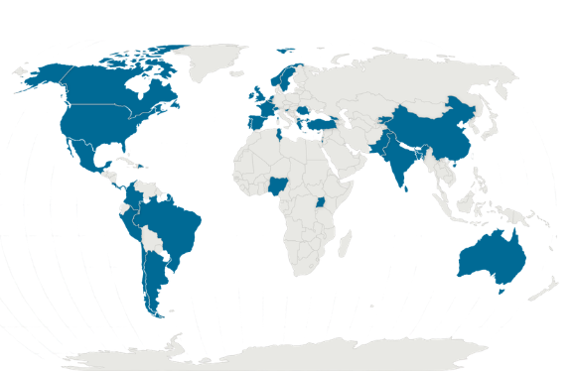


Question: How do primary healthcare professionals (PCPs) globally perceive and use systemic corticosteroids (SCS) for asthma and COPD?
Population
314 primary care prescribers
62 community pharmacists
Outcomes measured
PCP’s reported perceptions and practices of SCS use in asthma and COPD:
reported availability and use of clinical guidelines
indications and patterns of SCS prescribing or dispensing
perceived appropriateness of SCS use in different clinical scenarios
provision of SCS “action packs” for patient-initiated use
perceptions of OTC availability and self-medication with SCS
Findings
SCS perceived as overused in asthma and COPD - frequently outside guideline recommendations by ≈60% prescribers and 67% pharmacists
Causes of overuse: limited access to inhaled or biologic therapies and gaps in knowledge gaps
Despite ~60% reporting mandatory prescriptions, OTC availability still observed (oral 48%; injectable 36%), with variation across countries
Self-medication rates also high (oral: adults ~50%, children 34%; injectable: adults 30%, children 17%)
67% prescribers would issue repeat prescriptions without clinical review, compromising safety and increases risk of harm.
Use of SCS for long-term management:
Asthma: 23% prescribers, vs 59.7% of community pharmacists
COPD: 9.7% prescribers vs 46.8% of community pharmacists
What does this study add?
Addresses a key evidence gap in real-world prescribing behaviour in primary care
Demonstrates clear perceptions of widespread SCS overuse across settings
Highlights a disconnect between existing evidence and practice
Clarifies research needs, including the use of OTC data
Study design
Cross-sectional, observational study using online scenario-based self-administered questionnaire
Recommendations
Stronger SCS stewardship by primary care
  e.g. community pharmacy databases
Improve clinicians’ and public education about risks of long term SCS use
Improve access to inhaled corticosteroid therapies or biologics (when indicated)
National strategies for appropriate SCS use (e.g. emergency use out of hospital; stop-start guidance; dose, frequency and duration)
Location
41 countries
LMIC 46.3% HICs 53.7%
Franceschini J, Williams S, Fitch N, Fonte P, Correia-de-Sousa J, Kaplan A, van Boven JFM, Salvi S, Khoo EM. Global perceptions and practices on systemic corticosteroid use for asthma and COPD in primary care: results from a multinational survey on prescribers and community pharmacists. [Journal Name]. [Year];[Volume(Issue)]:[Pages].
May 2026

