Slide 1
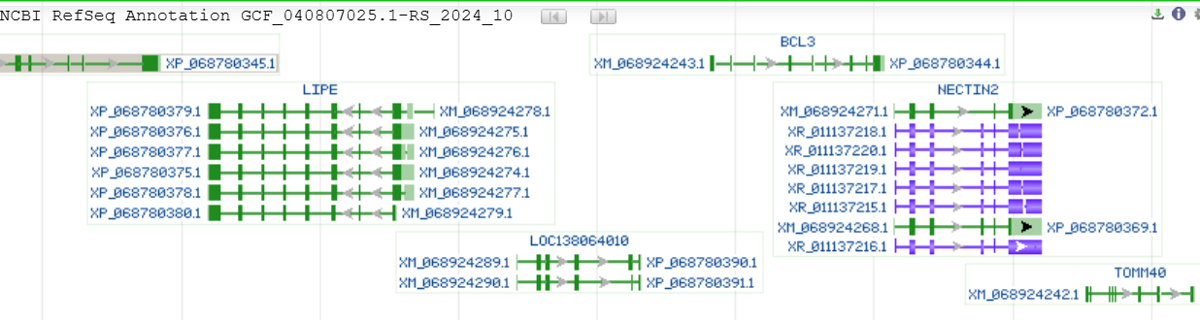
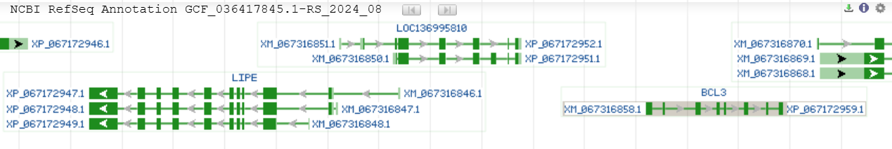
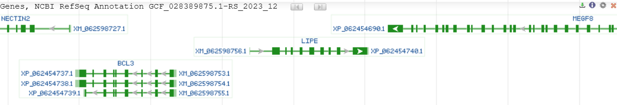
A
Struthio camelus (African ostrich) bStrCam1.hap1 (GCF_040807025.1) Chromosome 39 - NC_090980.1
BUSCO analysis (5.7.1)
Single copy 94.5%
Duplicated 3.4%
Fragmented 0.4
Missing 1.6%
= CEACAM1
Apteryx mantelli (North Island brown kiwi) bAptMan1.hap1 (GCF_036417845.1) NW_027118507.1
= CEACAM1
BUSCO analysis (5.7.1)
Single copy 97.9%
Duplicated 0.5%
Fragmented 0.4
Missing 1.2%
Rhea pennata (lesser rhea) bPtePen1.pri (GCF_028389875.1) Chromosome 36 - NC_084698.1
BUSCO analysis (5.7.1)
Single copy 98.6%
Duplicated 0.4%
Fragmented 0.2
Missing 0.8%

Slide 2
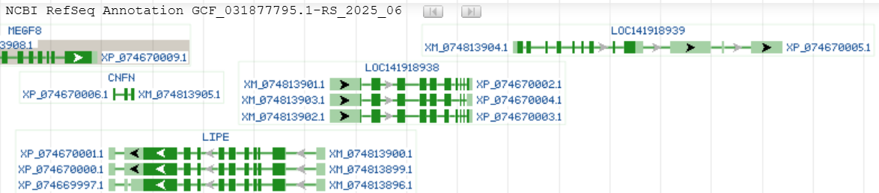
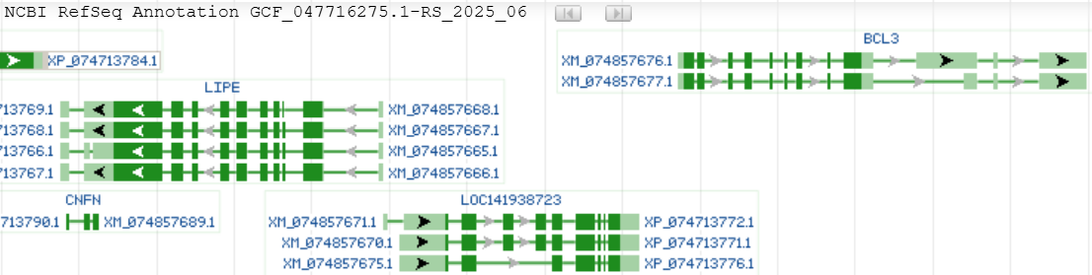
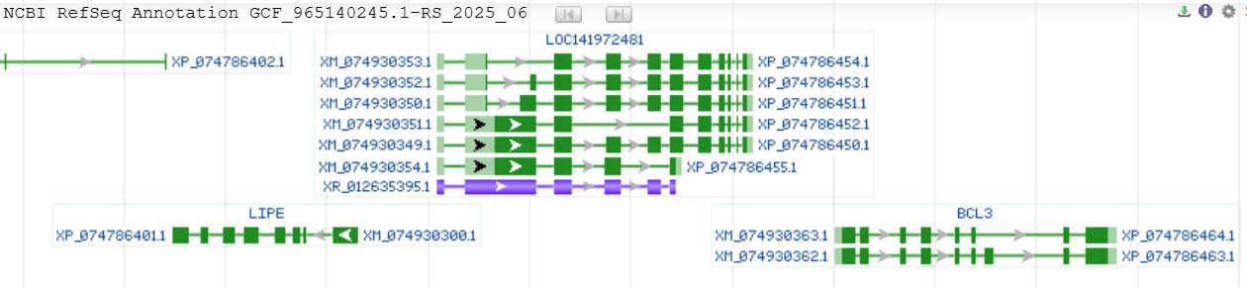
Strix aluco (tawny owl) bStrAlu1 (GCF_031877795.1) Scaffold NW_027436525.1
BUSCO analysis (5.7.1)
Single copy 98.0%
Duplicated 0.9%
Fragmented 0.5%
Missing 0.7%
= BCL3
= CEACAM1
Strix uralensis (Ural owl) bStrUra1 (GCF_047716275.1) Unplaced Scaffold NW_027436856.1
BUSCO analysis (5.7.1)
Single copy 98.4%
Duplicated 0.4%
Fragmented 0.5%
Missing 0.7%
= CEACAM1
Athene noctua (little owl) bAthNoc1.hap1.1 (GCF_965140245.1) Chromosome 33 - NC_134069.1
= CEACAM1
BUSCO analysis (5.7.1)
Single copy 98.9%
Duplicated 0.4%
Fragmented 0.3%
Missing 0.7%

Slide 3
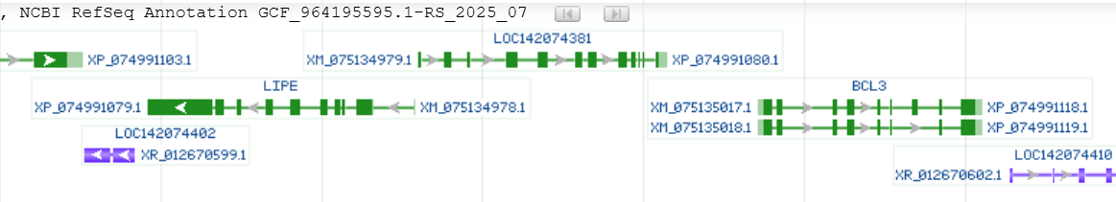
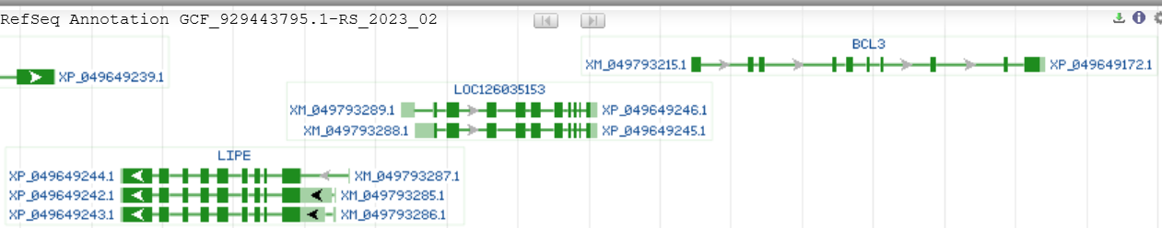
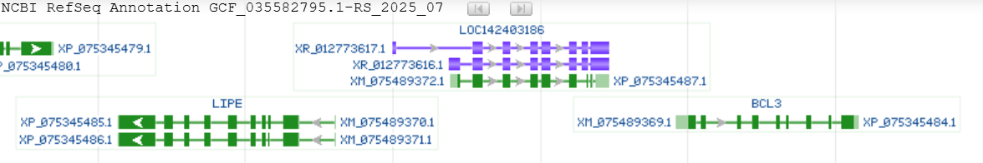
Calonectris borealis (Cory's shearwater) bCalBor7.hap1.2 (GCF_964195595.1) Chromosome 35 - NC_134346.1
= CEACAM1
BUSCO analysis (5.7.1)
Single copy 97.1%
Duplicated 1.5%
Fragmented 0.5%
Missing 0.9%
Astur gentilis (Northern goshawk) bAccGen1.1(GCF_929443795.1) Chromosome 37 - NC_064916.1
BUSCO analysis (4.1.4)
Single copy 98.6%
Duplicated 0.6%
Fragmented 0.1%
Missing 0.7%
= CEACAM1
Mycteria americana (wood stork) USCA_MyAme_1.0 (GCF_035582795.1) Unplaced Scaffold - NW_027445471.1)
= CEACAM1
BUSCO analysis (5.7.1)
Single copy 98.5%
Duplicated 0.5%
Fragmented 0.4%
Missing 0.6%

Slide 4
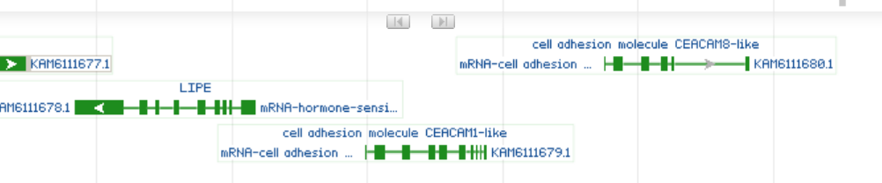
Phoenicopterus ruber ruber (American Flamingo) bPhoRub2.pri GCA_009819775.1 chromosome 30

Slide 5
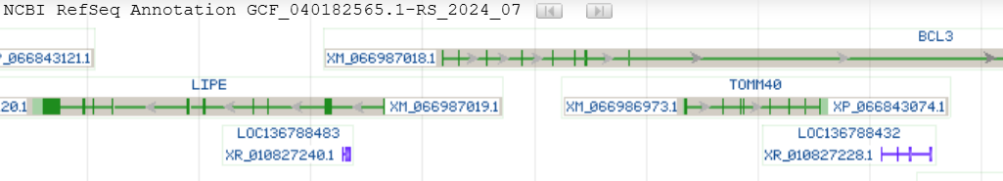
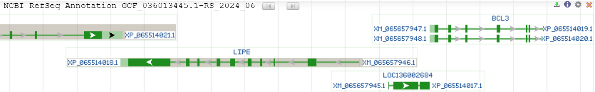
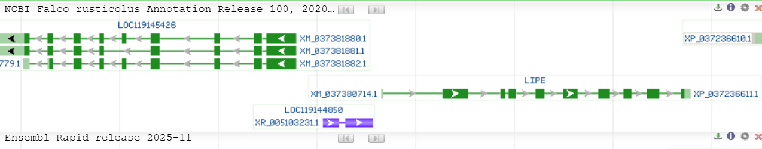
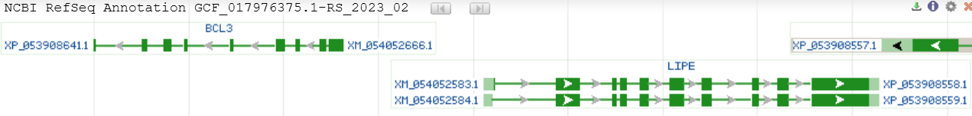
B
Anser cygnoides (Swan goose) Taihu_goose_T2T_genome (GCF_040182565.1) Chromosome 37 - NC_089909.1
BUSCO analysis (5.7.1)
Single copy 98.2%
Duplicated 0.5%
Fragmented 0.5%
Missing 0.8%
Caloenas nicobarica (Nicobar pigeon) bCalNic1.hap1 GCF_036013445.1Unplaced Scaffold NW_027017036.1
BUSCO analysis (4.1.4)
Single copy 99.1%
Duplicated 0.3%
Fragmented 0.1%
Missing 0.5%
Falco rusticolus (gyrfalcon) bFalRus1.pri (GCF_015220075.1) Chromosome 3 - NC_051189.1
BUSCO analysis (4.0.2)
Single copy 98.4%
Duplicated 0.6%
Fragmented 0.4%
Missing 0.6%
Cuculus canorus (common cuckoo) bCucCan1.pri (GCF_017976375.1) Chromosome 35 - NC_071435.1
BUSCO analysis (4.1.4)
Single copy 98.4%
Duplicated 0.5%
Fragmented 0.2%
Missing 0.9%

Slide 6
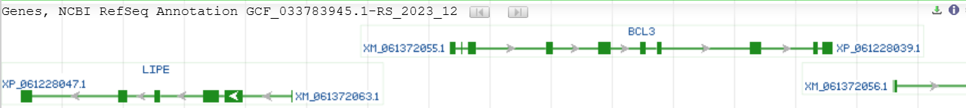
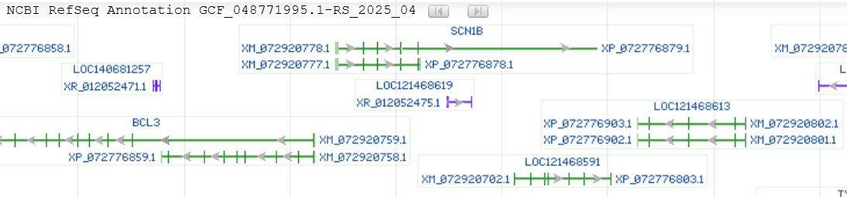
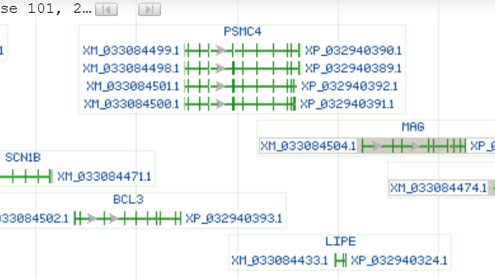
Neopsephotus bourkii (Bourke's parrot) CSIRO-AGI_Nbou_v1 (GCF_033783945.1) Scaffold - NW_026902066.1
BUSCO analysis (4.1.4)
Single copy 97.8%
Duplicated 0.8%
Fragmented 0.4%
Missing 1.0%
Taeniopygia guttata (zebra finch) bTaeGut7.mat (GCF_048771995.1) Chromosome 33 - NC_133058.1
BUSCO analysis (5.7.1)
Single copy 97.9%
Duplicated 0.4%
Fragmented 0.6%
Missing 1.1%
Catharus ustulatus (Swainson's thrush) bCatUst1.pri.v2 (GCF_009819885.2) Chromosome 39 - NC_046259.1
BUSCO analysis (4.1.4)
Single copy 96.3%
Duplicated 2.6%
Fragmented 0.2%
Missing 0.9%

Slide 7
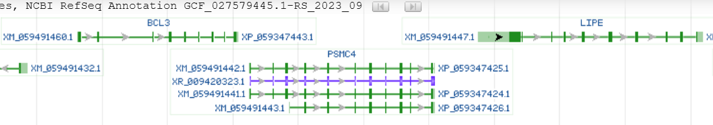
Ammospiza nelsoni (Nelson's sparrow) bAmmNel1.pri (GCF_027579445.1) Chromosome 34 - NC_080666.1
BUSCO analysis (4.1.4)
Single copy 98.7%
Duplicated 0.3%
Fragmented 0.1%
Missing 0.8%
C
Luscinia svecica (bluethroat) Sequence between BCL3 and LIPE
Supplementary Figure 1 - CEA gene family loci in birds with or without CEACAM1. Comparison of the CEA gene family locus in selected bird genomes where CEACAM1 was found (A) and bird genomes where CEACAM1 was not found (B). Screen shots of the NCBI genome graphic view show the sequence between the CEACAM1-flanking genes LIPE and BCL3. Arrowheads indicate the direction of the transcription of the genes. The quality and completeness of the annotation is indicated by BUSCO analysis as provided by NCBI. (C) Analysis of transposable elements in the genomic region between LIPE and BCL3 of the songbird Luscinia svecica. Besides various simple sequences (black lines) a Long Terminal Repeat (LTR) for an ERVL endogenous retrovirus (TguERVL2a2_LTR-La_fAlb) were found by searching in Dfam using Ficedula albicollis dataset as a songbird representative.

