Slide 1
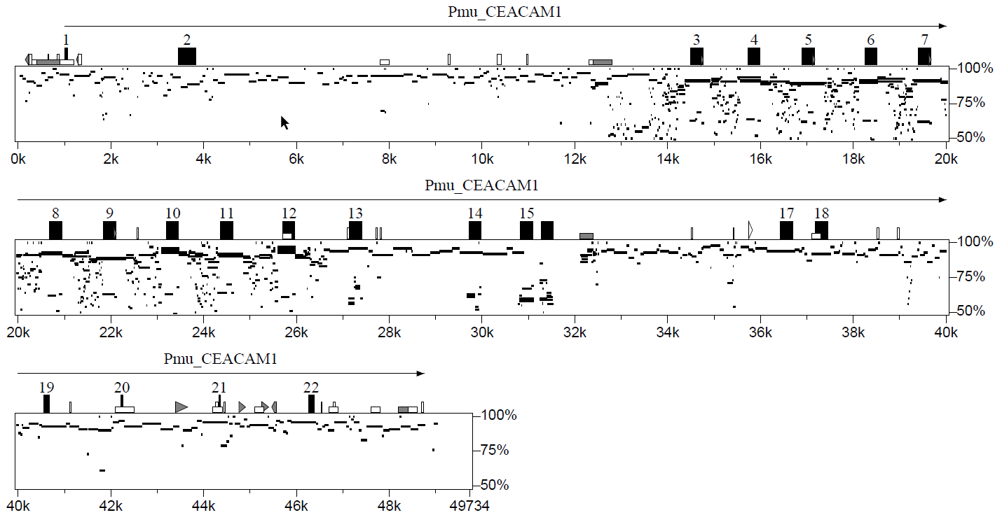
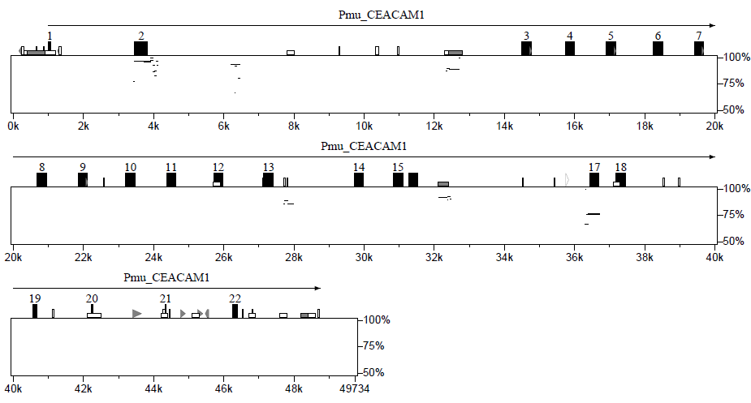
A
Common wall lizard Pmu_CEACAM1
identity
16
Sand lizard Lag_CEACAM1L5
3
B
Common wall lizard Pmu_CEACAM1
identity
16
identity
Common wall lizard Pmu_CEACAM1L1
3
Notes:
What are pared receptors? How are they defined?

Slide 2
Supplementary Figure 10 – Selection for CEACAM N exon diversification and conservation in lizards. (A) Diversification of N exon regions of putative pathogen CEACAM1 receptor genes between common wall and sand lizards was analyzed using the PipMaker program (gene names and species acronyms are shown in the lower right corner of the plot; please note that Lag_CEACAM1L5 represents the CEACAM1 ortholog in sand lizard). For contiguous stretches of nucleotides conserved between gene pairs, the degree of identity was calculated and displayed as horizontal black lines. The location of exons of the gene listed on top of the graphs is indicated by numbered boxes (red, IgV domain-encoding N exons; blue, IgC domain-encoding exons, black, transmembrane and cytoplasmic domain exons). Repeat sequences/mobile elements are shown by differently gray colored and shaped forms. For comparison, the level of conservation of the N exon regions is marked by red dashed lines, that of the most conserved IgC exon by blue lines. Red- and blue-outlined boxes indicate N exon- and C exon-encompassing regions of common identity. (B) Conservation of N exon regions of between CEACAM1 and the putative pathogen CEACAM1L1 decoy receptor gene in the common wall lizard was analyzed as described in (A). Lag, Lacerta agilis (sand lizard); Pmu, Podarcis muralis (common wall lizard).

