Slide 1
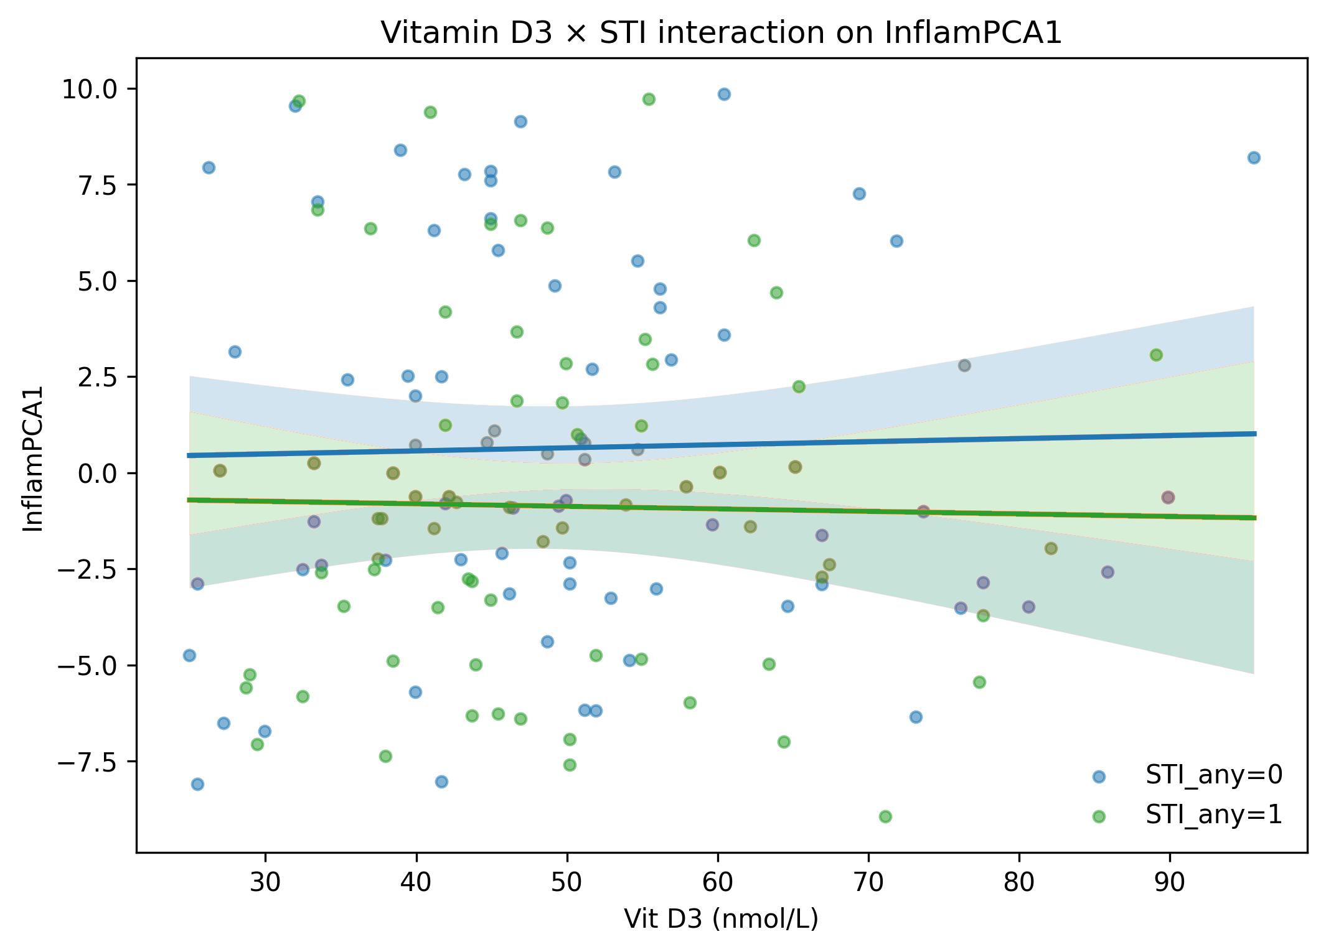
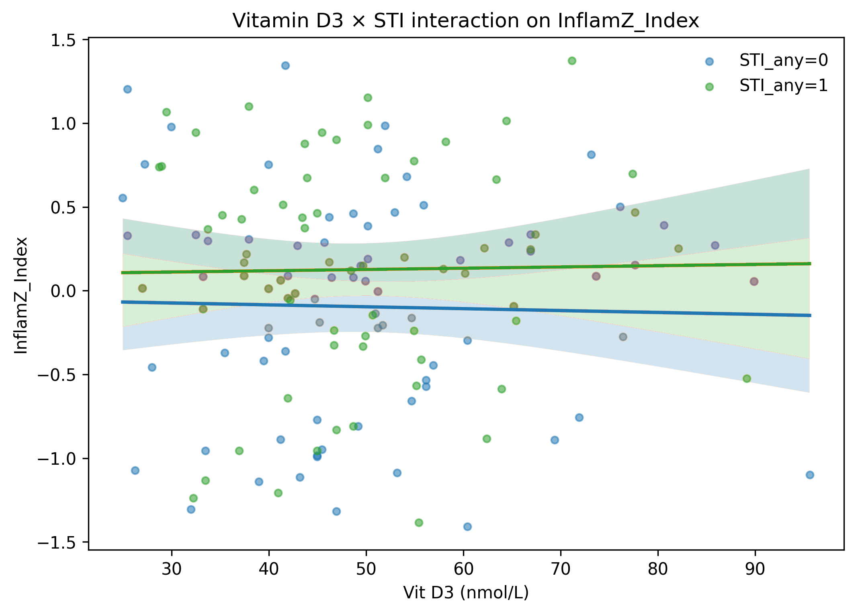
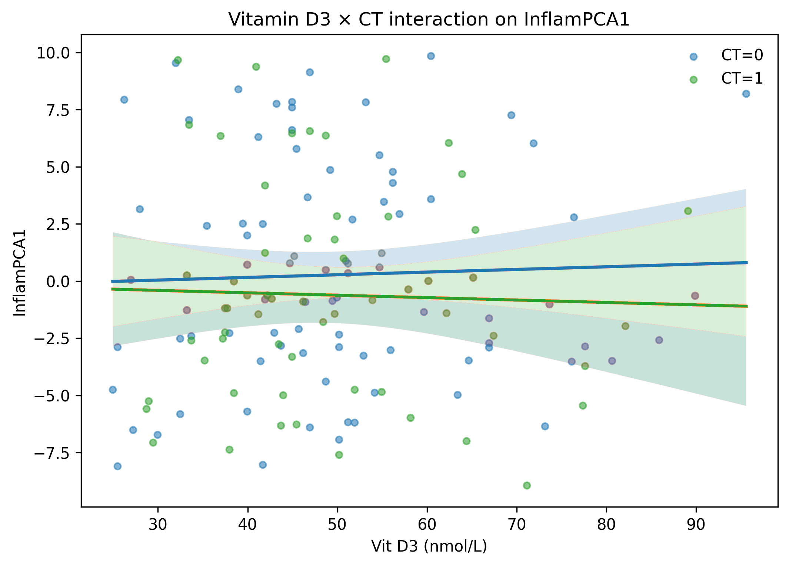
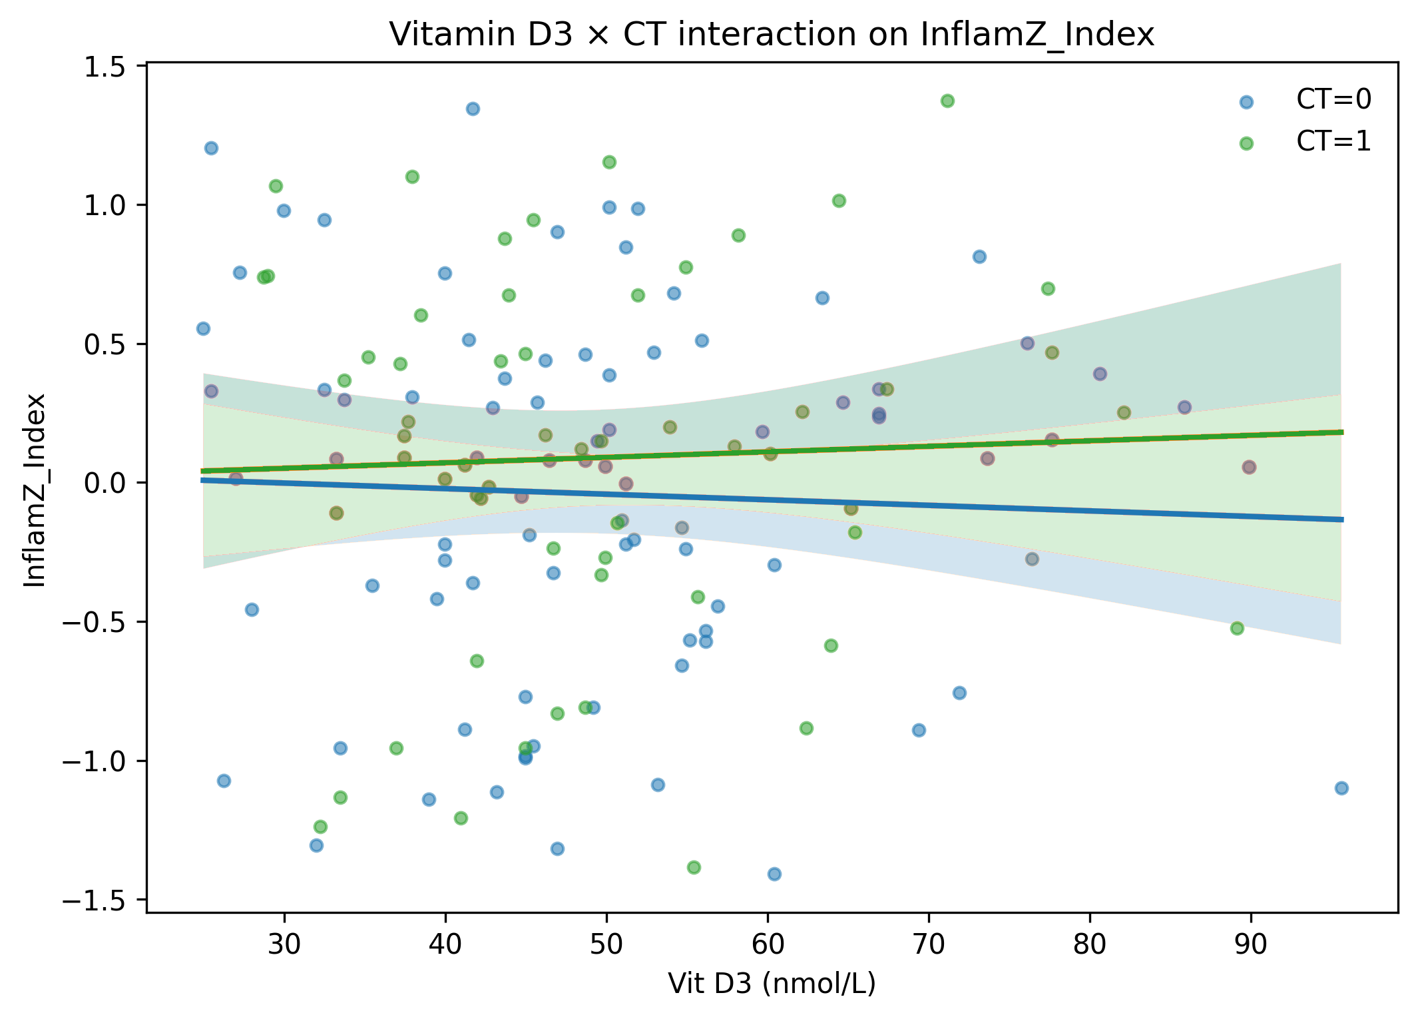
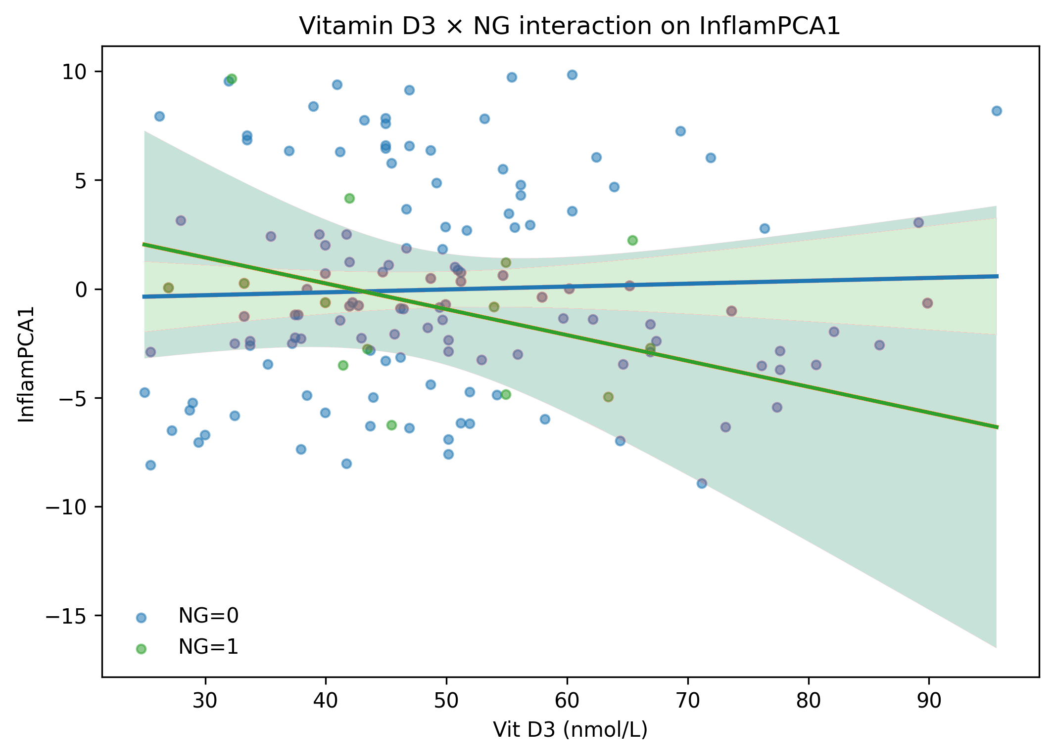
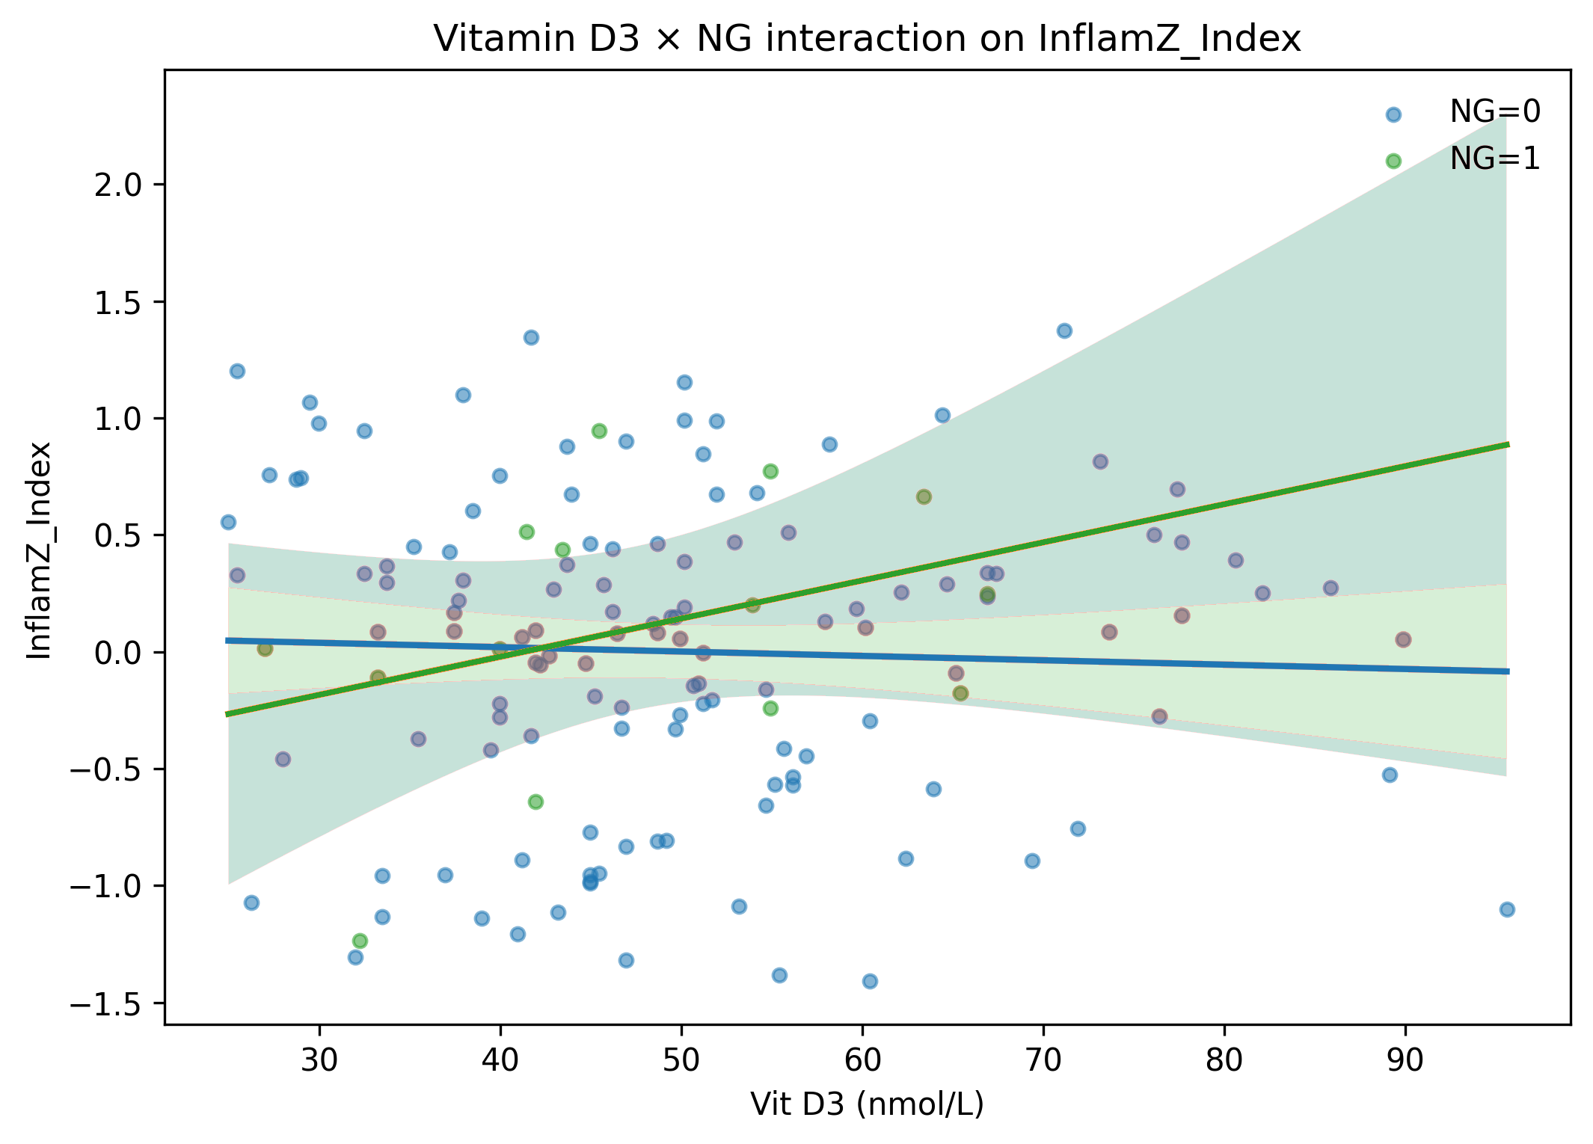
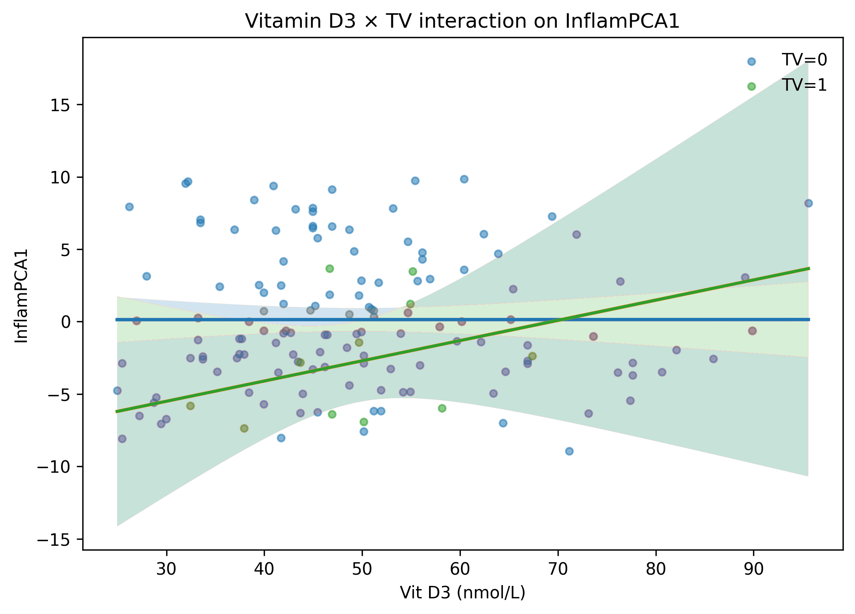
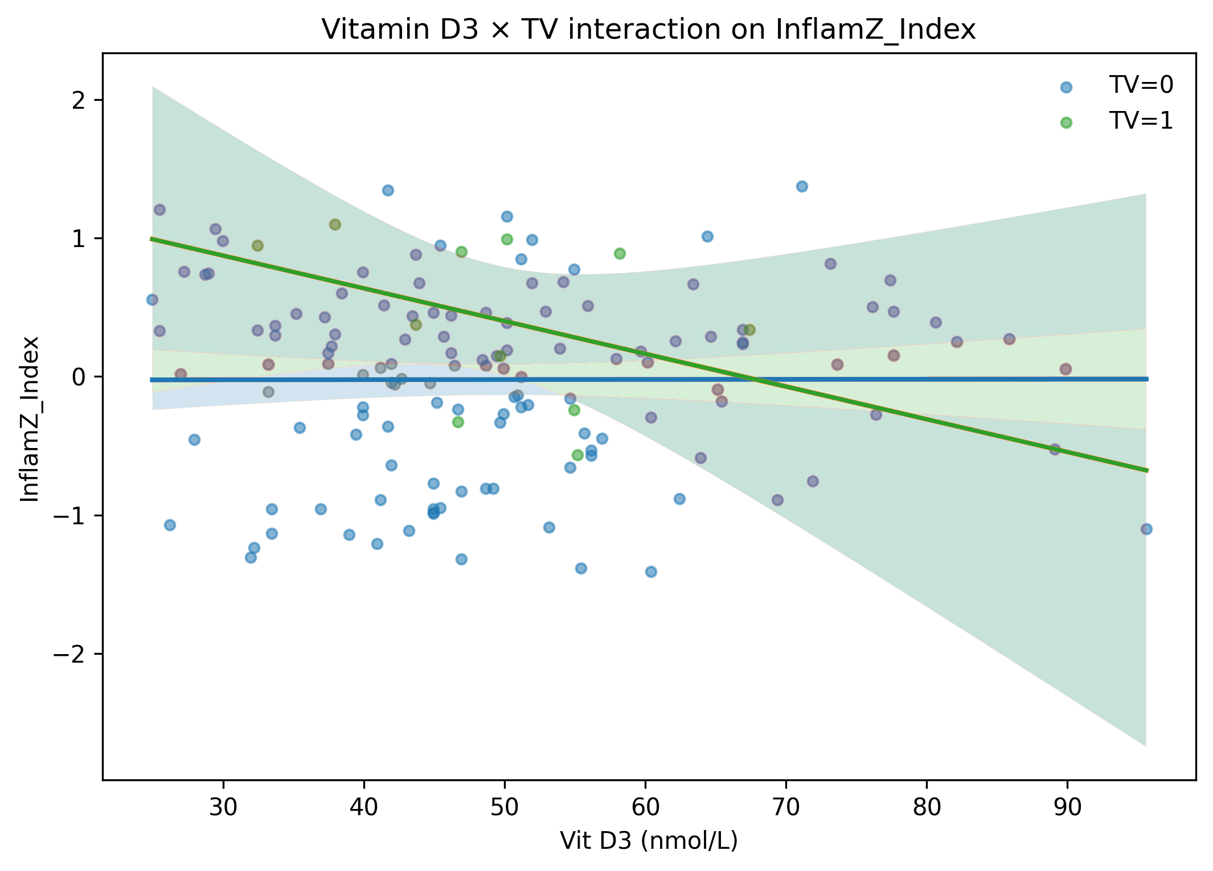
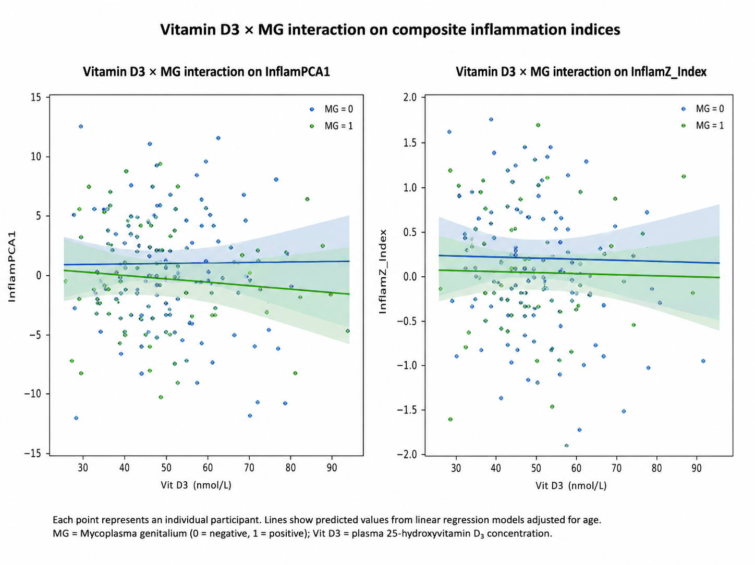
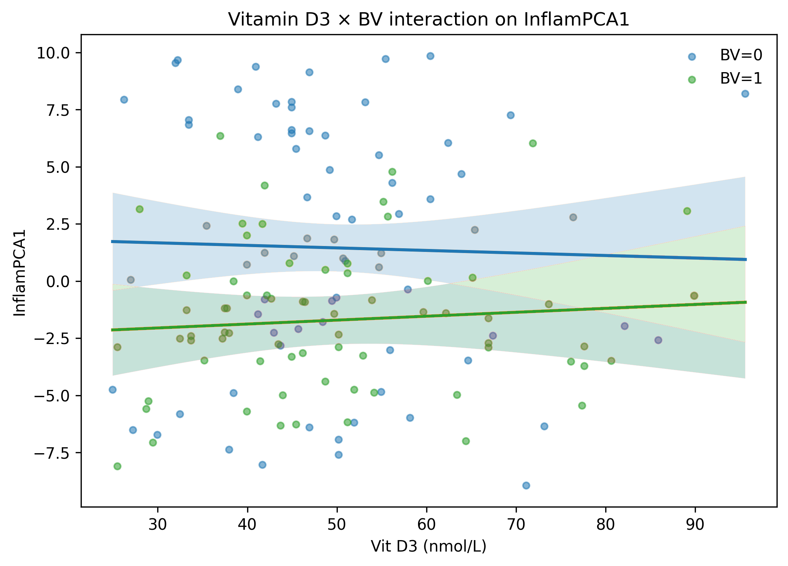
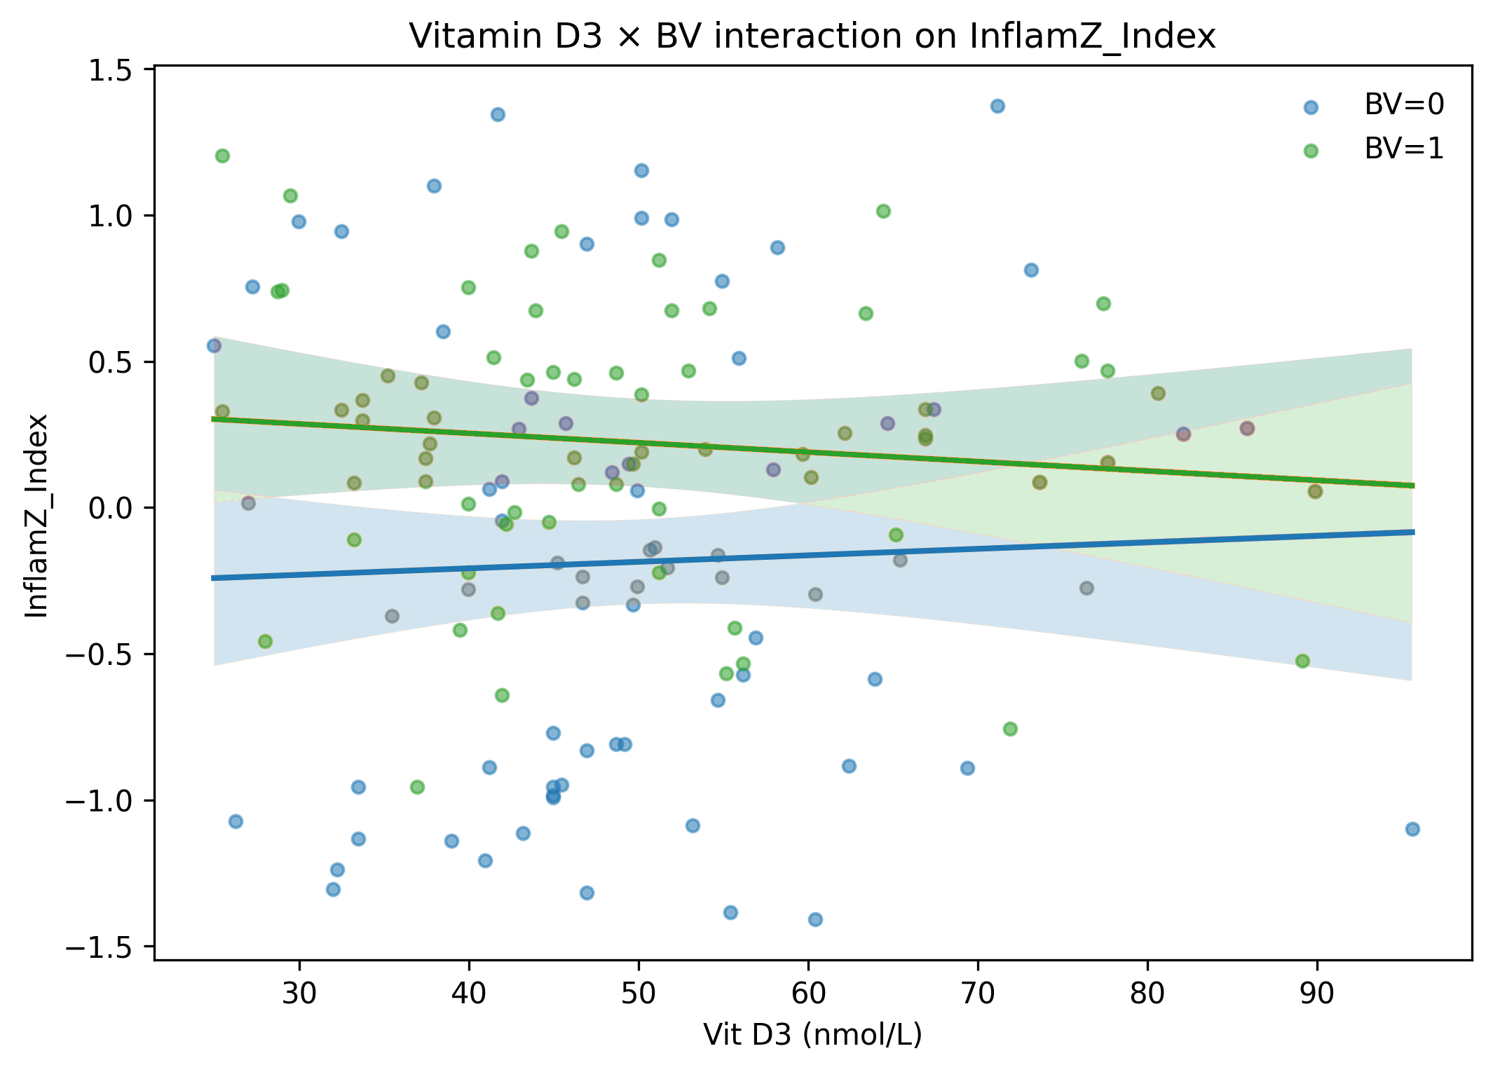
Any STI
CT
Inflammation PCA1 Score
Inflammation Z-Score
NG
TV
MG
BV
Plasma vitamin D₃ concentration (nmol/L)
Supplementary Figure 1

Slide 2
Supplementary Figure 1. Interaction between baseline plasma vitamin D₃ concentrations and genital infections on composite inflammatory indices. Scatterplots show the relationship between enrolment plasma vitamin D₃ concentrations (nmol/L) and two composite genital inflammatory indices: the first principal component (PC1, see supplementary Table 2) derived from cytokine concentrations PC analysis (InflamPCA1; left panels) and a standardized inflammatory Z-score index (InflamZ; right panels). Panels are stratified by infection status at enrollment (any STI, Chlamydia trachomatis [CT], Neisseria gonorrhoeae [NG], Trichomonas vaginalis [TV], Mycoplasma genitalium [MG], and bacterial vaginosis [BV]). Solid lines represent fitted linear regression estimates, with shaded bands indicating 95% confidence intervals. Points represent individual participants at baseline. In each panel, blue dots represent women without these infections/dysbiosis; while green dots represent women infected with CT, NG, TV, MG, or BV. Points represent individual participants, with blue indicating no infection/dysbiosis and green indicating presence of infection or BV. Fitted linear regression lines are colour-matched to each group, with shaded bands showing 95% confidence intervals. Interaction terms between vitamin D₃ and infection status were assessed using age-adjusted linear regression models.

Slide 3
Supplementary Table 1. Characteristics for study participants
COCP: Combined oral contraceptive pill; DPMA: depot medroxyprogesterone acetate; Net-EN: norethisterone enanthate
*Denotes missing data for 15 participants for these characteristics in the database.
Characteristics | Baseline
N Age (years, range) | 144 19 (18-19)
Condoms (always) | 20/129* (16%)
Condoms (last sex) | 96/129* (74%)
Sex w HIV+ partner | 13/129* (10%)
Anal sex (ever) Ever pregnant | 8/129* (6%) 34/129* (26%)
Contraceptive: None Condoms only COCP Implant Net-EN DMPA CCVR | 0/144 (0%) 0/144 (0%) 7/144 (4.9%) 9/144 (6.3%) 101/144 (70.5%) 26/144 (18.1%) 1/144 (0.7%)

Slide 4
Supplementary Table 2. Sensitivity analysis comparing associations between baseline versus prior-visit plasma vitamin D₃ concentrations and incident RTIs
Outcome | Baseline Poisson IRR per 10 nmol/L D3 (95% CI) | p-value | Prior-visit Poisson IRR per 10 nmol/L (95% CI) | p-value
CT | 1.16 (0.81–1.66) | 0,409 | 1.20 (0.84–1.71) | 0,326
NG | 0.66 (0.38–1.15) | 0,139 | 1.02 (0.62–1.70) | 0,927
TV | 0.57 (0.30–1.08) | 0,087 | 0.63 (0.33–1.22) | 0,173
MG | 1.49 (1.06–2.11) | 0,022 | 1.29 (0.84–1.97) | 0,239
BV | 0.95 (0.66–1.36) | 0,767 | 1.21 (0.83–1.76) | 0,311
HPV | 1.07 (0.77–1.47) | 0,693 | 1.06 (0.71–1.59) | 0,785
Supplementary Table 3. Cytokine loadings for the first principal component (InflamPCA1)
Loadings shown are standardized PCA coefficients. Cytokines are ordered by absolute contribution to PC1. Only cytokines with absolute PC1 loadings ≥0.10 are shown. All measured cytokines were included in the PCA.
Cytokine | PC1 loading | Functional class
IL-1α | +0.41 | Pro-inflammatory cytokine
IL-1β | +0.44 | Pro-inflammatory cytokine
IL-6 | +0.38 | Pro-inflammatory cytokine
IL-8 | +0.46 | Chemokine
TNF-α | +0.35 | Pro-inflammatory cytokine
IL-17A | +0.33 | Adaptive cytokine
GM-CSF | +0.31 | Growth factor
MIP-1α | +0.28 | Chemokine
MIP-1β | +0.27 | Chemokine
IP-10 | +0.25 | Chemokine
VEGF | +0.22 | Growth factor
IL-10 | −0.18 | Anti-inflammatory cytokine
IL-4 | −0.12 | Adaptive cytokine
IL-13 | −0.10 | Adaptive cytokine

