Slide 1
Fig . S1.
The last six bands correspond to the original PCR product of OPA1gene,which are 540bp.

Slide 2
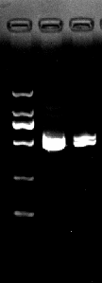
Fig . S2.
The first line shows DNA marker, second line shows the PCR purification product of the original OPA1 gene band at 540bp

Slide 3
Fig . S3.
The last four bands show the original bands of PCR result of OPA1-pET-32a bacterial solution (Clone) with the expected bands size is 540bp

Slide 4
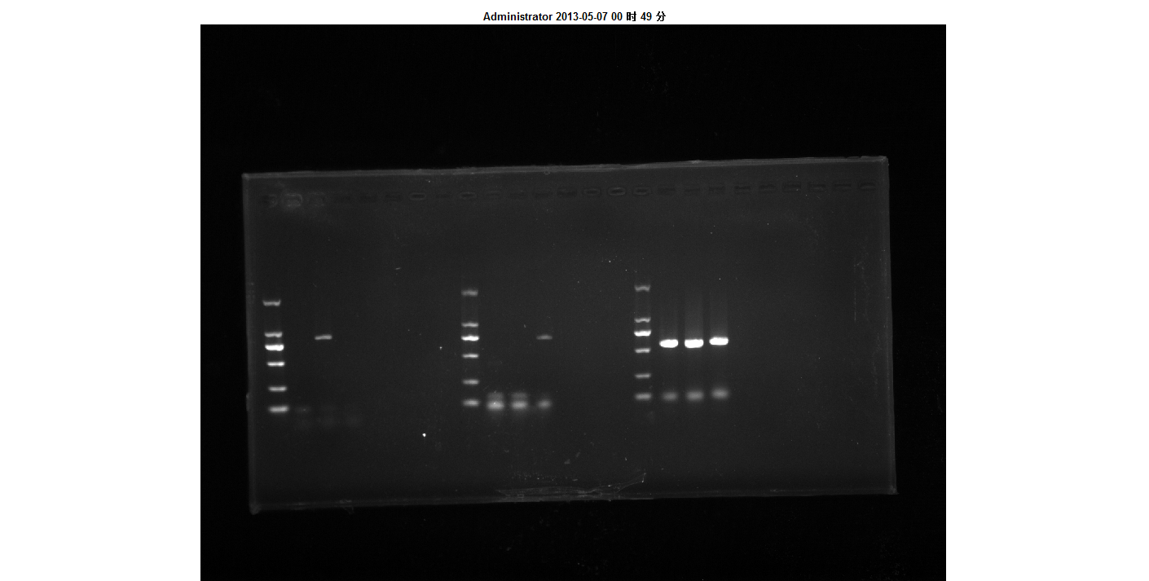
Fig . S4.
The last three bands show The original PCR result of recombinant OPA1-pET-32 expression vector with the expected band size 540bp

Slide 5
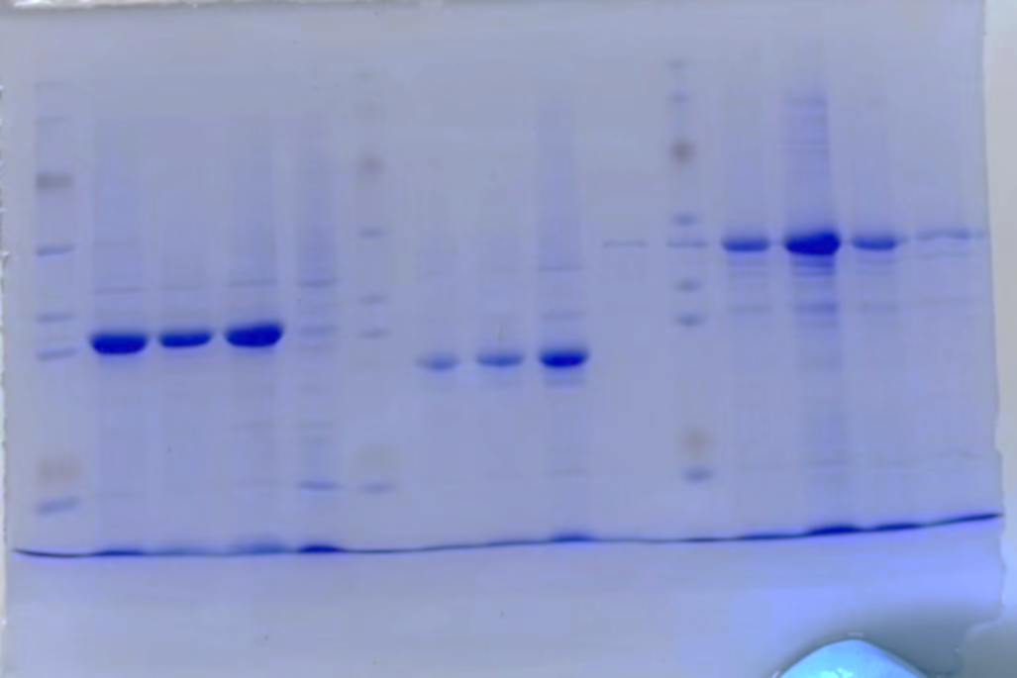
Fig . S5.
The first line is Protein marker(20-150kDa),the following three bands shows the OPA1recombinant protein with IPTG, followed line shows uninducible protein (without IPTG).

Slide 6
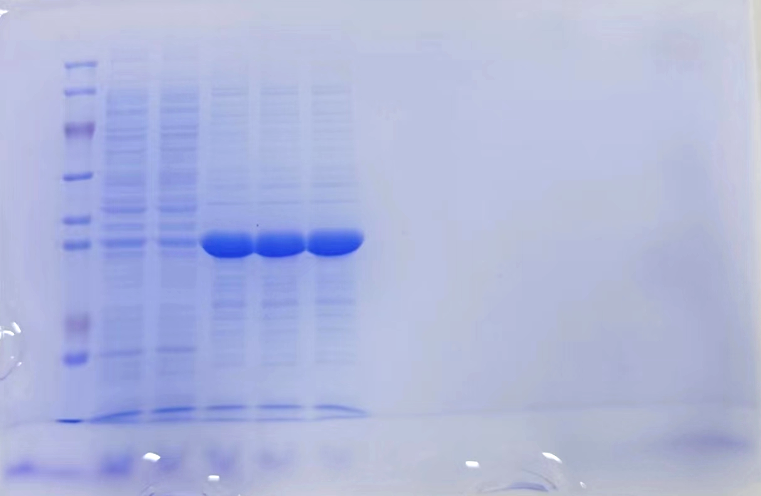
Fig . S6.
Inclusion bodies of recombinant OPA1 protein. The first is Protein marker, Lane 1-2 show, The OPA1 recombinant protein in the supernatant; Lane 3-4: The target protein in the precipitate after sonication.

Slide 7
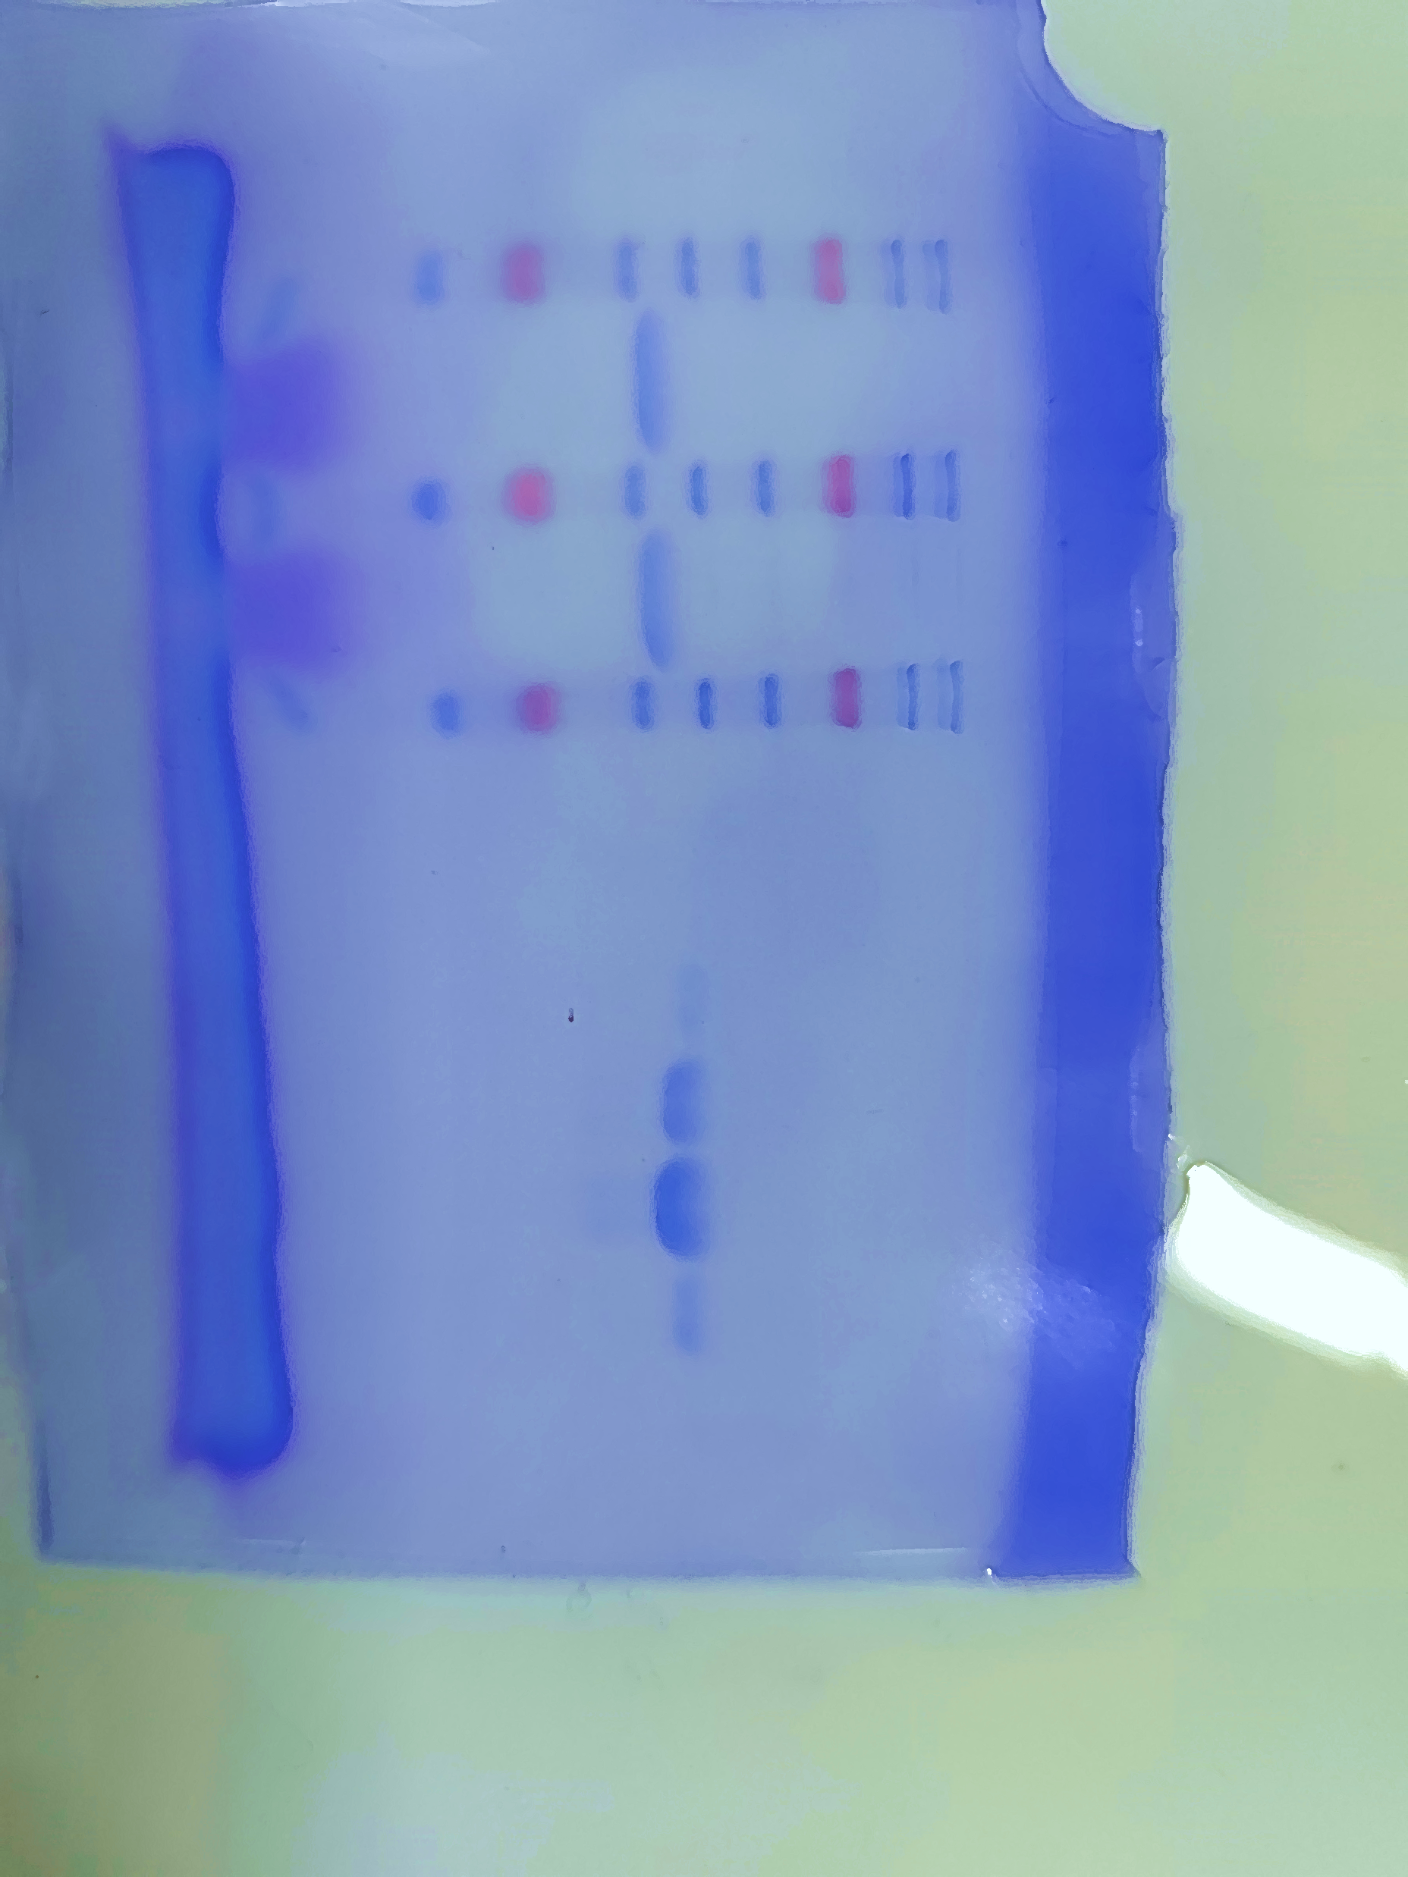
Fig . S7.
The last three bands shows the elution of target protein in different imidazole concentrations.

Slide 8
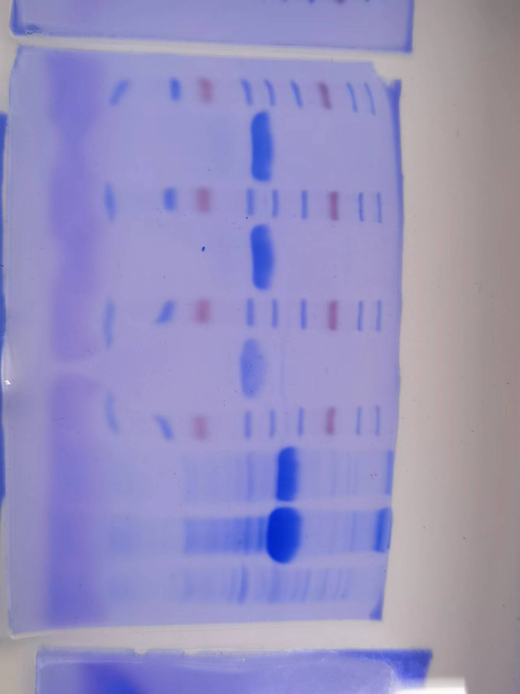
Fig . S8.
The second one are the bands used to show the Concentrated recombinant OPA1 protein in the article

Slide 9
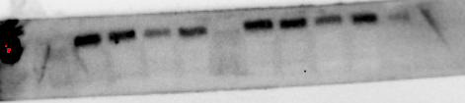

Fig . S9.
Effects of Naringenin and Heat stress on OPA1 protein level.
The above original picture of OPA1 at 85kda which is first bands is Control group , second Control+ Naringenin , third is Heat stress and last band is heat stress + naringenin. The last picture is actin with 42 kDa.

