Slide 1
Videos of B-S-C-S-I-Based
Spinal Nerve Bridging Experiments in Rats
（Video1-6）

Slide 2
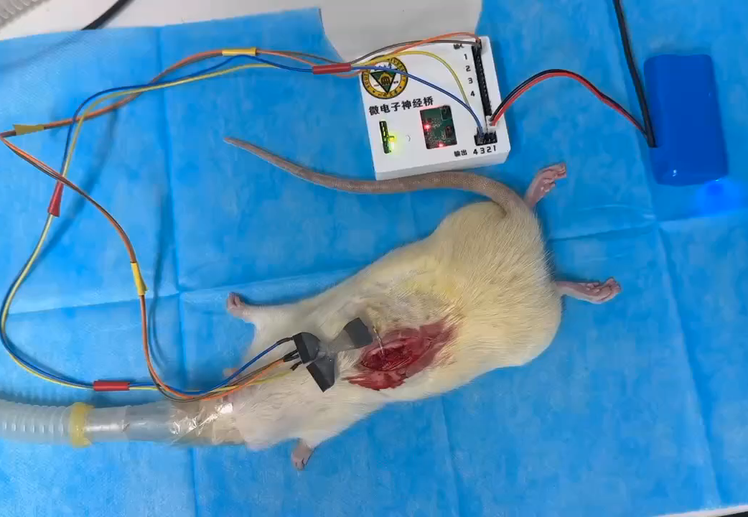
Video1：
An automatic tail flick in a spinal cord-transected rat under incomplete anesthesia after neural bridging

Slide 3
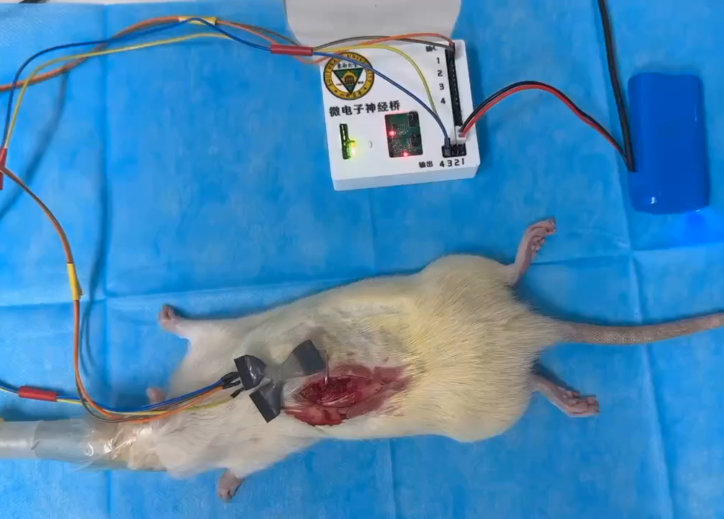
Video2：
An automatic withdrawal of the right hindlimb of the same rat as in Video1

Slide 4
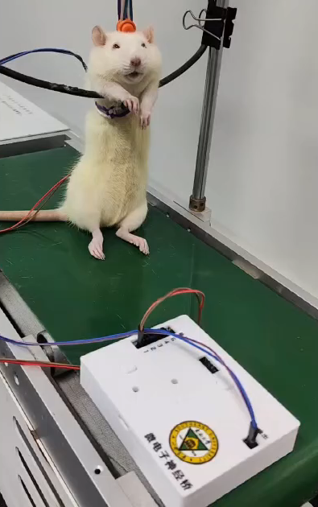
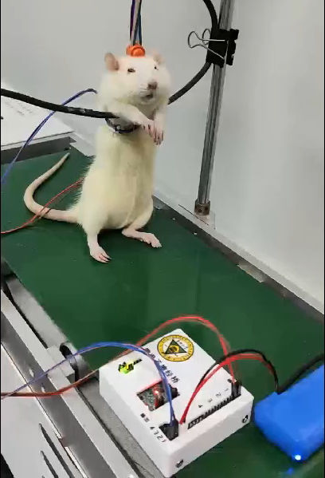
Video3:
Right hindlimb extension on a treadmill in a second awake spinal cordtransec-ted rat after neural bridging
Video4：
Five-toe extension in an awake spinal cord-transected rat after neural bridging

Slide 5
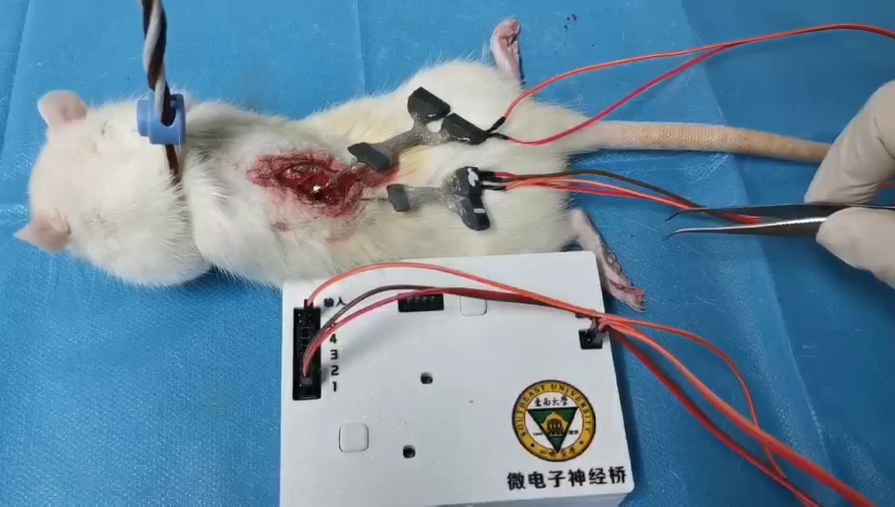
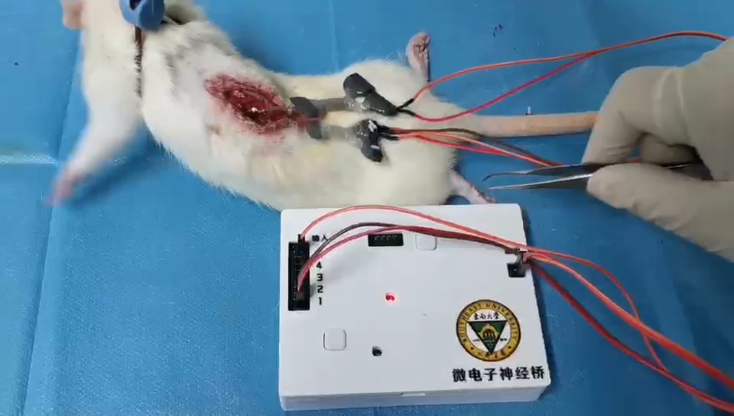
Experimental Video of Sensory Nerve Signal Bridging
in Spinal Cord Injury Rats Based on Microelectronic Neural Bridge Device
Video5:
Pre-activation of ascending sensory nerve bridging device
Video6：
Post-activation of ascending sensory nerve bridging device

