Slide 1
Western Blot analysis for EV marker BIP
Met5A
VMC23
CL
2.8K 10K 100K
MSTO
CL
2.8K 10K 100K
CL
2.8K 10K 100K
78 kDa
78 kDa

Slide 2
Western Blot analysis for EV marker CD9
Met5A
VMC23
MSTO
CL
2.8K 10K 100K
CL
2.8K 10K 100K
CL
2.8K 10K 100K
24 kDa
24 kDa

Slide 3
Western Blot analysis for EV marker CD81
VMC23
MSTO
CL
2.8K 10K 100K
CL
2.8K 10K 100K
Met5A
CL
2.8K 10K 100K
26kDa
26kDa

Slide 4
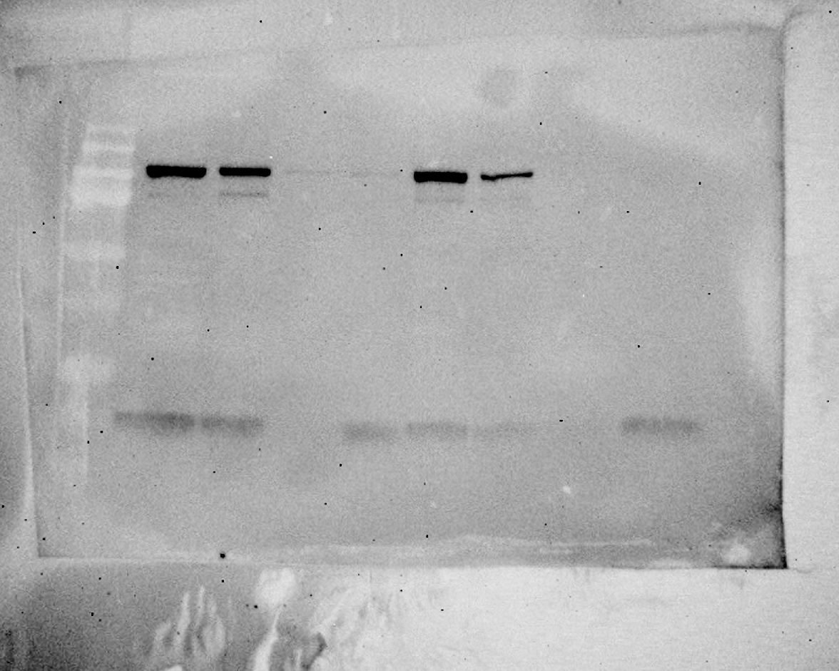
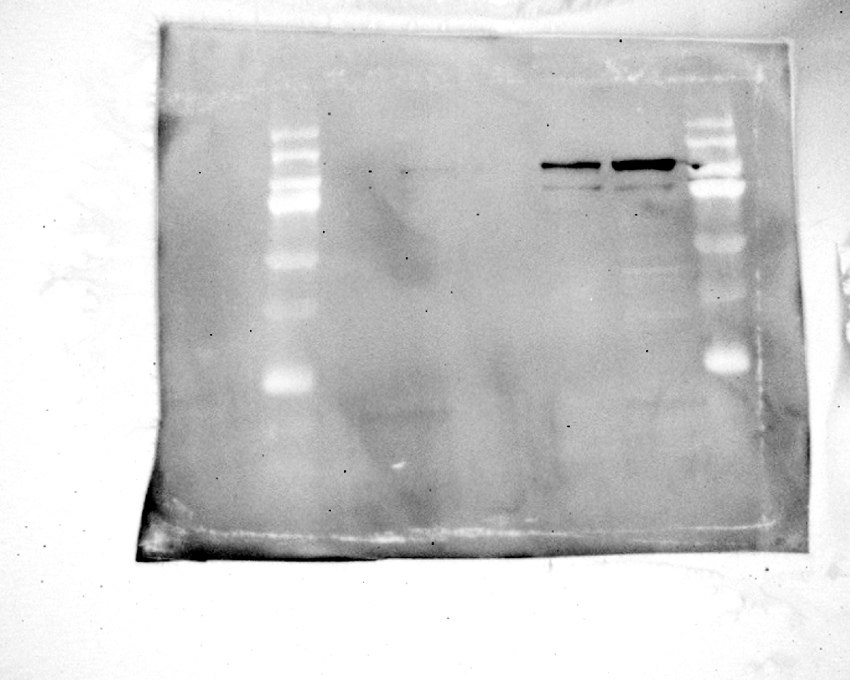
Western Blot analysis for EV marker GPR94
VMC23
MSTO
Met5A
CL
2.8K 10K 100K
CL
2.8K 10K 100K
CL
2.8K 10K 100K
94 kDa
94 kDa

Slide 5
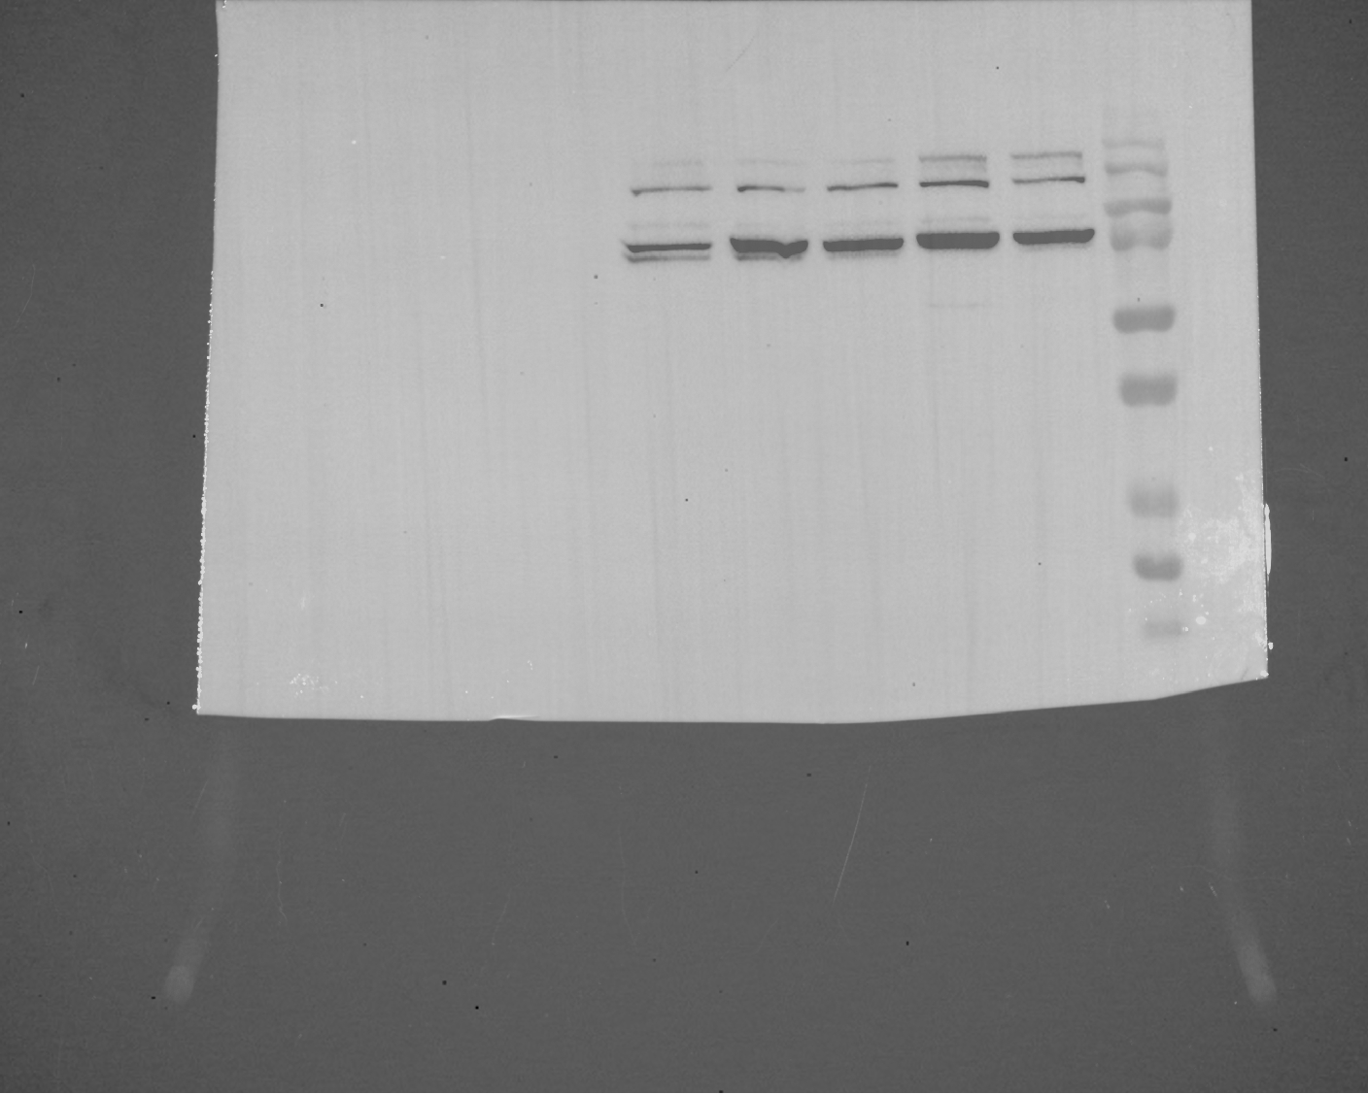
Western Blot analysis for pEZH2 (Thr345)
Actin
pEZH2 (Thr345)
CT
TGF-β
Met5A
VMC
MSTO
TGF-β
CT
Met5A
VMC
MSTO
98 kDa
42 kDa

