Slide 2
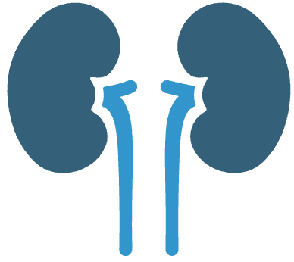




10 Year Kidney Outcomes & Healthcare Utilization in a Cohort of Pediatric Patients with Severe AKI by Subphenotype
18-82% of hospitalized children experience AKI
AKI is associated with worse short and long-term outcomes
AKI subphenotypes may result in differences in outcomes
572 patients admitted to a single PICU were evaluated
A total of 57 patients had AKI
Assigned AKI subphenotypes were sepsis associated, hemato-oncologic, cardiac, nephrotoxic medication associated, renal and other
Hospital admissions were 13-days longer for patients with AKI
Patients with nephrotoxic medication associated and hemato-oncologic AKI experienced the highest-proportion of mortality and longest hospital admissions
Created in BioRender. Rumlow, Z (2026)

