Slide 1
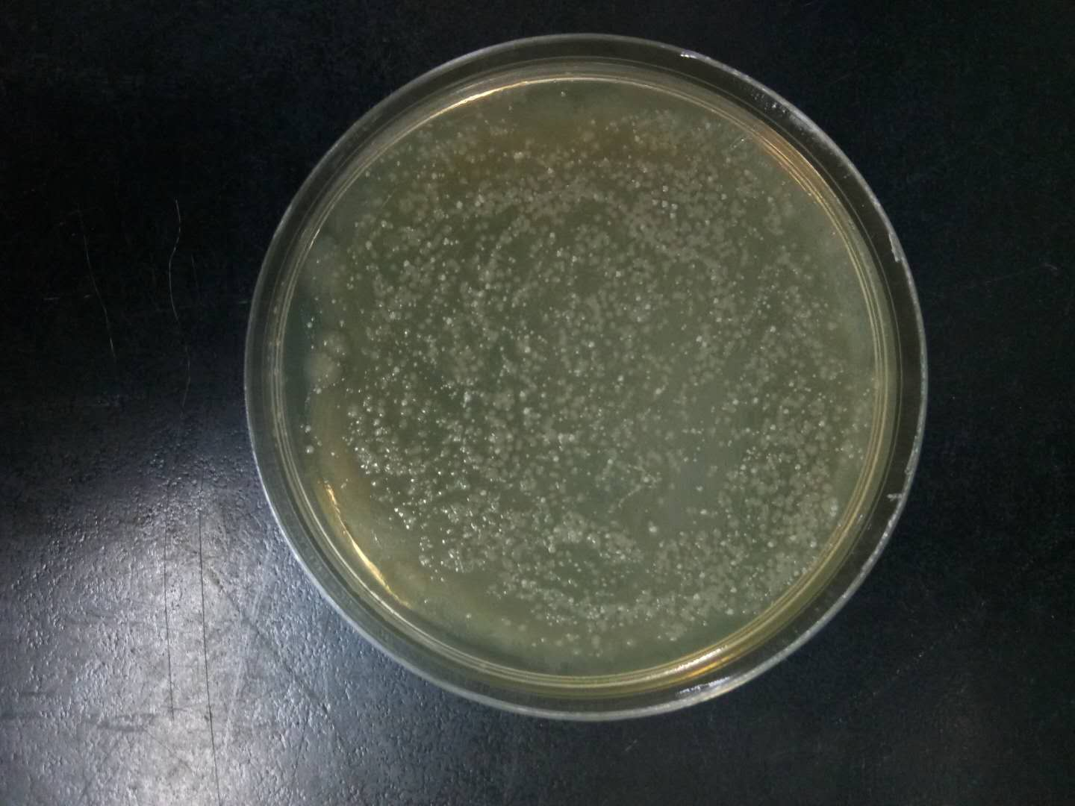
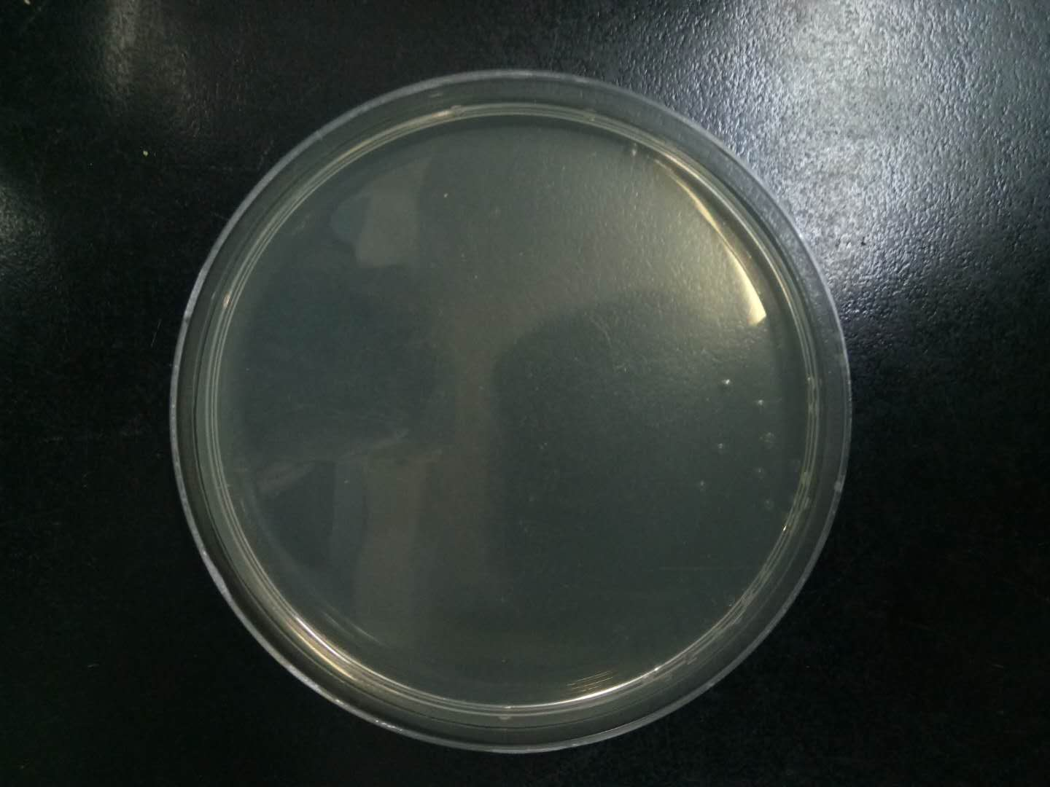
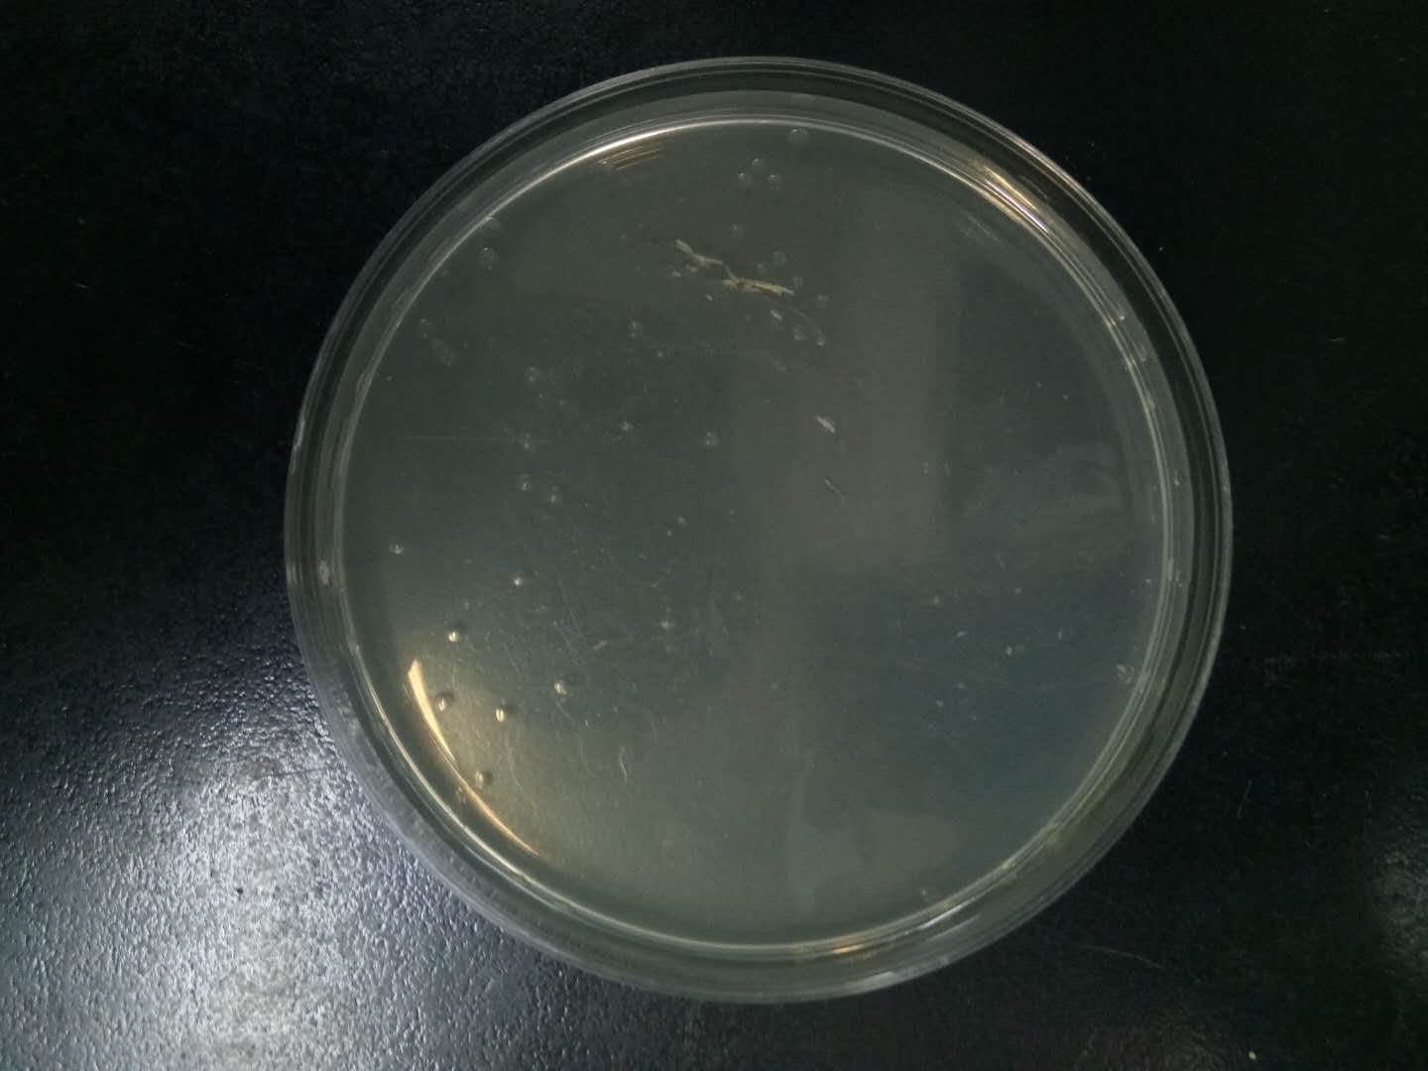
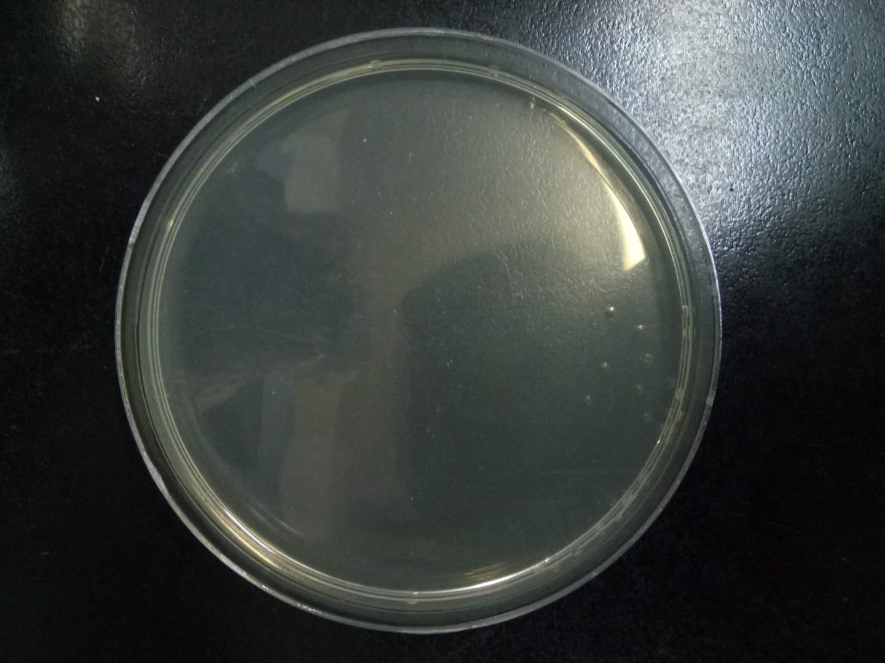
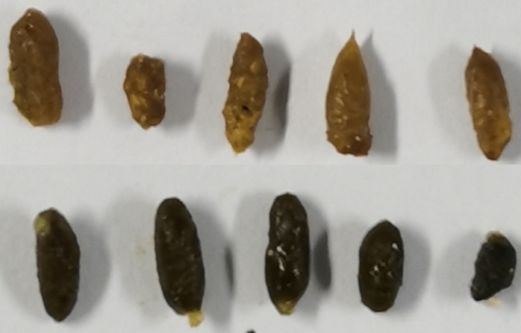
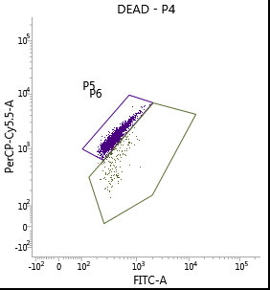
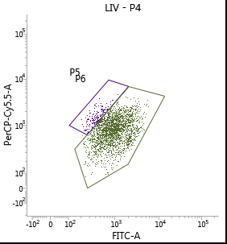
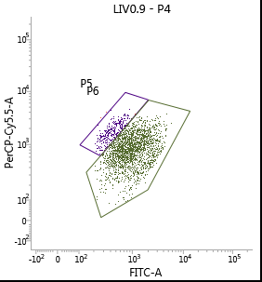
A
B
Control
Antibiotics-treated
Healthy control
FMT-saline
FMT-saline
FMT-Healthy patients
FMT-IMN patients
-7
-6
-5
-4
-3
-2
-1
0
1
2
3
4
5
6
7
8
9
10
11
12
13
14
15
16
17
FMT-Healthy
FMT
FMT
FMT
Urine, blood and tissue sample collection for analysis
Antibiotic treatment
Fecal microbiota transplantation(FMT)
FMT-IMN
A
C
D
Dead
Live
Before antibiotic
98.3%
92.7%
92.7%
89.7%
89.7%
Antibiotic-treated
FMT-saline
FMT-Healthy
FMT-IMN
Fecal microbiota of healthy control
Fecal microbiota of IMN patients

