Slide 1
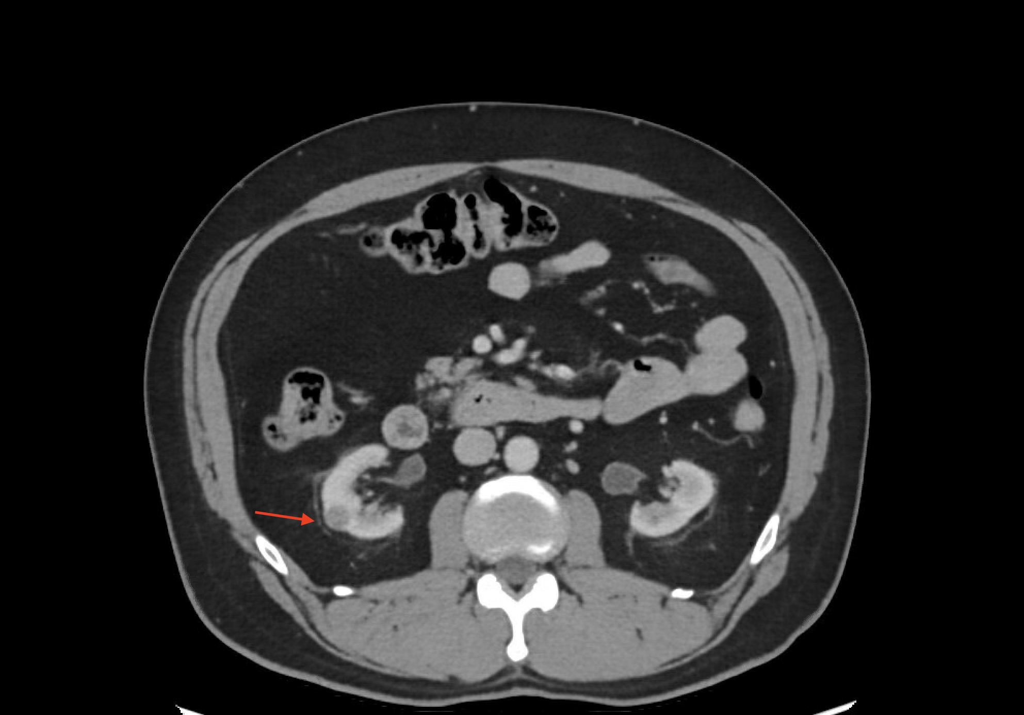
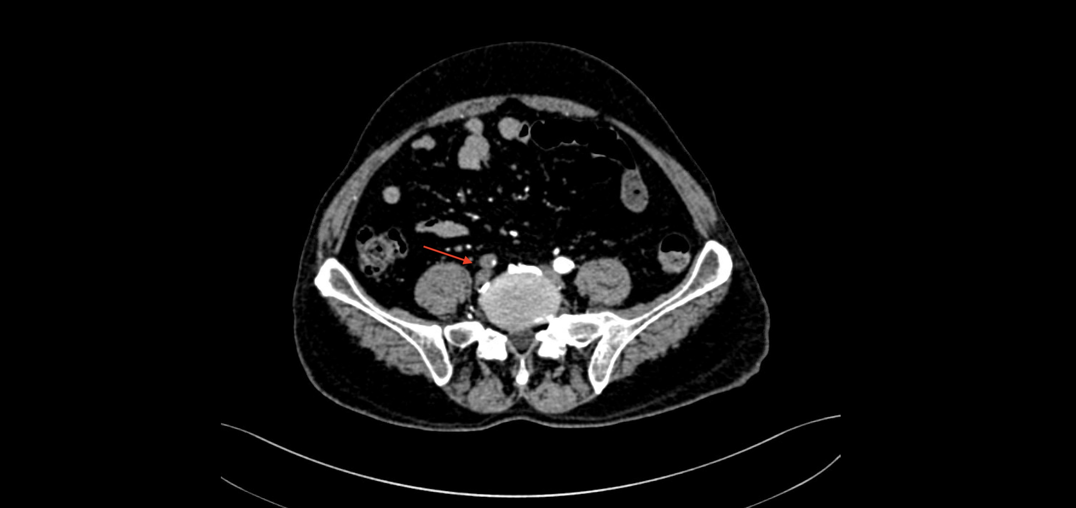
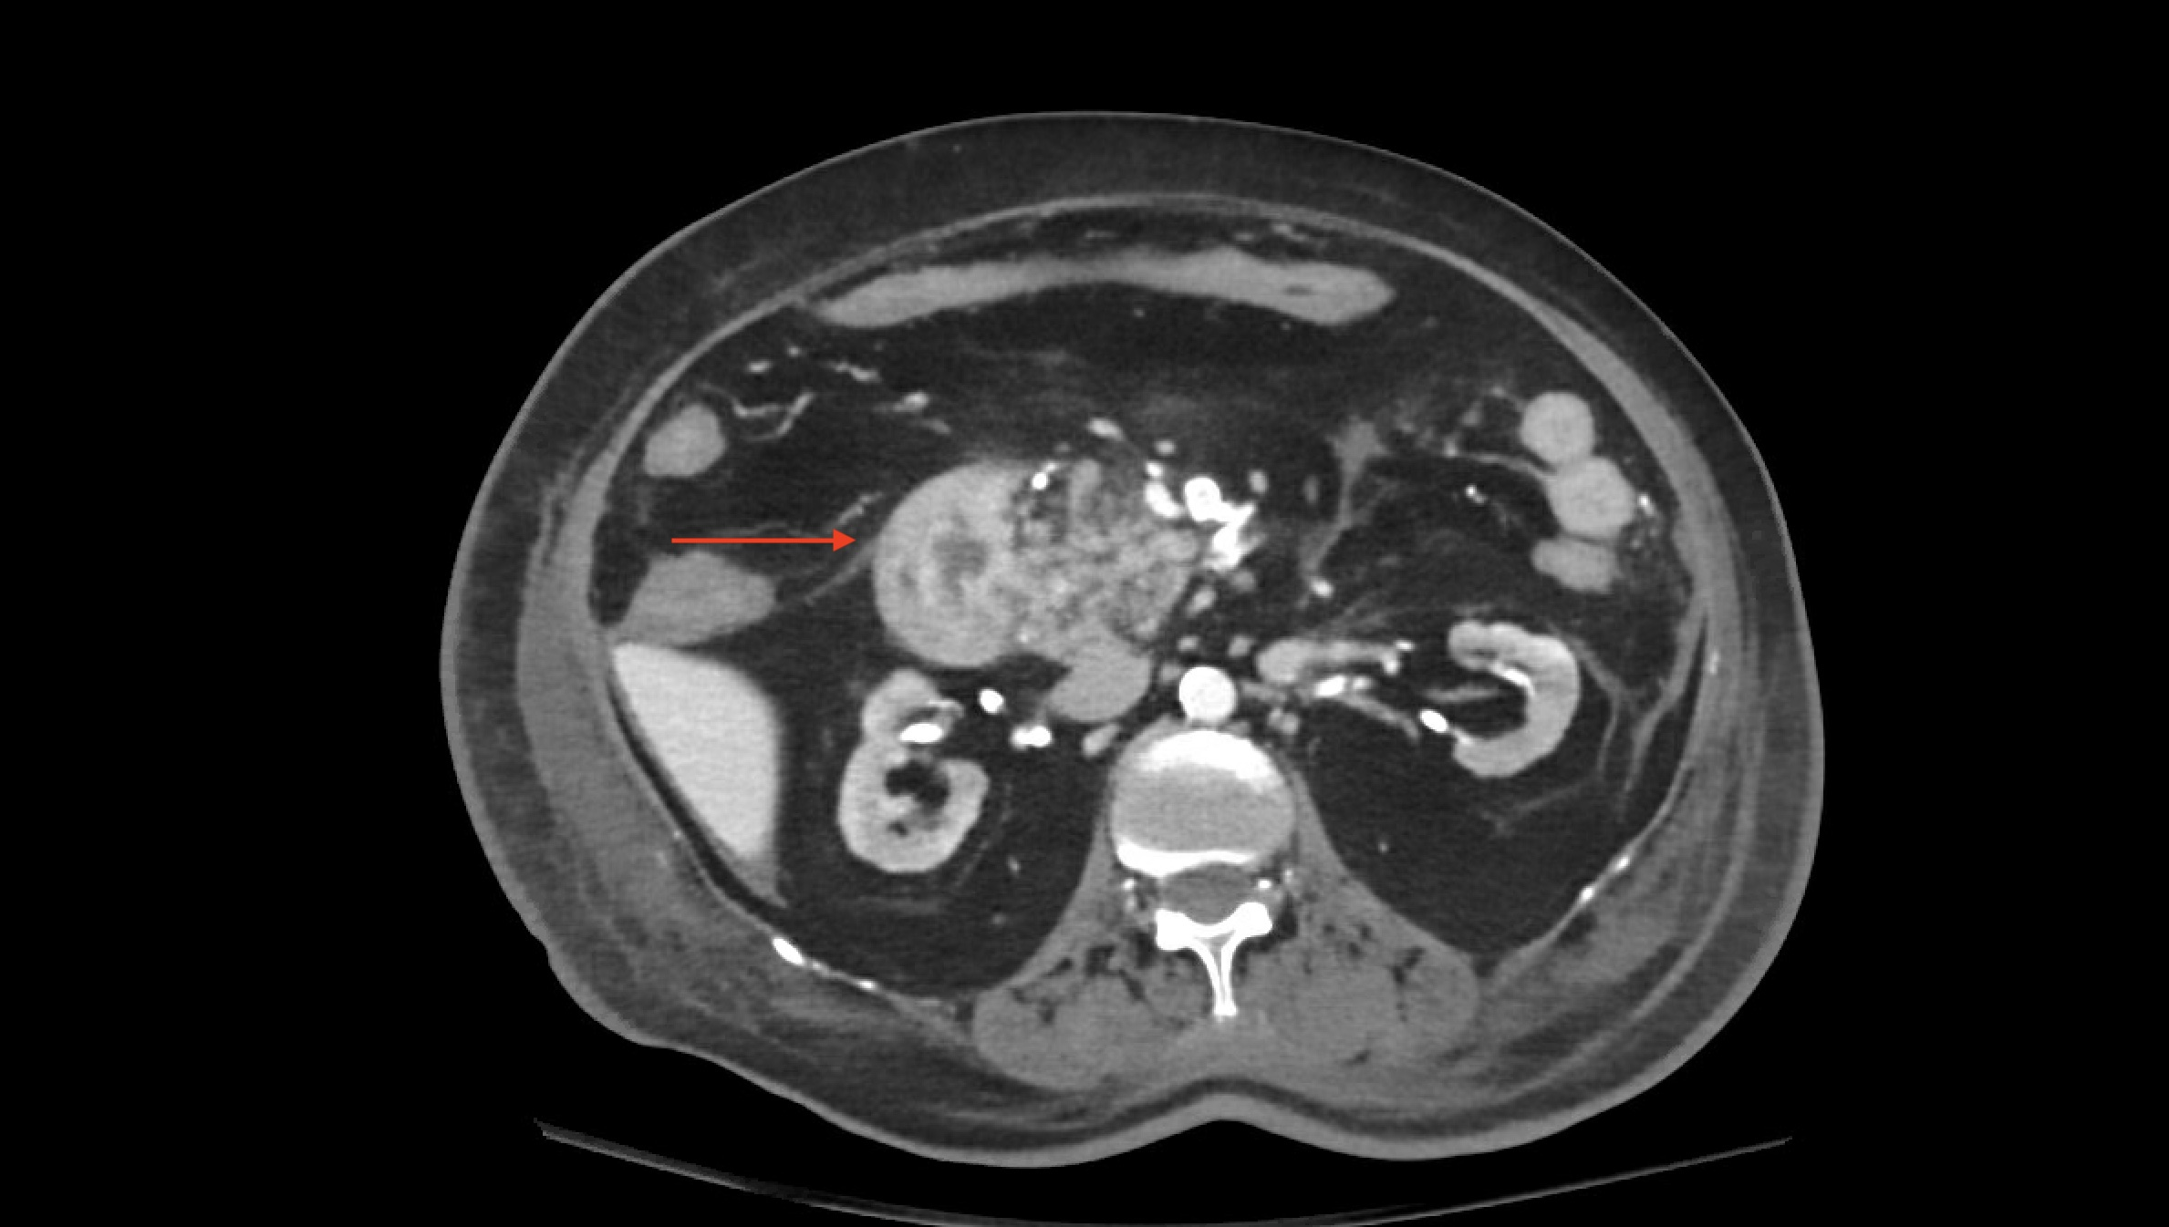
ORIGINAL RESEARCH
Dual Yield of Pre-Transplant CT Angiography in Renal Transplant Recipients
Incidental Extra-Vascular Findings, Predictors, and Implications for Surgical Planning
KEY FINDINGS
STUDY DESIGN
23.1%
Setting: Tertiary transplant centre, Jeddah, Saudi Arabia
Design: Retrospective cohort — January to December 2024
Clinically Significant IFs (ACR Type 3+)
Cohort: 143 consecutive renal transplant recipients
33 / 143 recipients — exceeds 5% actionability threshold
Mean age: 51.8 ± 13.6 years; 62.2% male
Fig 1 — Bosniak III renal cyst (ACR Type 3)
60.1%
Method: Blinded dual-reader review, ACR IF White Papers (2023)
Surgically Relevant Vascular Findings
Comorbidities: HTN 78.3%, DM 63.6%, mean CCI 4.2 ± 1.8
86 / 143 — directly altered operative planning
OR 9.64
CONCLUSION
Pre-transplant CTA delivers dual clinical value: surgically relevant vascular findings in 60.1% of recipients and ACR Type 3+ incidental findings in 23.1%. The strong association with vascular burden and identification of female sex as a significant univariate predictor provide actionable data for pre-transplant imaging triage. Systematic ACR-based incidental finding review should be standard in pre-transplant CTA reporting.
Vascular Finding → Significant IF
Fig 2 — Calcific iliac stenosis (Surgical finding)
95% CI 2.80–33.2; p<0.001 — strongest predictor
OR 2.91
Female Sex → Significant IF
95% CI 1.27–6.66; p=0.013 — significant univariate predictor
Interobserver Agreement: κ = 0.78 (95% CI 0.66–0.90) — Substantial
Systematic ACR IF review recommended as standard component of pre-transplant CTA reporting
Fig 3 — Mesenteric mass (ACR Type 3, oncology referral)
AlQudsi H, Krimli D, Felemban A, Nadra K, Meer E, Alsayed M, Zia Z | King Faisal Specialist Hospital and Research Centre – Jeddah, Saudi Arabia | BMC Medical Imaging (2026)

