Slide 1
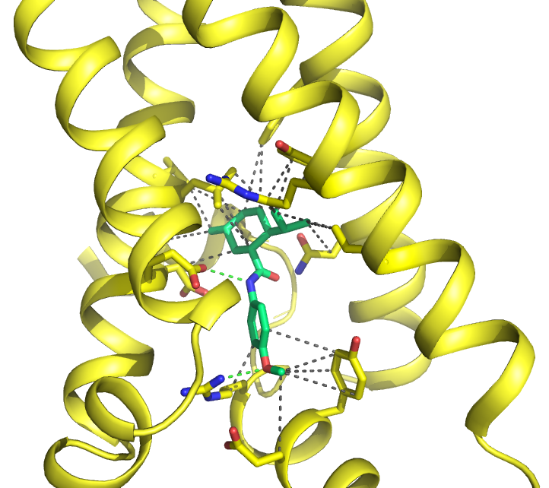
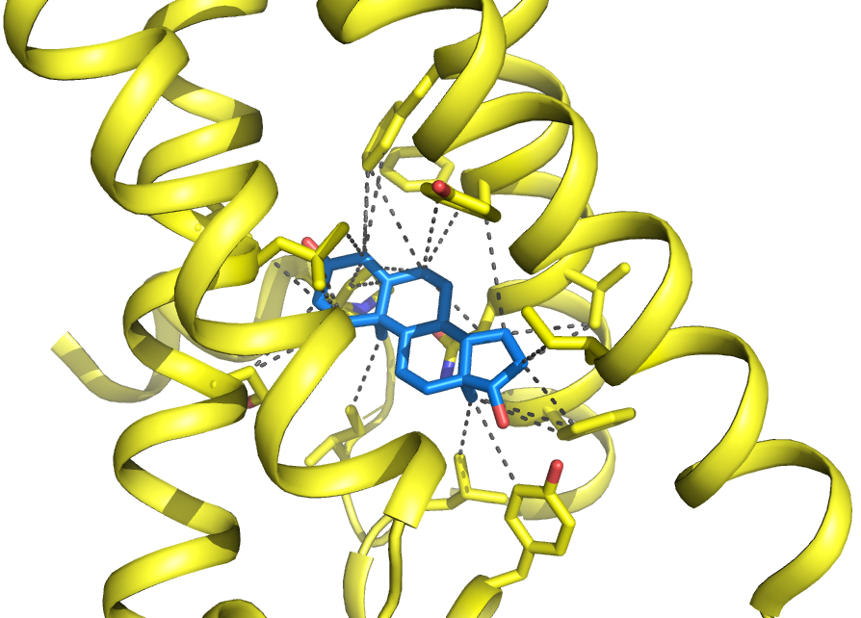
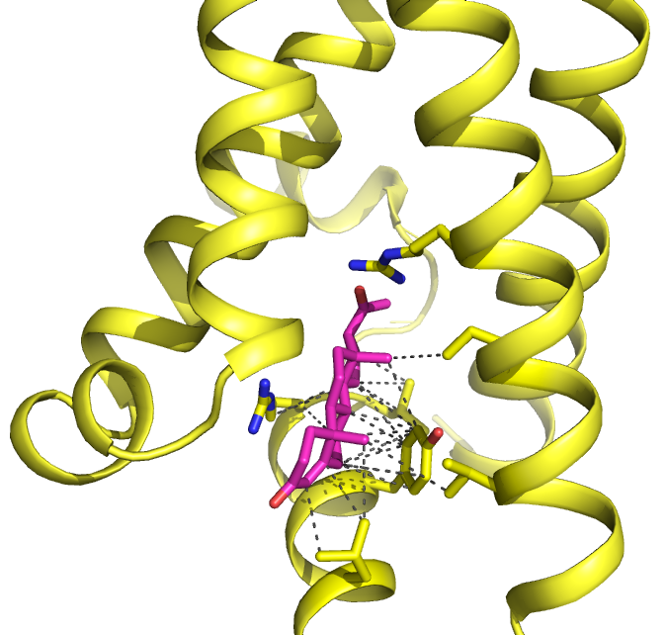
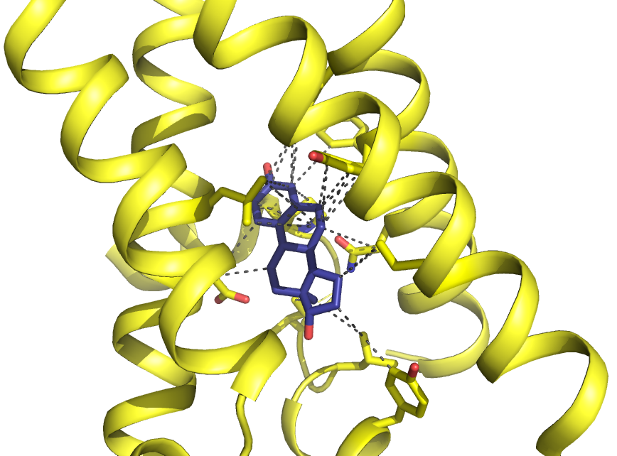
Supplementary Figure 5
A
WS12 - hTRPM8
B
Testosterone - hTRPM8
∆G (kcal/mol) = 8.1; Kd (nM) = 1147.3
∆G (kcal/mol) = 9.67; Kd (nM) = 80.9
S1
S1
S3
S2
S3
S4
S4
S2
TRP
TRP
C
Progesterone - hTRPM8
D
Estradiol - hTRPM8
∆G (kcal/mol) = 9.37; Kd (nM) = 134.3
∆G (kcal/mol) = 8.15; Kd (nM) = 1054.4
S3
S1
S2
S1
S3
S4
S2
TRP
TRP
S4
Supplementary Figure 5. Binding of the menthol derivative WS12 and sexual hormones to the human TRPM8 menthol pocket after local docking simulations.
A WS12 B Testosterone C Progesterone D Estradiol. The TRPM8 structure is shown as yellow cartoon representing with sticks the side chains involved in the binding. WS12 and testosterone are shown as sticks of different color. Gray-dashed lines indicate Van der Waals interactions with ligands, whereas blue-solid lines are hydrogen bonds. Hydrogen atoms have been removed. S1, S2, S3, S4 and TRP are TRPM8 transmembrane domains. ∆G is an estimation of the binding energy. Kd is the dissociation constant calculated with ΔG using the equation ΔG=R·T·lnKd.

