Slide 1
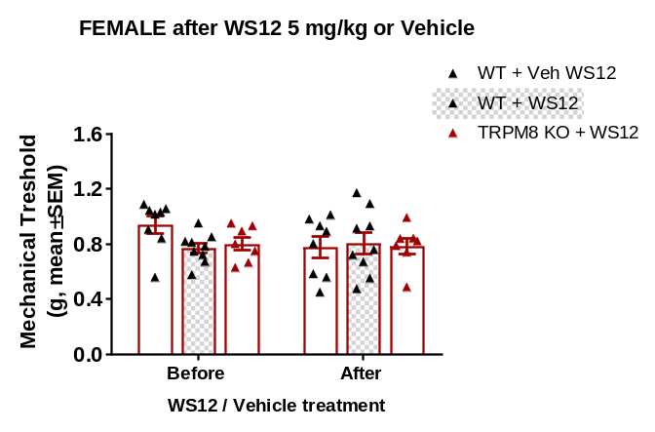
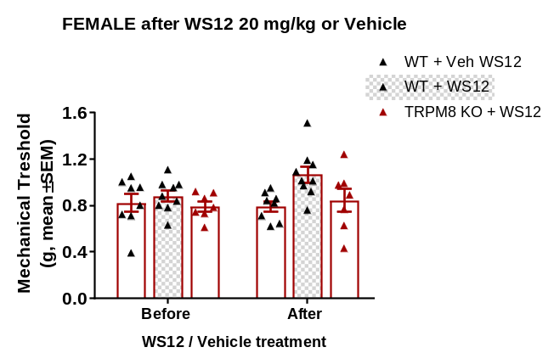
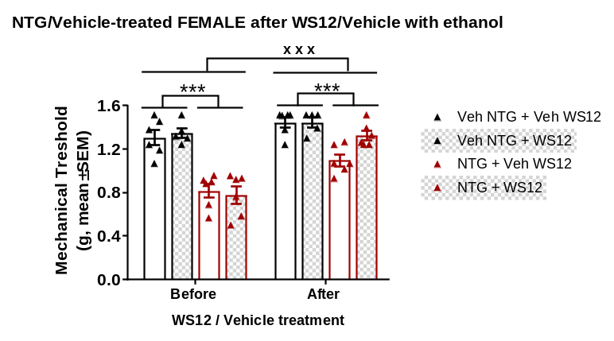
Supplementary Figure 4
A
NTG-treated
B
NTG-treated
C
Supplementary Figure 4. Effects of WS12 on mechanical hypersensitivity of nitroglycerin or vehicle-treated female. A WS12 5 mg/kg or its vehicle (2.5% DMSO in corn oil) did not modify mechanical sensitivity of female mice chronically treated with nitroglycerin. B WS12 20 mg/kg did not modify mechanical sensitivity of female mice chronically treated with nitroglycerin although a trend (p=0.053) was observed when comparing WS12 and vehicle-treated mice. C Administration of WS12 in a vehicle containing 5% ethanol induced significant alleviation in female mice treated with chronic nitroglycerin, although an effect of the vehicle was noted. Mean mechanical thresholds ± S.E.M. (A, B) 2-way RM ANOVA n=7-9 per group. (C) ***p<0.001, 3-way RM ANOVA, n=6-7 per group. NTG, nitroglycerin. Veh, Vehicle.

