Slide 1
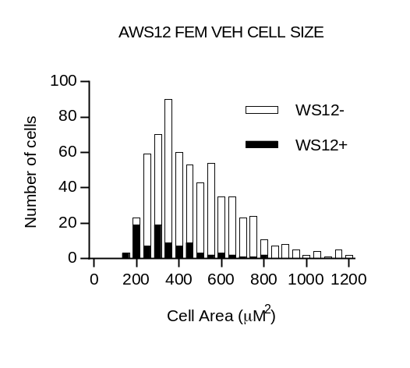
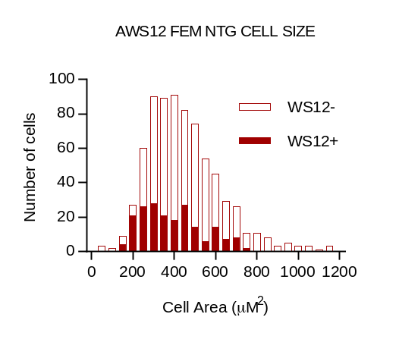
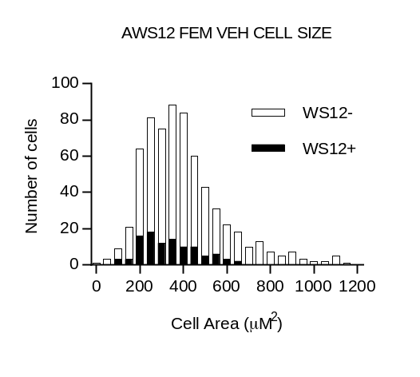
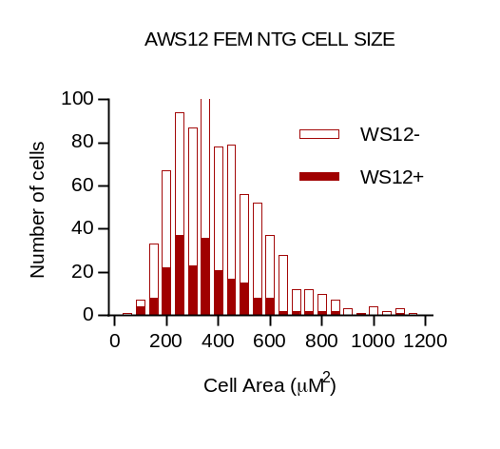
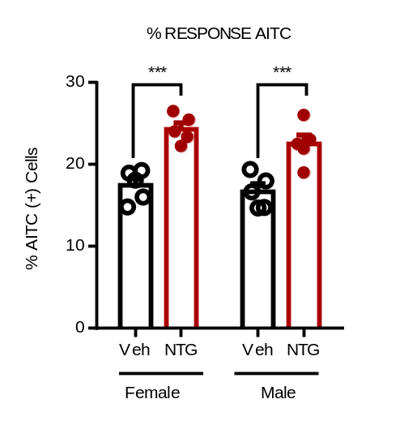
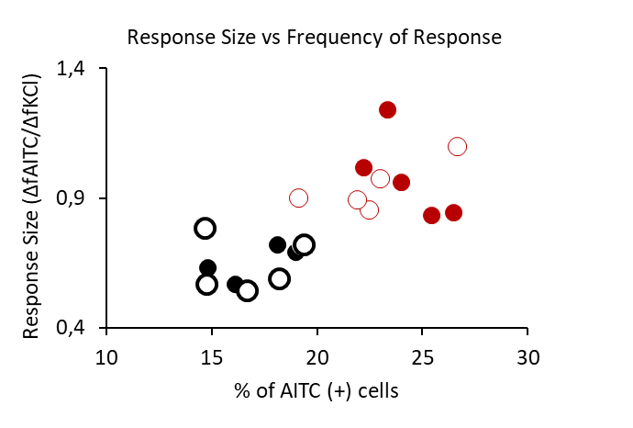
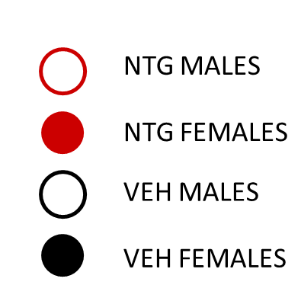
Supplementary Figure 2
A
Male Veh cell size
Male NTG cell size
AITC –
AITC +
AITC –
AITC +
B
Female Veh cell size
Female NTG cell size
C
D
AITC(+)/KCL(+)*100
Supplementary Figure 2. AITC activates small to medium-sized neurons in trigeminal cultures, and the percentage of AITC-sensitive neurons increases in samples of mice chronically treated with nitroglycerin. A, B Size (µm²) of neurons responding to AITC (yellow) or AITC-unresponsive (gray) in samples of vehicle (left, A) and nitroglycerin-exposed males (right, A) and in samples of vehicle and nitroglycerin-exposed females (B). AITC-responding cells form a population of small to medium size neurons. C Percentage of AITC-sensitive neurons defined by their sensitivity to KCl is similarly increased in cultures from male and female nitroglycerin-treated mice. ***p0.001, 2-way ANOVA, n=5. D The size of the responses to AITC is proportional to the percentage of AITC-sensitive neurons defined by their sensitivity to KCl. r² =0.5545; p<0.001. Linear regression n=5 mice per condition. NTG, nitroglycerin. Veh, Vehicle.

