Slide 1
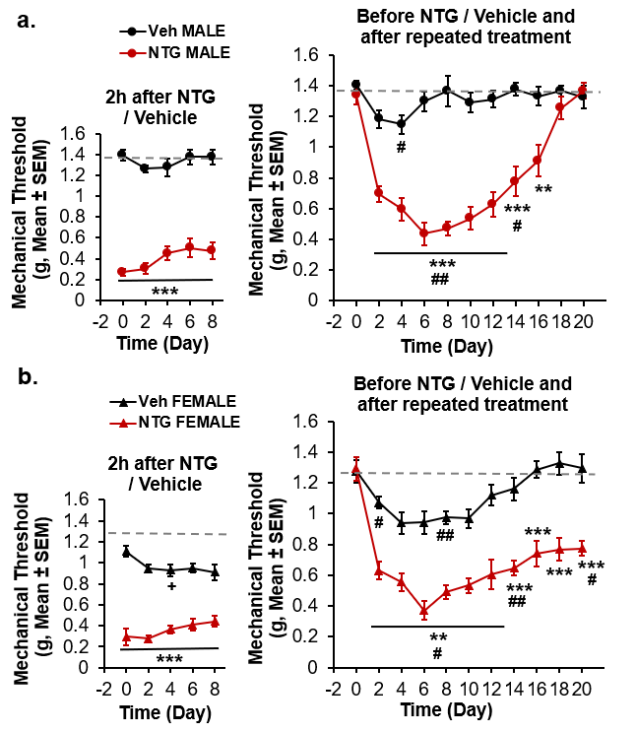
Supplementary Figure 1
A
B
Supplementary Figure 1. Nitroglycerin and a vehicle with high percentage of ethanol and propylene glycol induce mechanical sensitization. A, B Left panels. Nitroglycerin (red) 10 mg/kg dissolved in 10% ethanol and 20% propylene glycol induces similar acute mechanical hypersensitivity in males and females, and this vehicle (black) induces a selective acute sensitization in females. A, B Right panels. Chronic nitroglycerin induces persistent hypersensitivity exclusively in females, and a transient hypersensitivity is observed in males and females treated with this vehicle. Data are ± S.E.M. **p<0.01, ***p<0.001 vs vehicle. #p<0.05, ## p<0.01 vs baseline. 2-way RM ANOVA. n=6 per condition. NTG, nitroglycerin. Veh, Vehicle.

