Slide 1
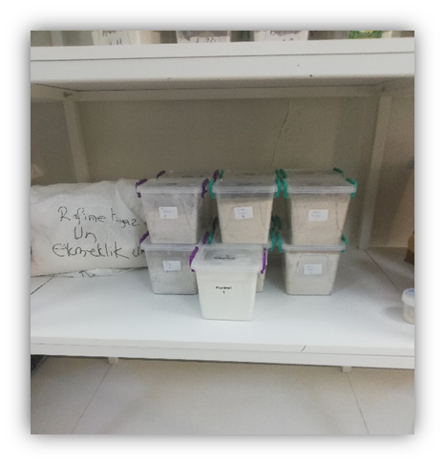
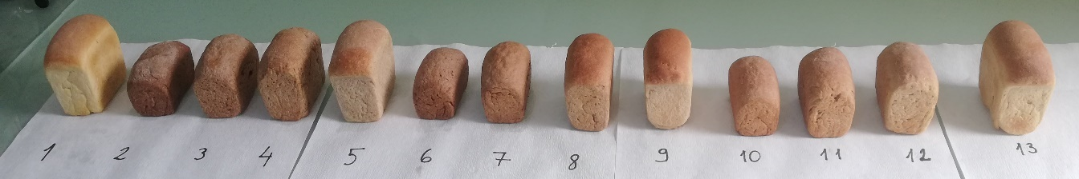
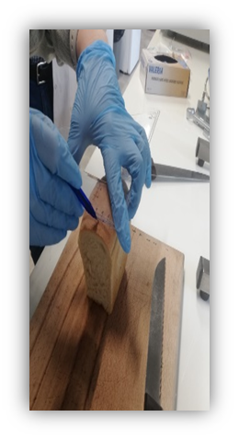
Technological and Nutritional Properties of Bread Enriched with Purple, Einkorn and Spelt Wheat Flours
Our Aim: To evaluate ancient wheat. whole grain flours (purple, spelt, einkorn) as bread substitutes (0-100%) for optimal nutrition and quality.
Ancient wheat
whole grain flours
Einkorn
Spelta
Purple
Increasing substitution progressively weakened gluten network
↑ Substitution level → ↓ Loaf volume ↑ Hardness ↓ Gluten quality
Optimal window: 25-50% Substitution:
At moderate substitution levels, nutritional enhancementwas achieved without compromising loaf volume or sensory acceptability.
Ancient wheat breads
Einkorn | Spelt | Purple Wheat
✓ Highest Soluble Fiber | ✓ Highest Insoluble Fiber | ✓ Rich in Anthocyanins
✓ Highest Methionine | ✓ Rich in Minerals (Fe, Zn, Ca) | ✓ Highest Lysine
✓ Highest Protein content | ✓ Highest Phenolics

