Slide 1
Extended Data Fig. 1 Heparosan fermentation
a)
Fructose-6-phosphate
GlmS
UPD-glucose
Glucosamine-6-phosphate
KfiD
UPD-glucronic acid
UPD-N-acetylglucosamine
KfiC
KfiA
Heparosan
b)
Growth (OD660)
Heparosan titer (g/L)
Cultivation time (h)
a) Biosynthetic pathway for heparosan biosynthesis. Enzymes introduced or overexpressed in the production strain are shown in boxes. b) Time course of heparosan production by strain KM1D in a 2 kL fermenter. Cell growth (OD660; black line) and heparosan titer (g L⁻¹; red line) are shown. The initial glucose concentration was 20 g L⁻¹. After glucose depletion (~12 h), a feeding solution containing 50% (w/v) glucose and 34 g L⁻¹ KH₂PO₄ was supplied at 7.5 L h⁻¹, maintaining residual glucose below 1 g L⁻¹. The pH was maintained at 6.6 using NH₃ gas. Cultivation was terminated after addition of 340 L of feed upon glucose exhaustion. Data represent mean ± s.d. of three independent cultivations.

Slide 2
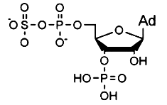
Extended Data Fig. 2 Permeabilized cells act on polymer substrate
a) Schematic of N-sulfation reaction catalyzed by permeabilized KM33 (NST) cells using PAPS as the sulfate donor. NST enzyme is indicated in green. Plasmids pKBM1 and pKBM3 were stably maintained by complementing chromosomal knockout of metK and ubiA, respectively (orange dashed lines). b) Time course of whole-cell N-sulfation of partially N-deacetylated heparosan (DAH) by KM33 (NST). Cells were permeabilized by treatment with xylene (0.09 ml added to 27 ml of the cultivation broth; ~90 g L⁻¹ wet cell mass). Reactions were performed in 100 mM HEPES (pH 7.0) containing 4.5 mM PAPS, ~5 g L-1 cell mass (with or without permeabilization), and 0.7 g L-1 of DAH at 32 ℃. Reactions were initiated by adding PAPS and terminated by heating at 80 ℃ for 10 min. Product formation was quantified by DS/TS analysis.
a)
DAH
NH
NH
NH
NH
NH
groEL
metK
P trc
ubiC
PAPS
pKBM1
NST
pKBM3
ubiA
groES
Ori
Cm^{R}
Km^{R}
Ori
P trp
ubiA
metK
NST
Chromosome
N-sulfoheparosan
b)
NS(%)
Reaction time (h)

Slide 3
Extended data Fig. ３ Changes in sugar composition upon simultaneous enzyme addition
a) Time course of the disaccharide composition during the whole-cell reaction with simultaneous addition of NST, C5, 2OST, 6OST and 3OST. ●; NS, ●; NS2S, ●; NS6S, ●; TriS. b) Time couse of the tetrasaccharide composition during the same reaction. ●; Tet1, ●; Tet2, ●; Tet3, ●Tet4. c) Di-and tetrasaccahride composition at the reaction end point.
a)
c)
Tet4
0S
Disaccharides content (%)
TriS
NS
2S6S
6S
2S
NS2S
NS6S
b)
Tetrasaccharides content (%)
Reaction time (h)

Slide 4
Extended data Table 1 USP compliance of BEH produced at different scales
USP NF analytical criteria and results for BEH produced at the 3-L, 30-L and 3-kL scales. NMR analysis, molecular weight determination and anticoagulant activities were measured as described in Methods. All other tests were conducted according to the USP NF 2025, Issue 3 heparin monograph. Criteria definitions for NMR identity, chromatographic identity and absence of oversulfated chondroitin sulfate are provided below the table. NA, not assayed.
Analytical items on USP monograph | Specification | BEH from 3 L reactor | BEH from 30 L reactor | BEH from 3 kL tank
¹H NMR spectrum | Meet criteria * | Pass | pass | pass
Chromatographic identity | Meet criteria # | pass | pass | pass
Molecular weight determinations | M24000 NMT 20% | 15 | 18 | 14
 | Mw 15000-19000 | 16300 | 16800 | 16100
 | M8000-16000/M16000-24000 NLT 1% | 2.0 | 1.8 | 1.9
Flame test | An intense yellow color | pass | pass | pass
Anti-IIa potency | NLT 180 U/mg | 221 | 271 | 255
Anti-Xa potency |  | 226 | 284 | 260
Anti-Xa/Anti-IIa ratio | 0.9-1.1 | 1.0 | 1.0 | 1.0
Nucleotide impurities | NMT 0.1% | <0.1 | 0.1 | 0.0
Protein impurities | NMT 0.1% | <0.1 | 0.1 | 0.1
Limit of galactosamine in total hexosamine | NMT 1% | NA | 0.0 | 0.0
Endotoxin | NMT 0.03 USP EU/ heparin U | <0.03 | 0.02 | <0.01
Absence of oversulfated chondroitin sulfate | Meet criteria $ | pass | pass | pass
Nitrogen determination | 1.3 – 2.5% | NA | NA | 2.0
Loss of drying | NMT 5% | NA | 0.5 | 1.5
pH | 5.0-7.5 | 6.9 | 6.2 | 6.6
Criteria *: The ppm values for H1 of GlcNAc/GlcNS, 6S (signal 1), H1 of IdoA2S (signal 2) of heparin are present at 5.42, 5.21 ppm, respectively. No unidentified signals greater than 4% of the mean of the height of signals 1 and 2 are present in the following ranges: 0.10–2.00, 2.10–3.20, and 5.70–8.00 ppm. No signals greater than 200% of the mean of the height of signals 1 and 2 are present in the 3.75–4.55 ppm for porcine heparin. Criteria #: The retention time of the major peak of the Sample solution corresponds to that of the Standard solution. Criteria $: A. Proceed as directed in Identification A. No features associated with oversulfated chondroitin sulfate are found between 2.12 and 3.00 ppm. B. Proceed as directed in Identification B. No peaks corresponding to oversulfated chondroitin sulfate should be detected eluting after the heparin peak.

Slide 5
Extended data Table 2 Saccharide composition of BEH
Disaccharide and tetrasaccharide composition determined by DS/TS analysis, and uronic acid composition determined by 2D NMR spectroscopy, for USP heparin and BEH produced at the 3 L, 30 L and 3 kL scales. DS/TS analysis was performed as described in Methods. Fragment peaks in 2D-NMR analysis were assigned based on the previous report ⁴⁸ as follows: IdoA2S (as IdoA2S-GlcNy3x6x); 101.0-103,3 ppm in F1 (¹³C) axis and 5.05-5.40 ppm in F2 (¹H) axis, IdoA (as IdoA-GlcNy + IdoA-GlcNy6S); 104.4-105.5 ppm in F1 axis and 4.95-5.09 ppm in F2 axis, GlcA2S; 102.3-104.2 ppm in F1 axis and 4.66-4.81 ppm in F2 axis, and GlcA (as GlcA-GlcNS3S6x + GlcA-GlcNS6x + GlcA-GlcNAc6x); 103.4-105.8 ppm in F1 axis and 4.43-4.66 ppm in F2 axis (x=SO3 or OH and y=SO3 or Ac or H). Integrated peak volumes were used to calculate relative molar fractions, assuming equimolar amounts of uronic acids and glucosamine residues in heparin..
Sample | Di- and tetrasaccharide composition determined by DS/TS analysis |  |  |  |  |  |  |  |  |  |  |  |  | Uronic acid contents based on monosaccharide composition determined by 2D NMR
 | 0S | NS | 6S | 2S | NS6S | NS2S | 2S6S | TriS | tet1 | tet2 | tet3 | tet4 | tet5 | IdoA2S | IdoA | GlcA2S | GlcA
USP heparin | 4.3 | 3.3 | 3.1 | 1.8 | 10.3 | 7.3 | 1.5 | 65.5 | 0.4 | 1.9 | 0.3 | 0.1 | 0.2 | 37.0 | 5.0 | ND | 8.0
BEH from 3 L jar reaction | 3.6 | 3.7 | 4.0 | 1.6 | 9.4 | 10.3 | 2.1 | 61.3 | 0.4 | 3.4 | 0.0 | 0.1 | 0.0 | 27.0 | 3.0 | 6.0 | 14.0
BEH from 30 L jar reaction | 3.5 | 4.0 | 4.7 | 1.1 | 11.5 | 6.0 | 0.3 | 64.9 | 1.2 | 2.8 | 0.1 | 0.0 | 0.1 | 28.0 | 4.0 | 3.0 | 14.0
BEH from 3 kL tank reaction | 2.3 | 1.6 | 5.8 | 0.4 | 15.7 | 3.9 | 0.6 | 66.2 | 0.2 | 3.3 | 0.0 | 0.0 | 0.0 | 29.2 | 4.0 | 2.2 | 14.4

Slide 6
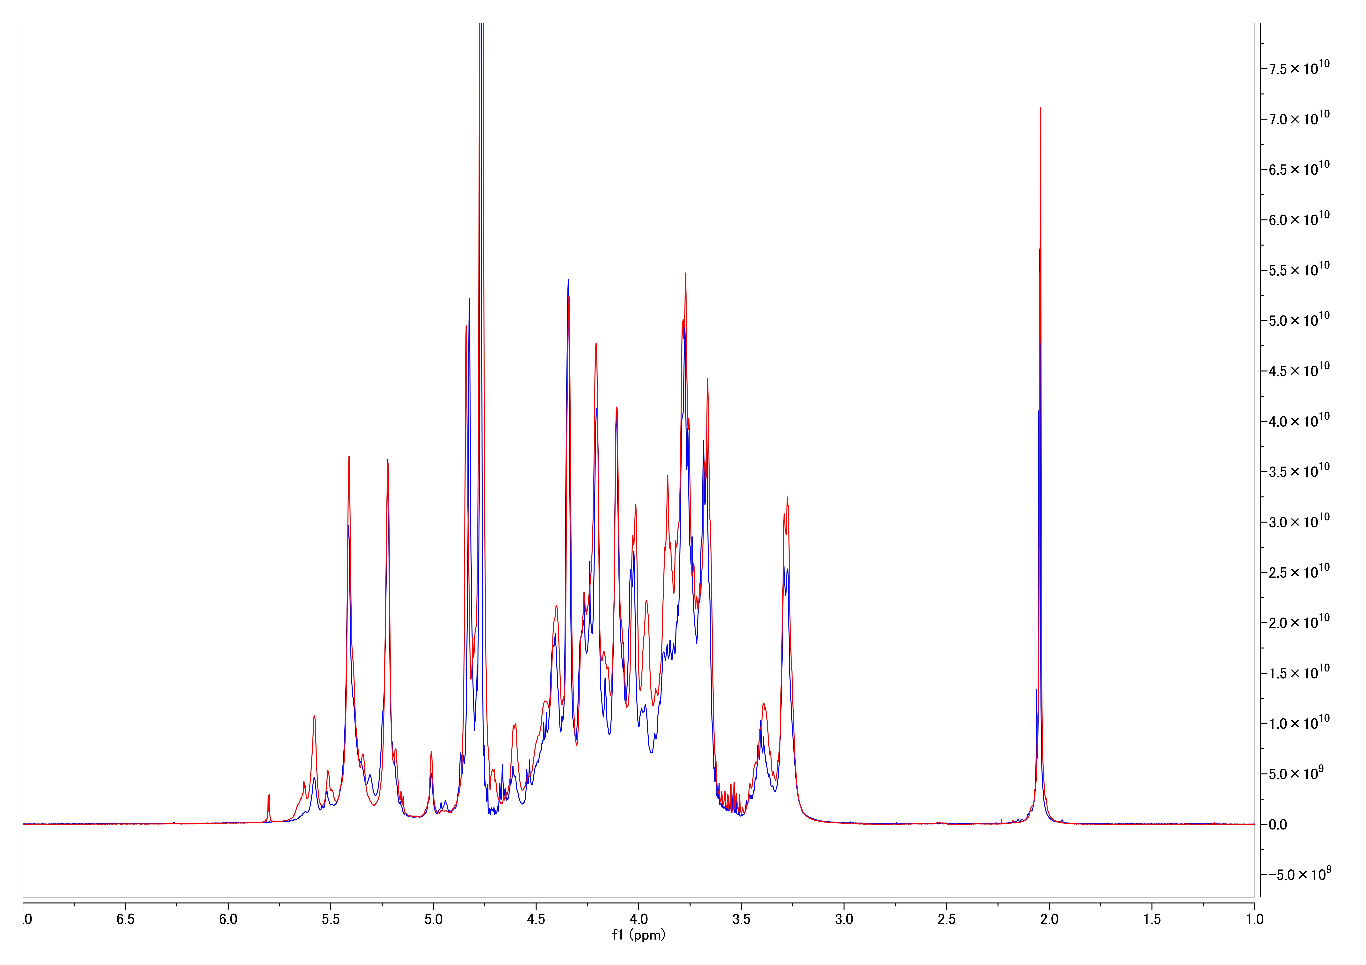
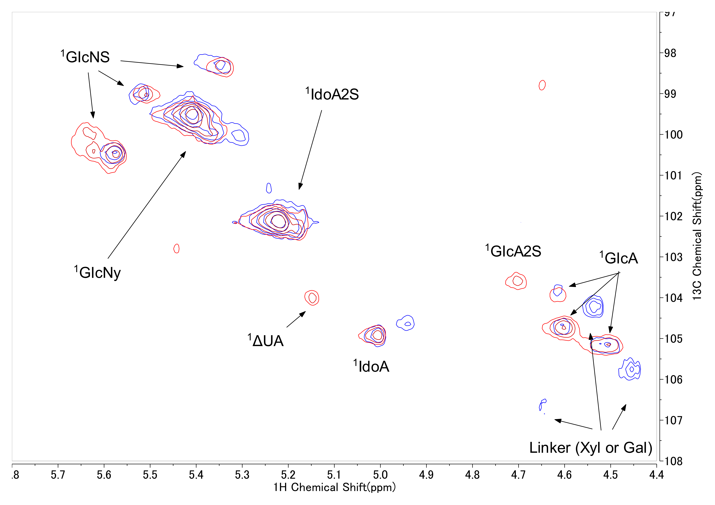
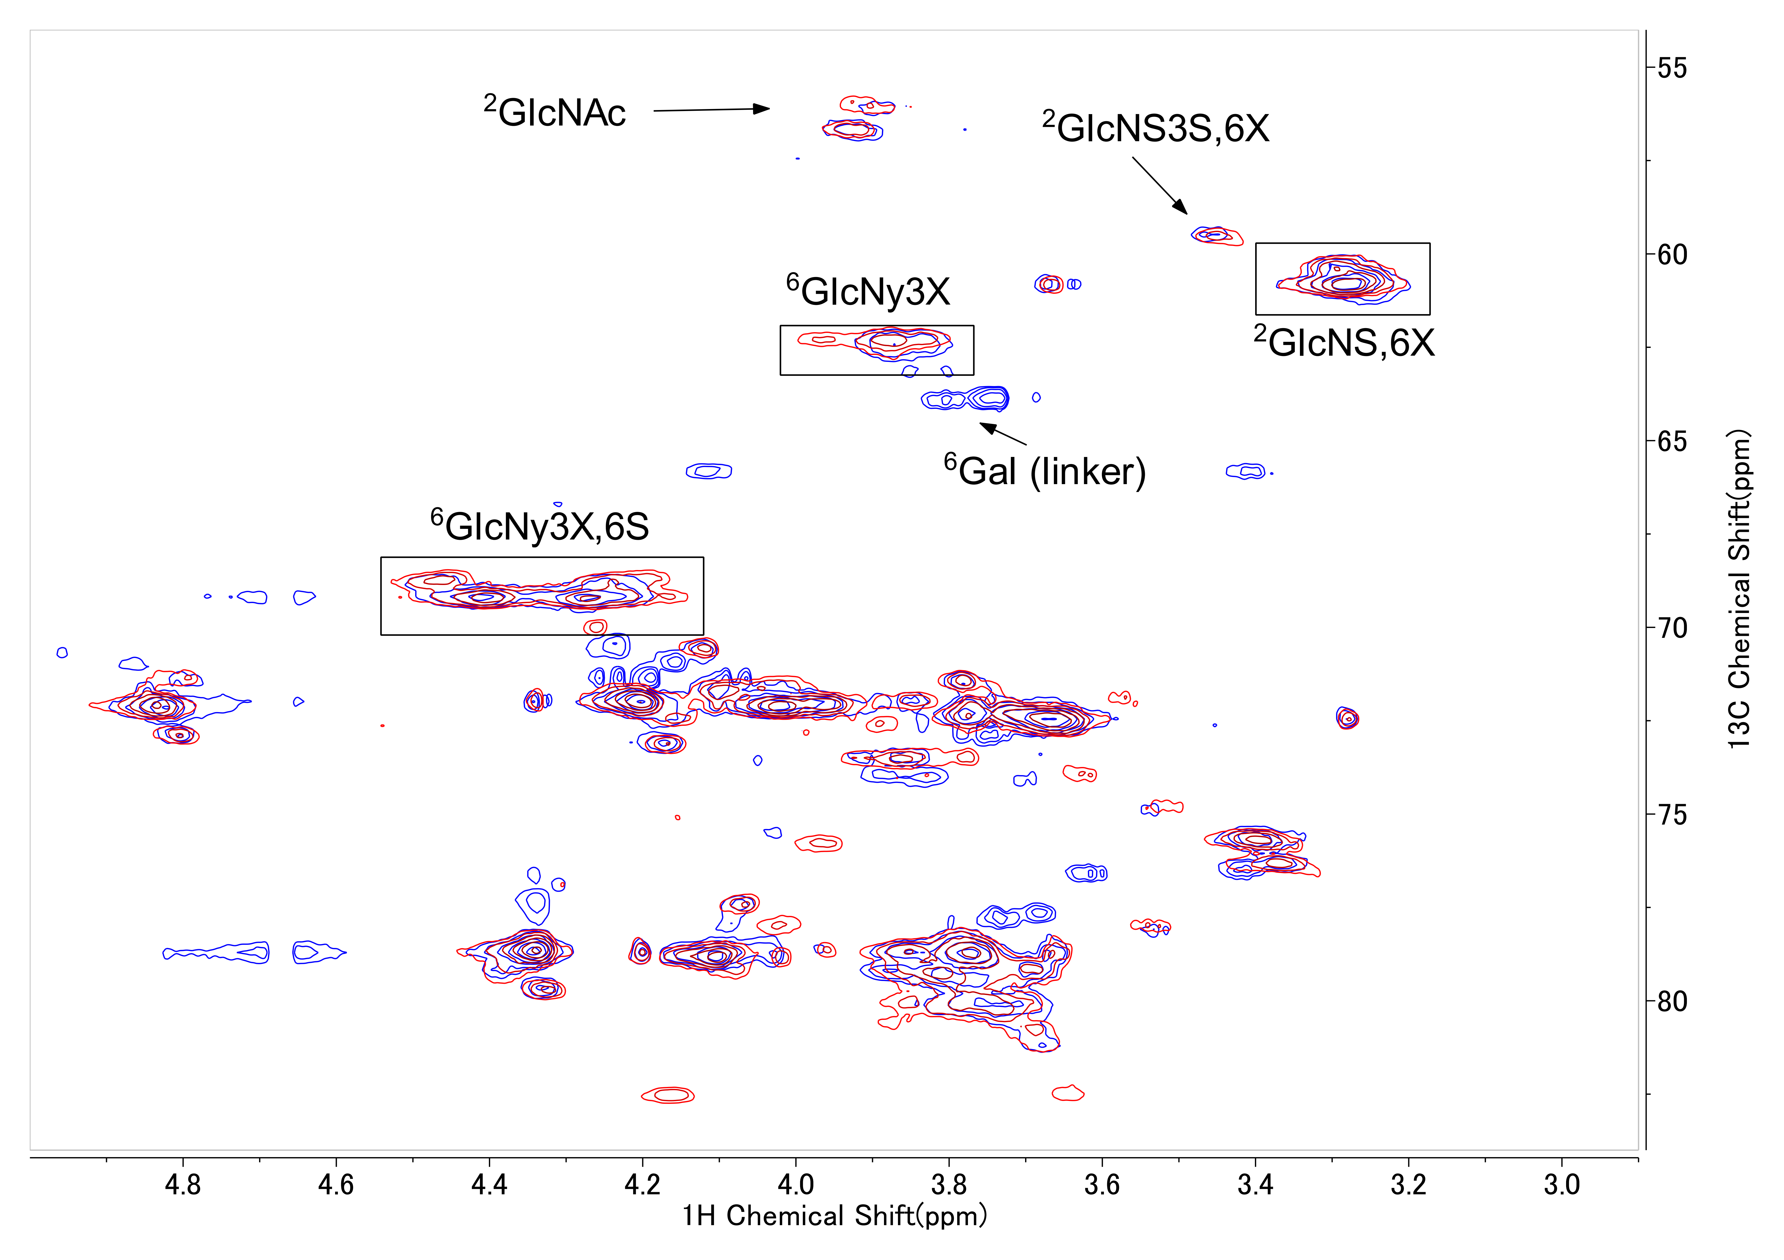
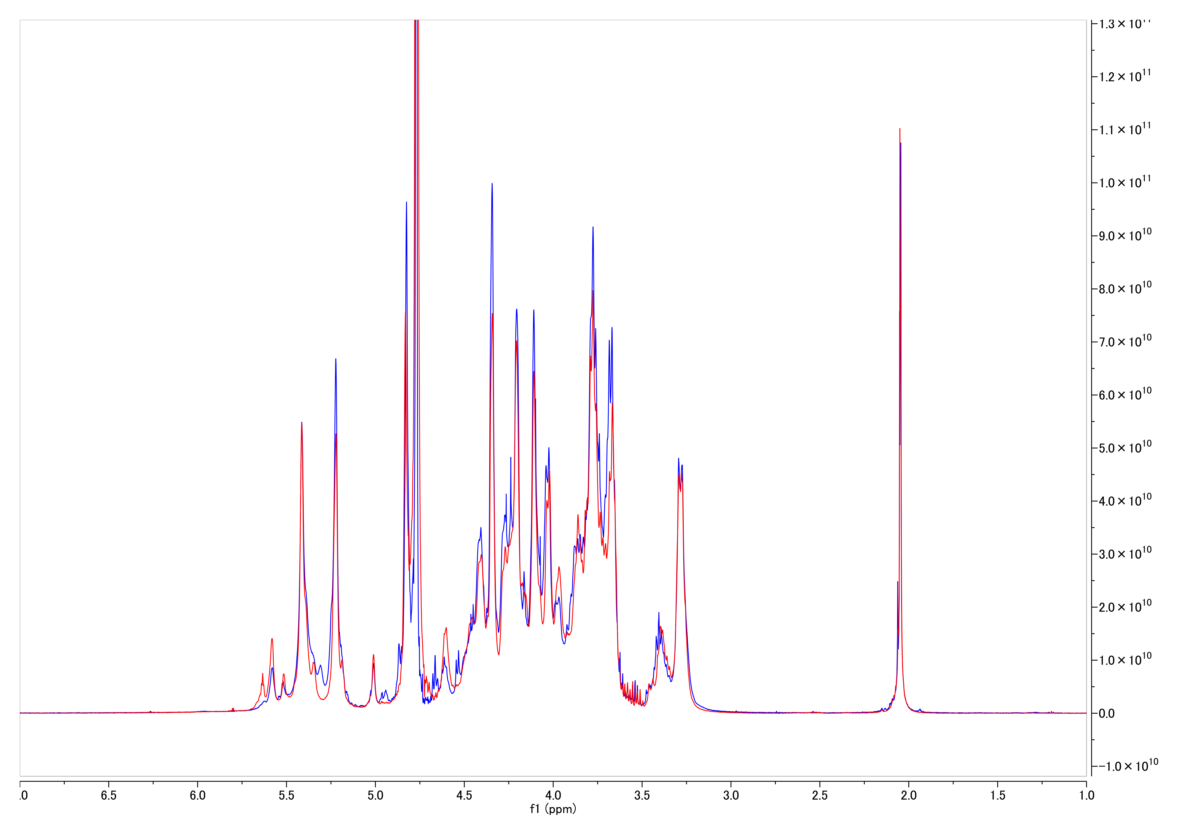
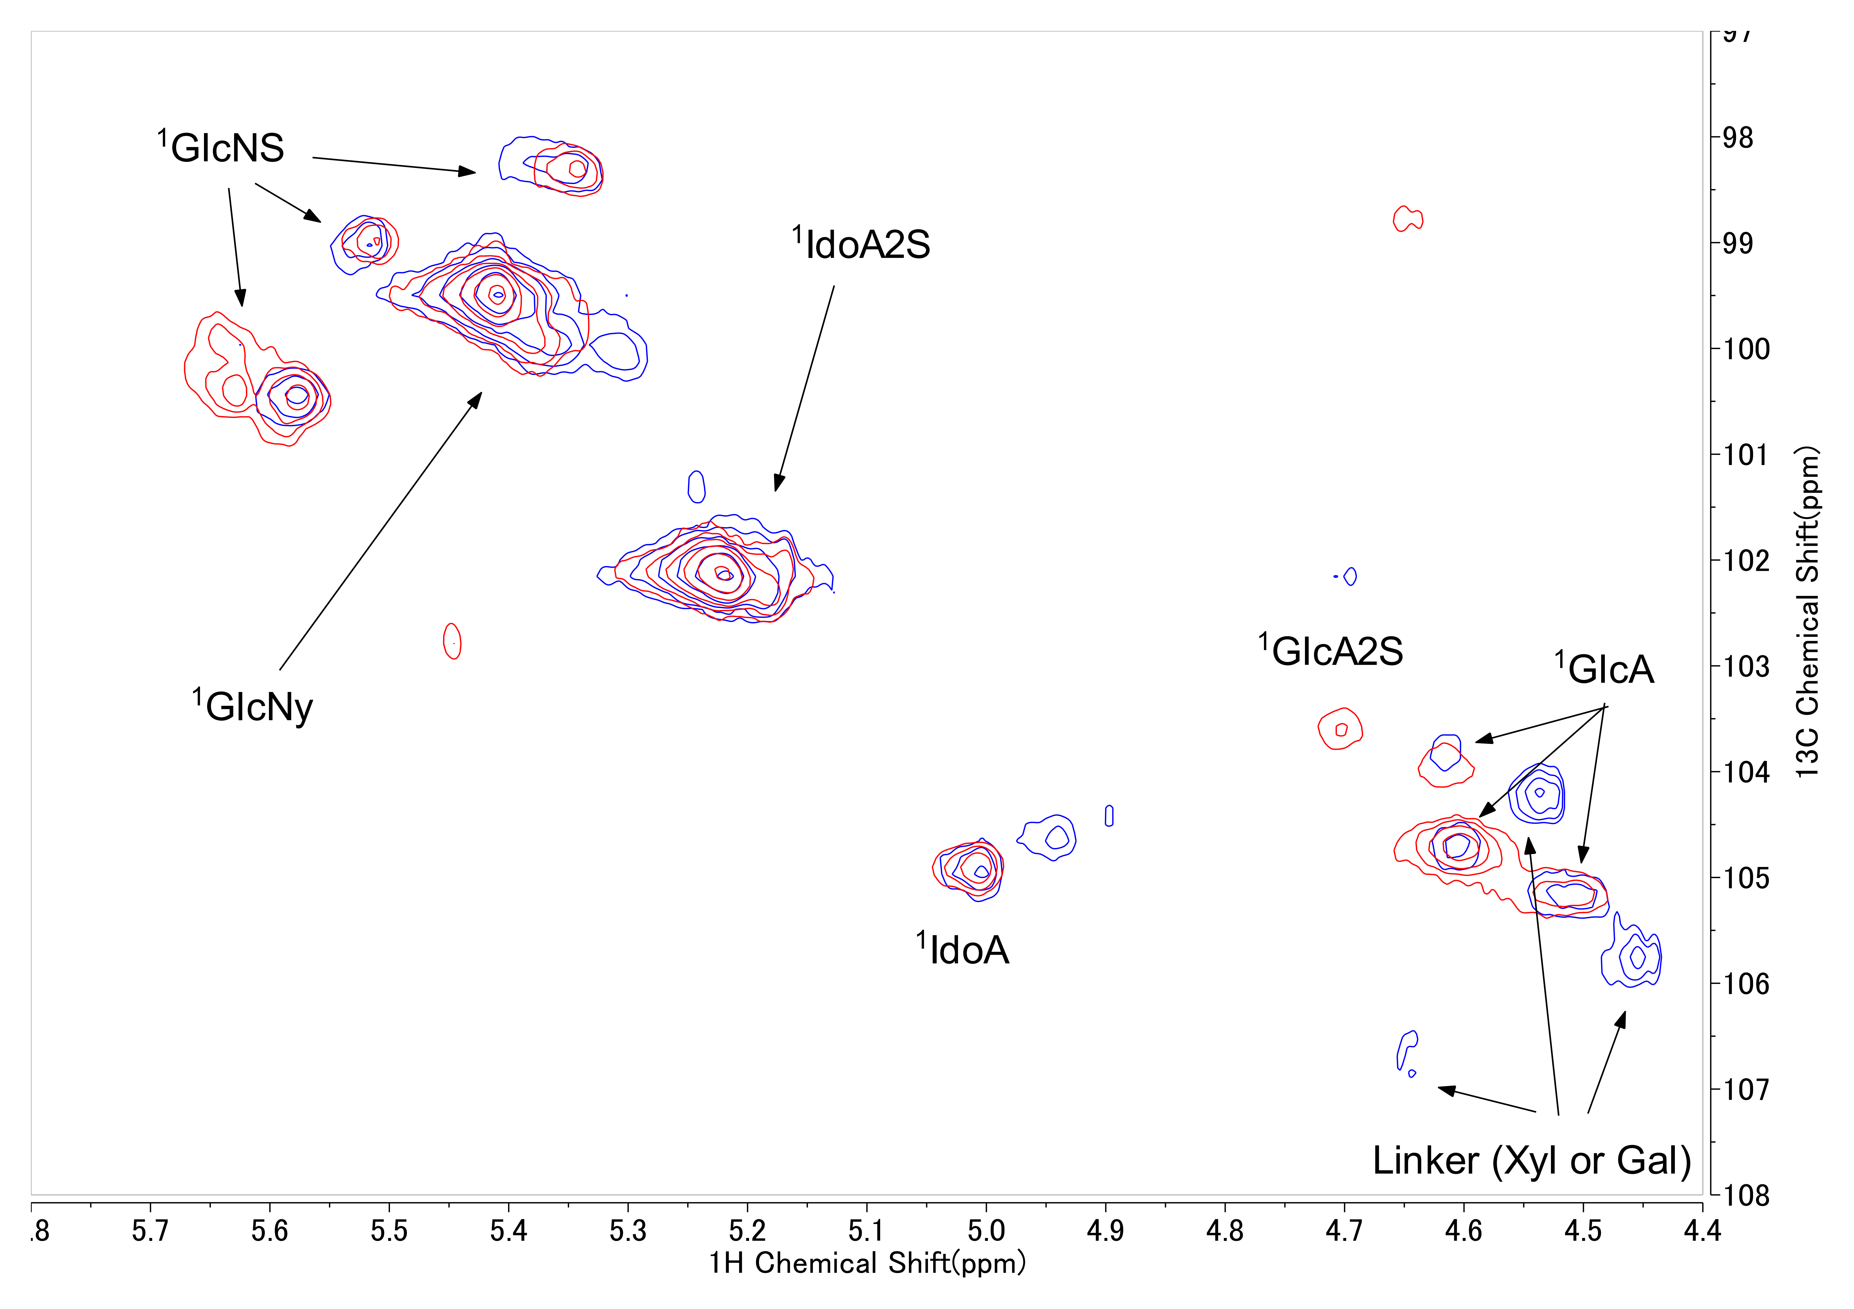

Extended Data Fig. ４ 1D and 2D NMR analysis of USP heparin vs. BEH
Comparison of 1D and 2D NMR spectra of USP porcine heparin and BEH produced at industrially relevant scales. a) BEH from 30-L reactor. b) BEH from 3-kL reactor. Anomeric and aliphatic regions are shown. Spectra were acquired under identical conditions as in Fig. 4.
a)
USP-H(porcine)
BEH
Anomeric region
Aliphatic region
b)
USP-H(porcine)
BEH
Anomeric region
Aliphatic region

Slide 7
Supplementary Fig. 1 Process robustness against variations in cell biomass
Assessment of process robustness to fluctuations in the biomass of individual whole cell biocatalysts. The standard 30-L process was scaled down to 3-L. Volume of each broth was as follows: KM101-1; 457 ml, KM33 (NST); 160 ml, KM34 (C5); 55 ml, KM35 (2OST); 168 ml, KM36 (6OST); 183 ml, additional KM101-1; 343 ml, KM37 (3OST); 95 ml. Eight grams of DAH were used per reaction. The di- and tetrasaccharide composition of the BEH product obtained after 163 h under control conditions (mean of five independent reactions) is shown in the control box. For robustness testing, the volume of each cell broth was increased or decreased as indicated, and resulting sugar compositions were determined by DS/TS analysis. Percent changes relative to control volumes are specified in the lower part of each box.
 | KM101-1 | KM33 (NST) | KM34 (C5) | KM35 (2OST) | KM36 (6OST) | Control
Increase
Decrease
Tet2
NS
0S
6S
NS6S
+40%
+20%
+40%
+40%
TriS
NS2S
-40%
-30%
-30%
-40%
-40%

Slide 8
Supplementary Data Calculation of PAPS generation per gram wet cell (specific PAPS productivity) of KM101-1
To quantify the capacity of the engineered KM101‑1 to generate PAPS, we calculated the specific PAPS productivity, defined as the amount of PAPS generated per gram of wet cell mass, under both uncoupled and coupled reaction conditions.
PAPS production in the absence of coupling reaction
In the uncoupled PAPS‑generation reaction, a final concentration of 25 mM PAPS was obtained in a total reaction volume of 913 mL, corresponding to a total PAPS amount of 22.8 mmol. The reaction contained 400 mL of KM101‑1 culture broth with a wet cell density of 327 g L⁻¹, equivalent to 130.8 g of wet cell mass. The specific PAPS productivity under uncoupled conditions was therefore calculated as:
Specific PAPS productivity = 22.8 mmol / 130.8 g = 0.17 mmol g⁻¹ wet cell.
2) PAPS generation during coupling whole-cell reactions in a 3-L jar
For the coupled reaction in a 3‑L jar, partially N‑deacetylated heparosan (DAH) with an N‑deacetylation degree of 86.5% was used as the substrate. Based on this deacetylation level, the average molecular weight of the disaccharide unit was estimated to be 361.0. An input of 3.45 g of DAH therefore corresponded to 9.6 mmol of disaccharide units. From DS/TS analysis, the degrees of sulfation were determined to be 88.7% for N‑sulfation, 75.4% for 2‑O‑sulfation and 80.5% for 6‑O‑sulfation. Contributions from 3‑O‑sulfation were neglected owing to its low abundance. Based on these values, the total amount of PAPS required to support the observed sulfation of 9.6 mmol disaccharide was calculated to be 23.5 mmol. At the end of the reaction, the final reaction volume was 1.4 L, and residual PAPS was detected at a concentration of 1 mM, corresponding to 1.4 mmol PAPS remaining in solution. Accordingly, the total amount of PAPS generated during the reaction was estimated to be 24.9 mmol. The coupled reaction contained the same amount of KM101‑1 biomass as in the uncoupled case (130.8 g wet cell mass, derived from 400 mL of culture broth at 327 g L⁻¹). The specific PAPS productivity during the coupled reaction was therefore calculated as:
Specific PAPS productivity = 24.9 mmol / 130.8 g = 0.19 mmol g⁻¹ wet cell
3) PAPS generation during coupling reactions in a 30-L jar up to completion of the 2OST reaction stage
For the scaled‑up coupled reaction performed in a 30‑L jar, 85 g of DAH with an N‑deacetylation degree of 85% was used as input material. This amount corresponds to 235.1 mmol of disaccharide units. At the end of the 2‑O‑sulfotransferase (2OST) reaction stage, DS/TS analysis showed an N‑sulfation ratio of 88.6% and a 2‑O‑sulfation ratio of 72.4%. Based on these values, the amount of PAPS required to support sulfation at this stage was calculated to be 378.5 mmol. The reaction contained 6.3 L of KM101‑1 culture broth with a wet cell density of 327 g L⁻¹, corresponding to a total wet cell mass of 2060.1 g. The specific PAPS productivity under these scaled‑up coupled conditions was therefore calculated as:
Specific PAPS productivity = 378.5 mmol / 2060.1 g = 0.18 mmol g⁻¹ wet cell

Slide 9
SupplementaryTable 1 Structure of disaccharides and tetrasaccharides in DS/TS analysis
Disaccharide and tetrasaccharide name | Structure
0S | ΔUA-(1→4)α,β-GlcNAc
NH | ΔUA-(1→4) α,β-GlcN
NS | ΔUA-(1→4) α,β-GlcN(NS)
6S | ΔUA-(1→4)α,β-GlcNAc(6S)
2S | ΔUA-2S-(1→4) α,β-GlcNAc
NS6S | ΔUA-(1→4) α,β-GlcN(NS, 6S)
NS2S | ΔUA-2S-(1→4) α,β-GlcN(NS)
2S6S | ΔUA-2S-(1→4) α,β-GlcNAc(6S)
TriS | ΔUA-2S-(1→4) α,β-GlcN(NS, 6S)
Tetra-1 | ΔUA-(1→4)α-GlcNAc(6S)-(1→4)β-GlcA-(1→4) α,β-GlcN(NS, 3S)
Tetra-2 | ΔUA-(1→4)α-GlcNAc(6S)-(1→4)β-GlcA-(1→4) α,β-GlcN(NS, 3S, 6S)
Tetra-3 | ΔUA-(1→4)α-GlcN(NS, 6S)-(1→4)β-GlcA-(1→4) α,β-GlcN(NS, 3S, 6S)
Tetra-4 | ΔUA-2S-(1→4)α-GlcNAc(6S)-(1→4)β-GlcA-(1→4) α,β-GlcN(NS, 3S, 6S)
Tetra-5 | ΔUA-2S-(1→4)α-GlcN(NS, 6S)-(1→4)β-GlcA-(1→4) α,β-GlcN(NS, 3S, 6S)
ΔUA: 4,5-unsaturated uronic acid, GlcN: D-glucosamine, GlcA: D-glucuronic acid, NAc: N-acetyl, NS: N-sulfate, 2S: 2-O-sulfate, 3S: 3-O-sulfate, 6S: 6-O-sulfate

Slide 10
Supplementary Table 2 Bacterial strain
E.coli
Strain | Relevant genotype | Source / comments
KY8119 | E.coli W strain | NITE BP-04409
KM1D | KY8119 malG::PuspA-glmS ycaD::Pilv-s-kifD yebQ::Pilv-s-kfiD apqZ::PuspA-kfiA-TF-kfiC | This study
RC912 | E.coli B strain | ATCC23226 Ref. 44
CRC2-12 | cys-/cys+ | This study
Oligami(DE3)/pGEX-3T3-NST1 | Oligami(DE3) harboring human NST expressing plasmid pGEX-3T3-NST1 | Ref. 28
KM30H0 | CRC2-12 galK::FRT metK::FRT ubiA::FRT / pBR-ubiA-Tet | This study
KM30H1 | CRC2-12 galK::FRT metK::FRT ubiA::FRT trxB::FRT gor::FRT ahpC(Y39D) / pBR-ubiA-Tet | This study
KM30H2 | CRC2-12 galK::FRT metK::FRT ubiA::FRT trxB::FRT gor::FRT ahpC(ΔF37) / pBR-ubiA-Tet | This study
KM33(NST) | KM30H1 / pKBM1, pKBM3 | This study
KM34(C5) | KM30H0 /pKBM1, pKBM4 | This study
KM35(2OST) | KM30H2 / pKBM1, kBM5 | This study
KM36(6OST) | KM30H1 / pKBM1, pKBM6 | This study
KM37(3OST) | KM30H0 / pKBM1, pKBM7 | This study
C.stationis
DN510 |  | Ref. 23
DN510F1 | DN510(DE3 ΔlacI) amn::T7-MET3-MET14 | This study
KM101-1 | DN510(DE3 ΔlacI) amn::T7-MET3-MET14 cam2339-2340::T7-MET3-MET14 | This study

Slide 11
Supplementary Table 3 Medium composition
Component | EF1 | CF1 | EF2 | LB medium | SCS medium | Reaction medium 1 | Reaction medium 2 | SM solution
KH₂PO₄ | 13.2 g | 10 g | 2.53 g |  |  | 6.7 g | 42.7 g
K₂HPO₄ |  | 10 g |  |  |  | 11.4 g | 73.1 g
Na₂HPO₄ |  |  | 5.05 g
MgSO₄・7H₂O | 1.7 g | 10 g | 2.5 g |  |  | 37.6 g | 103.0 g | 46.0 g
(NH₄)₂SO₄ | 3.9 g |  | 1.3 g
NaCl |  |  |  | 10.0 g | 3 g
Trisodium citrate | 2.1 g
Yest extract (Gistex) |  |  | 5.26 g |  | 5 g
Yest extract (Gibco) |  |  |  | 5.0 g
Trypton |  |  |  | 10.0 g
Pepton |  |  |  |  | 10 g
Meat Extract (Gibco) |  |  |  |  | 7 g
L-Glutamate |  | 1 g
L-Cytine |  | 20 mg
CaCl₂ | 26.0 mg | 74 mg
FeSO₄・7H₂O | 0.1 g | 20 mg | 0.1 mg
ZnSO₄・7H₂O | 21.6 mg | 10 mg
CuSO₄・5H₂O | 9.8 mg | 5 mg
MnSO₄・5H₂O | 4.9 mg | 20 mg | 9.4 mg
(NH₄)₆Mo₇O₂₄・4H₂O | 1.0 mg
BORAX | 0.2 mg
Nicotinic acid |  | 5 mg |  |  |  | 0.8 g | 2.1 g
Biotin |  | 150 μg
β-Alanine |  | 15.1 mg
Thiamine | 2.8 mg | 5.1 mg
Adenine |  |  |  |  |  | 7.5 g | 20.9 g | 25.3 g
Glucose | 20 g | 153 g | 5.26 g |  |  | 55.8 g | 278.1 g | 338.9 g
Fructose |  | 21 g
Sucrose |  |  |  |  | 100 g

Slide 12
Supplementary Fig. 2 Gene structure and sequence of engineered chromosomal regions
a)

Slide 13
b)

Slide 14
c)

Slide 15
d)

Slide 16
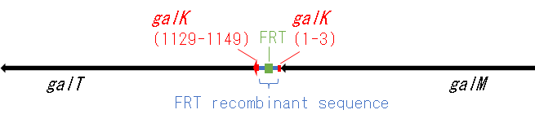
e)
galM-ΔgalK(FRT)-galT

Slide 17

f)
speA-yqgBCD-ΔmetK(FRT)-galP

Slide 18
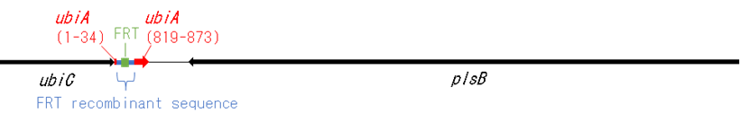
g)
ubiC-ΔubiA(FRT)-plsB

Slide 19
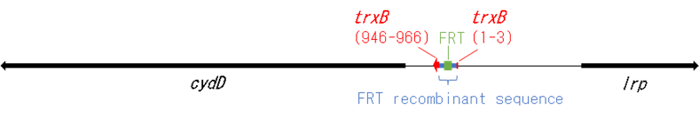
h)
cydD-ΔtrxB(FRT)-lrp

Slide 20
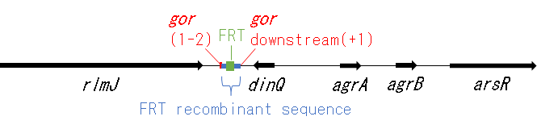
i)
rlmJ-Δgor(FRT)-dinQ-agrA-agrB-arsR

Slide 21
j)
Sequence of aphC wild type (upper line), Y39D (middleline), and ΔF37(bottom line)

Slide 22
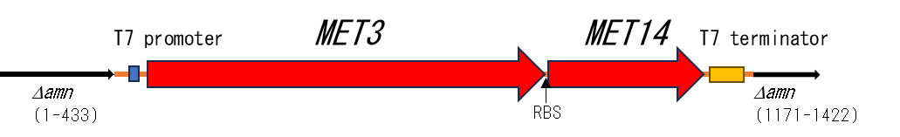
k)
Δamn::T7 promoter-MET3-RBS-MET14-T7 terminator

Slide 23
l)

Slide 24
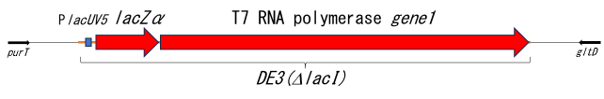
m)
purT-DE3(ΔlacI)-gltD

Slide 25
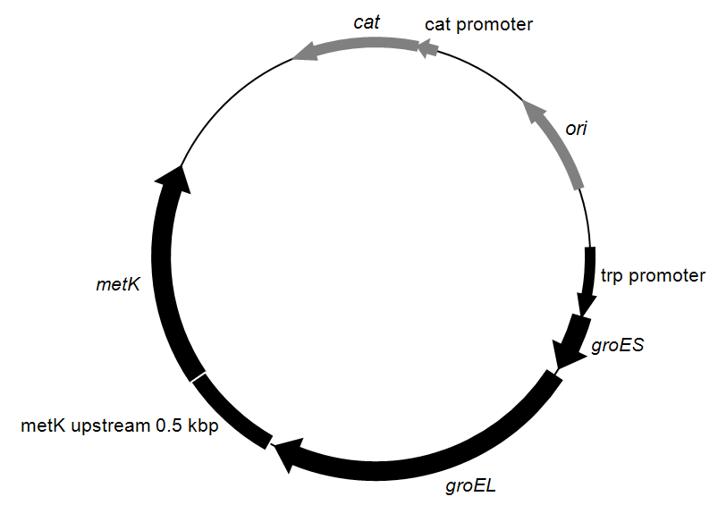
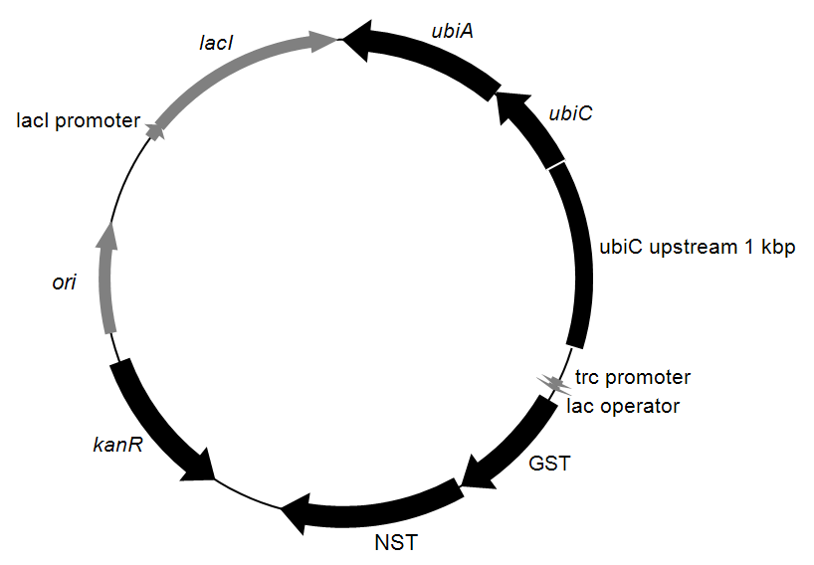
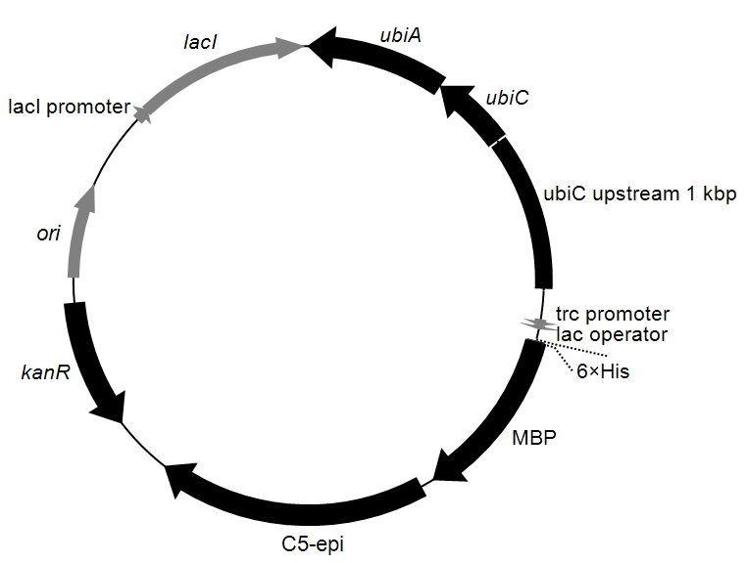
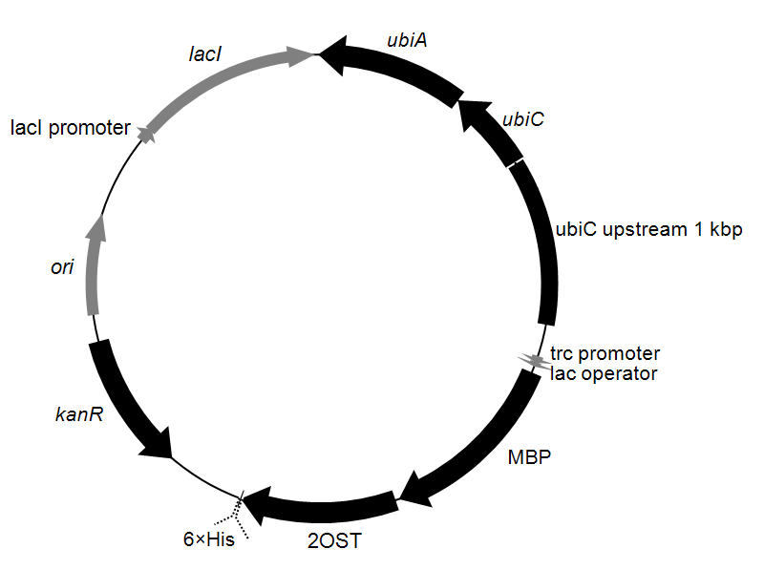
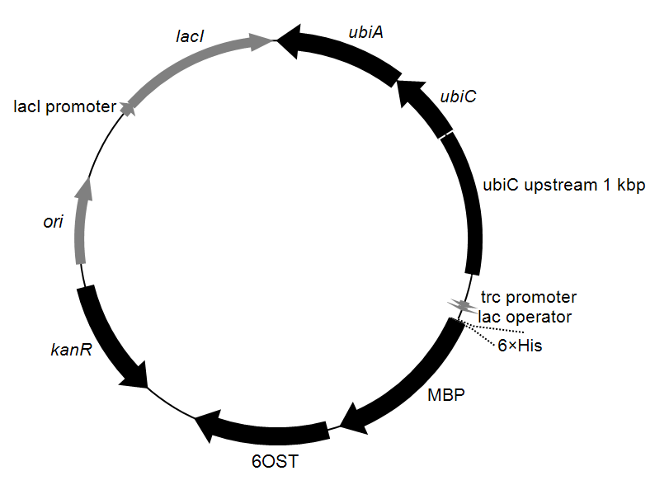
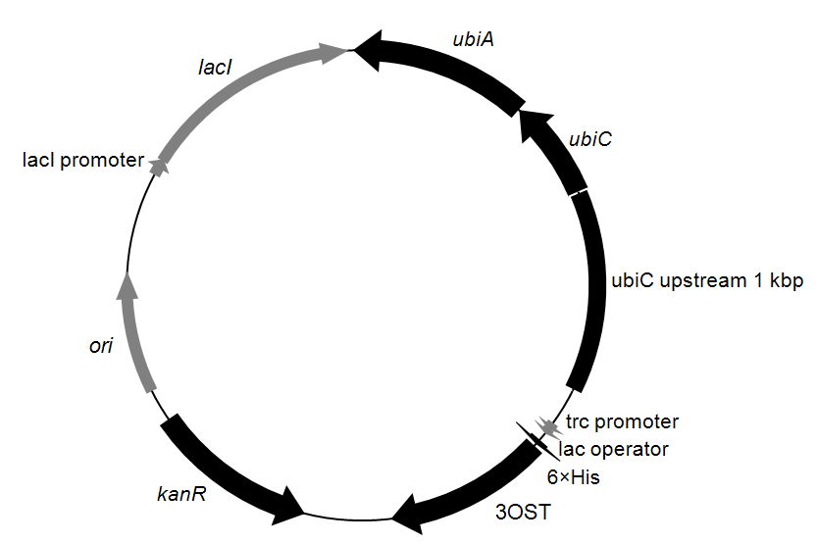
Supplementary Fig. 3 Plasmids used in this study
Plasmid maps of pKBM1, pKBM3, pKBM4, pKBM5, pKBM6 and pKBM7, showing relevant genes, promoters, selection markers and origins of replication.
pKBM1
pKBM3
pKBM4
pKBM5
pKBM6
pKBM7

