Slide 1
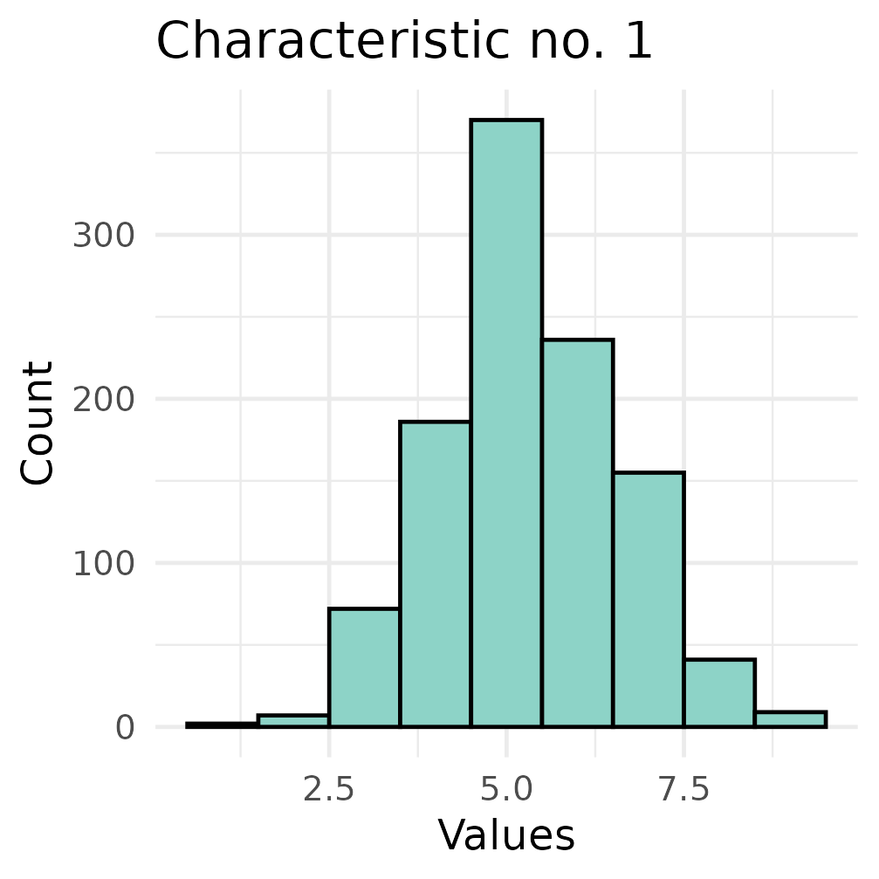
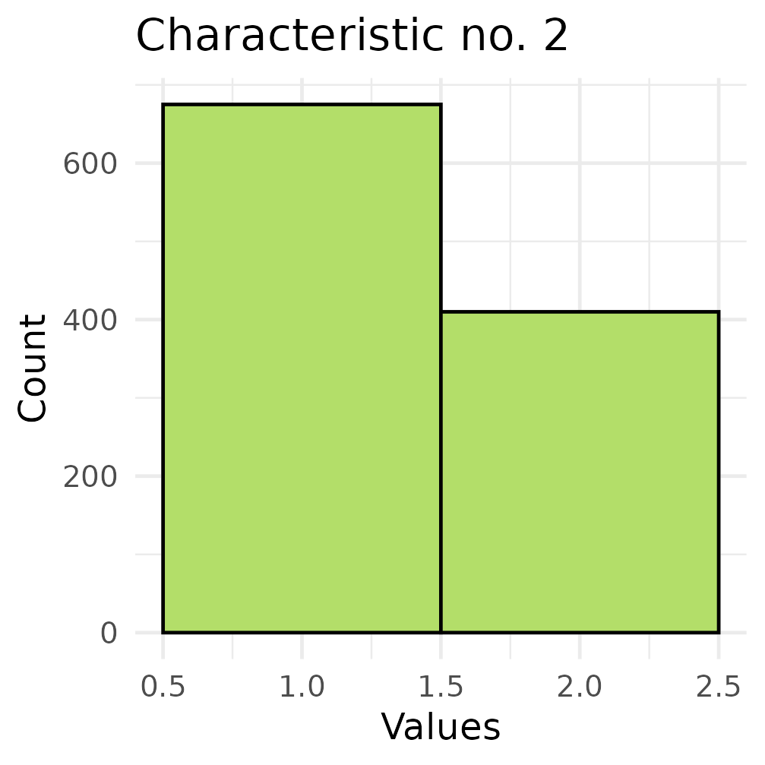
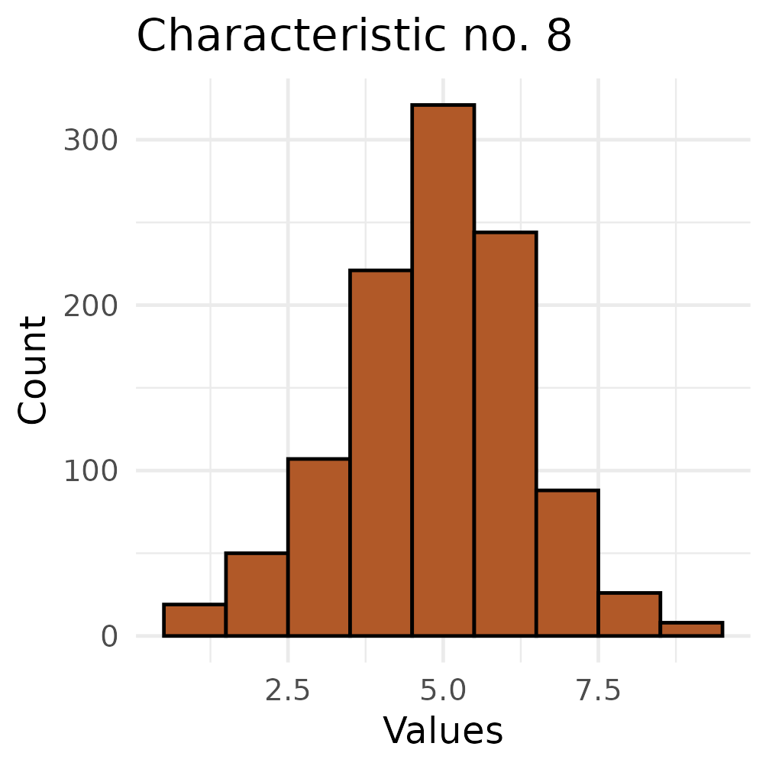
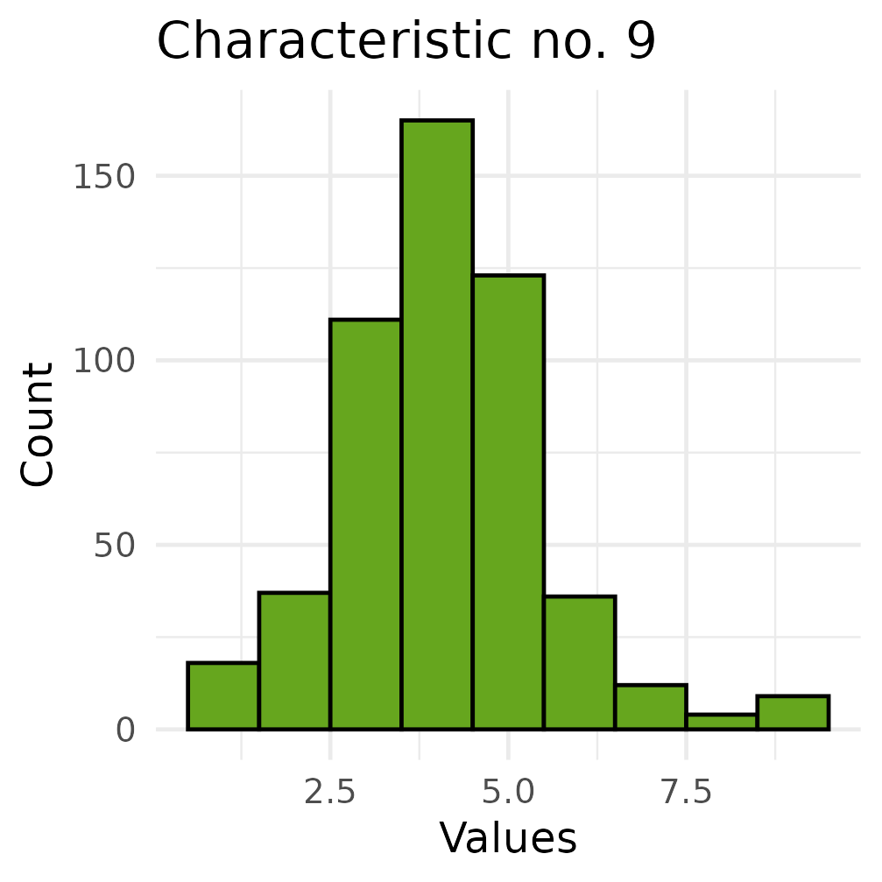
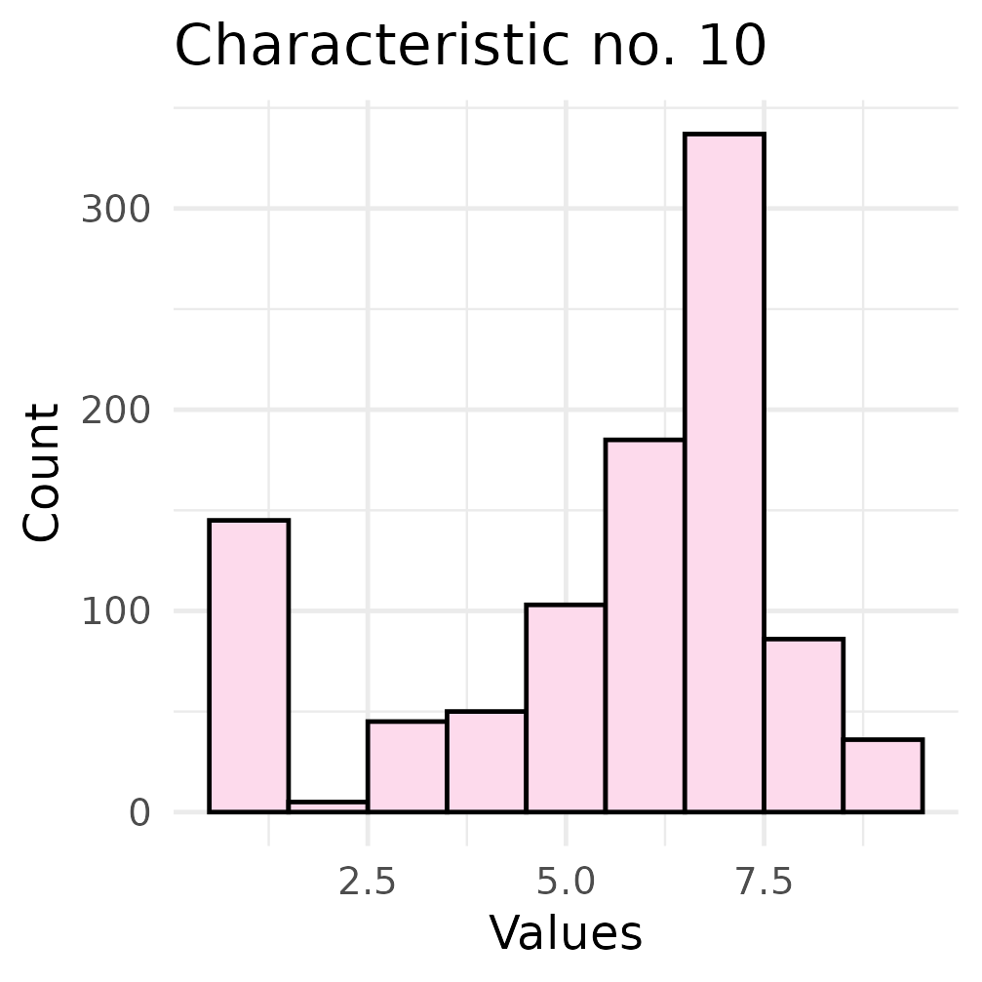
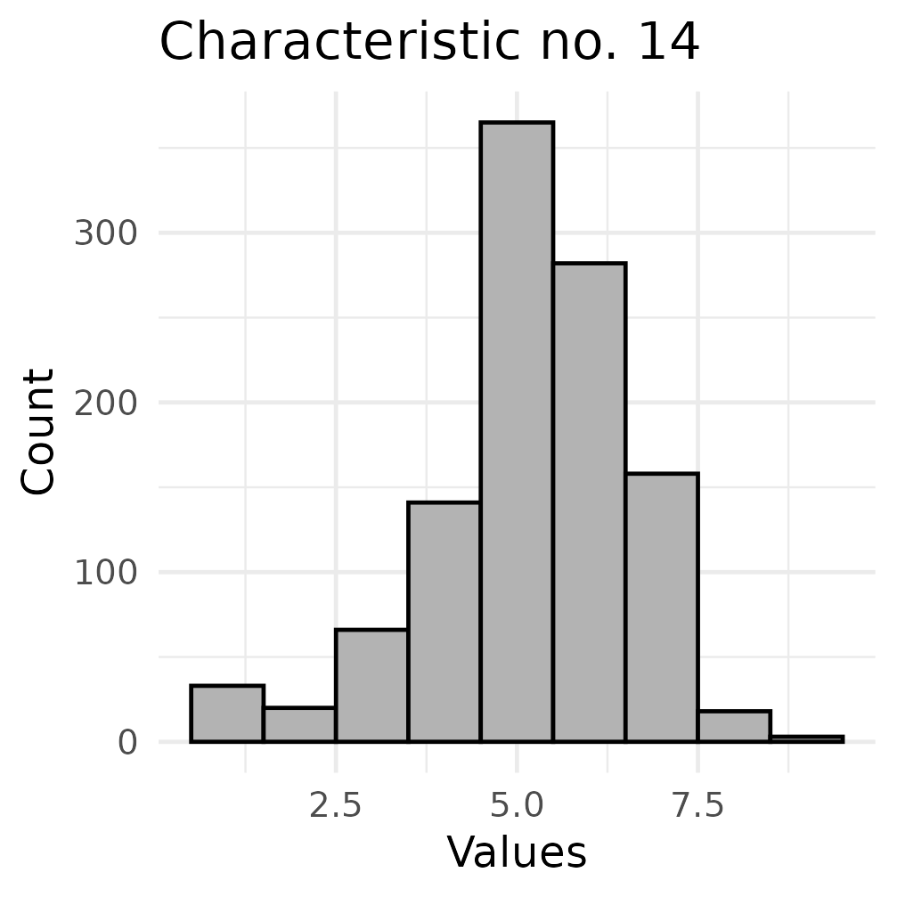
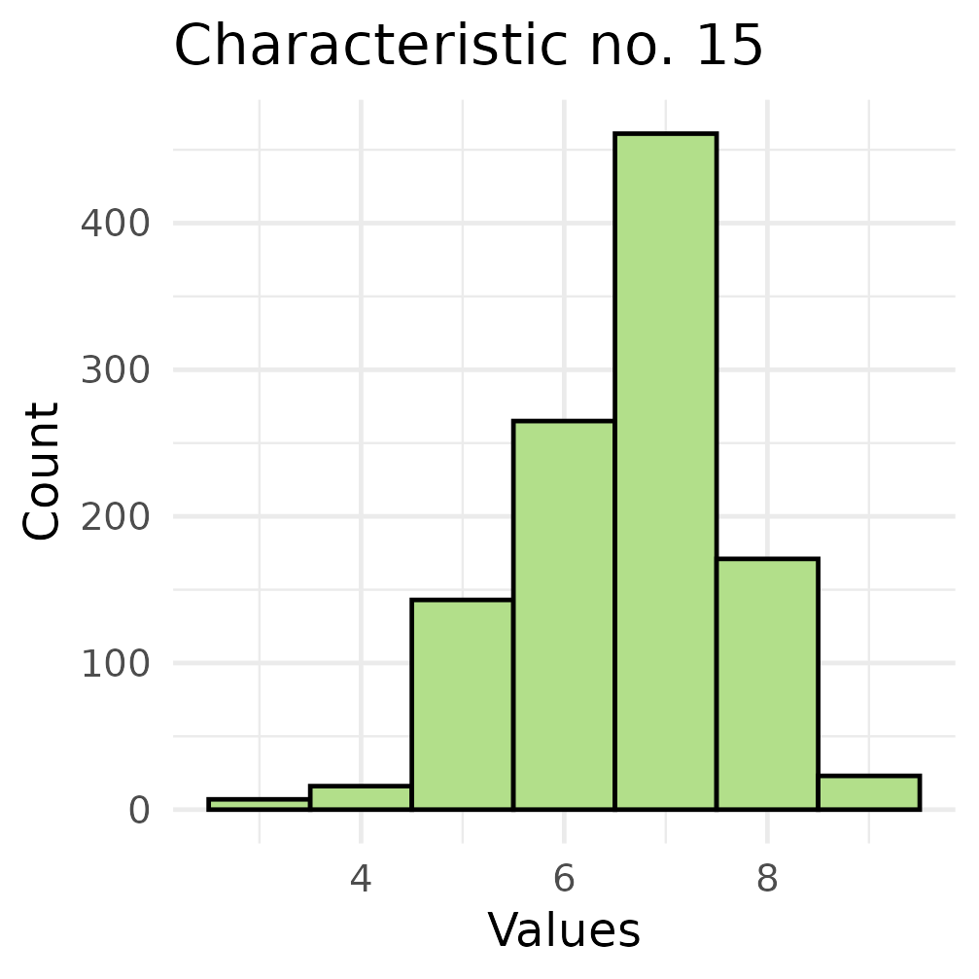
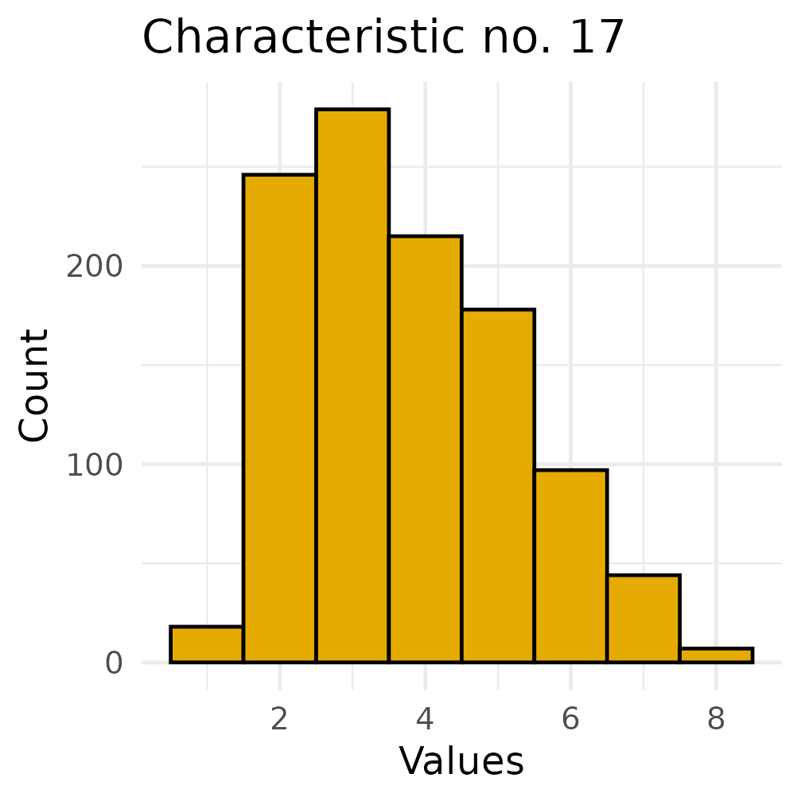
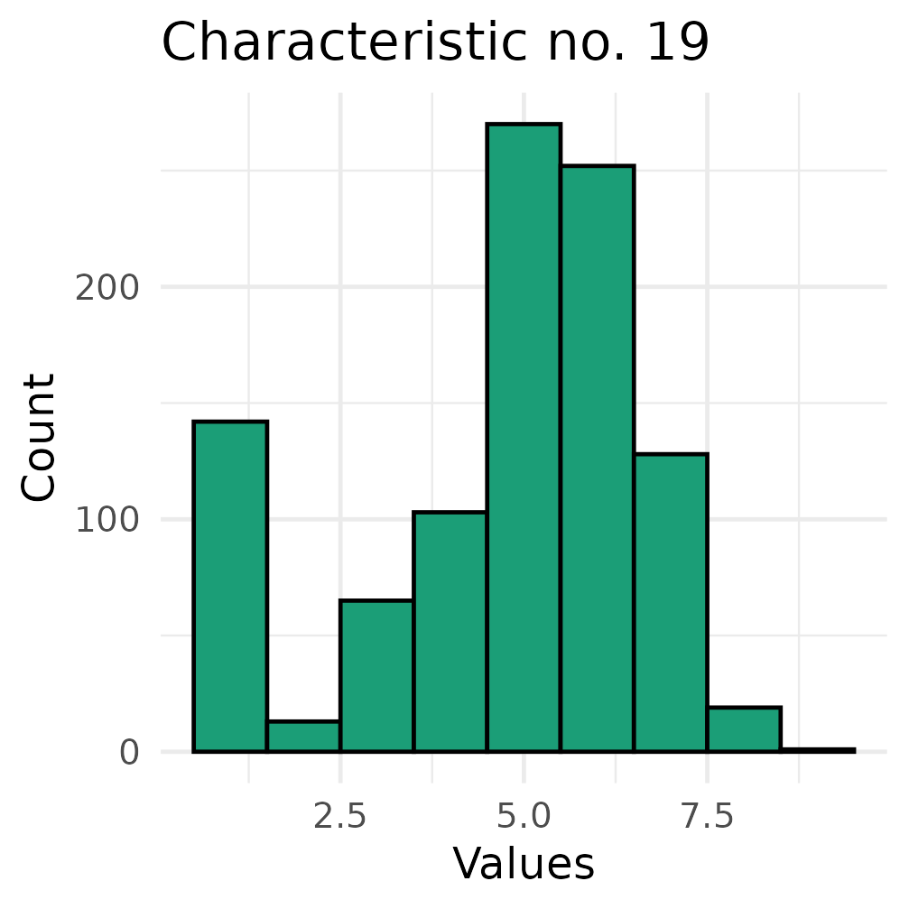
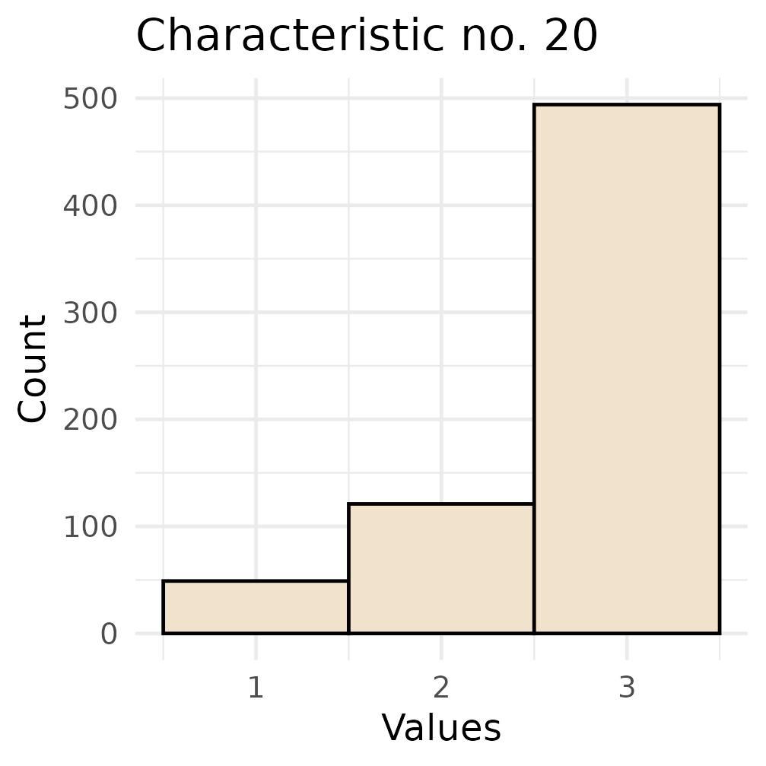
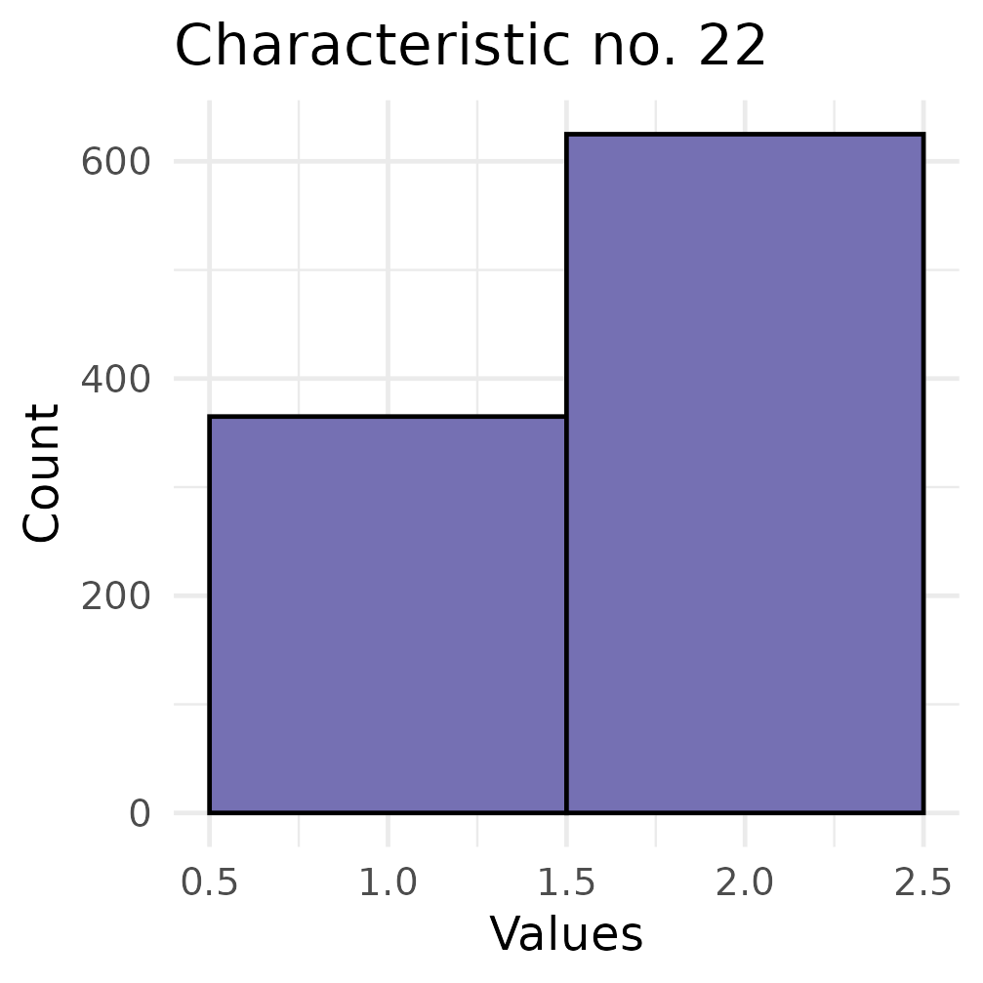
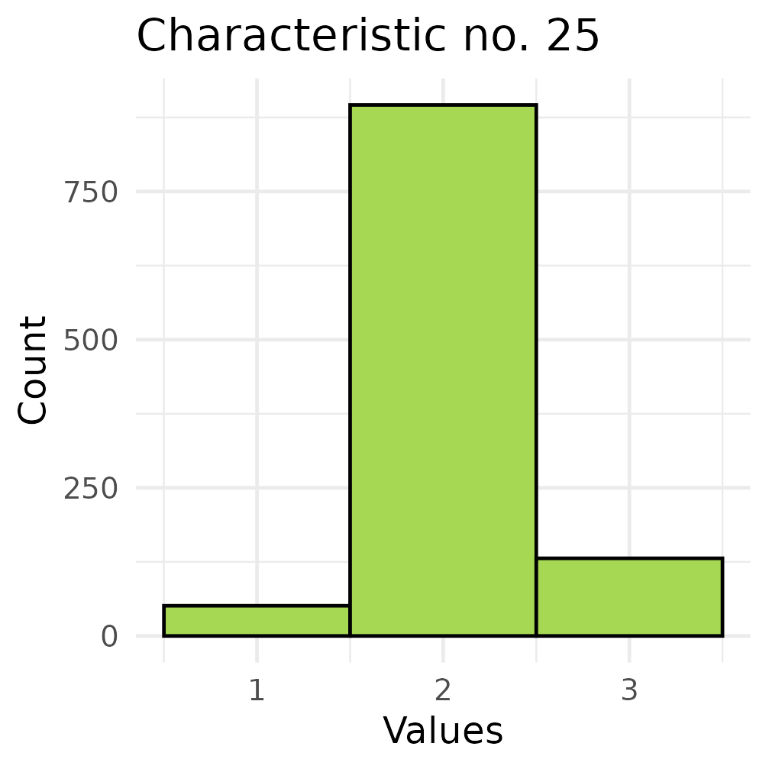
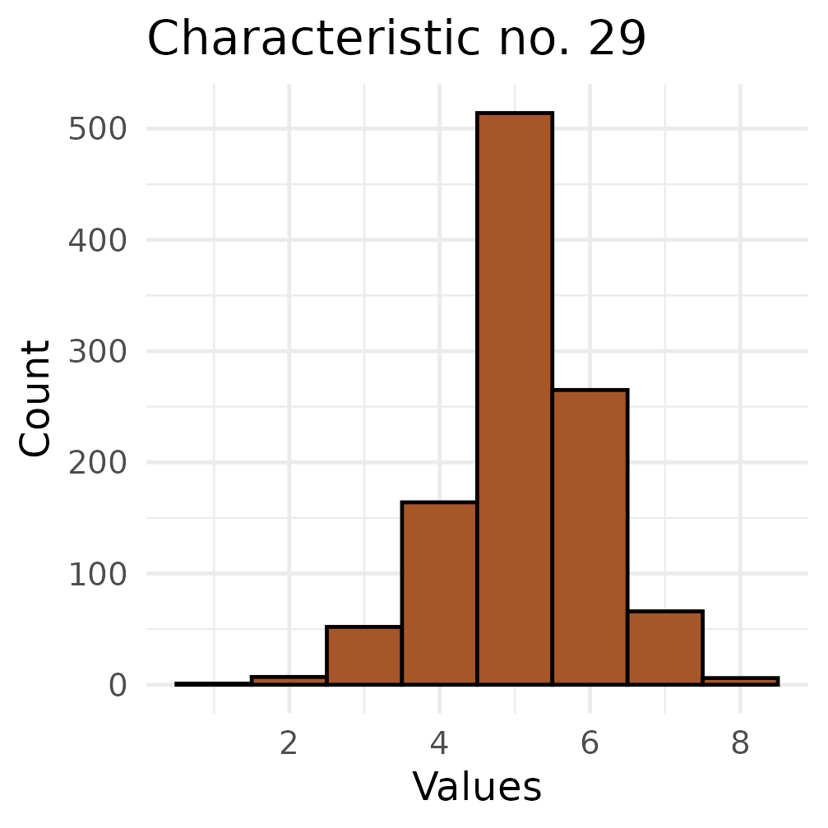
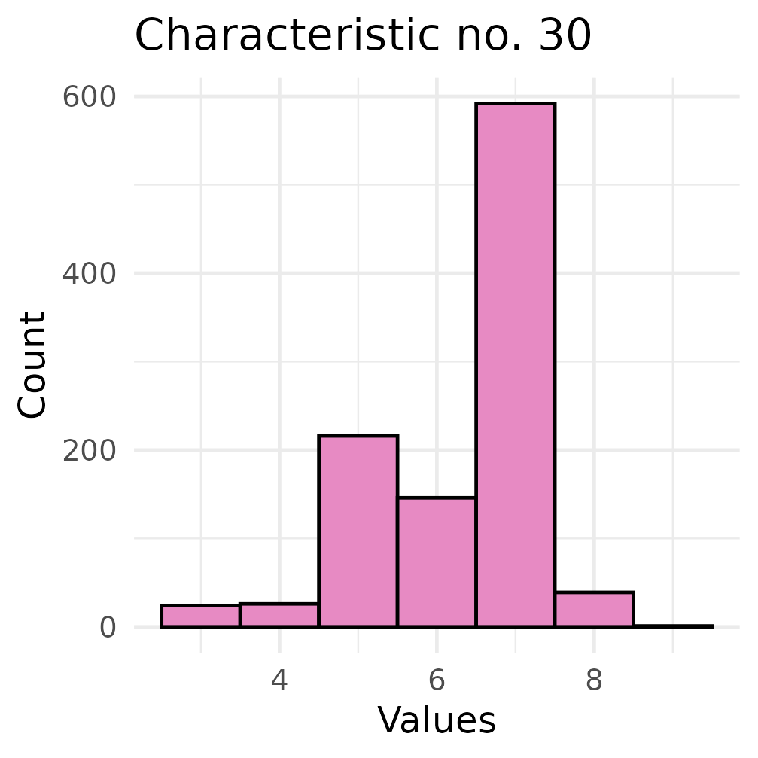
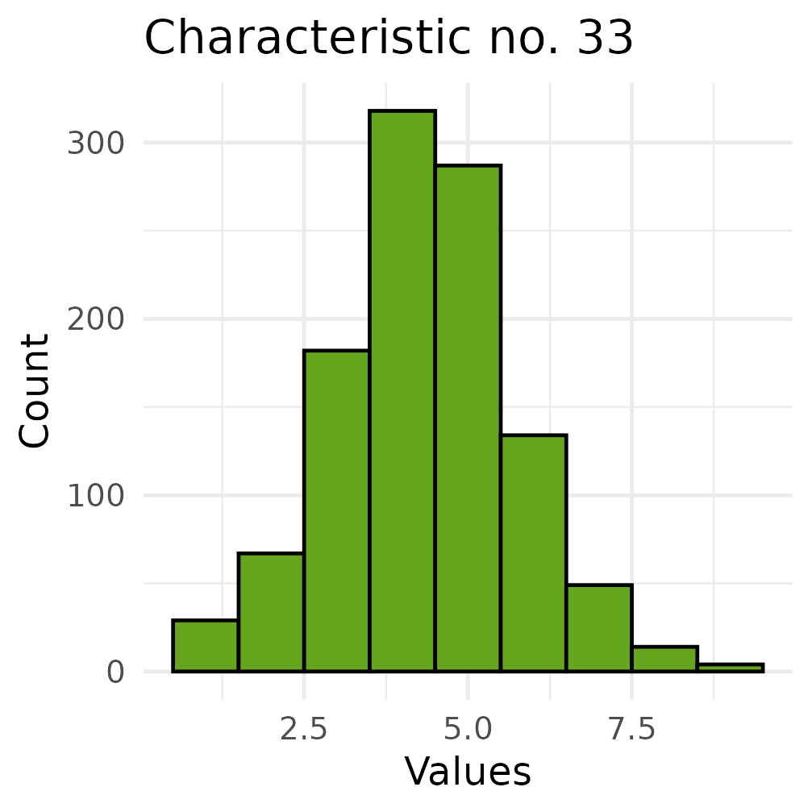
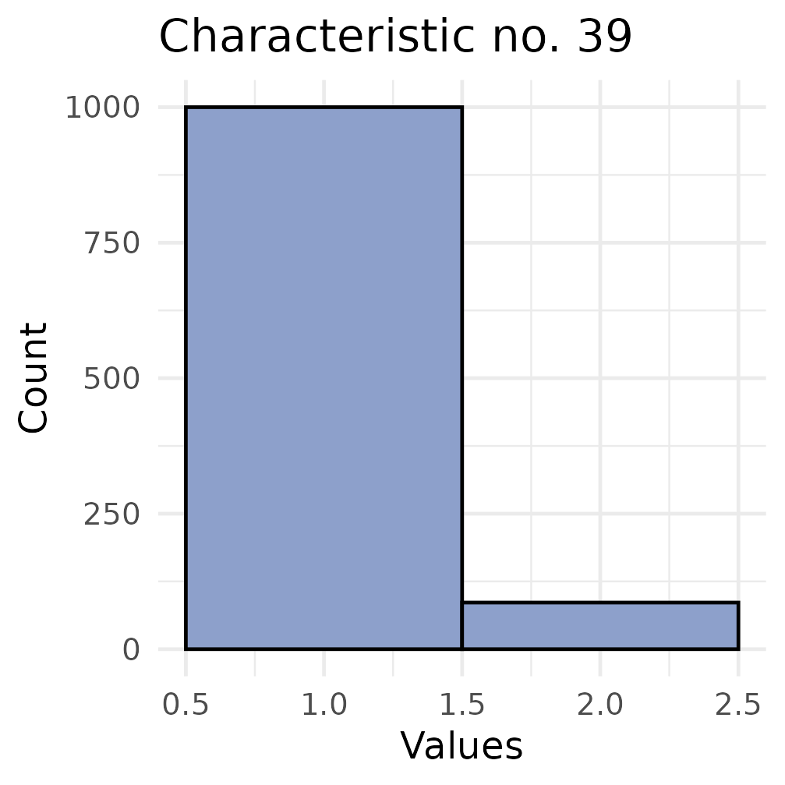
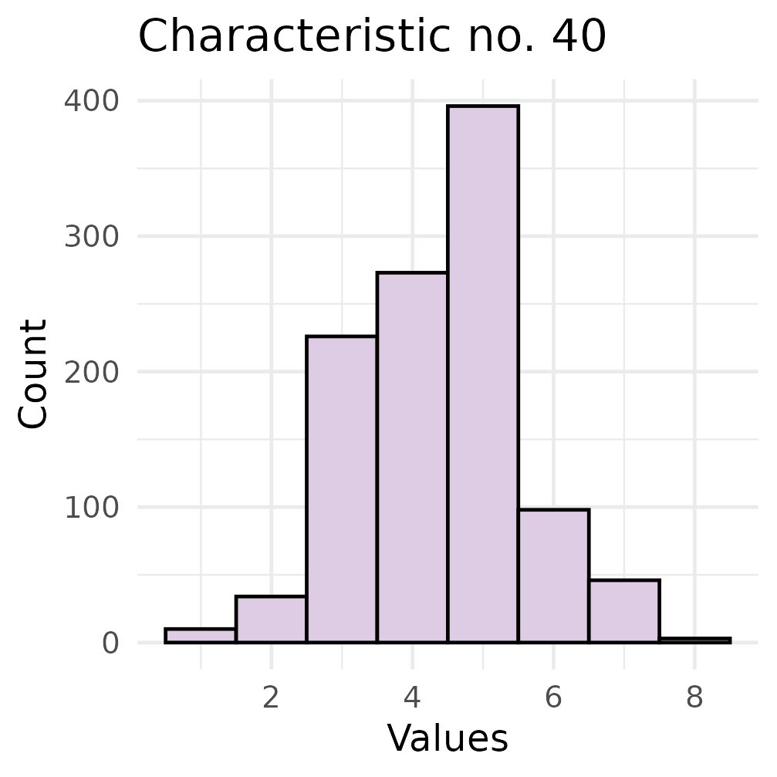
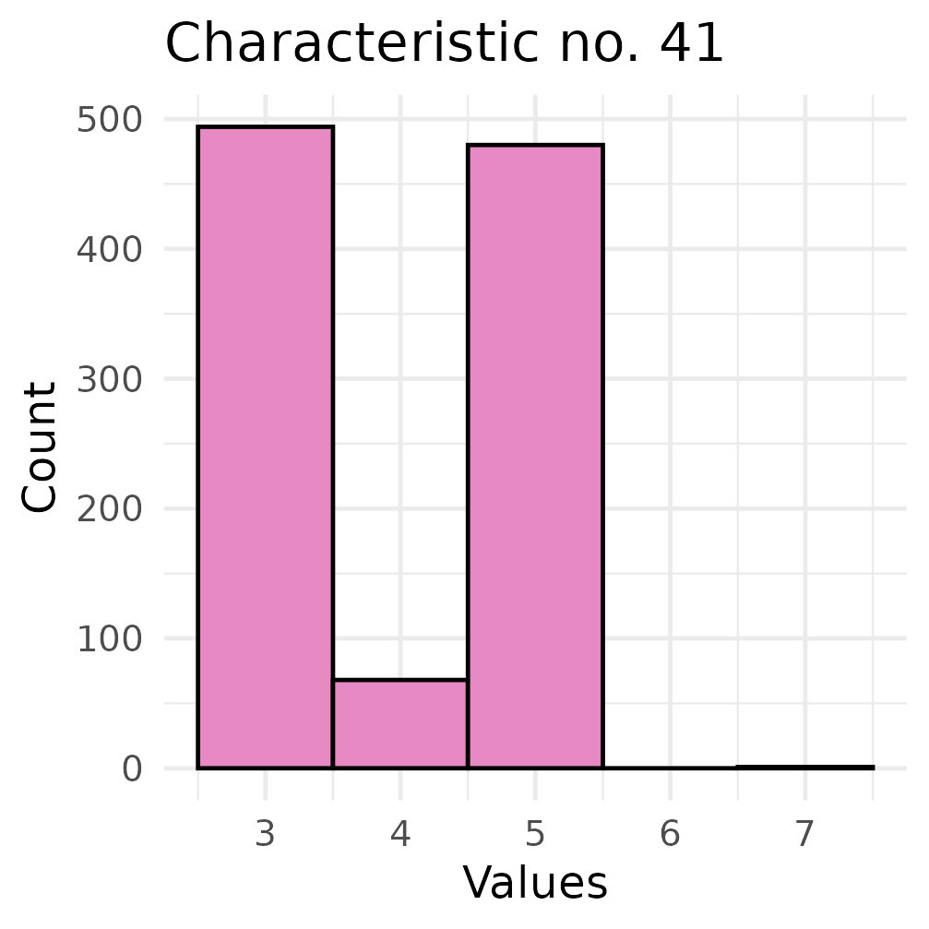
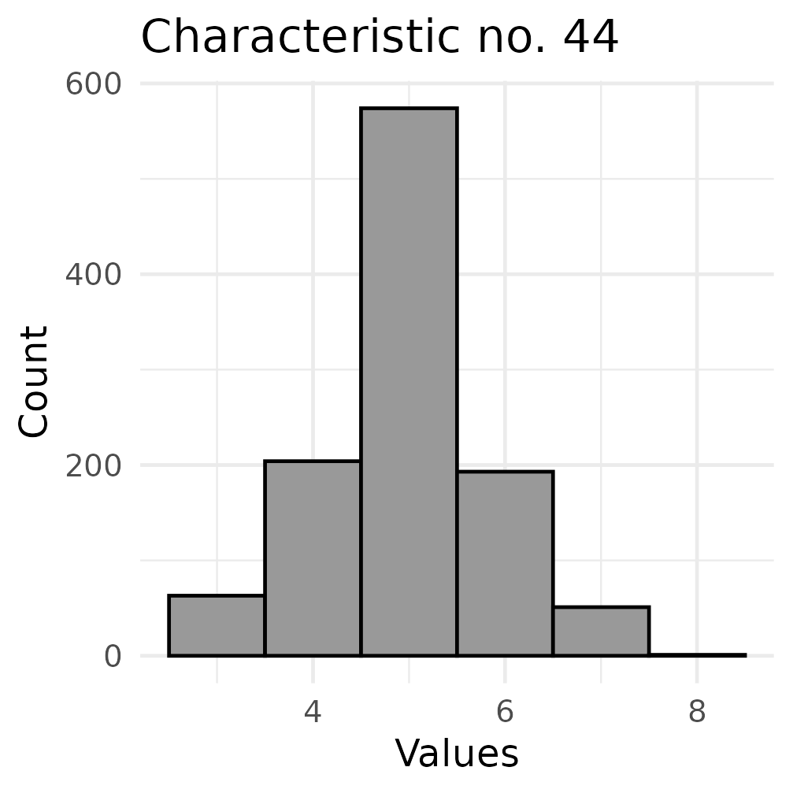
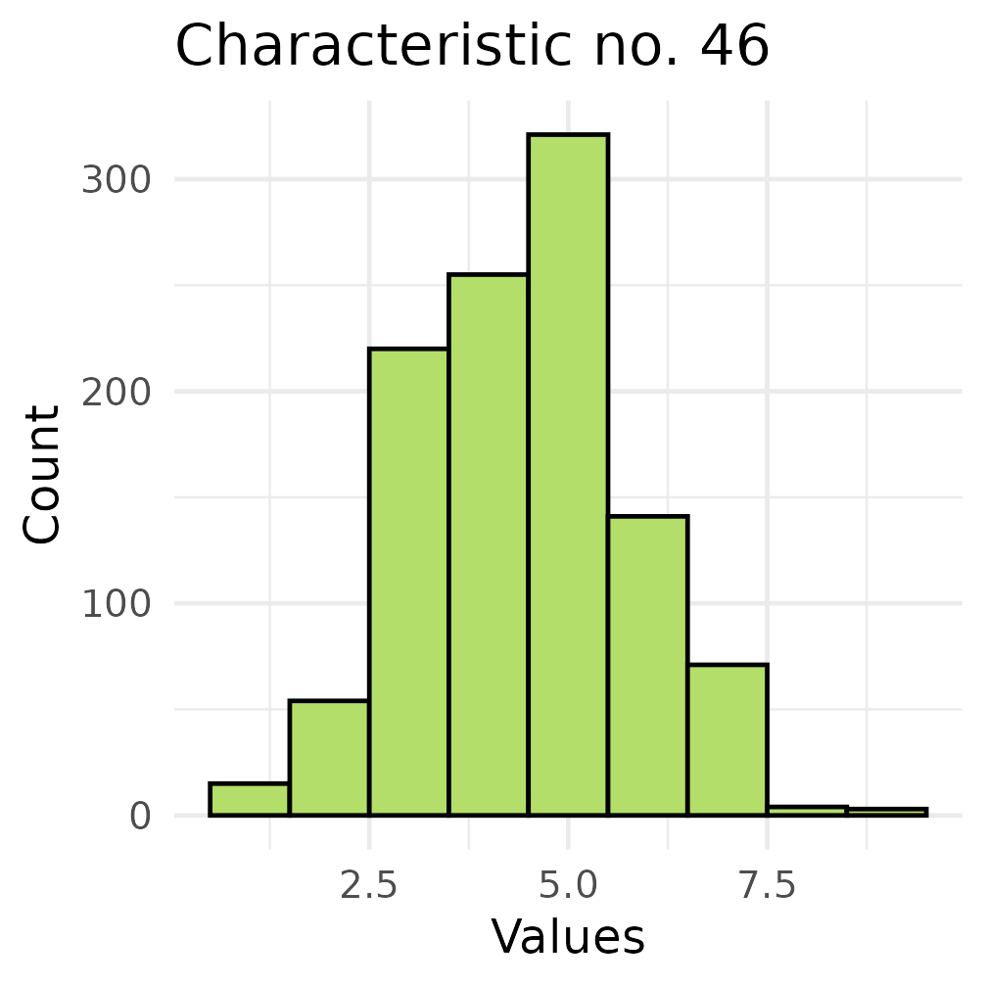
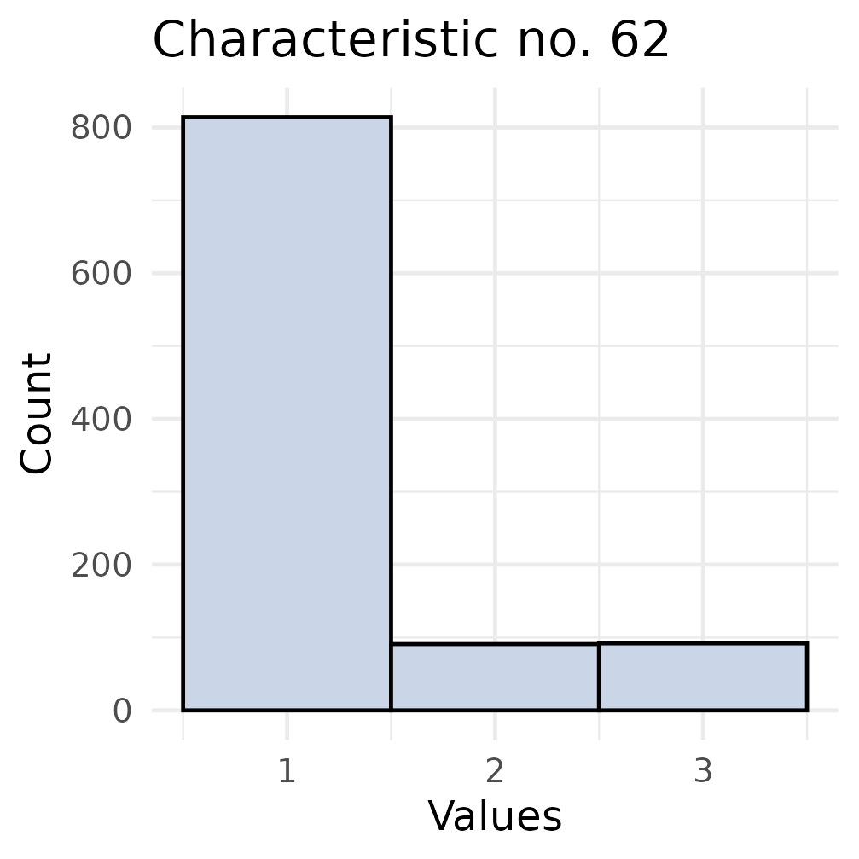
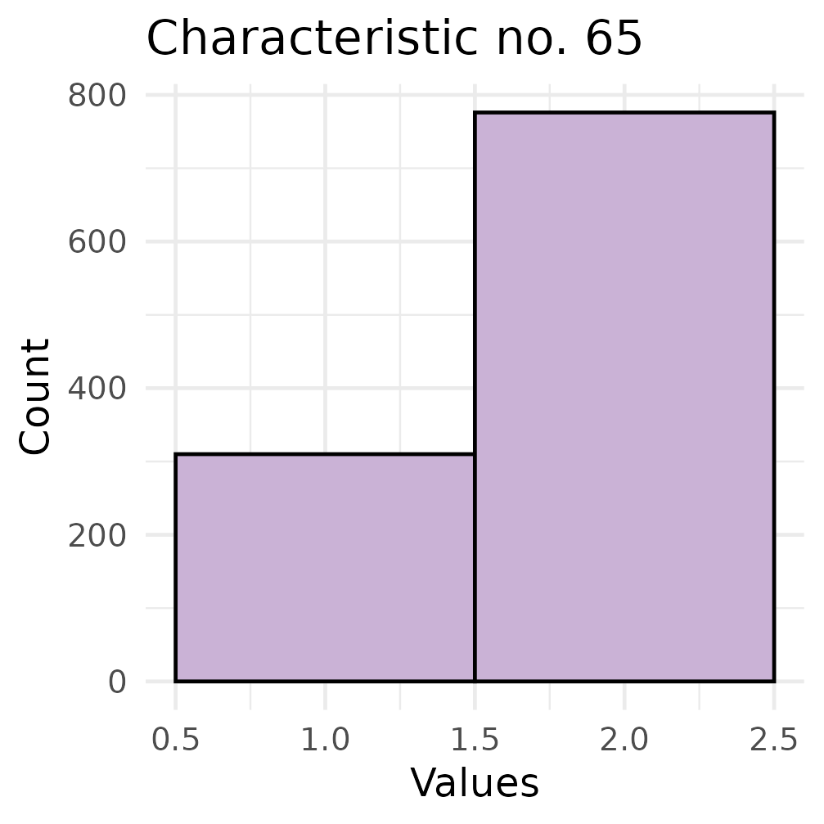
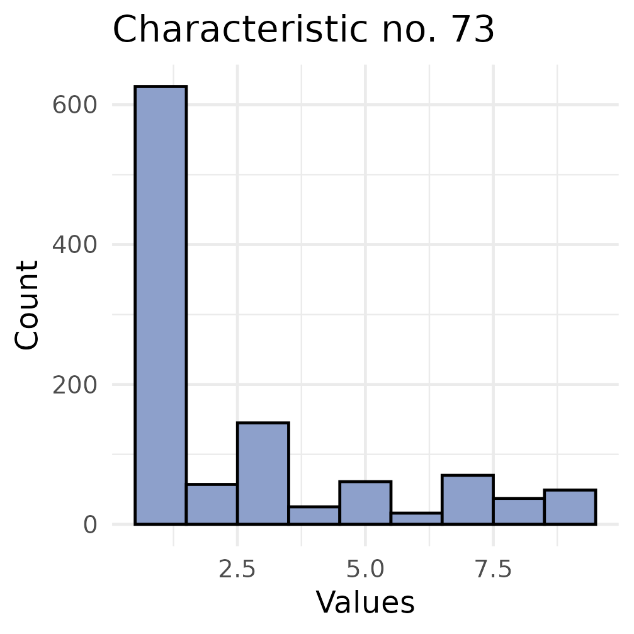
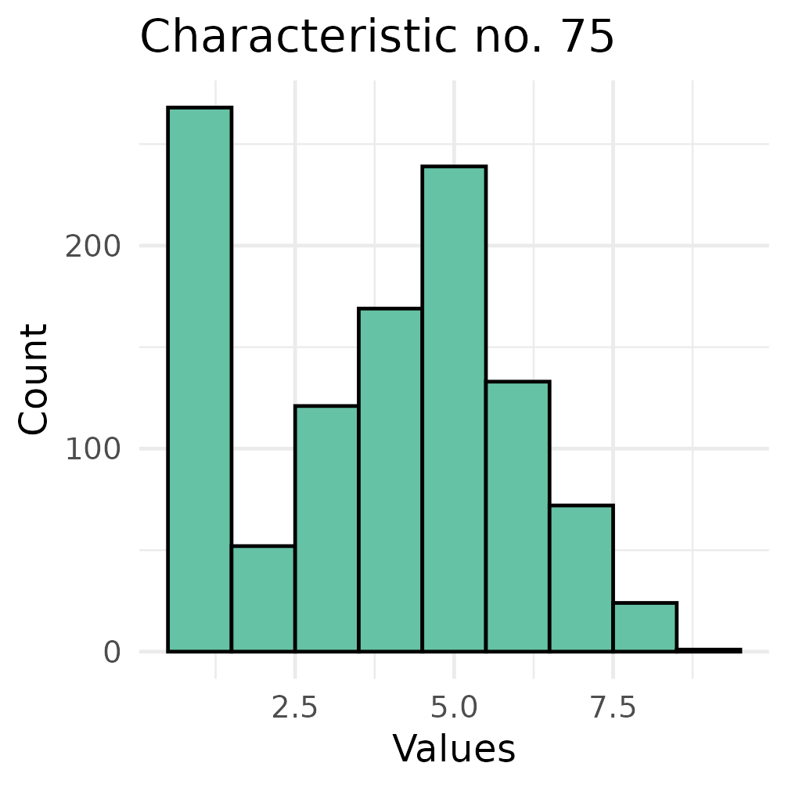
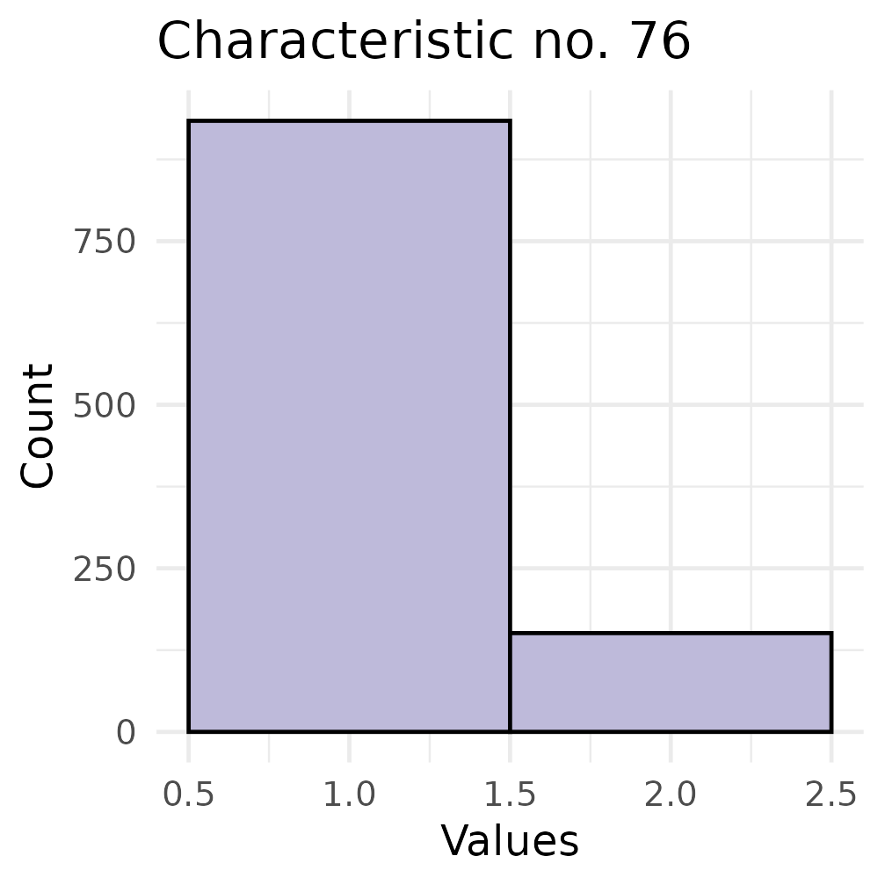
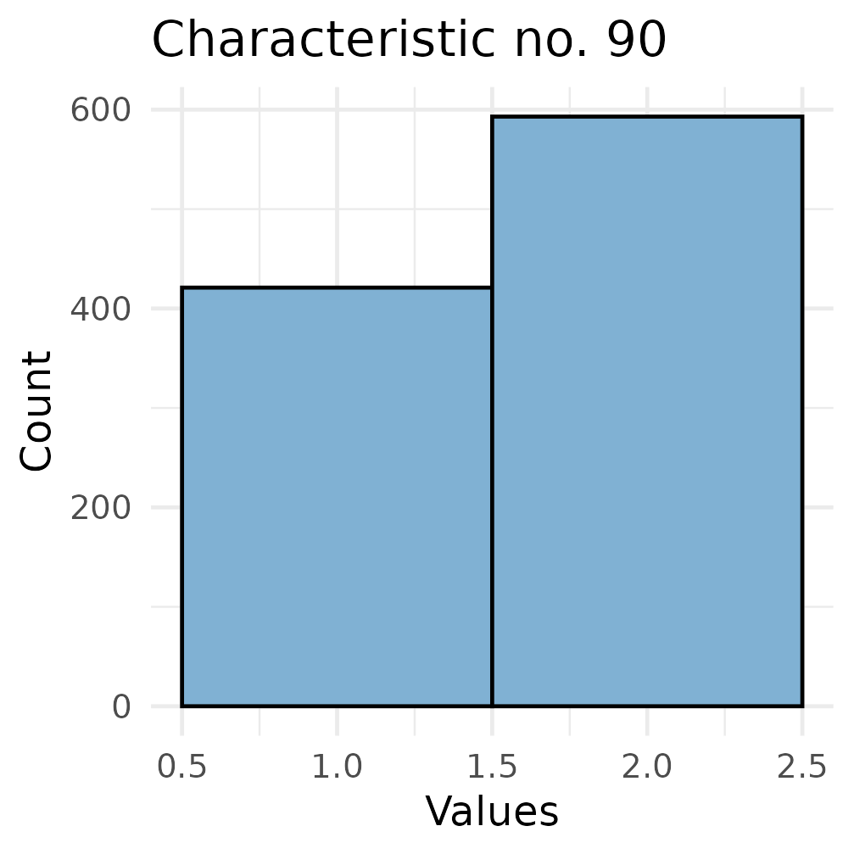
a)
b)
c)
d)
e)
f)
g)
h)
i)
j)
k)
l)
m)
n)
o)
p)
q)
r)
s)
t)
u)
v)
w)
x)
y)
z)
Supplementary Figure 1 – Characteristic distributions for the barley prediction panel. The histograms include the 26 DUS characteristics used for genome-wide association study (GWAS) and genomic prediction. Full characteristic names are shown in Table 1.

Slide 2
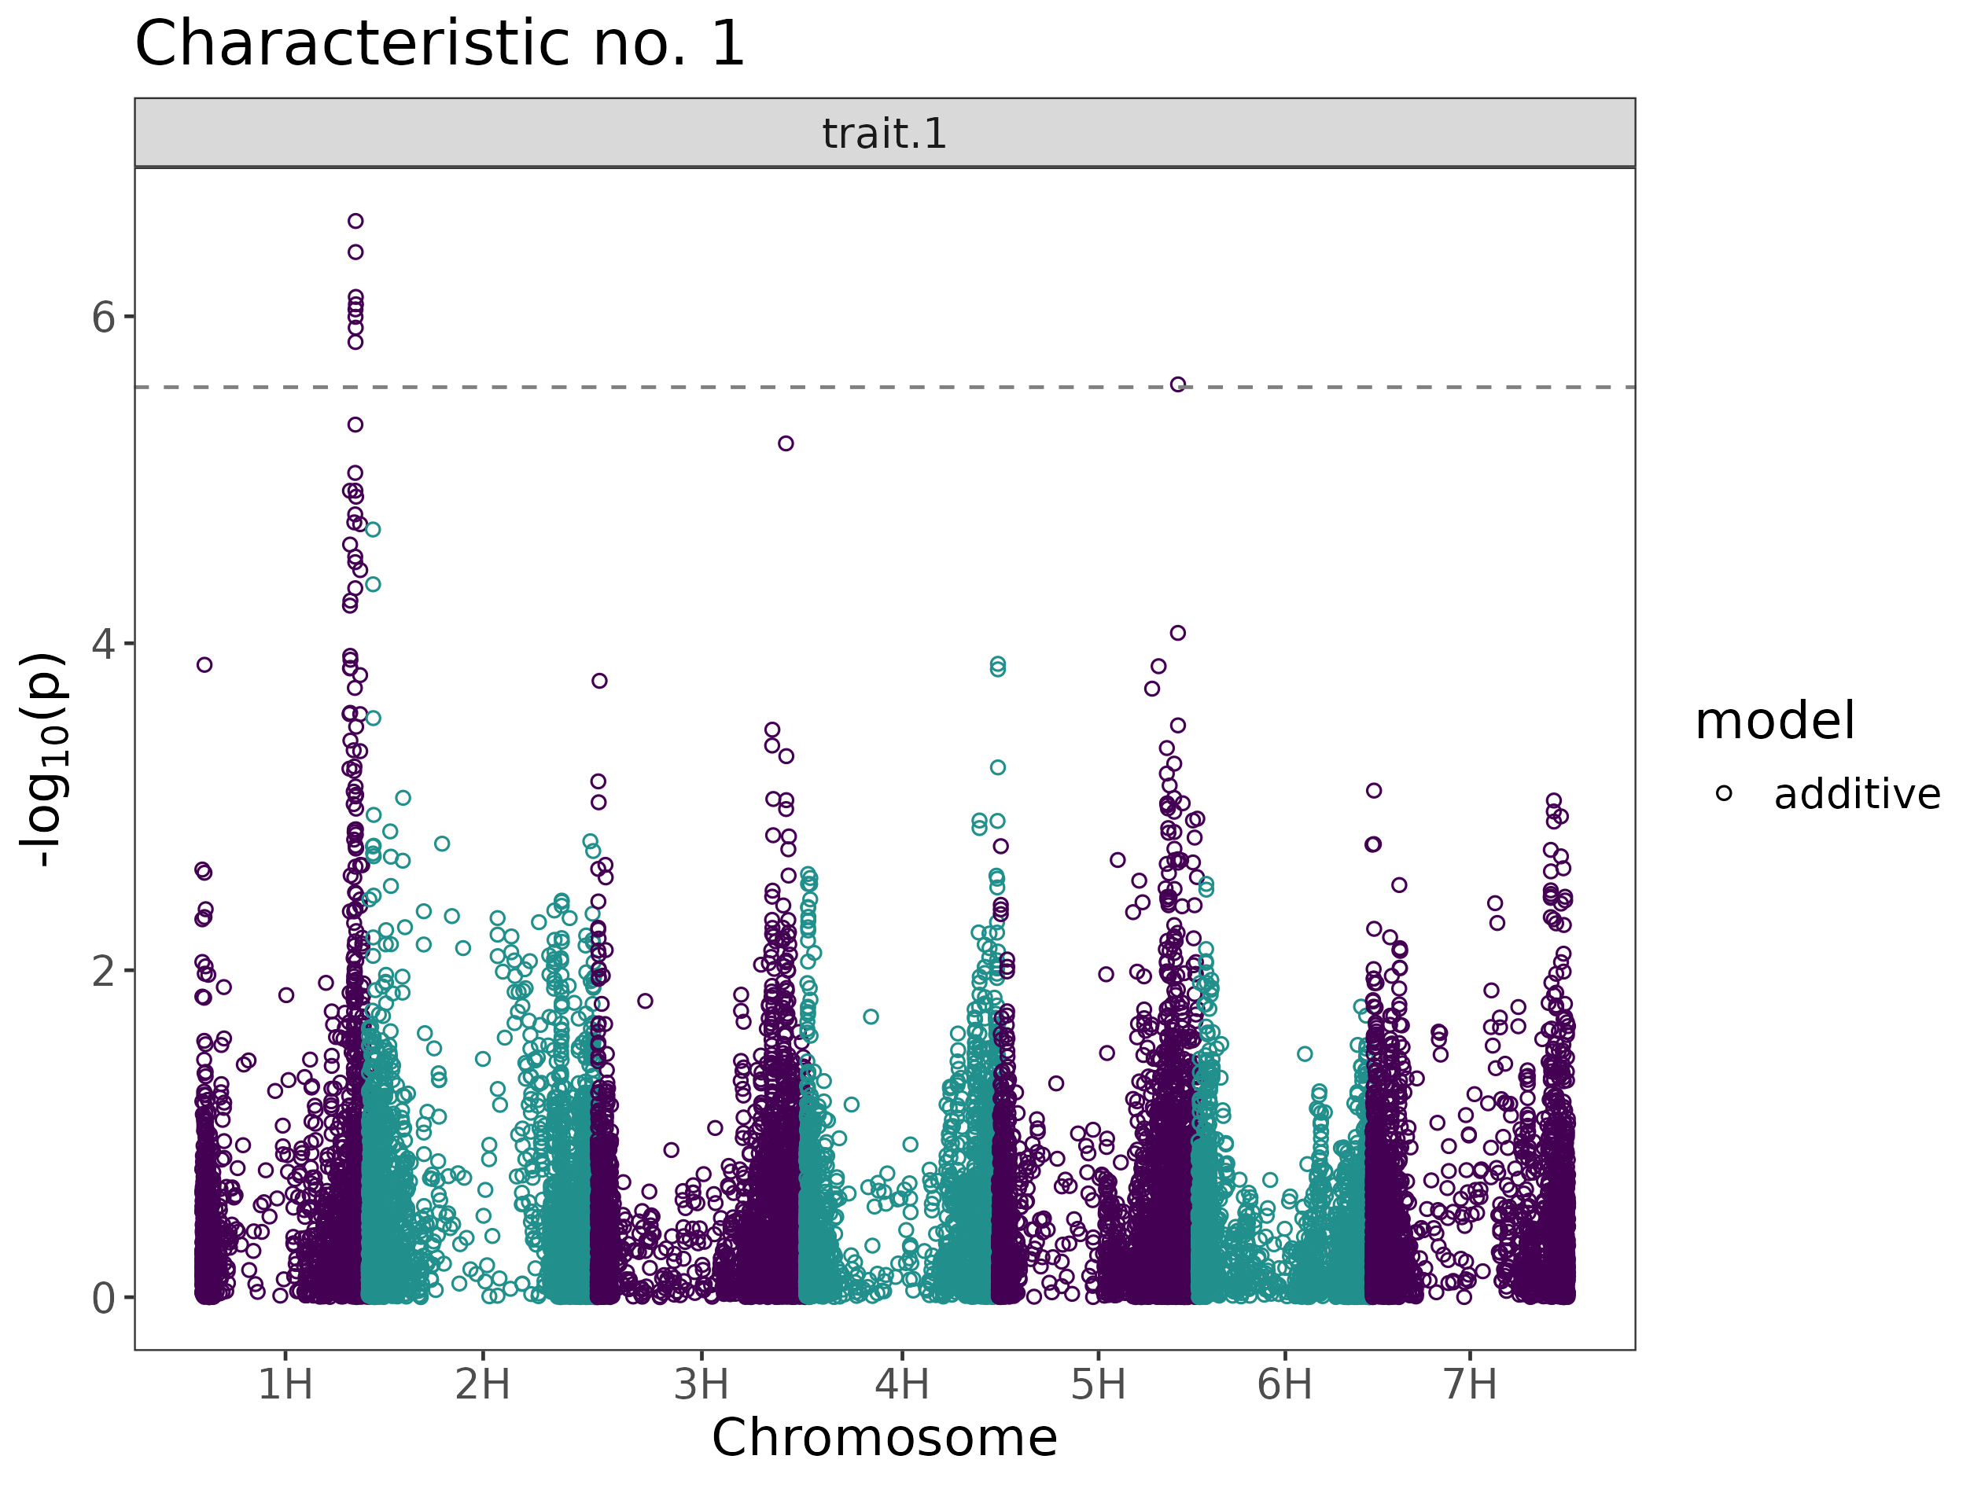
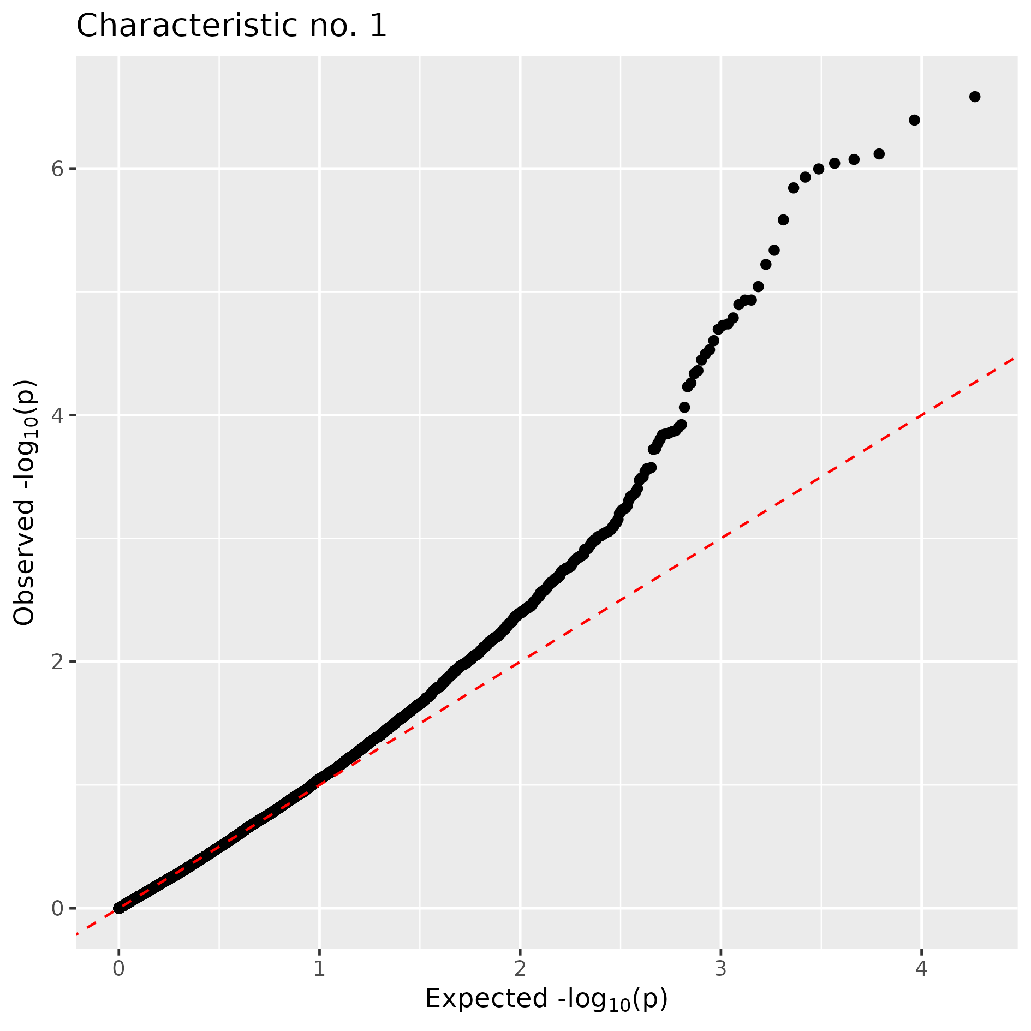
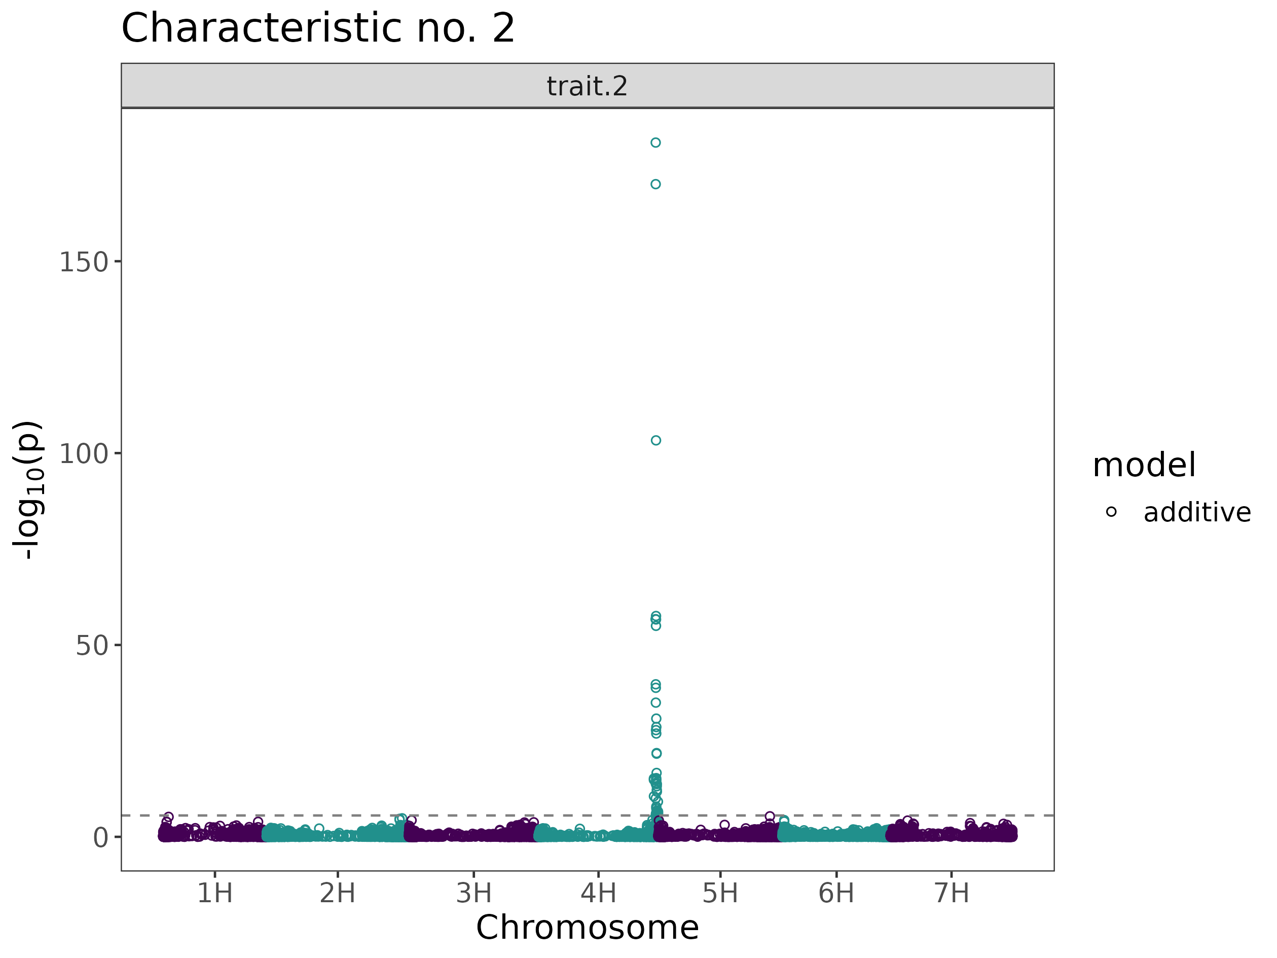
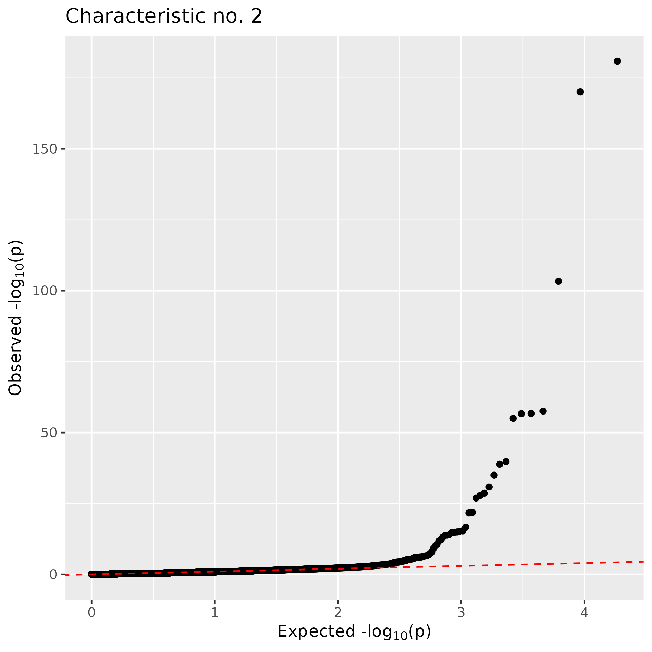
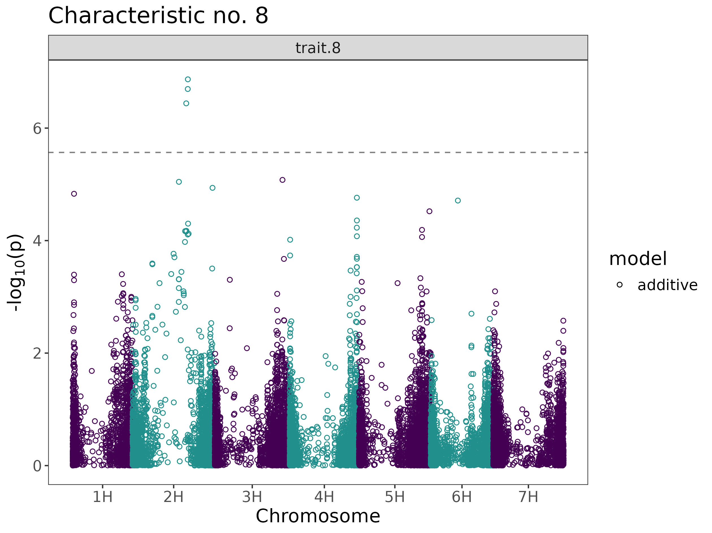
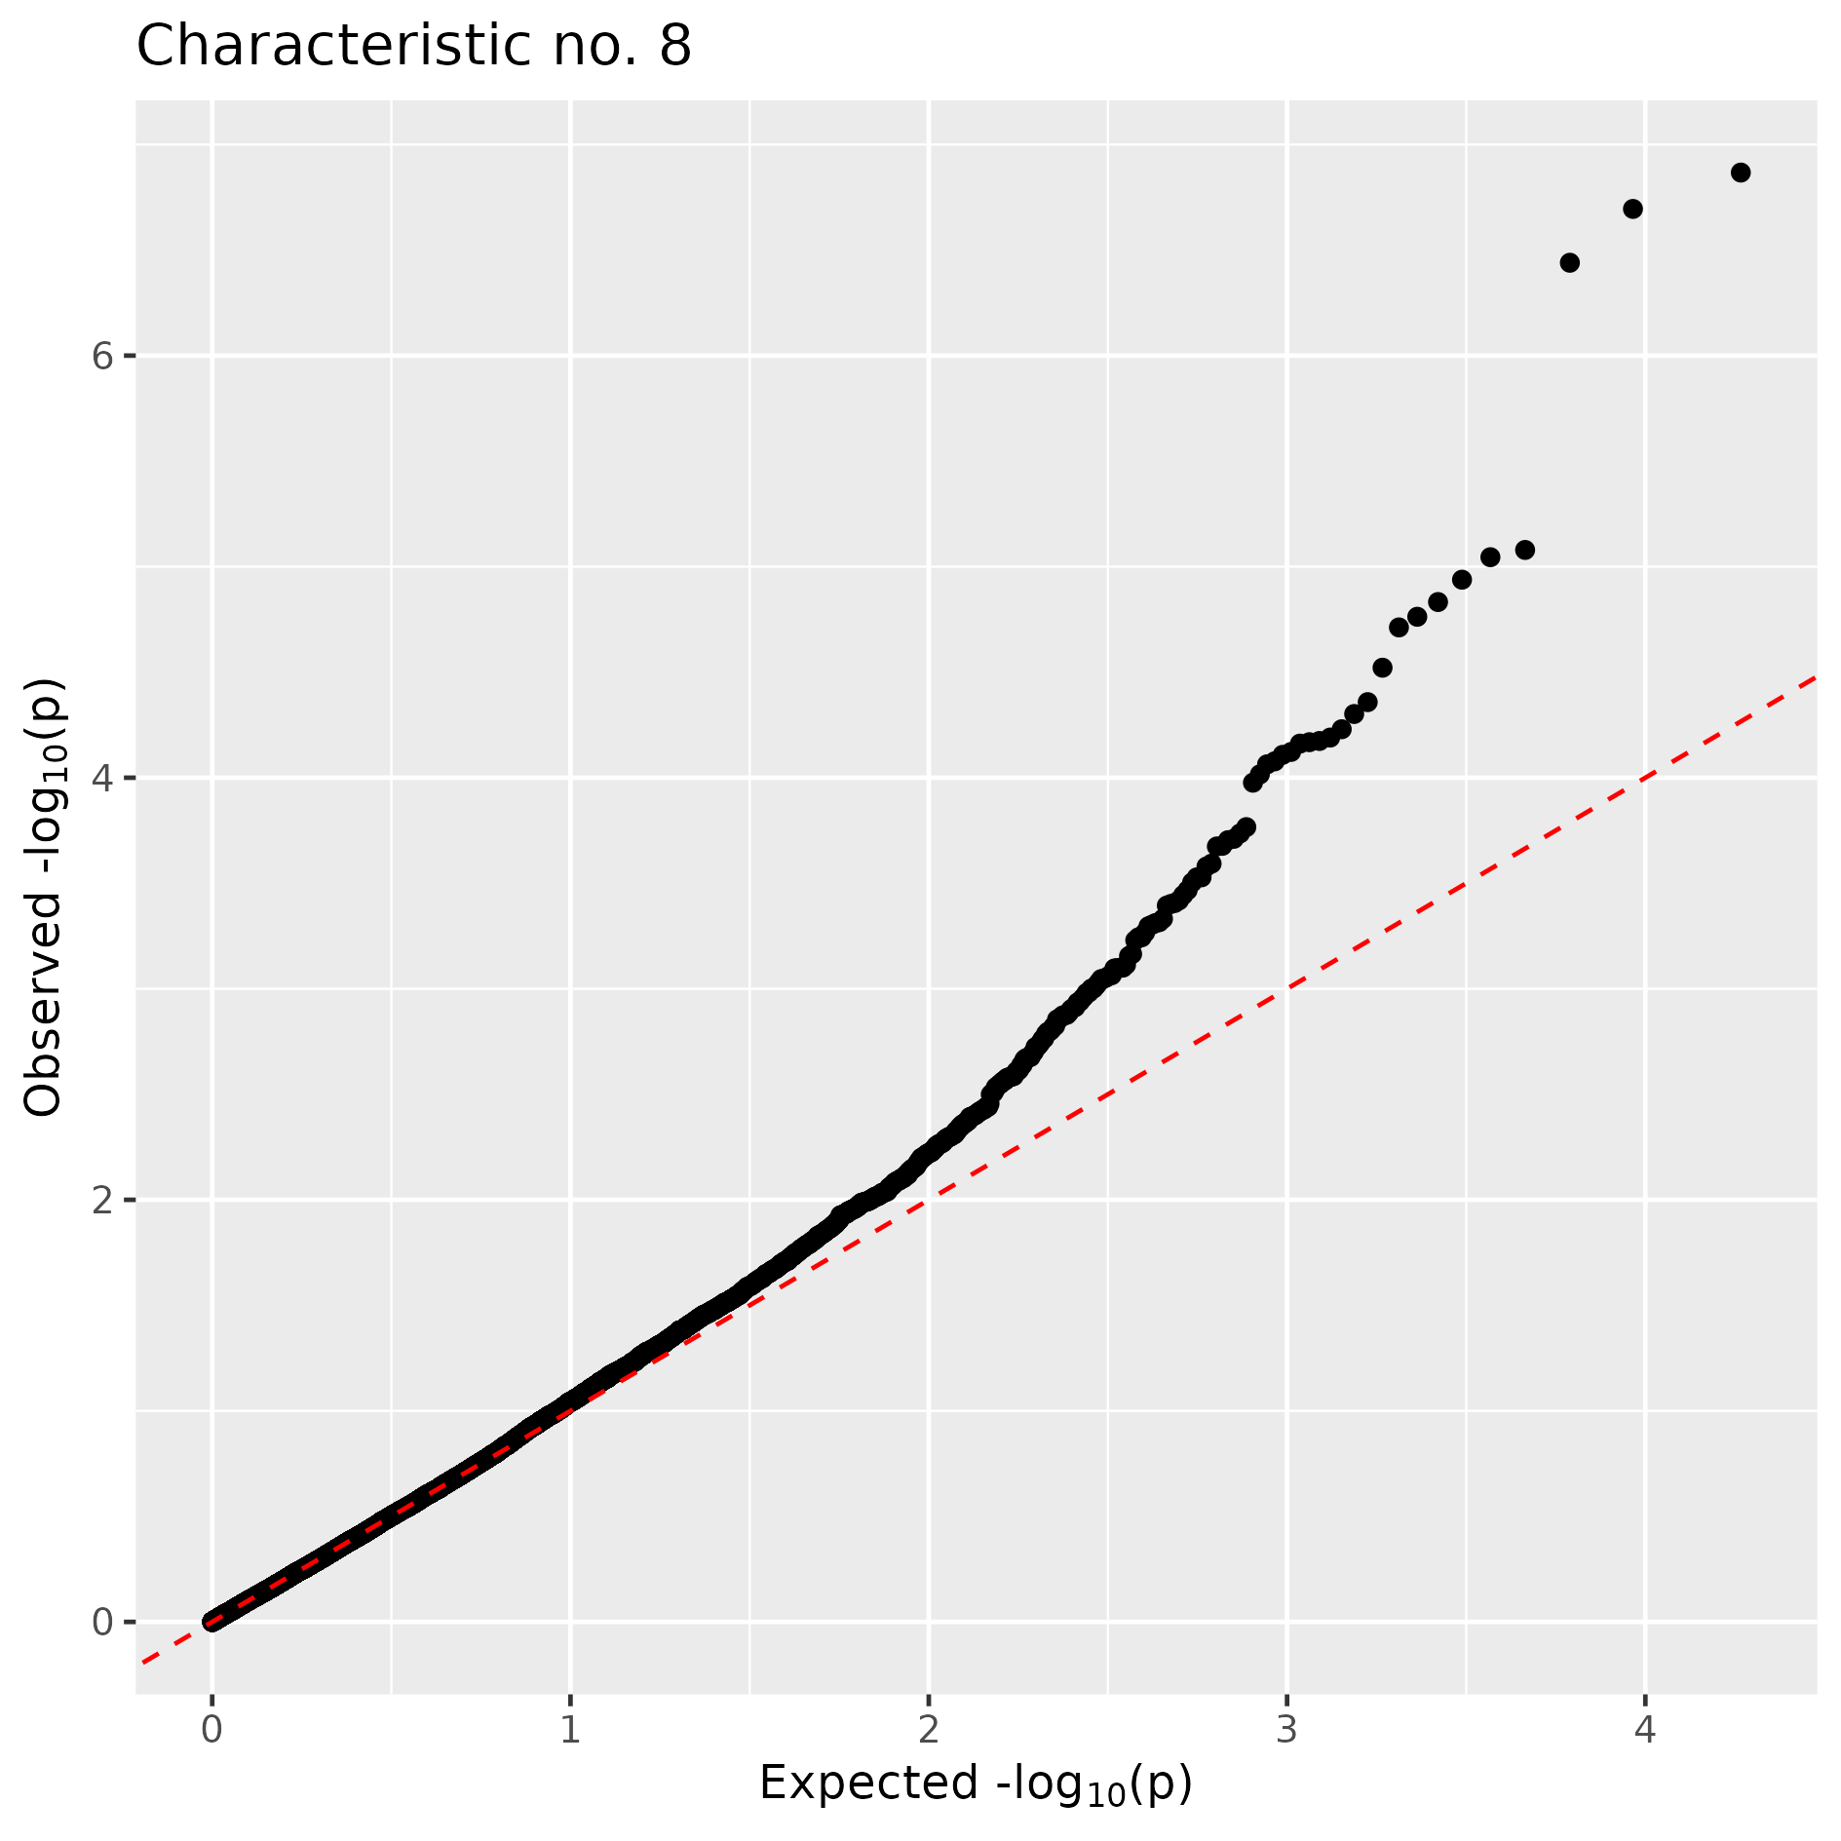
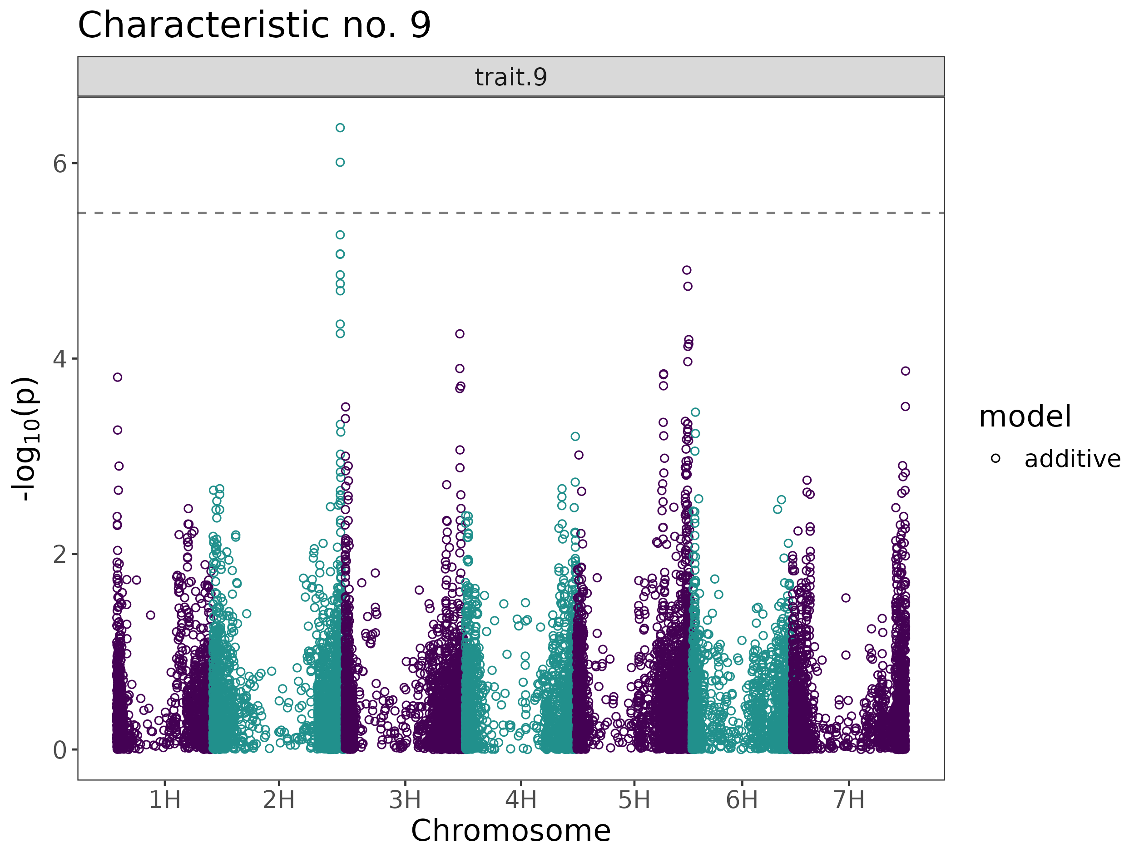
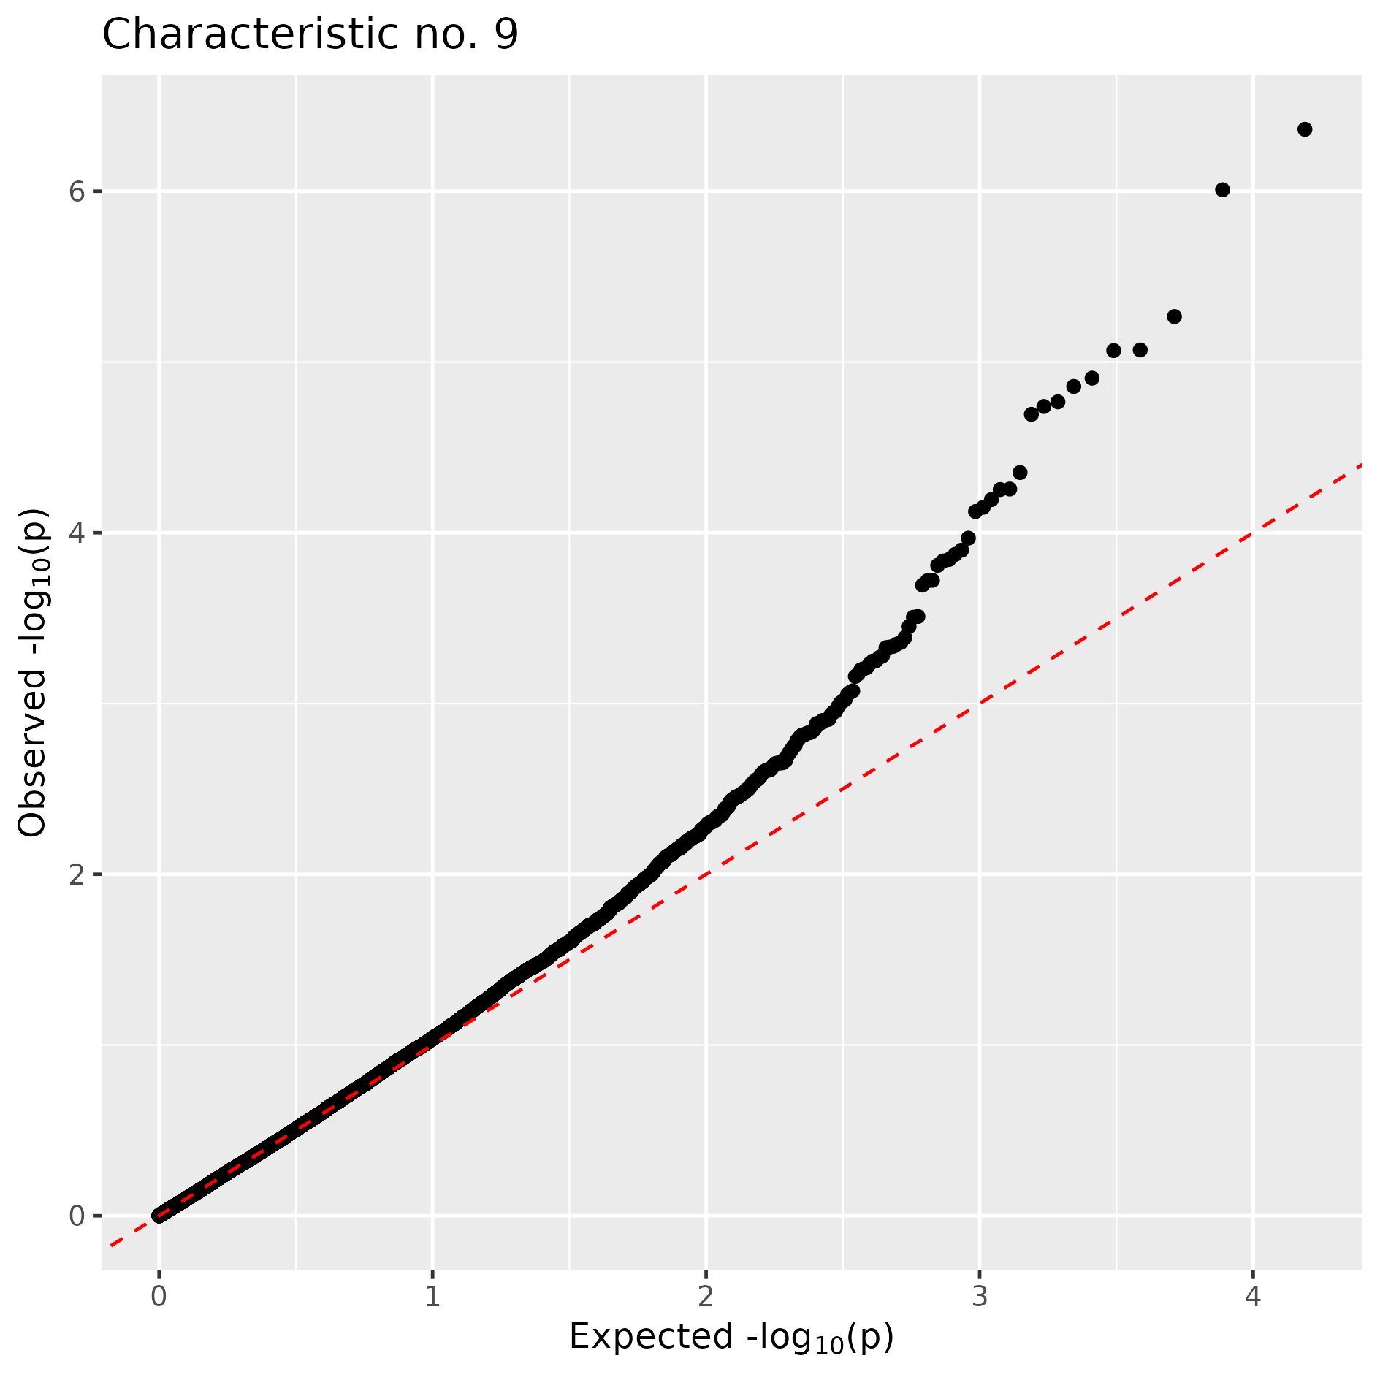
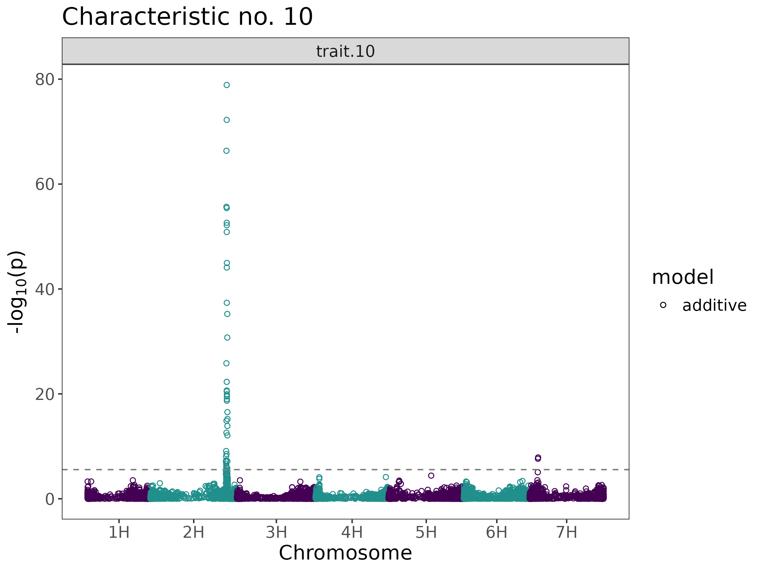
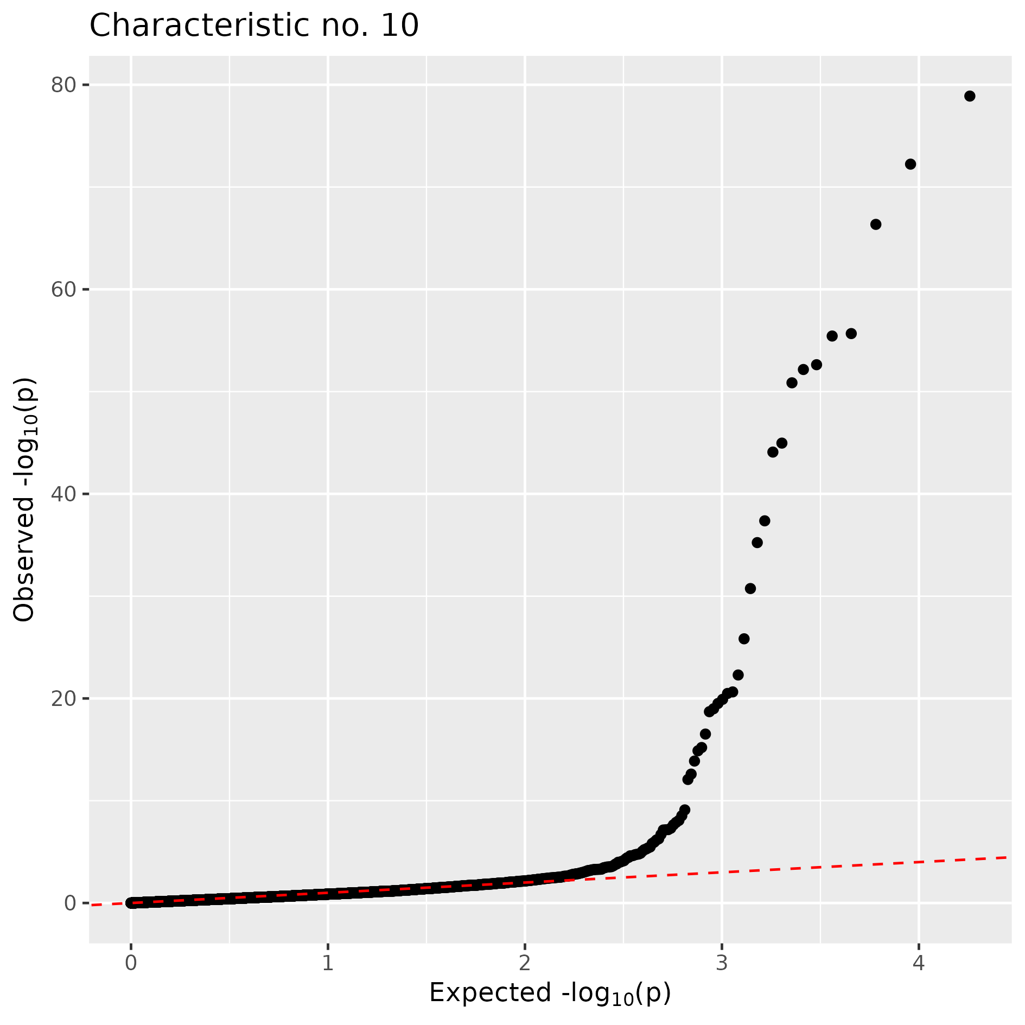
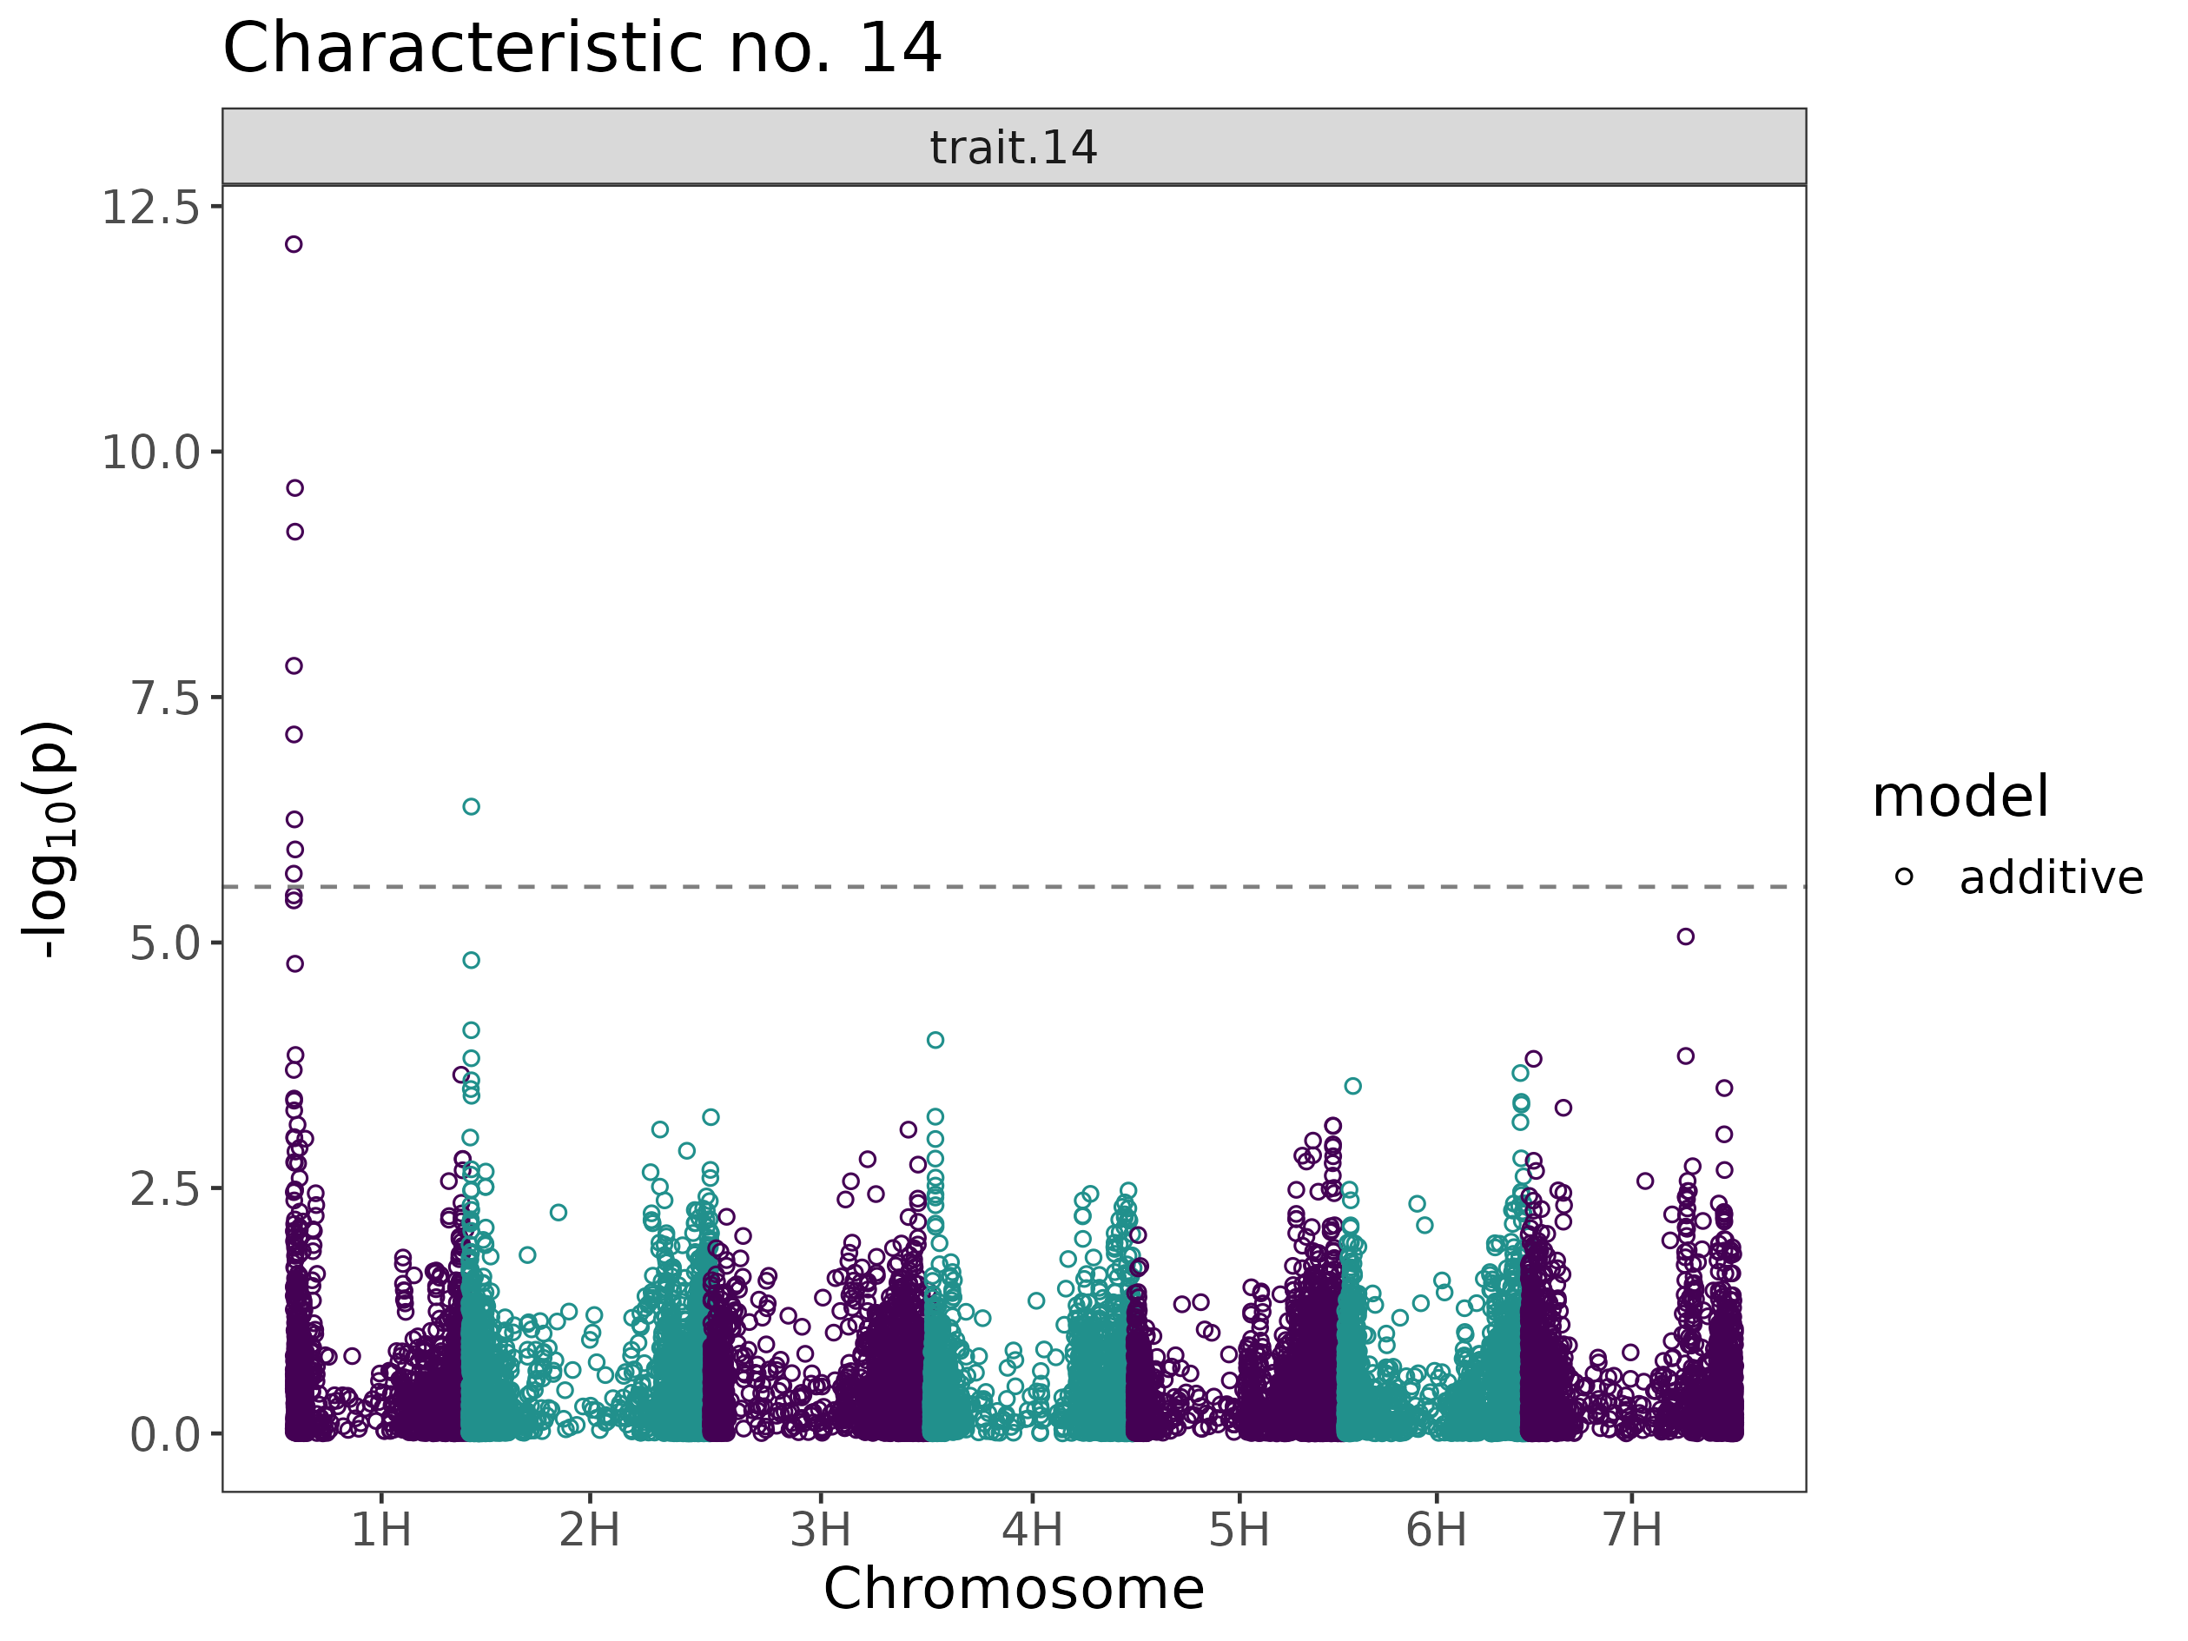
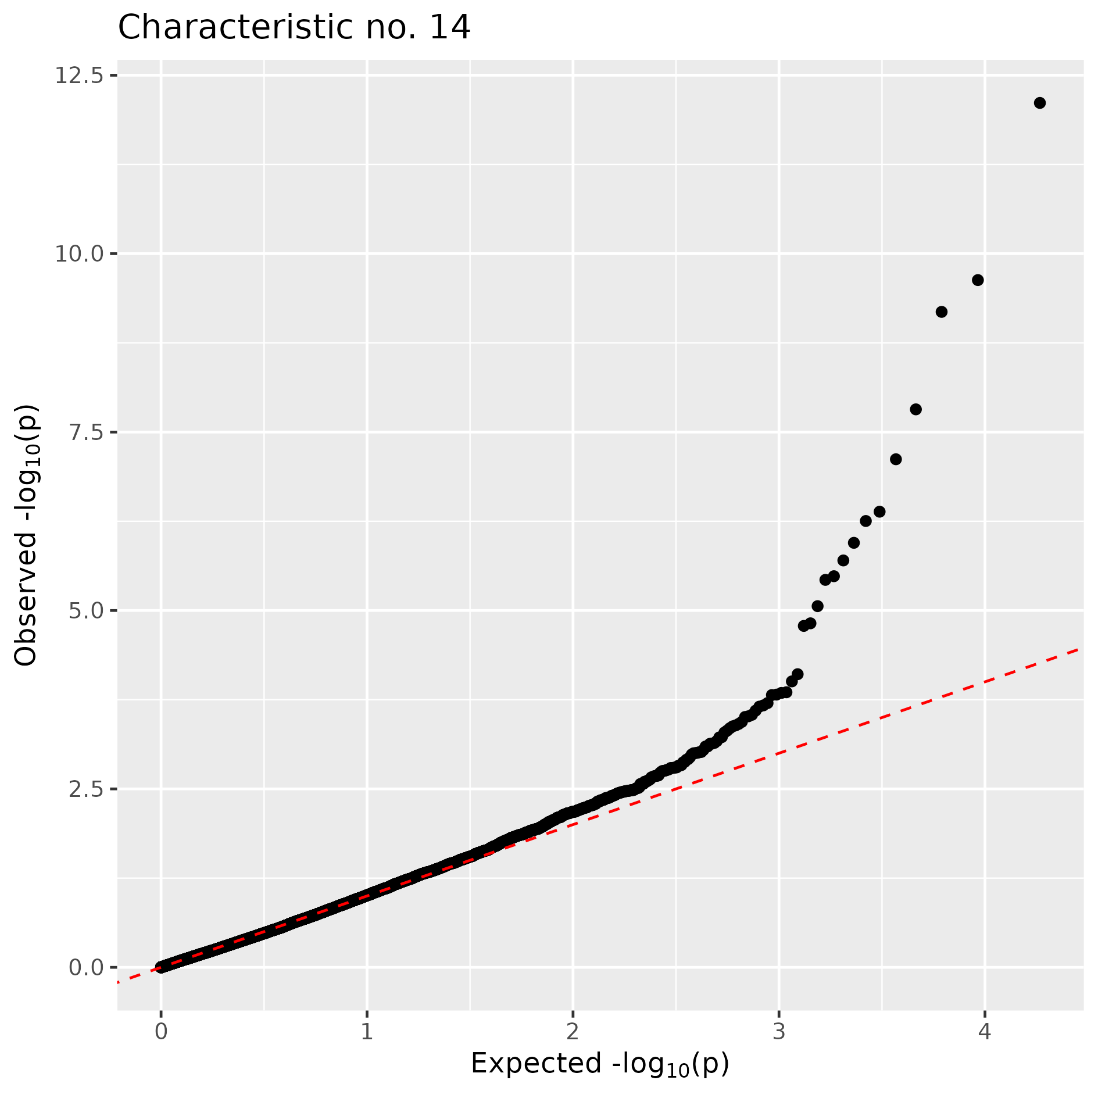
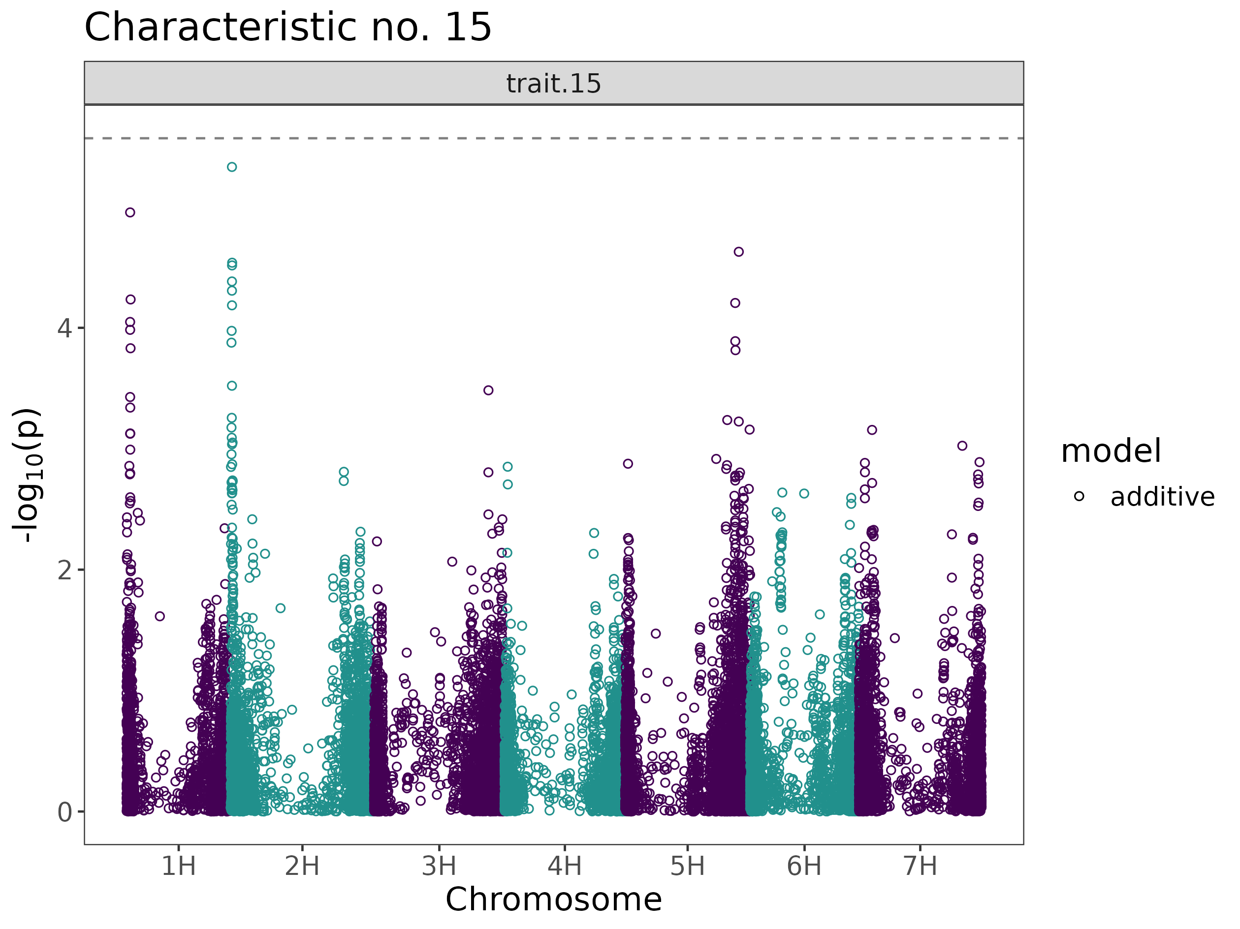
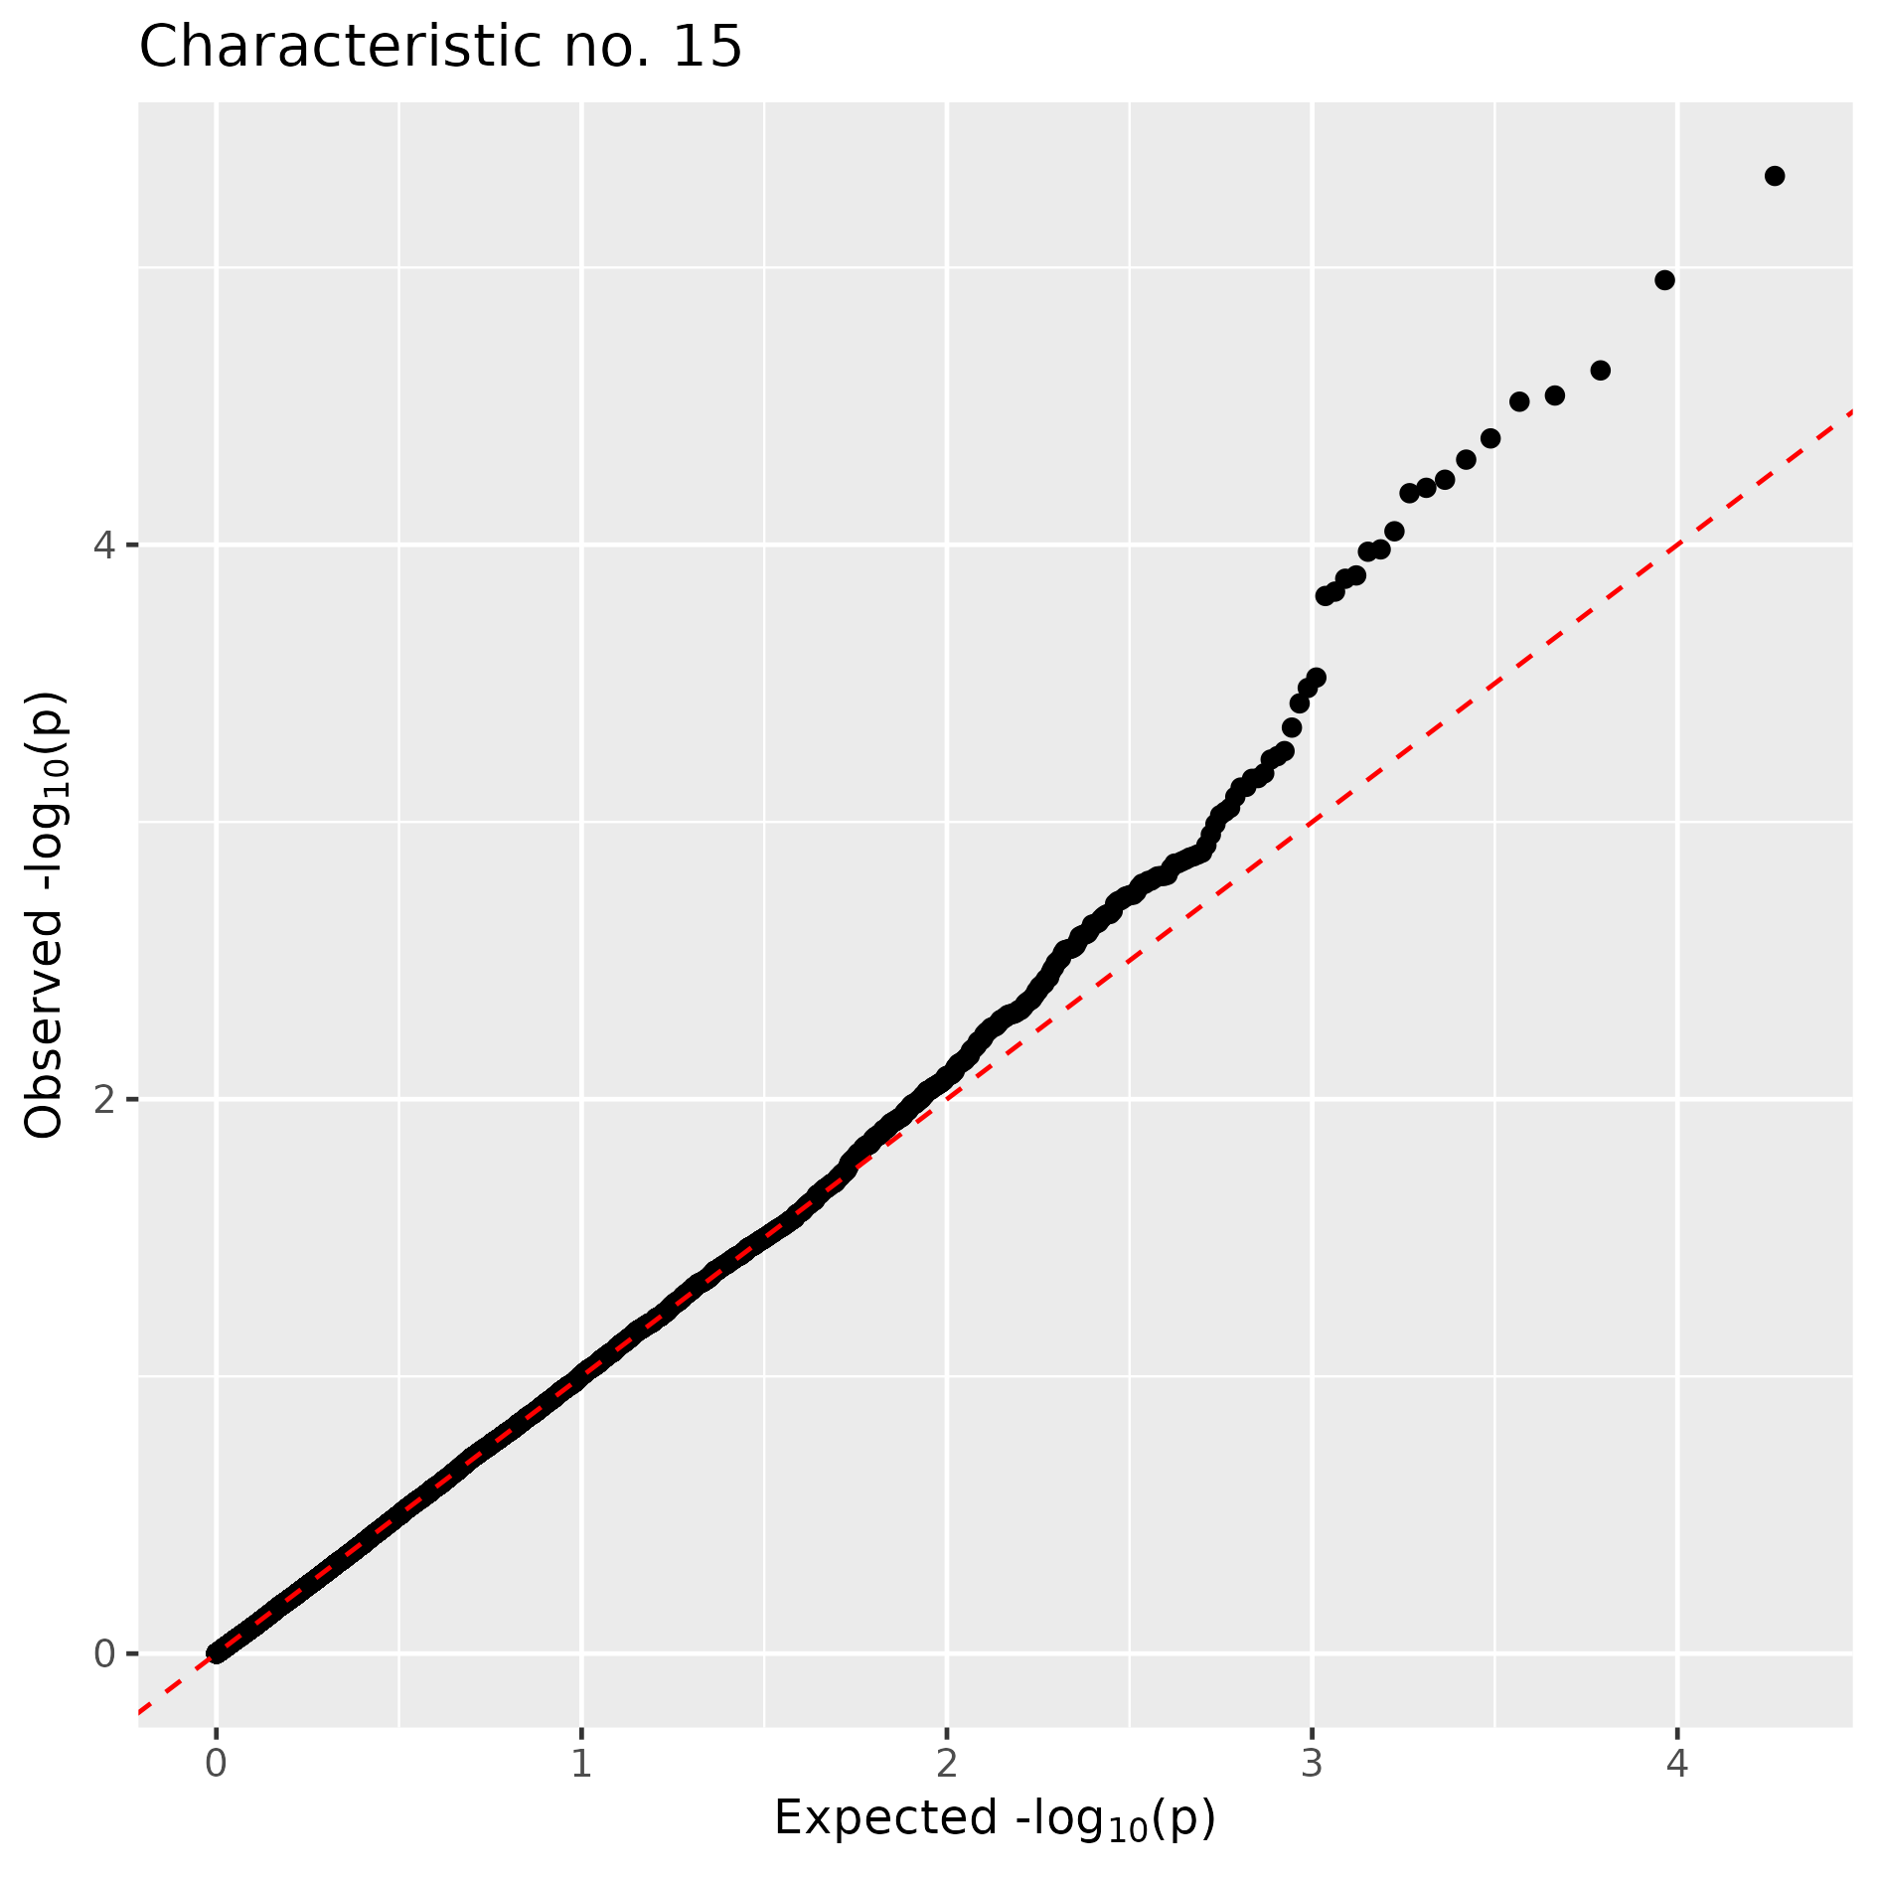
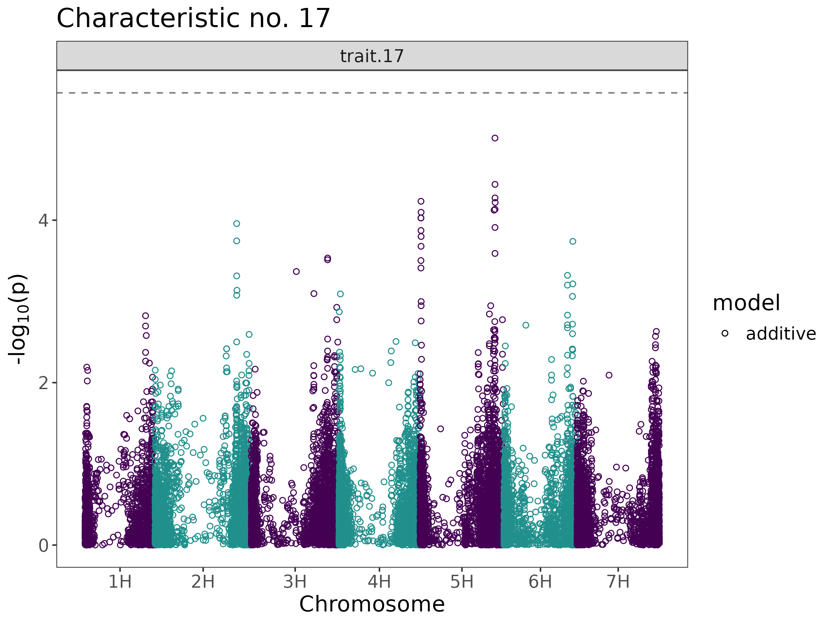
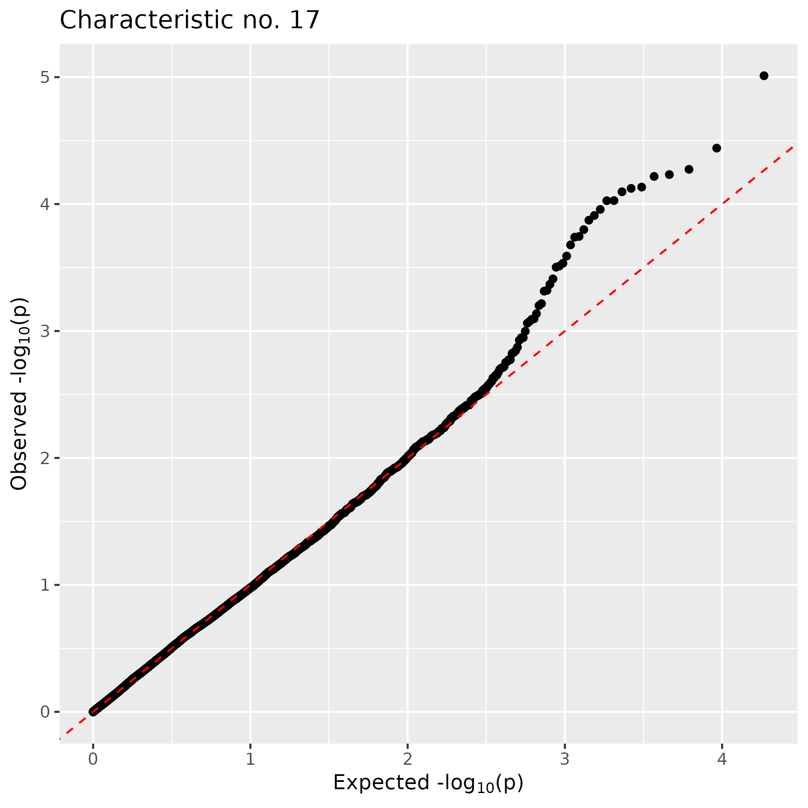
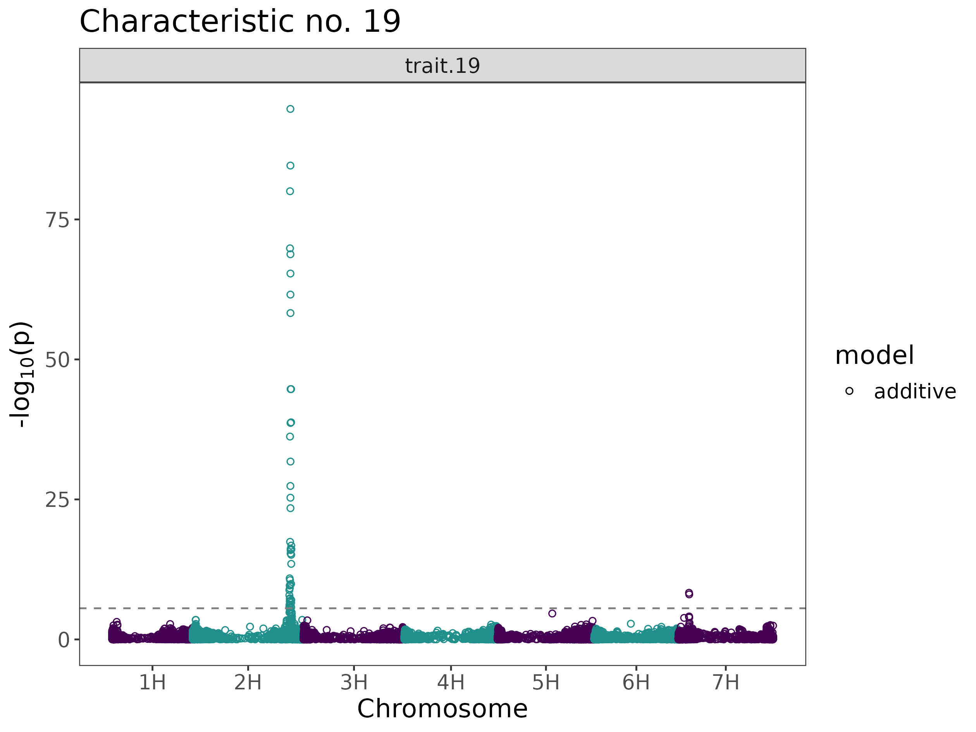
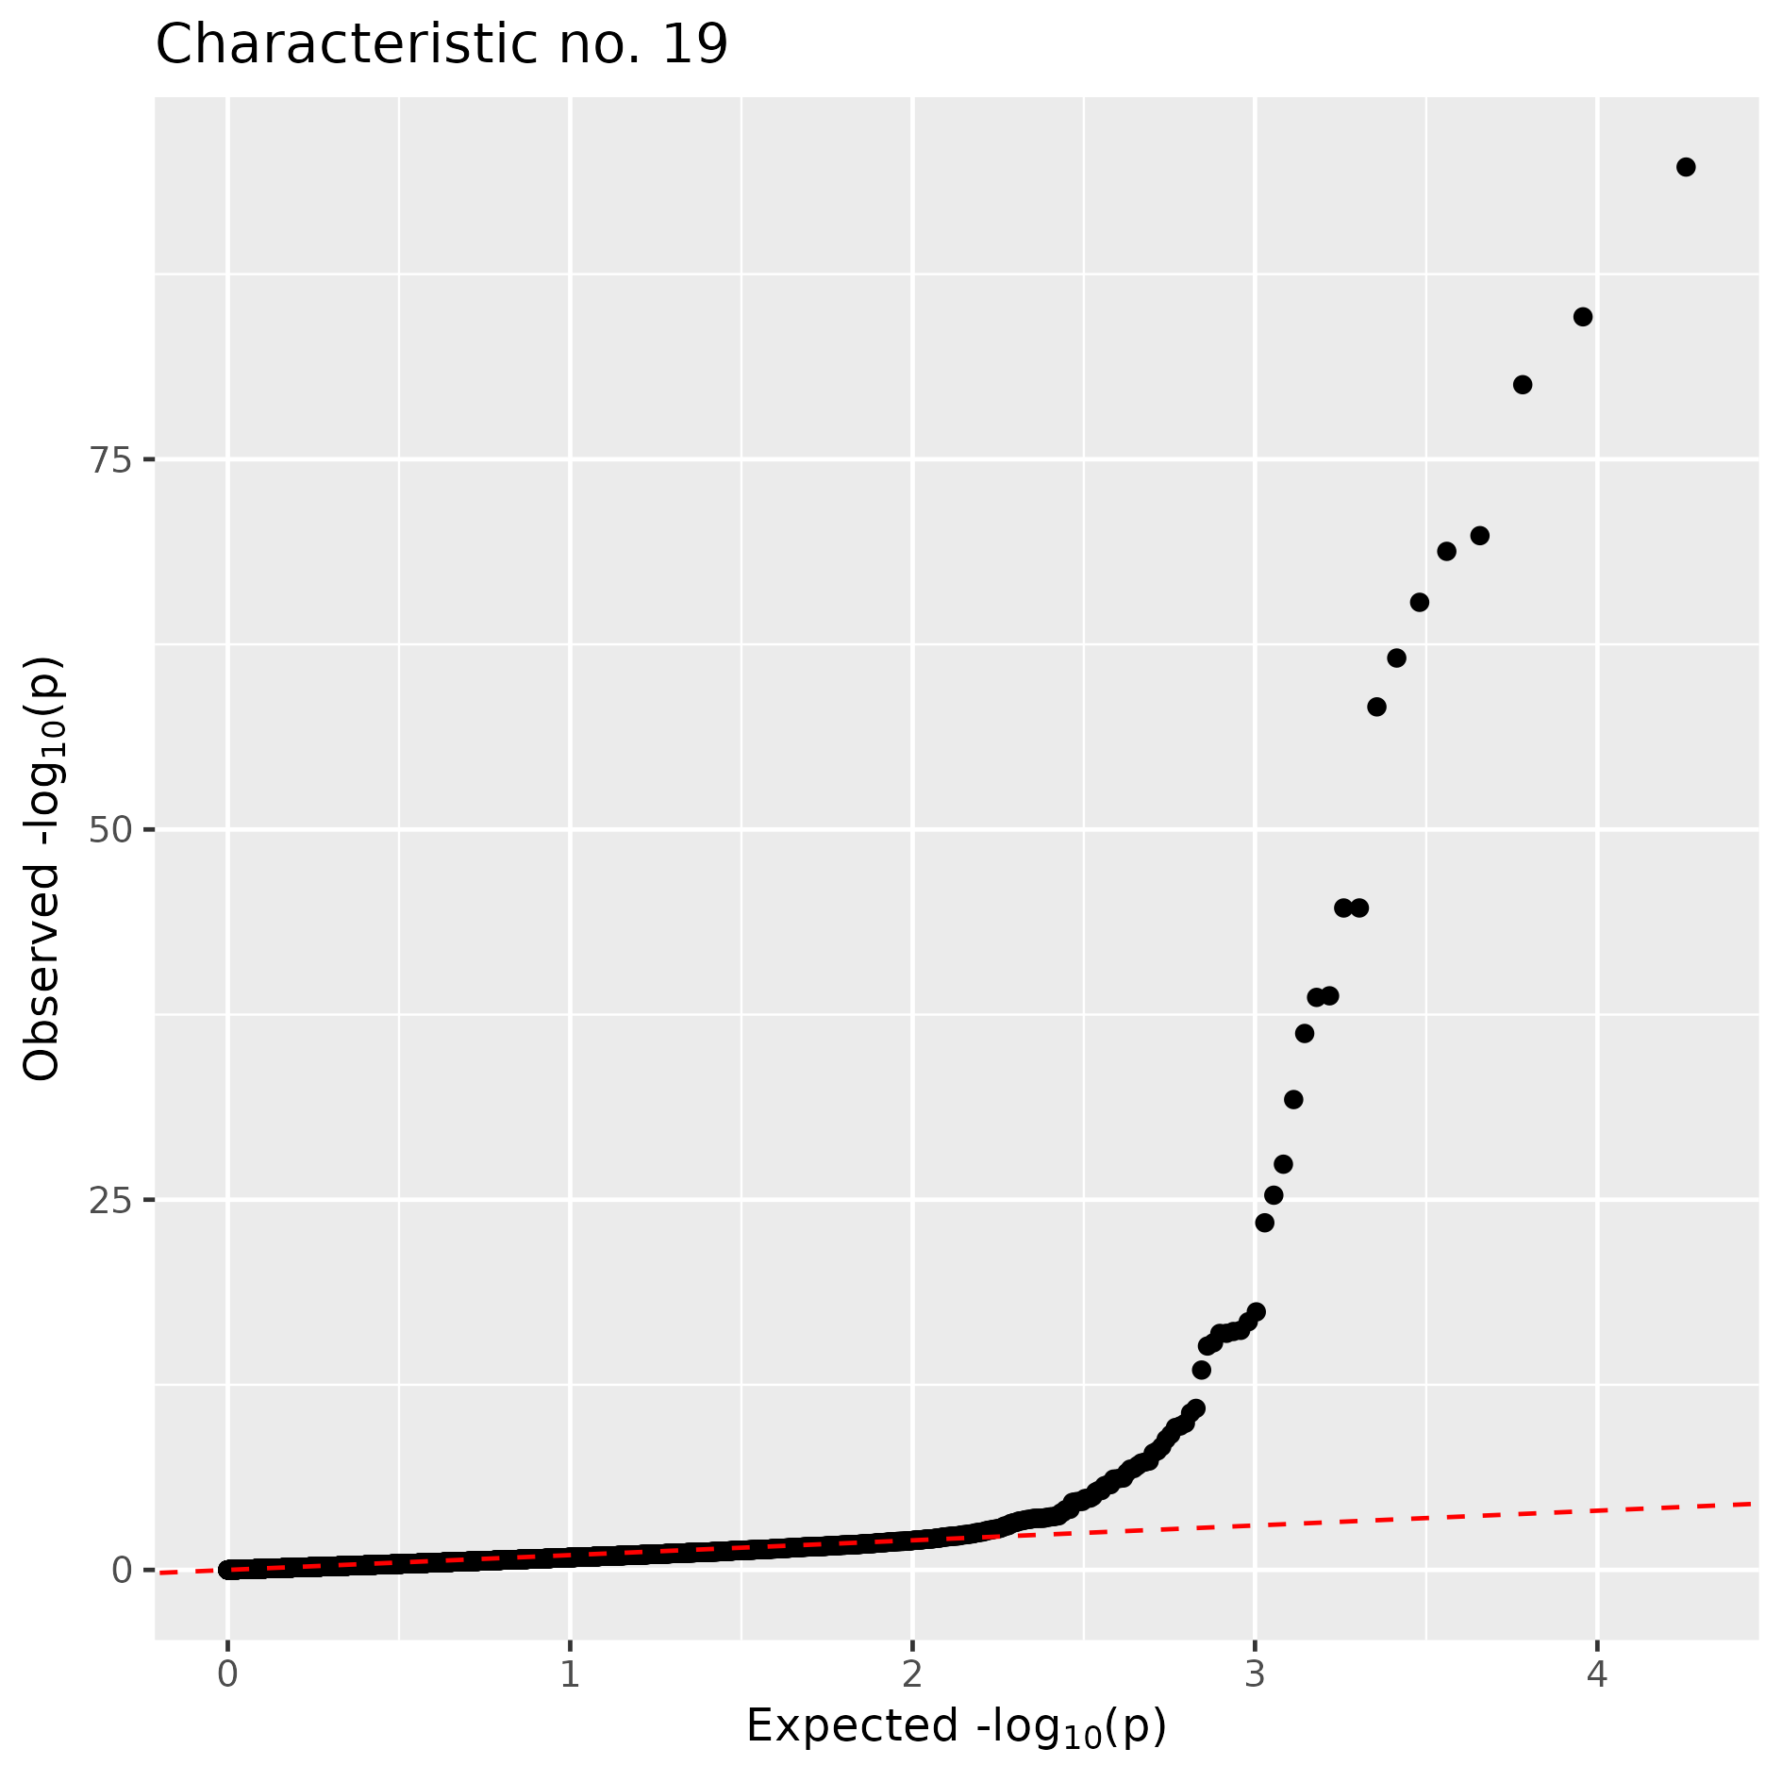
a)
b)
c)
d)
e)
f)
g)
h)
i)
Supplementary Figure 2 – Genome-wide association study (GWAS) results for the DUS characteristics numbered 1 to 19. For each characteristic, the left-hand plot shows the Manhattan plot with markers ordered on physical position and the Bonferroni genome-wide significance threshold is shown by a dashed horizontal line. The right-hand plot for each characteristic shows the quantile-quantile (QQ) plot. Full DUS characteristic names are shown in Table 1.

Slide 3
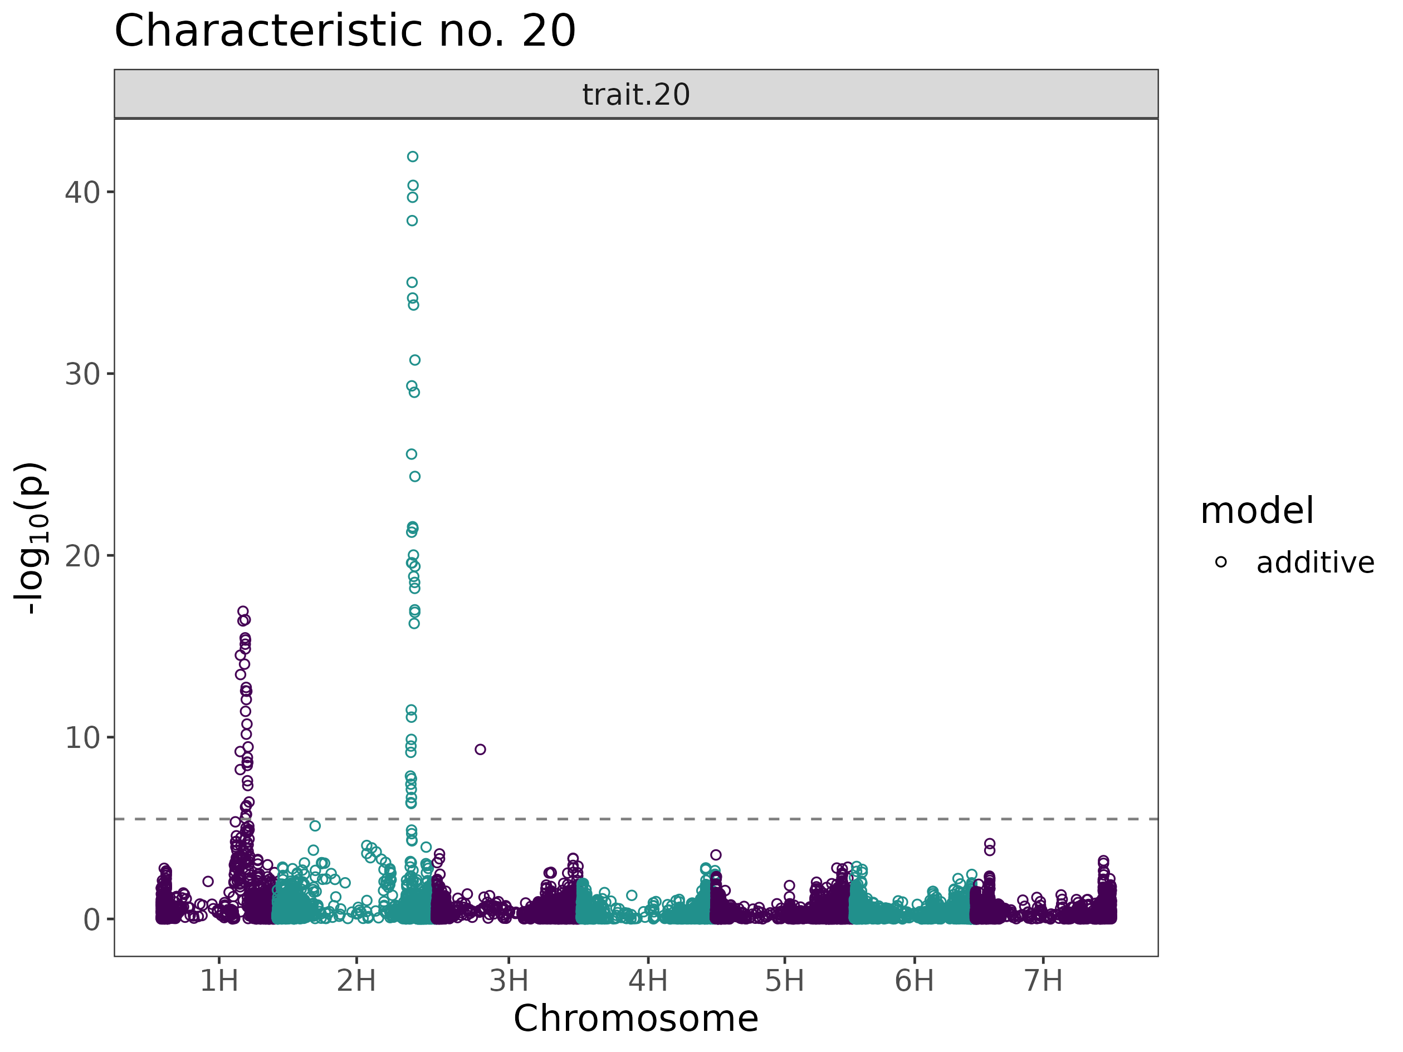
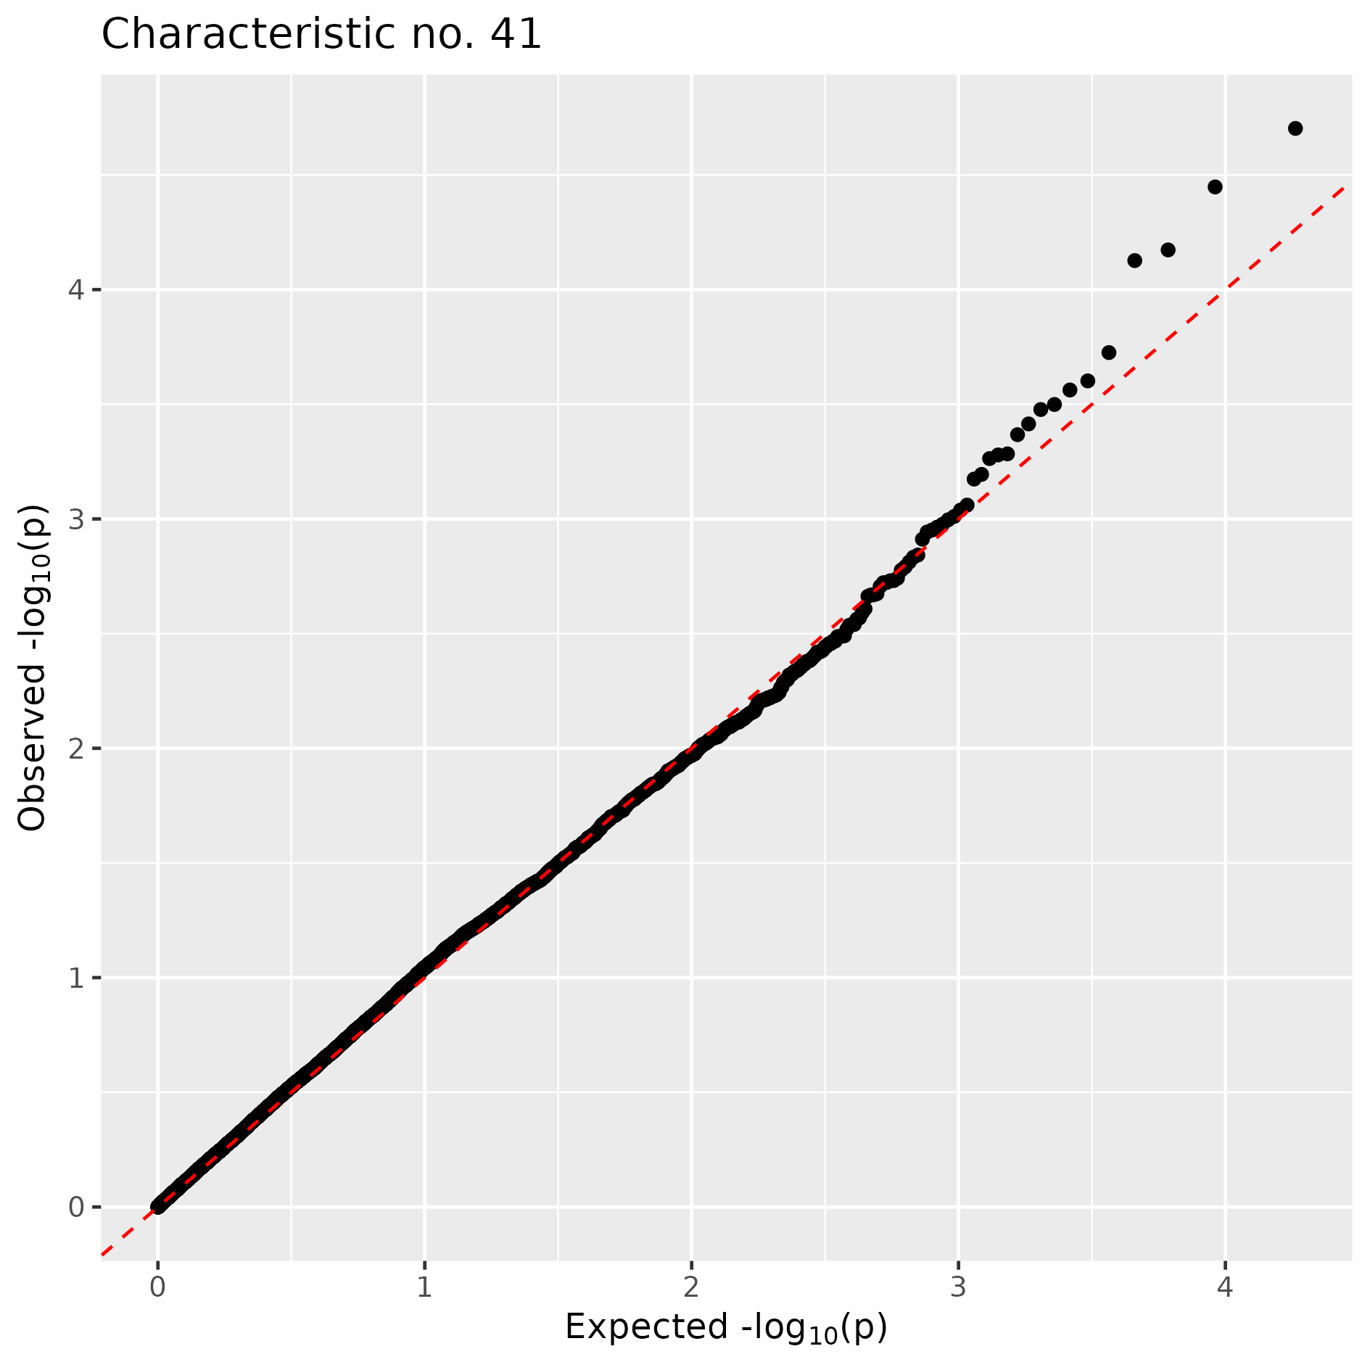
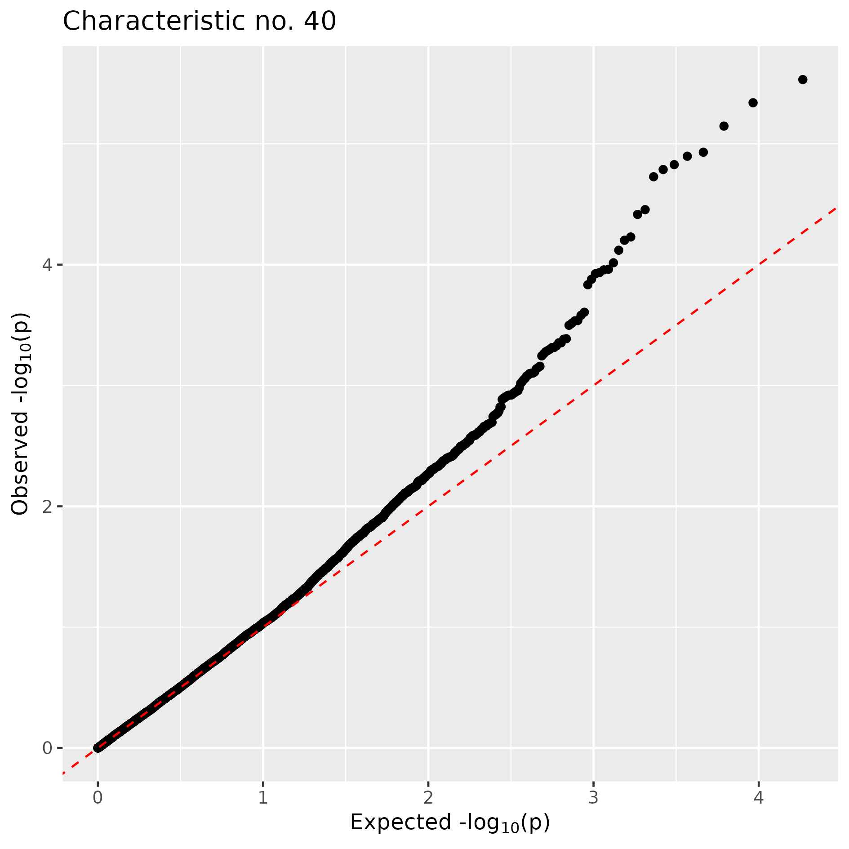
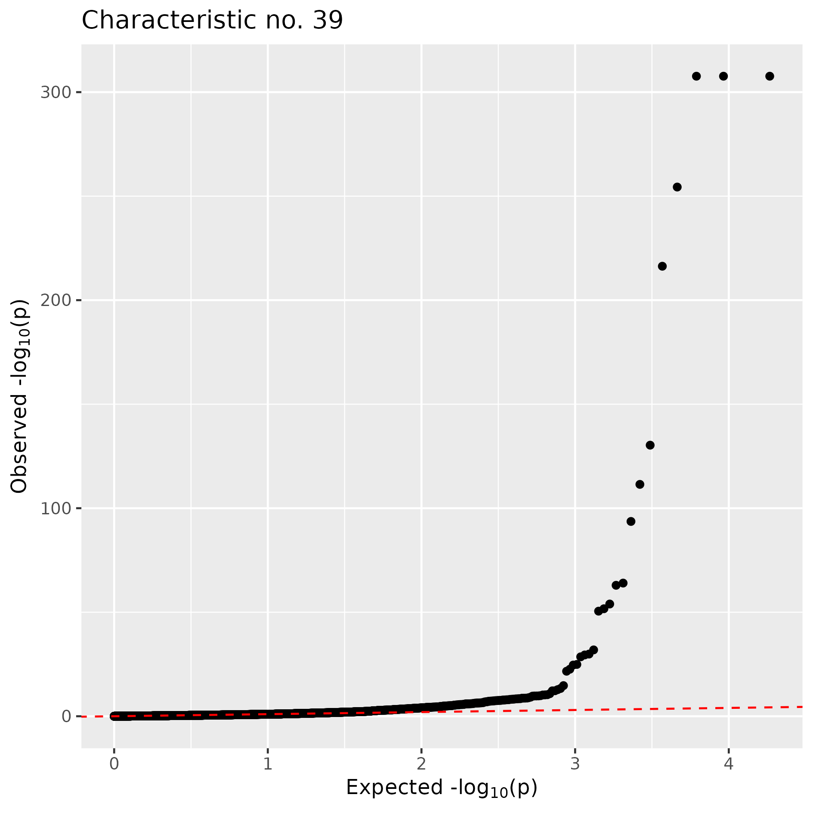
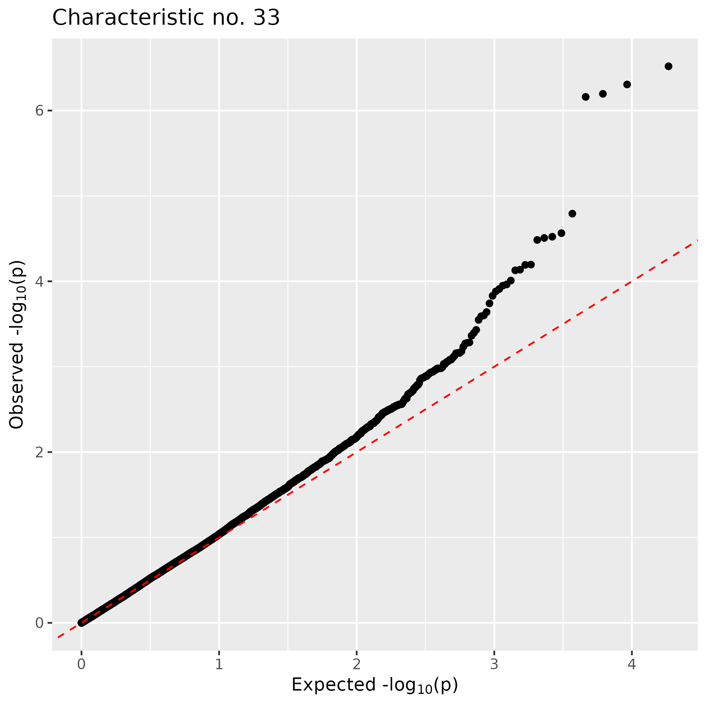
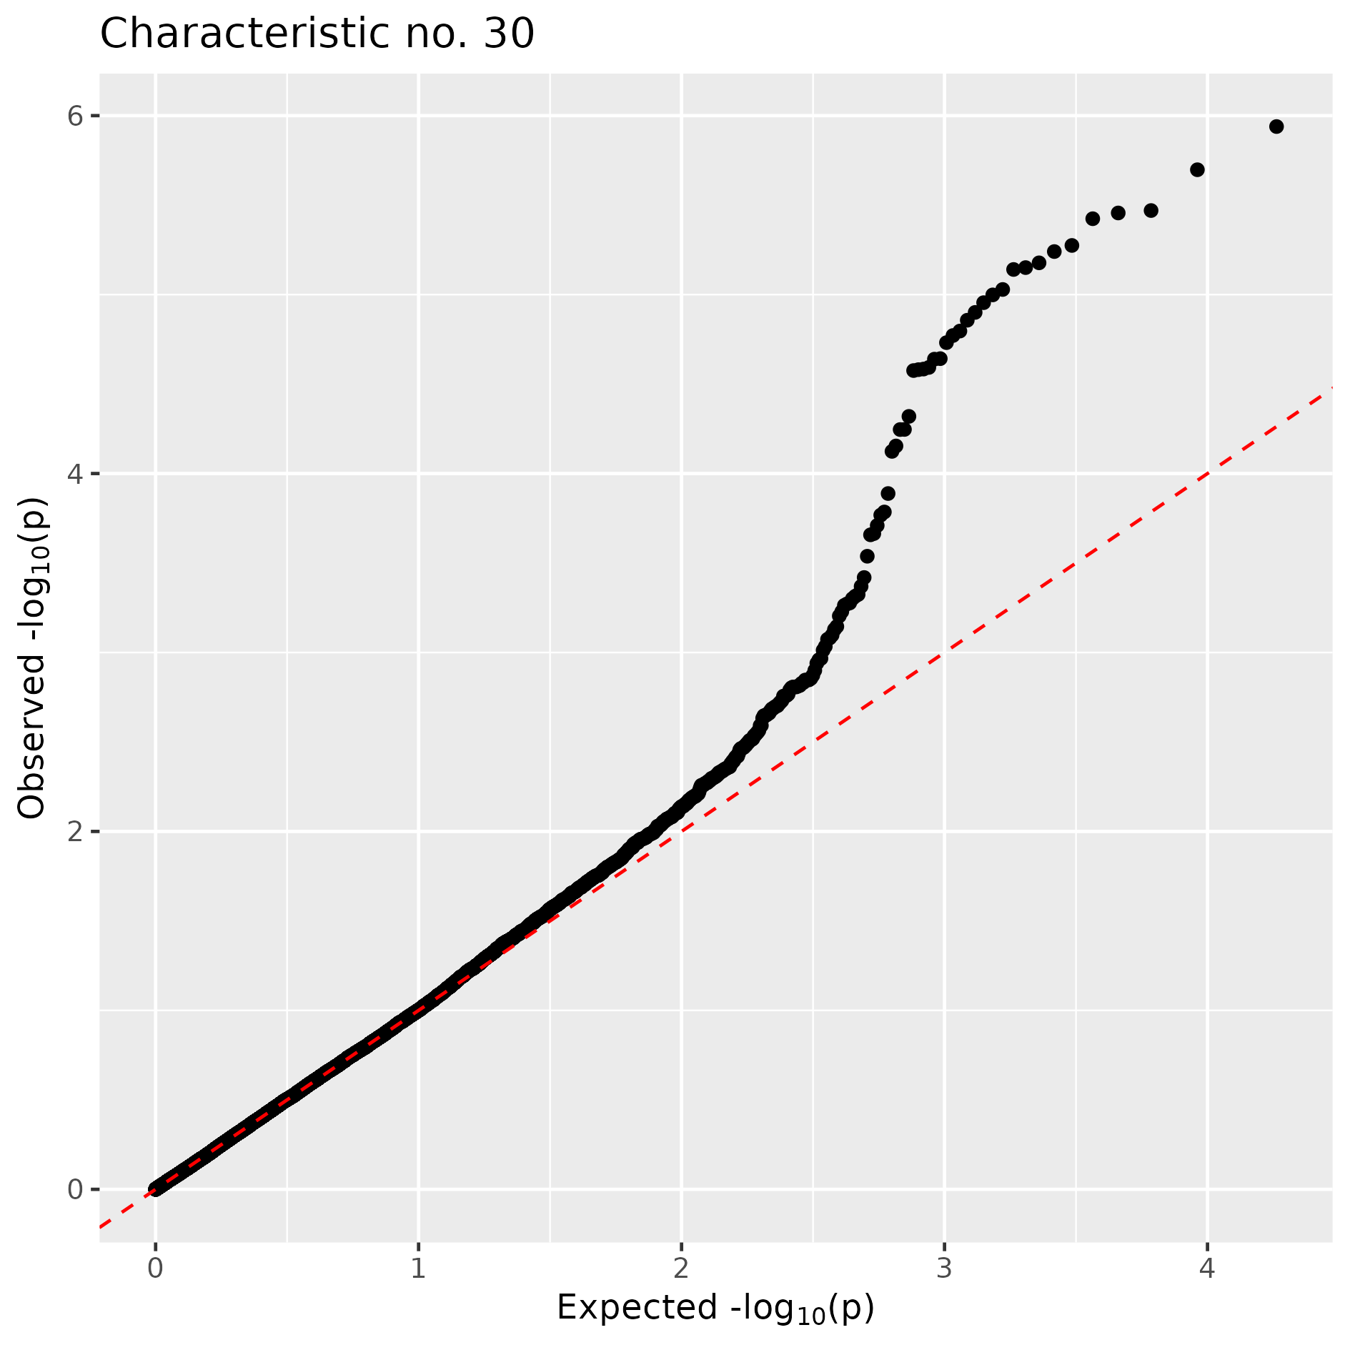












a)
b)
c)
d)
e)
f)
g)
h)
i)
Supplementary Figure 3 – Genome-wide association study (GWAS) results for the DUS characteristics numbered 20 to 41. For each characteristic, the left-hand plot shows the Manhattan plot with markers ordered on physical position and the Bonferroni genome-wide significance threshold is shown by a dashed horizontal line. The right-hand plot for each characteristic shows the quantile-quantile (QQ) plot. Full characteristic names are shown in Table 1.

Slide 4
















a)
b)
c)
d)
e)
f)
g)
h)
Supplementary Figure 4 – Genome-wide association study (GWAS) results for the DUS characteristics numbered 44 to 90. For each characteristic, the left-hand plot shows the Manhattan plot with markers ordered on physical position and the Bonferroni genome-wide significance threshold is shown by a dashed horizontal line. The right-hand plot for each characteristic shows the quantile-quantile (QQ) plot. Full characteristic names are shown in Table 1.

Slide 5













a)
b)
c)
d)
e)
f)
g)
h)
i)
j)
k)
l)
m)
Supplementary Figure 5 – Estimated means of prediction accuracies (r) for several methods of prediction for DUS characteristics numbered 1 to 29. The prediction methods included: ridge Regression-BLUP (rrBLUP), rrBLUP predictions rounded to the nearest integer (rrBLUP_int), Random Forest with default settings (rf), Random Forest with hyperparameter tuning (rf_tune) and, for characteristics controlled by major loci, Random Forest with different approaches to genetic marker weighting (rf_weight2 and rf_weight10). Letter display for pair-wise comparisons with Tukey adjustment is shown. Error bars are the standard error associated with each estimated mean. Full characteristic names are shown in Table 1.

Slide 6













a)
b)
c)
d)
e)
f)
g)
h)
i)
j)
k)
l)
m)
Supplementary Figure 6 – Estimated means of prediction accuracies (r) for several methods of prediction for DUS characteristics numbered 30 to 90. The prediction methods included: ridge Regression-BLUP (rrBLUP), rrBLUP predictions rounded to the nearest integer (rrBLUP_int), Random Forest with default settings (rf), Random Forest with hyperparameter tuning (rf_tune) and, for characteristics controlled by major loci, Random Forest with different approaches to genetic marker weighting (rf_weight2 and rf_weight10). Letter display for pair-wise comparisons with Tukey adjustment is shown. Error bars are the standard error associated with each estimated mean. Full characteristic names are shown in Table 1.

Slide 7













a)
b)
c)
d)
e)
f)
g)
h)
i)
j)
k)
l)
m)
Supplementary Figure 7 – Estimated means of proportion of correctly classified calls (PCCC) for several methods of prediction for DUS characteristics numbered 1 to 29. The prediction methods included: ridge regression-BLUP predictions rounded to the nearest integer (rrBLUP_int), Random Forest with default settings (rf), Random Forest with hyperparameter tuning (rf_tune) and, for characteristics controlled by major loci, Random Forest with different approaches to genetic marker weighting (rf_weight2 and rf_weight10). For characteristics where significant variation was observed between the methods, letter display for pair-wise comparisons with Tukey adjustment is shown. Error bars are the standard error associated with each estimated mean. Full characteristic names are shown in Table 1.

Slide 8













a)
b)
c)
d)
e)
f)
g)
h)
i)
j)
k)
l)
m)
Supplementary Figure 7 – Estimated means of proportion of correctly classified calls (PCCC) for several methods of prediction for DUS characteristics numbered 30 to 90. The prediction methods included: ridge regression-BLUP predictions rounded to the nearest integer (rrBLUP_int), Random Forest with default settings (rf), Random Forest with hyperparameter tuning (rf_tune) and, for characteristics controlled by major loci, Random Forest with different approaches to genetic marker weighting (rf_weight2 and rf_weight10). For characteristics where significant variation was observed between the methods, letter display for pair-wise comparisons with Tukey adjustment is shown. Error bars are the standard error associated with each estimated mean. Full characteristic names are shown in Table 1.

