Slide 1
Figure S1
mHNPC patients
with *high metastatic burden
Aomori database
ADT/CAB and/or upfront ABI therapy
n=168
(2008-2020)
mHNPC patients
with CHAARTED HVD
Michinoku database
ADT/CAB
n=563
(2008-2016)
Diagnosis at 2008-2013
n=22
Diagnosis at 2008-2013
n=131
Insufficient data, n=22
Insufficient data, n=354
ADT/CAB
LATTITUDE HRD
n= 57
ADT/CAB
CHAARTED HVD
n= 78
Upfront ABI
(2018-2020)
n=67
ADT/CAB
Historical cohort
(2014-2019)
n=135
*CHAARTED HVD and/or LATTITUDE HRD

Slide 2
Table S1
Comparison of background of Upfront ABI and ADT/CAB
 | Non-anemia-ABI | Non-anemia-ADT/CAB | P value | Anemia-ABI | Anemia-ADT/CAB | P value
n | 46 | 69 |  | 21 | 66
Age (years) | 71 (6) | 72 (9) | 0.237 | 74 (7) | 75 (8) | 0.565
ECOG-PS | 0 (0-0） | 0 (0-1） | 0.373 | 0 (0-1) | 0 (0-1） | 0.513
Initial PSA (ng/mL) | 189 (51-448) | 327 (122-645) | 0.236 | 818 (230-2699) | 895 (132-2437) | 0.506
Gleason score | 9 (8-9) | 9 (8-9) | 0.635 | 9 (8-10) | 9 (8-9) | 0.919
Visceral metastasis | 11 (24%) | 15 (22%) | 0.822 | 3 (14%) | 7 (11%) | 0.645
Lung | 11 | 9 |  | 2 | 7
Liver | 0 | 3 |  | 1 | 1
Others | 0 | 4 |  | 0 | 0
EOD | 2 (2-3） | 3 (2-3) | 0.546 | 3 (2-3) | 3 (2-3) | 0.693
ALP (IU/L) | 357 (258-717) | 374 (284-599) | 0.936 | 886 (329-1541) | 438 (292-1079) | 0.475
LDH (IU/L) | 199 (166-227) | 205 (179-260) | 0.105 | 230 (200-278) | 240 (196-293) | 0.929
Hb (g/dL) | 14.5 (1.1) | 14.4 (1.1) | 0.427 | 11.1 (1.7) | 10.6 (1.8) | 0.349
Follow-up period (months) | 13 (11-17) | 24 (10-33) | <0.001 | 11 (10-13) | 20 (11-15) | 0.013
ABI, abiraterone acetate; ADT/CAB, androgen deprivation therapy/complete androgen blockade; ECOG-PS, Eastern Cooperative Oncology Group performance status; PSA, prostate specific antigen; EOD, extent of disease; ALP, alkaline phosphatase; LDH, lactate dehydrogenase; Hb, hemoglobin; CRPC, castration resistant prostate cancer.

Slide 3
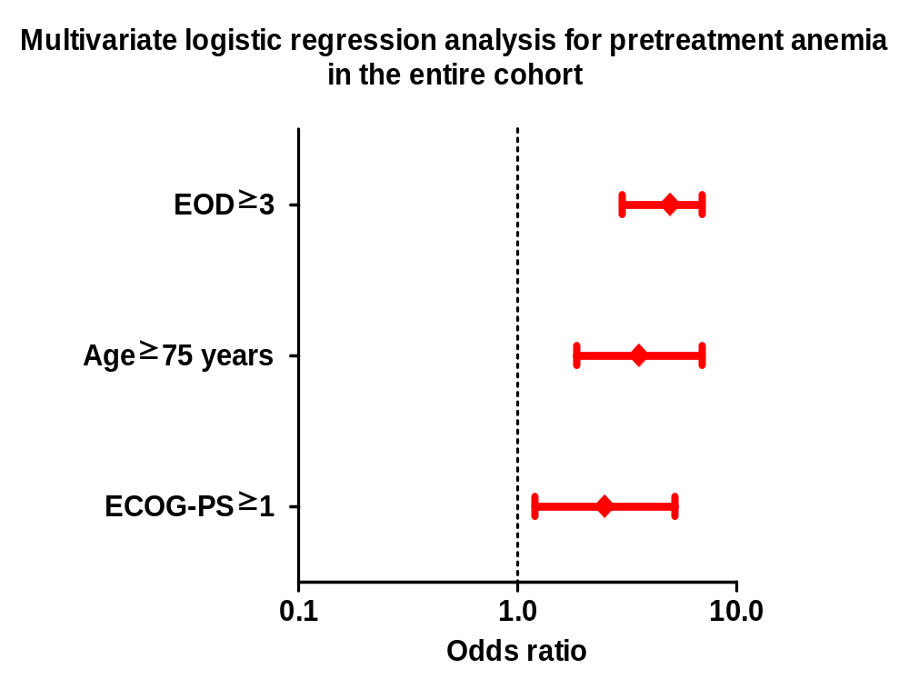
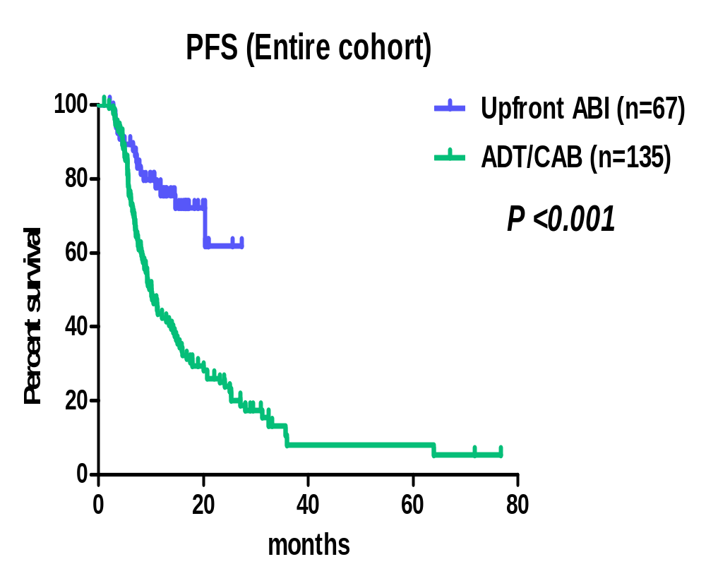
Figure S2
A
B

