Slide 1



11/21/25, 7:22 PM
Assessment Of Antiepileptic Drugs (AED) Use in Neurosurgical Patients: Adherence to Clinical Guidelines
Assessment Of Antiepileptic Drugs (AED)
Use in Neurosurgical Patients: Adherence to Clinical Guidelines
310 responses
Publish analytics
Demographic and Professional Information
What is your professional role?
310 responses
Copy
Neurosurgeon consultant level
Neurosurgeon associate consultant level
Neurosurgery registrar
Neurosurgery resident ( junior level)
24.2%
17.7%
11.3%
Neurosurgeon consultant level
145 (46.8%)
46.8%

Slide 2
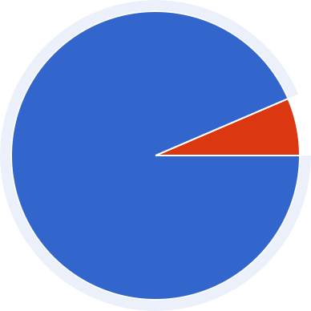

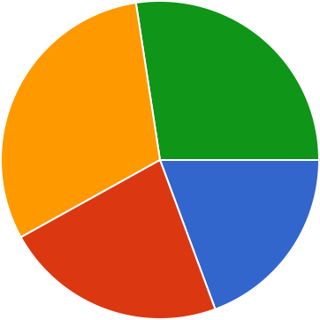
11/21/25, 7:22 PM Assessment Of Antiepileptic Drugs (AED) Use in Neurosurgical Patients: Adherence to Clinical Guidelines
In which region of the world is your primary practice?
310 responses
Copy
North America Latin America Europe
Middle East and North Africa Australia and the Pacific
Asia
1%
17.7%
56.5%
4.9%
7%
12.9%
What is your gender?
310 responses
Copy
Male Female
Prefer not to tell
93.5%
Male
290 (93.5%)
How many years of experience do you have in neurosurgery?
310 responses
Copy
 | 0–5 years
27.4% | 6–10 years 11–20 years
30.6% | More than 20 years
19.4%
22.6%

Slide 3
11/21/25, 7:22 PM Assessment Of Antiepileptic Drugs (AED) Use in Neurosurgical Patients: Adherence to Clinical Guidelines
In what type of institution do you primarily practice?
310 responses
Copy
Academic or University hospitals mainly
35.5%
16.1%
Public or Community hospitals mainly
Private practice mainly Military hospitals mainly
45.2%
On average, how many neurosurgical inpatient cases do you manage per week?
310 responses
Copy
12.9%
<10 cases
10–20 cases
21–30 cases
>30 cases
19.4%
40.3%
27.4%
On average, how many neurosurgical outpatient cases do you manage per week?
310 responses
Copy
<10 cases
10–20 cases
21–30 cases
>30 cases
45.2%
22.6%
25.8%

Slide 4
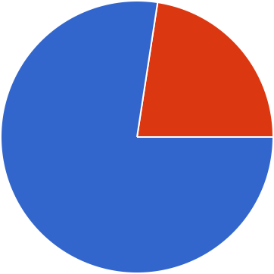
11/21/25, 7:22 PM Assessment Of Antiepileptic Drugs (AED) Use in Neurosurgical Patients: Adherence to Clinical Guidelines
What is your field of practice? (multiple options can be chosen)
310 responses
Copy
Functional General neurosurgery
Neurotrauma Neurooncology Pediatric neurosurgery
Spinal surgery Skull base
Vascular neurosurgery
Neurocritical
150 ((1166.11%%))
5275 ((8888.77%%))
3190 ((6611..33%%))
3180 ((5588.11%%))
2105 ((3333.99%%))
4200 ((6644.55%%))
2120 ((3388.77%%))
2200 ((3322.33%%))
2110 ((3355.55%%))
0
20
40
60
Knowledge of Guidelines
Are you aware of any clinical guidelines for the use of antiepileptic
Copy
drugs (AED) in your patients?
310 responses
Yes No
22.6%
77.4%

Slide 5
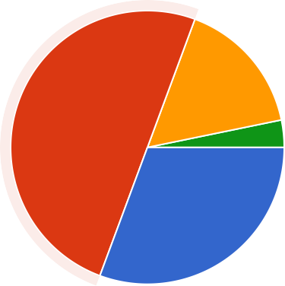

11/21/25, 7:22 PM Assessment Of Antiepileptic Drugs (AED) Use in Neurosurgical Patients: Adherence to Clinical Guidelines
Which guidelines for the use of AED in your patients do you primarily follow? (multiple options can be chosen)
310 responses
Copy
AANS/CNS (American A… American Heart Associati… Brain trauma foundation (… European Association of… China Association Agains… Italian society of neurosu… The Korean society for n… American Academy of Ne… EAN (European Academ… EANS (European Associ… Local National guidelines
Local institutional guideli… Neurocritical care society
NICE guidelines Child neurology society Senior colleagues
No specific guidelines
840 ((1122.99%%))
840 ((1122.99%%))
3160 ((5511.66%%))
2115 ((3377.11%%))
15 ((11..66%%))
315 ((44..88%%))
15 ((11.66%%))
150 ((1166..11%%))
420 ((66.55%%))
945 ((1144.55%%))
420 ((66.55%%))
840 ((1122.99%%))
525 ((88.11%%))
945 ((1144.55%%))
15 ((11.66%%))
155 ((1177.77%%))
160 ((1199..44%%))
0
50
100
150
200
How familiar are you with the full content of these guidelines?
310 responses
Copy
Somewhat familiar
155 (50%)
Very familiar Somewhat familiar
16.1%
Not familiar
I am not following any reference or guideline
50%
30.6%

Slide 6
11/21/25, 7:22 PM Assessment Of Antiepileptic Drugs (AED) Use in Neurosurgical Patients: Adherence to Clinical Guidelines
Do you receive periodic continuous medical education (CME) activities or the latest updates’ notifications regarding these guidelines?
310 responses
Copy
Yes No
66.1%
33.9%
Do you believe the current guidelines cover all possible clinical scenarios in managing AED use in neurosurgery patients?
310 responses
Copy
Yes No
Not sure
37.1%
38.7%
24.2%
If no, in which aspect do you feel the guidelines is deficient in managing AED use? (multiple options can be chosen)
310 responses
Copy
Neurotrauma
2120 ((3388.77%%))
Post craniotomy
3155 ((5500%%))
SAH
185 ((2277.44%%))
Brain tumour
125 ((4400..33%%))
Not applicable to me
121 105((3333.99%%))
0
50
100
150
200

Slide 7
11/21/25, 7:22 PM
Assessment Of Antiepileptic Drugs (AED) Use in Neurosurgical Patients: Adherence to Clinical Guidelines
AED Prescription Practices
Do you consider prescribing AED prophylactically for neurotrauma patients based on conscious level? (multiple options can be chosen)
310 responses
Copy
Patients with mild traumatic brain injuries (GCS 15& 14)
630 ((99.77%%))
Patients with moderate traumatic brain injury (G…
Patients with severe traumatic brain injury (G…
Patients whose GCS can’t be assessed, e.g., Patien…
I don’t consider GCS in my decision to prescribe pro…
0 10
141 140((4455.22%%))
15 150((4488..44
10 100((3322.33%%))
1 125((4400.33%%))
20
30
Do you consider prescribing AED prophylactically for neurotrauma patients based on the location or the mechanism of injury? (multiple options can be chosen)
310 responses
Copy
Epidural bleeding Subdural bleeding Subarachnoid bleeding
Cerebral intraparenchym… Cerebellar intraparenchy… Brain stem bleeding/cont… Non depressed skull fract… Depressed skull fracture Penetrating brain injury Pneumocephalus
Diffuse axonal brain injur… I don’t consider the locati…
1 105((3333.99%%))
2 220((7711%%))
215((6699.44%%))
75((
2244..22%%))
22 225((7722..66%%))
524 ((88.11%%))
315 ((44.88%%))
117 175((5566.55%%))
2 115((3377.11%%))
4 225((7722..66%%))
945 ((1144.55%%))
2110 ((3355.55%%))
0
100
200
300

Slide 8
11/21/25, 7:22 PM Assessment Of Antiepileptic Drugs (AED) Use in Neurosurgical Patients: Adherence to Clinical Guidelines
Do you consider prescribing AED prophylactically for neurotrauma patients based on patient age and gender? (multiple options can be chosen)
310 responses
Copy
Elderly patients (more than
65 years of age)
735 ((1111.33%%))
Adult patients (14 to 70)
735 ((1111..33%%))
Pediatric patients (2 to 14
years of age)
Infant patients (less than 2
years of age)
735 ((1111.33%%))
210 ((33.22%%))
I don’t consider the age of the patient in my decision…
0 100
5260 ((8833.99%%))
200
300
Do you consider prescribing AED prophylactically for neurotrauma patients based on patient maternity status? (multiple options can be chosen)
310 responses
Copy
Female patient in childbearing period
66 60((1199.44%%))
Female patient who is
pregnant
6 65((2211%%))
Female patient who is
breast-feeding
1 65((2211%%))
My decision to prescribe prophylactic AEDs is not influenced by the patient’…
4 240((7777.44%%))
0
100
200
300

Slide 9
11/21/25, 7:22 PM Assessment Of Antiepileptic Drugs (AED) Use in Neurosurgical Patients: Adherence to Clinical Guidelines
In the absence of any documented posttraumatic seizures, what is your typical duration for prophylactic AED use in neurotrauma cases ?
310 responses
Copy
week
weeks
1-3 monthS
3-6 months
6-12 months
12-24 months
I don't prescripe AED
11.3%
11.3%
14.5%
54.8%
In the occurrence of documented immediate posttraumatic seizures (onset within less than 12 hours of trauma), what is your typical duration for AED use in neurotrauma cases?
310 responses
Copy
1 week
11.3%
2 weeks
1-3 months
3-6 months
6-12 months
12-24 months
24 months
Guided only by EEG
11.3%
16.1%
16.1%
25.8%
1/2
In the occurrence of documented early posttraumatic seizures (onset within less than 7 days of trauma) , what is your typical duration for AED use in such cases?
310 responses
Copy
11.3%
week
weeks
1-3 months
3-6 months
6-12 months
12- 24 months
24 months
Guided only by EEG
11.3%
14.5%
17.7%
21%
17.7%
1/2

Slide 10
11/21/25, 7:22 PM Assessment Of Antiepileptic Drugs (AED) Use in Neurosurgical Patients: Adherence to Clinical Guidelines
In the occurrence of documented late posttraumatic seizures (onset within more than 7 days of trauma), what is your typical duration for AED use in such cases?
310 responses
Copy
week
weeks
1-3 months
3-6 months
6-12 months
12-24 months
>24 months
Guided only by EEG exam
29%
17.7%
22.6%
9.7%
AED Prescription Practices
In which scenarios do you prescribe AED for newly diagnosed (non- operated) brain tumors? (multiple options can be chosen)
310 responses
Copy
Supratentorial Intraaxial t…
4 205 ((6666.11%%))
Supratentorial Extra-axial…
420 ((66..55%%))
315 ((44.88%%))
211125 ((4400.33%%))
Infratentorial Intra-axial t…
Infratentorial Extra-axial t…
Frontal or Temporal lobe…
165 ((2211%%))
Only if patient develops s…
2125 ((4400..33%%))
Only if there is epileptic a…
155 ((1177.77%%))
I never prescribe prophyl…
735 ((1111.33%%))
0
100
200
300

Slide 11
11/21/25, 7:22 PM Assessment Of Antiepileptic Drugs (AED) Use in Neurosurgical Patients: Adherence to Clinical Guidelines
If AEDs were prescribed preoperatively, do you usually "reload" the patinet with AEDs at the end of the surgery after mannitol induced enuresis?
310 responses
Copy
Yes No
Sometimes
29%
37.1%
33.9%
If AEDs were prescribed preoperatively, how long do you usually continue to prescribe it postoperatively? multiple option can be chosen
310 responses
Copy
week
weeks
1-3 months
3-6 months
6- 12 months
12-24 months
>24 months Depends on extent of ex… Depends on histological t… Depends on the site of s… Depends on follow up EE… Depends on absence of…
210 ((33.22%%))
840 ((1122..99%%))
55 50((1166..11%%))
525 ((88.11%%))
5 50((1166..11%%))
210 ((33.22%%))
630 ((99..77%%))
525 ((88..11%%))
525 ((88.11%%))
945 ((1144.55%%))
95 ((3300.66%%))
90 90((2299%%))
0
25
50
75
100
AED Prescription Practices

Slide 12
11/21/25, 7:22 PM Assessment Of Antiepileptic Drugs (AED) Use in Neurosurgical Patients: Adherence to Clinical Guidelines
In which scenarios do you prescribe prophylactic AED for aneurysmal SAH? (multiple options can be chosen)
310 responses
Copy
All cases High Hunt and Hess scal… High WFNS score (≥ gra… Modified Fisher scale (≥… Presence of associated h… Presence of associated i… Presence of cortical infar…
55 55((1177.77%%))
1 165((5533.22%%))
25 25((88..11%%))
210 ((33.22%%))
630 ((99.77%%))
150 ((1166..11%%))
7 75((2244..22%%))
In cases of sylvian SAH s…
630 ((99.77%%))
Fluctuating neurological… If an open surgical interv… I never prescribe prophyl…
840 ((1122.99%%))
945 ((1144.55%%))
165 ((2211%%))
0 50 100 150
What is your preferred duration of prophylactic AED use in SAH? multiple option can be chosen
310 responses
200
Copy
I never prescribe prophyl…
1 week
2 weeks
1 month
1-3 months
3-6 months
6-12 months
12-24 months
>24 months Depends on patinet cons… Depends on occurnace o… Depends on follow up EE… Depends on the history o…
735 ((1111.33%%))
945 ((1144.55%%))
315 ((44.88%%))
735 ((1111.33%%))
735((1111.33%%))
315 ((44.88%%))
735 ((1111.33%%))
5 ((11.66%%))
15 ((11.66%%))
210 ((33.22%%))
195 ((3300.66%%))
735 ((1111.33%%))
656 65 ((2211%%))
0
25
50
75
100

Slide 13
11/21/25, 7:22 PM Assessment Of Antiepileptic Drugs (AED) Use in Neurosurgical Patients: Adherence to Clinical Guidelines
In which scenarios do you prescribe prophylactic AED for Intraparenchymal Hemorrhage (IPH)? (multiple options can be chosen)
310 responses
Copy
I never prescribe prophyl…
Lobar cortical IPH Deep IPH (e.g., in the ba…
Cerebellar IPH Associated Intraventricul… A prior history of seizures… Based on the hematoma… After surgical evacuation… Based on continuous EE… Based on associated GCS Based on the underlying…
5 50((1199..44%%))
22 205((6666.11%%))
375 ((44.88%%))
840((1122.99%%))
150 ((1166.11%%))
165 ((5533.22%%))
735 ((1111.33%%))
11 110 ((3355.55%%))
5 50((1166..11%%))
4 40((1122.99%%))
5 50((1166.11%%))
0 100 200
What is your preferred duration of prophylactic AED use in IPH? option can be chosen
310 responses
300
multiple
Copy
I never prescribe prophyl…
1 week
2 weeks
1 month
1-3 months
3-6 months
6-12 months
12-24 months
>24 months Depends on the history o… Depends on follow up EE… Depends on occurnace o…
55 55((1177.77%%))
1 15((44..88%%))
5 50((1166.11%%))
2 25 ((88..11%%))
3 30((99..77%%))
4 40((1122..99%%))
315(44.88%%))
210 ((33..22%%))
210 ((33.22%%))
315 ((44.88%%))
50 50((1166.11%%))
85 85((2277..44%%))
0
25
50
75
100
AED Prescription Practices

Slide 14
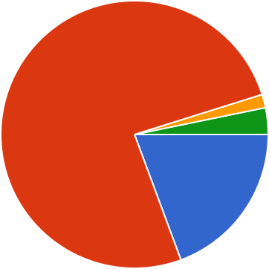
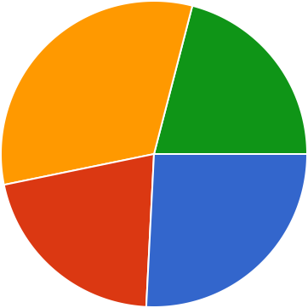
11/21/25, 7:22 PM Assessment Of Antiepileptic Drugs (AED) Use in Neurosurgical Patients: Adherence to Clinical Guidelines
Which antiepileptic medications do you most commonly prescribe? *
310 responses
Copy
Phenytoin Levetiracetam Valproate Carbamazepine Oxcarbazepine Fosphenytoin
Phenobarbital Clonazepam
75.8%
19.4%
What is the AED least associated with adverse events that lead to patient non-compliance in your patients?
310 responses
Copy
Phenytoin Levetiracetam Valproate Carbamazepine Oxcarbazepine Fosphenytoin
Phenobarbital Clonazepam
8.1%
54.8%
21%
Do you monitor serum levels of AEDs?
310 responses
Copy
Yes No
32.3%
21%
Sometimes
Only for specific drugs
21%
25.8%
Adherence to Guidelines

Slide 15
11/21/25, 7:22 PM Assessment Of Antiepileptic Drugs (AED) Use in Neurosurgical Patients: Adherence to Clinical Guidelines
How often do you deviate from the recommended guidelines for AED use? *
310 responses
Copy
Always Often Sometimes Rarely Never
22.6%
51.6%
16.1%
What are the reasons for your deviation? (Select all that apply)
310 responses
Copy
Lack of familiarity with th…
8 80((2255.88%%))
Limited evidence support…
7 75((2244..22%%))
Personal experience
135 135((4433.55%%))
Patient-specific factors (e…
1 150((4488.44%)
Institutional resources, pr…
70 70((2222.66%%))
Concerns about the serio…
8 80((2244..22%%))
I never deviate
2 25((88.11%%))
0 50 100
What do you perceive as the biggest barrier to applying AED guidelines in your patients?
310 responses
150
Copy
Lack of awareness about…
Too many guidelines avai… Recommendations chan… Various patient-specific f…
13 130((4411.99%%))
1 120((3388.77%%))
2 45((1144.55%%))
6 60((1199.44%%))
AED availability and costs
95((3300.66%%))
Patient non-compliance
4 45((1144.55%%))
I do not face any barrier
4 45((1144.55%%))
Others
420((66.55%%))
0
50
100
150

Slide 16
11/21/25, 7:22 PM
Assessment Of Antiepileptic Drugs (AED) Use in Neurosurgical Patients: Adherence to Clinical Guidelines
Interdisciplinary Collaboration
How often is the neurology service within your practice involved in prescribing AEDs for your cases?
310 responses
Copy
Always Very often Sometimes Rarely Never
29%
37.1%
27.4%
If consulting the neurology service is optional for AED prescription, in which scenarios would you typically consult a neurologist? (Select all that apply)
310 responses
Copy
Patients with pre-existing…
11 160((5511.66%%))
Refractory seizures to st…
255 ((8822.33%%))
When managing AED sid…
1 160((5511.66%%))
When considering long-t…
110((3355.55%%))
When planning to wean-…
2 20((66..55%%))
1 15(44.88%%))
12 120((3388.77%%))
I never consult them
Others
0
100
200
300
AED Withdrawal Practices

Slide 17
11/21/25, 7:22 PM Assessment Of Antiepileptic Drugs (AED) Use in Neurosurgical Patients: Adherence to Clinical Guidelines
When do you typically consider withdrawing AEDs in your patients? (Select all that apply)
310 responses
Copy
After a specific duration of being seizure-free (e.g.,…
2 260((8833.99%%))
Based on EEG findings (e.g., no epileptiform acti…
Radiological resolution of an intracranial pathology…
19 190((6611.33%%))
6 65((2211%%))
Patient preference
5((11..66%%))
Other
15((44.88%%))
0 100 200
If patient develps seizures in any of the previously discussed pathologies? What is your preferred duration of being seizure-free to consider withdrawing AEDs?
310 responses
300
Copy
1 week
1- 4 weeks
1- 3 months
3- 6 months
6- 12 months
12- 24 months
24 months
I recommend lifelong AED therapy
22.6%
17.7%
25.8%
24.2%
Do you use EEG to guide the decision to withdraw AEDs? *
310 responses
Copy
Yes No
22.6%
22.6%
Sometimes
54.8%

Slide 18
11/21/25, 7:22 PM Assessment Of Antiepileptic Drugs (AED) Use in Neurosurgical Patients: Adherence to Clinical Guidelines
What EEG finding influences your decision before withdrawing AEDs? (Select all that apply)
310 responses
Copy
Normal background activity
7 75((2244.22%%))
Absence of epileptiform
discharges
Resolution of previous wave abnormalities
I don’t consider EEG findings before withdrawi…
21 210((6677..77%%))
9 90((2299%%))
170 ((2222.66%%))
Other
1 15((44.88%%))
0 100 200
If you don’t consider EEG findings before withdrawing AEDs, why not? (Select all that apply)
310 responses
300
Copy
EEG is not readily available
in my center
945 ((1144.55%%))
EEG is operator dependent
55 55((1177..77%%))
EEG findings can be false
negative
Lack of evidence supporting EEG-guided… I always consider EEG findings before withdrawal
99 95((3300.66%%))
7 75((2244.22%%))
11 115((3377.11%%))
Other
65 65((2211%%))
0
50
100
150

Slide 19
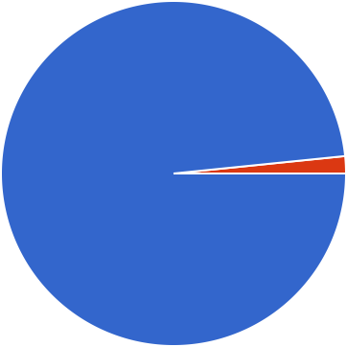
11/21/25, 7:22 PM Assessment Of Antiepileptic Drugs (AED) Use in Neurosurgical Patients: Adherence to Clinical Guidelines
What other factors influence your decision to withdraw AEDs? (Select all that apply)
310 responses
Copy
Patient preference
8 80((2255.88%%))
Side effects of AEDs
8 85((2277.44%%))
185(2277..44%%))
1 170((5544.88%%))
History of cranial surgery
Persistent brain parench…
Patient occupation Site of brain inury (cortic…
None Others
6 60((1199.44%%))
5 50((1166..11%%))
135((4433.55%%))
3 30((99.77%%))
0
50
100
150
200
Educational Needs and Feedback
Would you benefit from additional education or training on the proper use of AEDs in neurosurgical patients?
310 responses
Copy
Yes No
98.4%

Slide 20
11/21/25, 7:22 PM Assessment Of Antiepileptic Drugs (AED) Use in Neurosurgical Patients: Adherence to Clinical Guidelines
What educational/training format would be most convenient? (Select all that apply)
310 responses
Copy
Online Webinars
2 205((6666..11%%))
Online self-paced courses
1 1351(4433.55%%))
Periodic emails with guideline summaries and… Periodic emails with Case-
based discussions
A mobile application that guides AED application i…
1 155((5500%%))
1 115((3377.11%%))
150((4488.44%%))
Others
5 25((88.11%%))
0
100
200
300

Slide 21

11/21/25, 7:22 PM Assessment Of Antiepileptic Drugs (AED) Use in Neurosurgical Patients: Adherence to Clinical Guidelines
Do you have any suggestions for improving the use of AEDs in neurosurgical patients?
62 responses
No
No
.
Nil
Guideline should be printed and put on wards and icu board Limit duration of prophylaxis
No suggestion Tk
CME
One guidelines to include all pathologies
Should be a simple that maximising one AED and additional AED to aid the primary AED for refractory seizure "Drugbased guideline"
Such as phenytoine guideline for any of type of seizure, if this type combination with a b c Or such as valproic acid guideline for any type of seizure, if this type combine with a b c
Better education on guidelines. I believe they are overprescribed. We need further training
No such suggestion thx
Any condition with cortical irritation require use od AED None

Slide 22
11/21/25, 7:22 PM Assessment Of Antiepileptic Drugs (AED) Use in Neurosurgical Patients: Adherence to Clinical Guidelines
Trying to give one specific guidelines
Antiepileptic drugs (AEDs) are associated with a range of side effects, some of which can be serious. Therefore, their use in neurosurgical patients should be carefully considered and guided by clear clinical benefit. However, the efficacy of AEDs remains uncertain in many neurosurgical conditions, especially for seizure prophylaxis in patients without a prior history of seizures. This underscores the need for evidence-based protocols that define when AEDs are truly indicated, balancing potential benefits against risks. Developing such protocols based on high-quality clinical data will help standardize care and optimize outcomes in neurosurgical patients.
Clear guidelines
There should be definite recommendations for post craniotomy pt . Only to say Thank you
Only to say Thank you Case scenarios learning
Provide courses and webinars
BETTER AWARENESS WITH CME / WEBINAR / COURSES
Follow guide lines,
Having a flow-chart to provider a correct way of administering the AED One summarized guideline for all scenarios.
No nthank you Including us toncourses Na
1-Monocerapy is a rule unless improper control and therapeutic level is normal Distrusting the Guidlines among centers
UPDATED GUIDELINES
Read ILAE guidelines

Slide 23
11/21/25, 7:22 PM
Assessment Of Antiepileptic Drugs (AED) Use in Neurosurgical Patients: Adherence to Clinical Guidelines
-
to follow the guide line of uses AEDs Monthly email of the antiseptic guidelines
Robust randomized study for each neurosurgical pathology More collaboration with neurologists in management
more awareness of drugs
Clear hospital based guidelines

Slide 24

11/21/25, 7:22 PM Assessment Of Antiepileptic Drugs (AED) Use in Neurosurgical Patients: Adherence to Clinical Guidelines
Are there any specific challenges you face in managing AEDs in your practice?
62 responses
No
Yes no None
.
Nil
Doctor insist on following seniors recommendations rather than guidelines
Yeah there are many the patients to response to one AED some cases given them three medicines AED but the attacks still coming
_
Medication availability Certain AED availability No
Only familiar with a few of AED
Poor data in pediatrics, specifically in trauma in infants, which is the most common scenario in which I consider prescribing AEDs for which there is no good data
Duration and type of AED Yes
thx
Liver affection most frequent , cognitive impairment Lack of specific guidelines

Slide 25
11/21/25, 7:22 PM
Assessment Of Antiepileptic Drugs (AED) Use in Neurosurgical Patients: Adherence to Clinical Guidelines
Lots of challenges.
Lack of clear guidelines
No definite guideline with consensus Lack of availability of some drugs Not really
LACK CONCENSUS IN GUIDE LINES
Lack of specific medication in my center (Lorazepam) Administering AED to the correct patient
Availability of the drug Education
Na
Sometimes intractable epilepsy despite multiple therapy, no interrupted medication and avoidance as possible as drugs interaction
No clear guidlines
PATIENT COMPLIANCE AND SOMETIMES EFFICAY
-
Find out balance between to treat and overtreat, and when deciding when and how to stop AEDs
Many times reduced by collaborative team work
Lack of clear protocols for follow up guidelines or weaning
This content is neither created nor endorsed by Google. - Contact form owner - Terms of Service - Privacy Policy Does this form look suspicious? Report
Forms

Slide 26
11/21/25, 7:22 PM
Assessment Of Antiepileptic Drugs (AED) Use in Neurosurgical Patients: Adherence to Clinical Guidelines

