Slide 1
Supplementary data 1
A
B
C

Slide 2
Supplementary data 2
A
B
C
D
E
F

Slide 3
Supplementary data 3
A
B
C

Slide 4
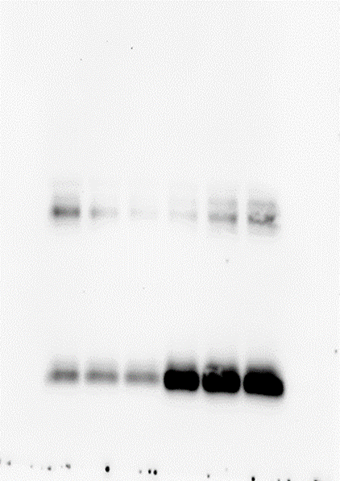
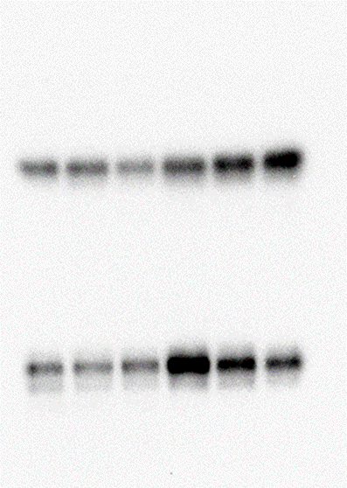
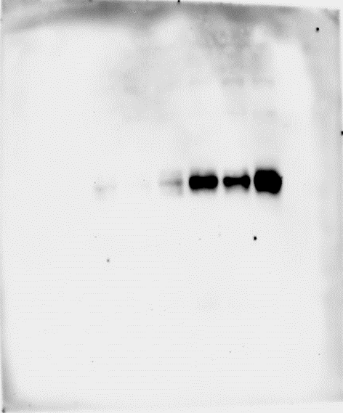
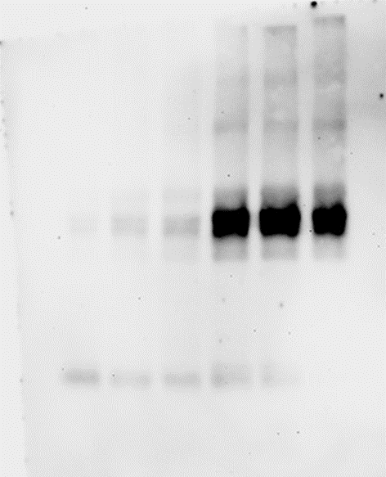
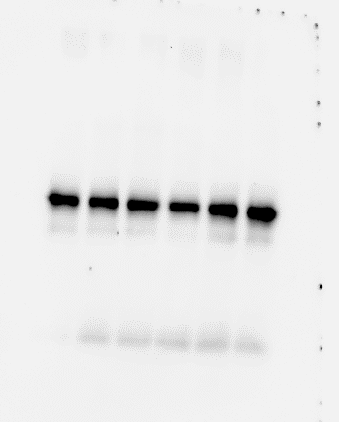
Supplementary data 4
HMGB1
HMGB2
RAGE
TLR4
β-Tubulin
45kDa
45kDa
55kDa
25kDa
24kDa

