Slide 1
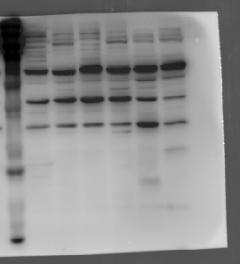
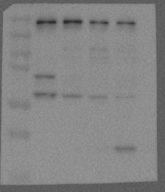
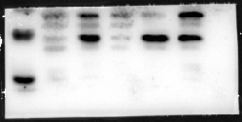
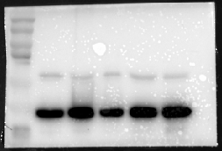

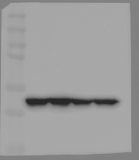
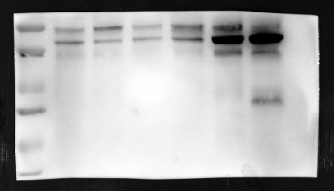
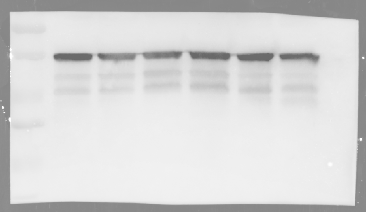
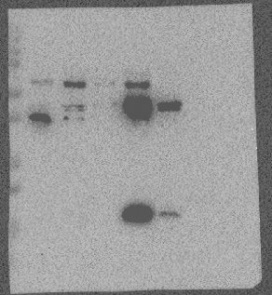
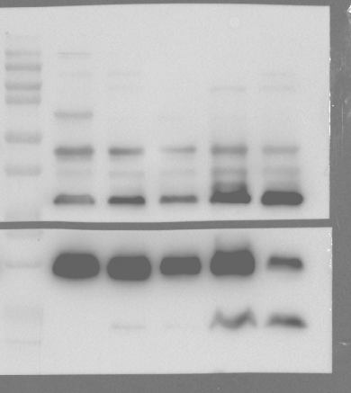
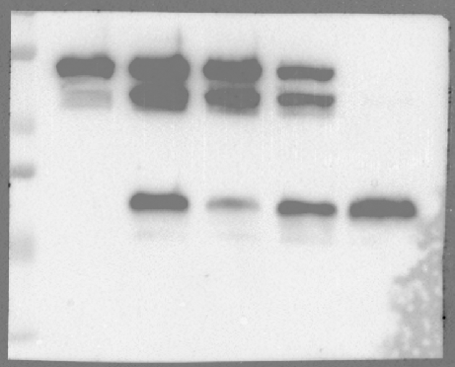
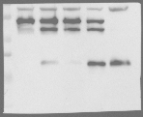
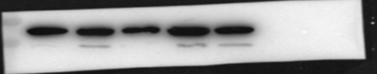
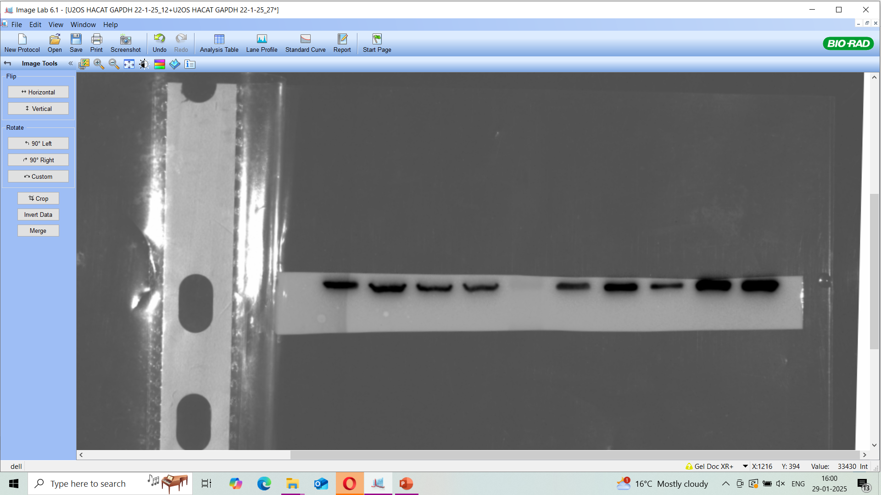
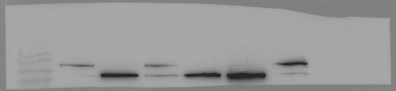
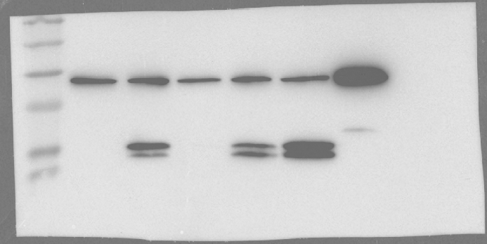
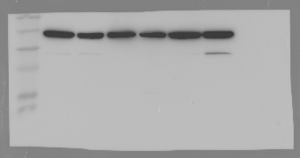
For Figure 4
a
NINJ1
GSDMD
GSDME
GAPDH
GAPDH
CASP1
β-actin
GAPDH
b
CASP8
CASP9
CASP7
BID
β-actin
β-actin
GAPDH
PARP
CASP3
β-actin

Slide 2
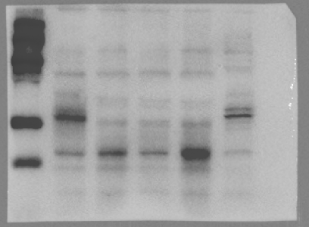
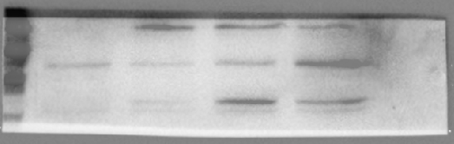

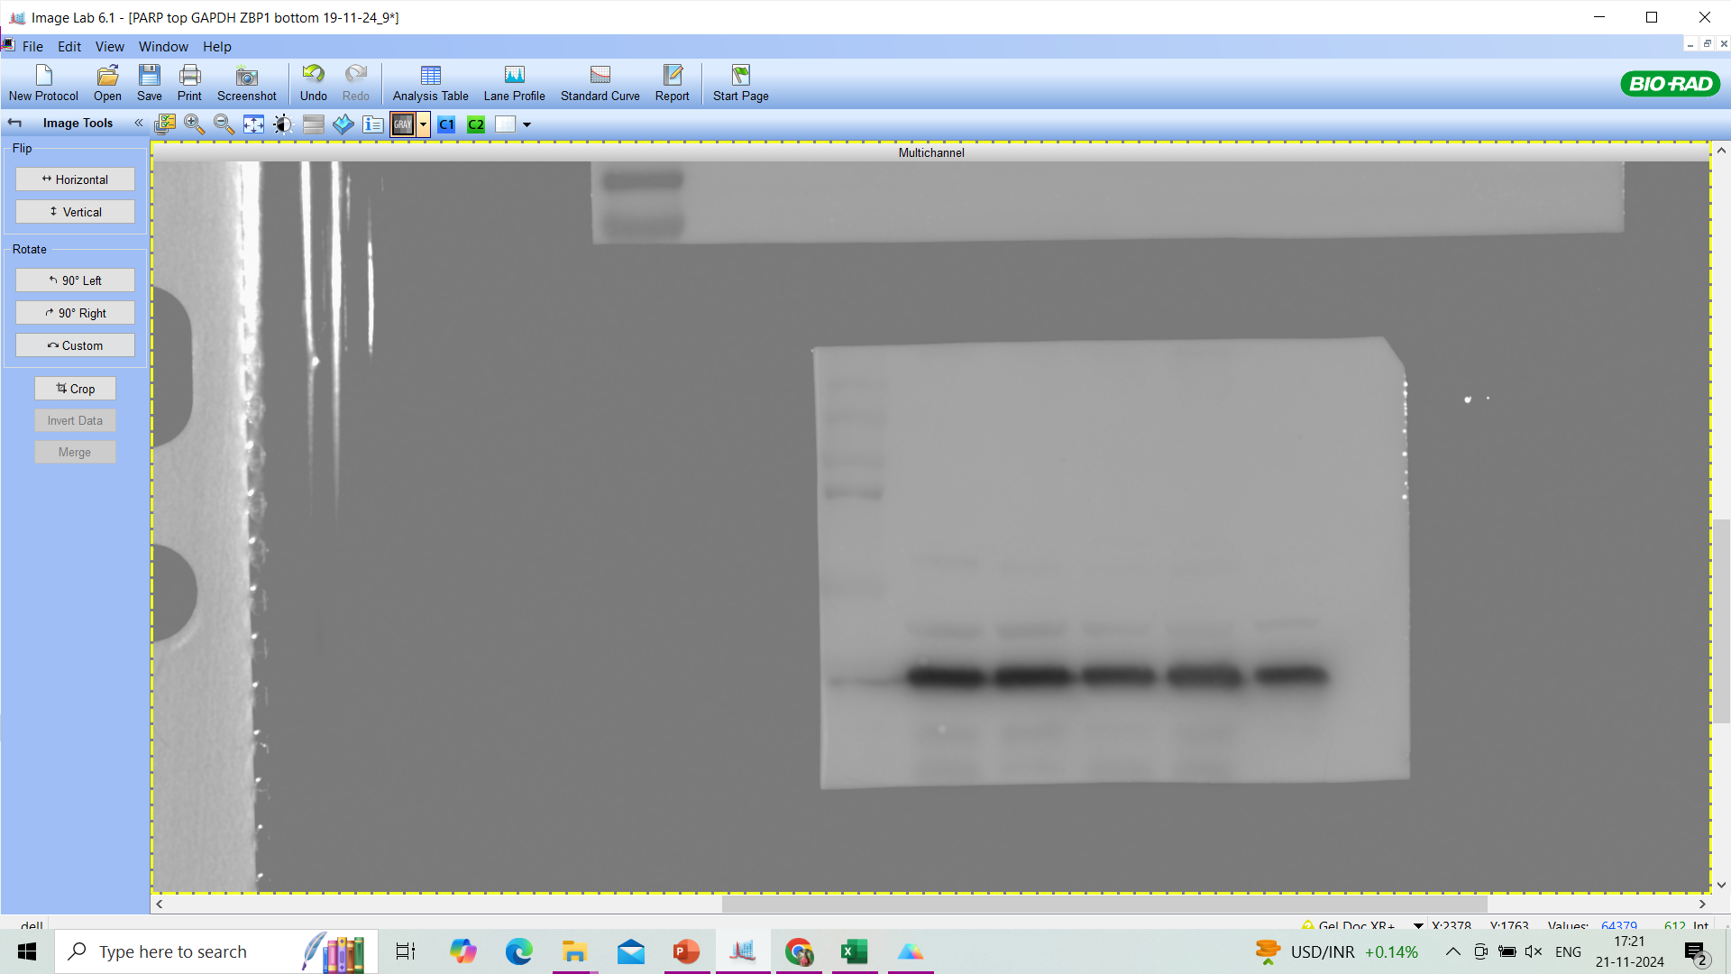
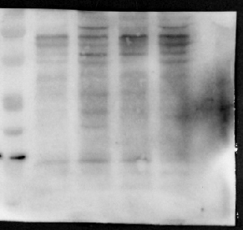

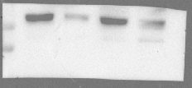
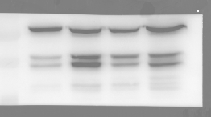
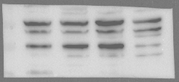
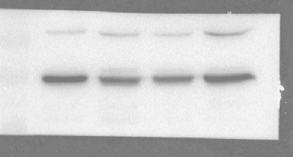
For Figure 4
c
CYLD
ZBP1
RIPK1
pMLKL
GAPDH
pRIPK3
tRIPK3
tMLKL
β-tubulin
GAPDH

Slide 3
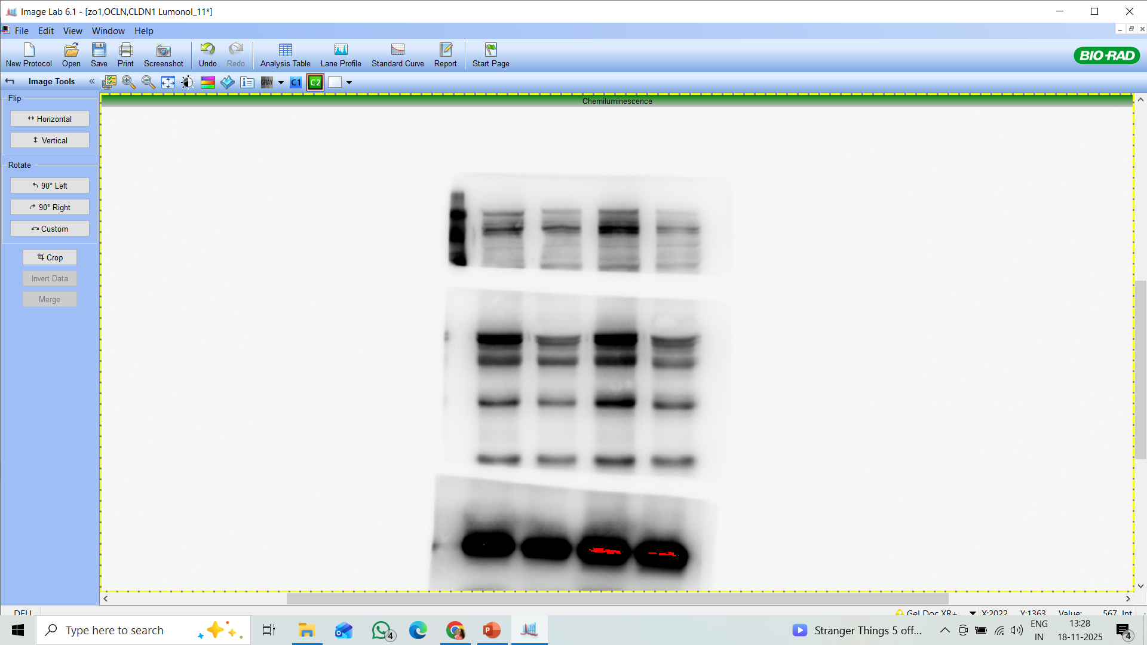
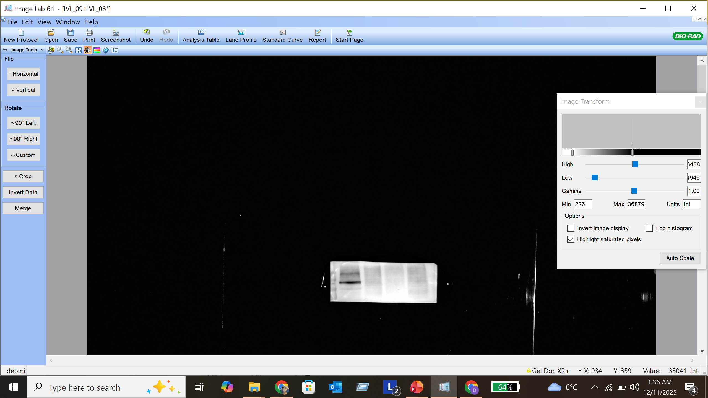
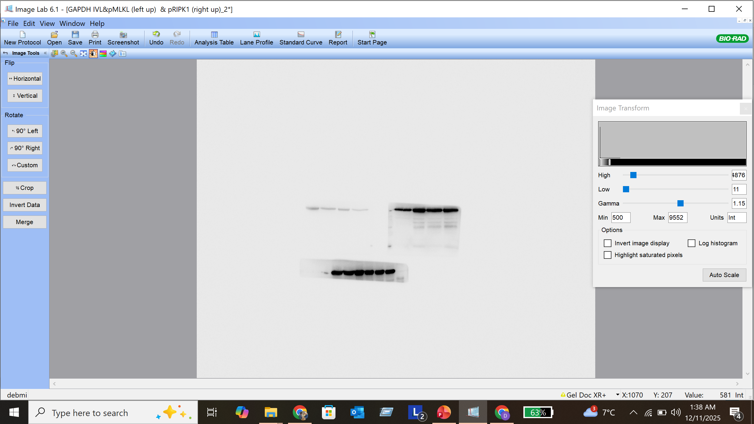
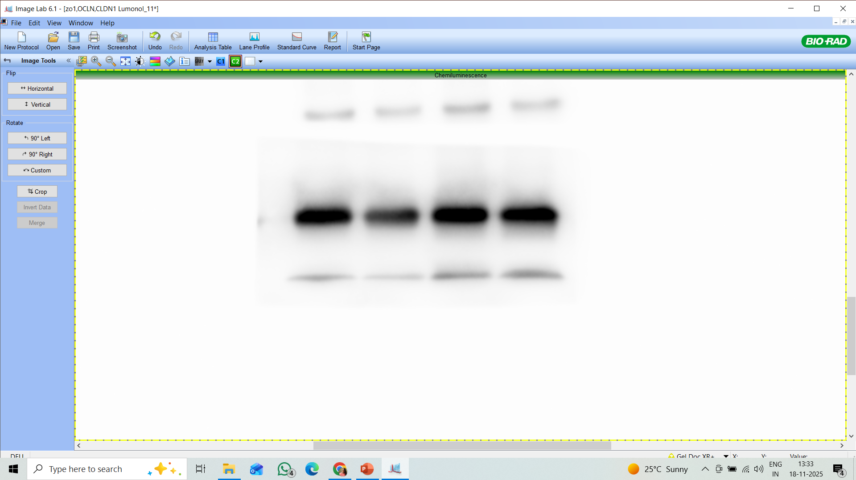
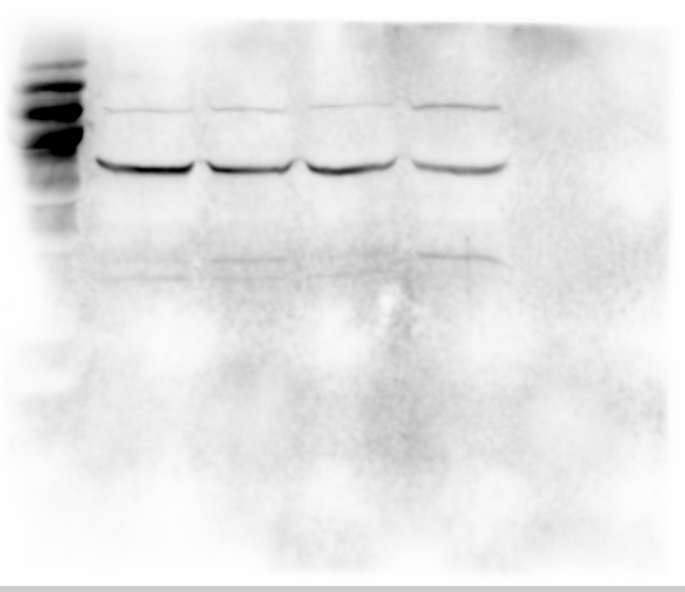
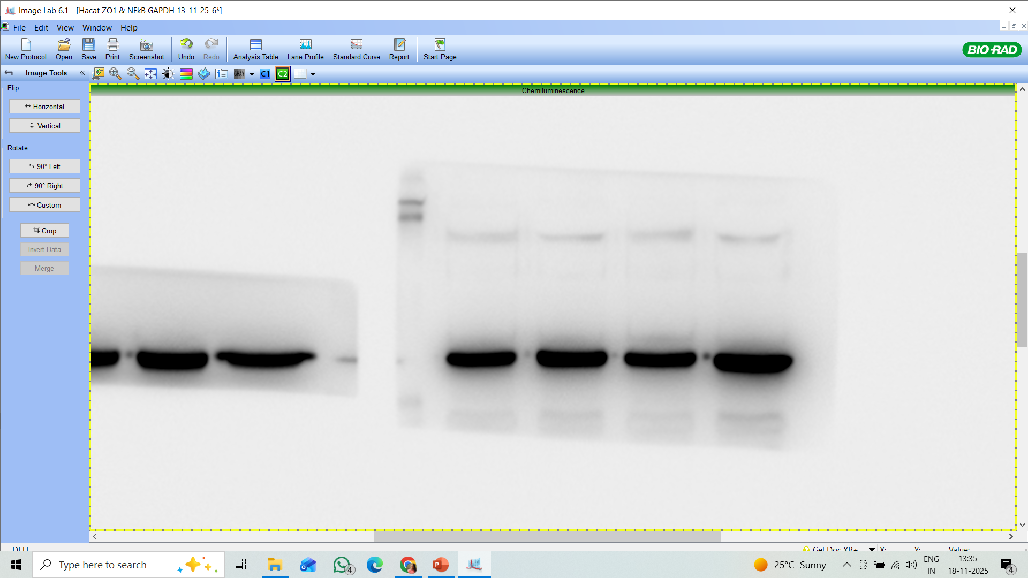
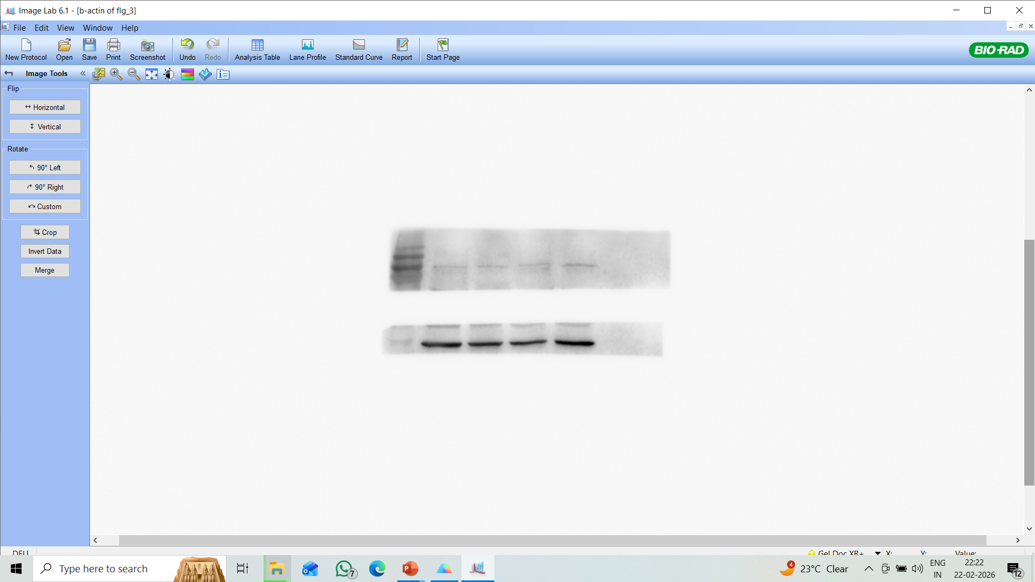
For Supplementary Figure 7
e
TJP-1
IVL
GAPDH
OCLN
CLDN1
Filaggrin
GAPDH
β-actin

Slide 4
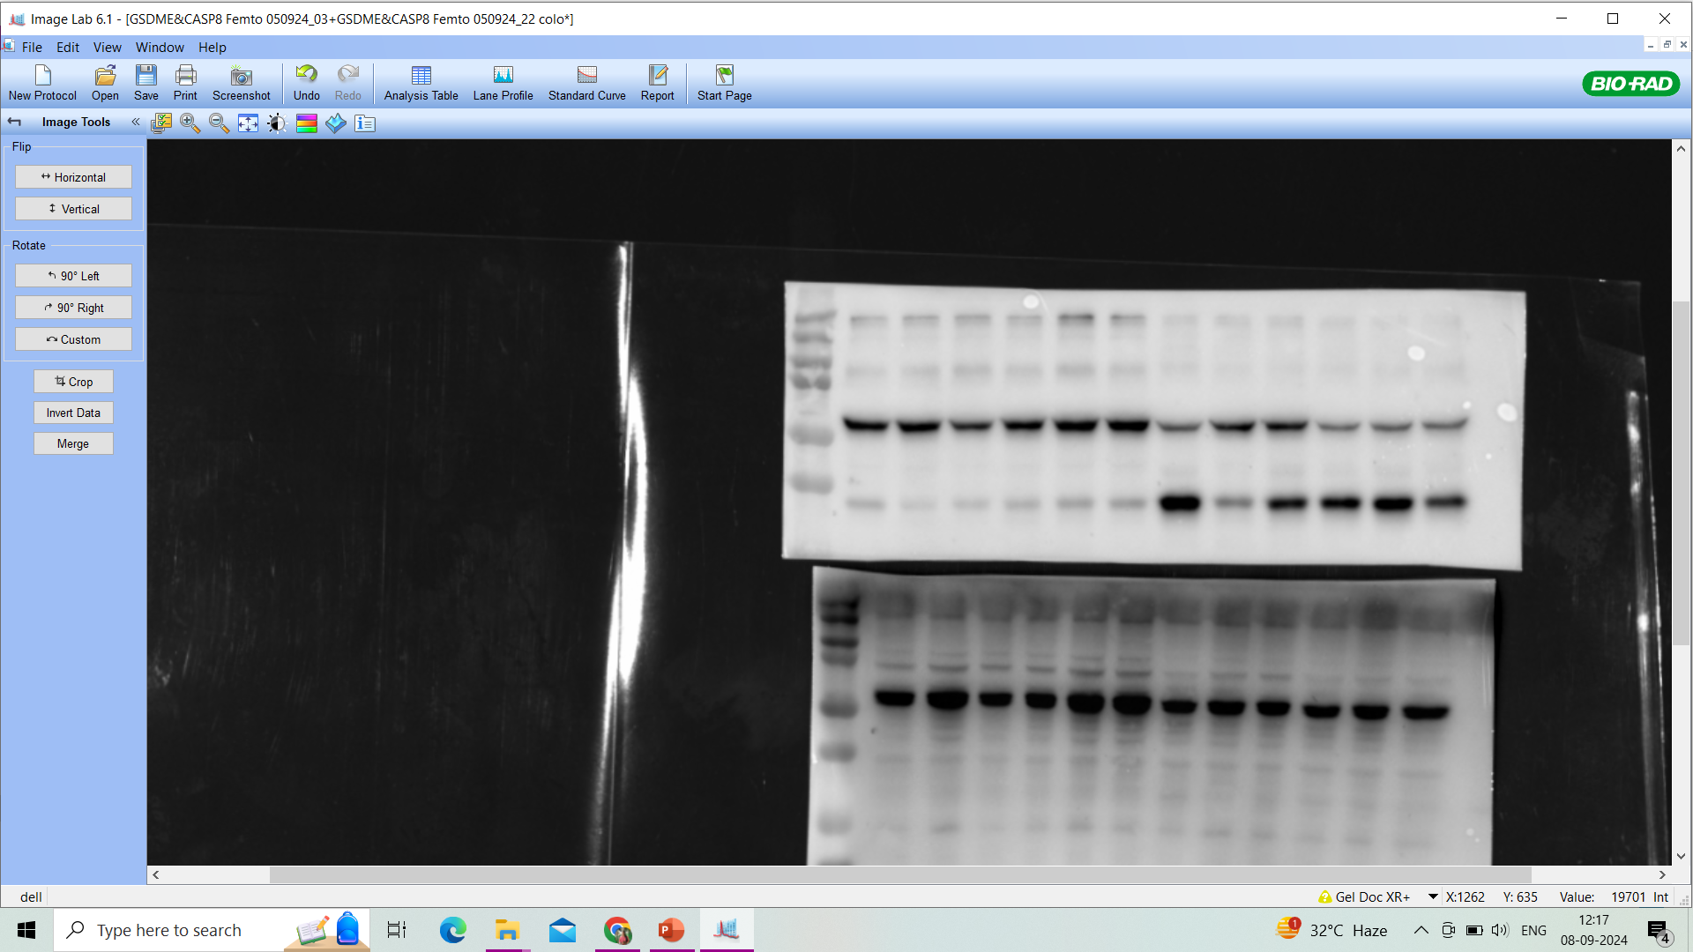
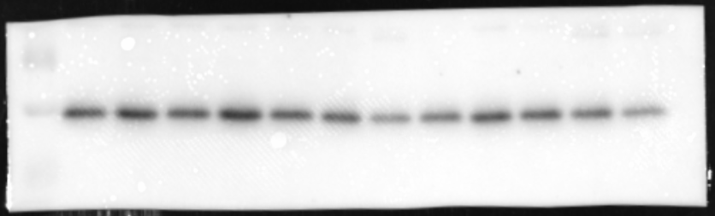
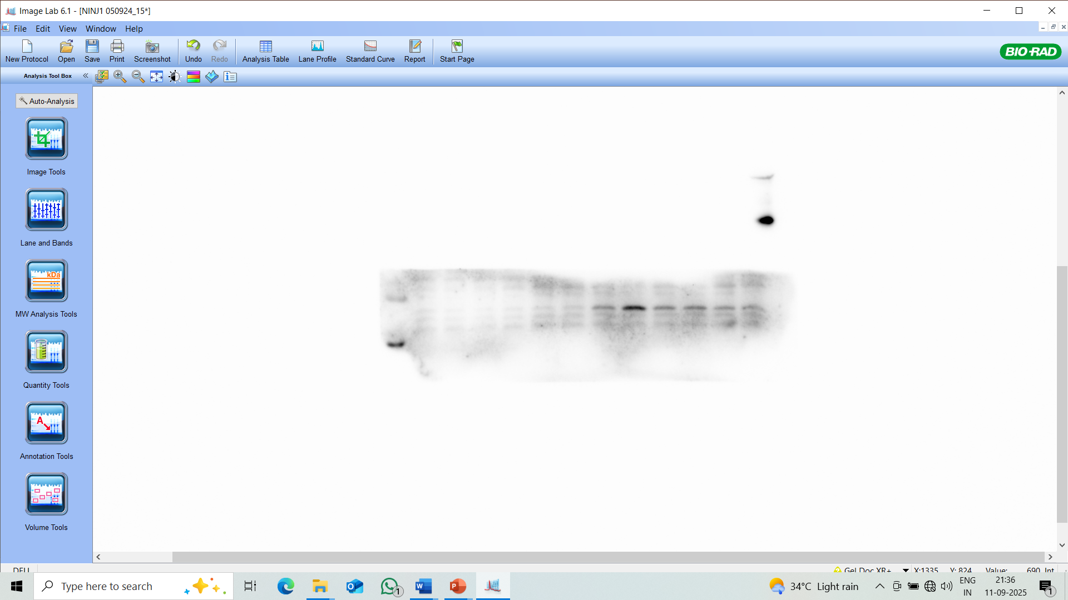
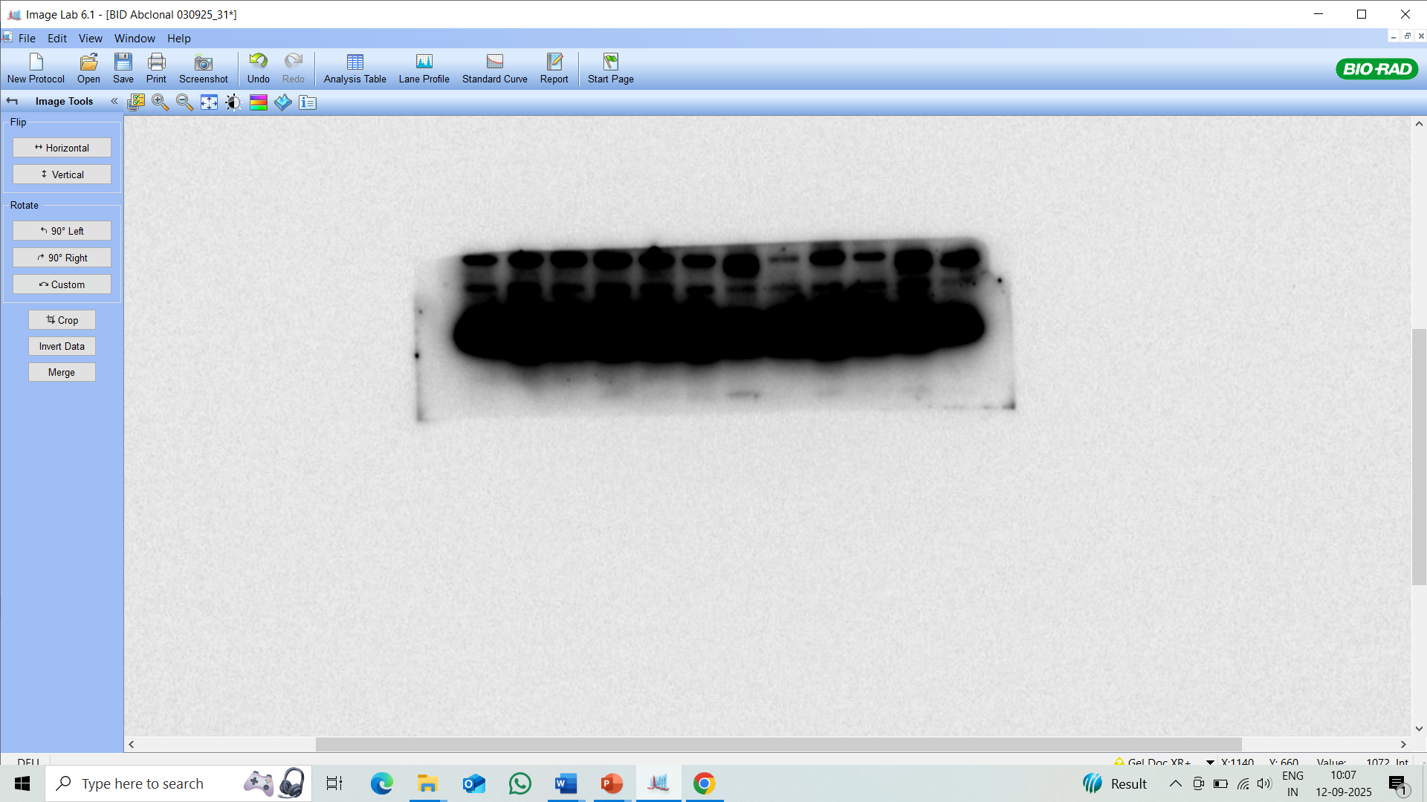
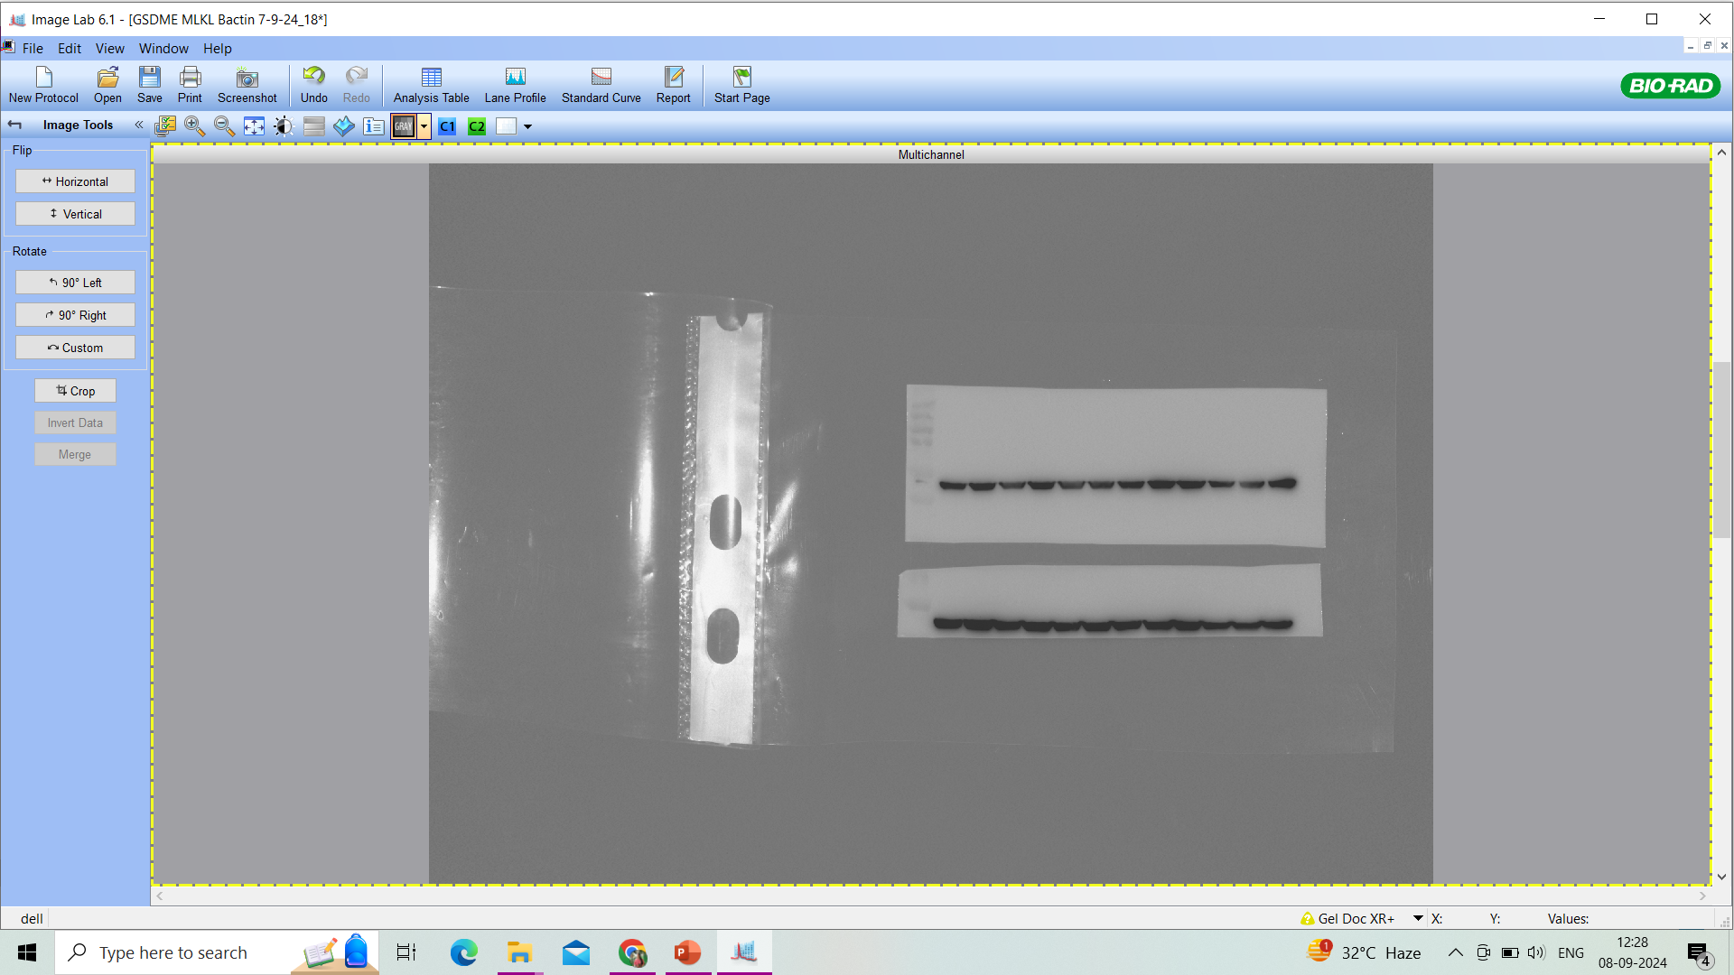
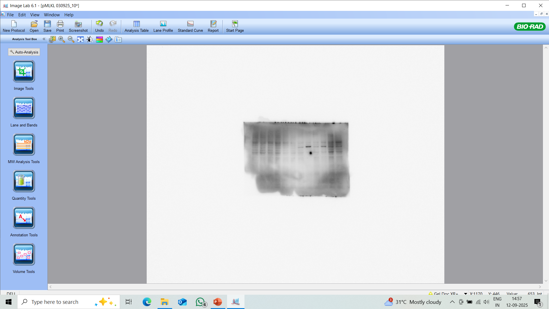
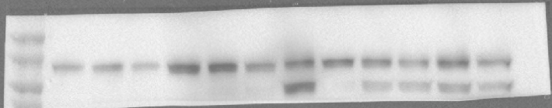
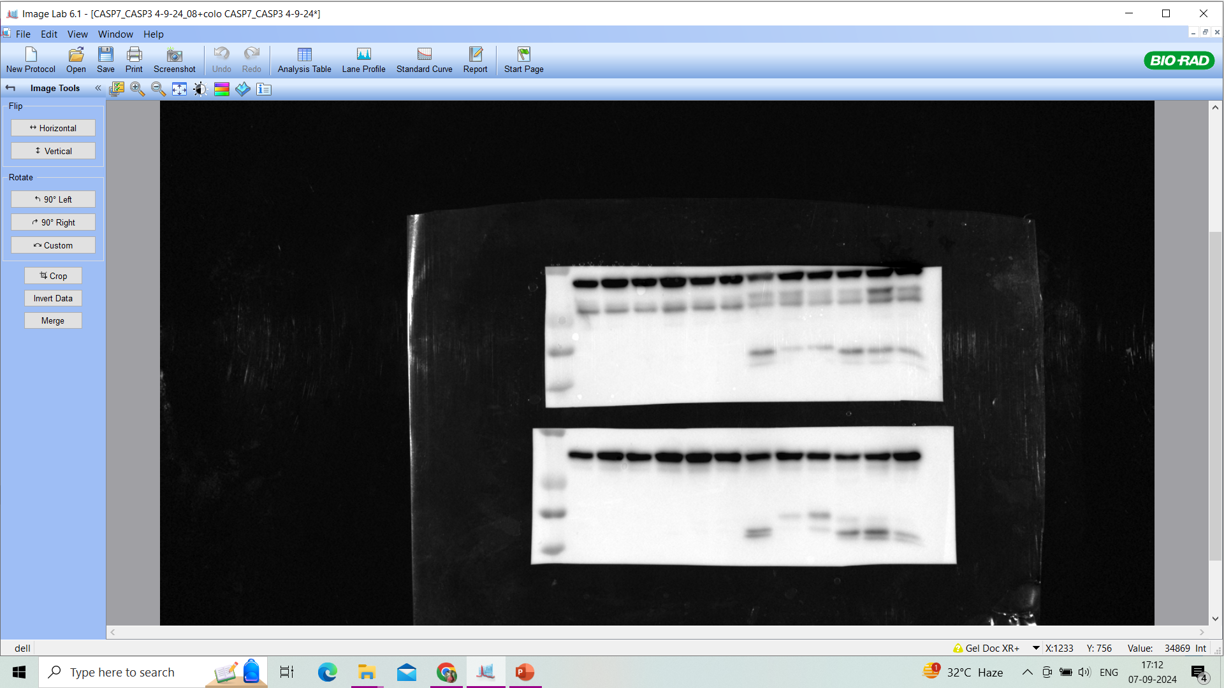
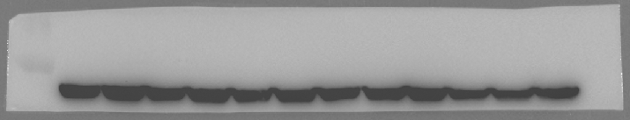
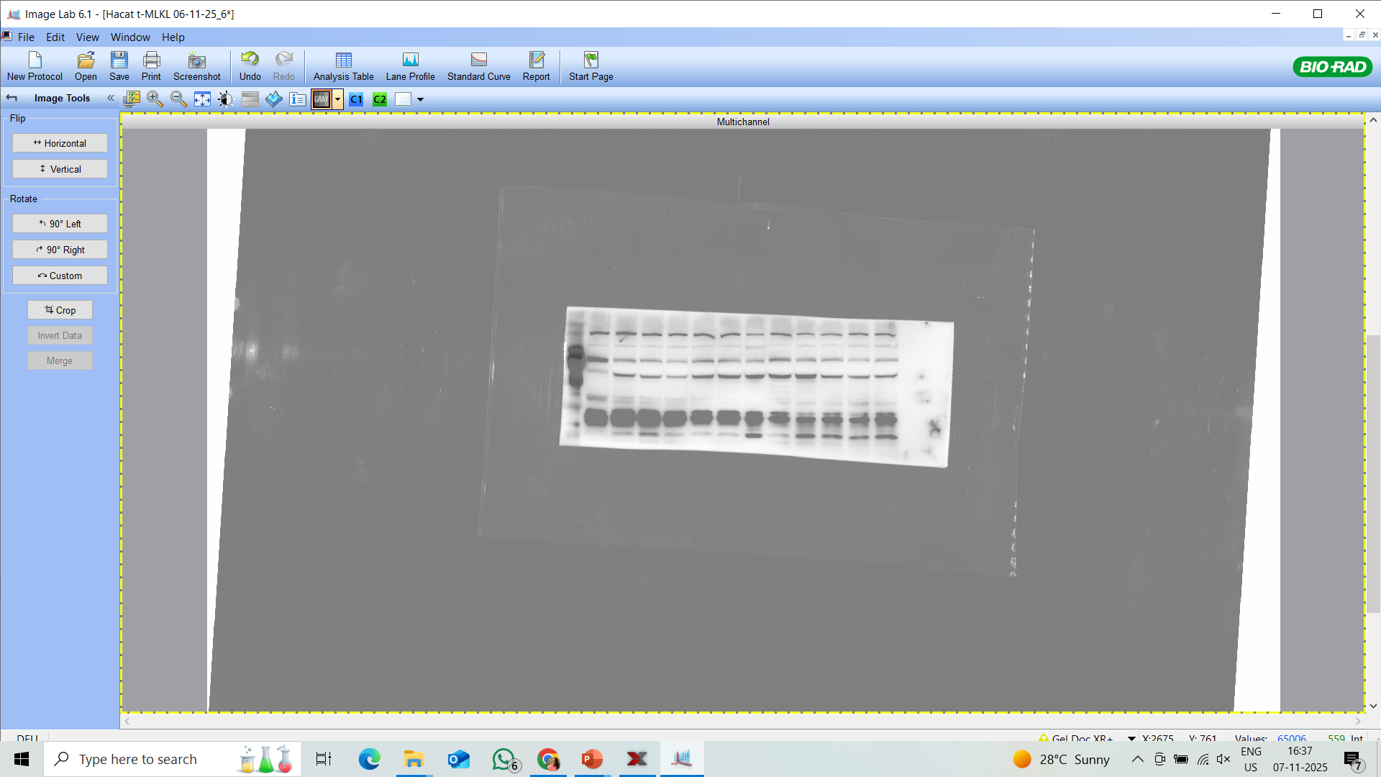
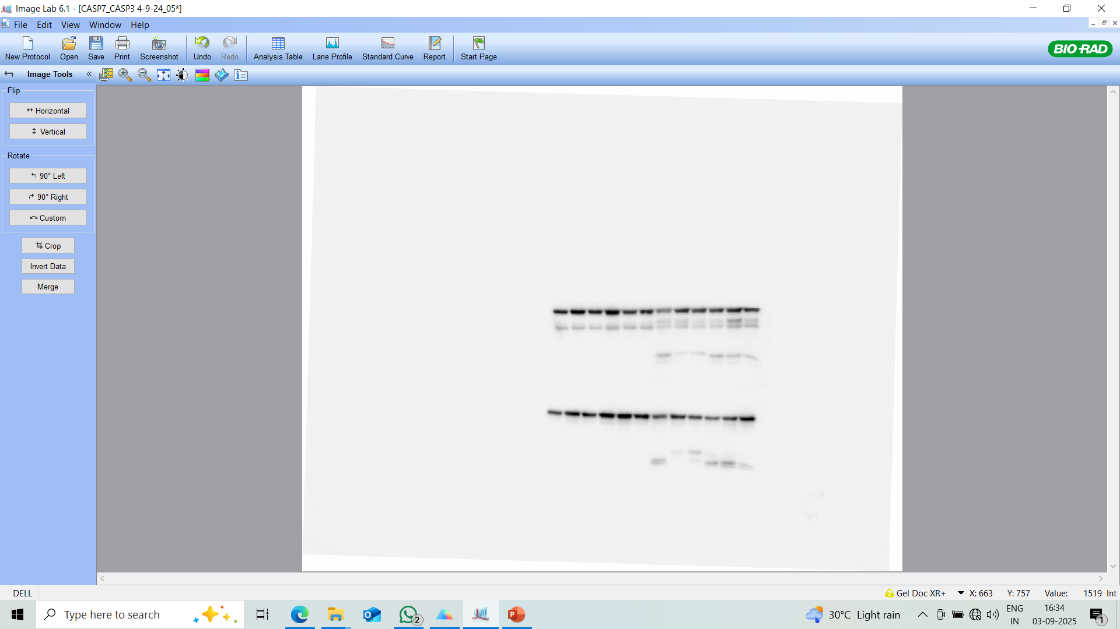
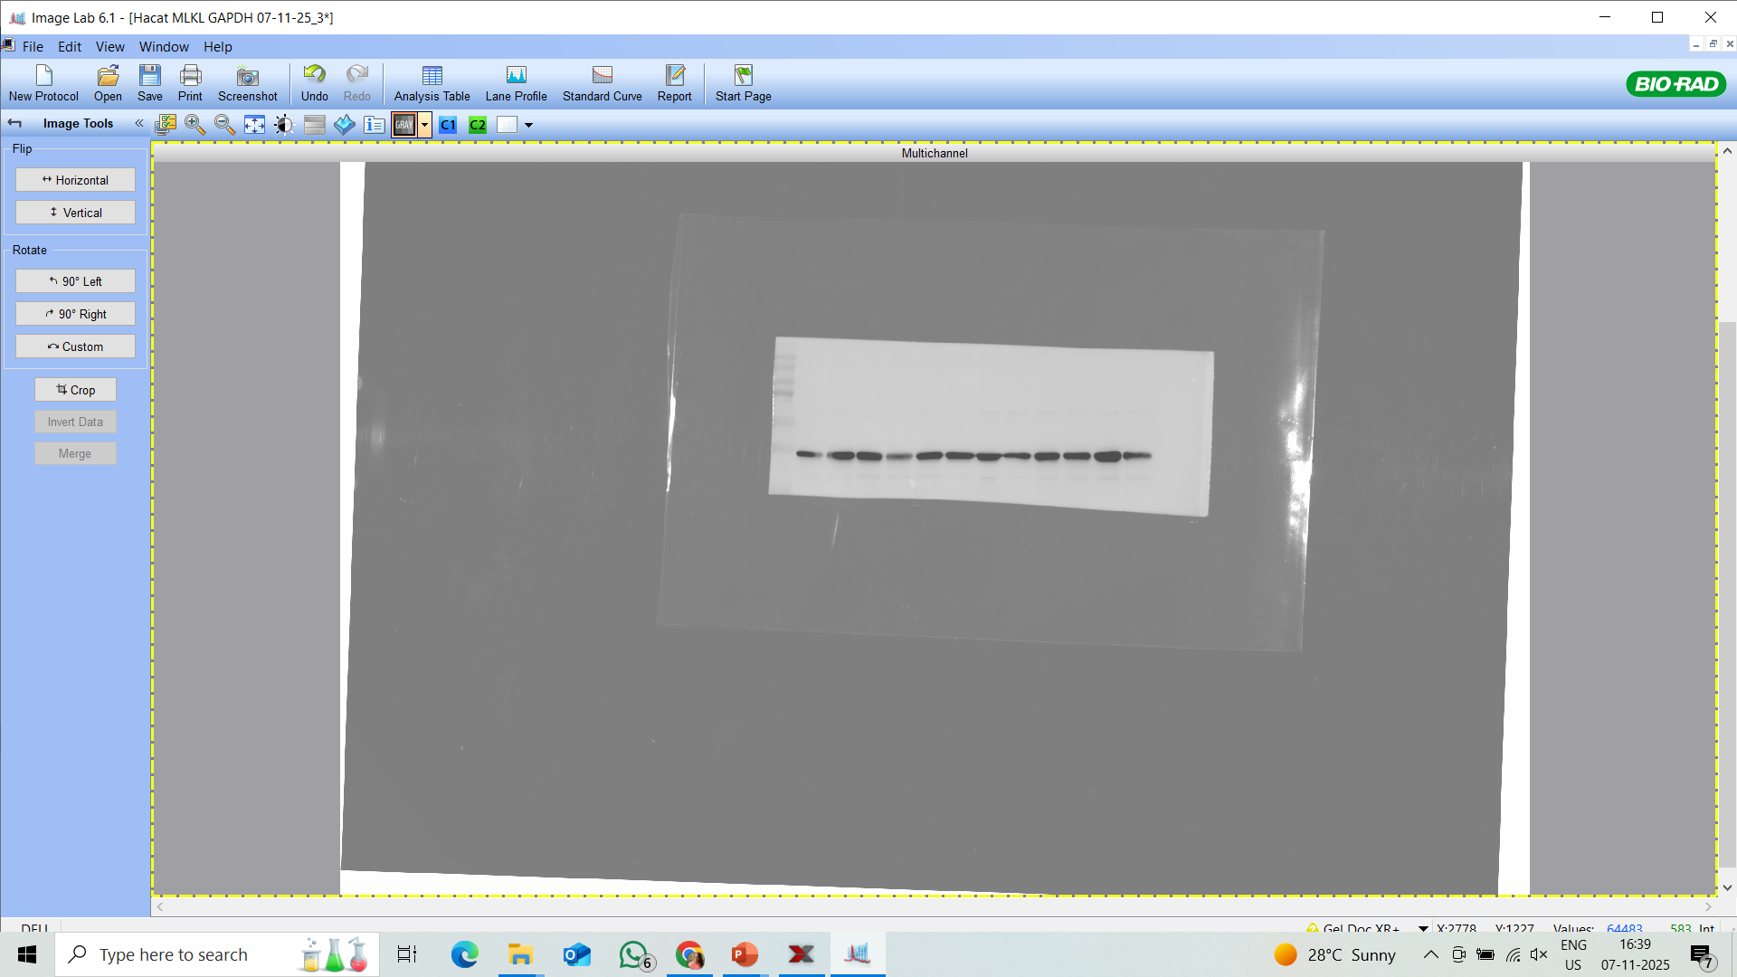
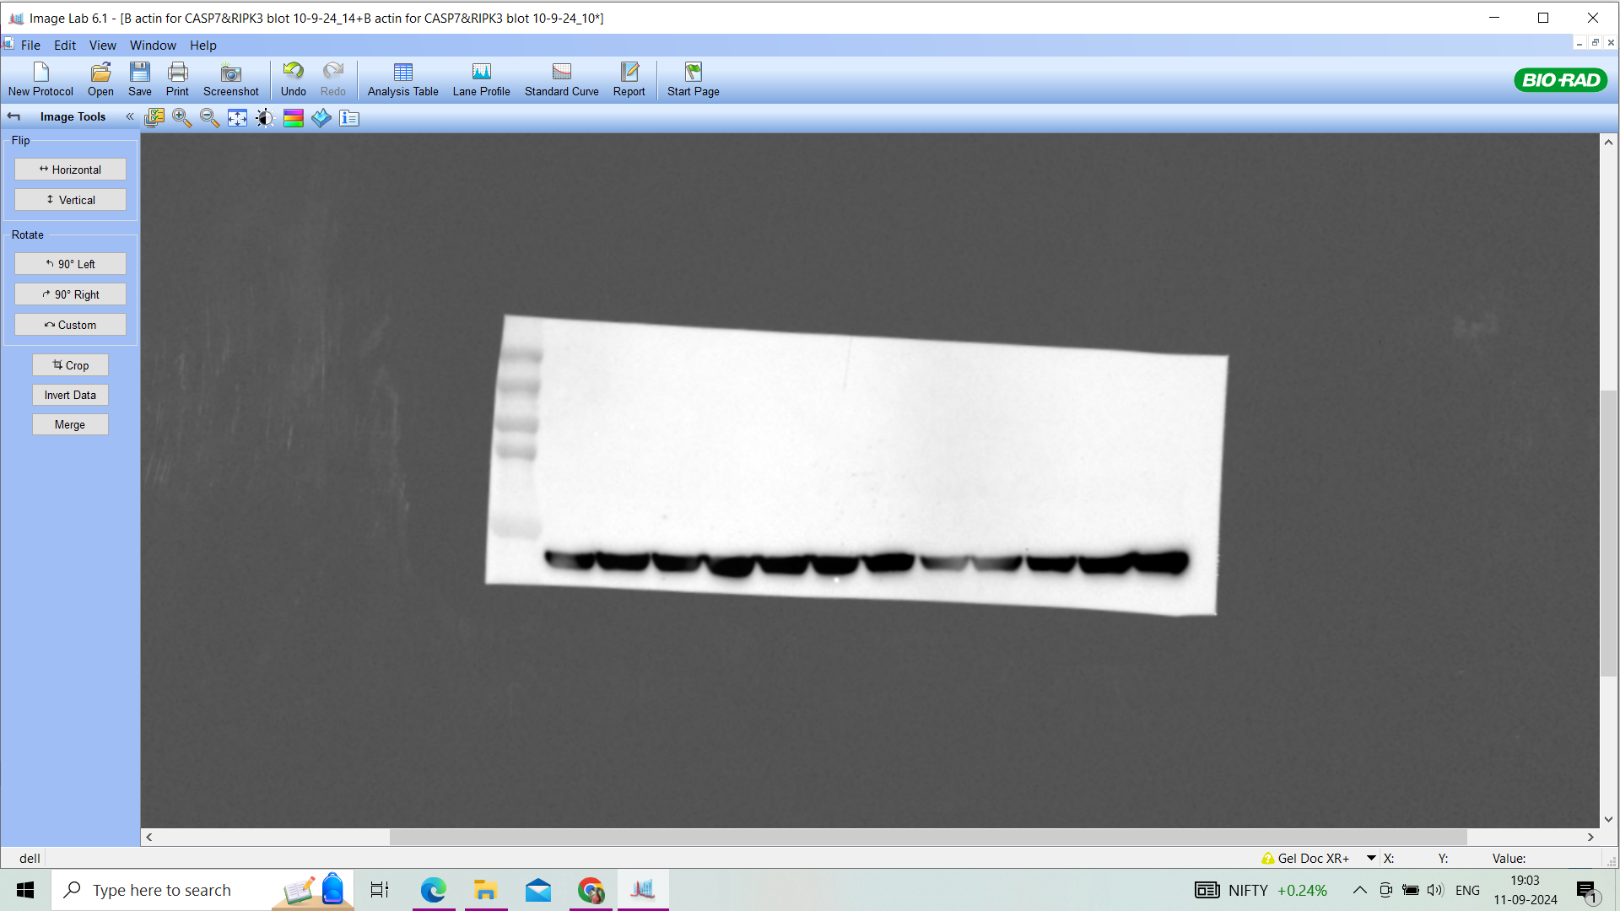
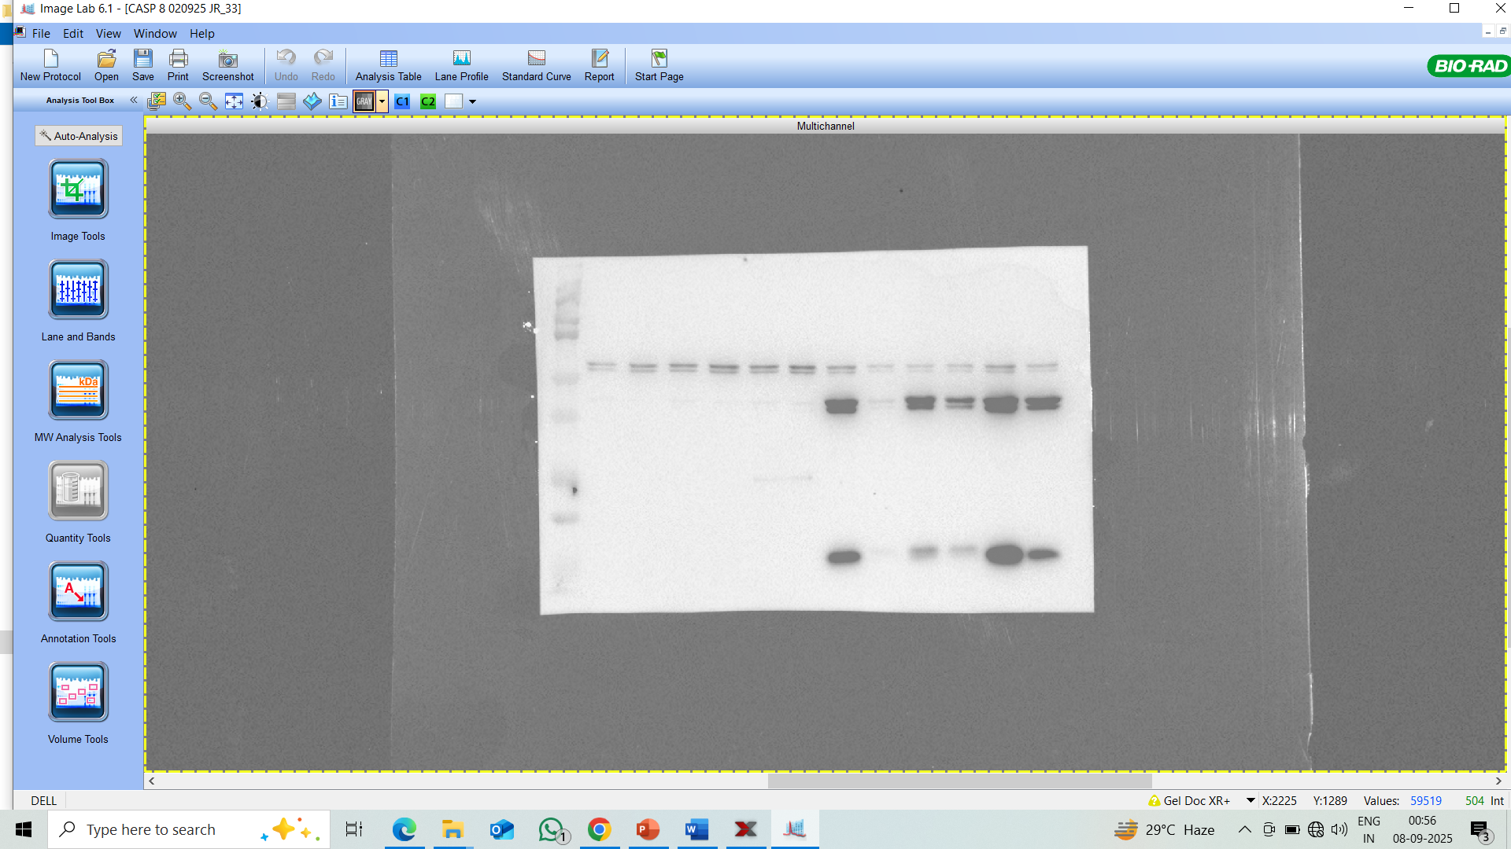
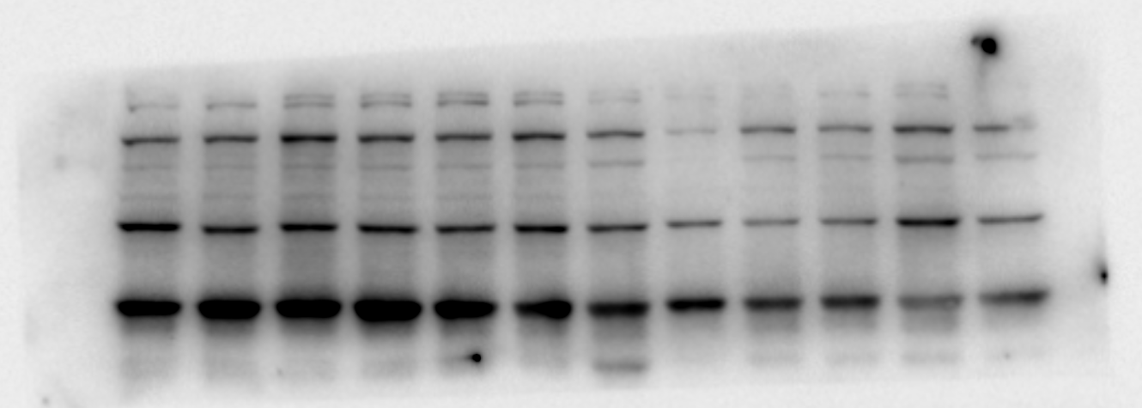
For Figure 5
b
GSDME
BID
(Total, low exposure
NINJ1
BID
(Cleaved, high exposure
β-actin
PARP
pMLKL
CASP3
β-actin
tMLKL
CASP7
GAPDH
β-actin
CASP8
CASP9

Slide 5
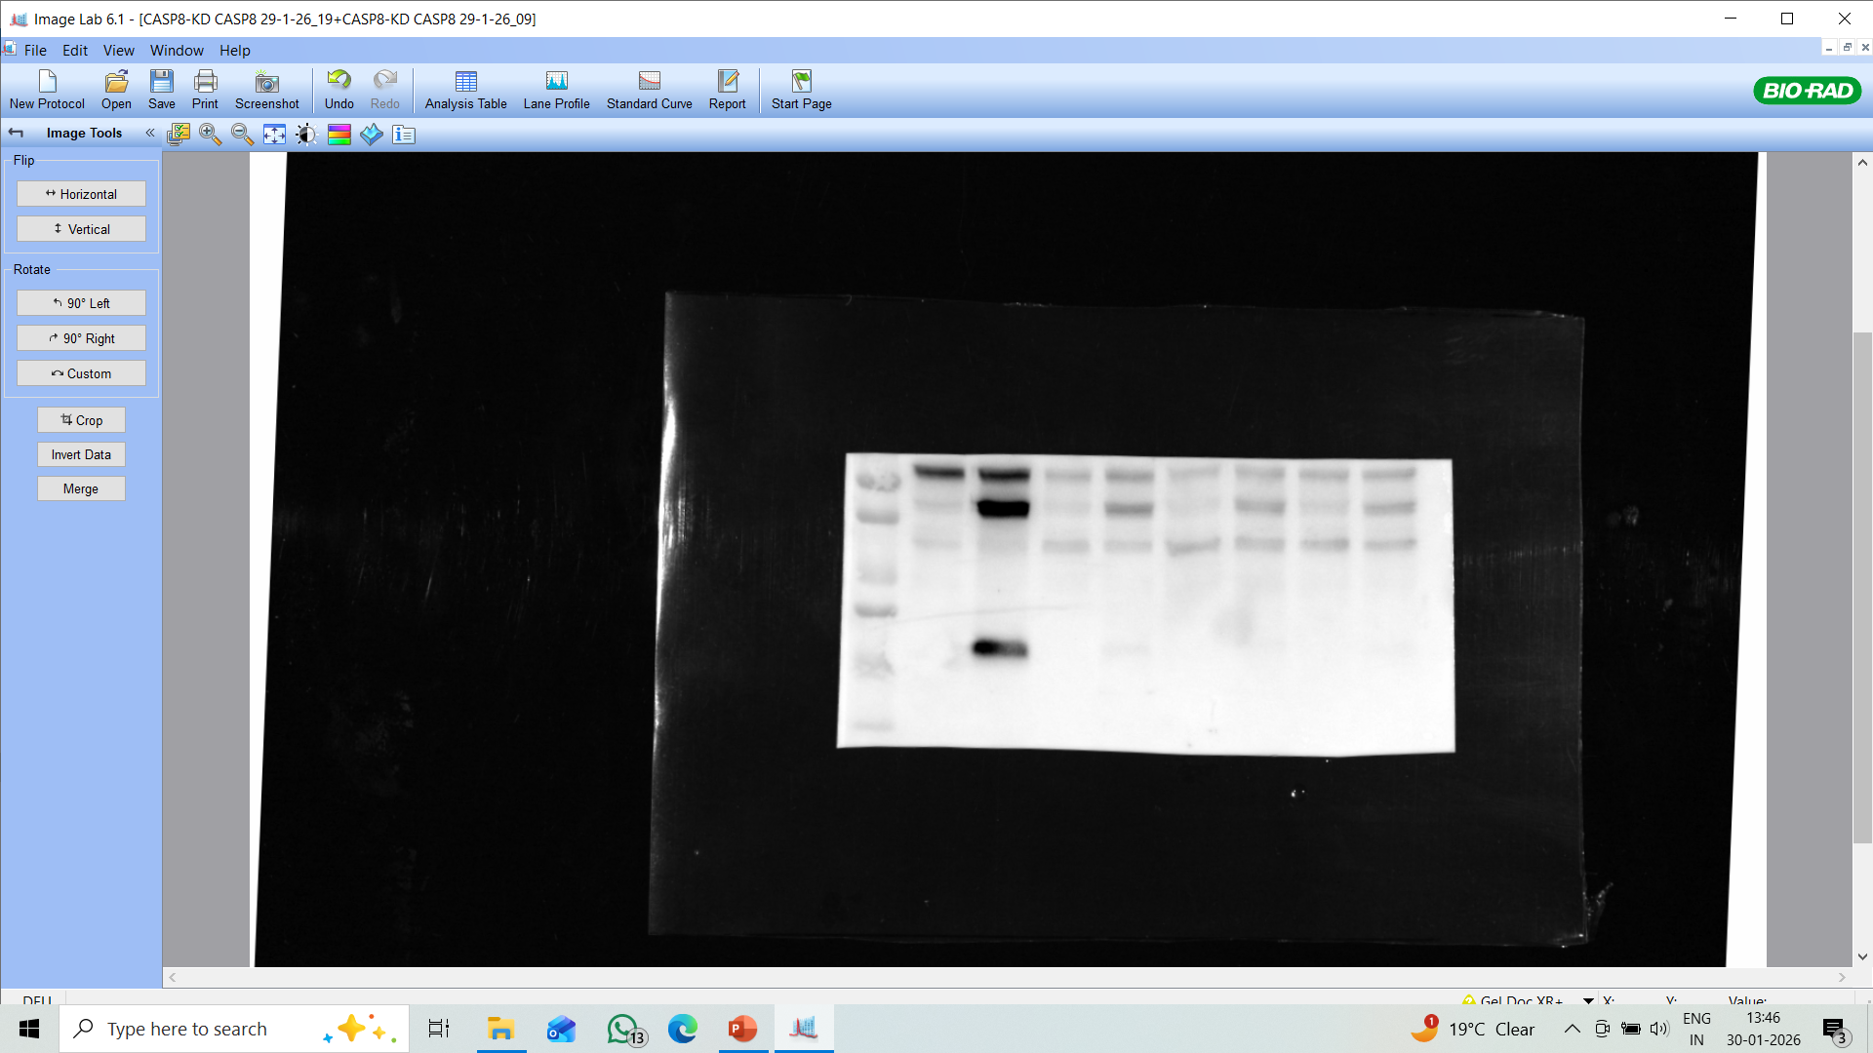
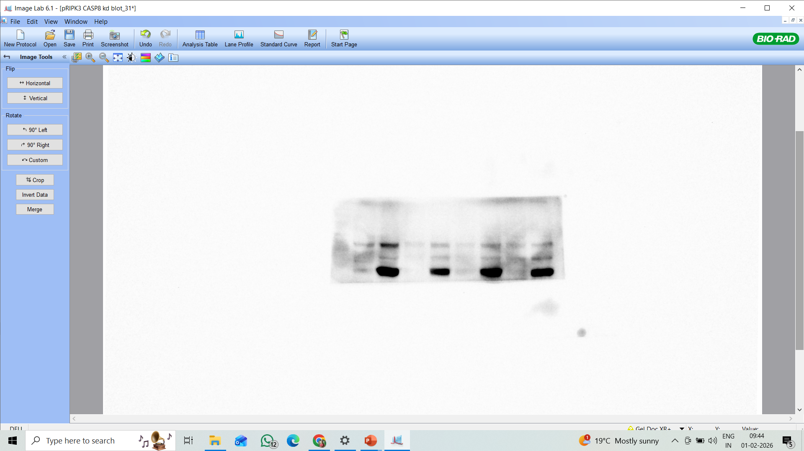
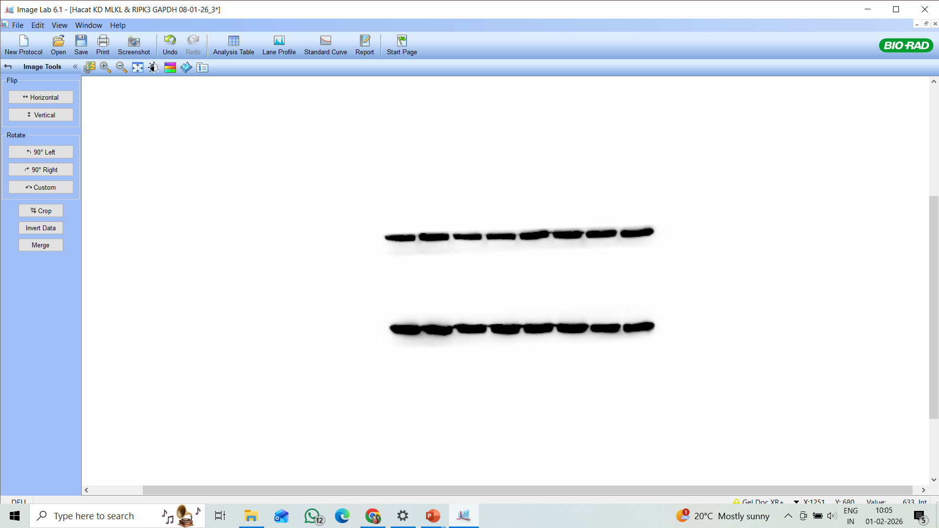
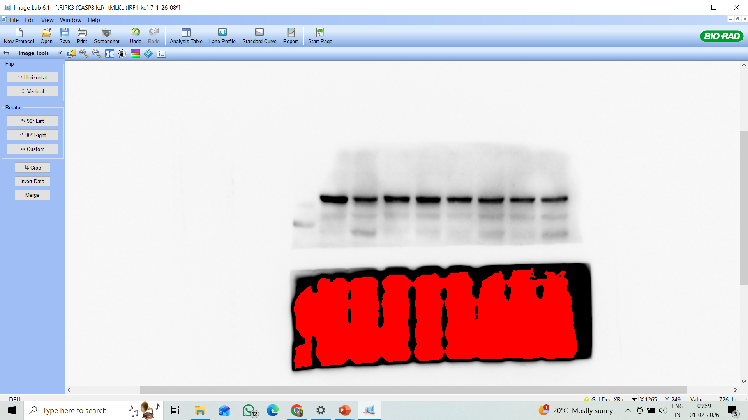








d
Figure 5
CASP8
pRIPK3
GAPDH
pRIPK3
GSDME
pMLKL
CASP3
tMLKL
PARP
GAPDH
BID
GAPDH

Slide 6














For Figure 6
b
ZBP1
pMLKL
PARP
CASP3
tMLKL
GAPDH
pRIPK3
CASP8
tRIPK3
GSDME
GAPDH
GAPDH
c
iNOS
GAPDH

Slide 7























For Figure 7
b
e
f
pSTAT 1
IRF 1
CASP8
GSDME
tSTAT 1
β-actin
GAPDH
GAPDH
CASP3
NINJ1
GAPDH
β-actin
PARP
GAPDH
g
ZBP1
CASP7
β-actin
pMLKL
GAPDH
pRIPK3
tMLKL
tRIPK3
GAPDH
GAPDH

Slide 8


















For Supplementary Figure 9
a
b
pSTAT1
pSTAT1
IRF1
IRF1
tSTAT1
GAPDH
tSTAT1
GAPDH
pNFkB
pNFkB
tNFkB
tNFkB
GAPDH
GAPDH
d
STAT1
NFkB
GAPDH
IRF1
H3
GAPDH
H3

Slide 9












For Figure 8
IRF1
BID
PARP
pRIPK3
CASP8
pRIPK3
CASP3
pMLKL
GSDME
tMLKL
GAPDH
GAPDH

