Slide 1
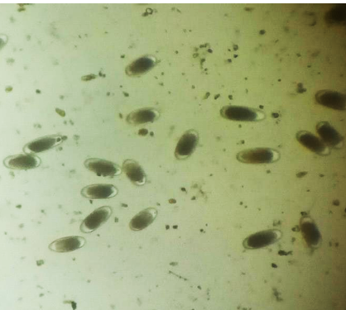
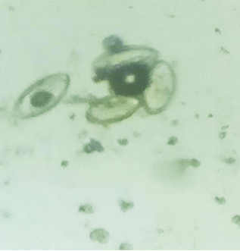
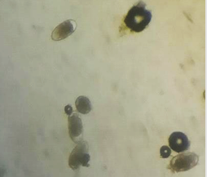
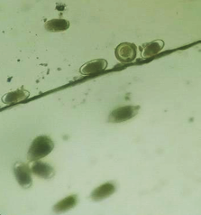
A
B
C
D
Image A shows the egg of Strongylus; Image B shows eggs of Oxyuris equi; Image C (black arrow) indicates eggs of Strongyloides westeri; and Image D (black arrow) shows eggs of Parascaris equorum.

Slide 2
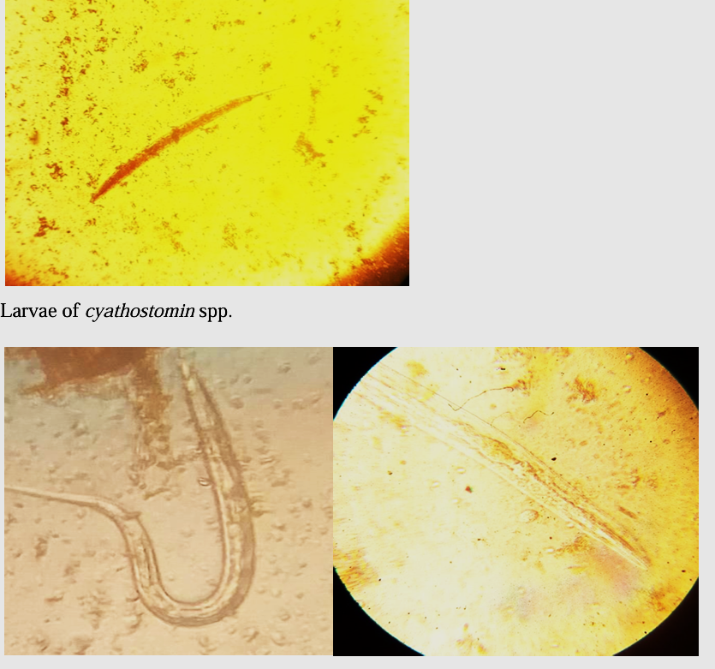
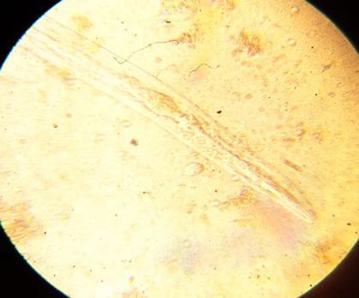
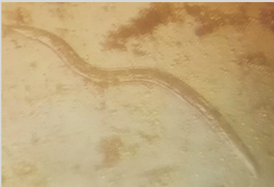
A
B
C
Image A shows the larva of Cyathostomum spp.; Image B shows larva of Strongylus vulgaris and Image C indicates larva of Strongylus equinus.

