Slide 1
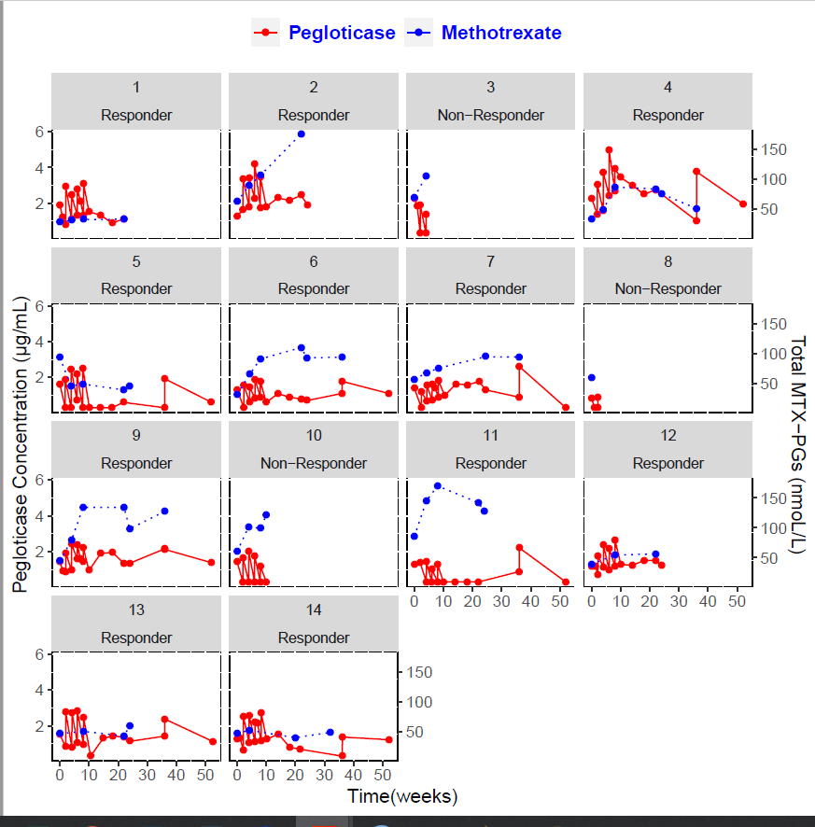
Supplemental Figure 2. Individual concentration-time course of pegloticase and MTX polyglutamates.

