Slide 1
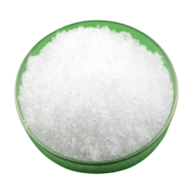
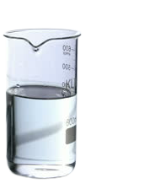

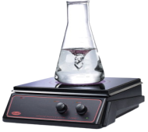

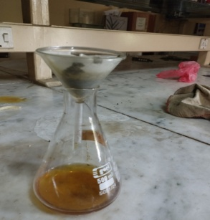
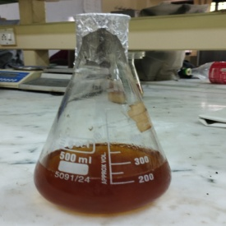
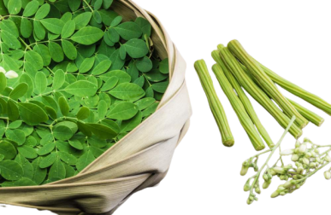
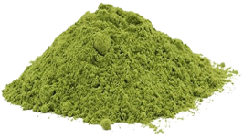
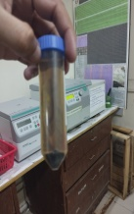
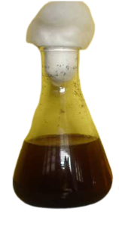
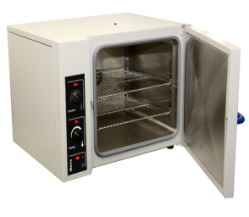
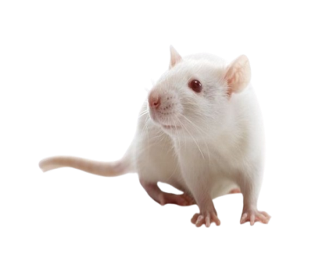
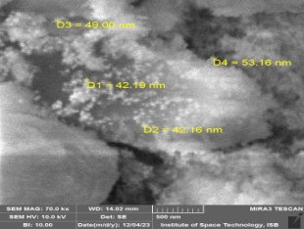
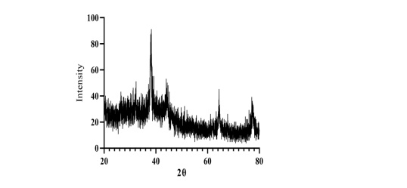
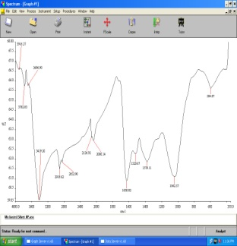
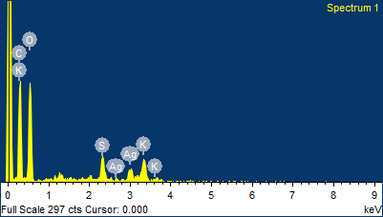
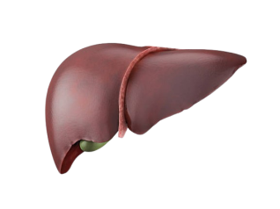
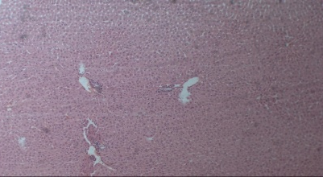
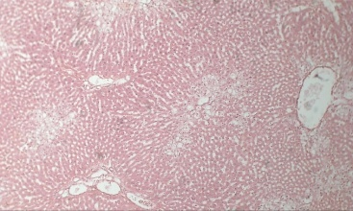
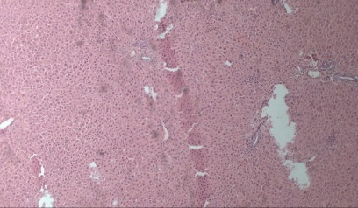
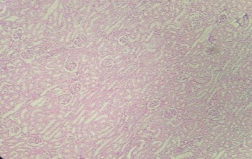
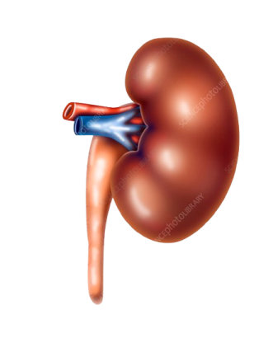
Preparation of MO crude extract
AgNO₃
Distilled water
Heating at 50°c
Distilled water
Microwave at 600 watt
Nanoparticles Synthesis
Animal Grouping and Dosage
G-1 Control Group
Group II- Negative control group
Group-III : CCl₄ +Silymarin
UV
SEM
XRD
Group-IV : CCl₄ +MO -NPs (@ 4mg/kg b.w)
Group-IV : CCl₄ +MO -NPs (@ 2.500mg/kg b.w)
Group-IV : CCl₄ +MO Extract (@ 500mg/kg b.w)
EDS
FTIR
Nanoparticles characterization
Histopathology
Results
Treatment | ALT | AST | Total bilirubin | Total protein | Albumin
Control | 43.67±0.88 | 133.17±1.40 | 0.78±0.031 | 7.90±0.093 | 3.35±0.052
CCl4 | 151.00±2.88* | 283.67±2.79* | 1.40±0.090* | 4.93±0.071* | 2.37±0.033*
Silymarin | 77.17±1.56** | 217.83±0.83** | 1.17±0.057** | 4.90±0.045 | 2.58±0.031**
MO-1 | 74.67±0.88** | 206.50±1.54** | 1.08±0.053** | 5.33±0.049** | 2.92±0.048**
MO-2 | 52.50±0.72** | 182.00±1.00** | 0.96±0.0213** | 6.62±0.054** | 3.08±0.054**
MO-NPs1 | 64.67±1.26** | 202.33±2.75** | 0.93±0.0215** | 6.32±0.079** | 2.93±0.032**
MO-NPs2 | 52.50±0.72** | 151.83±1.82** | 0.88±0.0252** | 7.37±0.095** | 3.19±0.051**
Treatment | Blood urea | Createnine | Uric acid
Control | 23.83±0.601 | 0.38±0.038 | 2.67±0.049
CCl4 | 45.17±1.249* | 1.32±0.040* | 5.68±0.059*
Silymarin | 41.33±0.494** | 1.10±0.052** | 4.93±0.033**
MO-1 | 37.83±0.477** | 0.87±0.021** | 4.23±0.031**
MO-2 | 33.17±0.946** | 0.67±0.033** | 3.52±0.048**
MO-NPs1 | 31.50±0.563** | 0.55±0.022** | 3.22±0.031**
MO-NPs2 | 30.17±0.477** | 0.48±0.0311 | 2.95±0.043**

