Slide 1
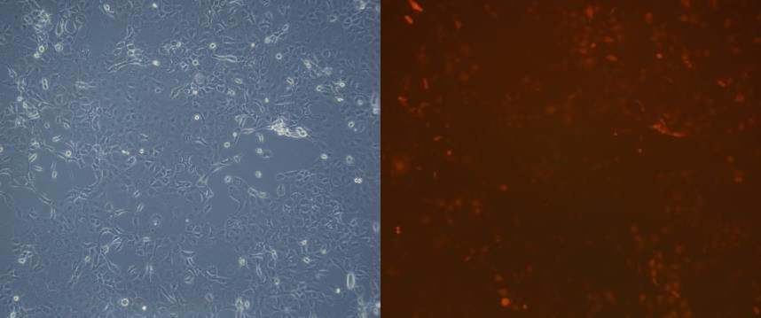
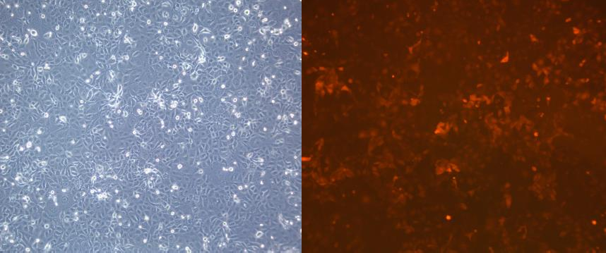
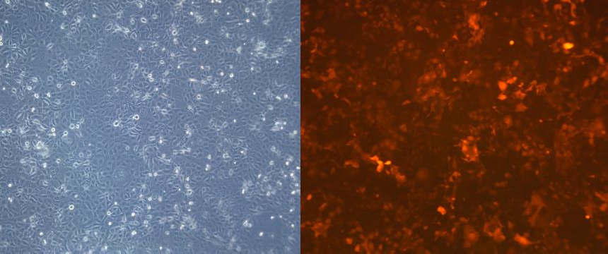






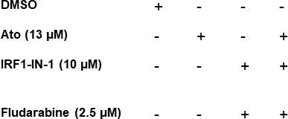
Supplementary Figure 1
A
RFP
OVCAR-5
BrightField
B
 | Lentiviral vectors | Normalized Signal | Knockdown efficiency (%)
control | DTN | 0.00123
shIRF1a | KXF | 0.00163 | -32.0327
shIRF1b | QPW | 0.00045 | 72.34146
shIRF1c | TNS | 0.000G2 | -103.813
Control vector MOI 3
Control vector MOI 5
C
OVCAR-5 (shIRF1b cells)
ns
ns
1000
✱✱
ns
PD-L1 positive cells (%)
100
✱✱✱✱
ns
MFI (PD-L1)
800
80
600
60
Control vector MOI 7
400
40
200
20
0
0
DMSO | + | - | - | - | - | -
Ato (30 µM) | - | + | - | - | + | +
PX-478 (10 µM) | - | - | + | - | + | -
PX-478 (15 µM) | - | - | - | + | - | +
DMSO | + | - | - | - | - | -
Ato (30 µM) | - | + | - | - | + | +
PX-478 (10 µM) | - | - | + | - | + | -
PX-478 (15 µM) | - | - | - | + | - | +
D
OVCAR-5 (shIRF1b)
E
250
✱
✱✱
ID8 F3
20
ns
ns
1500
✱✱✱
✱✱
PD-L1 positive cells (%)
80
✱✱
✱
200
PD-L1 positive cells (%)
15
1000
60
MFI (PD-L1)
150
10
MFI (PD-L1)
40
100
5
500
20
50
0
0
0
0
DMSO | + | - | - | -
Ato (30 µM) | - | + | - | +
Fludarabine (5 µM) | - | - | + | +
DMSO | + | - | - | -
Ato (30 µM) | - | + | - | +
Fludarabine (5 µM) | - | - | + | +
Supplementary Figure 1: A,B – Optimization of shRNA lentiviral vector transduction at different concentrations and its knockdown efficiency. C-OVCAR-5 shIRF1 cells were pretreated with HIF1alpha inhibitor (PX-478- 10 & 15 µM) following 48 h atovaquone treatment and measured cell surface PD-L1 expression using MFI and percentage positive cells by flow cytometry. D,E -OVCAR-5 IRF1 knockdown cells and ID8 cells pretreated with IRF1 inhibitor (IRF-IN-1 – 10 µM ) or a combination of IRF1 inhibitor (IRF-IN-1 – 10 µM ) and STAT1 inhibitor (Fludarabine – 2.5 & 5 µM) following 48 h atovaquone treatment and measured cell surface PD-L1 expression using MFI and percentage positive cells by flow cytometry.

Slide 2
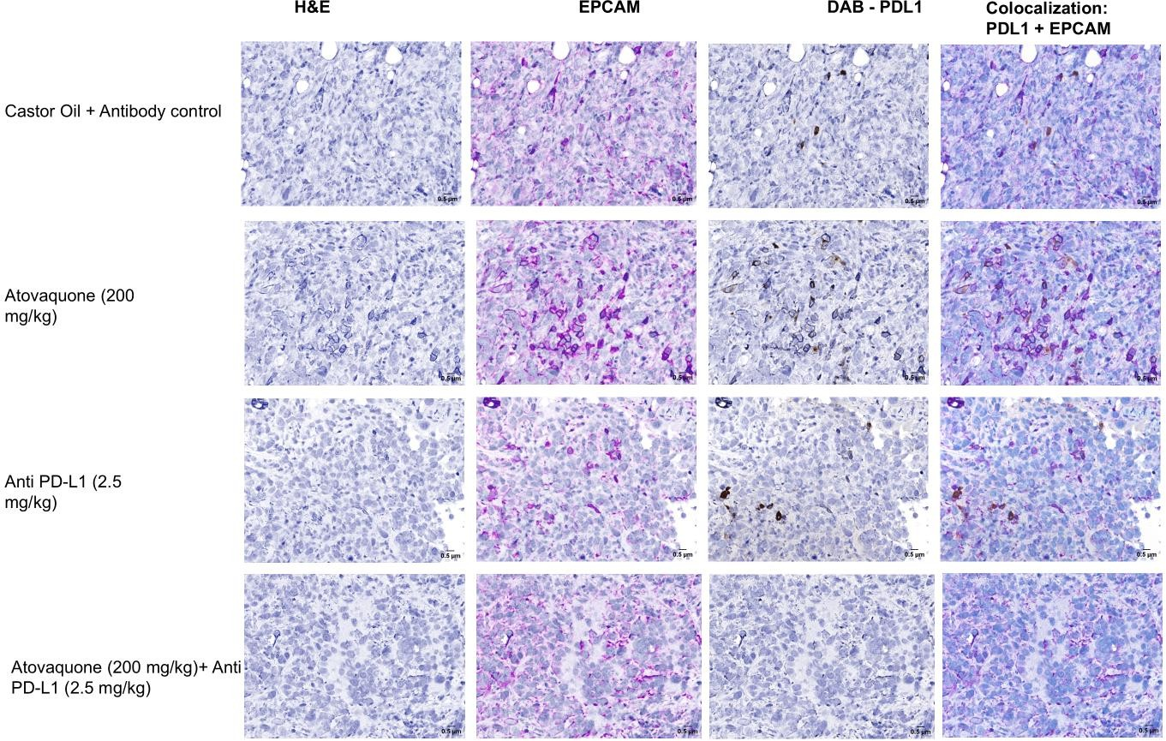
Supplementary Figure 2
A
H&E
EpCAM-Purple
PD-L1 - DAB
EpCAM+PD-L1
Co-localization
Castor Oil + Rat IgG antibody
Atovaquone
(200 mg/kg)
Anti PD-L1
(2.5 mg/kg)
Atovaquone (200 mg/kg) + Anti PD-L1 (2.5 mg/kg)
Supplementary Figure 2: A. Representative IHC images of PD-L1 expression in tumors collected from all treatment groups. Tumors were stained with DAB (PD-L1), Purple (EPCAM), Colocalization (PD-L1 and EPCAM), and Hematoxylin (0.5 µM)

