Slide 1
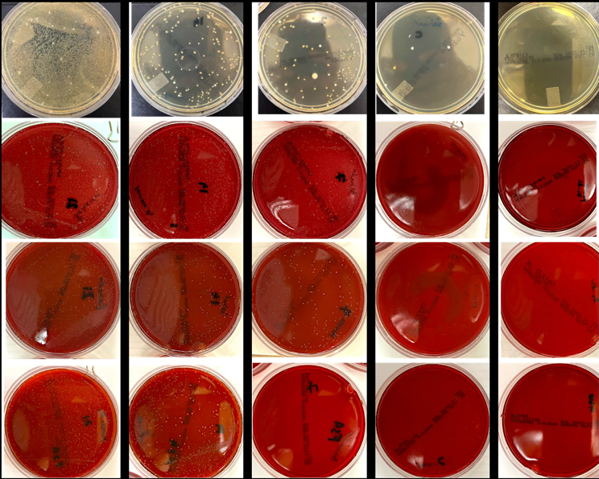
Appendix Figure1
TSBV-Selective for A. a comitans
TSA-NAM—Selective for T. forsythia
P. gingivalis Agar—Selective for P. gingivalis
FSA—Selective for F. nucleatum
Day 21
Day 14
Day 07
Control
Negative Control

