Slide 1
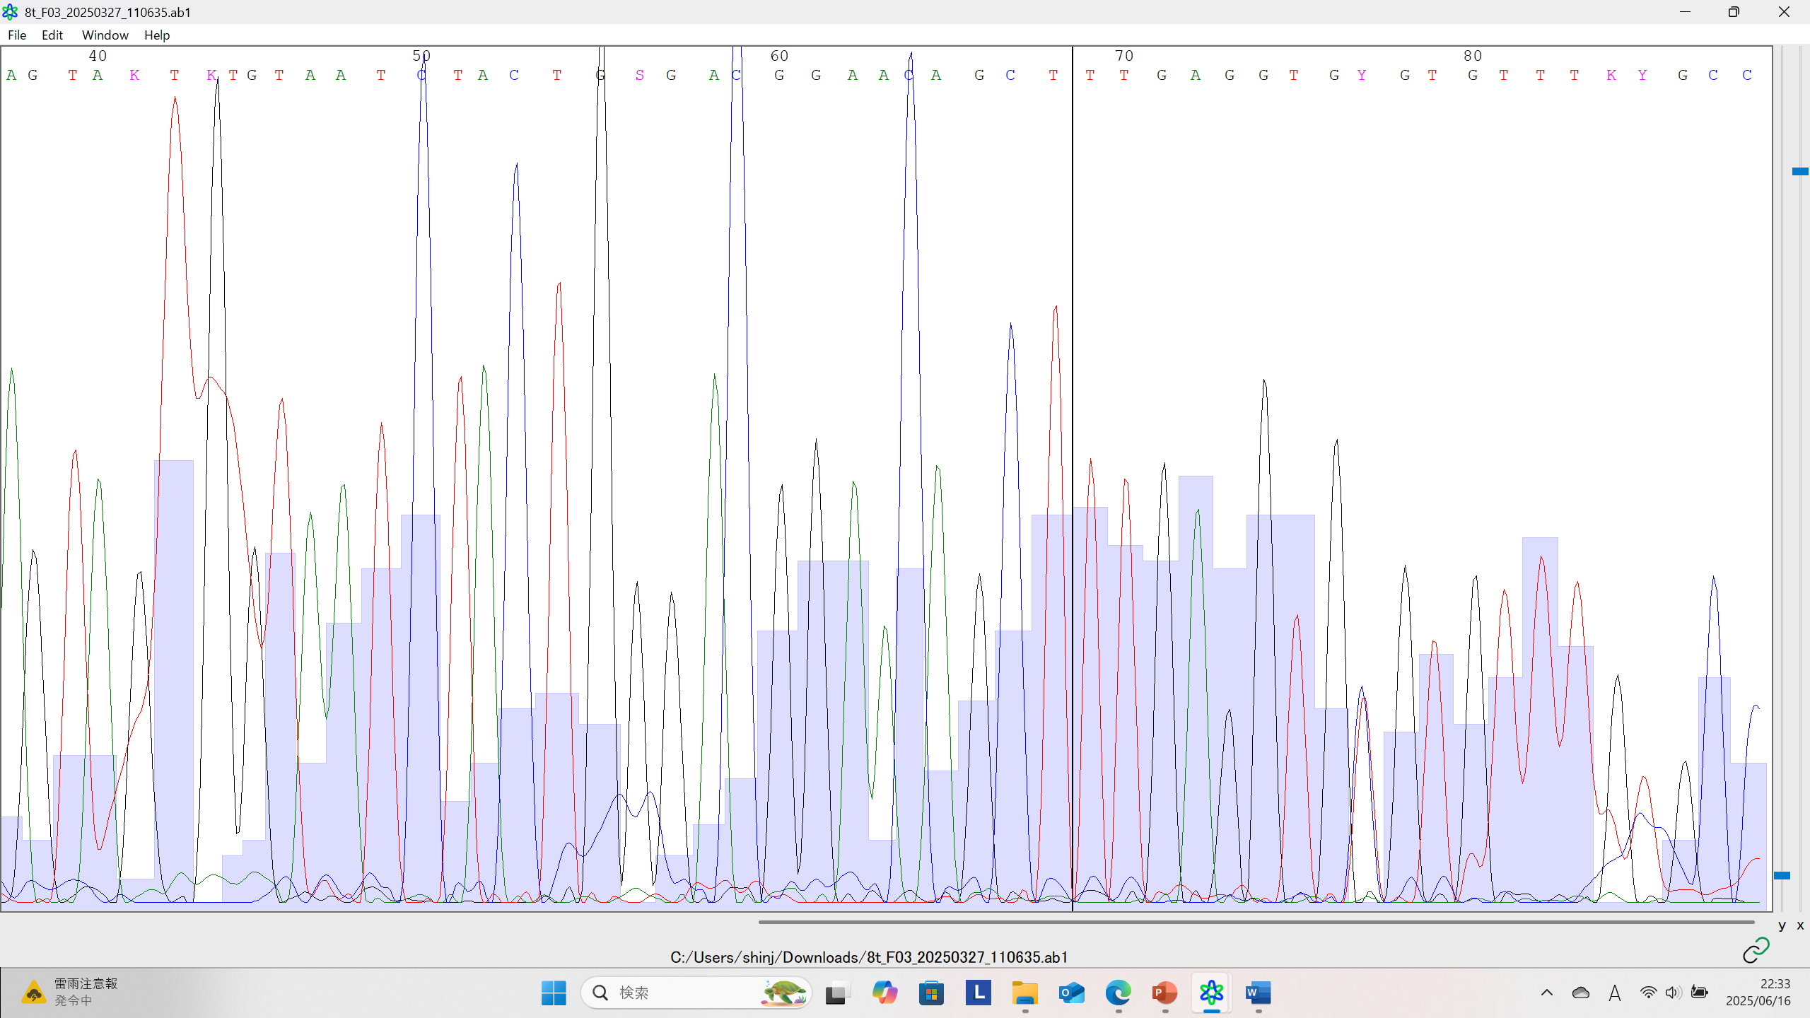
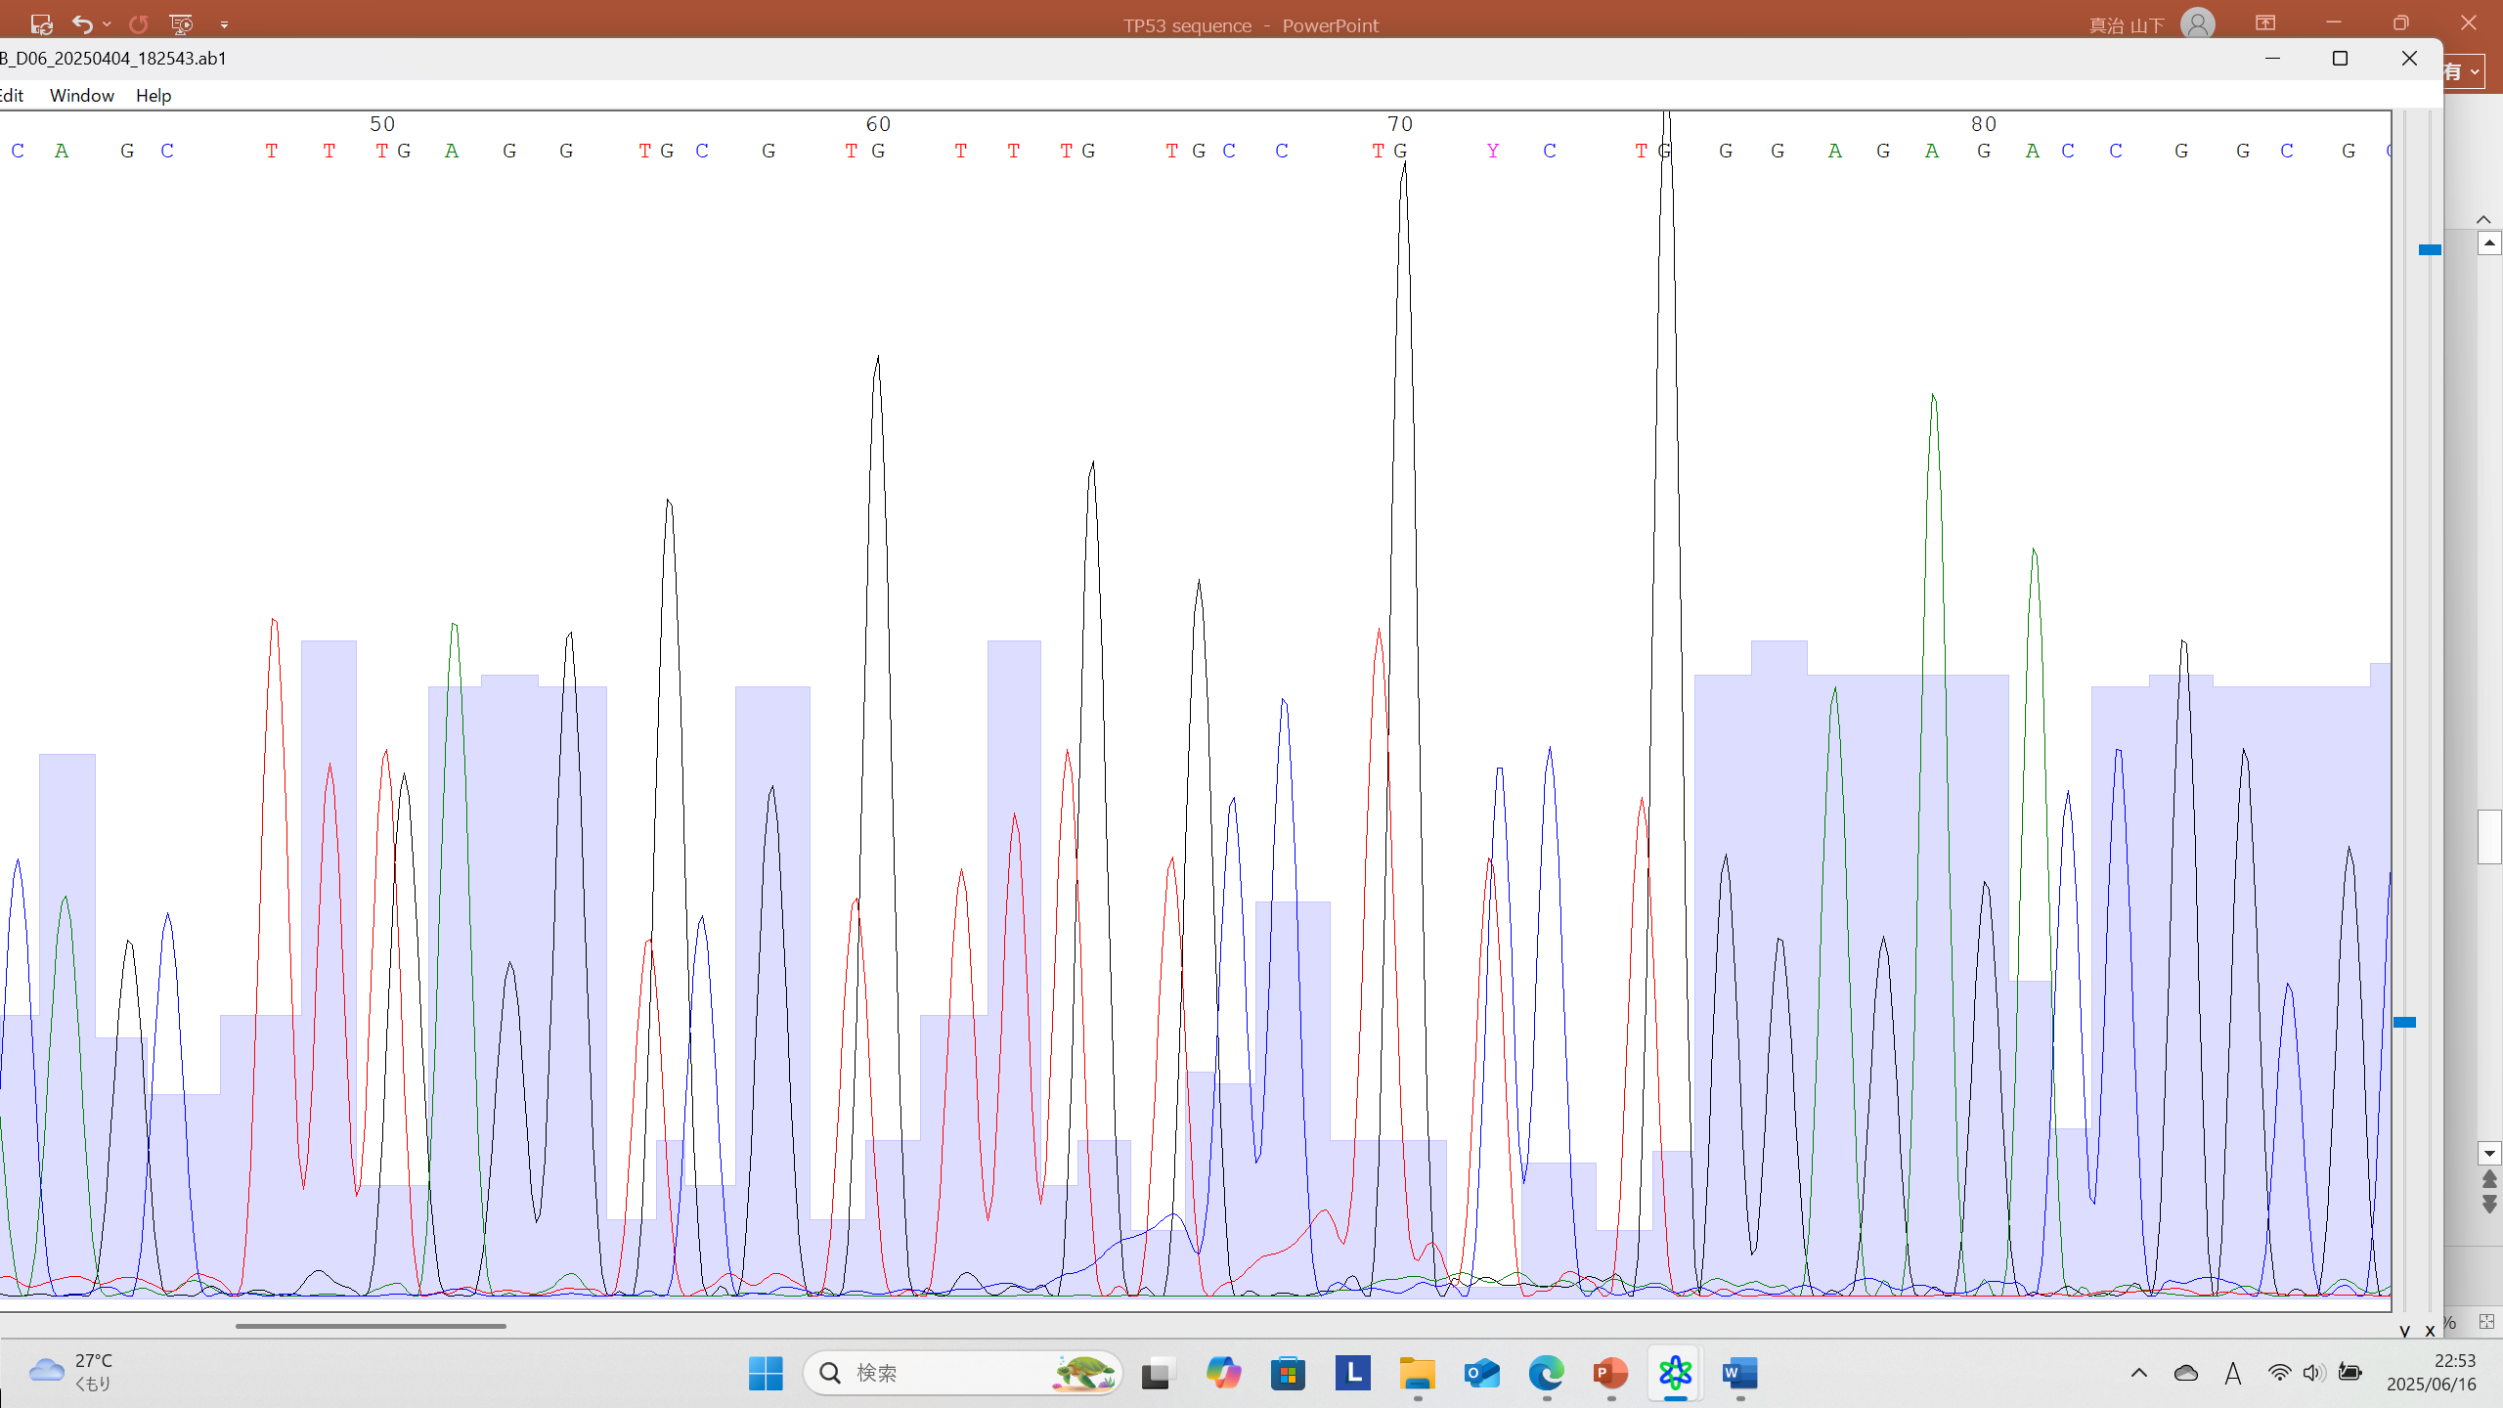
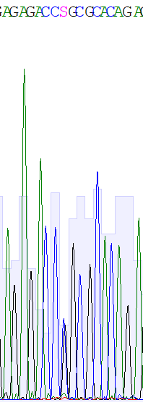
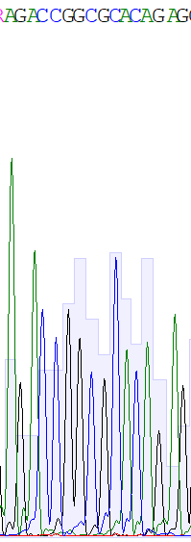
Supplementary 1
No.1
No.3
Tumor
Blood
Tumor
Blood
c.817C>T
wild
c.845G>C
wild

Slide 2
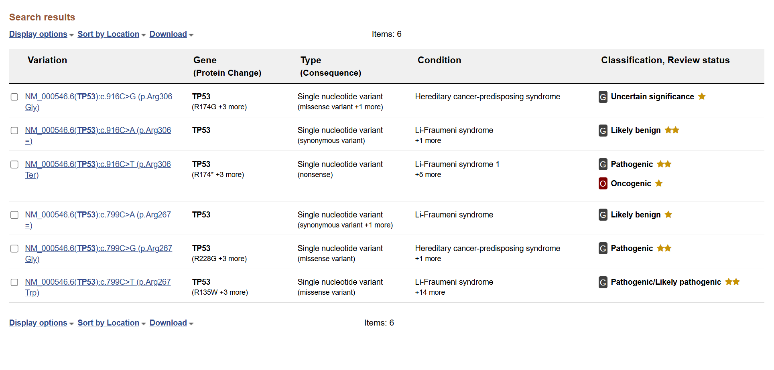
Supplementary 2
ClinVar

Slide 3
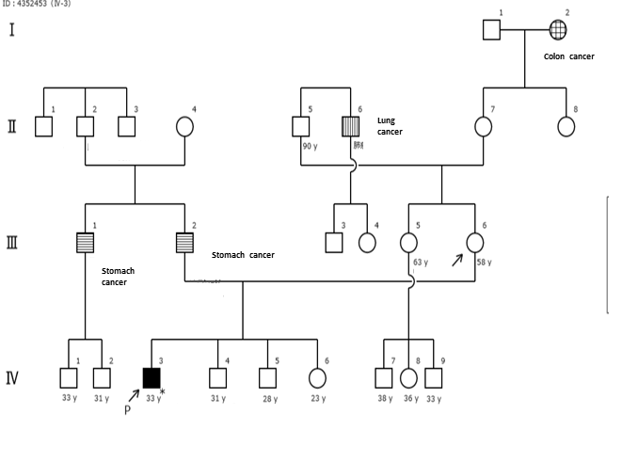
Supplementary 3
Patient

Slide 4
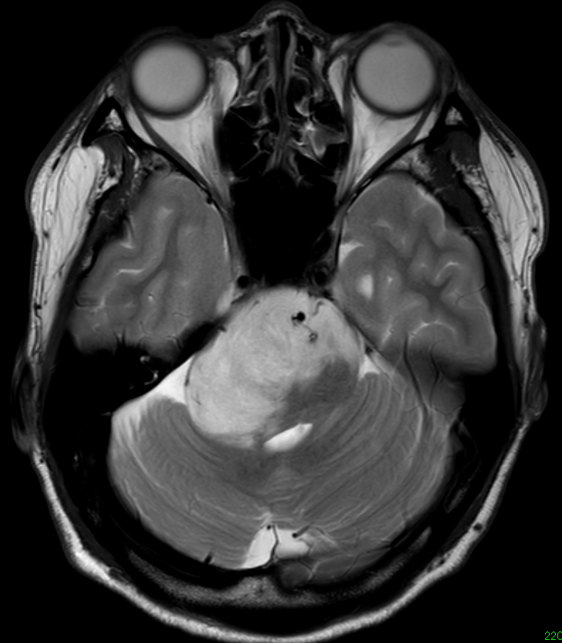
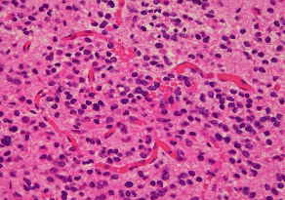
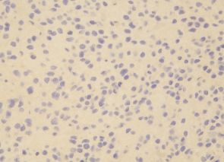
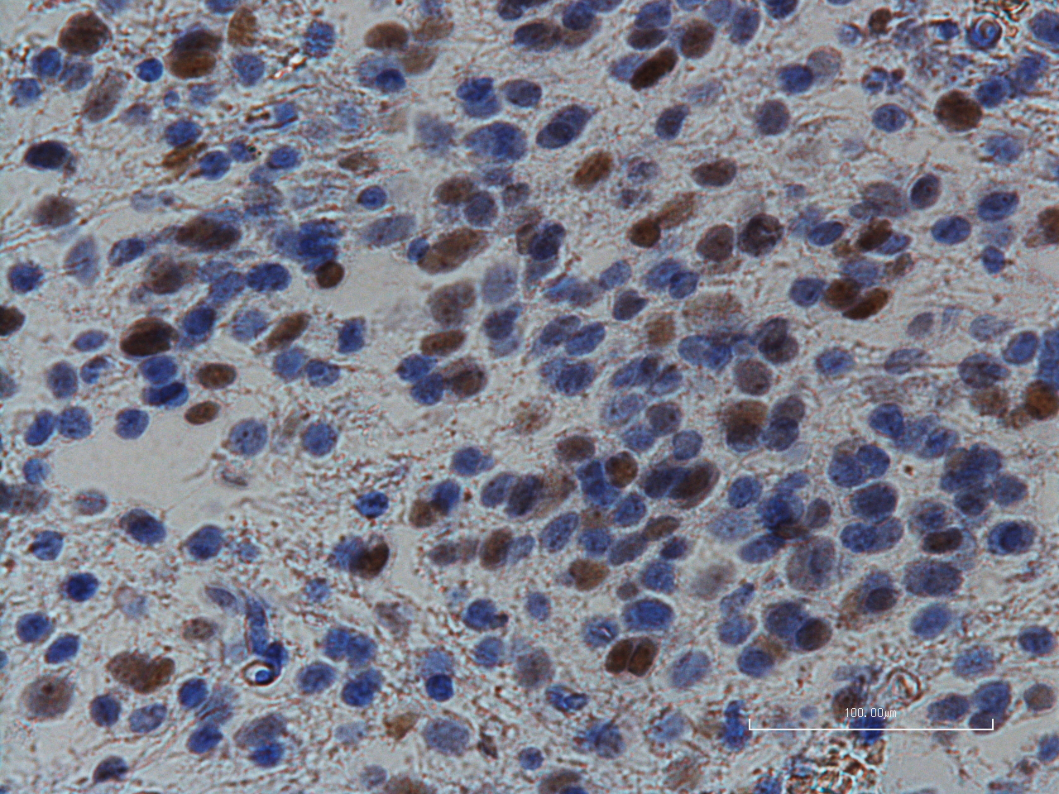
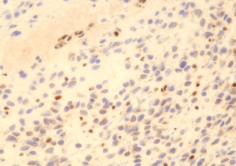
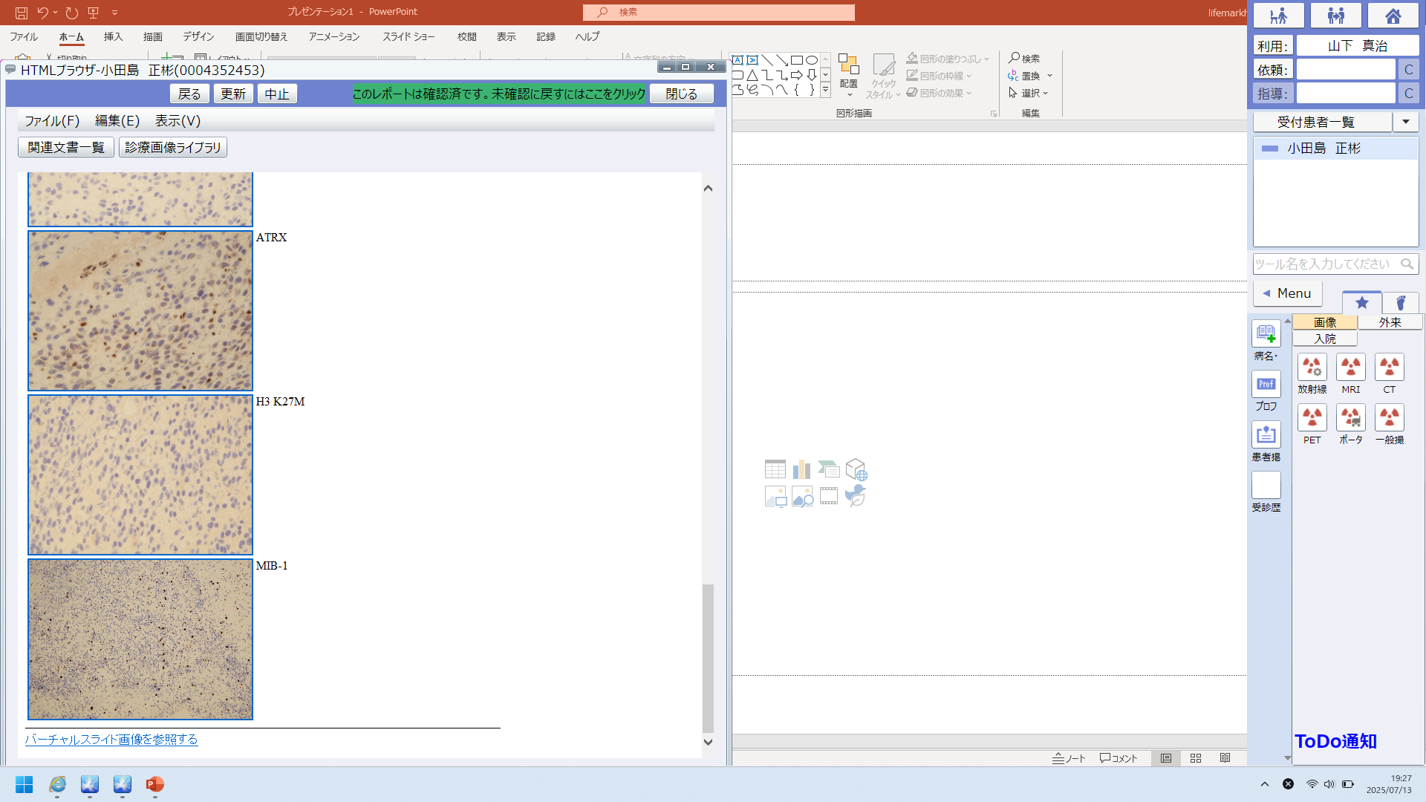
Supplementary 4
MRI FLAIR image
Pathological findings
H.E
IDH1 R132H
TP53
ATRX
H3K27M
MIB-1
MIB-1 L.I. : 8%

Slide 5
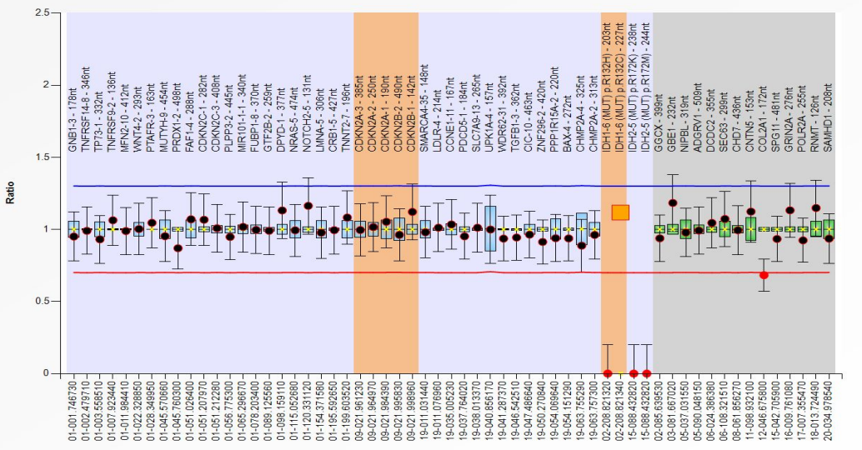
Supplementary 5
MLPA (probe set: 1p19q)

Slide 6
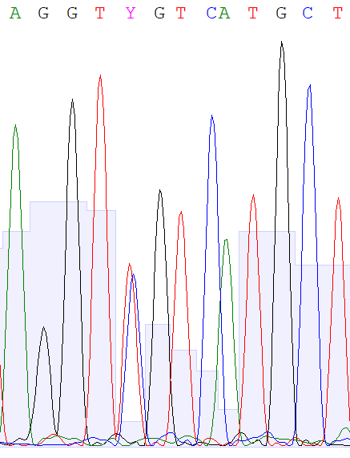
Supplementary 6
IDH1
R132C (CGT→TGT)

Slide 7
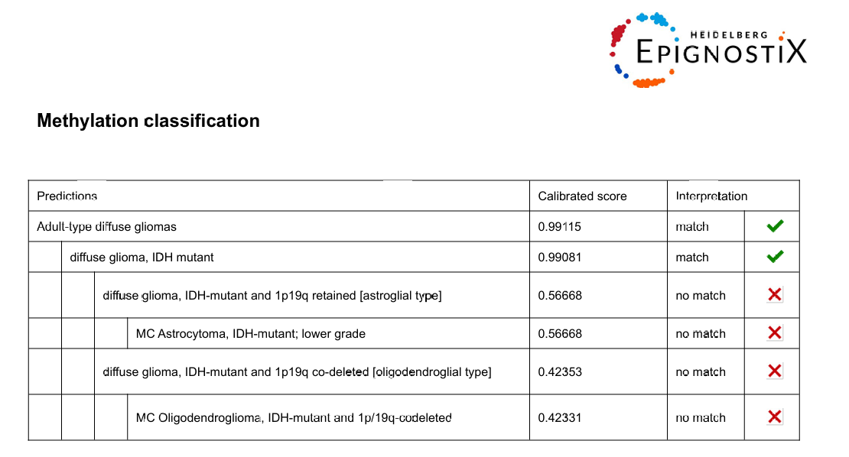
Supplementary 7

Slide 8
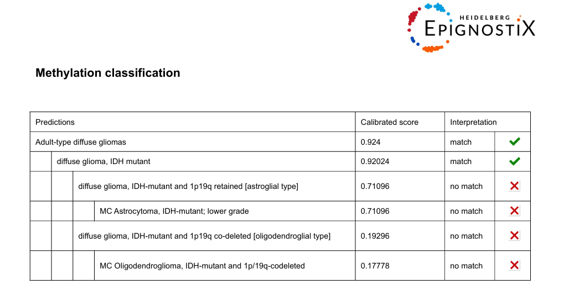
Supplementary 8

