Slide 1
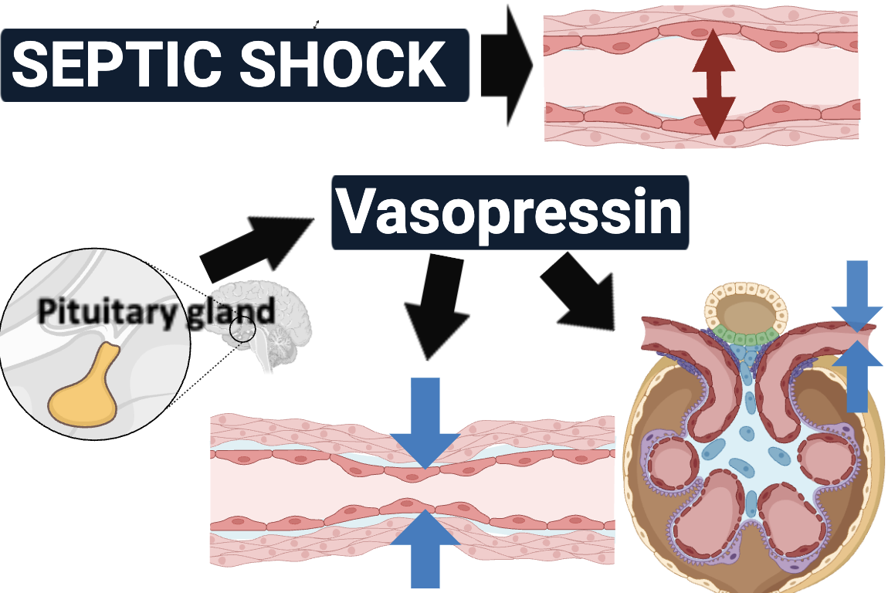
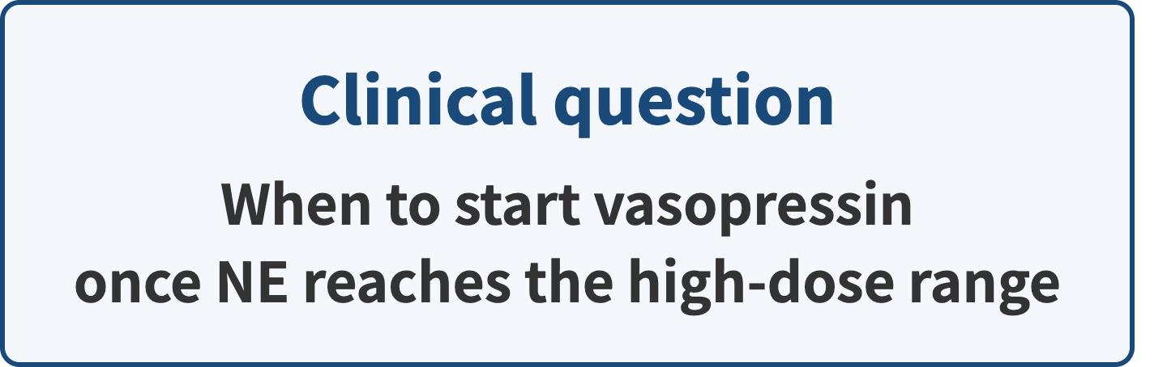
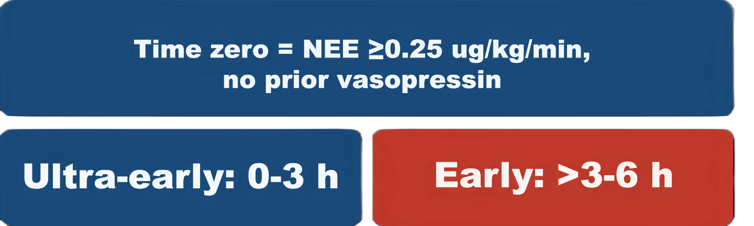
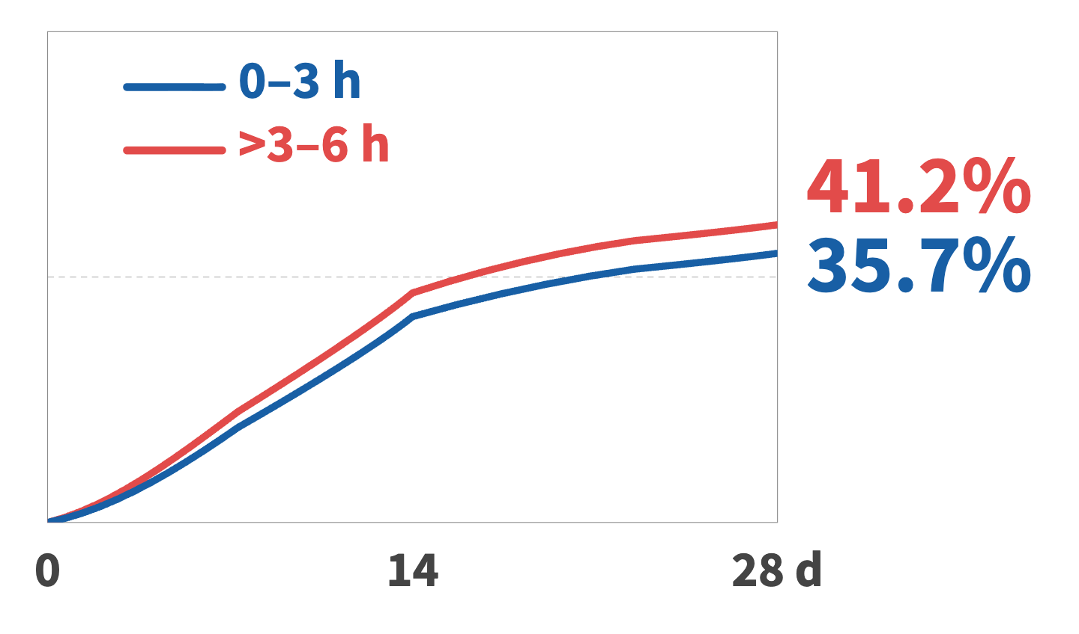
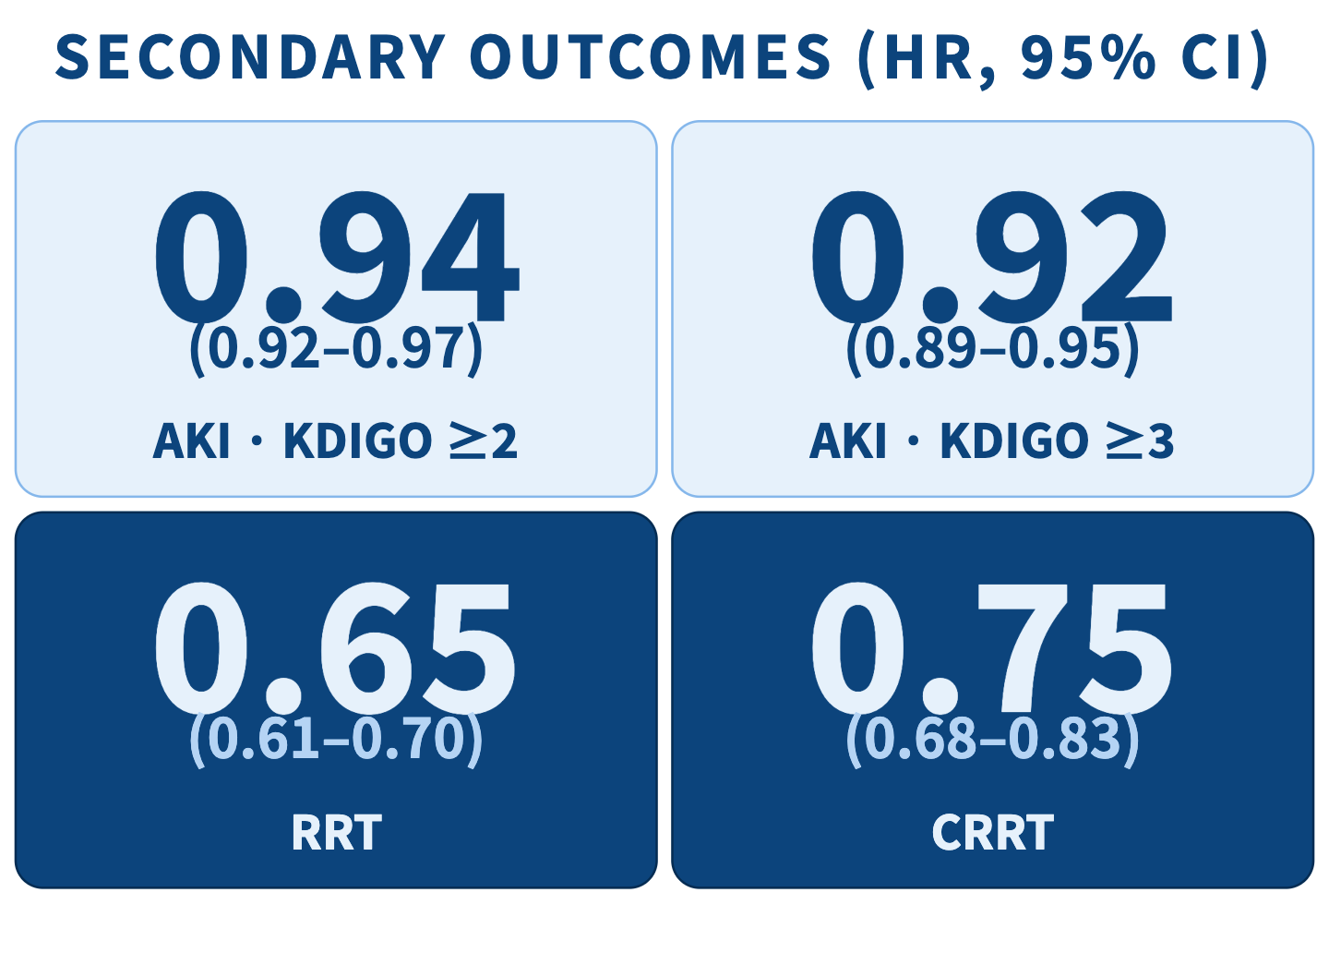
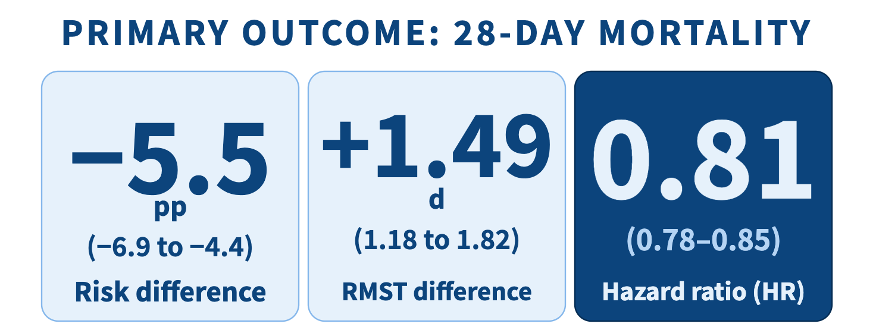
Ultra-early vs early vasopressin initiation after norepinephrine escalation in septic shock
TARGET TRIAL EMULATION • MIMIC-IV & eICU-CRD • N = 5,157
SETTING AND RATIONALE
CLONE-CENSOR-WEIGHT METHOD
Cloning
Censoring
Weighting
Eligible cohort
at time zero
＋
＋
＋
＋
＋
KEY RESULTS
Conclusion : Earlier vasopressin initiation after norepinephrine escalation was associated with lower 28-day mortality.

