Slide 1
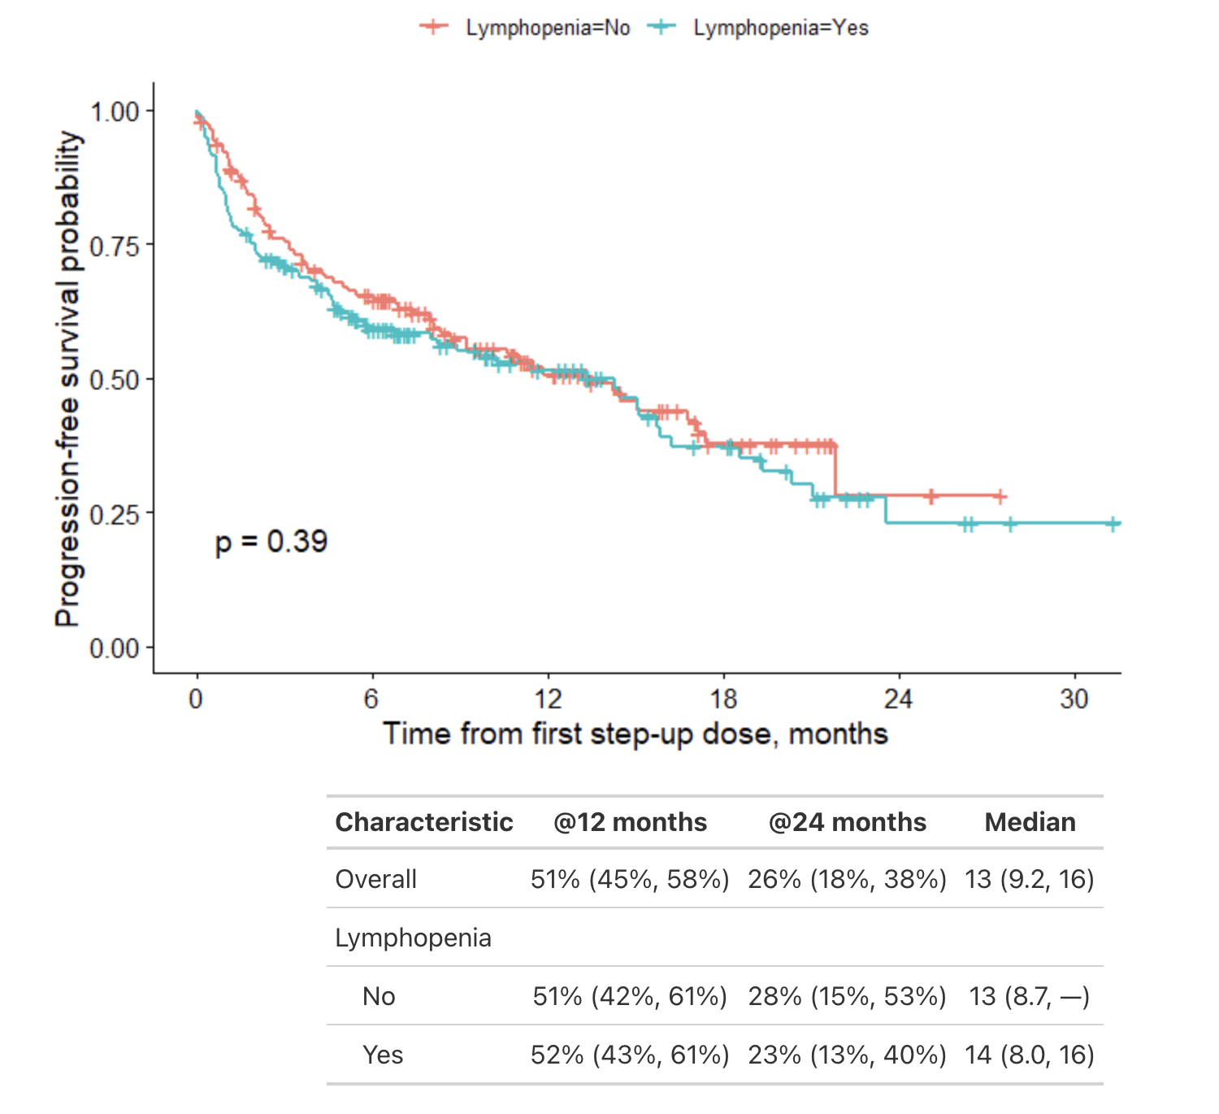
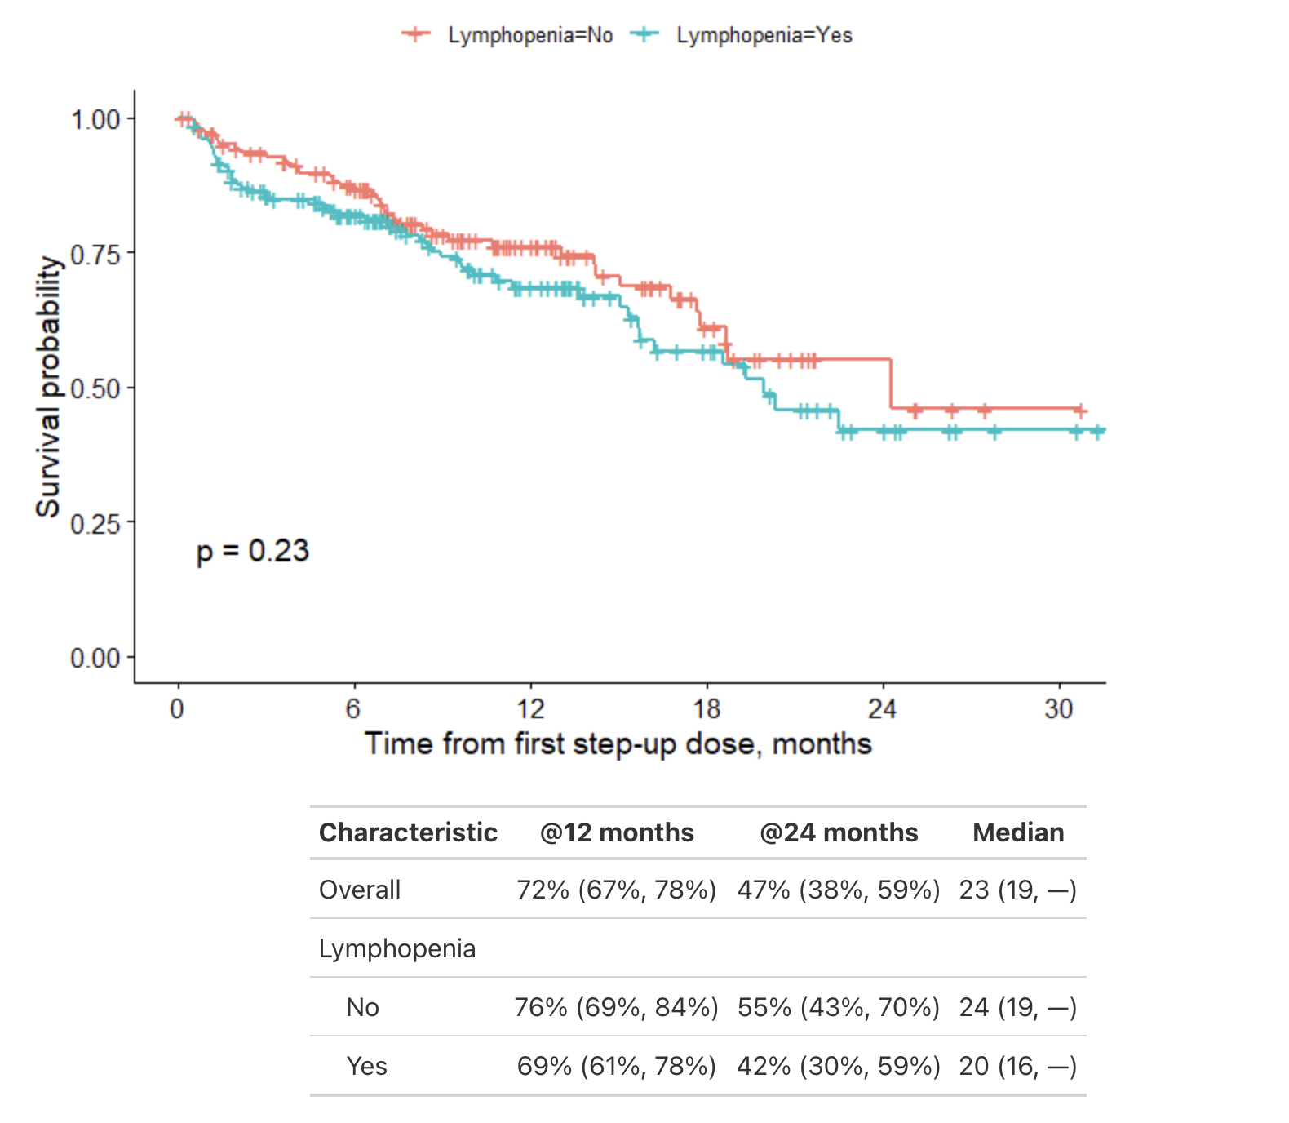
Suppl. Fig. 1
Progression Free Survival
B
Overall Survival
A

