Slide 1
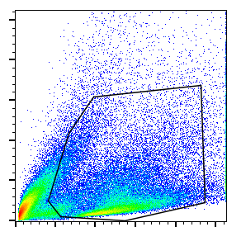
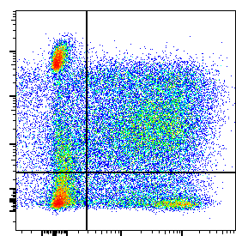
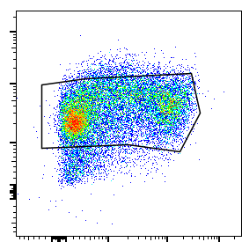
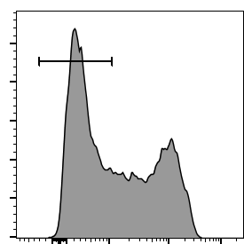
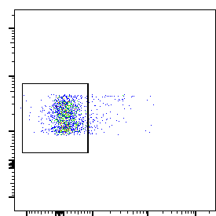
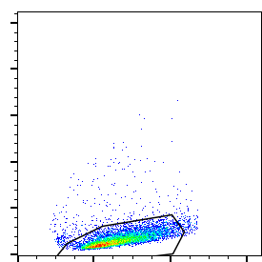
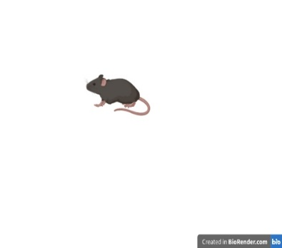

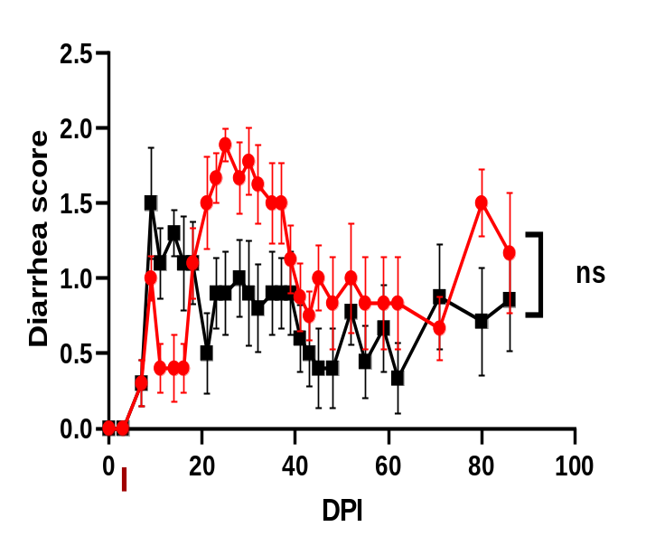
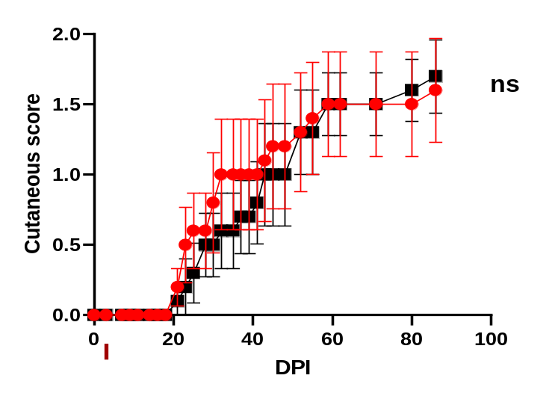
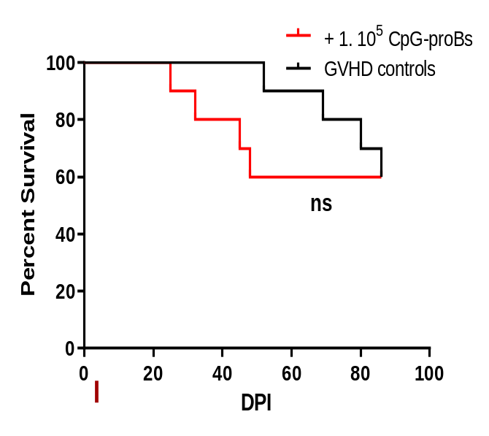
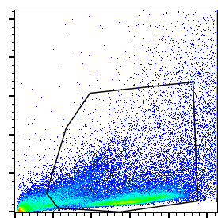
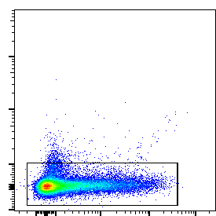
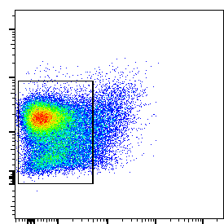
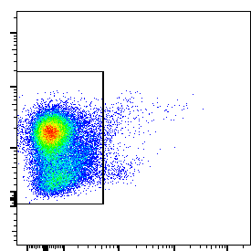
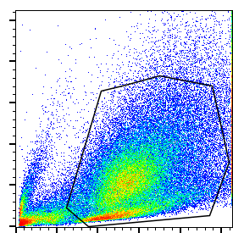
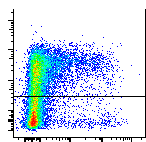
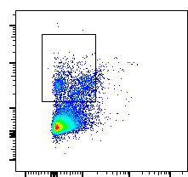
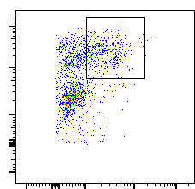
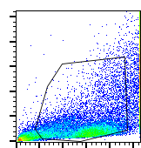
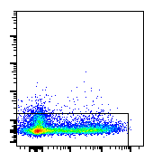
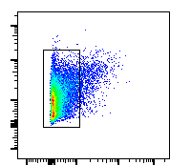
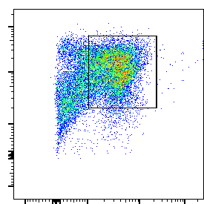
Agbogan V.A et al, Supplementary figure 1
Sorting pre-expansion
Magnetic sorting
Electronic sorting
A
SSC-A
c-kit
B220
B220
SSC-A
BM cells
+ CpG
1µg/mL
47.0
45.5
86.5
56.7
90.0
18h, 37°C,
5% CO₂
94.6
FSC-A
Sca-1
PDCA-1
PDCA-1
IgM
FSC-A
B
C
CpG-proB electronic cell-sorting post-expansion
SSC-A
c-kit
B220
B220
46.7
90.4
98.3
98.7
FSC-A
Sca-1
PDCA-1
IgM
BM proBs cell-sorting pre-expansion
Magnetic sorting
Electronic sorting
SSC-A
c-kit
50.2
B220
9.43
CD24
24.5
FSC-A
Sca-1
PDCA-1
CD43
BM proBs electronic cell-sorting post-expansion
SSC-A
c-kit
B220
93.5
CD24
67.0
45.2
97.6
FSC-A
Sca-1
PDCA-1
CD43
Supplementary Figure 1. (A) Cell culture and cell-sorting procedure of CpG-proBs. (B) Evaluation of CpG-proBs adoptively transferred at day+2 at 1 x 10⁵ cells per recipients in mice with cGVHD: left, diarrhea score; center, cutaneous score, both ns, by two-way ANOVA with Bonferroni post-test; right, survival curve, ns, by Kaplan Meier estimates, N=10 mice per group. (C) Upper panel: electronic cell-sorting of CpG-proBs post-expansion over OP-9 cells; middle panel: Cell-sorting of proBs isolated from fresh BM; lower panel: Electronic cell-sorting of BM proBs after expansion over OP-9 cells.

