Slide 1
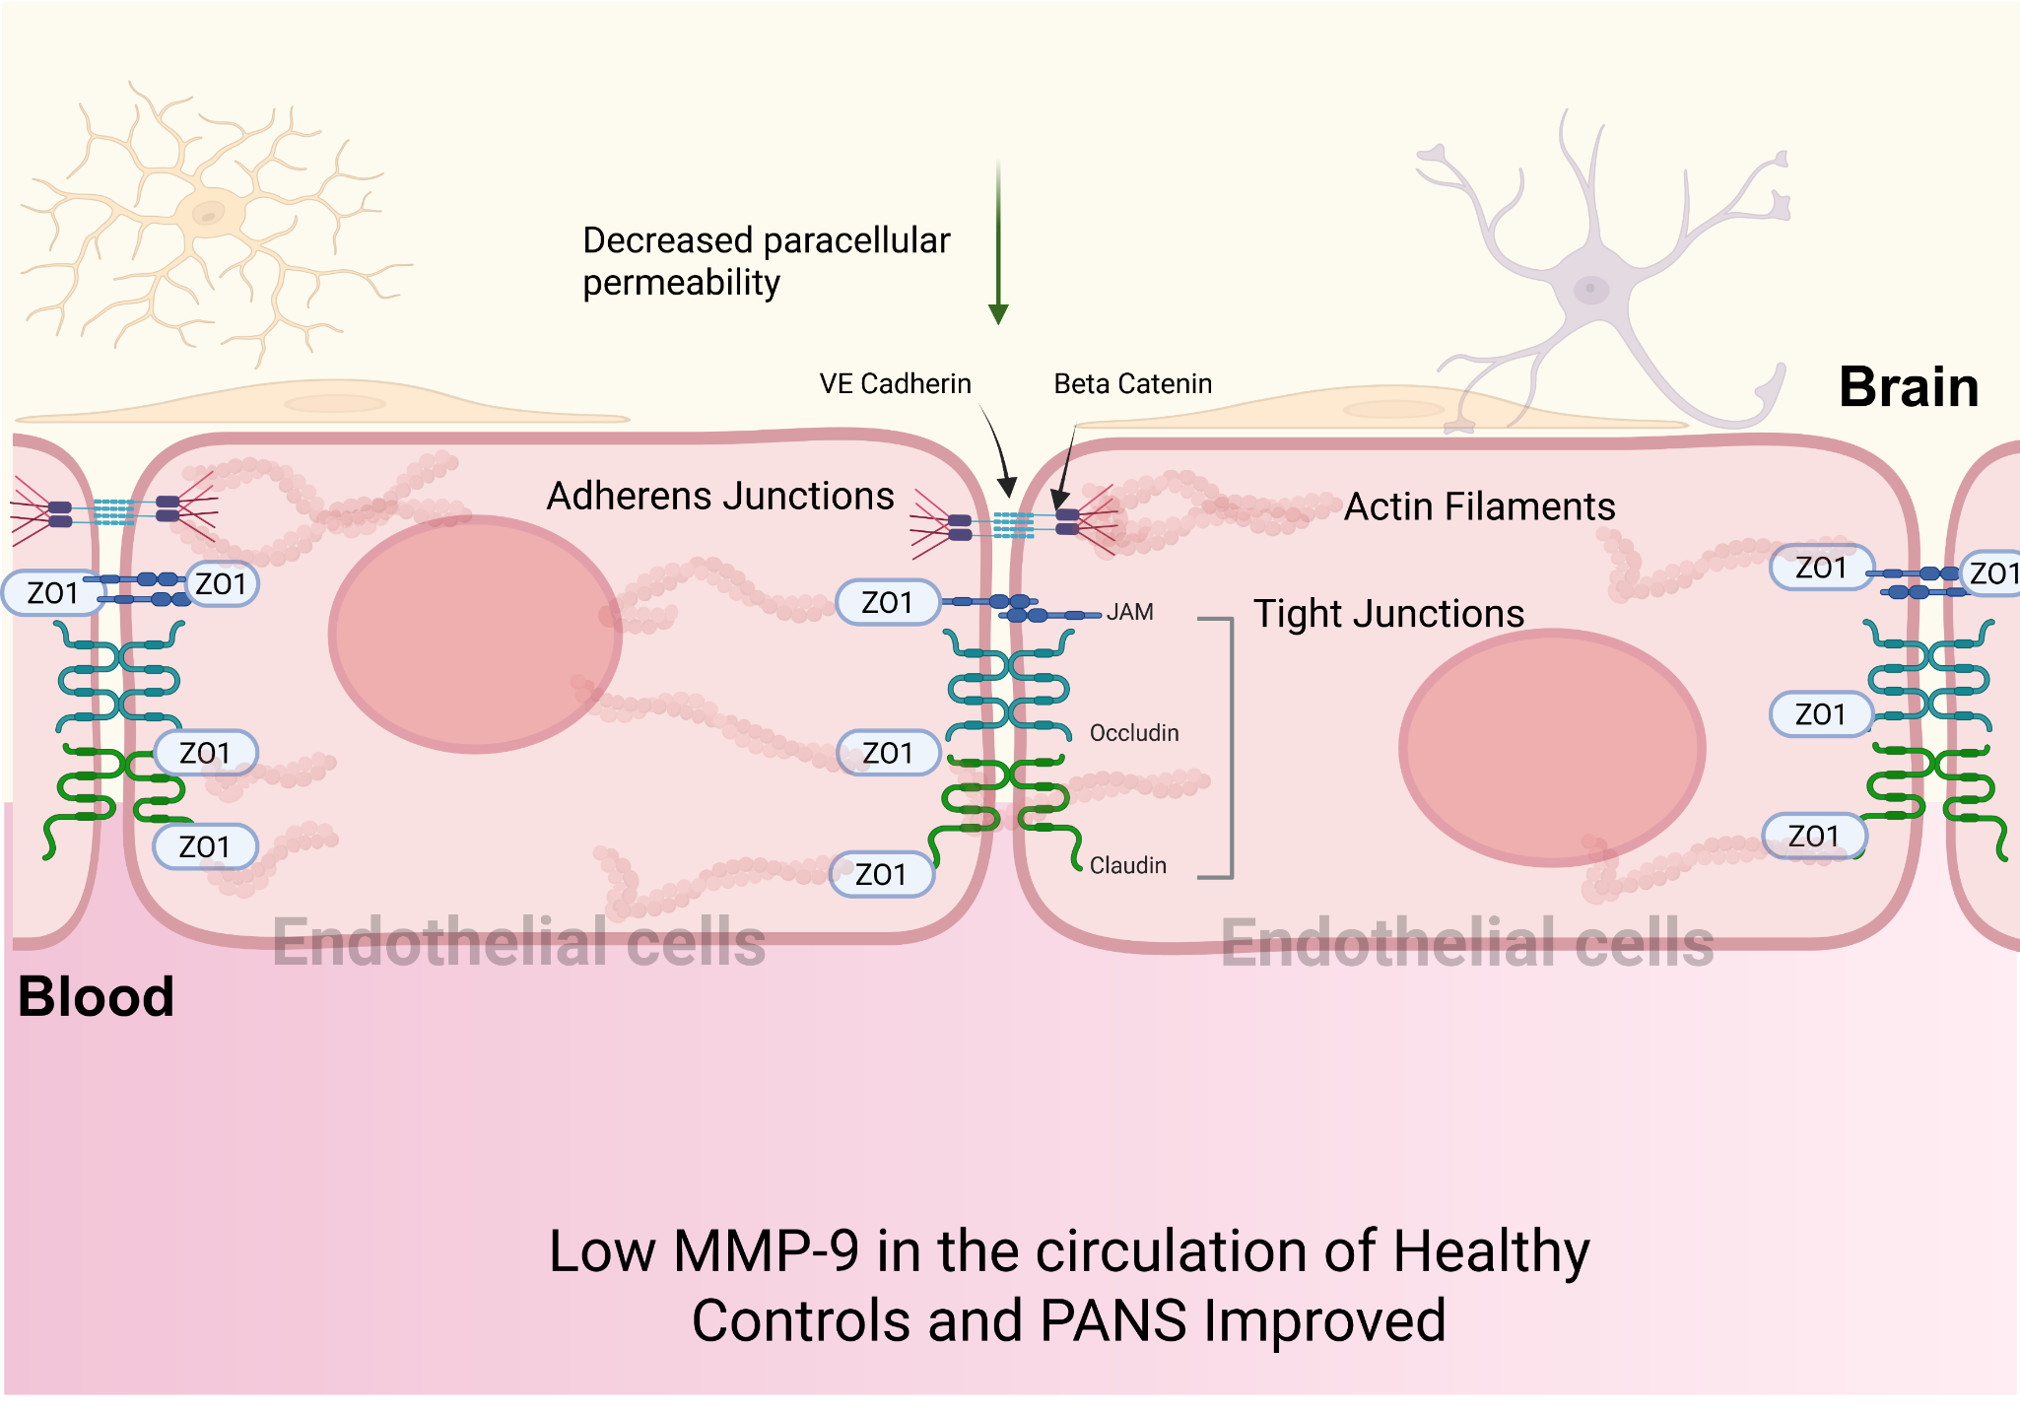
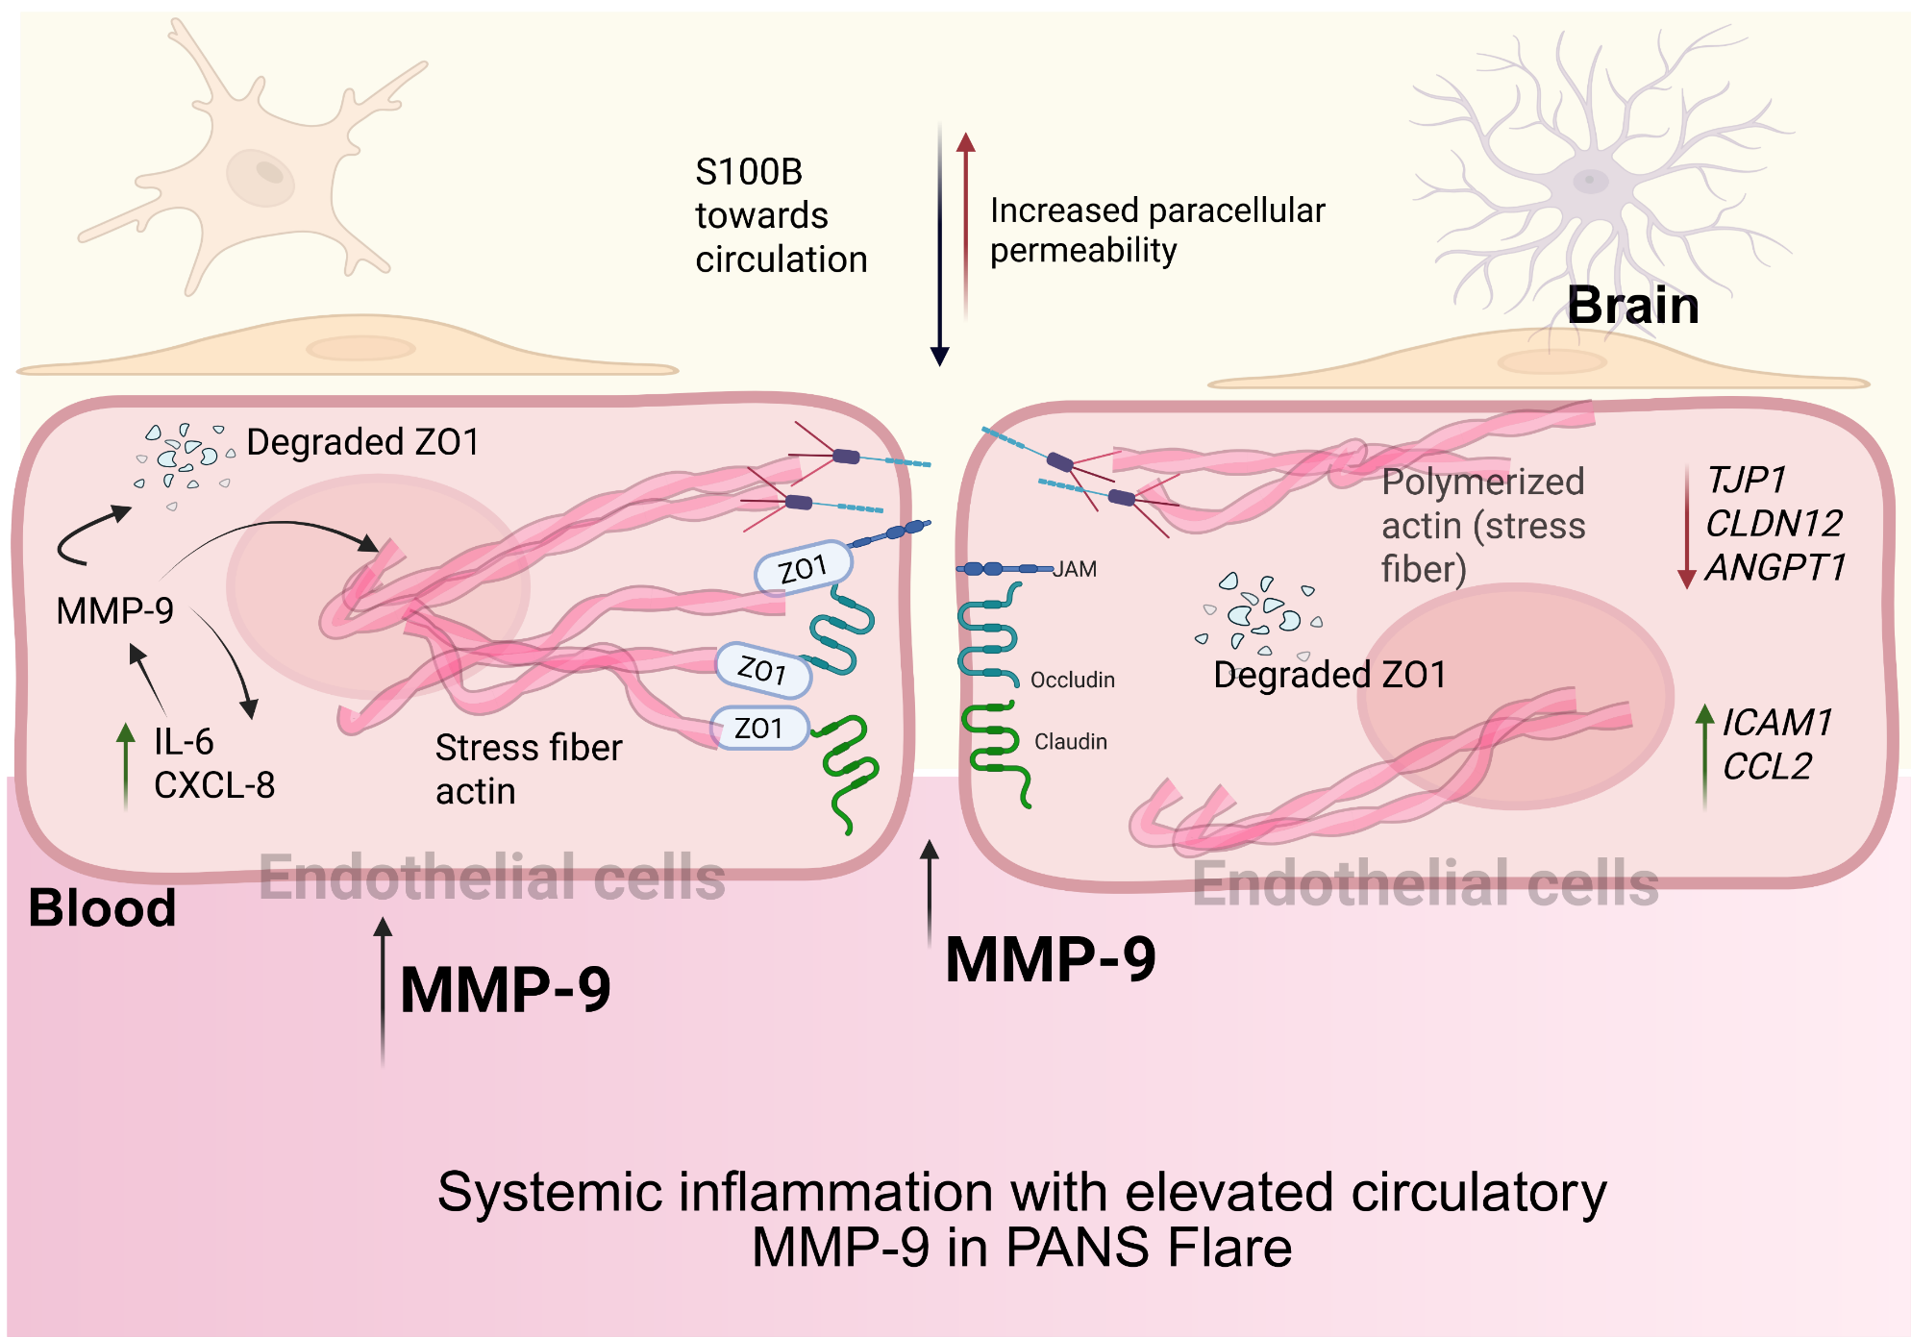
Schematic representation of MMP-9–mediated brain endothelial cells disruption in PANS
A.
B.
:A. Under physiological conditions (healthy control/PANS recovery), brain endothelial cells maintain intact barrier integrity through well-organized tight junctions (claudin, occludin) and adherens junctions (VE-cadherin), supported by a stable cortical actin cytoskeleton, resulting in low paracellular permeability. B. During PANS flare, elevated circulating MMP-9 induce degradation of junctional proteins, disruption of endothelial cell–cell contacts, and reorganization of the actin cytoskeleton into stress fibers. These changes lead to increase in paracellular permeability and inflammation.

